Slide 1



Laser source for PLC
Optical R&D for Laser beam - electron beam Compton scattering Technology
Laser Request for PLC
Technical solutions
  ➔ Non linear cavity
  ➔ Fabry-Perot optical resonator
R&D of optical cavities
F. Zomer, 25, march, 2011

Slide 2
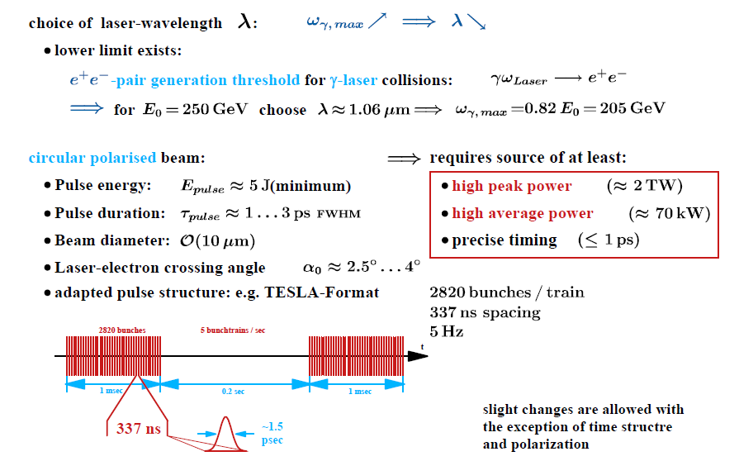
Laser beam requested for PLC
Such a laser beam does not exist
➔one has to use specific solutions

Slide 3
1rst class of technical solution to reach high laser average power:
Nonlinear circulating cavity
&
Regenerative cavity
Principle

Slide 4
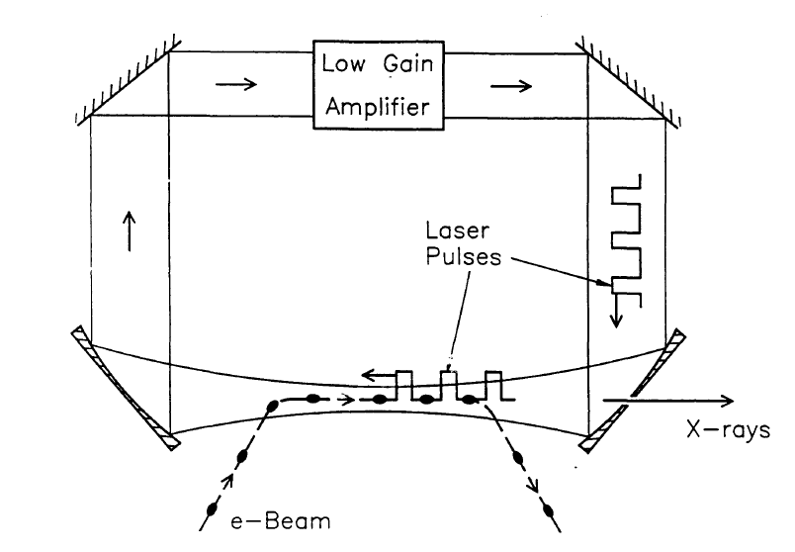
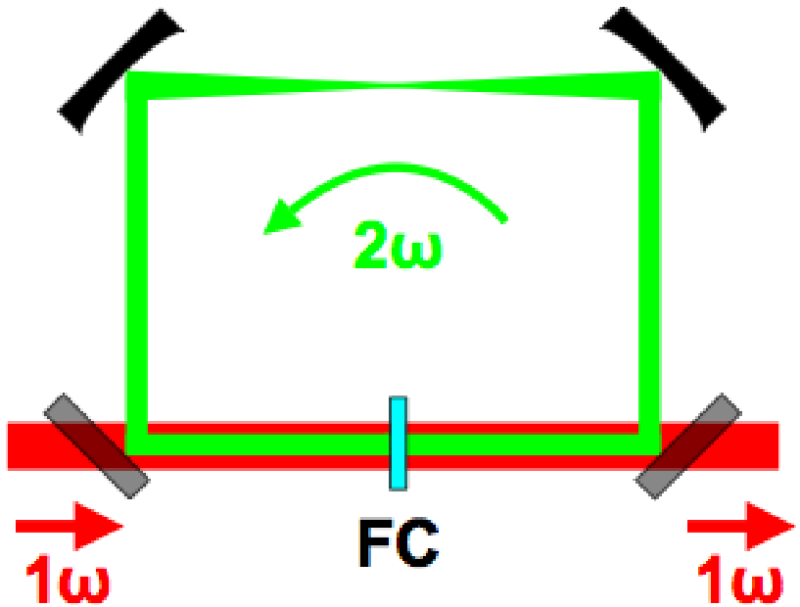
Regenerative cavity
Sprangle et al. JAP72(1992)5032
Non linear cavity (LLNL)
Jovanovic et al.,NIMA578(2007)160
Thermal issues
in the pumped
gain medium
Frequency doubling
cristal allowing high fluence
Non-linear effects issue

Slide 5
2nd technical solution to reach high laser average power:
Fabry-Perot cavity
Principle

Slide 6
Fabry-Perot cavity:
Principle with continous wave
Gain=1/(1-R)∼10000
~10kW
e beam
~1W
isolateur
LASER
~1W
JLAB/Saclay Polarimeter, NIMA459(2001)412
HERA /Orsay Polarimeter, JINST 5(2010)P06005
When ν_{Laser} ∝ c/2L ⇒ résonance
But: Δν/ν_{Laser} = 10⁻¹¹ ⇒ STRONG & ROBUST laser/cavity feedback needed…

Slide 7
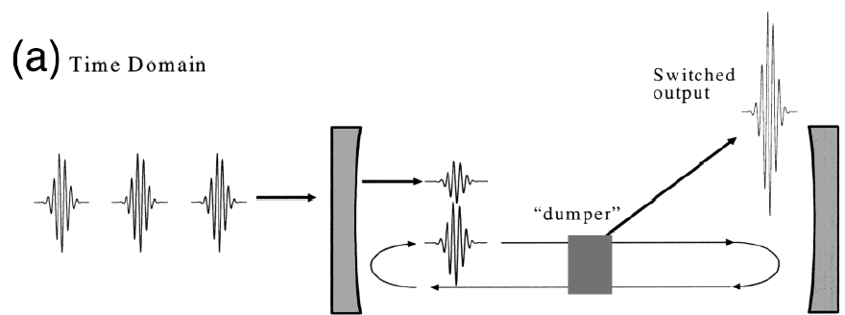
Fabry-Perot cavity in pulsed regime
Electron beam
1ps
Mode lock
oscillator
Fabry-Perot cavity
with Super mirrors
Same feedback technics (more complexe) is used in cw & pulsed regime
State of the art (Garching MPI) : ~70kW, 2ps pulses @78MHz, stored in a cavity
(O.L.35(2010)2052) ~20kW, 200fs pulses @78MHz

Slide 8
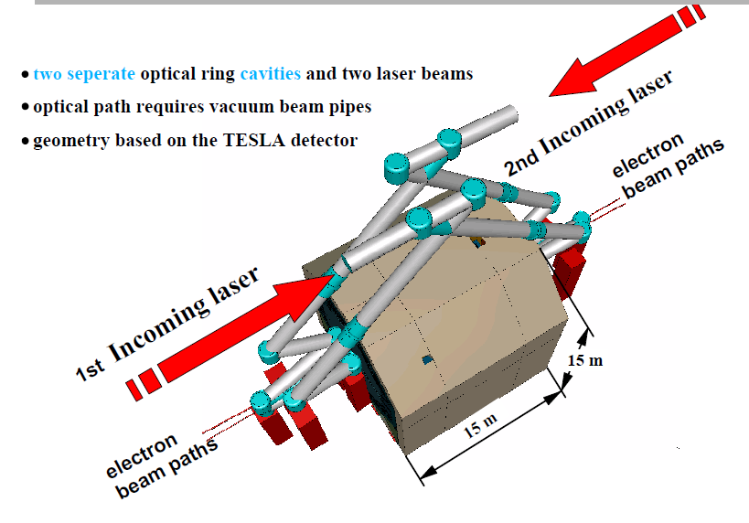

Technical design study for PLC

Slide 9
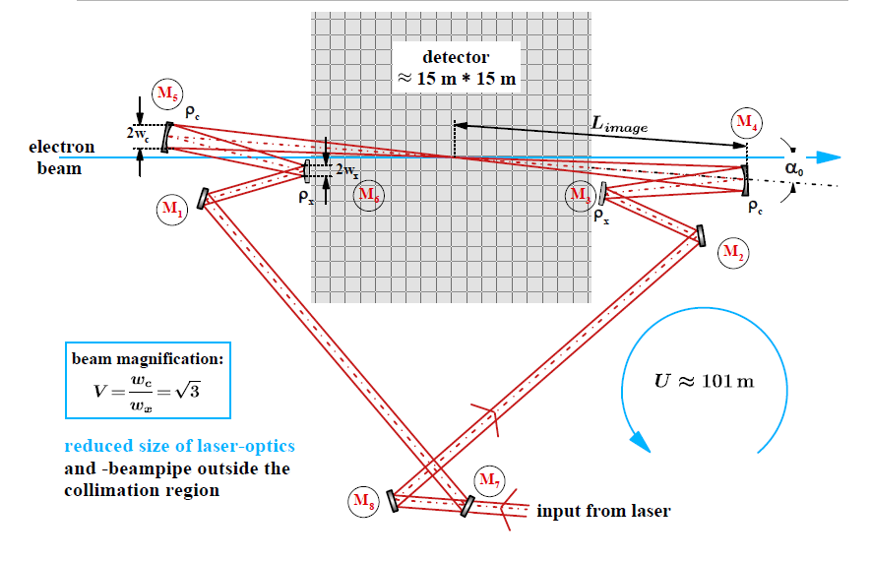
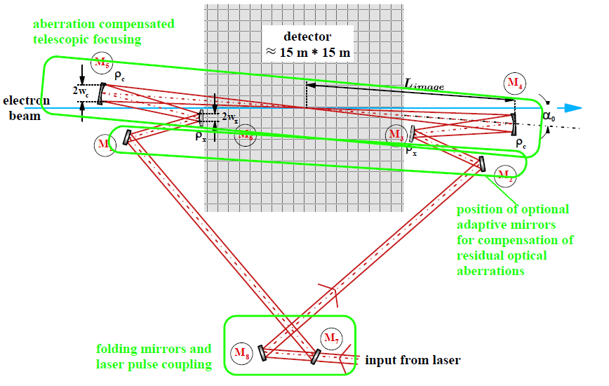
Cavity ‘gain’
~100-500
50mJ/pulse

Slide 10
Technological issues
Incident laser seems deliverable (J Gronberg ILWC2010)
Damage thresholds of the mirror/optics coatings
  Average power ➔thermal load
    Seems ok for 70kW @1ps
  Peack power damage ?
Huge mechanical structure (~15m!)➔mechanical stability ?
Frequency and spatial quality of the incident laser beam ?
Polarisation of the cavity eigen modes ?
Laser beam/cavity feedback @ 5Hz ? (@~100MHz usually !)
ILWC2010 Geneva Switzerland

Slide 11
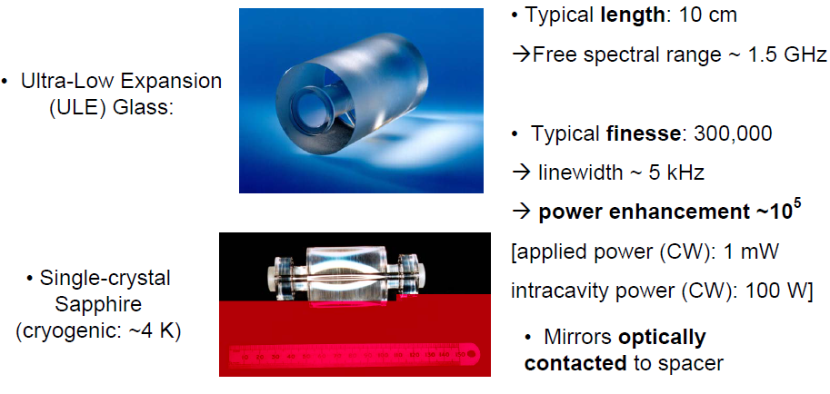

Illustration of one issue : the laser cavity feedback
Cavity finesse : F=(100-500) π
Optical path length : L~100m
Cavity resonance
frequency linewidth
Δν=c/(LF)~(2-9) kHz !
Δν/ν=λ/(LF)=~10⁻¹¹-10⁻¹²
Same numbers as in metrology !!!
M. Oxborrow

Slide 12
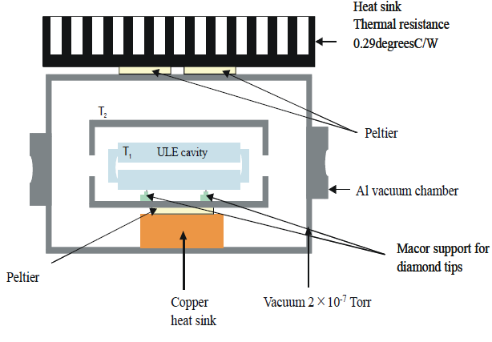
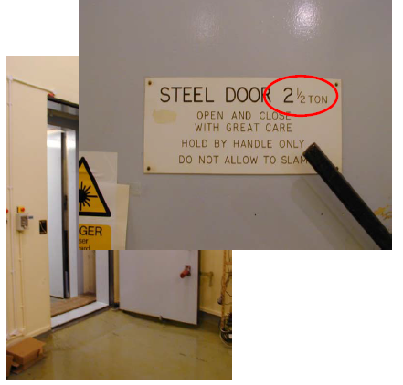
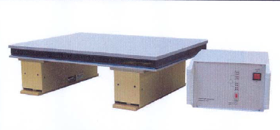
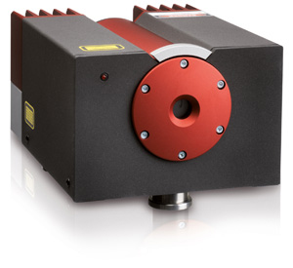
From a feedback point of view:
Locking a ‘100m’ cavity to finesse~ 600 (‘gain’~2000) is the same as
Locking 0.2m cavity to 300000 finesse !
BUT
The hyper stable small cavity is ‘hyper’ temperature stabilised
Into an hyper isolated room
In the case of PLC
Huge laser beam peak power
  large frequency/amplitude noise
  bad beam profile quality
  Trains@5Hz pulse structure
Giant cavity geometry
  Uneasy isolation from noisy accelerator
  environment
R&D requied
Put on an hyper stabilised optical table
And an hyper stable cw laser is used, linewidth 1kHz
http://www.innolight.de/index.php?id=mephisto
~100mW power
M. Oxborrow

Slide 13
Four-mirror Fabry-Perot cavity R&D at ATF
R&D context
Starting point : ILC polarised positron source (2005):
>10MW cavity average power needed for ILC/CLIC
Now : fundings for compact X-ray sources projects
Quantum beam/Japan; ThomX/France
100kW-1MW average power needed

Slide 14

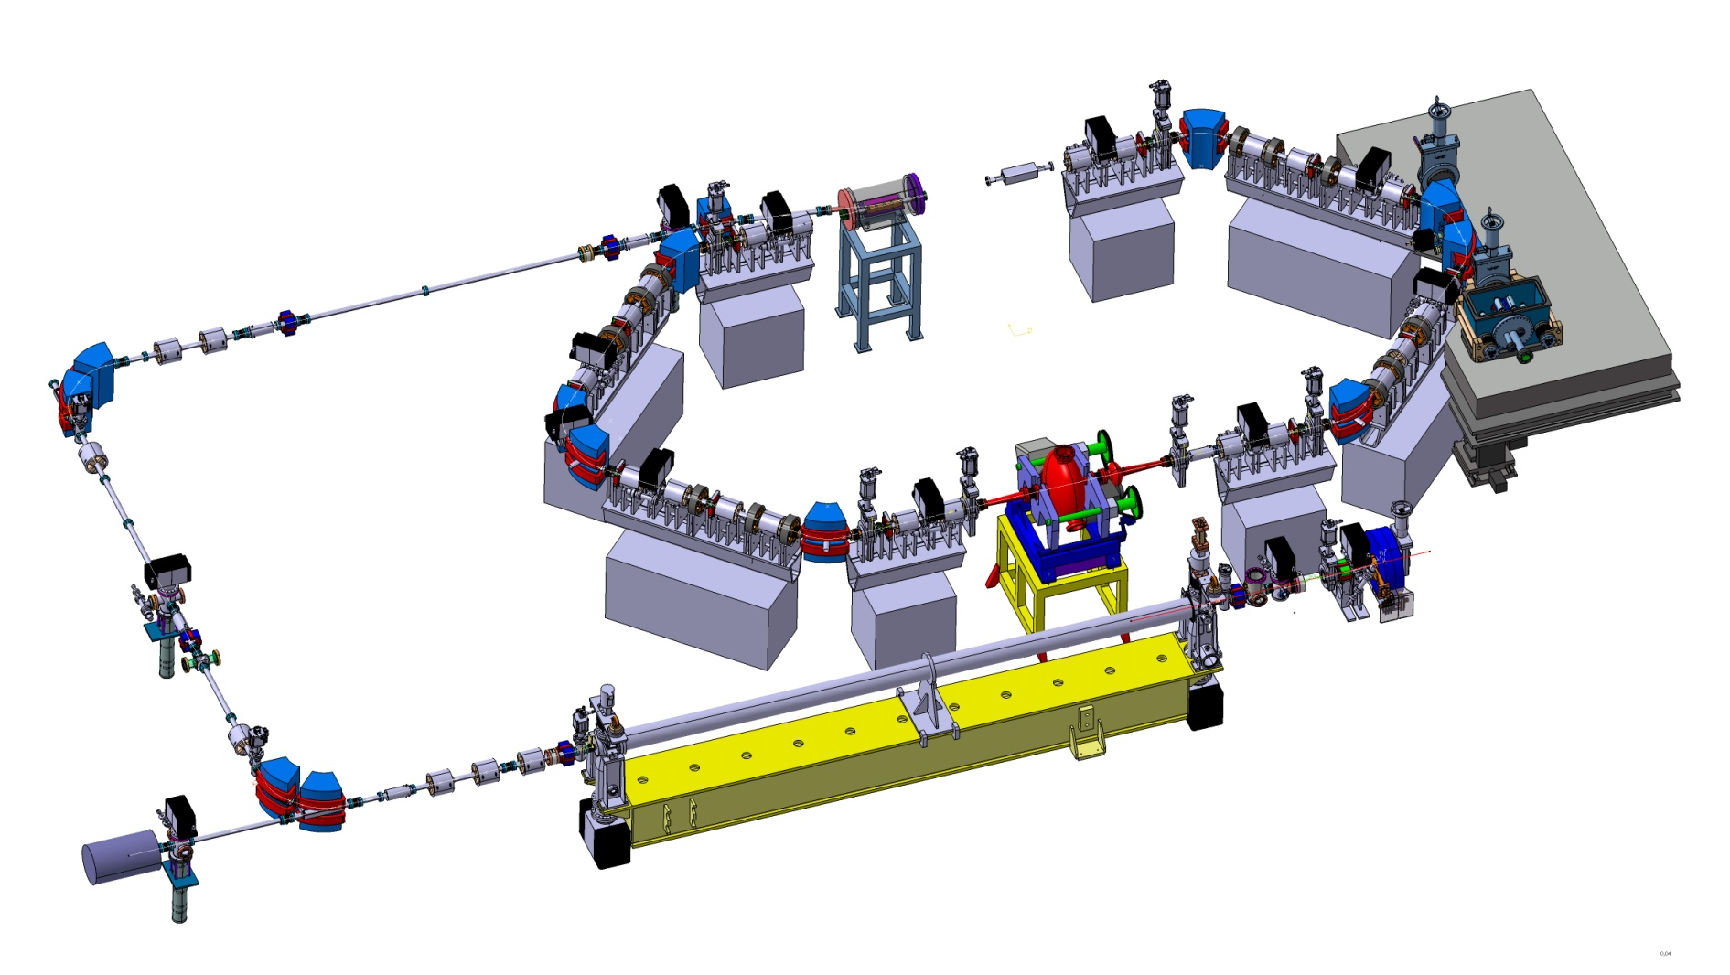
Cavité optique
The compact Compton X-ray machine (museum , medical applications)
~50MeV
electrons ring
Optical resonator
Size ~10mx7m
X rays
Photo gun
S-band (3GHz) LINAC

Slide 15
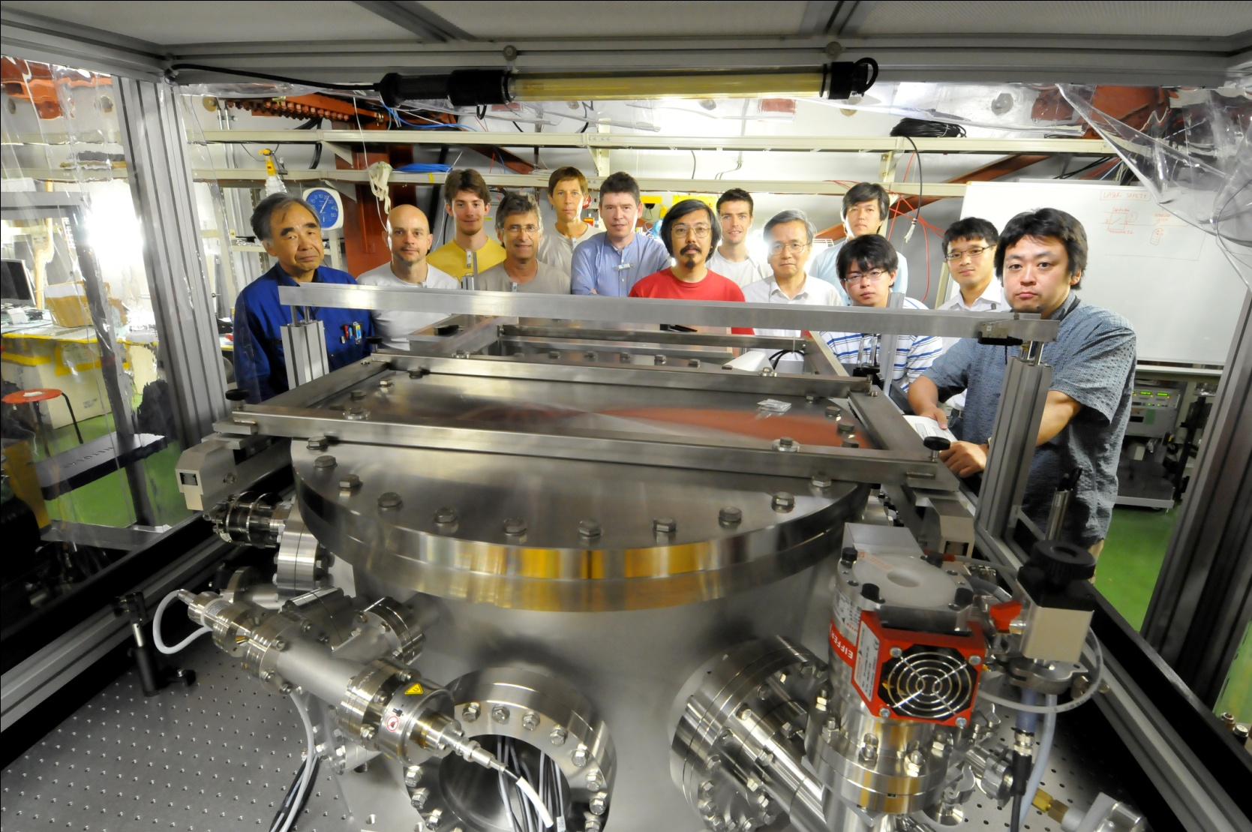
French Japanese Collaboration
+I. Chaikovska, N. Delerue, R. Marie LAL/France
Araki-san

Slide 16

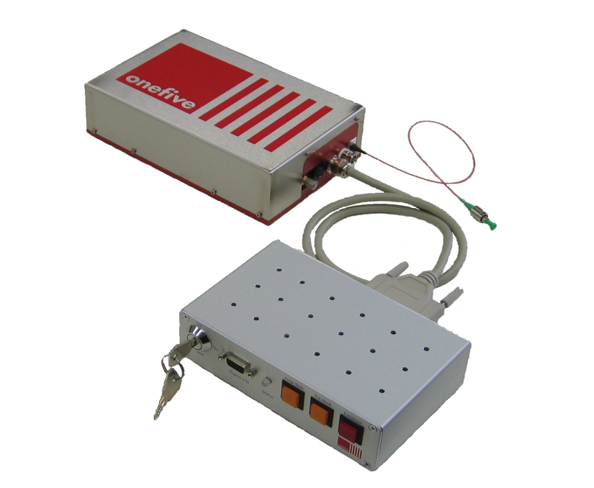
2 steps R&D
STEP ONE: commissioning a 4-mirror cavity at ATF, done end 2010
Oscillator (commercial)
=0.2W, 1030nm
Δt~0.2ps frep=178.5MHz
STEP TWO: upgrade mirrors & laser power
~5W
→100W
Amplifier
photonic fiber
Yb Doped
4-mirror
Fabry-Perot cavity
Gain~1000
1 piezo
→10000
2 piezos
1 temp. Ctrl.
Numerical feedback
ATF clock
STEP ONE (done end 2010)
With cavity laser/coupling ~50% ➔Power_cavity~2.5kW
STEP TWO (with sapphire mirror substrates)
With cavity laser/coupling ~50% ➔Power_cavity~250kW
Final goal: to reach the MW average power (➔~5mJ/pulse but @178.5MHz…)
Difference with PLC :
5J/pulse
~100kW average power

Slide 17
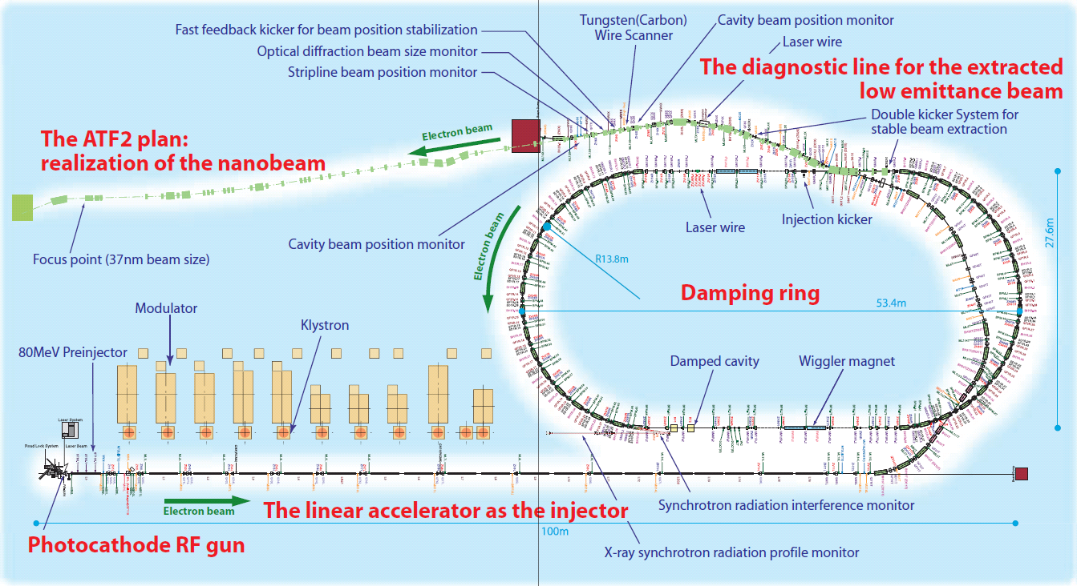
Cavity installation on the Accelerator Test Facility (ATF) at KEK
~30MeV γ
BaF2 calo
Cavity

Slide 18
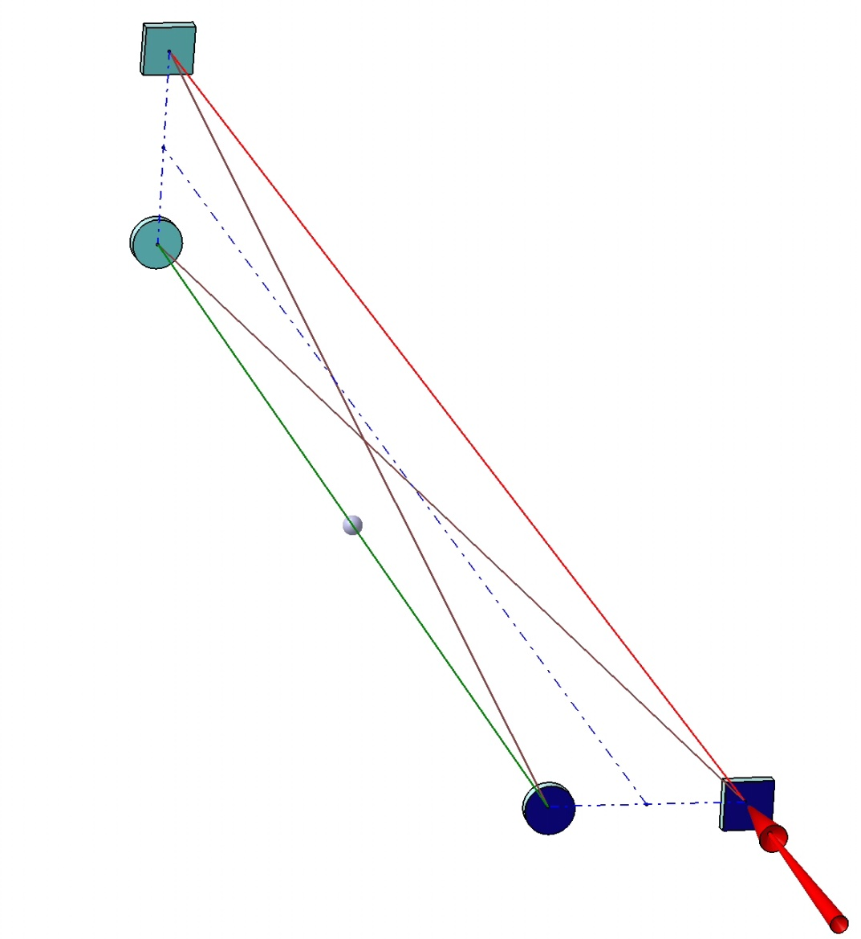
Small laser beam size +stable resonator ➔ 2-mirror cavity
Stable solution: 4-mirror cavity
as in Femto laser technology
Laser input
BUT
➔ elliptical & linearly
polarised eigen-modes
which are instable because of vibrations
at very high finesse
e⁻ beam
Non-planar 4-mirror cavity
➔Stable & circularly polarised
eigenmodes (AO48(2009)6651)
as needed for an ILC polarised positron source
and PLC

Slide 19
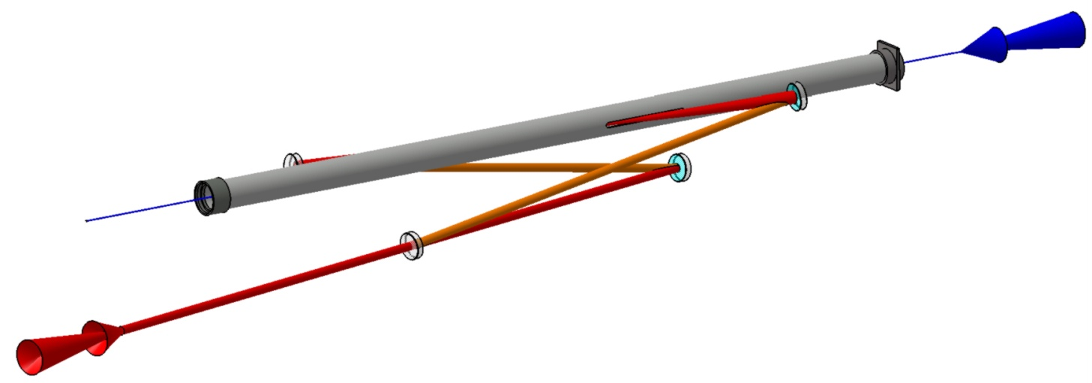
Non planar 4-mirror compact cavity design for
an accelerator (➔ATF)
ATF beam pipe: 5mm slit…
2 spherical mirrors
Angle laser / e⁻ beam= 8°
ATF e⁻ beam
laser/beam
Interaction point
~50cm
Injection laser
2 flat mirrors

Slide 20
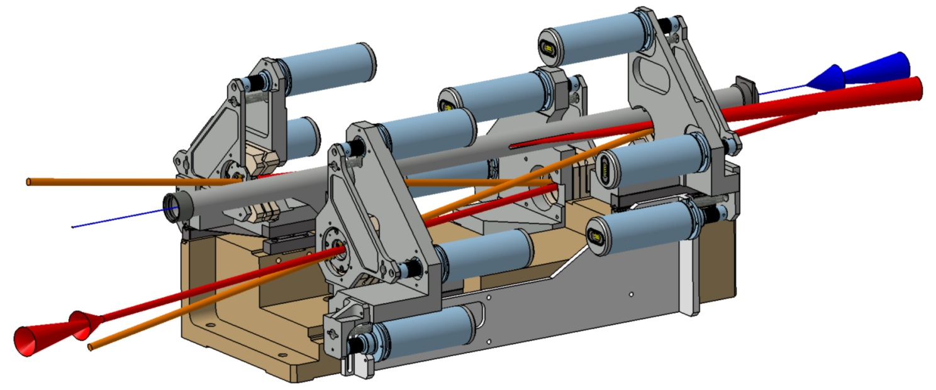
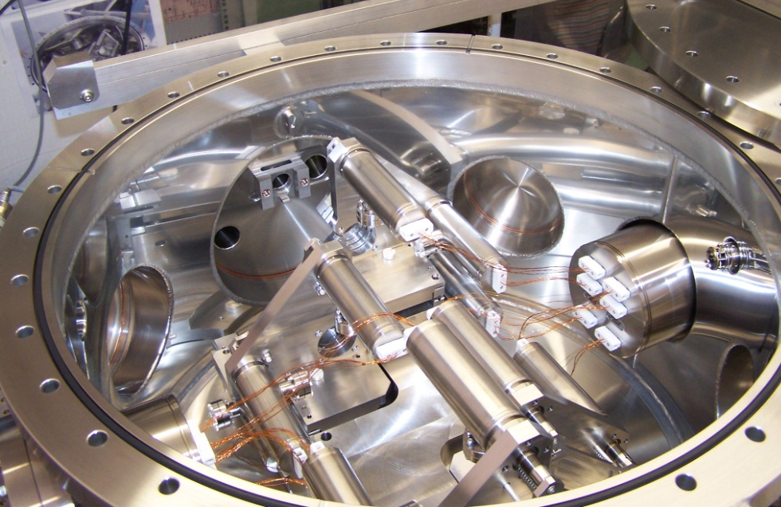
Mirror positioning system
12 encapsulated Motors
2 spherical mirrors
e⁻
Vacuum inside
~3x10⁻⁸mbar
without baking
(in situ)
laser
Invar base
to ensure
length
stability
2 flat mirrors

Slide 21
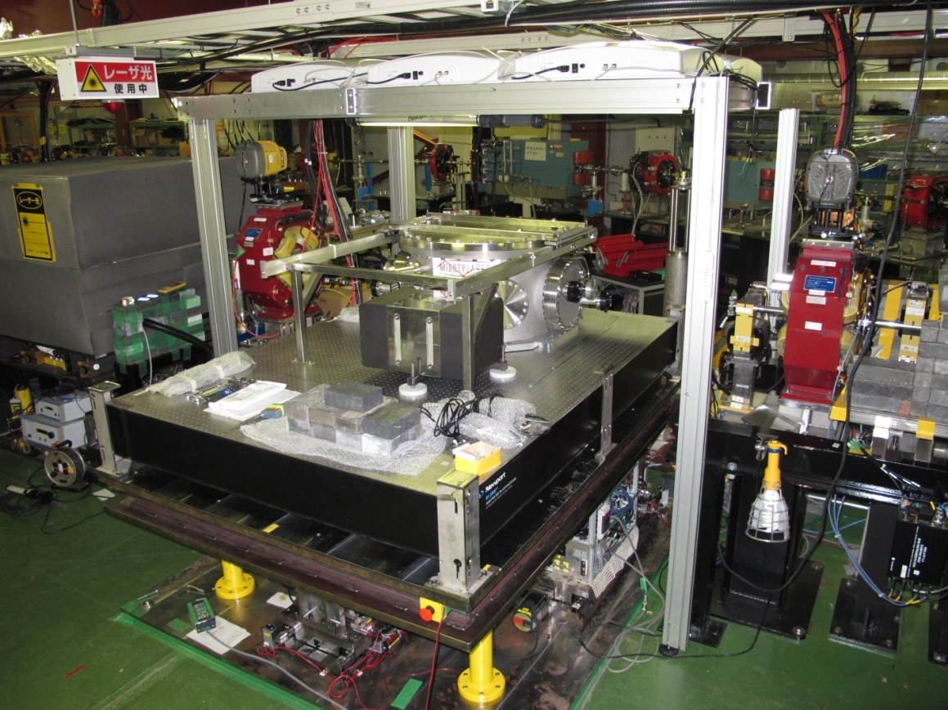
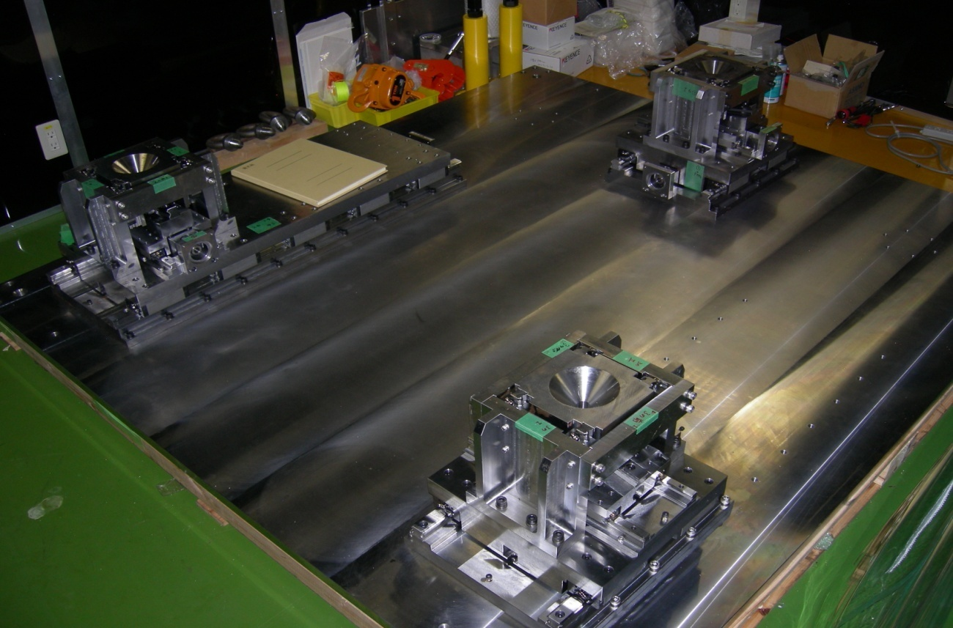
Class 100 air flow
Electron beam pipe
ATF table mount system (~1µm precision) used for spatial laser and e⁻ beam matching
Assumed ATF Beam Line
KEK 2-mirror cavity
Implementation at ATF
Pulse Motor Port
for
Up-Down Move
Pulse Motor Port
for
Horizontal Move
From Hirotaka-san

Slide 22
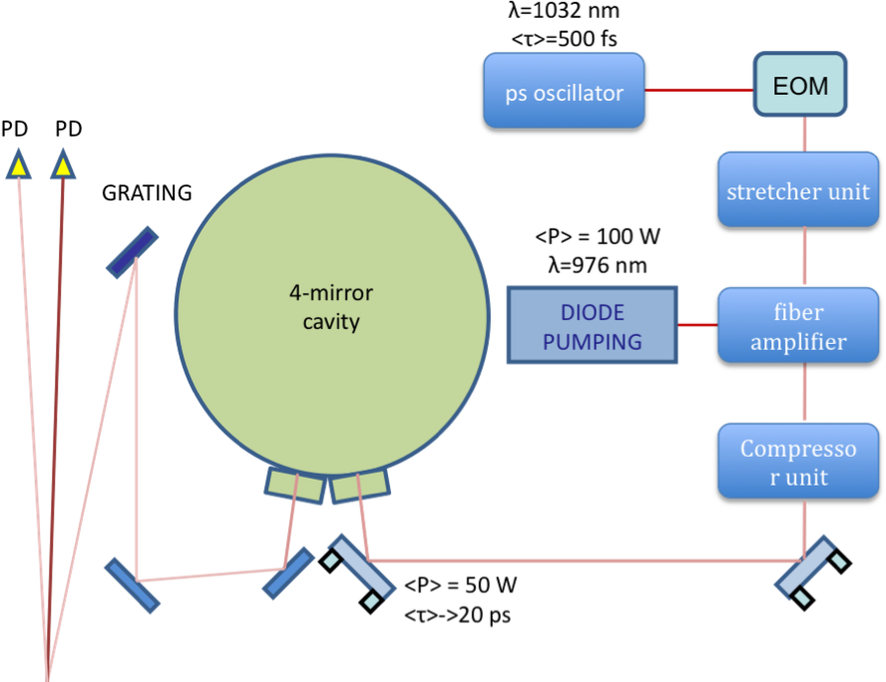
The optical scheme
Feedback
system
Phase modulator
needed for the
laser/cavity
feedback
Signal reflected by the cavity used to build the laser/cavity feedback signal:
  interference between the modulated incident laser beam
  AND the leackage on the beam circulating inside the cavity

Slide 23

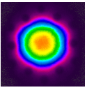
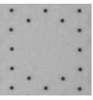
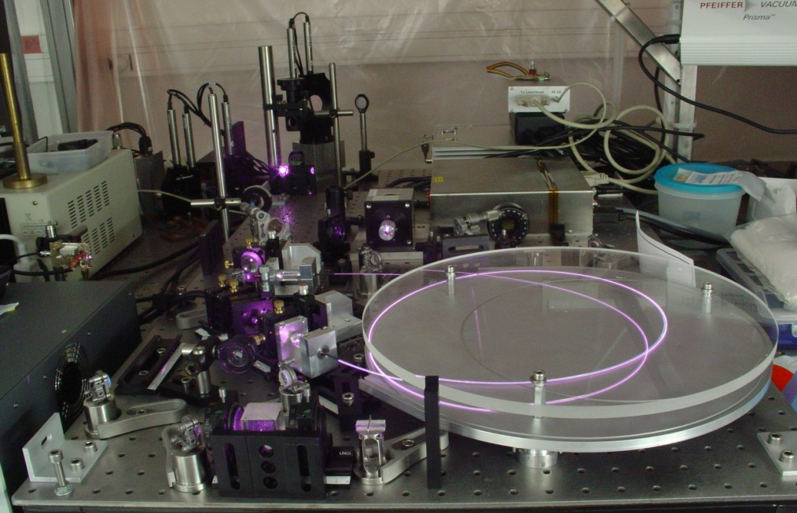
The laser amplification R&D
We use Ytterbium
doped photonic
cristal fiber
as amplifier
Ø core = 40 µm
Ø cladding = 200 µm
We obtained 60W average power ~stable thanks to connectorisation R&D
800W (11µJ/pulse) demonstrated with the same technique Limpert,OL35(2010)94
Toward
cavity
laser
Fiber
amplifier
23

Slide 24
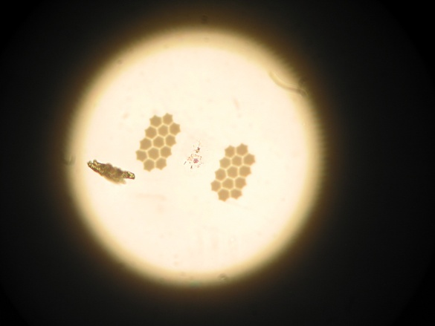
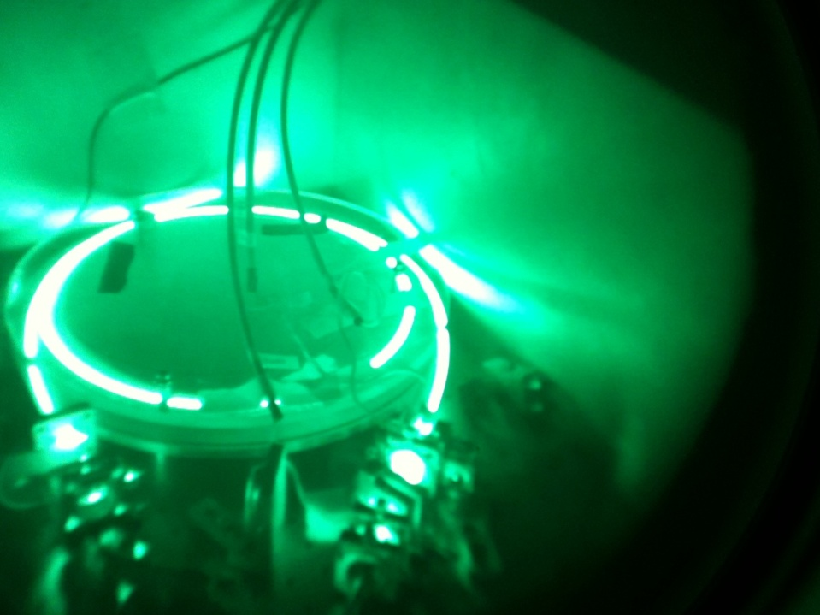
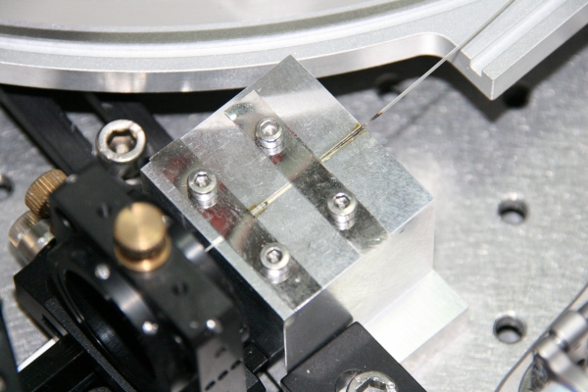
But we broke, burnt many fibres
Using 100W pumping diode (focused on 400µm)…
➔technological R&D to reach long term stability and reliability …
➔additive phase noise also an issue…

Slide 25
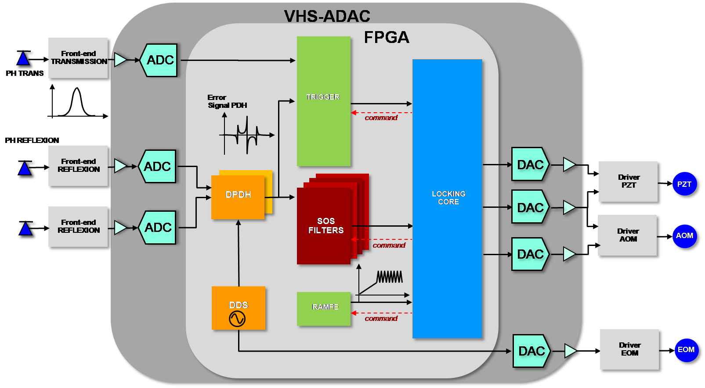
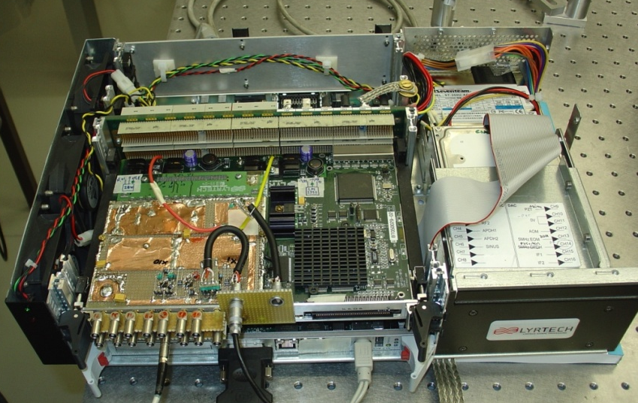
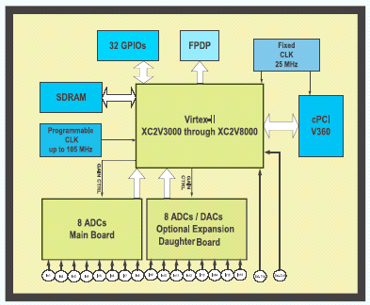
Laser/cavity numerical feedback development
Rétroaction on laser frequency
Clk = 100 MHz
8x ADC 14 bits
8x DAC 14 bits => Filtering => 18 bits / 400 kHz
FPGA Virtex II
25

Slide 26
Results before the earth quake
One very short run before ATF breakdown (modulator on fire
3 week before the earth quake…)
Laser power ~10W (we had ~60W aside)
Cavity laser/coupling ~30% (best measured~60%)
➔Power_cavity~3kW
PM Waveform
~25/γ/bunch-Xsing (Emax=28MeV)

Slide 27
Summary
The resonant cavity is a technical issue for the PLC laser beam
  Same feedback performance as for metrology experiment is required …
Benefit can be taken from R&D on compact Compton X-ray sources
  To reach high stack average power with stable laser/cavity locking
  To provide stable/stabilised optical resonator design for accelerator environment
    Geometry➔ mode polarisation
  Robust feedback system
Still, locking a 5 Hz train of ~3000 laser pulses of 50mJ will remain to be demonstrated …

