Slide 1
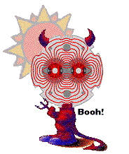

Probing eV-Scale Axions with the CAST experiment at CERN
Julia Vogel
Albert-Ludwigs-Universität Freiburg,Germany
Seminar in Louvain-la-Neuve
November 26, 2009
CAST

Slide 2
The CAST Experiment
Canada
University of British Columbia, Vancouver
M. Hasinoff
Croatia
Rudjer Bošković Institute, Zagreb
K. Jakovčić, M. Krčmar, B. Lakić, A. Ljubičić
France
DAFNIA, CEA-Saclay, Gif-sur-Yvette
S. Aune, T. Dafni, E. Ferrer-Ribas, I. Giomataris, T. Papaevangelou
Germany
Albert-Ludwigs-Universität Freiburg
H. Fischer, J. Franz, D. Kang, E. Gruber, T. Guthörl,
K. Königsmann, J. Vogel
TU Darmstadt, Institut für Kernphysik
H. H. Hoffmann, M. Kuster, A. Nordt, H. Riege
Universität Frankfurt
J. Jacoby
MPE Garching
H. Bräuninger, R. Hartmann, P. Friedrich, M. Kuster, A. Nordt
MPI München
R. Kotthaus, G. Lutz, A. Mirrizi, G. Raffelt
MPI für Sonnensystemforschung, Katlenburg-Lindau
S. Solanki
Greece
University of Patras
Y. Semertzidis, M. Tsagri, K. Zioutas
National Center for Scientific Research „Demokritos“, Athen
G. Fanourakis, T. Geralis, K. Kousouris
Aristotle University of Thessaloniki
C. Eleftheriadis, A. Liolios, I. Savvidis, T. Vafeiadis
National Technical University of Athens, Athen
E. Gazis, T. Karageorgopoulus
Italy
INFN Trieste
G. Cantatore, M. Karuza, V. Lozza, G. Raiteri
Russia
Russian Academy of Science, Moskow
A. Belov, S. Gninenko
Switzerland
CERN, Genf
K. Barth, S. Borghi, M. Davenport, F. Haug, L. Di Lella, N. Elias,
C. Lasseur, H. Mota, T. Niinikoski, A. Palacci, H. Riege,
P. Serpico, P. S. Silva, L. Stewart, L. Walckiers, Y. Wong
Spain
University of Zaragoza
J. Carmona, S. Cebrián, J. Galán, H. Gómez, F. J. Iguaz,
I. G. Irastorza, G. Luzón, J. Morales, A. Ortiz, A. Rodriguez,
J. Ruz, J. Villar
Turkey
Dogus University, Istanbul
S. Boydag, S. A. Cetin, C. Ezer, I. Hikmet
USA
Lawrence Livermore National Laboratory
M.Pivovaroff, R. Soufli, K. van Bibber
University of Chicago, Enrico Fermi Institute and KICP
J. Collar, D. Miller
Notes:
Altogether 20 institues from 11 countries

Slide 3
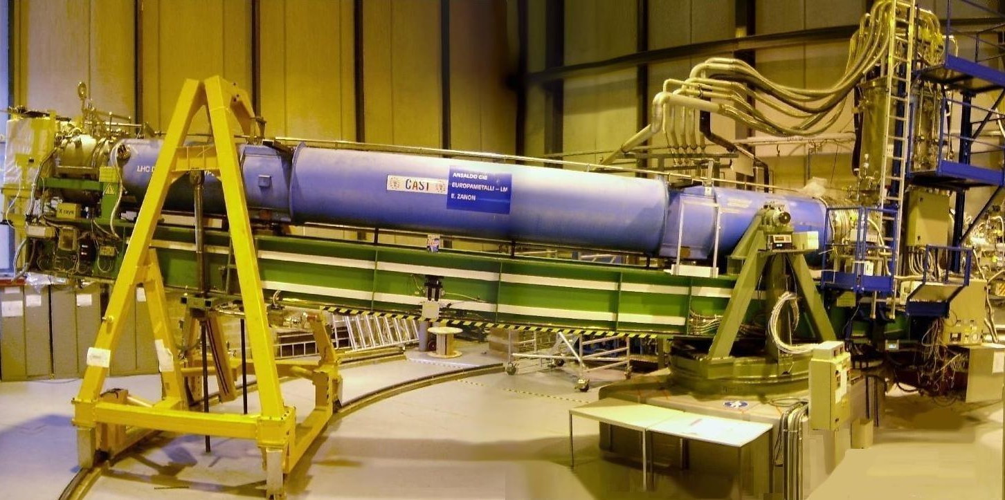
Overview
Theoretical motivation for axions
Search for solar axions with helioscopes
The CAST-Experiment
X-ray mirror optics and CCD detector
Exemplary Analysis of the ⁴He data
Results and Prospects

Slide 4
Theoretical Motivation
for Axions

Slide 5
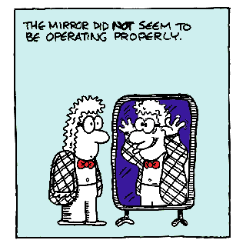
Theoretical Motivation for Axions
The strong CP-problem
CP-violation necessary in the standard model: Explanation of matter-antimatter-asymmetry
CP-violation in weak interactions CP-conservation in electromagnetic+strong interactions
QCD predicts violation in strong interactions
HOWEVER:
So far no experiment has observed this CP-violation in QCD!
Notes:
Sakaro

Slide 6
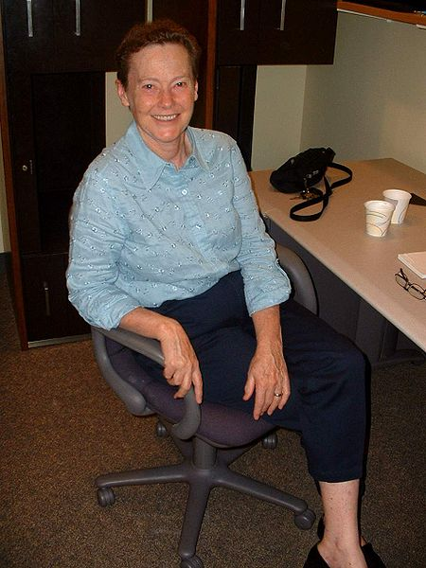
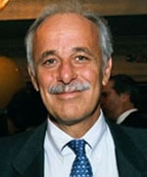

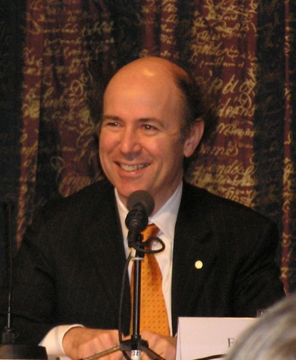
Theoretical Motivation for Axions
The Peccei-Quinn-Solution
A possible solution to the strong CP-problem:
Elimination of CP-violating term in QCD Lagrangian by introduction of new
additional global U(1) symmetry
→ New pseudo-scalar field AXION
→ First proposed by Peccei & Quinn (1977)
→ Particle interpretation by Weinberg, Wilczek (1978)

Slide 7
Theoretical Motivation for Axions
The Axion: Properties
  Neutral pseudo-scalar Goldstone-Boson
  Only feable interaction with ordinary matter
  Mass (from axion-π⁰-mixing):
  (Astrophysical criterion)
  Coupling to photons: with
  Mean lifetime: for i.e.
Notes:
Lifetime for 150keV (visible axion) about 0.1s

Slide 8
Theoretical Motivation for Axions
The Axion: Models
Distinguishing feature for different axion models is size of PQ breaking scale:
„Visible Axion“ (PQWW-Axion)
  Large axion mass ( keV),
  since GeV
  → Excluded by experiments and theory
„Invisible Axion“
  Small axion mass ( μeV-eV)
  Kim-Shifman-Vainshtein-Zakharov-Model
  Exotic, heavy quark carries PQ-charge
  Dine-Fischler-Srednicki-Zhitnitskii-Model
  SM fermions carry PQ-charge

Slide 9
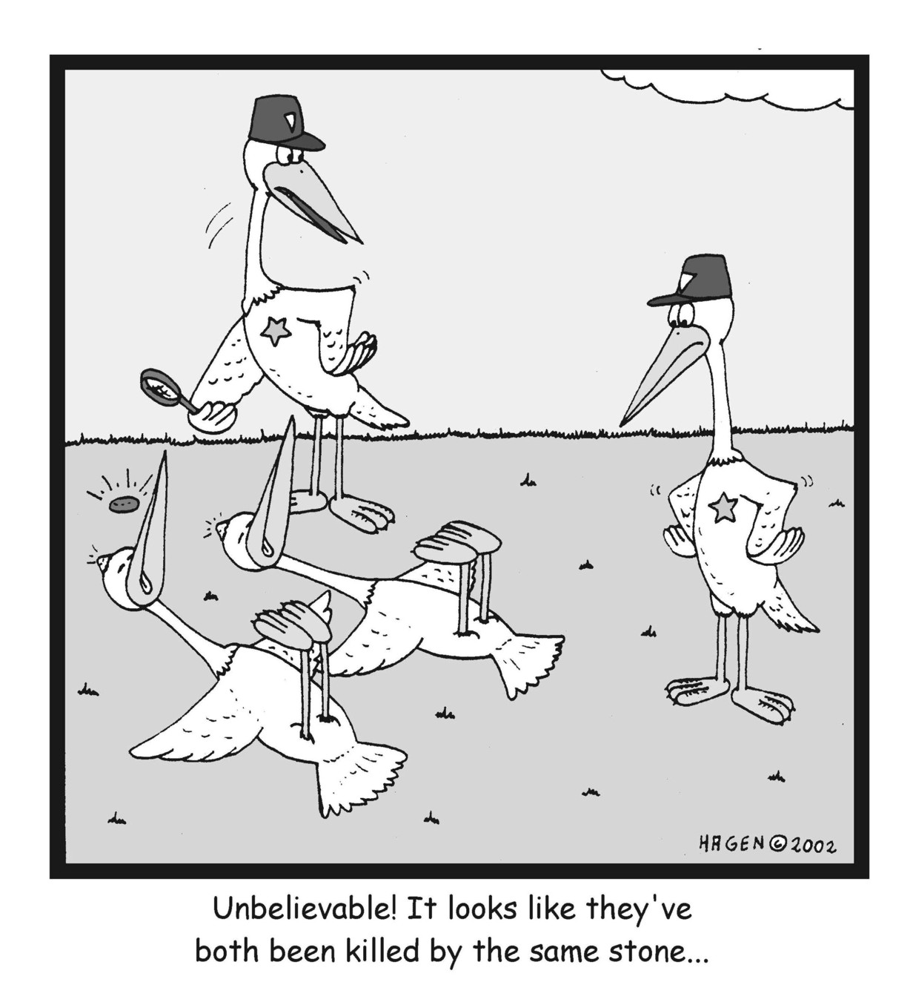
Theoretical Motivation for Axions
The Axion: Killing two birds with one stone
Axions as
Solution to the strong
CP-problem
Candidate for dark matter

Slide 10
Theoretical Motivation for Axions
The Axion: Experimental searches
Galactic axions
  Haloscopes
  (ADMX, Carrack)
  Telescopes
  (Haystack)
Laboratory axions
  Shining-Light-through-Walls
  (OSQAR, LIPSS, ALPS)
  Polarization
  (PVLAS)
Solar axions
  Crystals
  (SOLAX,COSME)
  Helioscopes
  (Tokyo, CAST)
Notes:
Overclosure: Too much dark matter….

Slide 11
Search for solar axions
with helioscopes

Slide 12
Search for solar axions with helioscopes
Production and detection of axions
Primakoff-Effect:
Photons of blackbody radiation
Strong electric fields
in solar core
Axions
(X-ray photons)
Inverse Primakoff-Effect:
Strong magnetic field
in laboratory on Earth
Axions
X-ray photons
Notes:
Mixing of a with gamma via pion mixing or via triangle loop of fermions carrying PQ and electric charge
Axion spin 0, Photon spin 1

Slide 13
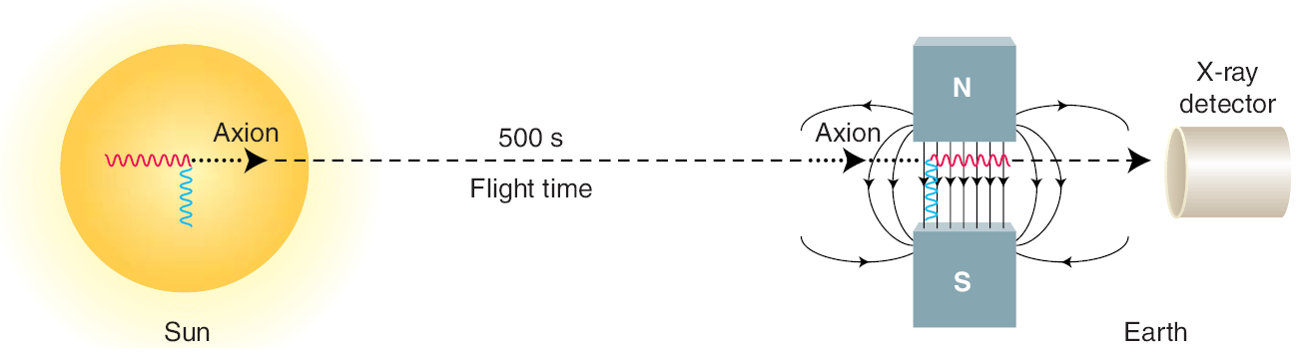
Search for solar axions with helioscopes
Production and detection of axions
Primakoff-Effect:
Photons of blackbody radiation
Strong electric fields
in solar core
Axions
(X-ray photons)
Inverse Primakoff-Effect:
Strong magnetic field
in laboratory on Earth
Axions
X-ray photons
Notes:
Mixing of a with gamma via pion mixing or via triangle loop of fermions carrying PQ and electric charge
Axion spin 0, Photon spin 1

Slide 14
Search for solar axions with helioscopes
Expected solar axion flux at Earth
Mean Energy of axions: <E_{a}> = 4.2 keV
Flux of axions:
(Serpico & Raffelt, based on standard solar model BP2004 of Bahcall et al.)

Slide 15
Search for solar axions with helioscopes
Conversion probability and coherence condition
With momentum transfer , effective photon mass
in ⁴He and absorption Γ

Slide 16
Search for solar axions with helioscopes
Conversion probability and coherence condition
With momentum transfer , effective photon mass
in ⁴He and absorption Γ
(if absorption Γ = 0)

Slide 17
Search for solar axions with helioscopes
Conversion probability and coherence condition
(if absorption Γ = 0)
Coherence condition:
qL/2 < π

Slide 18
Search for solar axions with helioscopes
Conversion probability and coherence condition
Coherence condition: qL/2 < π
CAST Phase I: Vacuum in magnet (m_{γ}= 0, qL/2 < π)
CAST Phase II: ⁴He / ³He in magnet (m_{γ}≠ 0, qL/2 < π)
  0.02 eV < m_{a} < 1.16 eV
  Effective mass of photon m_{γ}=0
  Range of axion masses: m_{a}≤0.02 eV
  Effective mass of photon m_{γ}>0
  Extended range of axion masses

Slide 19
Search for solar axions with helioscopes
Expected number of photons from axion conversion
A: detector area, Δt: exposure time, ε(E_{a}): efficiency
Notes:
Plot für 90 minuten unter CAST Bedingungen, Eff=1

Slide 20
The CAST-Experiment

Slide 21

The CAST Experiment
CMS
LHC
Point 8:
CAST
CERN Prevessin
France
Switzerland
CERN Meyrin

Slide 22

The CAST Experiment
Experimental Setup
Prototype of an LHC dipole magnet (B=9.0 Tesla, L=9.3 m, T=1.8 K)
Range of movement: 80° horizontally and ± 8° vertically
Solar tracking possible during sunrise and sunset (2 x 1.5 h per day)
Three X-ray detectors and one X-ray mirror optics:
MicroMEGAS (MM), Charge Coupled Device (CCD),Time Projection Chamber (TPC)

Slide 23
The CAST Experiment
Experimental Setup
Prototype of an LHC dipole magnet (B=9.0 Tesla, L=9.3 m, T=1.8 K)
Range of movement: 80° horizontally and ± 8° vertically
Solar tracking possible during sunrise and sunset (2 x 1.5 h per day)
Three X-ray detectors and one X-ray mirror optics:
MicroMEGAS (MM), Charge Coupled Device (CCD),MicroMEGAS (MM)

Slide 24
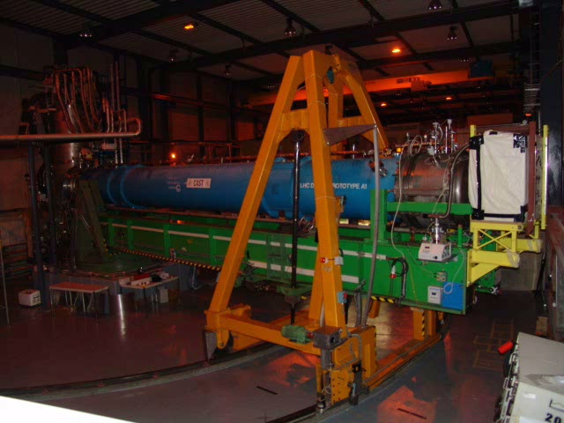

Slide 25
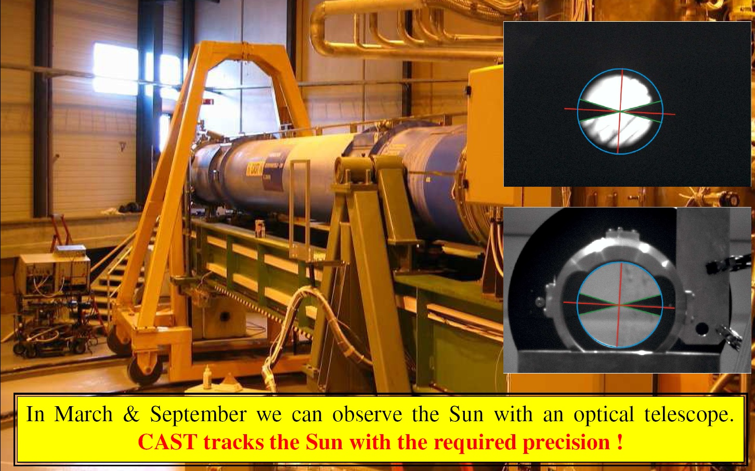
The CAST Experiment
Solar Filming
In March and September, Sun is directly observable through window:
CAST is able to follow the Sun with required accuracy (0.02°)!

Slide 26
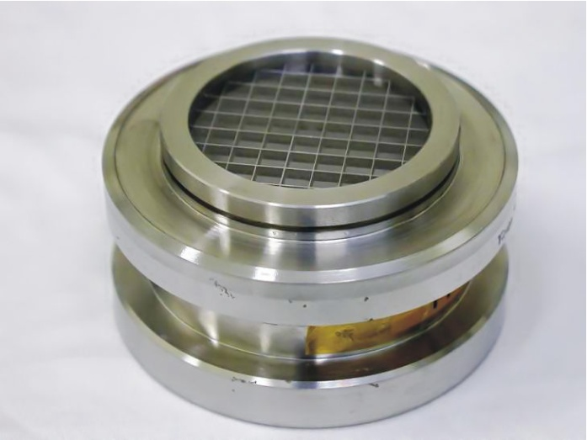
The CAST Experiment
Vacuum and helium gas system
Phase I : Vacuum (2003+2004)
Phase II: ⁴He (2005+2006)
³He (2007- 2010)

Slide 27
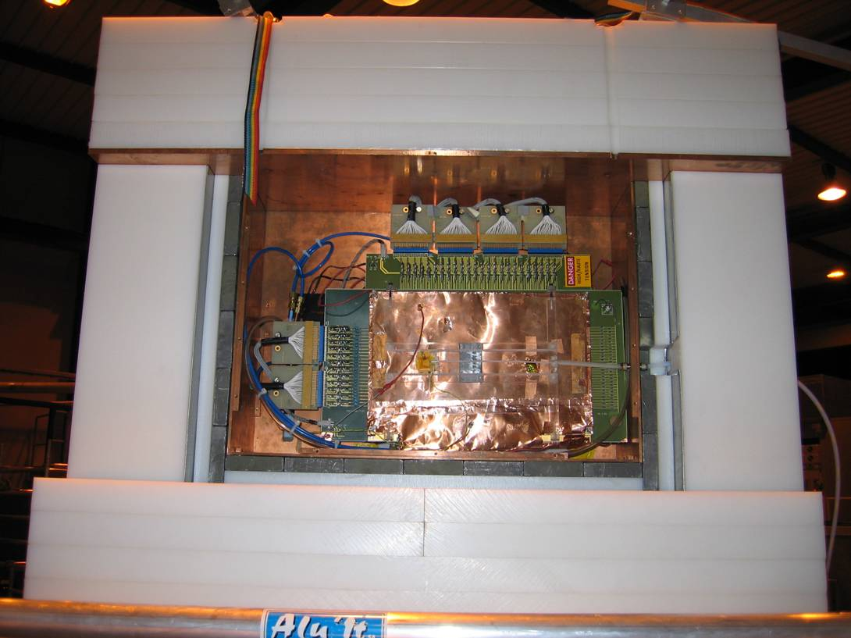
The CAST Experiment
CAST detectors until 2006 (Phase I and II with ⁴He)
MicroMEGAS
Background count rates:
TPC: 85 cts/h (2-12 keV)
MM : 25 cts/h (2-10 keV)
Telescope/CCD: 0.25 cts/h (1- 7 keV)
TPC
New J. Phys. 9 (2007) 170
X-ray telescope with CCD
New J. Phys. 9 (2007) 169
New J. Phys. 9 (2007) 171
Sunrise detectors
Sunset detector

Slide 28
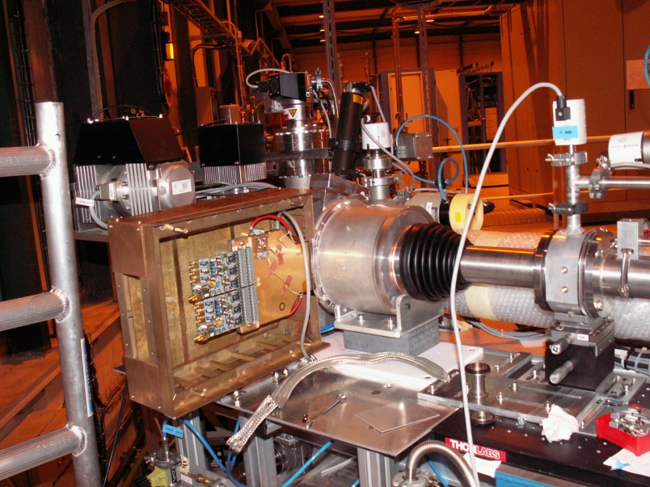
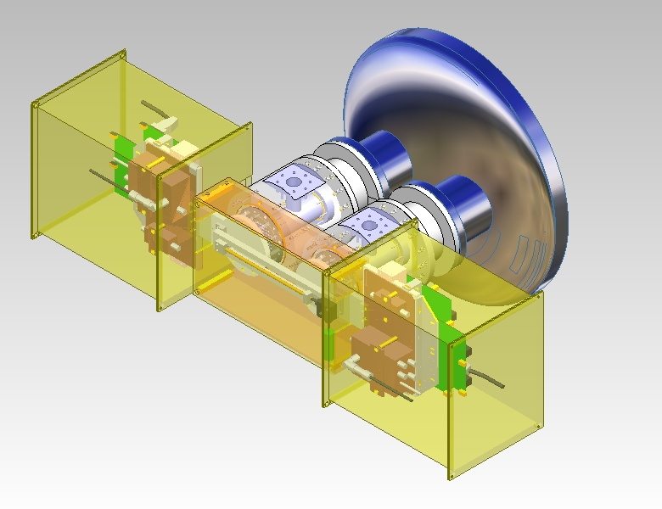
The CAST Experiment
Detector upgrades since 2007 (Phase II with ³He)
MicroMEGAS (2nd generation)
Background count rates:
MM : 3 cts/h (2-10 keV)
Teleskope/CCD: 0.16 cts/h (1- 7 keV)
X-ray telescope with CCD
New J. Phys. 9 (2007) 169
MicroMEGAS (2nd generation)
Sunrise detectors
Sunset detectors

Slide 29
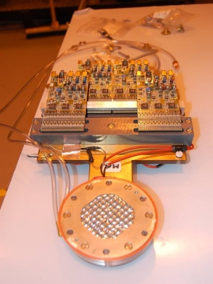
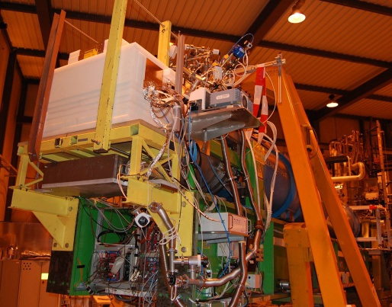
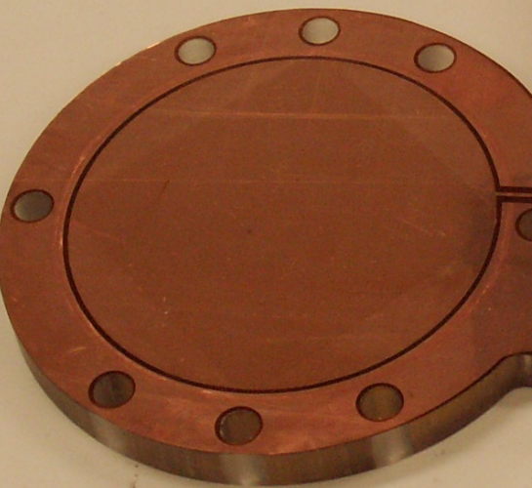
The CAST Experiment
Detector upgrades since 2007 (Phase II with ³He)
2nd generation Micromegas:
Novel manufacturing technique (microbulk technology)
Materials selected based on low intrinsic radioactivity
Improved shielding
Good potential for very-low background rates

Slide 30
X-Ray Mirror Optics
and
CCD Detector

Slide 31
X-ray mirror optics and CCD detector
Experimental Setup

Slide 32
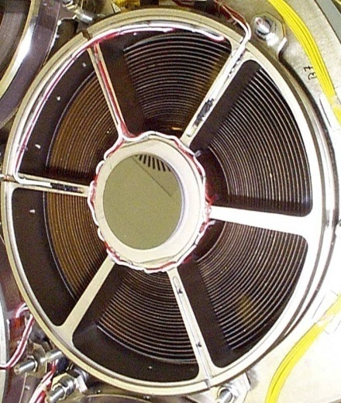
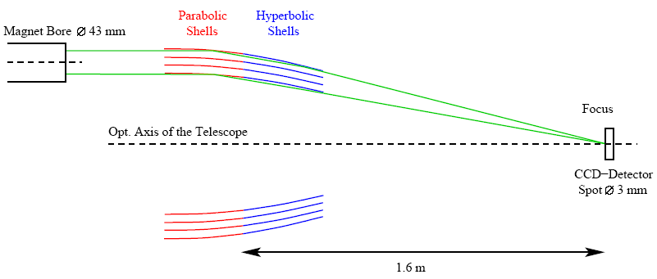
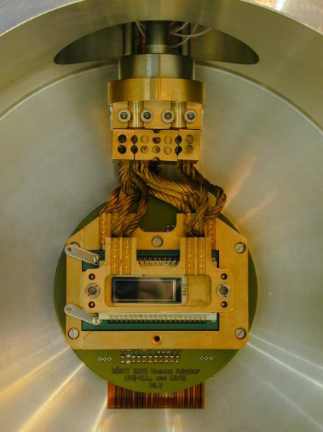
X-ray mirror optics and CCD detector
Experimental Setup
      Wolter-I-type telescope (Prototype of ABRIXAS mission)
      27 nested, gold-coated mirror shells
      Only one sector of telescope illuminated at CAST
      pn-CCD (Prototype of XMM-Newton mission)
      Very good spatial and energy resolution
      Simultaneous measurement of signal and background possible
  Improvement of signal-to-background ratio by a factor of ~150!
Magnet bore
Ø 43 mm
X-rays
Focal plane
Optical axis of telescope
CCD
Ø 3 mm
Focal length 1.6 m

Slide 33
X-ray mirror optics and CCD detector
Characterization of X-ray telescope (Optics + CCD)
Efficiency for X-ray mirror optics and CCD detector for CAST Phase I und II (⁴He)
- X-ray mirror optics for CAST
- Mirror optics + QE of CCD
(Phase I)
- Consideration of the
Cold Window
(Phase II, from 2005 on)

Slide 34
X-ray mirror optics and CCD detector
In-situ calibration of detector
X-Ray Tube – Ti-K Lines
Background
Calibration of detector at CAST using X-ray tube
Lines in background spectrum used for E > 10 keV
Additionally daily calibrations with ⁵⁵Fe (Energy resolution: 170 eV @ 5.9 keV)
Detector is calibrated till ≈14 keV: absolute energy calibration better than 1%
Notes:
Cu, Cr, Mg, Fe, Ti, Ag
Bgrd: Au M-alpha: 2.1 keV, Au-L-alpha: 9.7 Au L-beta:11.5

Slide 35
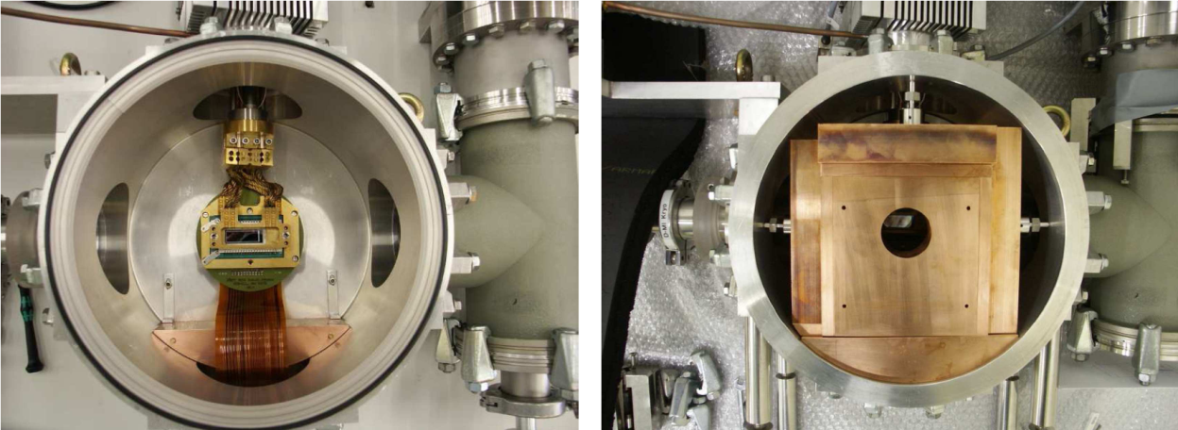
X-ray mirror optics and CCD detector
Experimental background
Rare event search:
→ Reduction of background
→ Material close to detector
Pattern recognition algorithm
→ MIP´s
Shielding
→ Inner part:
1-4 cm Cu & 2.2 cm Pb
External γ-Background
→ Outer part:
Pb against γ‘s (walls)
Focussing via telescope
→ Minimization of
detector volume

Slide 36
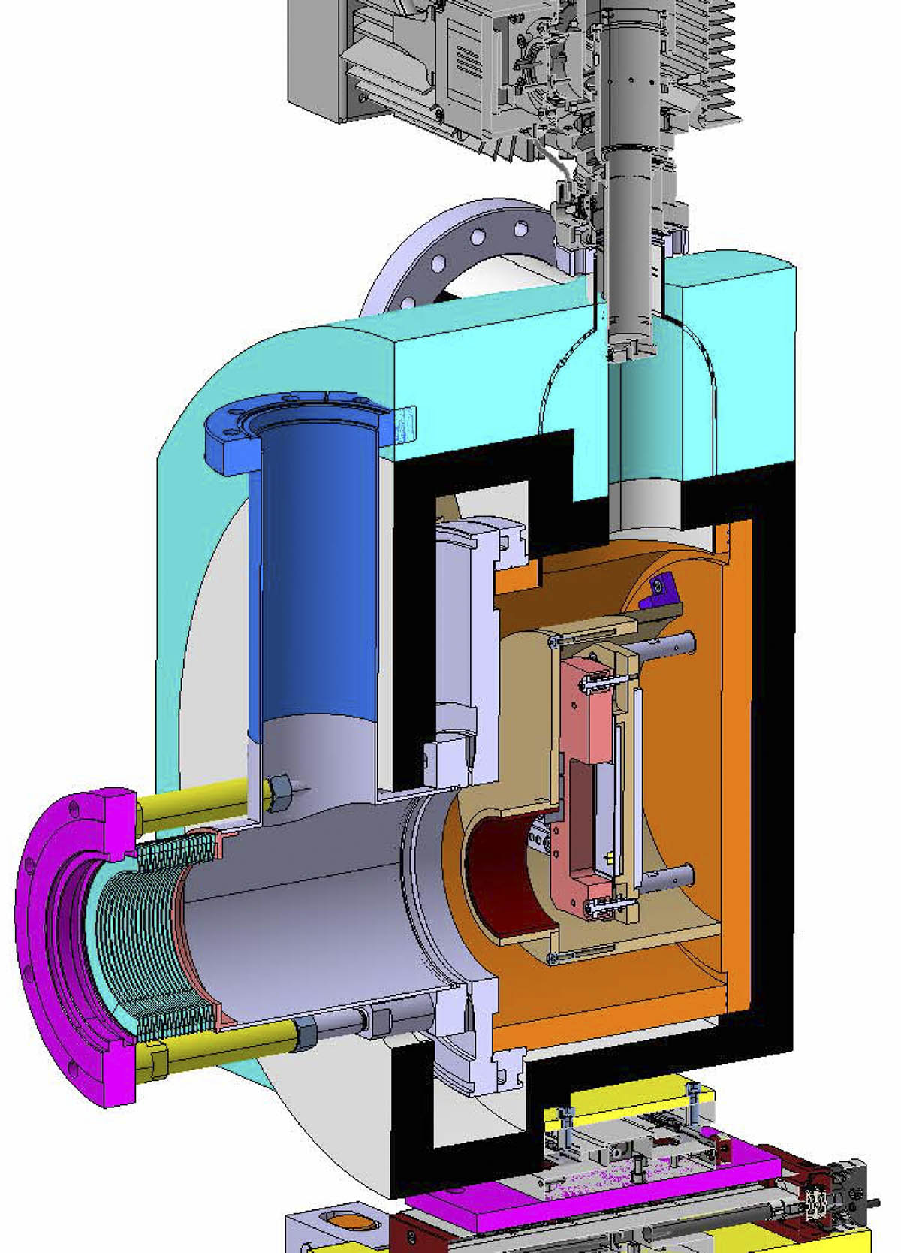
X-ray mirror optics and CCD detector
Upgrade CCD Frame-Store Detector
Frame-Store CCD Design
Better low energy response
  → 0.2 keV < E < 1keV
Use of radiopure material+shielding
  → Lower background
Less out of time events
  8% of measured flux
State of the art technology
  Supported by other laboratories
Decoupling of telescope and detector
  → Simplification of alignment
PE Layer
Pb Layer
Cu Vessel
Al Layer/
Cold Trap
PE Layer

Slide 37
Exemplary Analysis of the ⁴He data

Slide 38
Exemplary Analysis of the ⁴He data
Expected signal for the CCD detector
For one helium density setting P_{k} one expects N_{γ,k} photons
from axion-to-photon conversion via Primakoff-effect:

Slide 39
Exemplary Analysis of the ⁴He data
Expected signal: Efficiency and axion flux
For one helium density setting P_{k} one expects N_{γ,k} photons
from axion-to-photon conversion via Primakoff-effect:

Slide 40
Exemplary Analysis of the ⁴He data
Expected signal: Conversion probability
For one helium density setting P_{k} one expects N_{γ,k} photons
from axion-to-photon conversion via Primakoff-effect:
(for absorption Γ = 0)

Slide 41
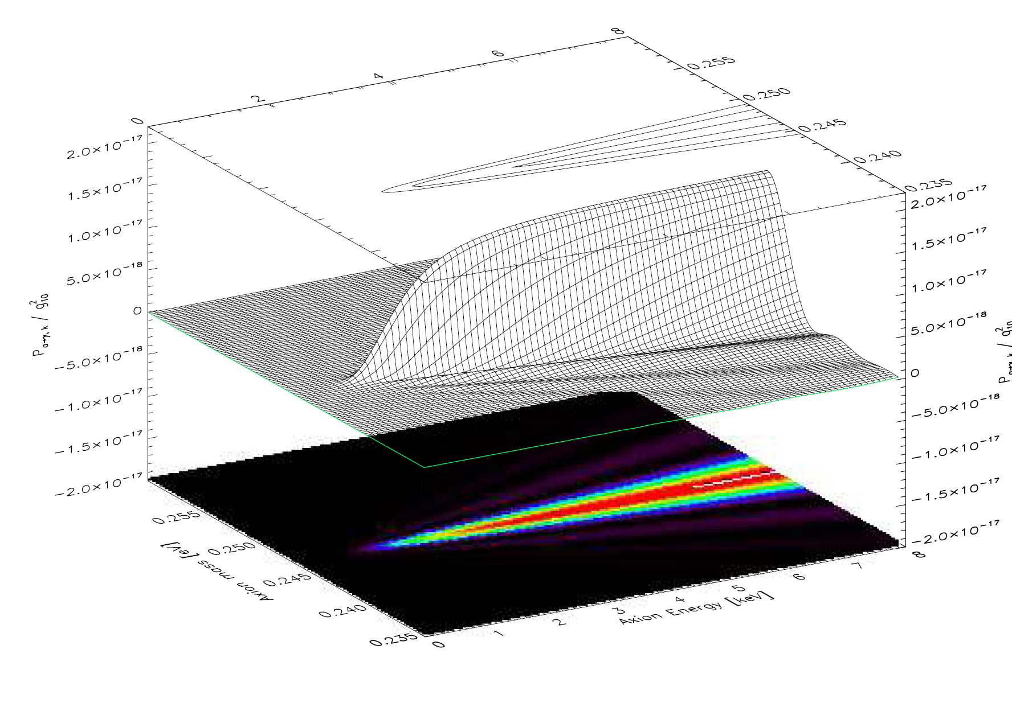
Exemplary Analysis of the ⁴He data
Expected signal: Conversion probability
P_{aγ,k}/g₁₀²
Axion Mass [eV]
Axion Energy [keV]
k=60, p_{k}=5.49 mbar
Notes:
0.247eV

Slide 42
Exemplary Analysis of the ⁴He data
Expected signal: Number of photons N_{γ}
N_{γ,k}/g₁₀⁴
Axion Mass [eV]
Axion Energy [keV]
k=60, p_{k}=5.49 mbar

Slide 43
Exemplary Analysis of the ⁴He data
Expected signal: Number of photons N_{γ}
N_{γ,k}/g₁₀⁴
Axion Mass [eV]
Axion Energy [keV]
k=60, p_{k}=5.49 mbar

Slide 44
Exemplary Analysis of the ⁴He data
Expected signal: Number of photons N_{γ}

Slide 45
Exemplary Analysis of the ⁴He data
Analysis: Definition of tracking and background
Tracking:
→ 294.8 h (1508/45 cts chip/spot)
→ 8.58 ± 0.17 x 10⁻⁵ cts/cm²/s/keV
Background:
→ 2758.1 h (14245/430 cts chip/spot)
→ 8.66 ± 0.06 x 10⁻⁵ cts/cm²/s/keV
Tracking
Background
NO SIGNIFICANT AXION SIGNAL ABOVE BACKGROUND OBSERVED!

Slide 46
Exemplary Analysis of the ⁴He data
Analysis: Maximum Likelihood Method
Expected counts in CCD for helium pressure P_{k} are
Poissonian distributed with mean μ_{ik}
i = Number of energy bin
k = Number of pressure step
n_{ik} = Total number of counts in tracking in energy bin i
and pressure setting k
μ_{ik} = b_{ik} + (N_{γ})_{ik} (g_{aγ}⁴,m_{a})
= expected background + theoretical axion signal

Slide 47
Exemplary Analysis of the ⁴He data
Analysis: Single pressure settings
Expected counts in CCD for helium pressure P_{k} are
Poissonian distributed with mean μ_{ik}
i = Number of energy bin
k = Number of pressure step
n_{ik} = Total number of counts in tracking in energy bin i
and pressure setting k
μ_{ik} = b_{ik} + (N_{γ})_{ik} (g_{aγ}⁴,m_{a})
= expected background + theoretical axion signal
    Single pressure settings
      Calculation of single pressure likelihood functions L_{k}
      χ²-Distribution χ_{k}²= -2 ln L_{k}
      Upper limit via integration of Bayesian probability up to 95%
      Exclusion plot for single pressure settings

Slide 48
Exemplary Analysis of the ⁴He data
Analysis: Single pressure settings
0.1
0.2
0.3
0.4

Slide 49
Exemplary Analysis of the ⁴He data
Analysis: All pressure settings
Expected counts in CCD for helium pressure P_{k} are
Poissonian distributed with mean μ_{ik}
i = Number of energy bin
k = Number of pressure step
n_{ik} = Total number of counts in tracking in energy bin i
and pressure setting k
μ_{ik} = b_{ik} + (N_{γ})_{ik} (g_{aγ}⁴,m_{a})
= expected background + theoretical axion signal

Slide 50
Exemplary Analysis of the ⁴He data
Analysis: All pressure settings
Expected counts in CCD for helium pressure P_{k} are
Poissonian distributed with mean μ_{ik}
i = Number of energy bin
k = Number of pressure step
n_{ik} = Total number of counts in tracking in energy bin i
and pressure setting k
μ_{ik} = b_{ik} + (N_{γ})_{ik} (g_{aγ}⁴,m_{a})
= expected background + theoretical axion signal
    Combination of all pressure settings
      Determination of the global likelihood function L
      via multiplication of likelihoods for all pressure settings L = Π L_{k}
      Global χ²-Distribution χ²= -2 ln L
      Upper limit via integration of Bayesian probability up to 95%
      Exclusion plot for all pressure settings

Slide 51
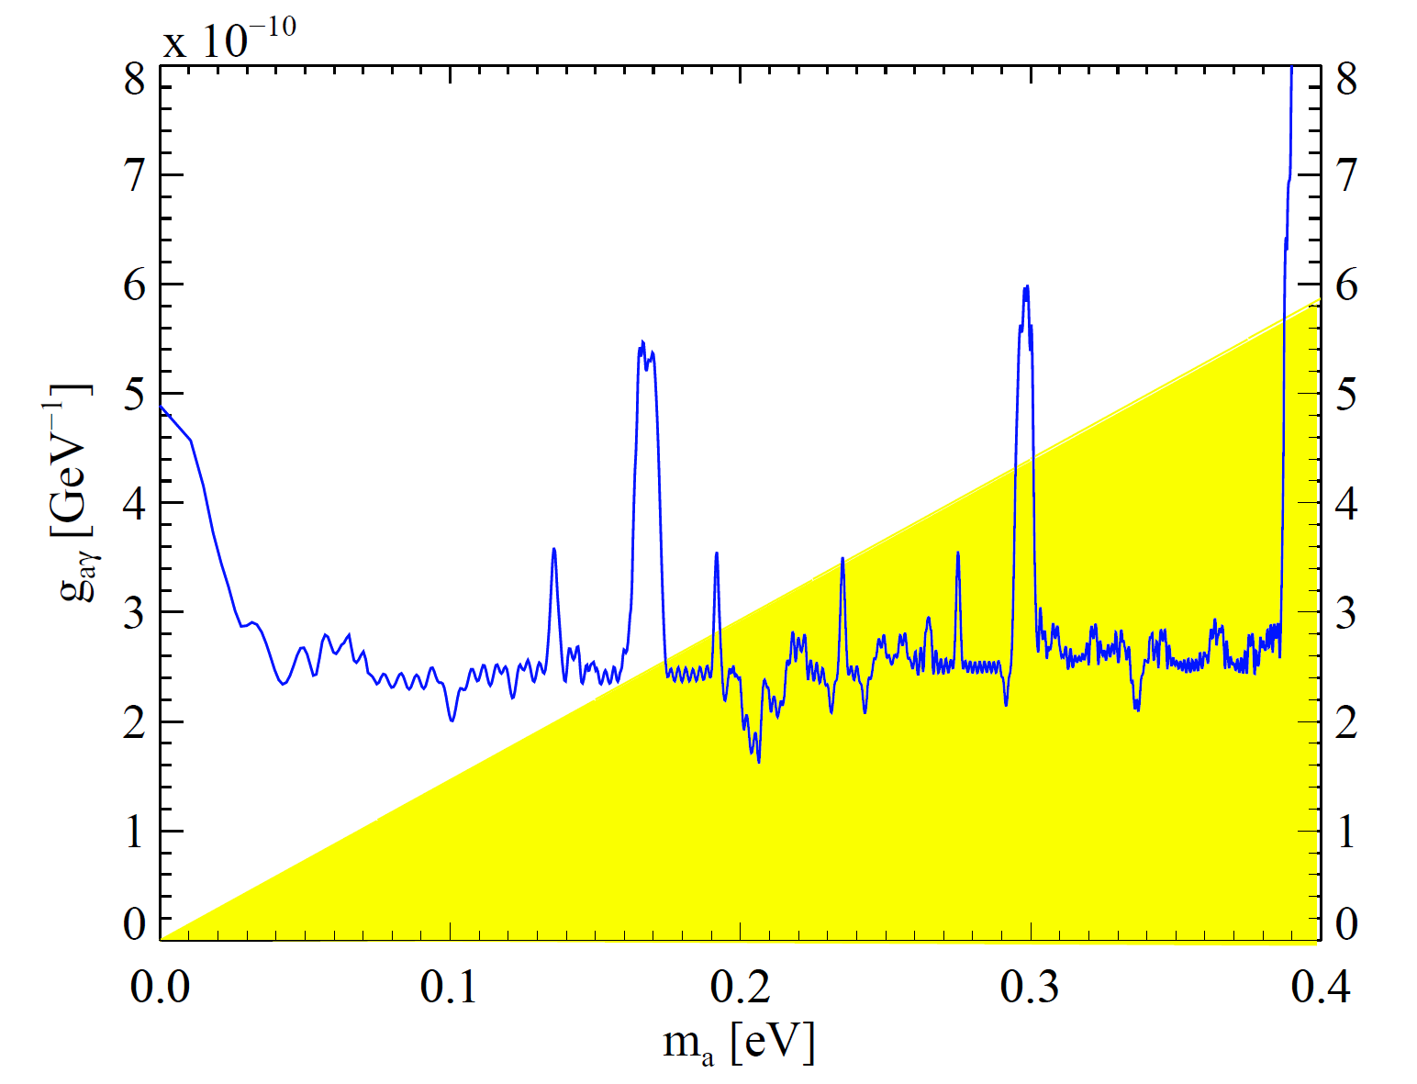
Exemplary Analysis of the ⁴He data
Combined CCD result for Phase I and Phase II with ⁴He

Slide 52
Exemplary Analysis of the ⁴He data
Combined CCD result for Phase I and Phase II with ⁴He

Slide 53
Results and Prospects

Slide 54
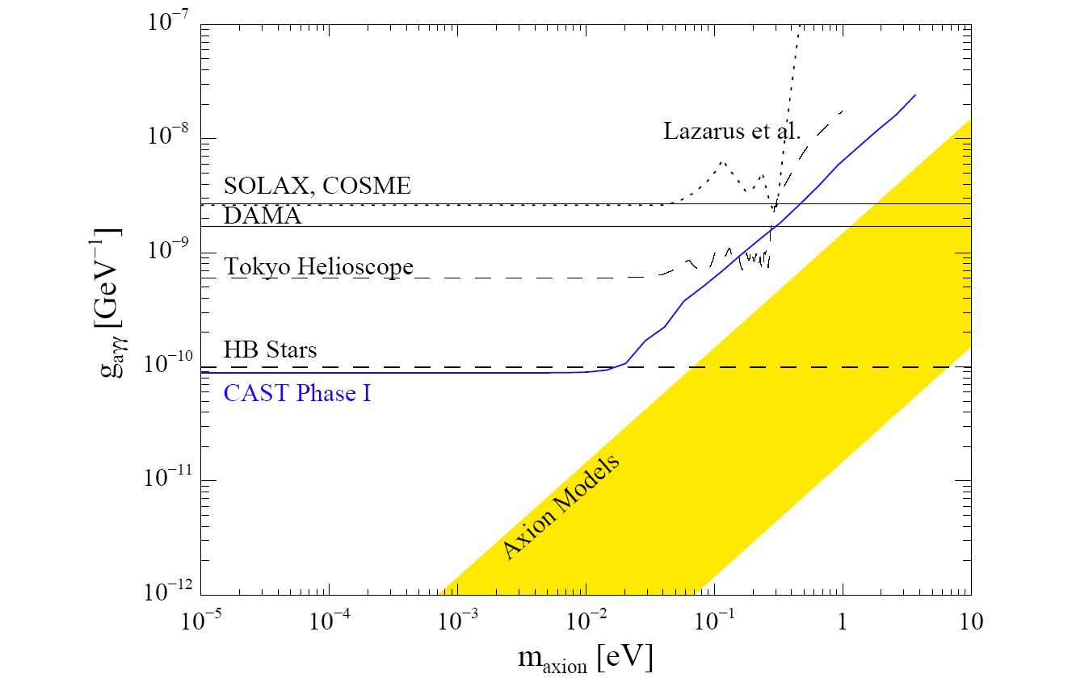
Results and Prospects
CAST Result Phase I
JCAP 04 (2007) 010
No significant signal
over background
CAST Phase I yielded most
restrictive experimental upper
limit in wide axion mass range
CAST is more sensitive than
best astrophysical limit for
axion masses m_{a} < 0,02 eV
Improvement of the upper
limit compared to previous
experiments by factor of 7
Upper Limit g_{aγγ} for m_{a} < 0,02 eV
g_{aγ} (95%) = 0,88 x 10⁻¹⁰ GeV⁻¹

Slide 55
Results and Prospects
CAST Result Phase I and II with ⁴He
160 measured p-settings
with ⁴He in the magnet
(p=13.4 mbar, m_{a}=0.39 eV)
No significant signal observed
CAST enters in theoretically
favored model regions
Typical upper limit:
for m_{a} < 0.39 eV
⁴He analysis completed
→ JCAP 02 (2009) 008
³He measurements ongoing!
(Over 480 new ³He steps done!)
g_{aγ} (95%) = 2,2 x 10⁻¹⁰ GeV⁻¹
Notes:
487 Thursday morning

Slide 56
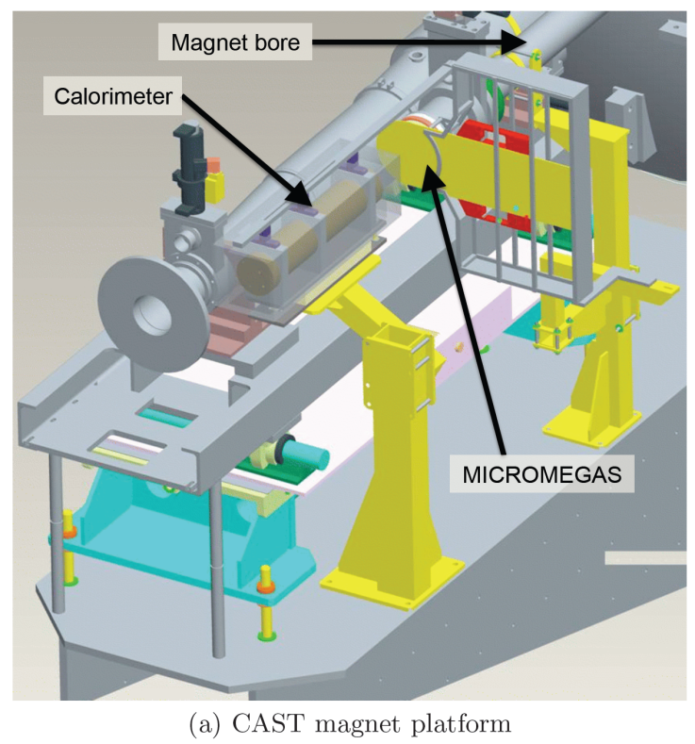
Results and Prospects
Additional Searches at CAST: HE and 14.4 keV Axions
„Search for solar axion emission from
⁷Li and D(p,γ)³He nuclear decays with
the CAST γ-ray calorimeter“
HE Calorimeter
arXiv:0904.2103

Slide 57
Results and Prospects
Additional Searches at CAST: HE and 14.4 keV Axions
„Search for solar axion emission from
⁷Li and D(p,γ)³He nuclear decays with
the CAST γ-ray calorimeter“
„Search for 14.4 keV solar axion emitted in
the M1-transition of ⁵⁷Fe nuclei with CAST“
TPC
HE Calorimeter
arXiv:0904.2103
arXiv:0906.4488

Slide 58
Results and Prospects
Additional Searches at CAST: LES Axions and Galactic Sources
„Search for low energy solar axion with CAST“
See also contributions to
5th Patras Workshop on
Axions, WIMPs and WISPs
→ http://axion-wimp.desy.de/
arXiv:0809.4581

Slide 59
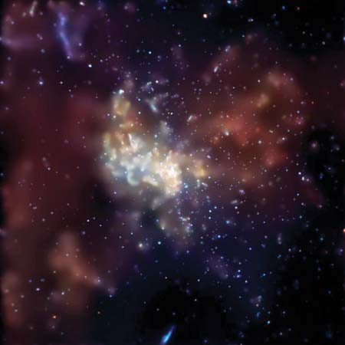
Results and Prospects
Additional Searches at CAST: LES Axions and Galactic Sources
„Search for low energy solar axion with CAST“
Search for Axions from galactic
sources at CAST/ Sky Survey
See also contributions to
Patras Workshop on
Axions, WIMPs and WISPs
→ http://axion-wimp.desy.de/
arXiv:0809.4581

Slide 60
Results and Prospects
Towards future axion helioscope searches
Magnet
Stronger field, bigger cross sectional area,…
Along the years CAST gained
valuable expertise in working
with the helioscope technique
Possible improvements for next
generation helioscopes:
  New low background detectors
  X-ray focussing devices
  More flexible movement
  More powerful magnet !!!
See also talk of T. Papaevangelou
in the recent workshop
„New opportunities in the Physics
Landscape at CERN“
Detectors
Very low background
and/or X-ray telescopes
Movement System
Extension of Observation
time

Slide 61
Results and Prospects
Towards future axion helioscope searches
Large parts of the model region
for QCD axions could be
studied in the coming decade
Combination of
Helioscopes experiments and
Dark matter axion searches
such as ADMX

Slide 62
Latest Results of Phase I and II
CAST Phase I
No significant axion signal observed
Best experimental upper limit in large axion mass range up to 0.02 eV
Comparable to best astrophysical limit
CAST Phase II
Upgraded detectors and sophisticated gas system for the use of helium
CAST enters theoretically favored axion parameter space
⁴He run completed with typical upper limit for 0.02 < m_{a} < 0.39 eV of
Data taking with ³He since 2007 (approved till 2010): m_{a} < 1.2 eV [0.89 eV]
More interesting Physics done/to be done at CAST
High energy axions / 14.4 keV axions
Low energy solar axions (LES axions)
Galactic tracking for non-solar axions / Sky Survey
g_{aγ} (95%) = 0.88 x 10⁻¹⁰ GeV⁻¹
g_{aγ} (95%) = 2.2 x 10⁻¹⁰ GeV⁻¹

Slide 63
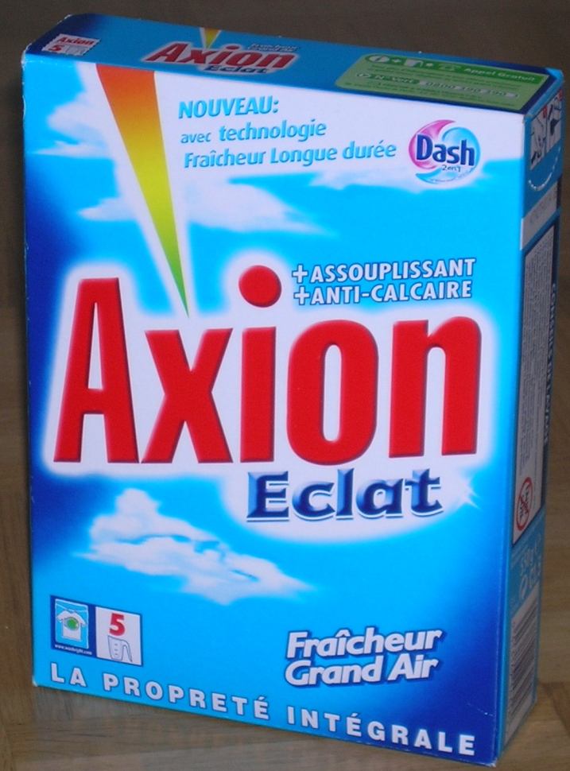
Axions ?!? Not yet… but stay tuned…

Slide 64
Thank you!
CAST

Slide 65
Backup

Slide 66
Backup: Theoretical Motivation for Axions
The strong CP-problem
New term in Lagrangian violates both P and CP:
Compare to
Since:
Strong CP-Problem:
No violation of CP in strong interactions observed so far!
Could be observed via:
Electric dipole moment (EDM) of the neutron (Dependency on θ)

Slide 67
Backup: X-ray mirror optics and CCD detector
Experimental Setup
CAST Setup

Slide 68
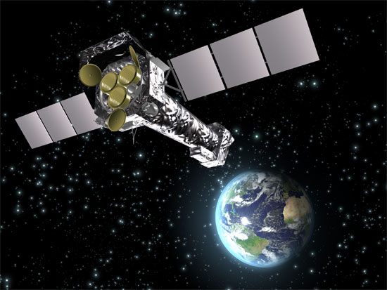

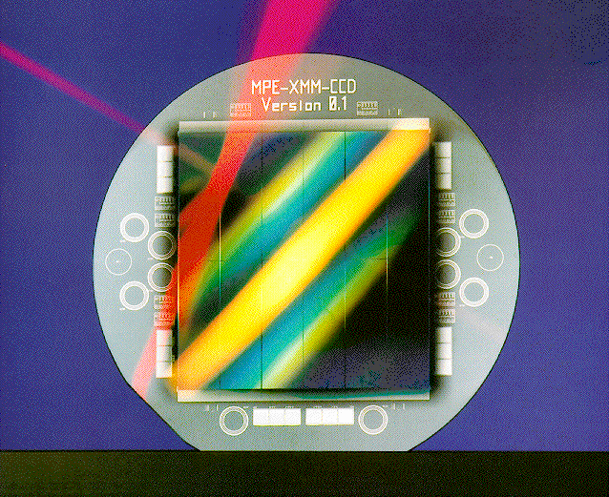
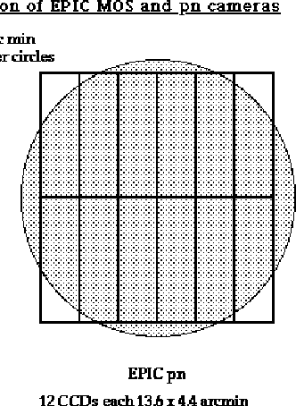
Backup: X-ray mirror optics and CCD detector
Cold Finger
Cooling Mask
pn-CCD Chip
Flexlead

Slide 69
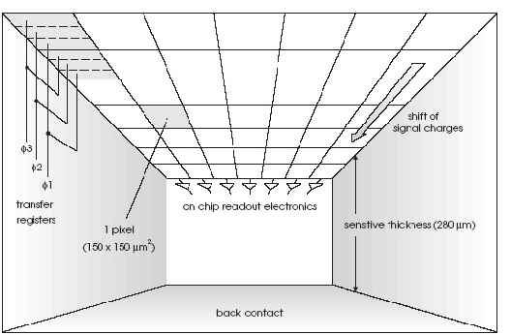
Backup: X-ray mirror optics and CCD detector
Working principle of the CCD detector

Slide 70
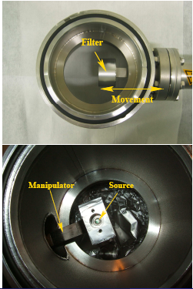
X-ray mirror optics and CCD detector
In-situ calibration of detector
Daily calibration with ⁵⁵Fe before run
Energy resolution: 170 eV @ 5.9 keV

Slide 71
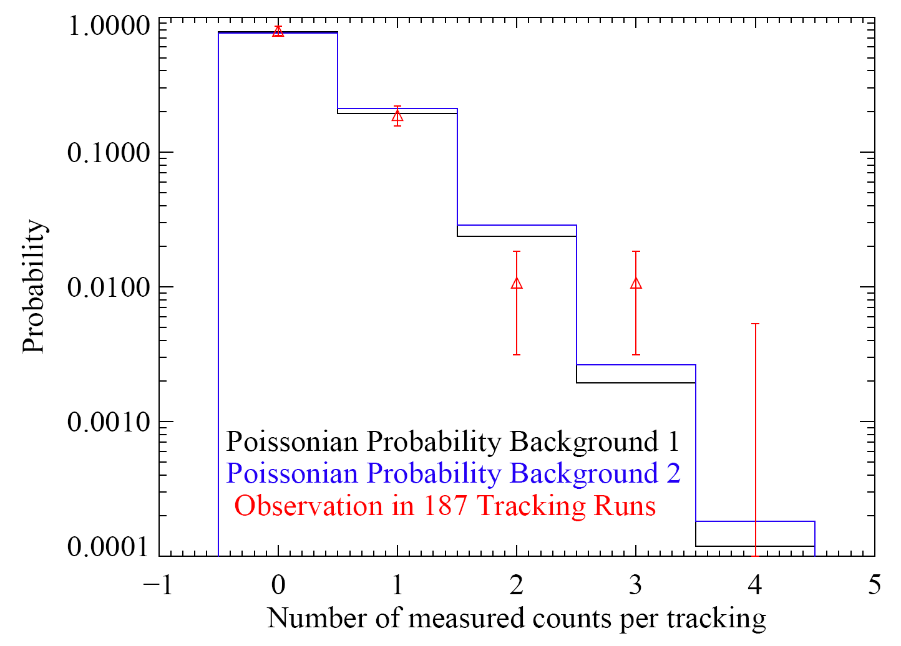
Analysis of CCD data for the ⁴He Phase
Analysis: Absence of a signal

Slide 72
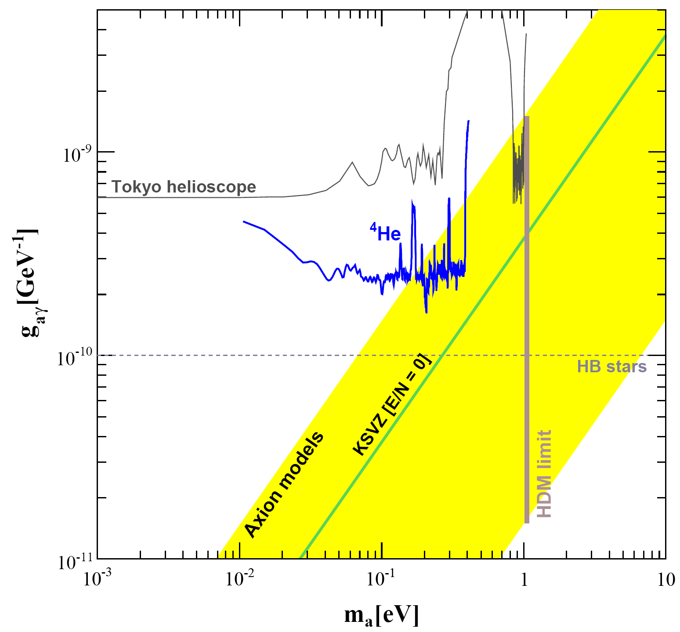
Exemplary Analysis of the ⁴He data
CCD result for Phase II with ⁴He

