Slide 1
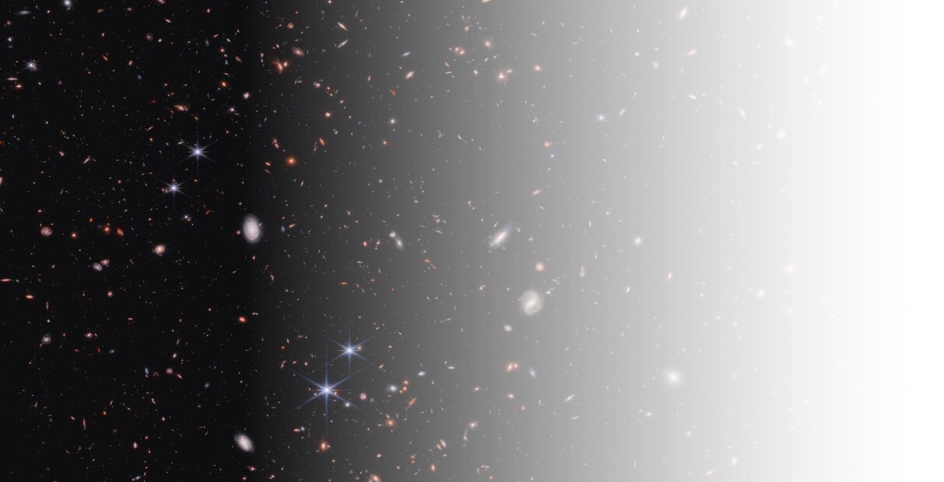


Not-quite-primordial black holes and early Star formation
Enhanced cosmic structure
Wenzer Qin
Simons Junior Fellow, New York University
Oct 6th , 2026 | UCLouvain CP3 Seminar
Notes:
Thanks for the opportunity to speak in front of you all today
For those of you who don’t know me...simons junior at NYU.
So my research sits at the interface of particle physics, cosmology, and astrophysics---traditionally, much of my work has focused for example on constraining particle properties of dark matter using cosmological observables
But recently, my interests have led me towards thinking about how we can use early structure formation to constrain beyond standard model physics
So for today’s talk, I will be focusing on a phenomenon that we’ve been calling not-quite-primordial…

Slide 2
Outline
Based on works (2506.13858) and (2609.35991)
Introduction and supermassive black hole (SMBH) origins
Mechanism: Modestly enhanced fluctuations seed SMBHs
Results, implications, and follow-up work
Notes:
- Mention accepted in PRL

Slide 3
introduction

Slide 4
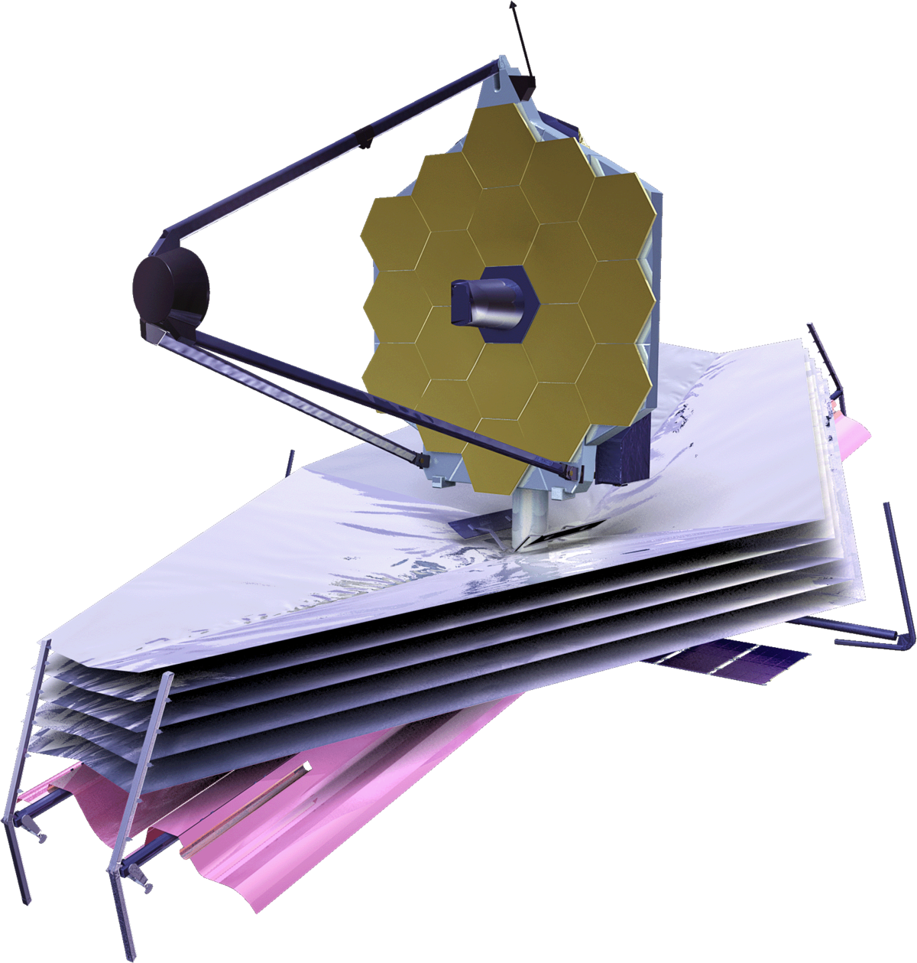
James Webb Space Telescope (JWST)
Launched on Christmas 2021
Notes:
The idea for this project began with the James Webb…which launched…
Has teams led by faculty here in Arizona’s astronomy department
James Webb is the successor to the Hubble Telescope
But looks deeper into the infrared spectrum to search for objects that are older, farther, and fainter than what Hubble was capable of seeing.
In the few years since it began observing…

Slide 5
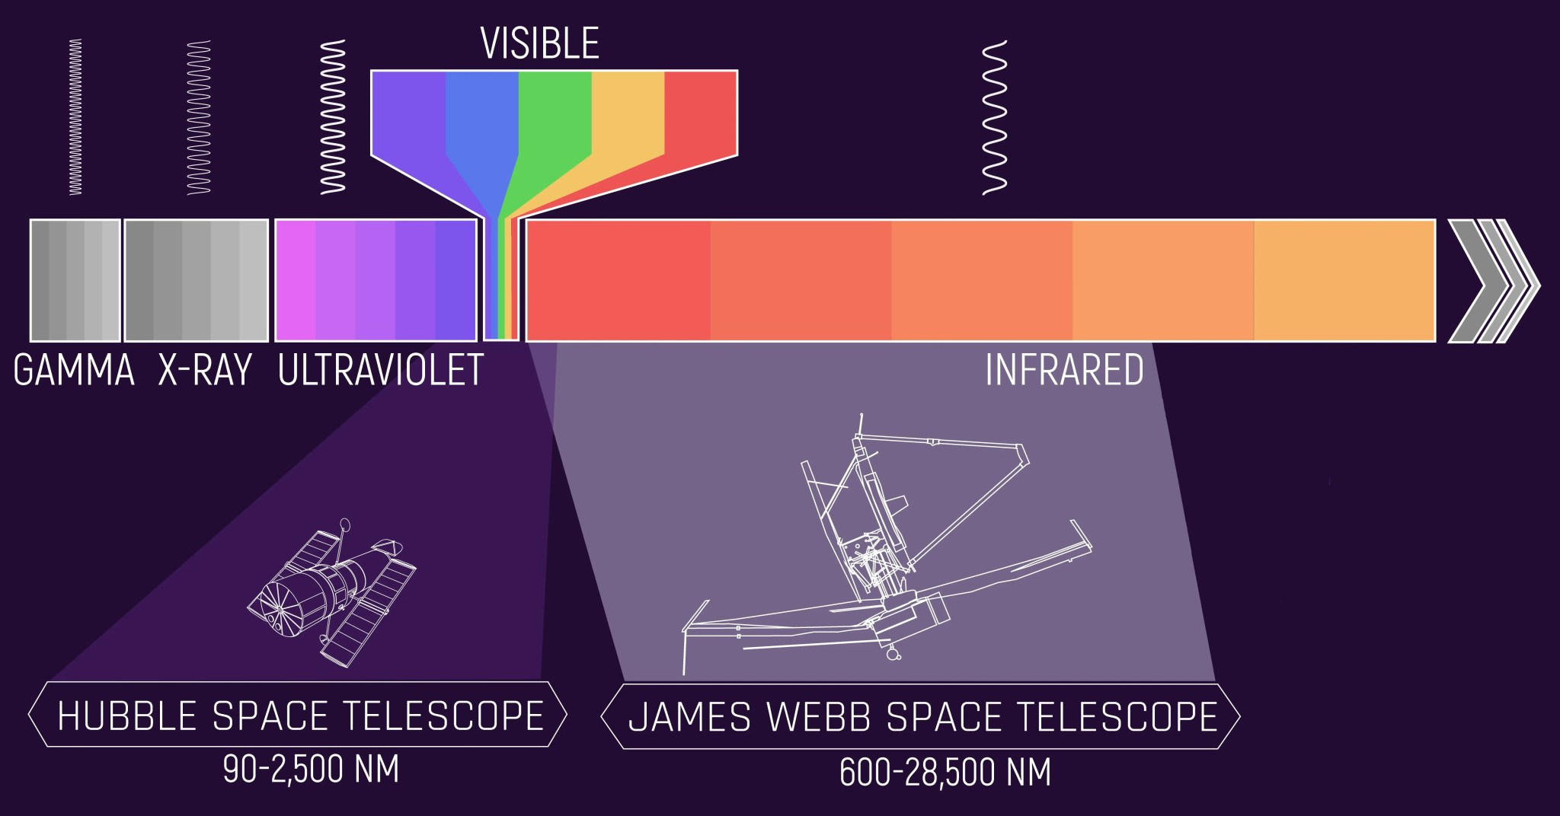
Hubble vs James Webb
James Webb sees redder objects → higher redshift → farther/older

Slide 6
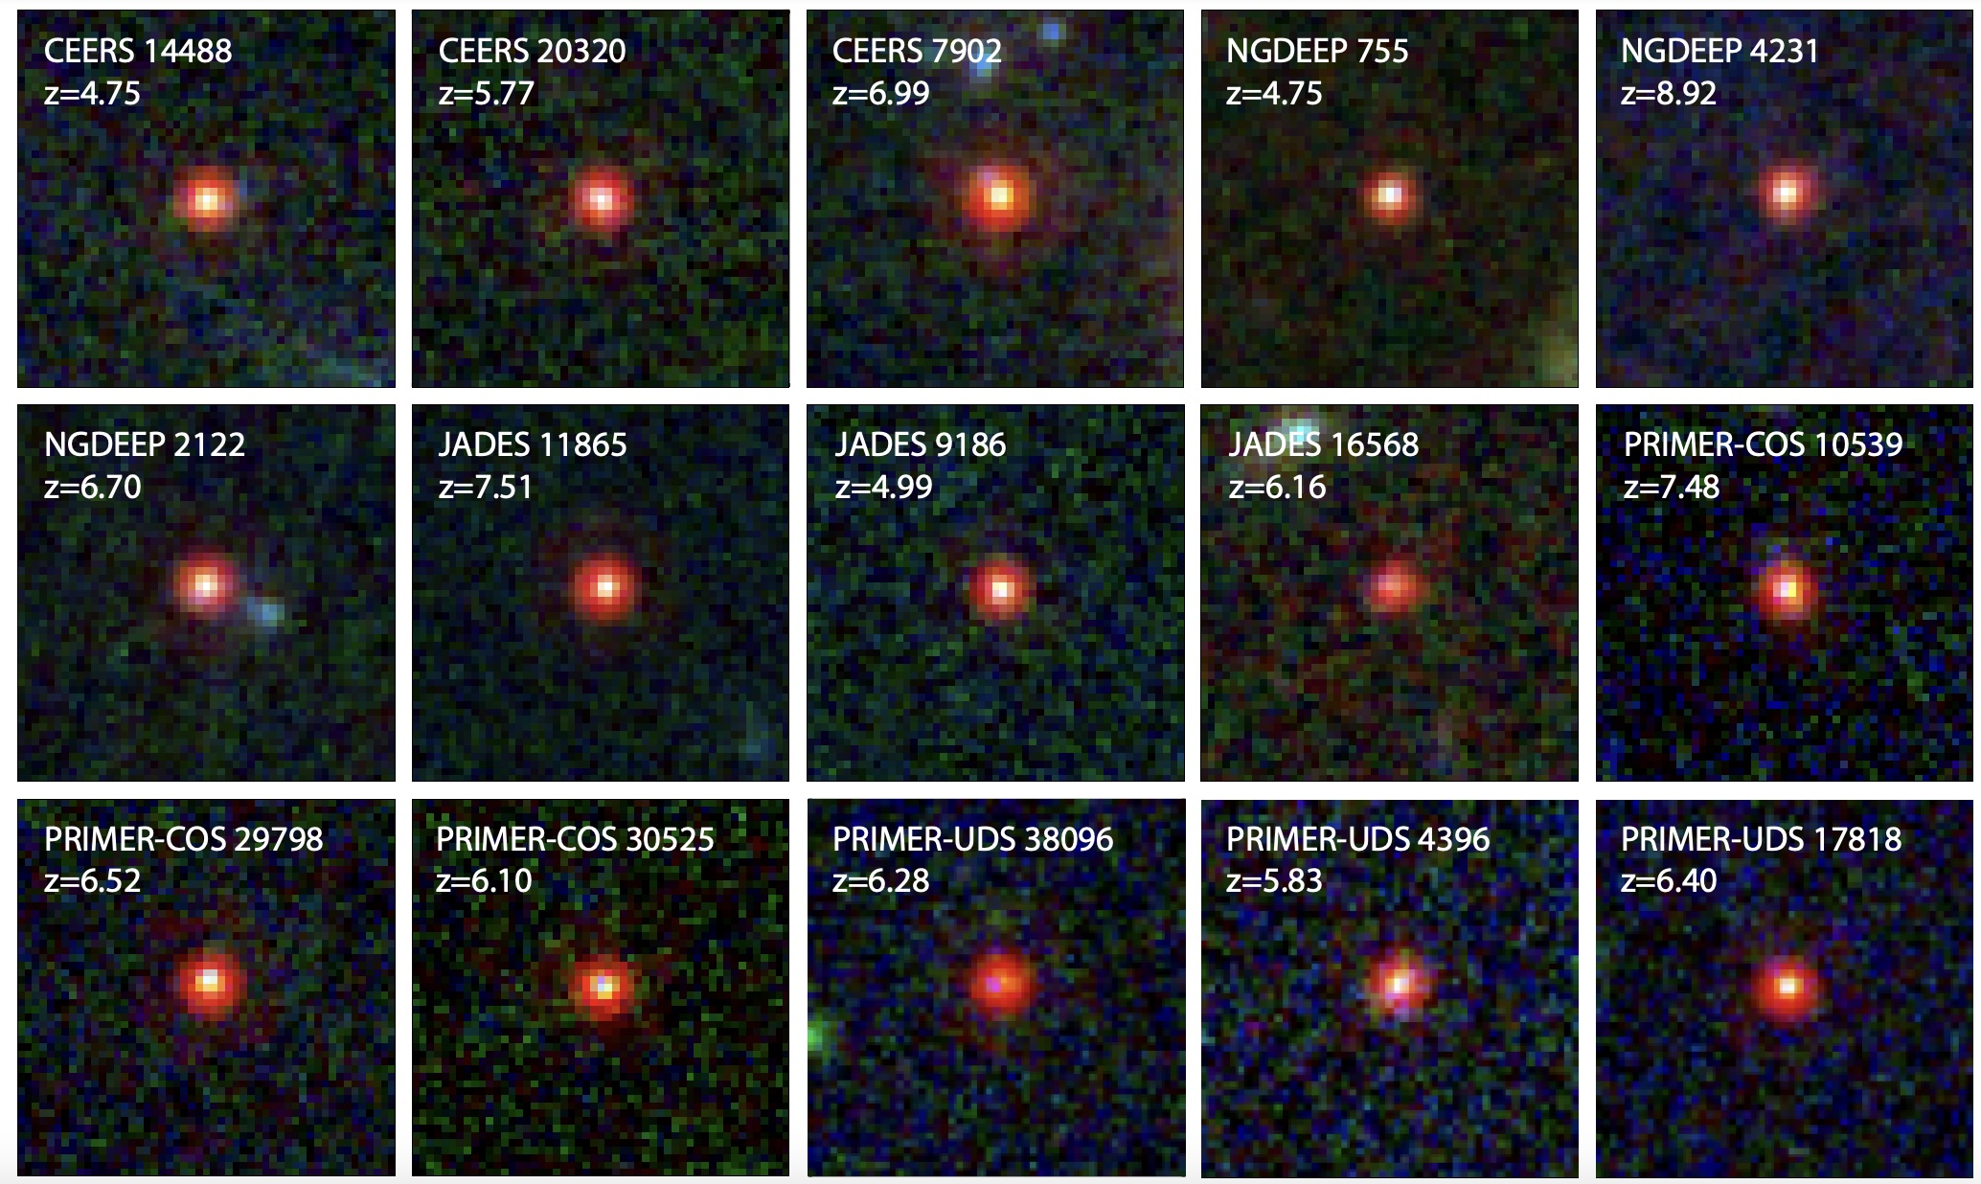

James Webb Space Telescope (JWST)
“Little red dots” (LRDs) at $z=4−9$ [Labbe et al. 2023, Kocevski et al. 2023, Harikane et al. 2023, Matthee et al. 2024, Maiolino et al. 2024]

Slide 7
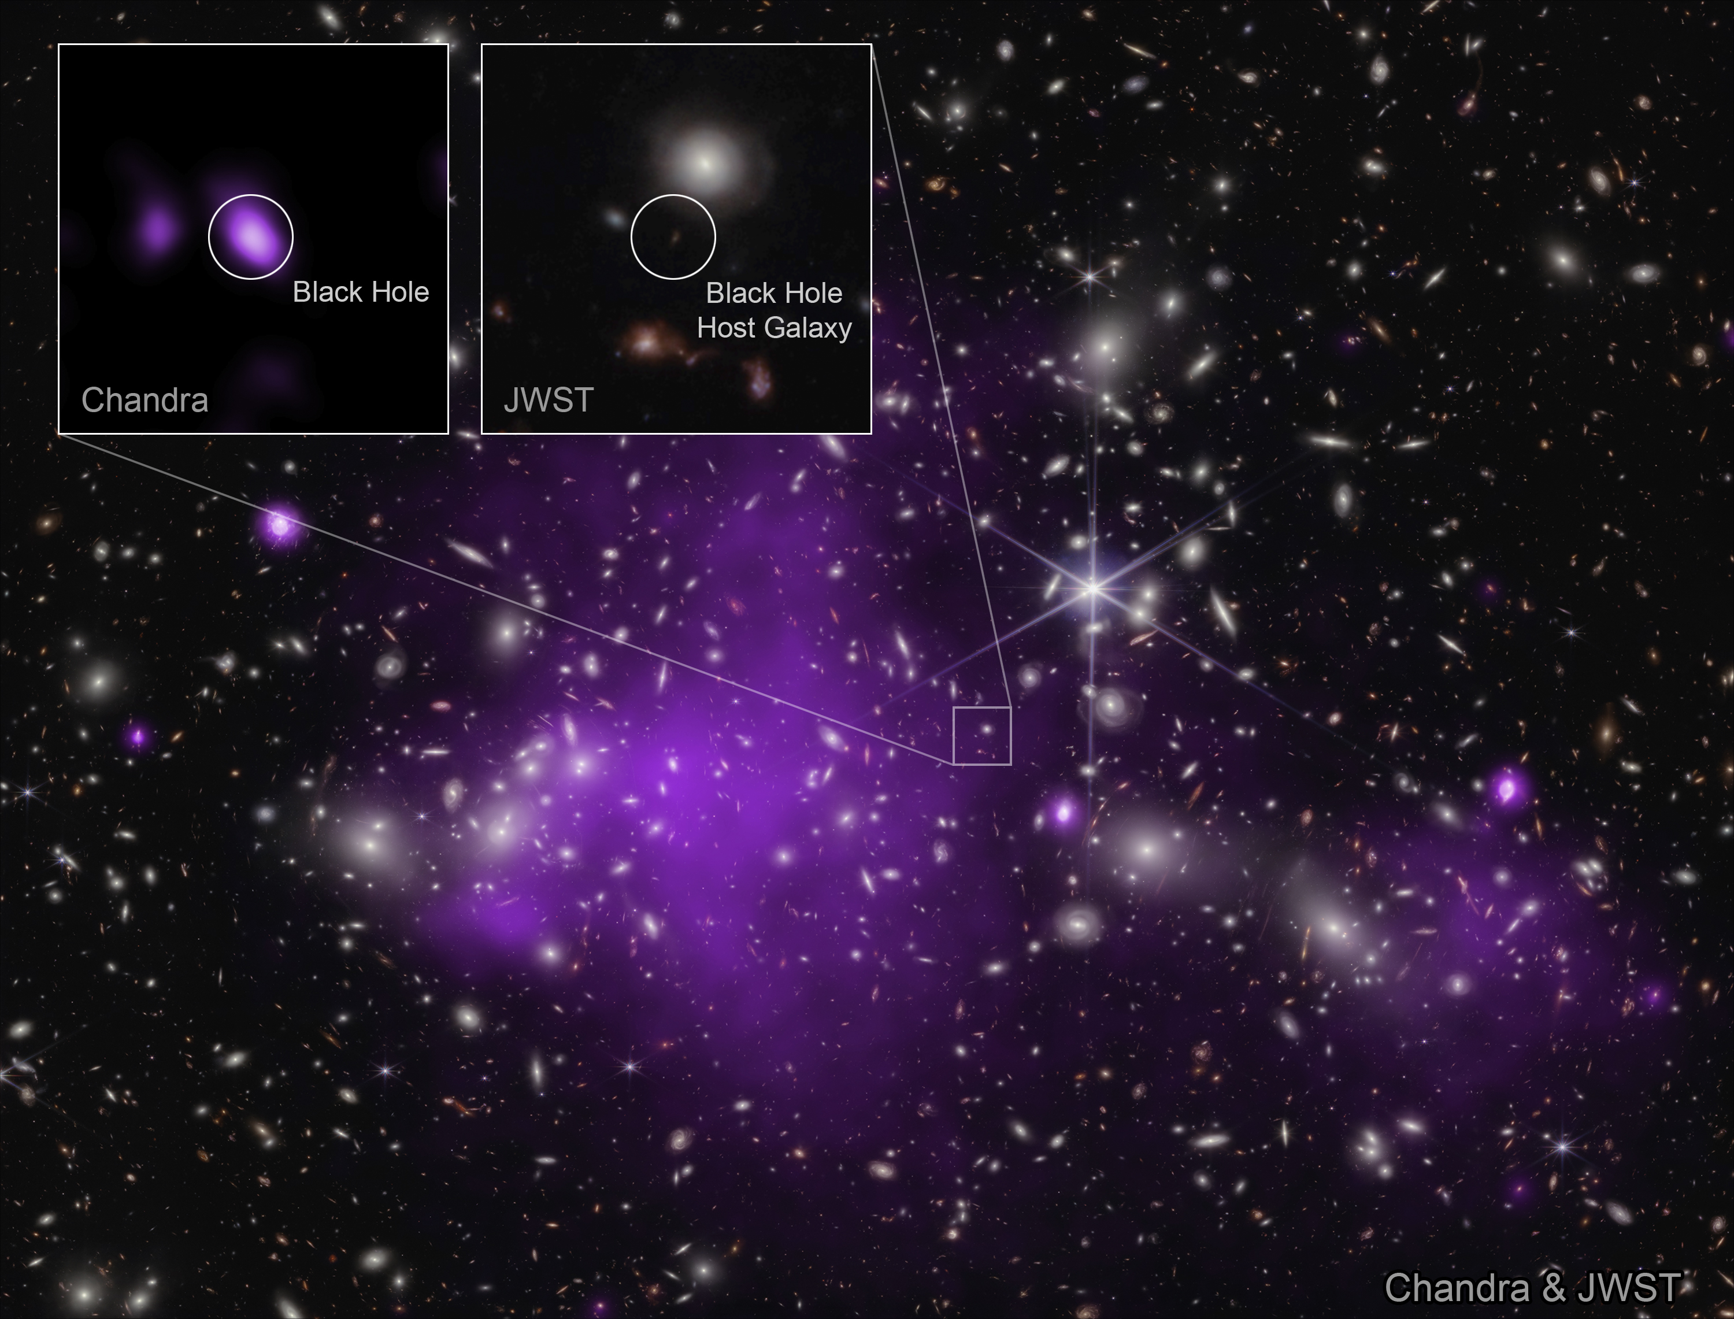

James Webb Space Telescope (JWST)
Overmassive black holes ( $\frac{M_{BH}}{M_{∗}}\sim 1$ ) at $z=10$ [Natarajan et al. 2024]

Slide 8
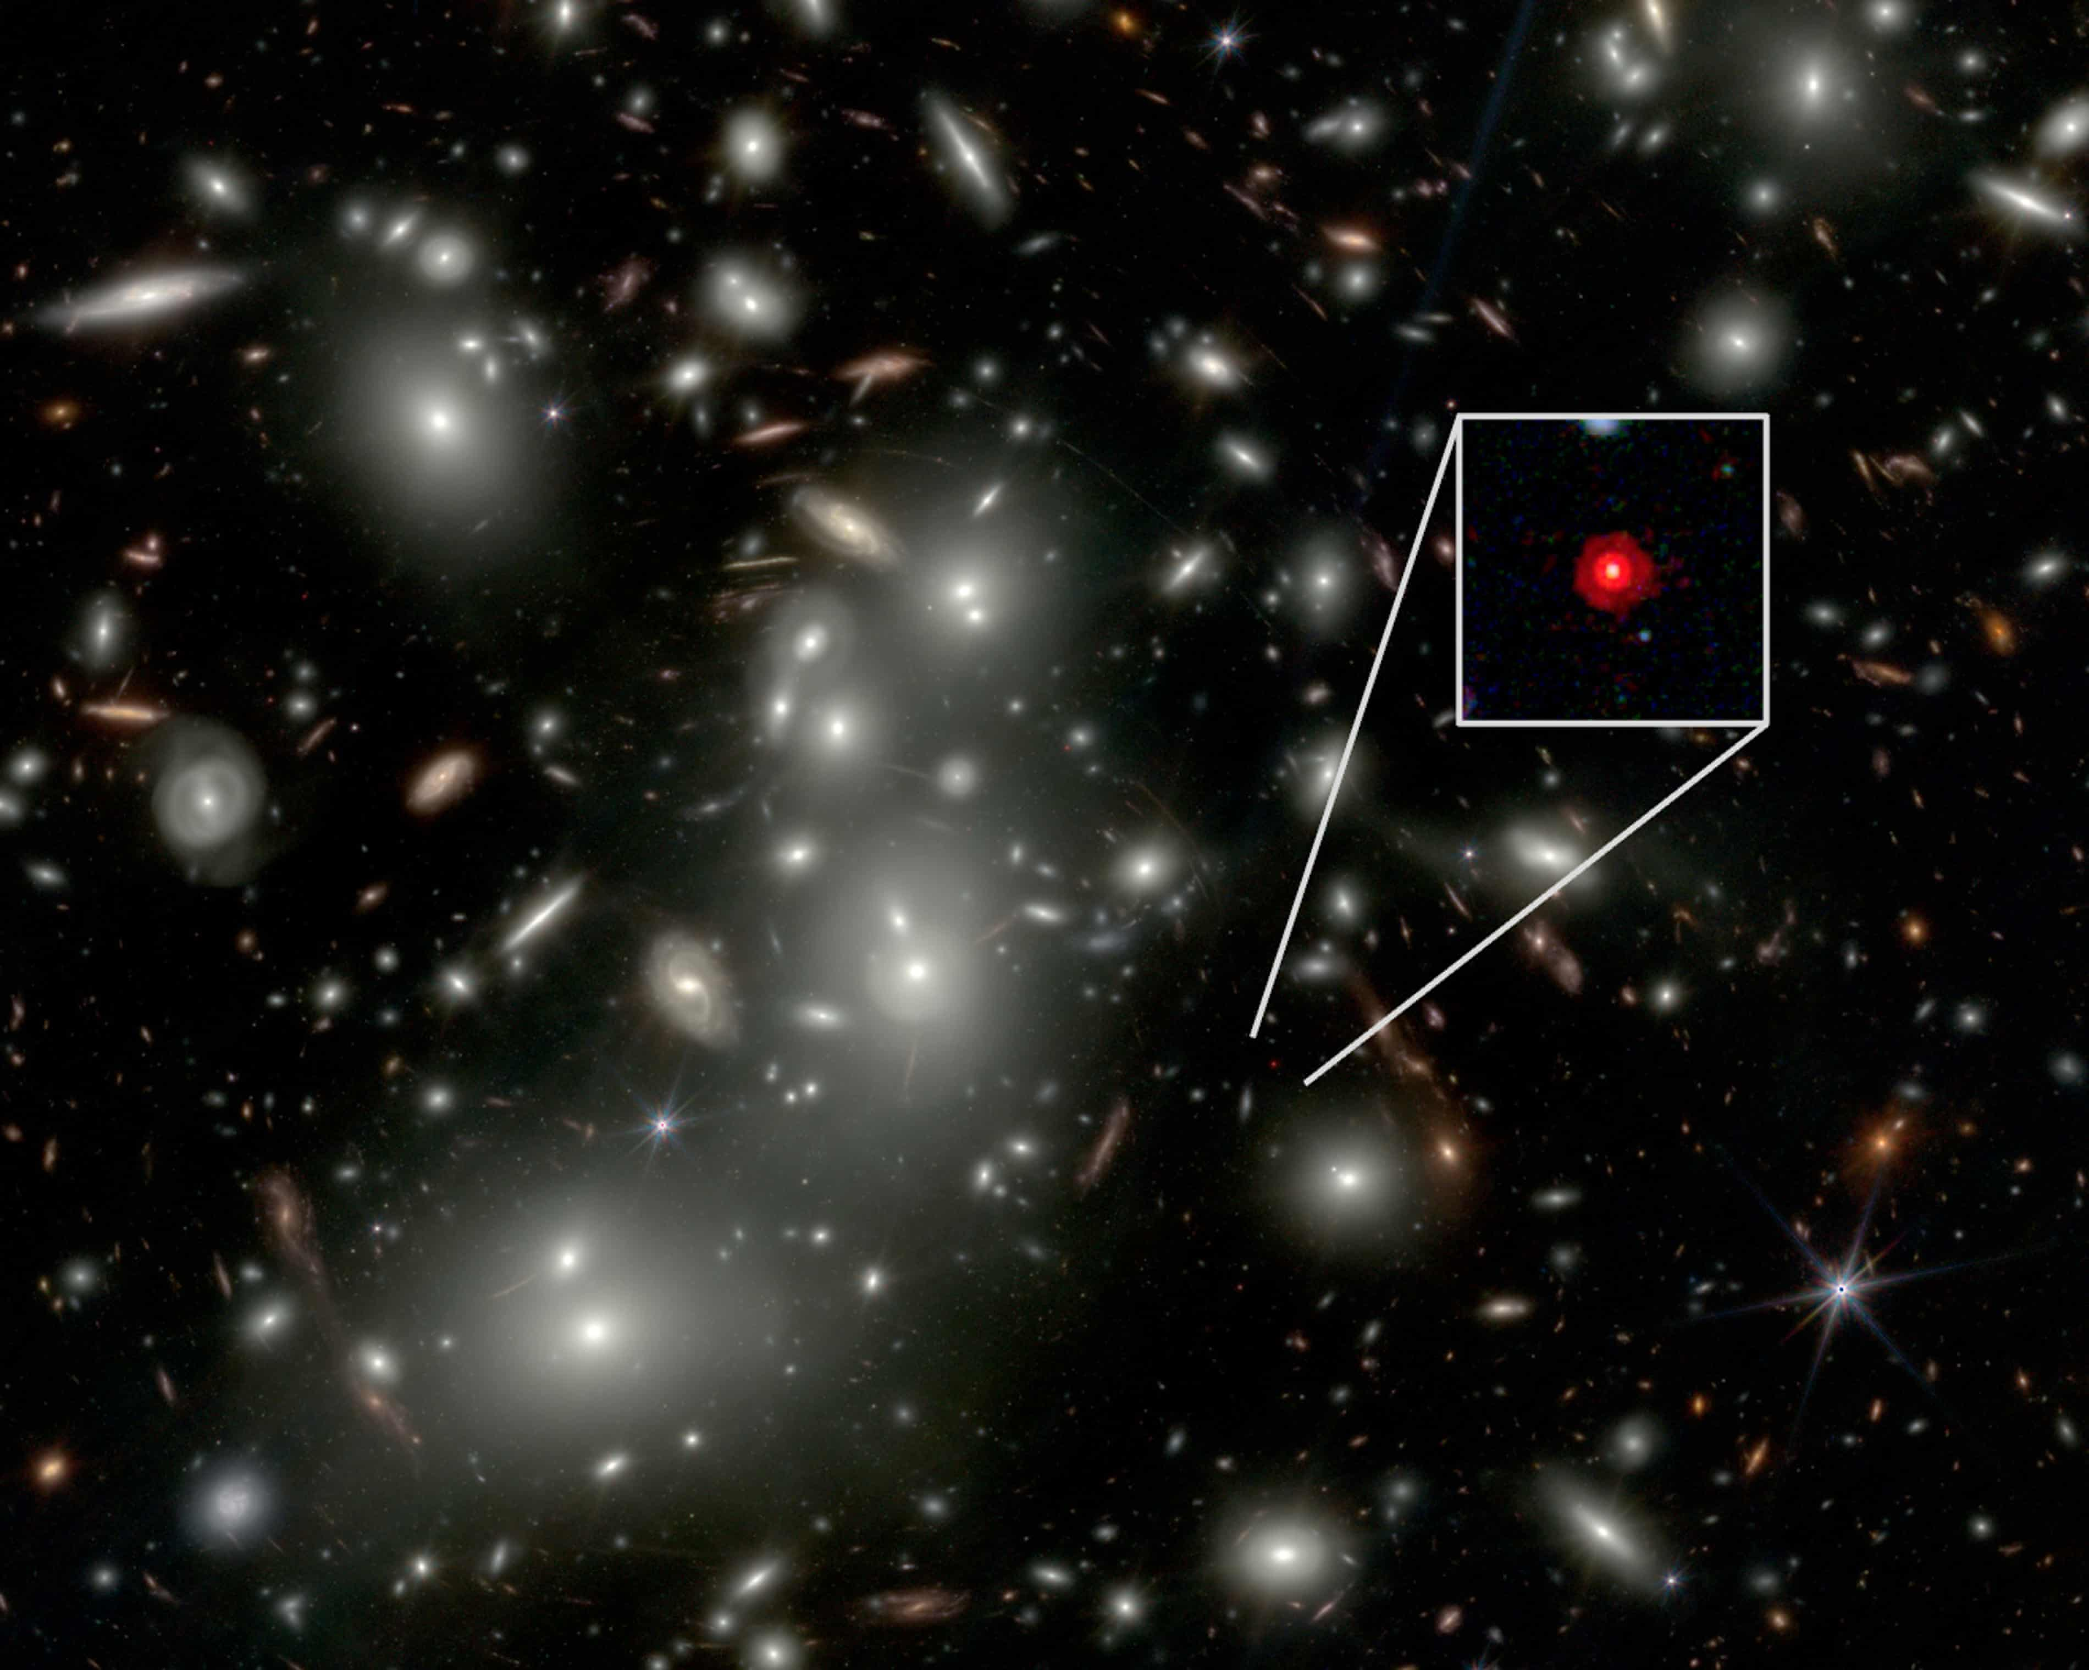

James Webb Space Telescope (JWST)
Black hole in LRD with $M_{BH}>5×{10}^{7} M_{⊙}$, $\frac{M_{BH}}{M_{∗}}>2$
[Juodzbalis et al. 2026]

Slide 9
Growing body of evidence for heavier/brighter objects at high redshifts than expected

Slide 10
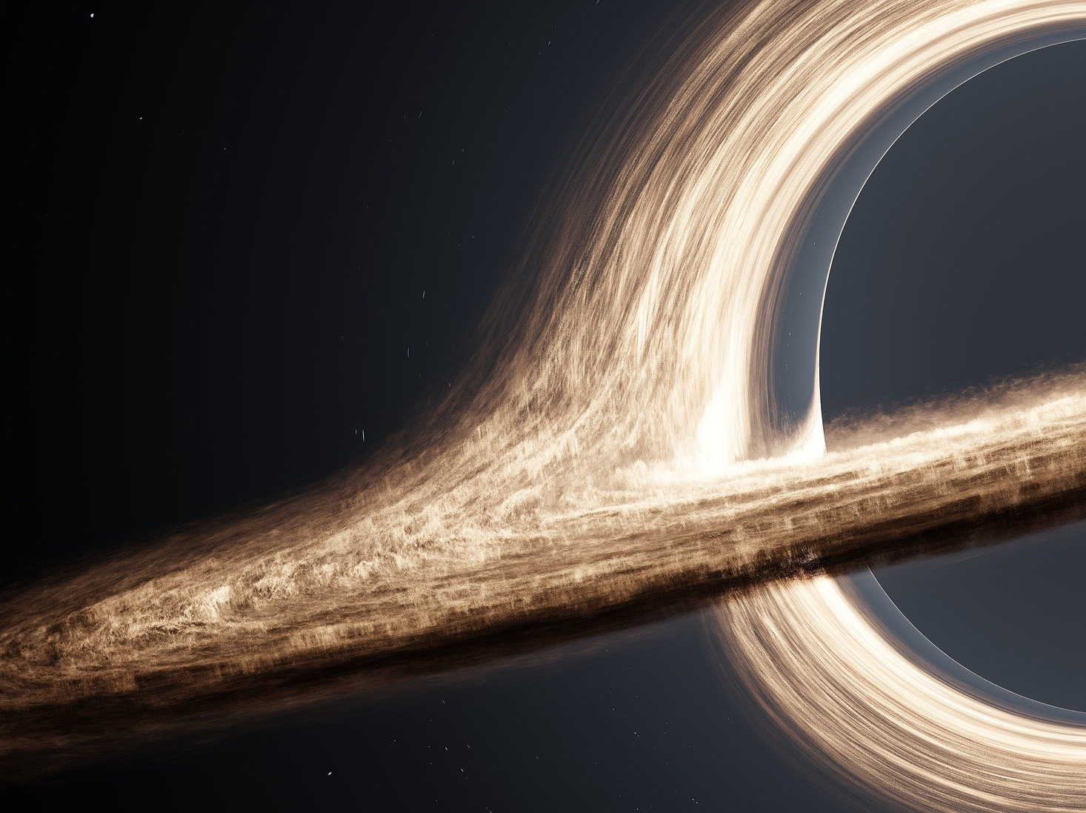
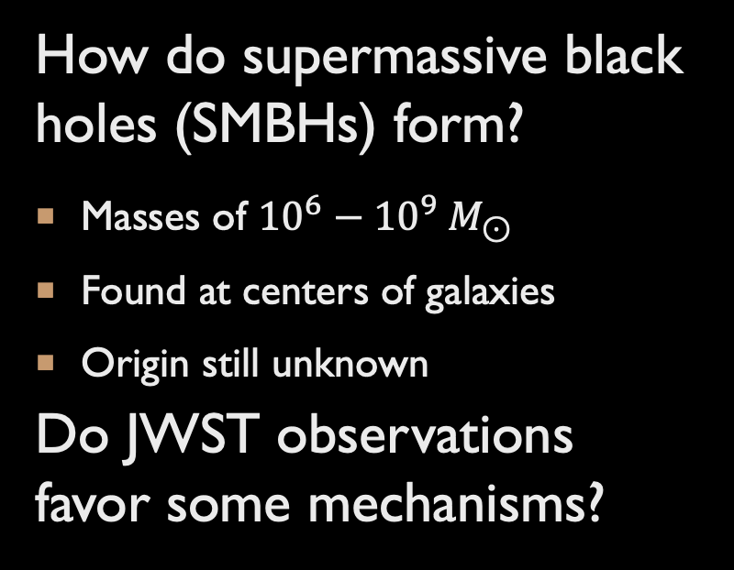
How do supermassive black holes (SMBHs) form?
Masses of ${10}^{6}−{10}^{9} M_{⊙}$
Found at centers of galaxies
Origin still unknown
Do JWST observations favor some mechanisms?
Are the observations consistent with standard physics?
If not, how can we explain them?
Notes:
And because of these observations, there has been revived interest in the question of…

Slide 11
FORMATION OF A SUPERMASSIVE BLACK HOLE
Notes:
So now, let’s talk about what we don’t and don’t know about how SMBHs form
The general picture for their formation is that you start with some relatively small “seed” black hole…

Slide 12
FORMATION OF A SUPERMASSIVE BLACK HOLE
Initial seed
Notes:
- The black hole then grows by accreting matter or merging with other black holes

Slide 13
FORMATION OF A SUPERMASSIVE BLACK HOLE
Initial seed
Growth by accretion/mergers
Notes:
- Until it grows to the size of

Slide 14
FORMATION OF A SUPERMASSIVE BLACK HOLE
Initial seed
Growth by accretion/mergers
SMBH

Slide 15
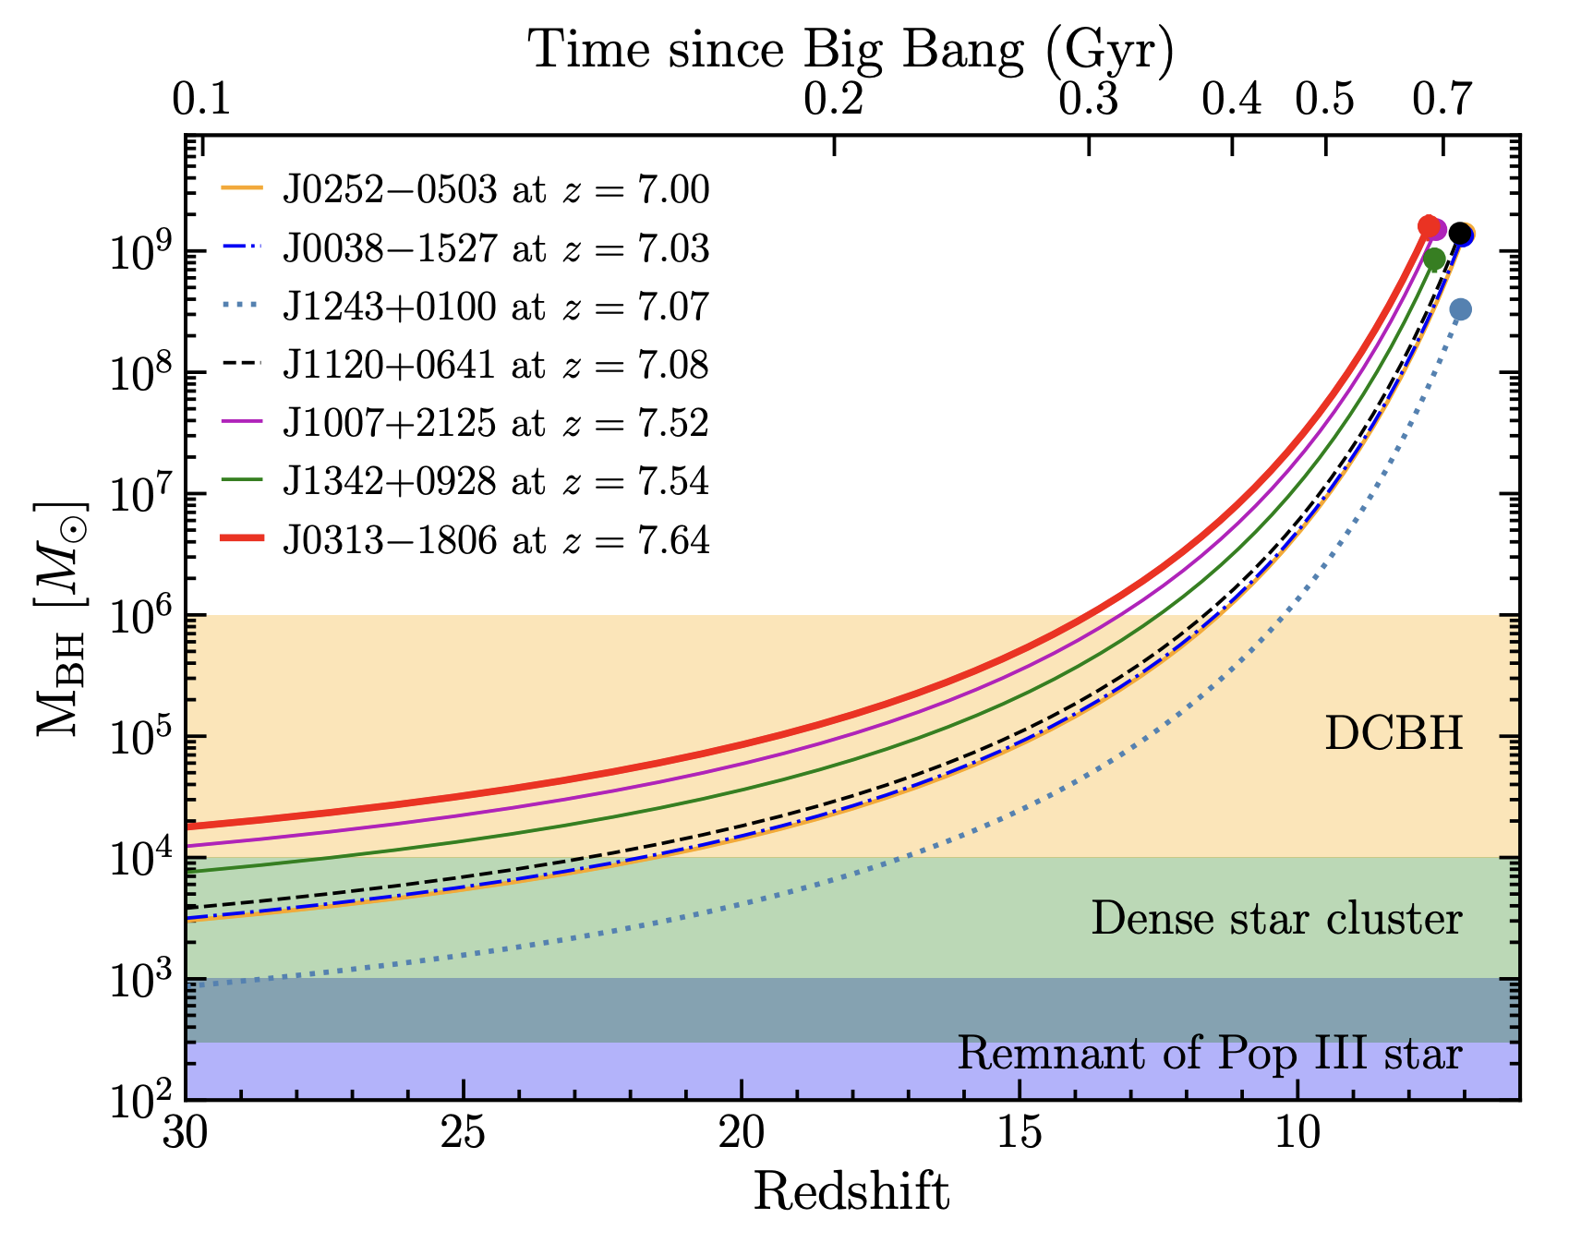
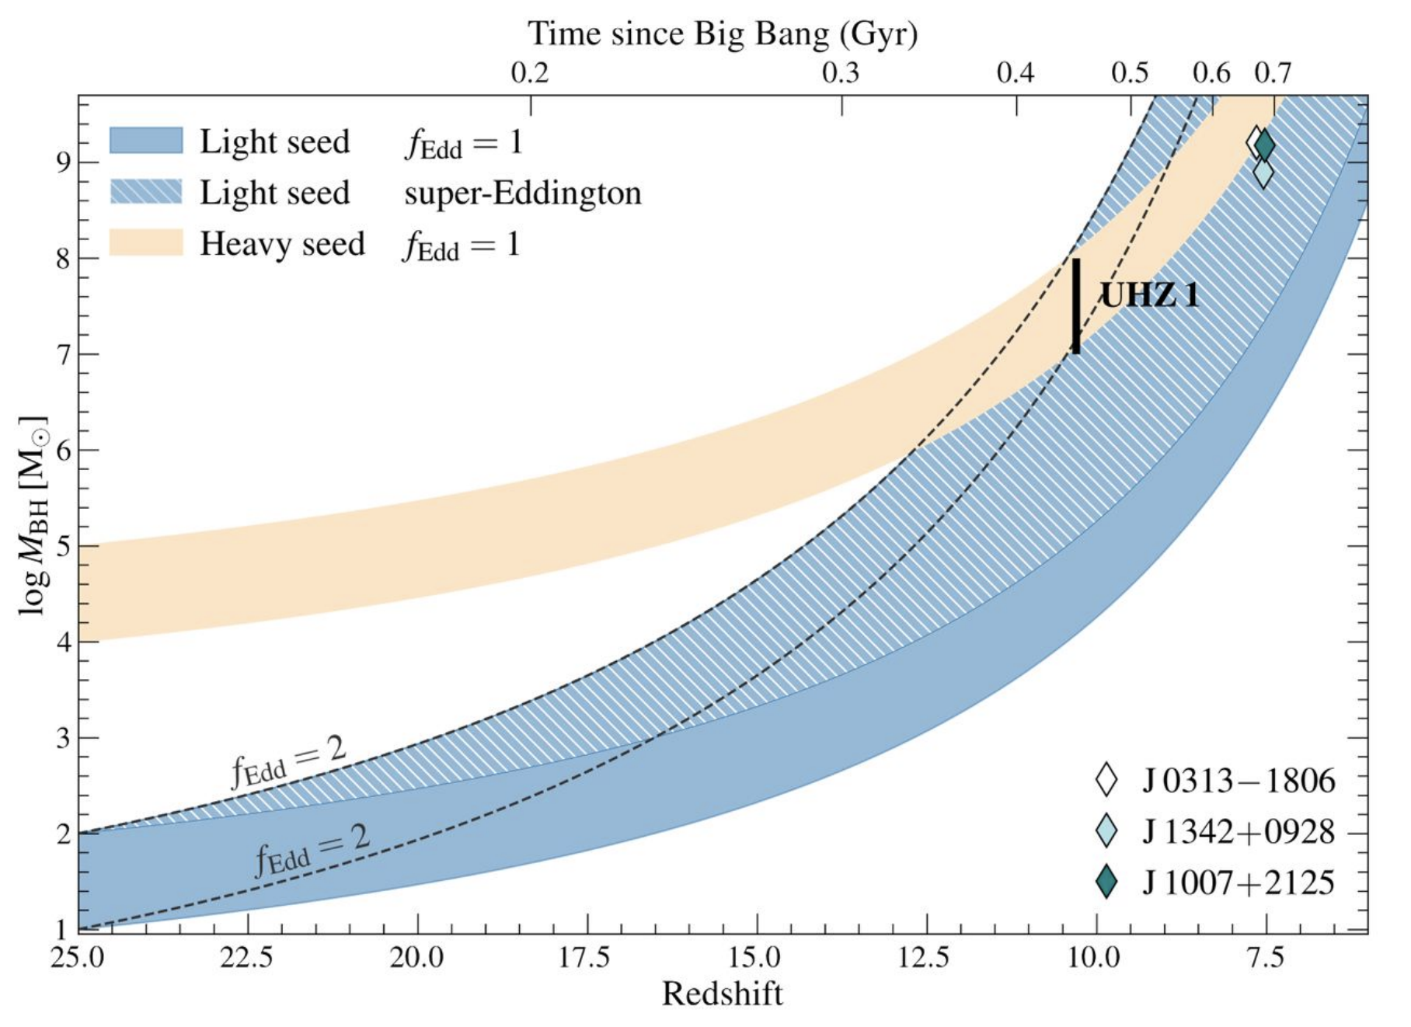
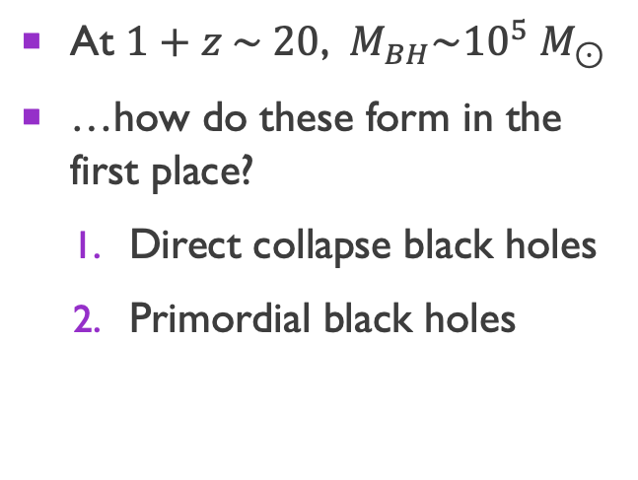
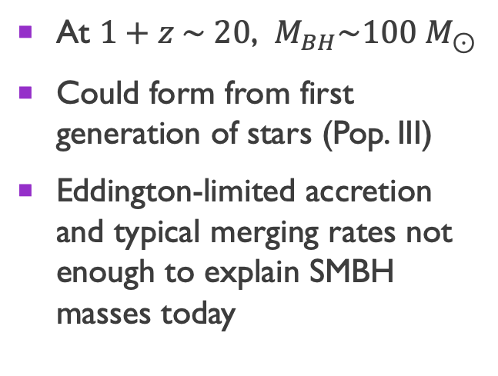
Hypotheses for smbh formation
Light seeds
Heavy seeds
At $1+z \sim 20$, $M_{BH}\sim 100 M_{⊙}$
Could form from first generation of stars (Pop. III)
Eddington-limited accretion and typical merging rates not enough to explain SMBH masses today
At $1+z \sim 20$, $M_{BH}\sim {10}^{5} M_{⊙}$
…how do these form in the first place?
  Direct collapse black holes
  Primordial black holes
Bogdan et al. 2023
Wang et al. 2021

Slide 16

Direct Collapse
First, overdensity must collapse and virialize to form a halo
For baryons to continue collapsing, must dissipate kinetic energy, e.g. have a cooling mechanism
kinetic energy
gravity

Slide 17
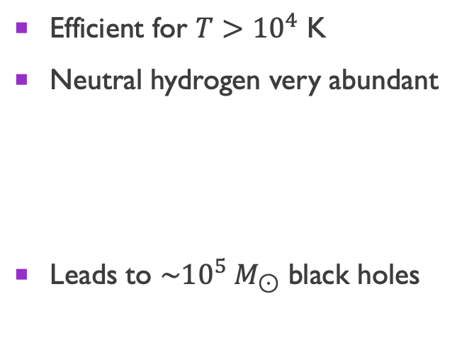
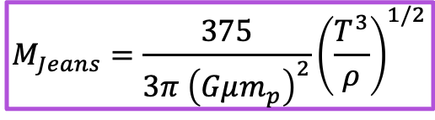
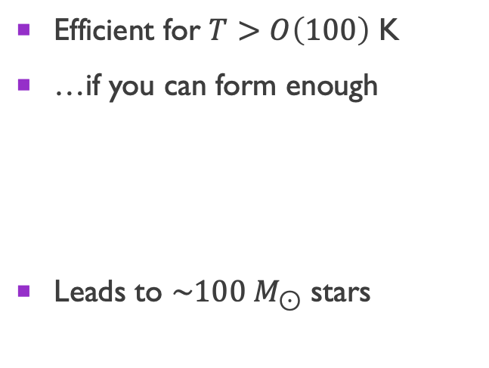
Direct collapse
Atomic hydrogen cooling
Molecular hydrogen cooling
Efficient for $T>{10}^{4}$ K
Neutral hydrogen very abundant
Leads to $\sim {10}^{5} M_{⊙}$ black holes
Efficient for $T>O\left(100\right)$ K
…if you can form enough
Leads to $\sim 100 M_{⊙}$ stars
$$M_{Jeans}=\frac{375}{3π {\left(Gμm_{p}\right)}^{2}}{\left(\frac{T^{3}}{ρ}\right)}^{1/2}$$
Suppression of molecular cooling can lead to formation of a heavy seed
Notes:
Add references, e.g Eisenstein, Priya
Final sentence: there is a ton of molecular hydrogen! How to avoid it?
Visuals for how line cooling/hydrogen cooling work

Slide 18
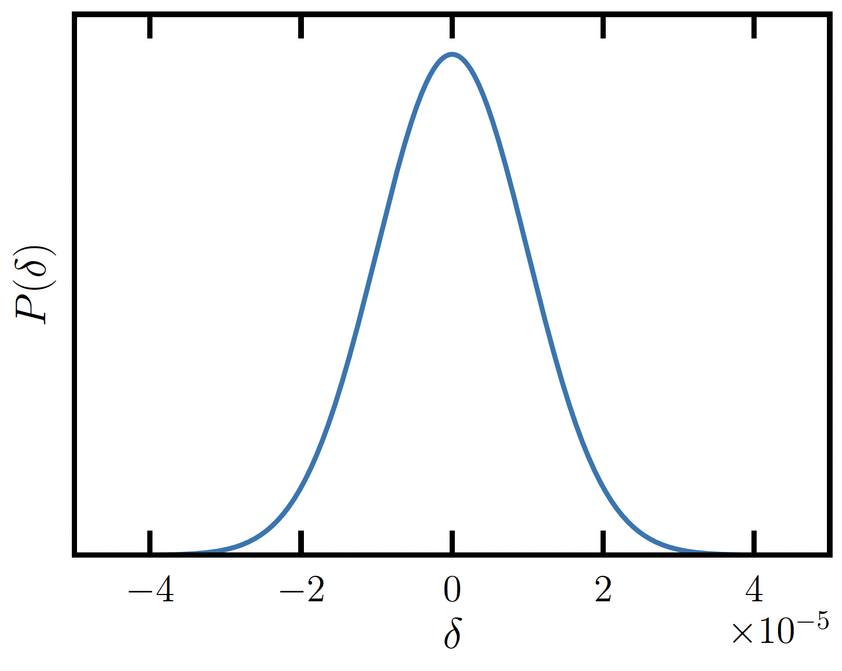
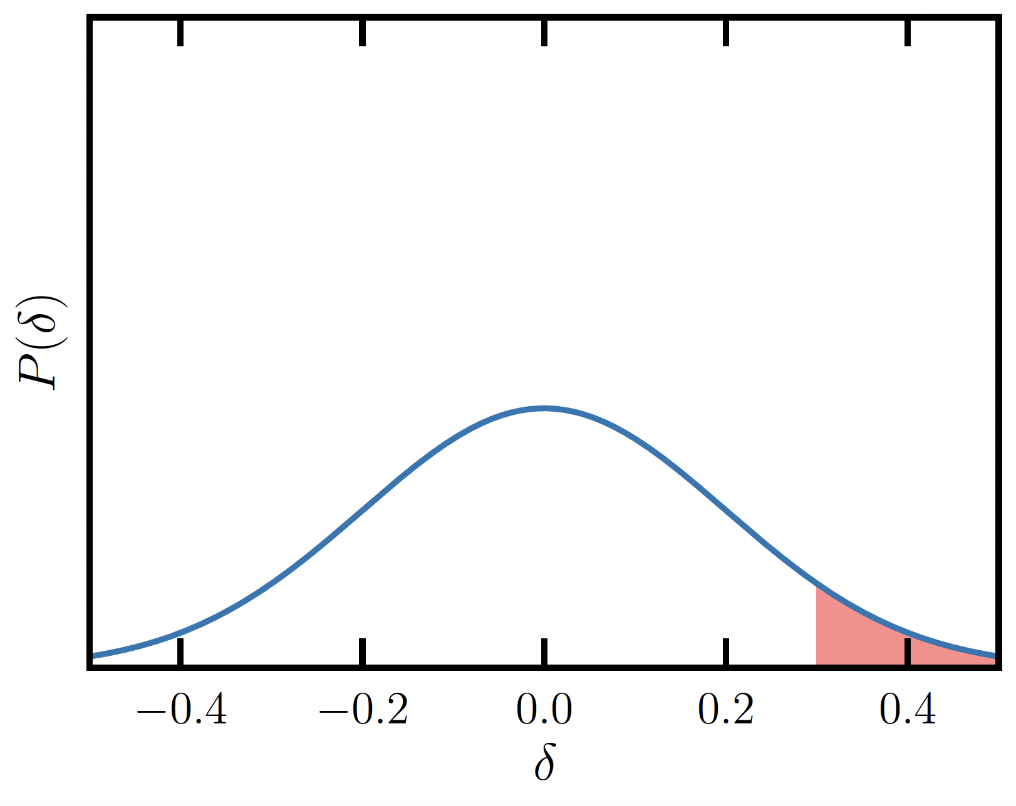
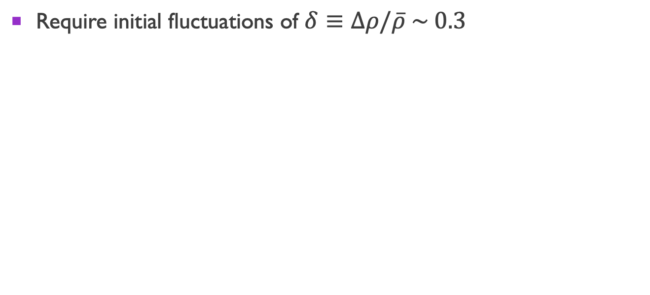
Primordial black holes
Require initial fluctuations of $δ≡Δρ/\overline{ρ} \sim 0.3$
CMB length scales
Necessary for PBH population

Slide 19
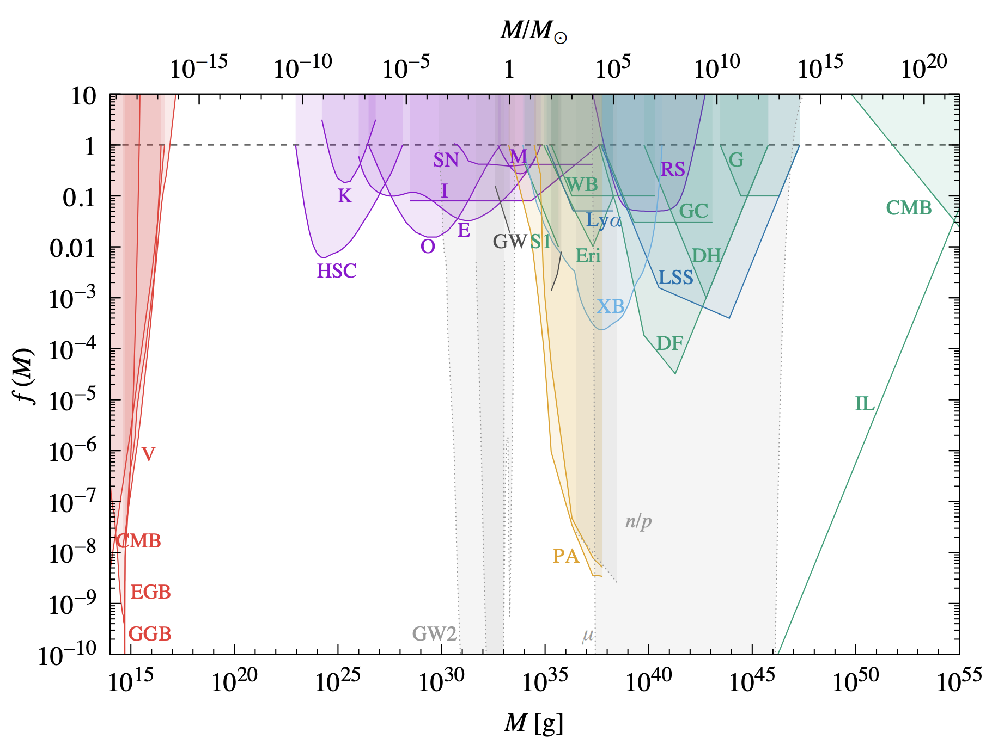
Primordial black holes
concern of this work
PBHs as
dark matter
Carr & Kuhnel 2021

Slide 20
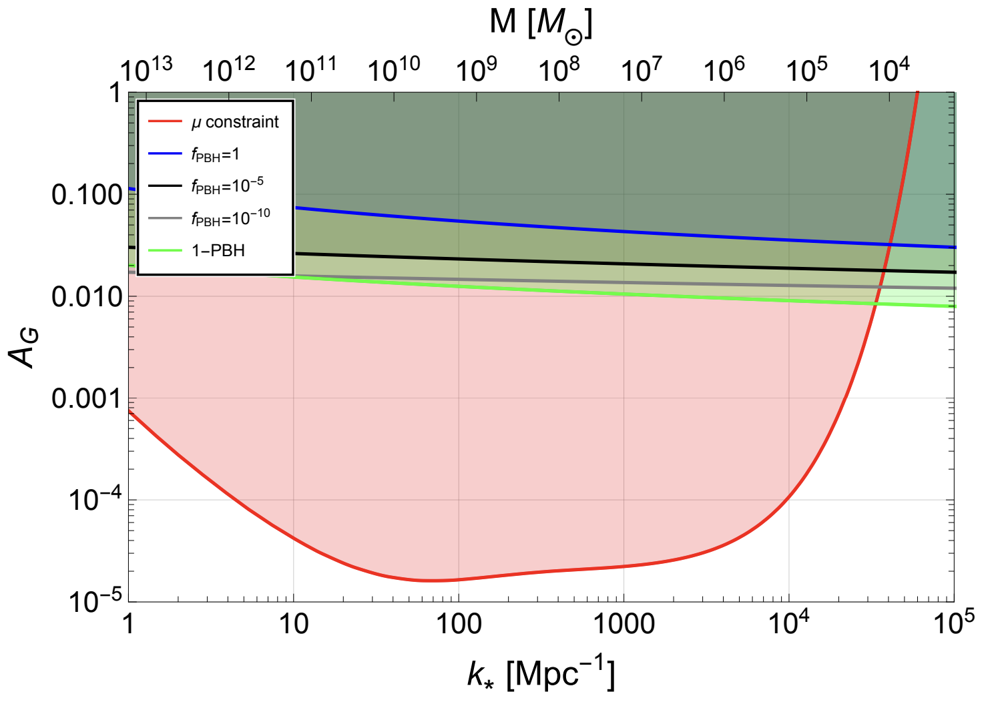
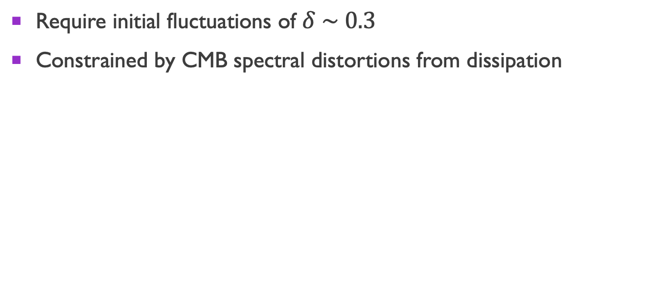
Primordial black holes
Require initial fluctuations of $δ \sim 0.3$
Constrained by CMB spectral distortions from dissipation
Byrnes, Lesgourgues, & Sharma 2024
Notes:
doesn’t rule out PBHs as SMBH seeds, but complicates the picture

Slide 21
The mechanism

Slide 22
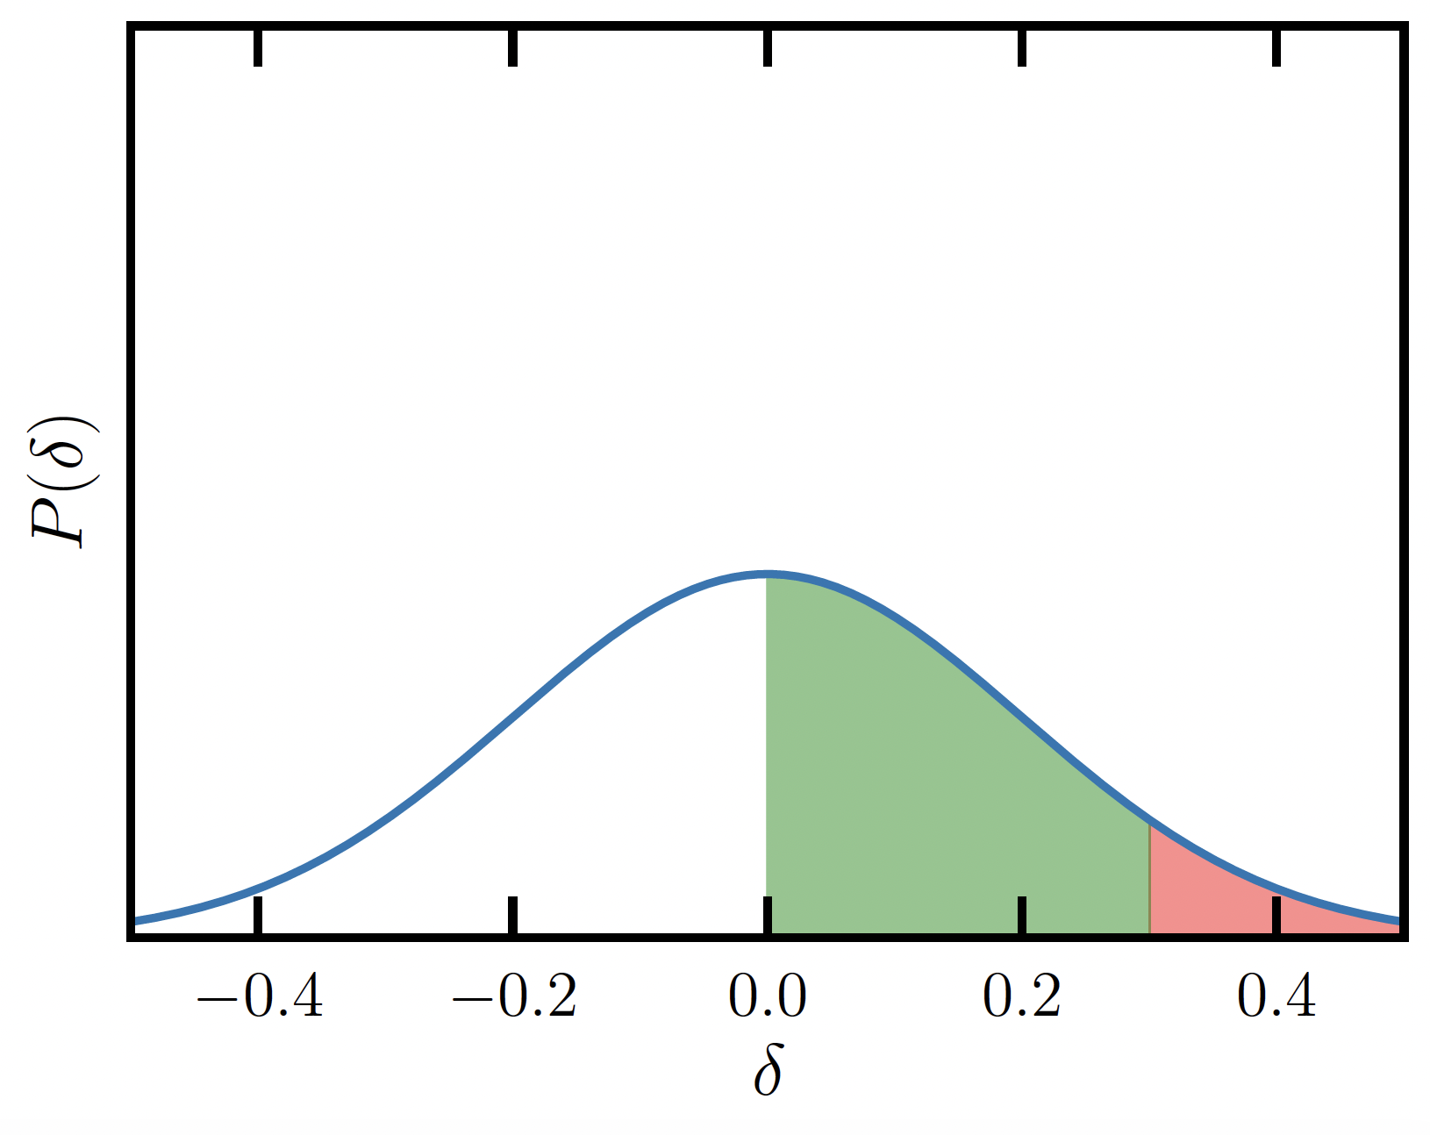
What about initial fluctuations of intermediate amplitude?
?

Slide 23
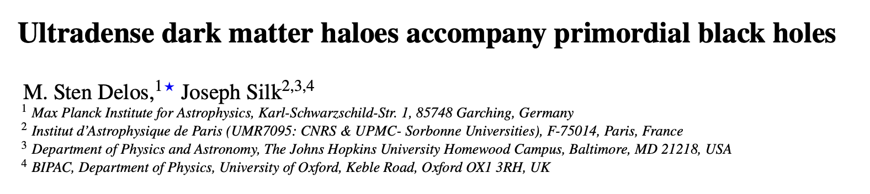
Studied to some extent…e.g.
Notes:
There has been some work on the phenomenology of early and dense dark matter halos --- that is what the literature on ultradense or ultracompact dark matter halos is about
But the consequences for baryons falling into these halos seems somewhat underexplored, and that’s the more general motivation for the work I’m going to be discussing for the reminder of this talk.

Slide 24
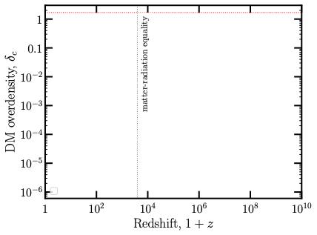
Evolution of density perturbations

Slide 25
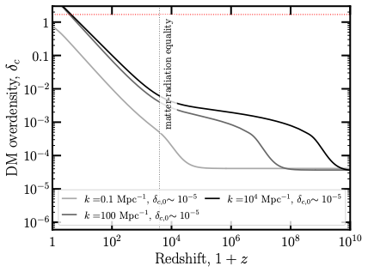
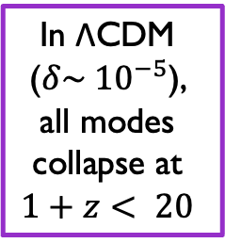
Evolution of density perturbations
In ΛCDM ($δ\sim {10}^{−5}$),
all modes
collapse at
$$1+z< 20$$

Slide 26
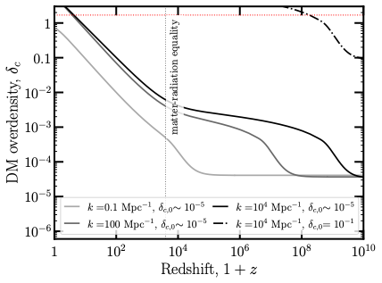
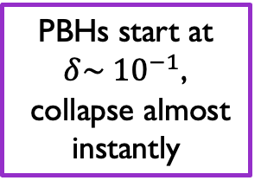
Evolution of density perturbations
PBHs start at $δ\sim {10}^{−1}$,
collapse almost instantly

Slide 27
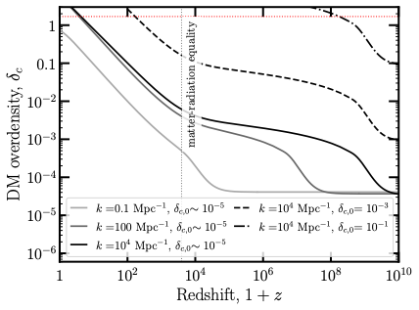
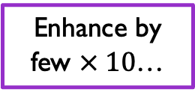
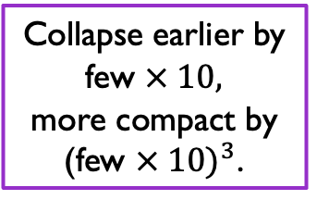
Evolution of density perturbations
Collapse earlier by few $× 10,$
more compact by
(few $× 10)^{3}$.
Enhance by few $× 10$…

Slide 28
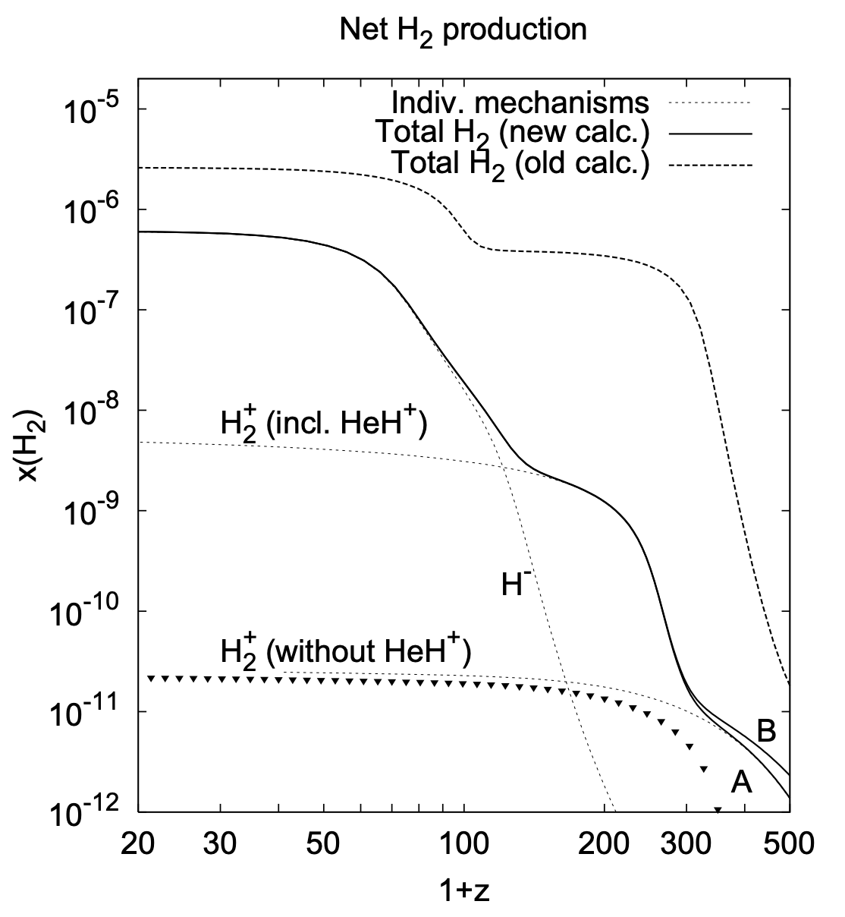
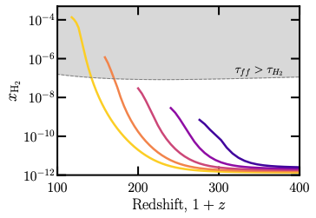
Molecular hydrogen suppressed at early times
Cosmic abundance
(Hirata & Padmanabhan 2006)
Estimated halo abundance
(our work)
direct collapse
for free??
See also Hirano et al. 2015, Ito & Omukai 2024
Notes:
- emphasize that my code ends at virialization

Slide 29
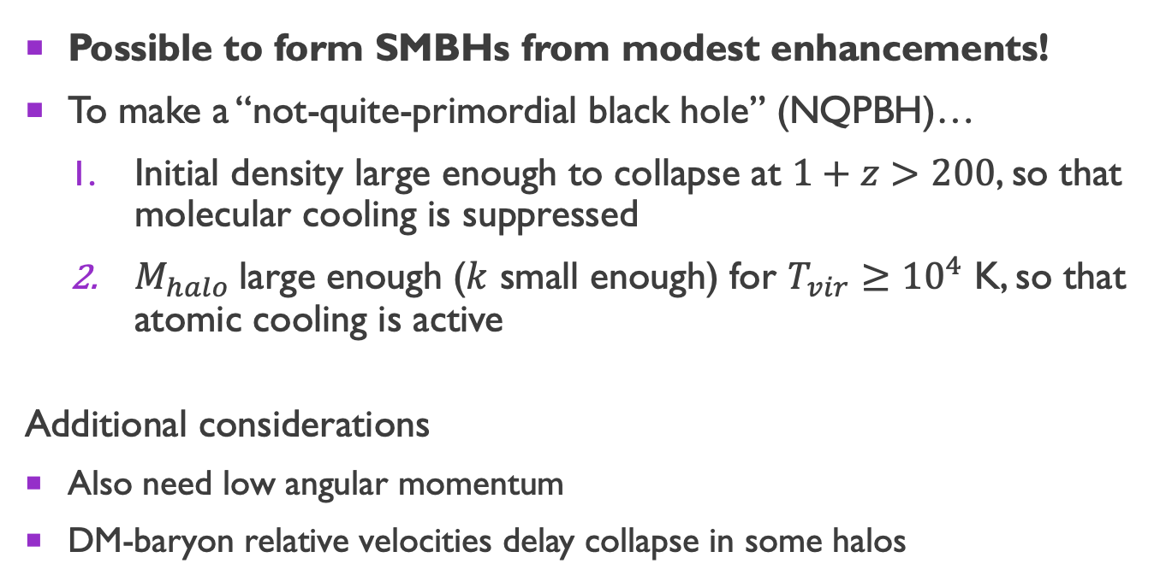
Putting everything together…
Possible to form SMBHs from modest enhancements!
To make a “not-quite-primordial black hole” (NQPBH)…
  Initial density large enough to collapse at $1+z>200$, so that molecular cooling is suppressed
  $M_{halo}$large enough ($k$ small enough) for $T_{vir}≥{10}^{4}$ K, so that atomic cooling is active
Additional considerations
Also need low angular momentum
DM-baryon relative velocities delay collapse in some halos

Slide 30
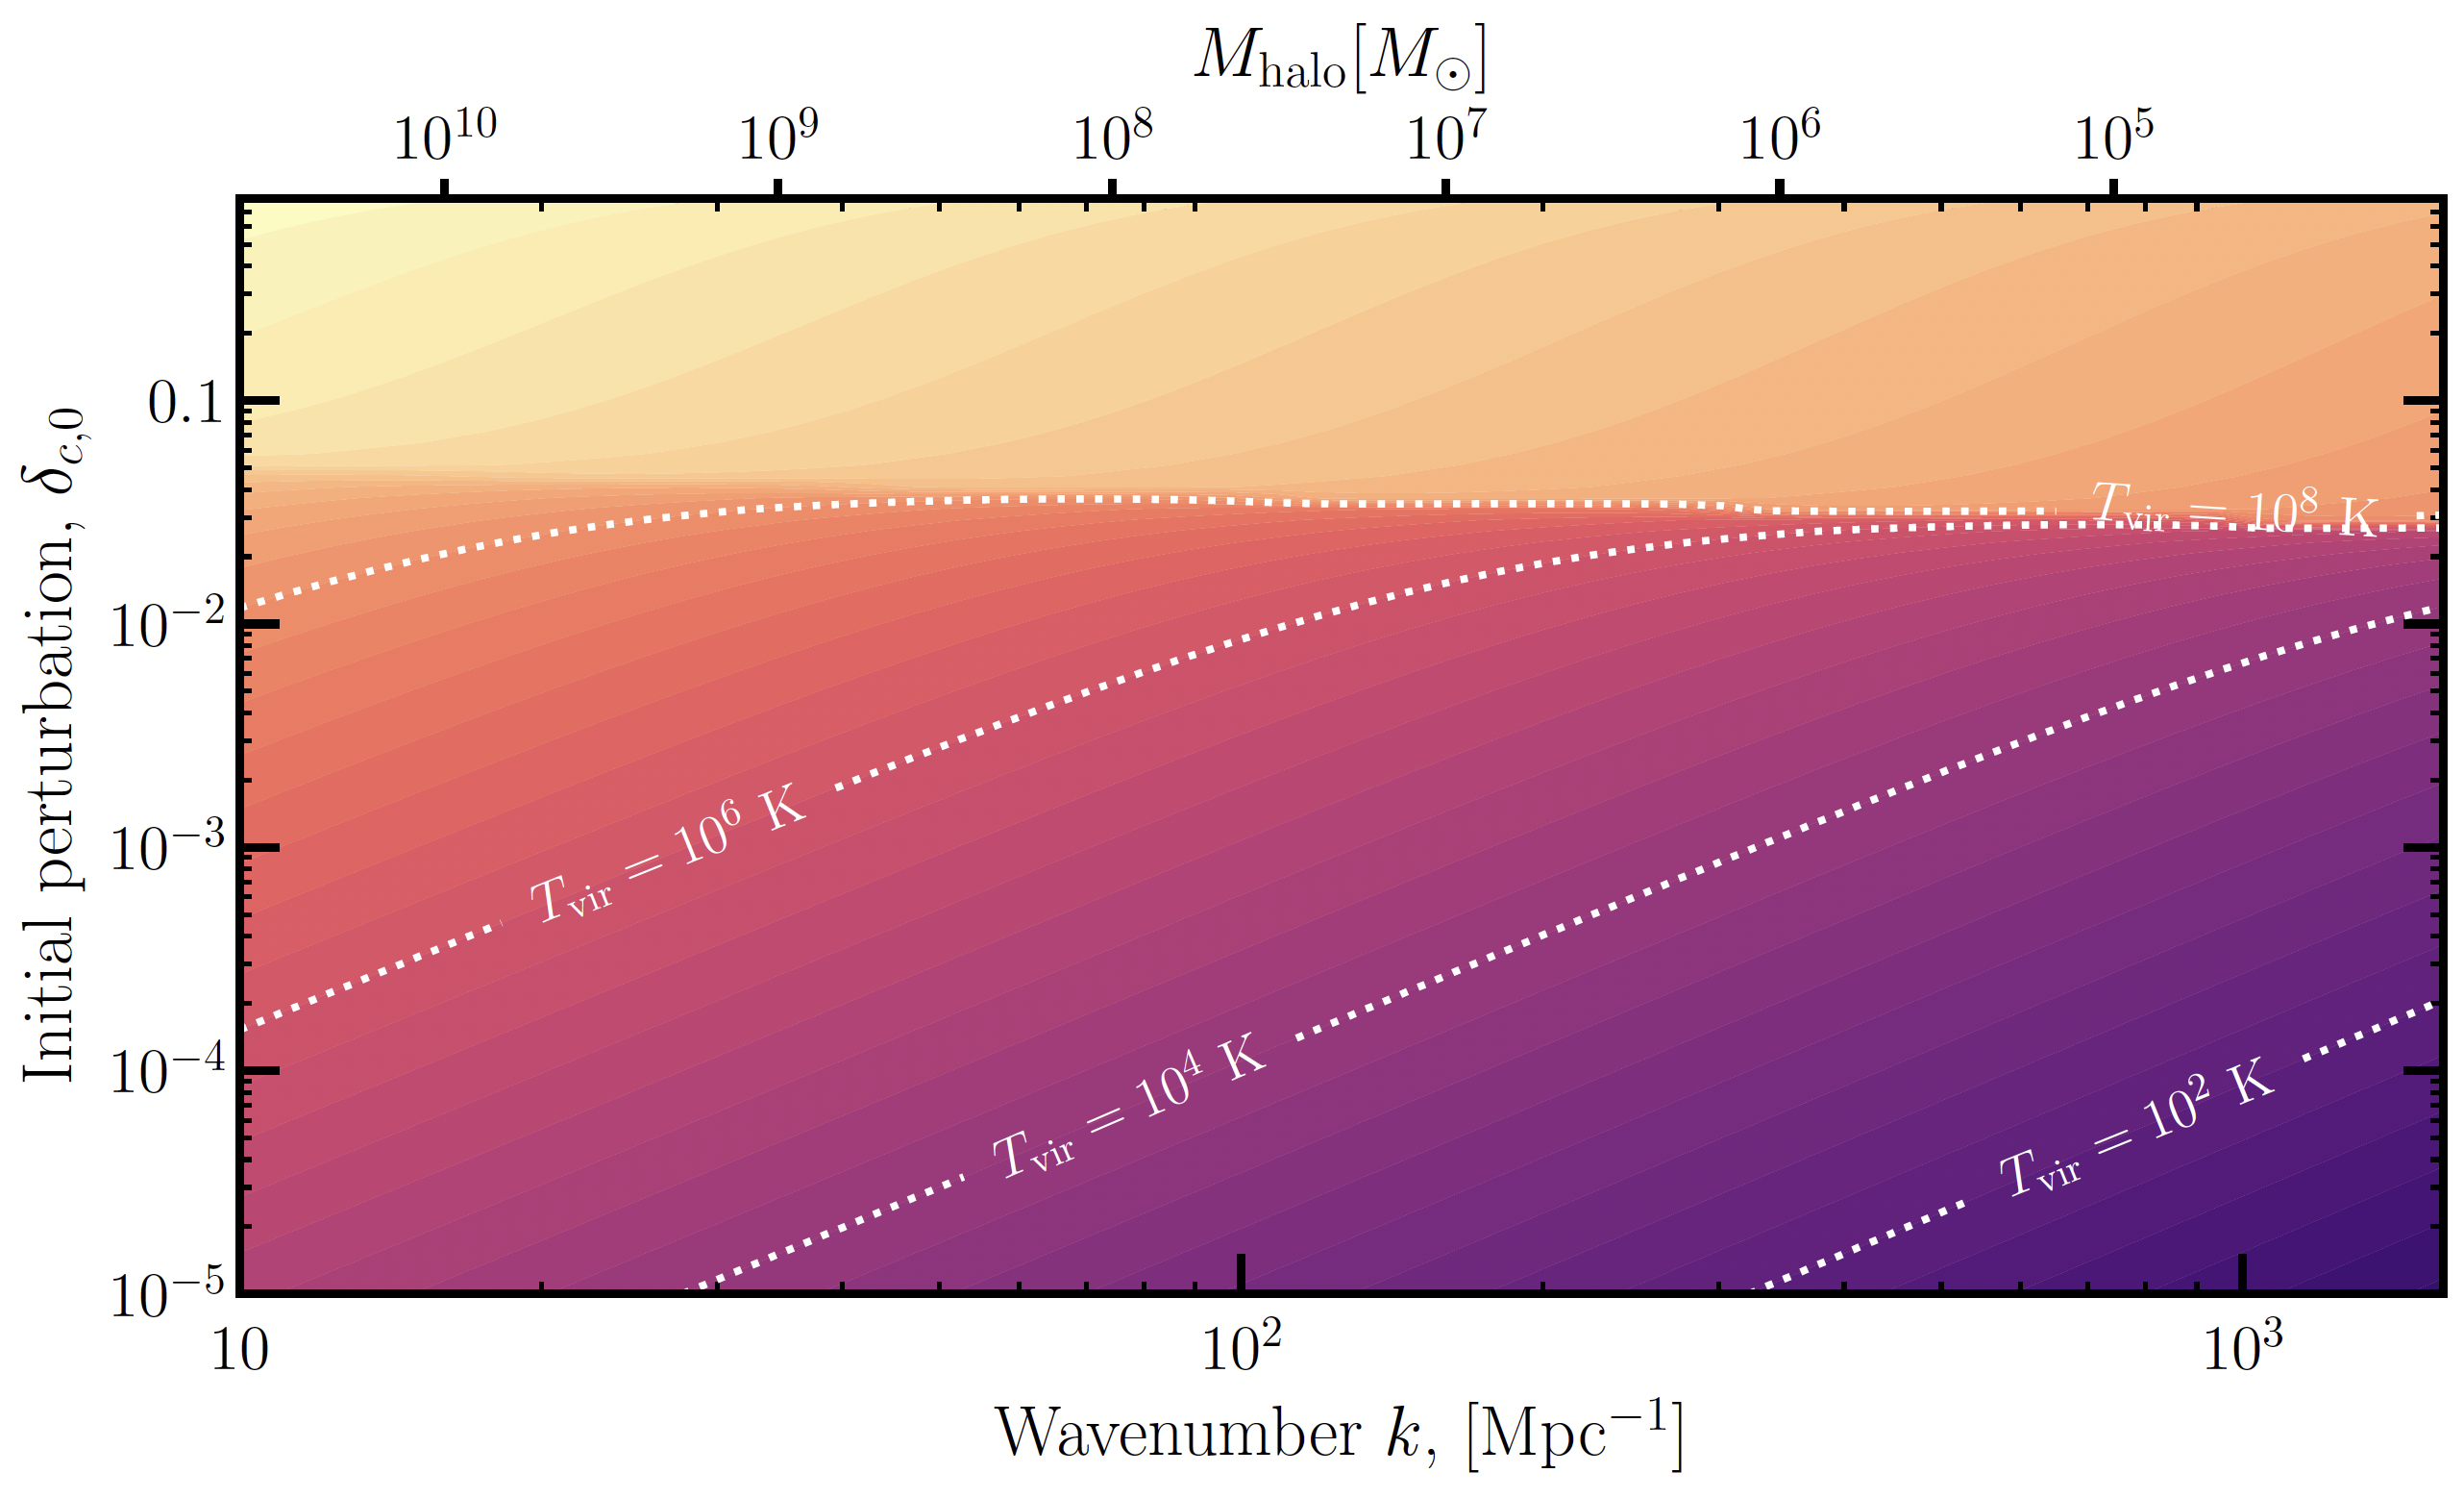
Overdensities and outcomes

Slide 31
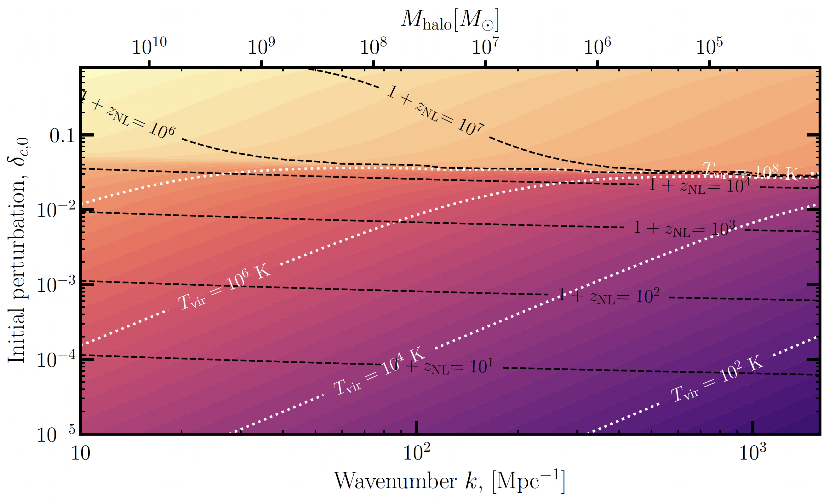
Overdensities and outcomes

Slide 32
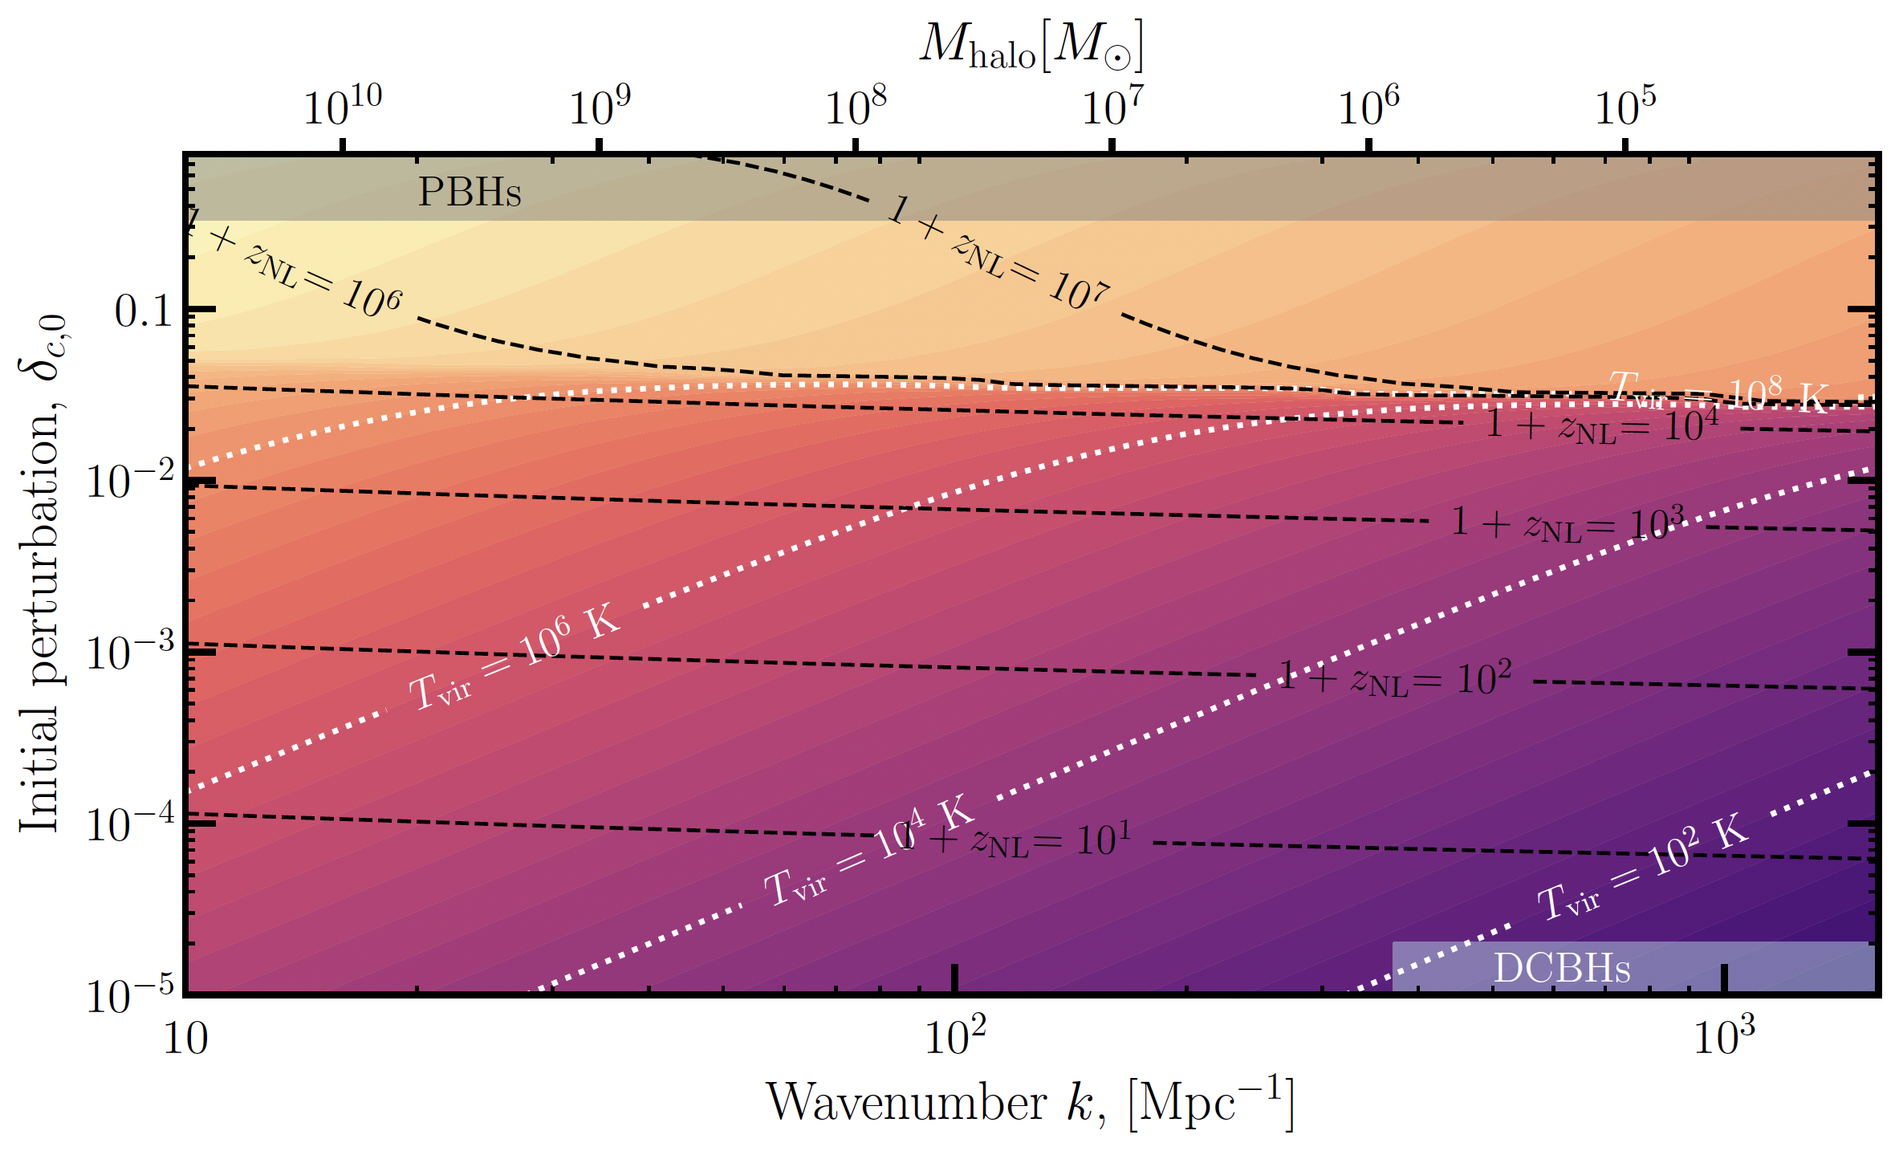
Overdensities and outcomes

Slide 33
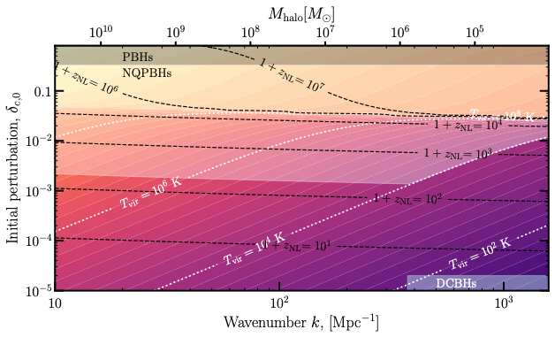
Overdensities and outcomes
WQ, Kumar, Natarajan, and Weiner 2025
Notes:
Point out contours
Lot more parameter space for NQPBHs than PBHs

Slide 34
Results

Slide 35
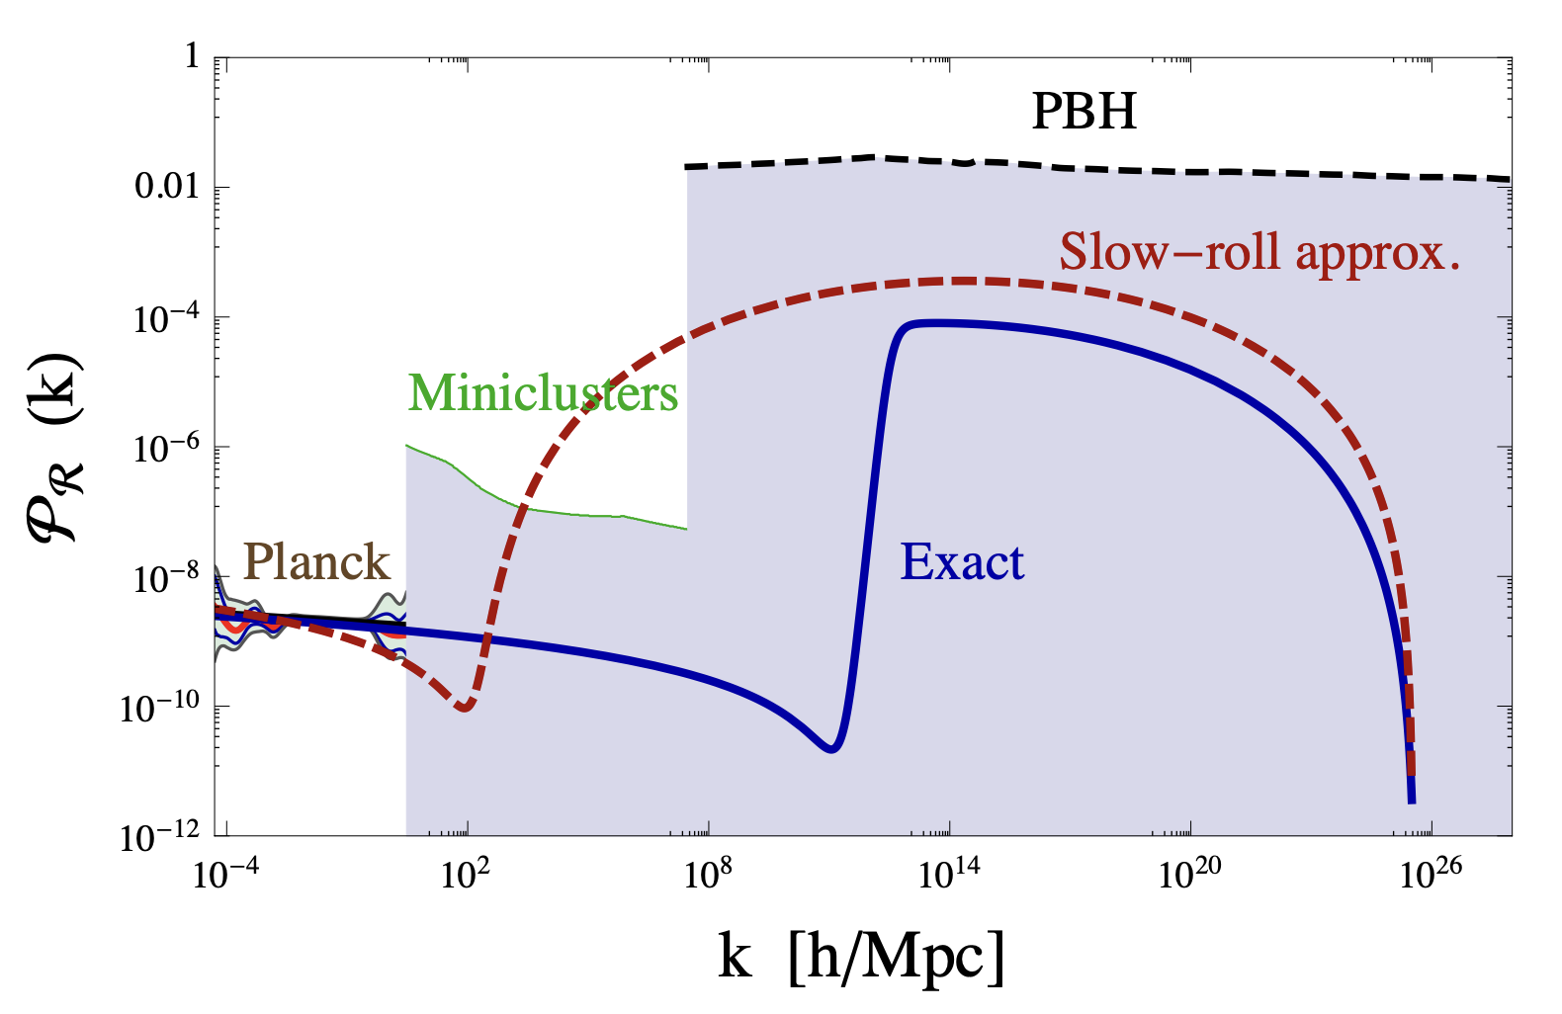
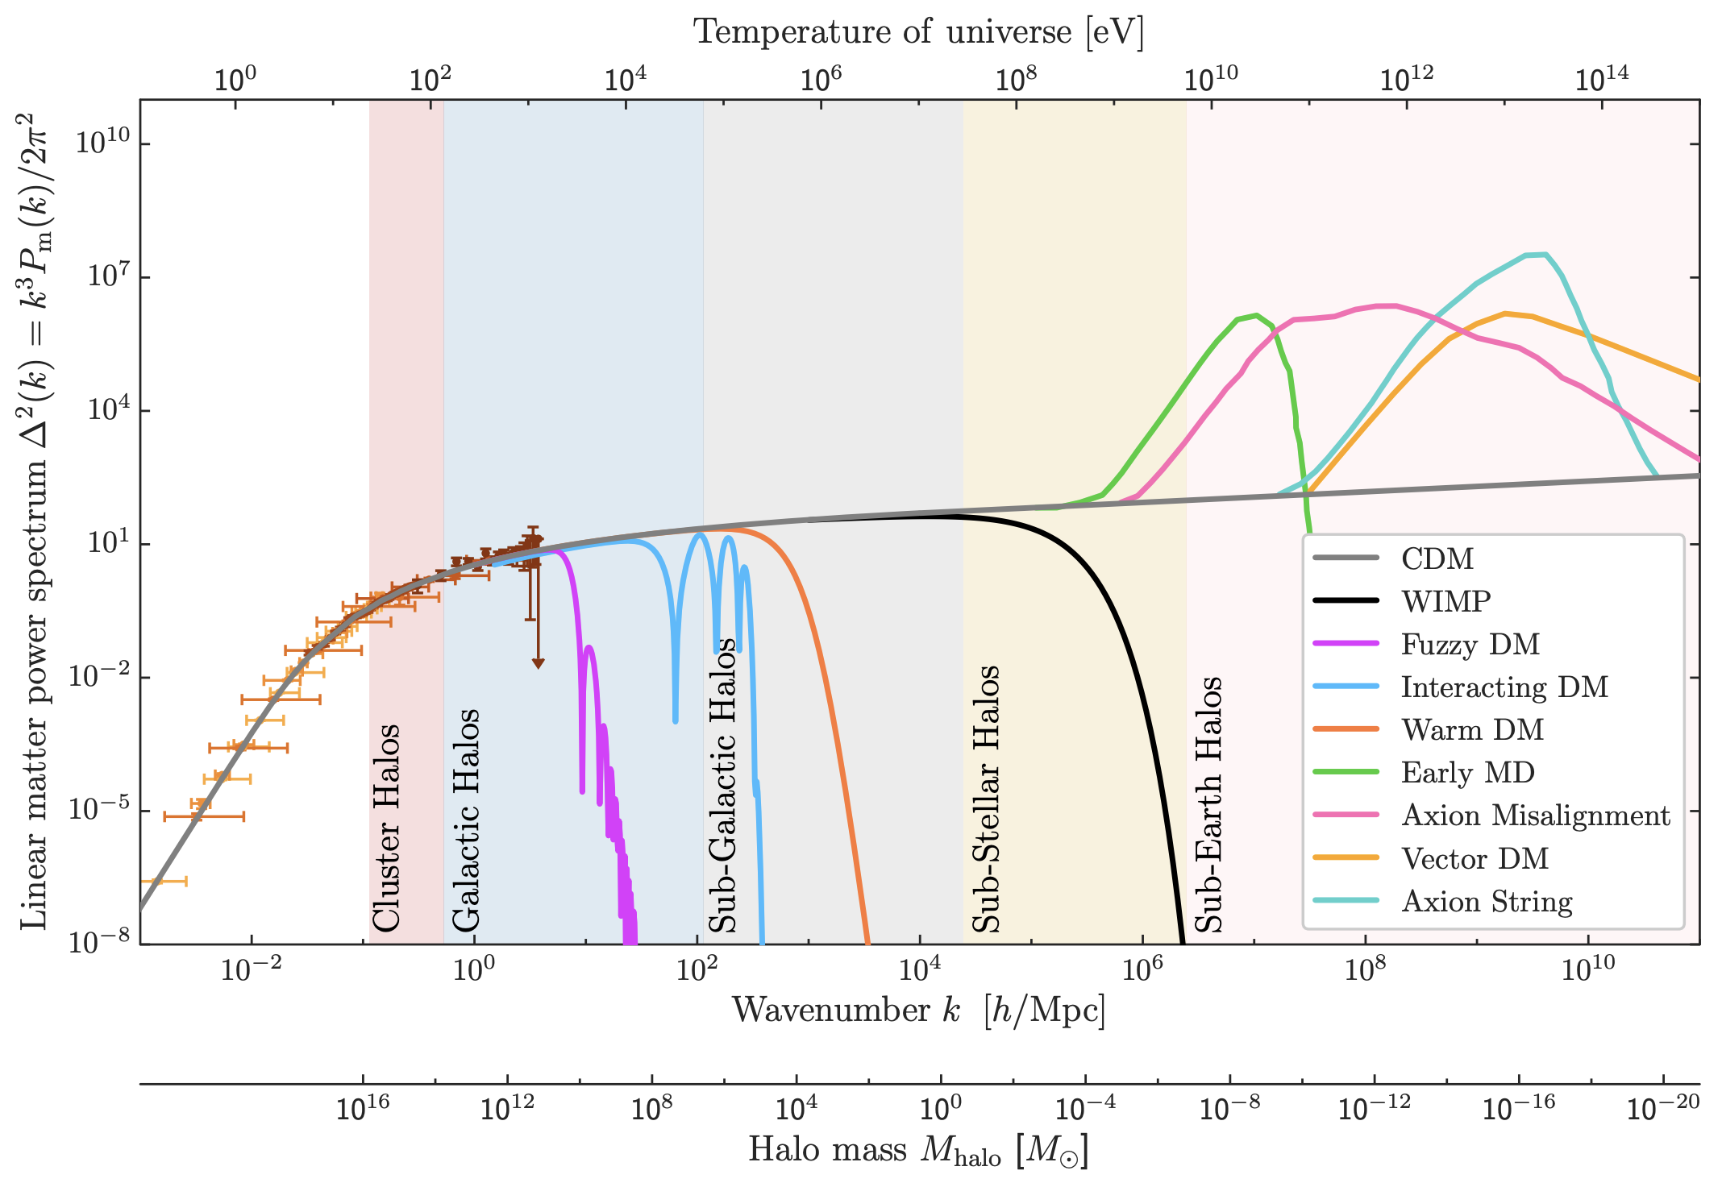
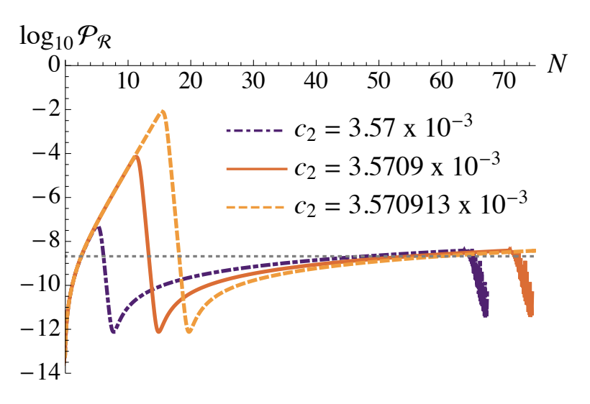
Models
Many models predict enhanced matter power
  Inflation models
  More inflation models
  Alternative dark matter
We will work generally, and model enhancements as
  Narrow peaks
  Step functions
Garcia-Bellido & Morales 2017
Snowmass: Cosmic Probes of Dark Matter
Geller, WQ, et al. 2022
Notes:
So you might be asking what kind of physics can give overdensities that are enhanced relative to our usual standard cosmology expectations
Actually, such enhancements appear in all kinds of particle physics contexts
For example, there many inflationary models in the PBH literature such as this single field example by Garcia-Bellido & Morales that enhance the power spectrum for the primordial perturbations or initial conditions of our universe
There are lots of other models…I personally have worked on multi-field inflation models, you have hybrid inflation, inflation with a spectator field, etc., LOTS OF MODELS
In addition, certain exotic dark matter models also predict enhancements in the matter power spectrum at small scales that could potentially seed NQPBHs
But for this talk we will focus on the primordial curvature perturbations

Slide 36
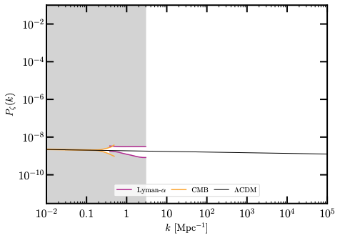
CONSTRAINTS ON PRIMORDIAL CURVATURE
Notes:
So now, what I want to do is give you some benchmarks for how much enhancement is necessary to make a lot of NQPBHs
Shown here is the primordial curvature power spectrum

Slide 37
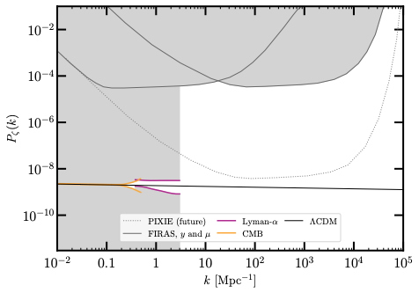
CONSTRAINTS ON PRIMORDIAL CURVATURE
Notes:
- Spectral distortions constraints for delta-function power spectra, stronger for broader shapes

Slide 38
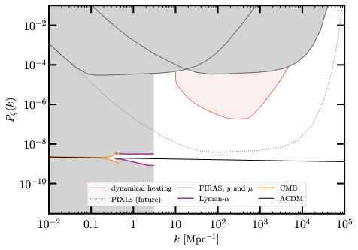
CONSTRAINTS ON PRIMORDIAL CURVATURE

Slide 39
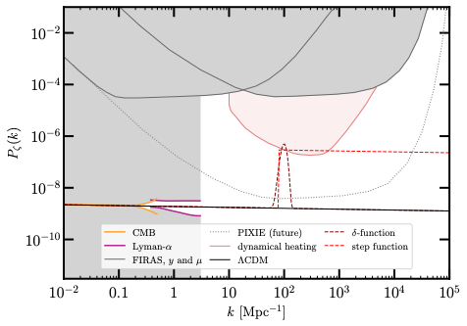

Can produce density of BHs inferred from JWST little red dots ($n=1.3 × {10}^{−5} {\text{M}\text{pc}}^{−3}$) with narrow peak (x310) and step-function enhancement (x180)
WQ, Kumar, Natarajan, and Weiner 2025
Notes:
- discuss overlap with constraint

Slide 40
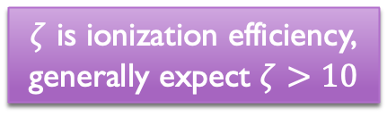
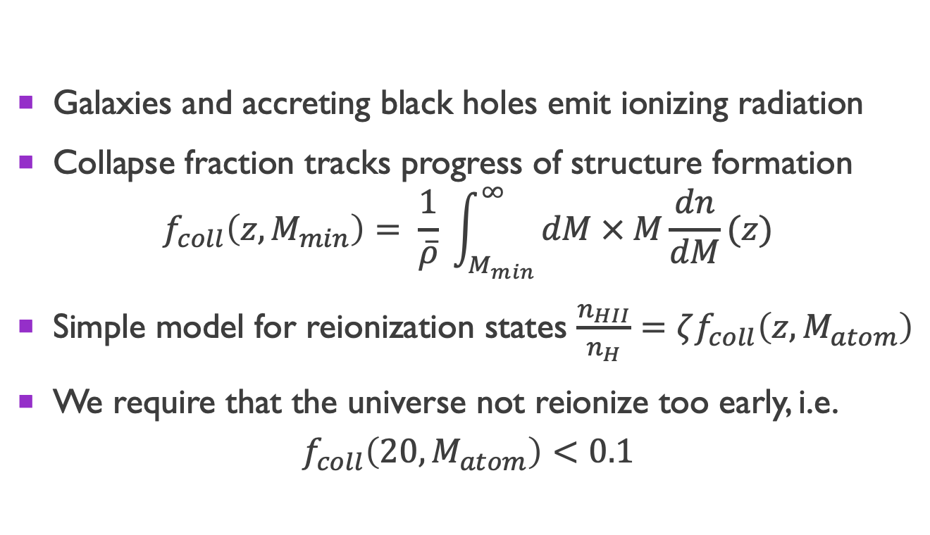
Early reionization
Galaxies and accreting black holes emit ionizing radiation
Collapse fraction tracks progress of structure formation
$f_{coll}\left(z, M_{min}\right)= \frac{1}{\overline{ρ}} \int_{M_{min}}^{∞}{dM × M\frac{dn}{dM}(z)}$
Simple model for reionization states $\frac{n_{HII}}{n_{H}}=ζf_{coll}\left(z, M_{atom}\right)$
We require that the universe not reionize too early, i.e.
$$f_{coll}\left(20, M_{atom}\right)<0.1$$
$ζ$ is ionization efficiency,
generally expect $ζ>10$

Slide 41
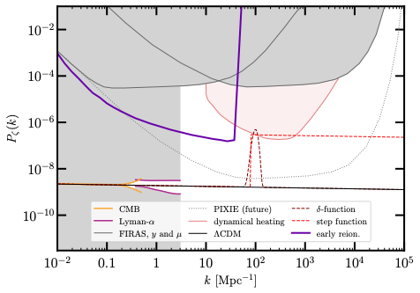
Constraints on primordial fluctuations
WQ, Kumar, Natarajan, and Weiner 2025

Slide 42
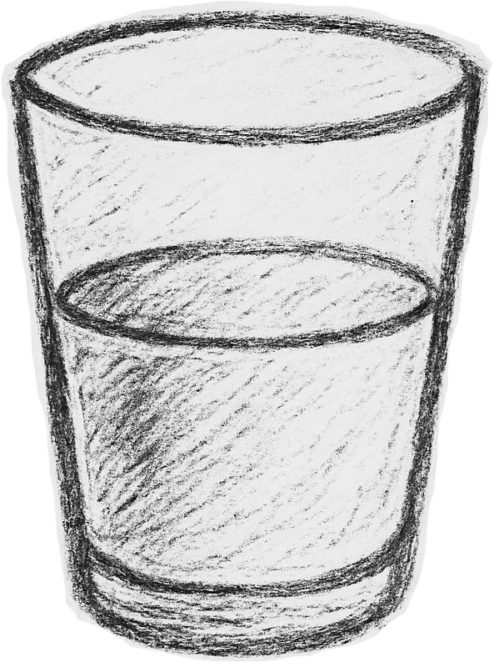
Implications for primordial black holes
Pessimist: So I can’t make PBHs without NQPBHs? :c
Optimist: I can make SMBHs with modest enhancements and less fine-tuning! :D

Slide 43
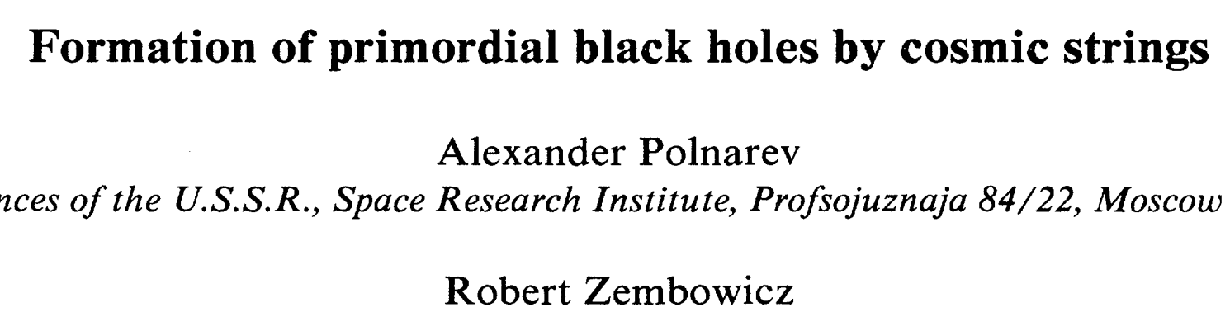





Examples of PBH → NQPBH Models
Cosmic string loops
Collapsing domain walls…
Ultra slow-roll…
Your favorite model???

Slide 44
Other ways to seed NQPBHs
Snowmass: Cosmic Probes of Dark Matter

Slide 45


NQPBHs: enhanced growth (+rong xu)
Can also be caused by enhanced growth of density perturbations
Investigating NQPBHs in enhanced power spectrum from axion kination causing early matter domination [Co et al. 2025]

Slide 46



NQPBH: Impact on CMB (+Tony/zilu Zhou)
NQPBH accretion is a form of exotic energy injection
  Deposit energy in the form of heating/ionization/etc.
  Potentially observable in 21cm signals or CMB

Slide 47



Not quite NQPBHs…
If overdensities fail to form NQPBHs, may form stars
What do such stellar systems look like today?
Can you form stars?
Can you retain stars/survive supernova feedback?
Can the stars cluster under dynamical friction?

Slide 48

Not quite NQPBHs…
If overdensities fail to form NQPBHs, may form stars
What do such stellar systems look like today?
WQ, Kaplan, and Weiner 2026

Slide 49

Conclusions
Lots to explore in the realm of early universe/small scales!
NQPBHs -- a new mechanism explaining origin of SMBHs that is less demanding than PBHs
Future directions:
Gravitational wave signatures?
Properties/spectra of very early stars and black holes?
Realistic model enhancements?
Notes:
So that brings me to the end of my talk
As you can see, there is a lot to be explored in the realm of both high-redshifts and enhanced small-scale structure
In particular, the one phenomenon that I’ve outlined for you today is these NQPBHs, which is a new mechanism for seeding SMBHs that is much less demanding than what was necessary for PBHs
Besides the ongoing work that I discussed, there’s a lot of interesting future directions to go from here.
What is the additional contribution to gravitational wave backgrounds from these early SMBH seeds?
What are the other properties and spectra of these early stars/BHs? This is necessary to be able to rigorously compare this mechanism to existing astrophysical observations
In this work, we’ve mostly been considering toy model enhancements of power spectra. What about enhancements from more motivated, realistic models? What do these models predict in terms of black holes and early stars?
These directions also have many synergies with upcoming surveys, which I will simply list here for the sake of time.
Besides NQPBHs, I’ve also worked on a number of other topics in cosmology and astroparticle physics that I didn’t have time to talk about today, but in case you are interested in hearing more about any of these, feel free to ask me later.
Thank you very much!

Slide 50
Backup slides

Slide 51



Abundance of molecular hydrogen
“Too much” cooling → cooling time shorter than free-fall time
$τ_{H_{2}}=\frac{T}{{\dot{T}}_{H_{2}}}, τ_{ff} =\sqrt{\frac{3π}{32Gρ} }$
* Assuming $T={10}^{4}$ K
and $ρ=18π^{2}\overline{ρ}$

Slide 52

Abundance of molecular hydrogen
Evolve $H_{2}$ abundance in top-hat halos virializing at different $z$
Earlier $z$ → CMB hotter, suppresses abundance of $H^{−}$ and $H_{2}$
Prior to $1+z∼200$, halos are unable to fragment/form stars

Slide 53


DM-baryon relative velocities
Tseliakhovich & Hirata 2010: After baryons decouple from photons, have a velocity relative to DM
When is this a problem for structure formation? Compare to gas sound speed
$$v_{\text{DM−b}}\left(z\right)=30 \text{km/s }× \frac{1+z}{1100}$$
$c_{s}=\sqrt{\frac{5T}{3μm_{p}}}≈11 \text{km/s}$ at $T={10}^{4}$K
$v_{\text{DM−b}}\left(z\right)<c_{s}$ for $1+z<400$

Slide 54


angular momentum considerations
Dimensionless spin parameter $λ=\frac{{J\left|E\right|}^{1/2}}{GM^{5/2}}$
Lodato & Natarajan 2006 find direct collapse occurs for $λ<0.02$
At $1+z=10$, spin distribution is lognormal with $\left\langle λ\right\rangle ∼0.04$ and $σ_{λ}∼0.55$
10% of halos meet criteria
Conservative b/c later halos have more spin

Slide 55


Eddington limit
Theoretical limit on luminosity, when radiation pressure = gravity
Luminosity is caused by accretion onto the black hole
Can therefore translate this to limit on accretion

