Slide 1
Displacement sensor based on a maser reference
C. Bragard^{1,2}, A.S. Bogomolov¹, A. Altman¹, A. Goodwin-Jones¹ and C. Lauzin¹
¹Université Catholique de Louvain, Louvain-La-Neuve, 1348, Belgium
²Université de Namur, Namur, 5000, Belgium
Belgian-Dutch Gravitational Wave meeting 2026

Slide 2
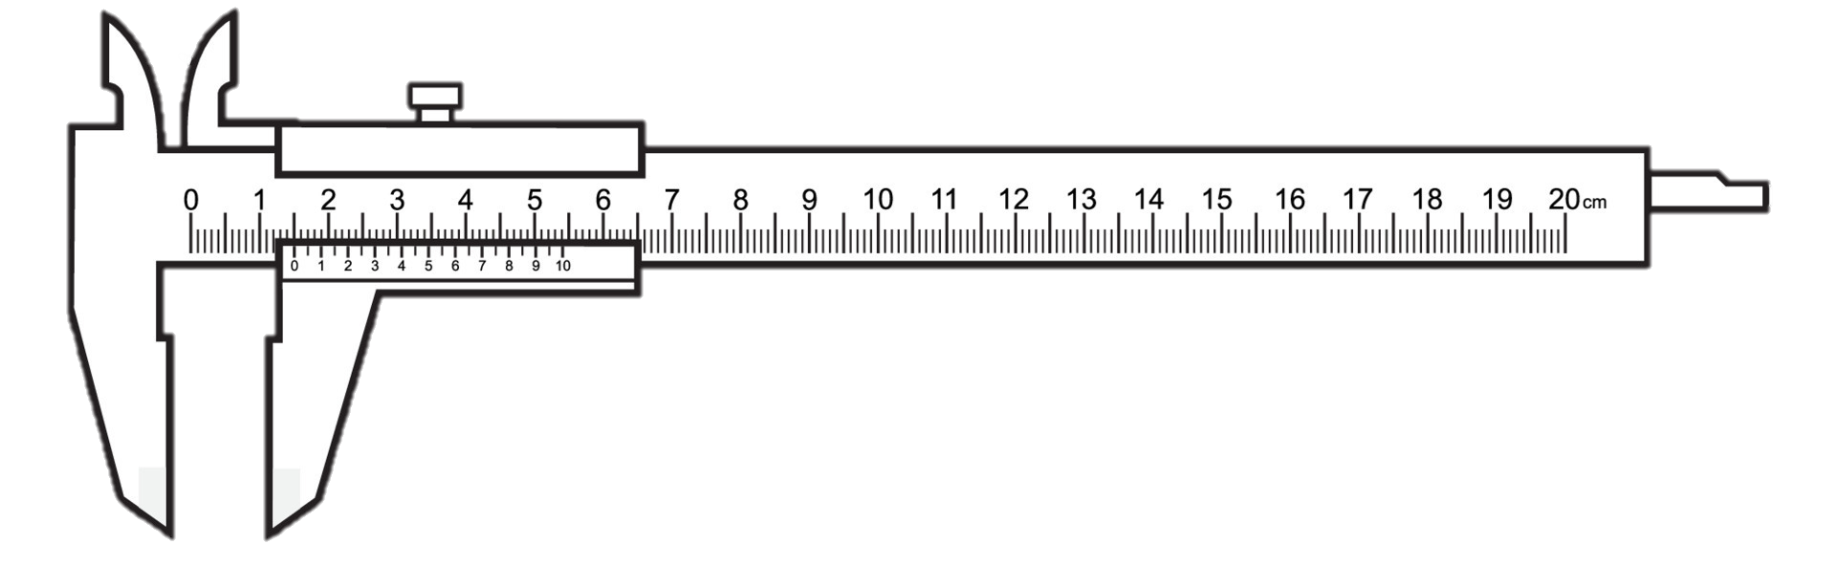


Interest of displacement sensing
Displacement sensors measure a distance variation $ΔL$

Slide 3
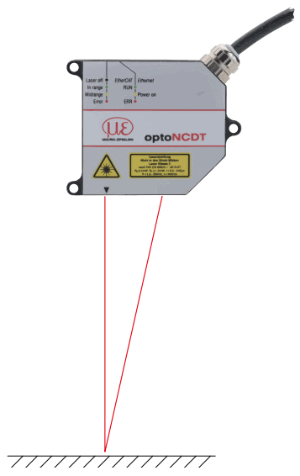
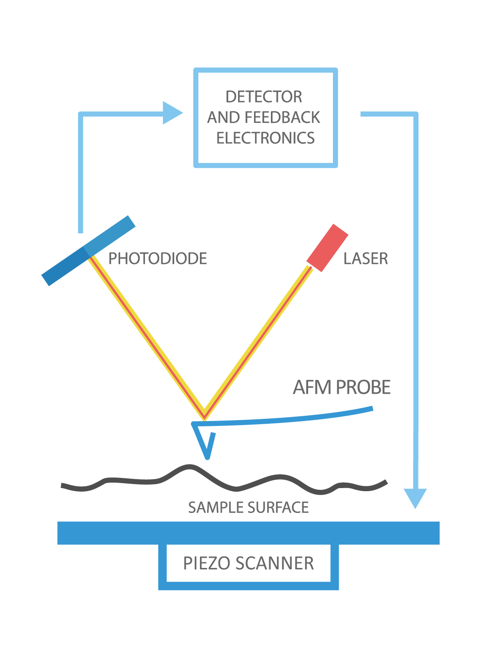
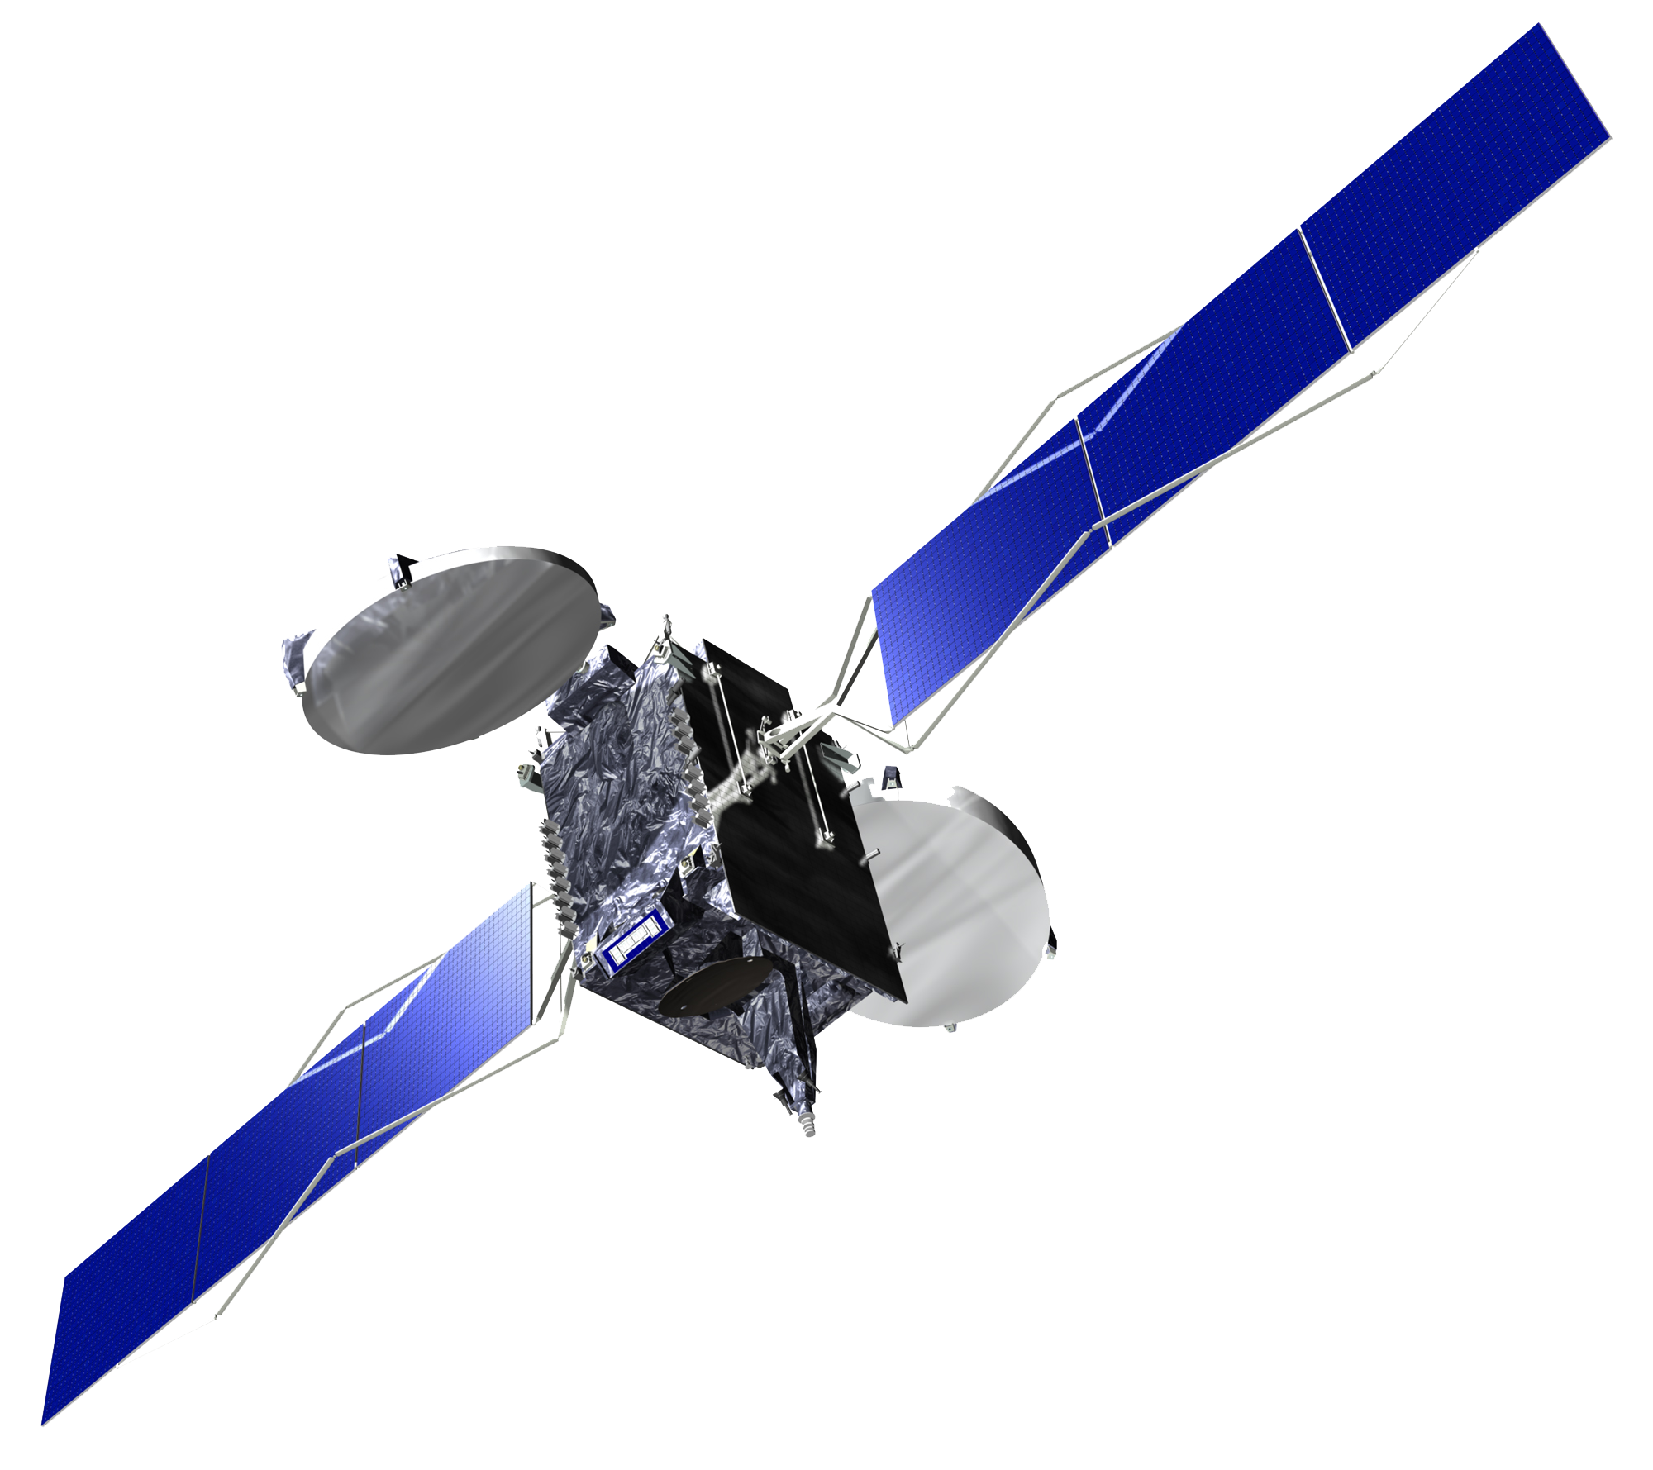
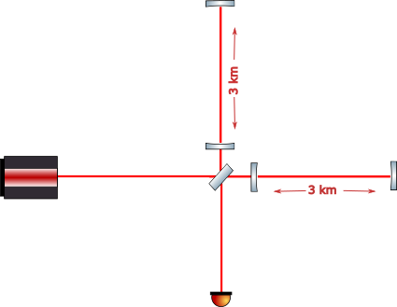


Interest of displacement sensing
Displacement sensors measure a distance variation $ΔL$
Satellites
Industry
Precision microscopy
Fundamental physics
$$L$$
$$L$$
Micro-Epsilon, optoNCDT – Laser displacement sensors, product catalog, accessed 2026.
https://www.nanoandmore.com/what-is-atomic-force-microscopy
$$ΔL=c Δτ$$
Notes:
Inertial sensors are classified into two main categories: accelerometers and gyroscopes. Broadly, accelerometers measure specific forces or accelerations, while, gyroscopes measure angular velocities.

Slide 4
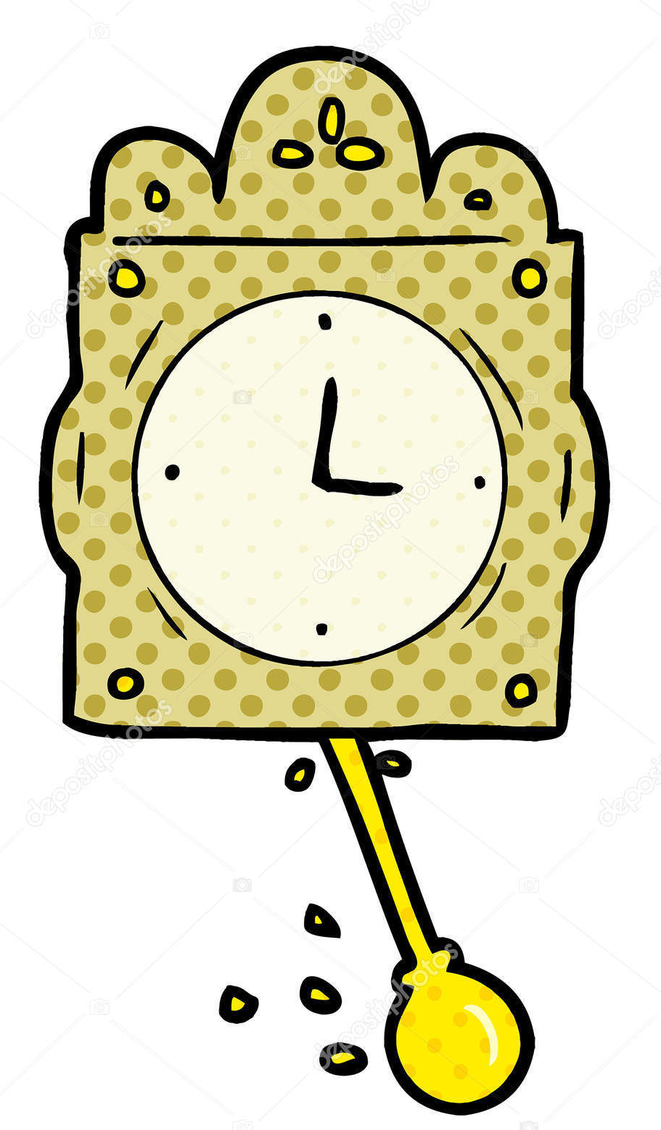

Interest of displacement sensing
Displacement sensors measure a distance variation $ΔL$
Satellites
Industry
Precision microscopy
Fundamental physics
$$L$$
$$L$$
Micro-Epsilon, optoNCDT – Laser displacement sensors, product catalog, accessed 2026.
https://www.nanoandmore.com/what-is-atomic-force-microscopy
Time
1 ns
=
Length
30 cm
$$ΔL=c Δτ$$
$$\frac{Δτ}{τ}=\frac{Δν}{ν}$$
constant
Notes:
Inertial sensors are classified into two main categories: accelerometers and gyroscopes. Broadly, accelerometers measure specific forces or accelerations, while, gyroscopes measure angular velocities.

Slide 5
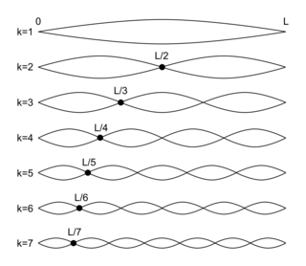


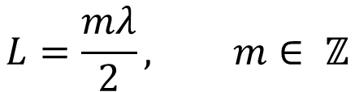
Interferometry to probe distance variation
Fabry-Perot interferometer
m = 1
m = 2
$$L=\frac{mλ}{2}, m∈ ℤ$$
m = 3
m = 4
m = 5
$$L$$
m = 6
m = 7

Slide 6
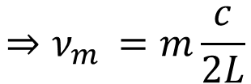
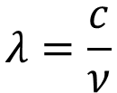
Interferometry to probe distance variation
Fabry-Perot interferometer
m = 1
m = 2
$$L=\frac{mλ}{2}, m∈ ℤ$$
m = 3
m = 4
m = 5
$$L$$
$$λ=\frac{c}{ν}$$
$$⇒ν_{m }=m\frac{c}{2L}$$
m = 6
m = 7

Slide 7
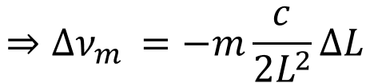
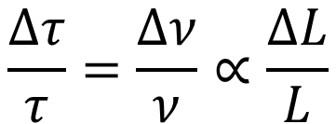
Interferometry to probe distance variation
Fabry-Perot interferometer
m = 1
m = 2
$$L=\frac{mλ}{2}, m∈ ℤ$$
m = 3
m = 4
m = 5
$$L$$
$$λ=\frac{c}{ν}$$
$$⇒ν_{m }=m\frac{c}{2L}$$
m = 6
m = 7
$$⇒{Δν}_{m }=−m\frac{c}{2L^{2}}ΔL$$
$$\frac{Δτ}{τ}=\frac{Δν}{ν}∝\frac{ΔL}{L}$$
Therefore :

Slide 8
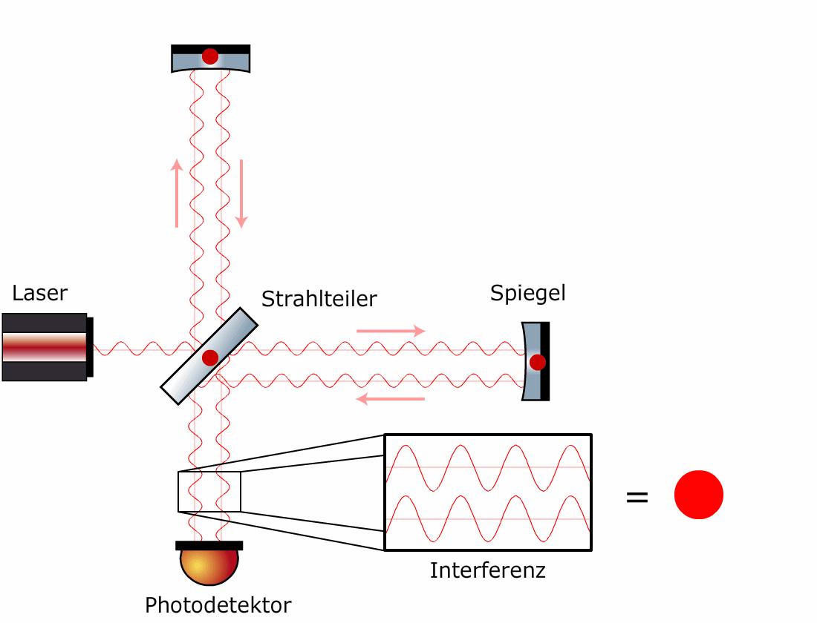


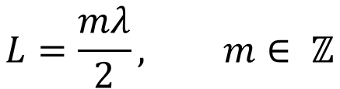
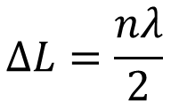
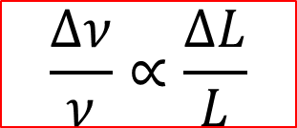
Interferometry to probe distance variation
Fabry-Perot interferometer
Michelson interferometer
Test mirror
$$ΔL=\frac{nλ}{2}$$
$$n∈ ℤ$$
$$L$$
Laser
Beamsplitter
$$L=\frac{mλ}{2}, m∈ ℤ$$
Tracking mirror
$$\frac{Δν}{ν}∝\frac{ΔL}{L}$$
Photodiode

Slide 9
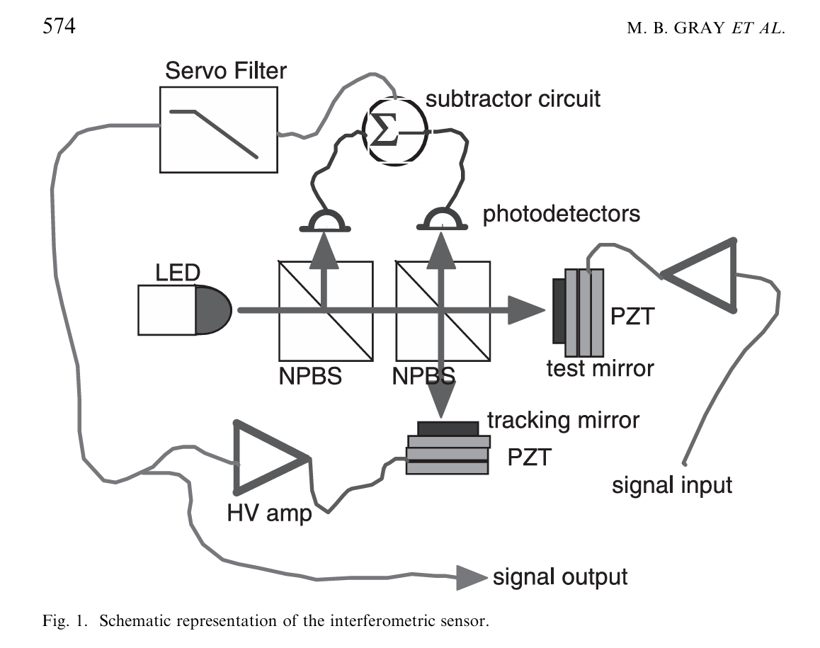
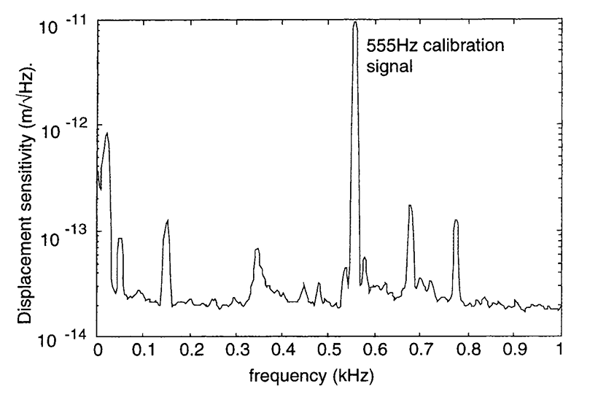

State-of-the-art interferometric displacement sensor
$⇒20 fm/\sqrt{Hz}$ sensitivity
M. B. Gray et al., “A simple high-sensitivity interferometric position sensor for test mass control on an advanced LIGO interferometer,” Optical and Quantum Electronics, vol. 31, pp. 571–582, 1999.

Slide 10


Sensor recently developed by the community :
Heterodyne cavity tracking
Test cavity
Laser 1
$$ΔL$$
Reference cavity
Laser 2

Slide 11
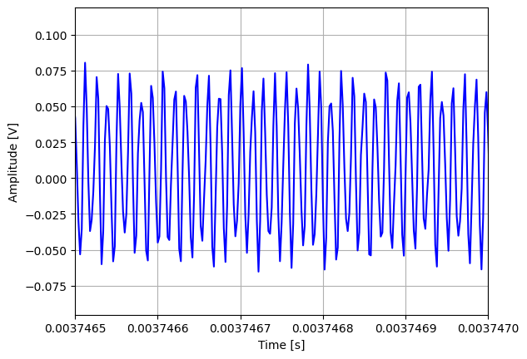



Sensor recently developed by the community :
Heterodyne cavity tracking
Test cavity
Inertial sensor based on optical beating measurement
Laser 1
$ν_{1}$ = 200 THz
$$ΔL$$
$$ν_{2}−ν_{1}$$
Reference cavity
Laser 2
$ν_{2}$ = 200.000001 THz

Slide 12
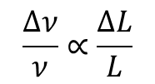
Sensor recently developed by the community :
Heterodyne cavity tracking
Test cavity
Laser 1
$ν_{1}$ = 200 THz
$$ΔL$$
Phasemeter
$$\frac{Δν}{ν}∝\frac{ΔL}{L}$$
$$ν_{2}−ν_{1}$$
Reference cavity
Laser 2
$ν_{2}$ = 200.000001 THz

Slide 13
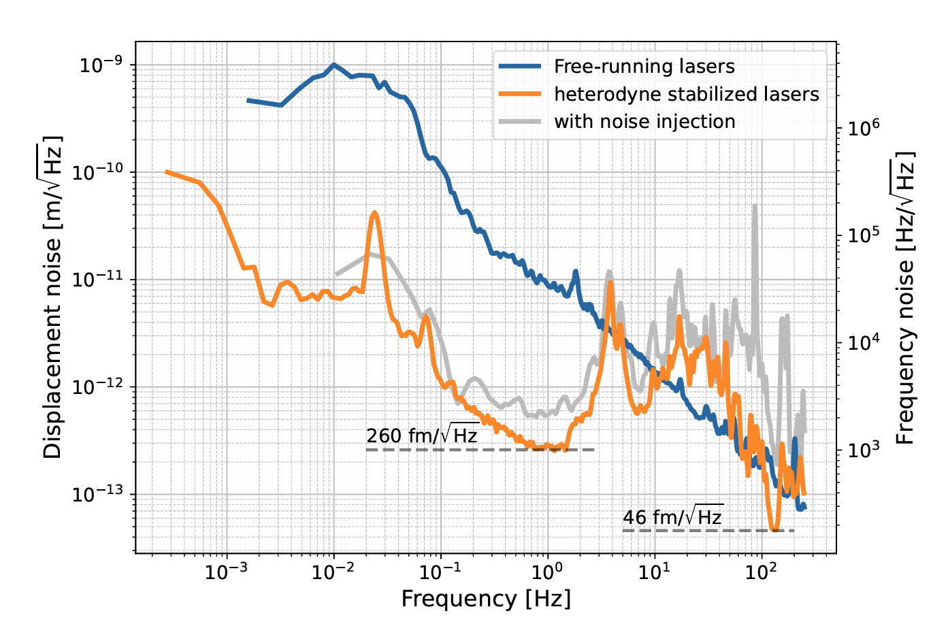

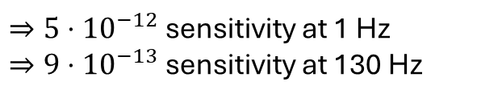
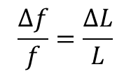
Sensor recently developed by the community :
Heterodyne cavity tracking
Test cavity
$ΔL$ sensitivity
Laser 1
$$ΔL$$
Phasemeter
$$\frac{Δf}{f}=\frac{ΔL}{L}$$
Reference cavity
Laser 2
$⇒5⋅{10}^{−12}$ sensitivity at 1 Hz
$⇒9⋅{10}^{−13}$ sensitivity at 130 Hz

Slide 14
What needs to be built?
3
1
Test cavity
2
Laser 1
Phasemeter
$$\frac{Δν}{ν}∝\frac{ΔL}{L}$$
Reference cavity
Laser 2

Slide 15
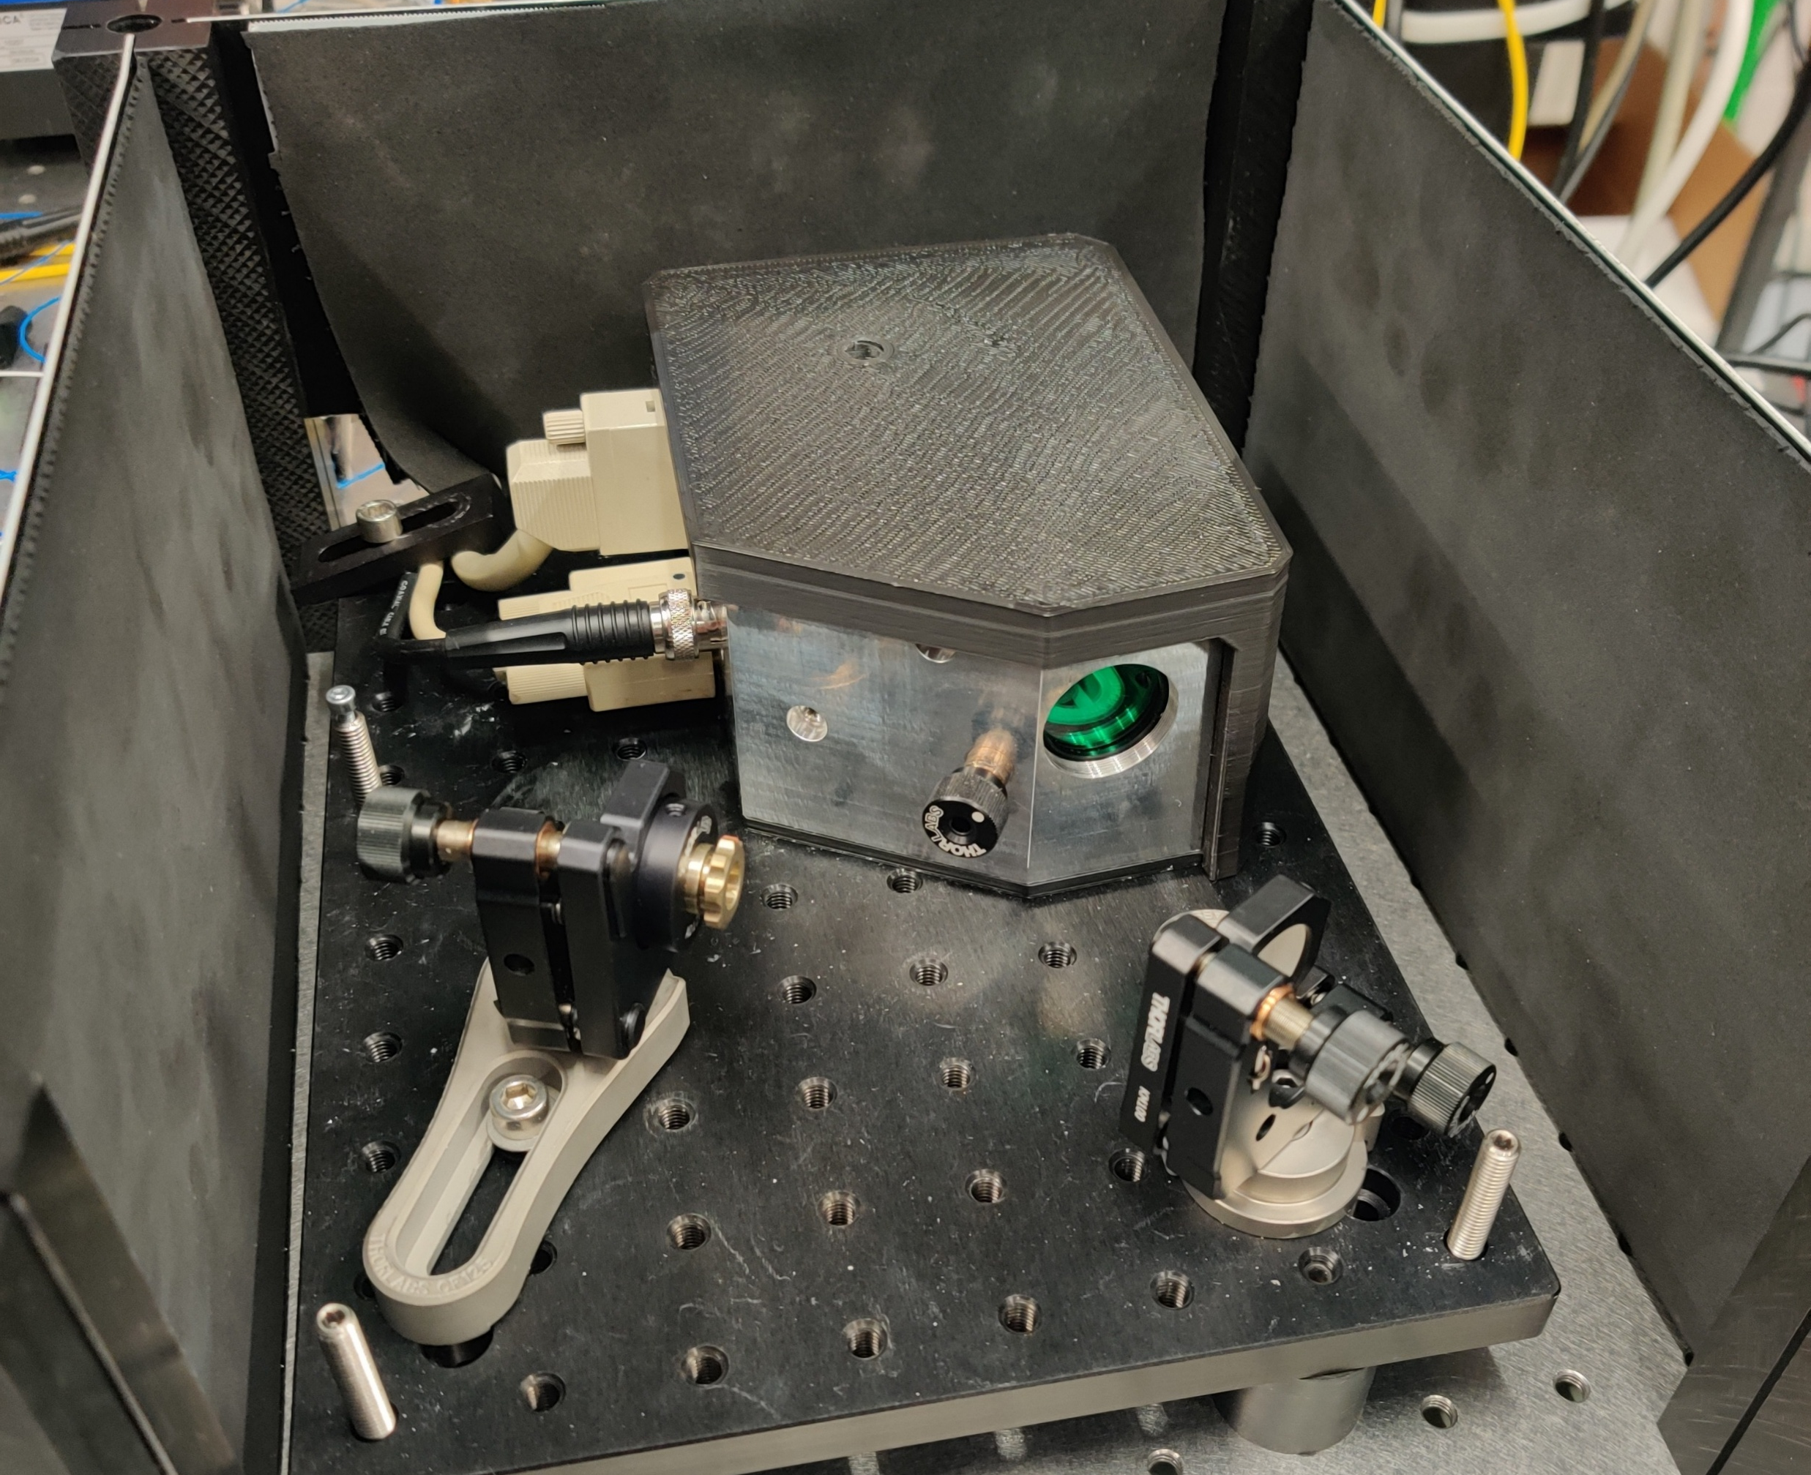
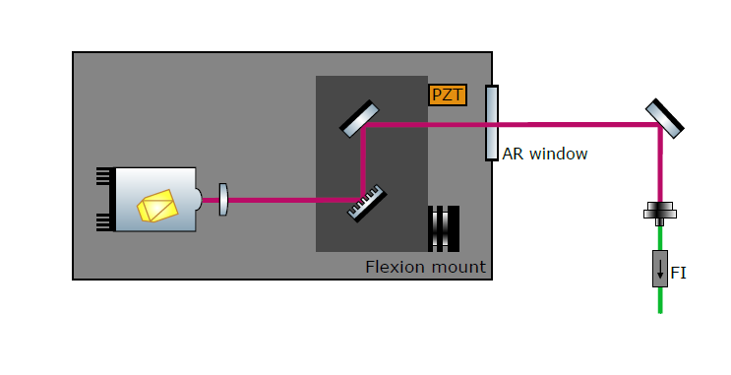
Laser source
Home-built External Cavity Diode Laser (ECDL)
Tunable
Narrow linewidth ?
Dr A.S. Bogomolov’s design

Slide 16
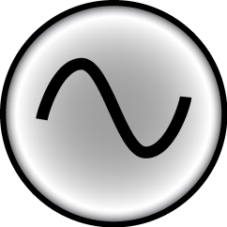
Laser source characterisation
Short Delay Self-Heterodyne interferometry
2 km Delay line
Balanced photodiode
Spectrum analyzer
Laser
Combiner 50/50
AOM
40 MHz
AOM = Acoust-Optic Modulator

Slide 17
Laser source characterisation
Short Delay Self-Heterodyne interferometry
$$S\left(f\right) = \frac{P_{0}^{2}}{4π}\frac{Δf}{ Δf^{2}+{\left(f−f_{1}\right)}^{2}}\left(1−\exp\left(−2πτΔf\right)\left[\cos\left(2πτ(f−f_{1}\right)+Δf\frac{sin⁡(2πτ(f−f_{1})}{f−f1}\right]\right)+\frac{πP_{0}^{2}}{2}\exp\left(−2πτΔf\right)δ(f−f_{1})$$

Slide 18
Laser source characterisation
Short Delay Self-Heterodyne interferometry
$$S\left(f\right) = \frac{P_{0}^{2}}{4π}\frac{Δf}{ Δf^{2}+{\left(f−f_{1}\right)}^{2}}\left(1−\exp\left(−2πτΔf\right)\left[\cos\left(2πτ(f−f_{1}\right)+Δf\frac{sin⁡(2πτ(f−f_{1})}{f−f1}\right]\right)+\frac{πP_{0}^{2}}{2}\exp\left(−2πτΔf\right)δ(f−f_{1})$$
Lorentzian

Slide 19
Laser source characterisation
Short Delay Self-Heterodyne interferometry
$$S\left(f\right) = \frac{P_{0}^{2}}{4π}\frac{Δf}{ Δf^{2}+{\left(f−f_{1}\right)}^{2}}\left(1−\exp\left(−2πτΔf\right)\left[\cos\left(2πτ(f−f_{1}\right)+Δf\frac{sin⁡(2πτ(f−f_{1})}{f−f1}\right]\right)+\frac{πP_{0}^{2}}{2}\exp\left(−2πτΔf\right)δ(f−f_{1})$$
Lorentzian
Interference between the two arms

Slide 20
Laser source characterisation
Short Delay Self-Heterodyne interferometry
$$S\left(f\right) = \frac{P_{0}^{2}}{4π}\frac{Δf}{ Δf^{2}+{\left(f−f_{1}\right)}^{2}}\left(1−\exp\left(−2πτΔf\right)\left[\cos\left(2πτ(f−f_{1}\right)+Δf\frac{sin⁡(2πτ(f−f_{1})}{f−f1}\right]\right)+\frac{πP_{0}^{2}}{2}\exp\left(−2πτΔf\right)δ(f−f_{1})$$
Lorentzian
Interference between the two arms
AOM carrier frequency

Slide 21
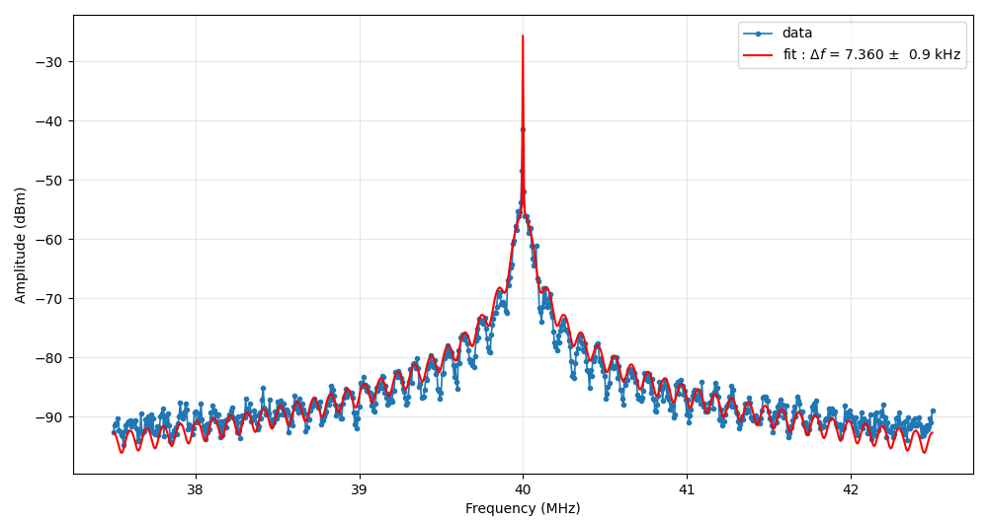
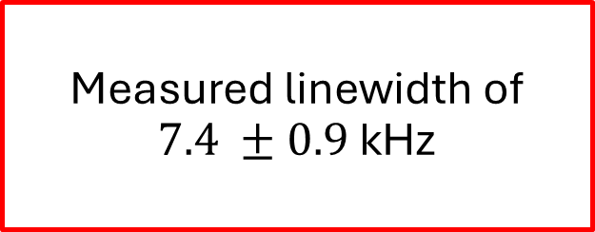
Laser source characterisation
Short Delay Self-Heterodyne interferometry
$$S\left(f\right) = \frac{P_{0}^{2}}{4π}\frac{Δf}{ Δf^{2}+{\left(f−f_{1}\right)}^{2}}\left(1−\exp\left(−2πτΔf\right)\left[\cos\left(2πτ(f−f_{1}\right)+Δf\frac{sin⁡(2πτ(f−f_{1})}{f−f1}\right]\right)+\frac{πP_{0}^{2}}{2}\exp\left(−2πτΔf\right)δ(f−f_{1})$$
Measured linewidth of $7.4 ±0.9$kHz

Slide 22
What needs to be built?
1
Test cavity
Laser 1
Phasemeter
$$\frac{Δν}{ν}∝\frac{ΔL}{L}$$
Reference cavity
Laser 2

Slide 23
What needs to be built?
1
Test cavity
2
Laser 1
Phasemeter
$$\frac{Δν}{ν}∝\frac{ΔL}{L}$$
Reference cavity
Laser 2

Slide 24
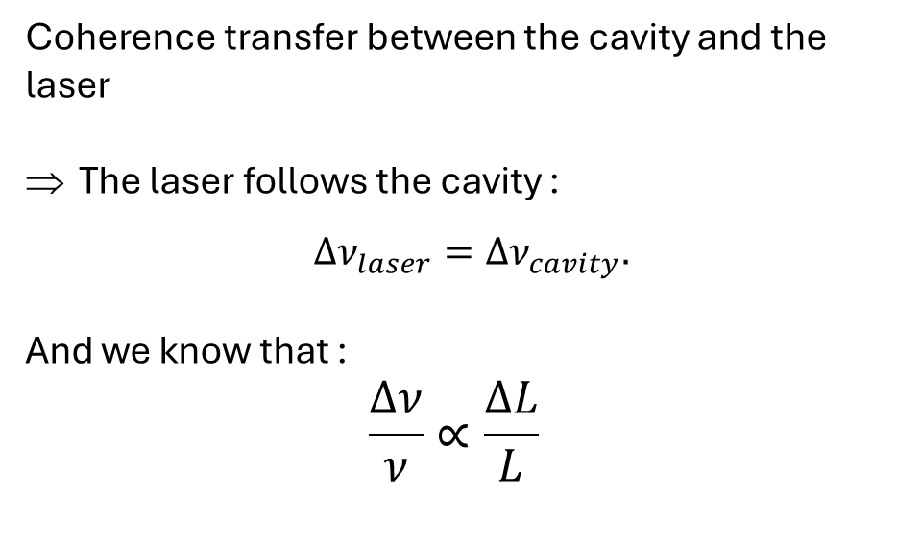
Locking to test cavity
= Pound-Drever-Hall (PDH) lock
Coherence transfer between the cavity and the laser
The laser follows the cavity :
$Δν_{laser}=Δν_{cavity}.$
And we know that :
$$\frac{Δν}{ν}∝\frac{ΔL}{L}$$

Slide 25
What needs to be built?
3
1
Test cavity
2
Laser 1
Phasemeter
$$\frac{Δν}{ν}∝\frac{ΔL}{L}$$
Reference cavity
Laser 2

Slide 26

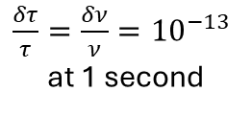

Heterodyne cavity tracking: our approach
Cavity 2
ECDL 2
OFC
Maser
Phasemeter
$$\frac{Δν}{ν}∝\frac{ΔL}{L}$$
$\frac{δτ}{τ}=\frac{δν}{ν}={10}^{−13}$ at 1 second
Cavity 1
ECDL 1
OFC = Optical Frequency Comb:
$$ν_{n}=ν_{0}+nν_{rep}$$

Slide 27
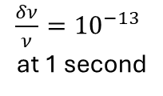
Heterodyne cavity tracking: our approach
Cavity 2
Test cavity
ECDL 2
OFC
Maser
Phasemeter
$$\frac{Δν}{ν}∝\frac{ΔL}{L}$$
Reference
$\frac{δν}{ν}={10}^{−13}$ at 1 second
Cavity 1
ECDL 1
Test cavity

Slide 28
Heterodyne cavity tracking: our approach
Cavity 2
Two advantages:
ECDL 2
Use of the most sensitive clocks
OFC
Maser
Reference
$\frac{δν}{ν}={10}^{−13}$ at 1 second
Knowledge of which cavity is moving
Cavity 1
ECDL 1
Test cavity
Test cavity

Slide 29
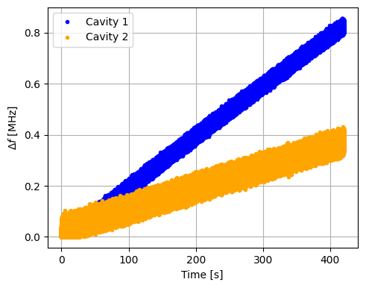
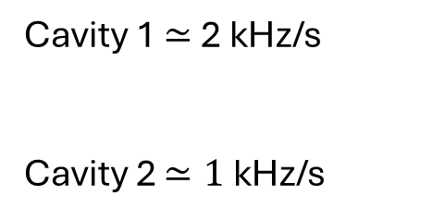
Heterodyne cavity tracking: our results
Evolution of the beating frequency variations over time
Cavity 1 $≃$ 2 kHz/s
Cavity 2 $≃1$ kHz/s

Slide 30
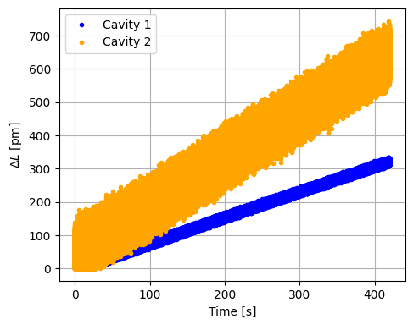
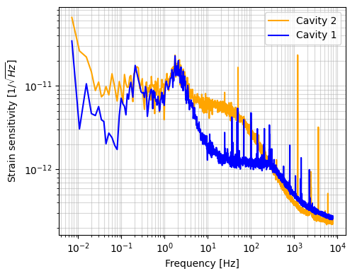


$L_{cavity1}=7.5$ cm
Heterodyne cavity tracking: our results
$L_{cavity2}=37.1$ cm
Evolution of the cavity length variations over time
$ΔL/L$ sensitivity of both cavities

Slide 31
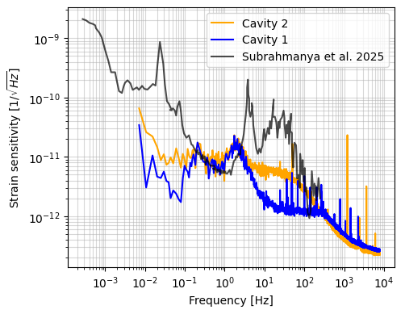
Heterodyne cavity tracking: comparison
$ΔL/L$ sensitivity comparison

Slide 32
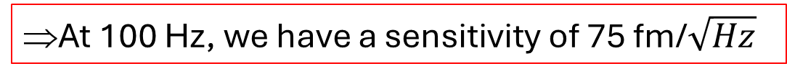
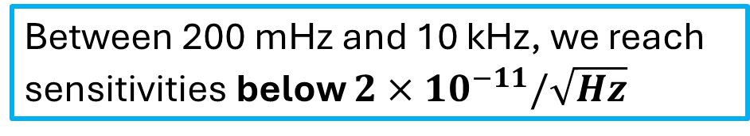
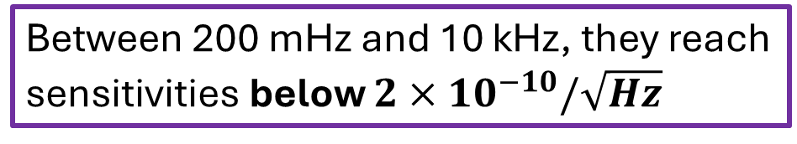
Heterodyne cavity tracking: comparison
$ΔL/L$ sensitivity comparison
Between 200 mHz and 10 kHz, they reach sensitivities below $2×{10}^{−10}/\sqrt{Hz}$
Between 200 mHz and 10 kHz, we reach sensitivities below $2×{10}^{−11}/\sqrt{Hz}$
At 100 Hz, we have a sensitivity of 75 fm/$\sqrt{Hz}$
Note: they have published on ArXiV a article with improved results in May 2026

Slide 33
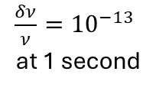
Perspectives
Cavity 2
ECDL 2
OFC
Maser
Phasemeter
$\frac{δν}{ν}={10}^{−13}$ at 1 second
Cavity 1
ECDL 1

Slide 34
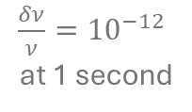
Perspectives
Stable laser with narrow linewidth : 160 Hz
Cavity 2
ECDL 2
OFC
Maser
Phasemeter
$\frac{δν}{ν}={10}^{−12}$ at 1 second
Cavity 1
ECDL 1

Slide 35
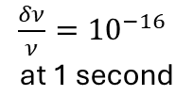
Perspectives
Frequency link with ORB
Cavity 2
ECDL 2
OFC
Strontium clock
Phasemeter
$\frac{δν}{ν}={10}^{−16}$ at 1 second
Cavity 1
ECDL 1

Slide 36
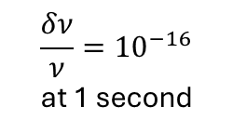
Perspectives
Development of other frequency standards
Cavity 2
ECDL 2
Ultra-stable cavity
$$\frac{δν}{ν}={10}^{−16}$$
at 1 second
Stable laser
Phasemeter
Cavity 1
ECDL 1

Slide 37
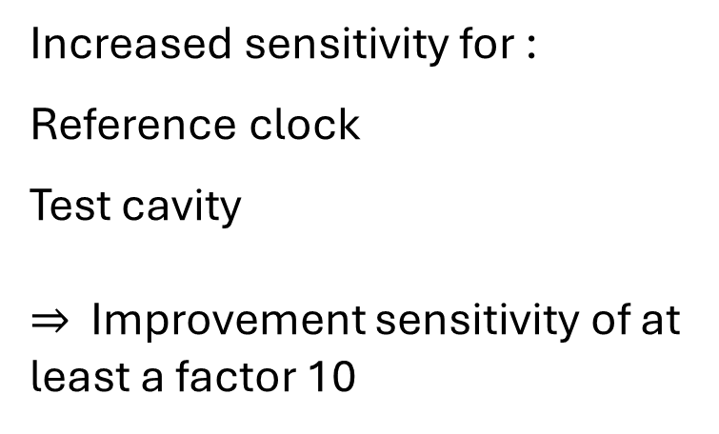
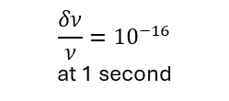
Perspectives
Increased sensitivity for :
Reference clock
Test cavity
$⇒$ Improvement sensitivity of at least a factor 10
Cavity 2
ECDL 2
OFC
Strontium clock
Phasemeter
$$\frac{δν}{ν}{=10}^{−16}$$
at 1 second
Cavity 1
Laser 1
Notes:
Maser à 5 10^-13 à 1 sec?

Slide 38
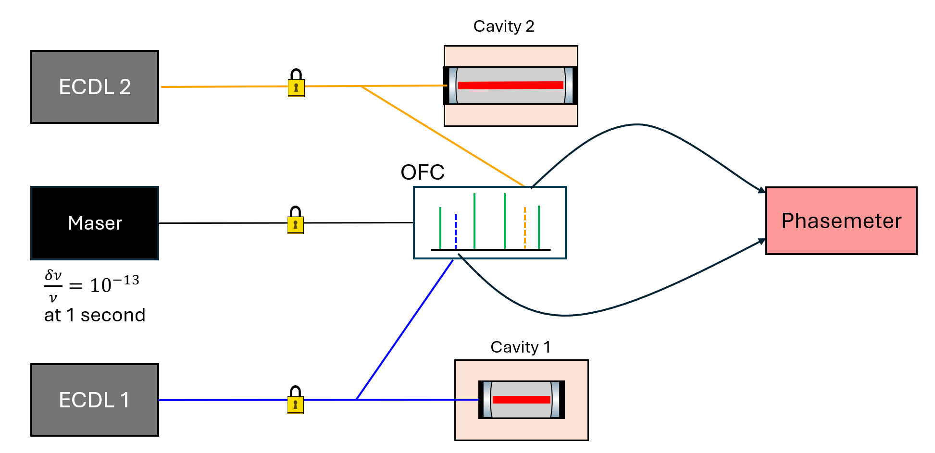
Thank you for your attention

Slide 39
Backups

Slide 40
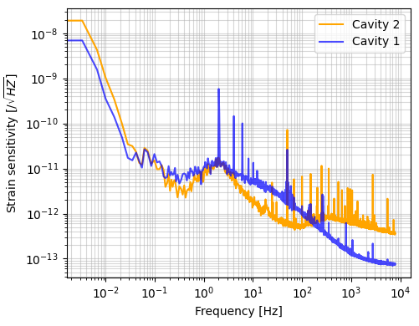
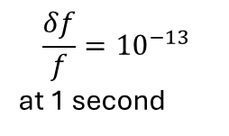
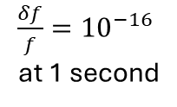
Perspectives
Frequency link with ORB
Cavity 2
Development of other frequency standards
ECDL 2
Ultra-stable cavity
OFC
$\frac{δf}{f}={10}^{−16}$ at 1 second
Phasemeter
$$\frac{δf}{f}={10}^{−13}$$
at 1 second
Hydrogen maser
Cavity 1
ECDL 1

Slide 41
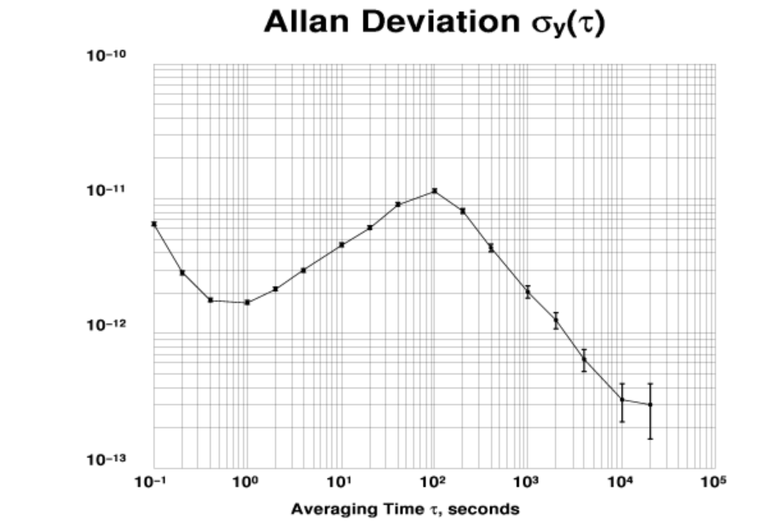

Frequency reference
GPS-disciplined oscillator
Frequency stability between
${10}^{−11}$ and ${10}^{−13}$ over 10 000 s

Slide 42

Linear drift removed

Slide 43
ECDL
ECDL center frequency at 193.548 THz (~1550 nm)
    Laser diode tunability : 1500 to 1630 nm
15 GHz mode hop free tuning range
Dr A.S. Bogomolov’s design

Slide 44






Pound-Drever-Hall locking
Pound-Drever-Hall locking
Generation of sidebands
Error signal
$$ω_{c}−ω_{m}$$
$$ω_{c}$$
$$ω_{c}+ω_{m}$$
Frequency modulation
$$\frac{ν_{m}}{Γ/2}≈8$$
Feedback loop
Notes:
/!\ stabilisation of the laser frequency in comparison to the cavity, not absolute
When you lock on a cavity you stabilise your laser frequency in regards of the cavity so if the cavity is moving then the laser moves as well

