Slide 1
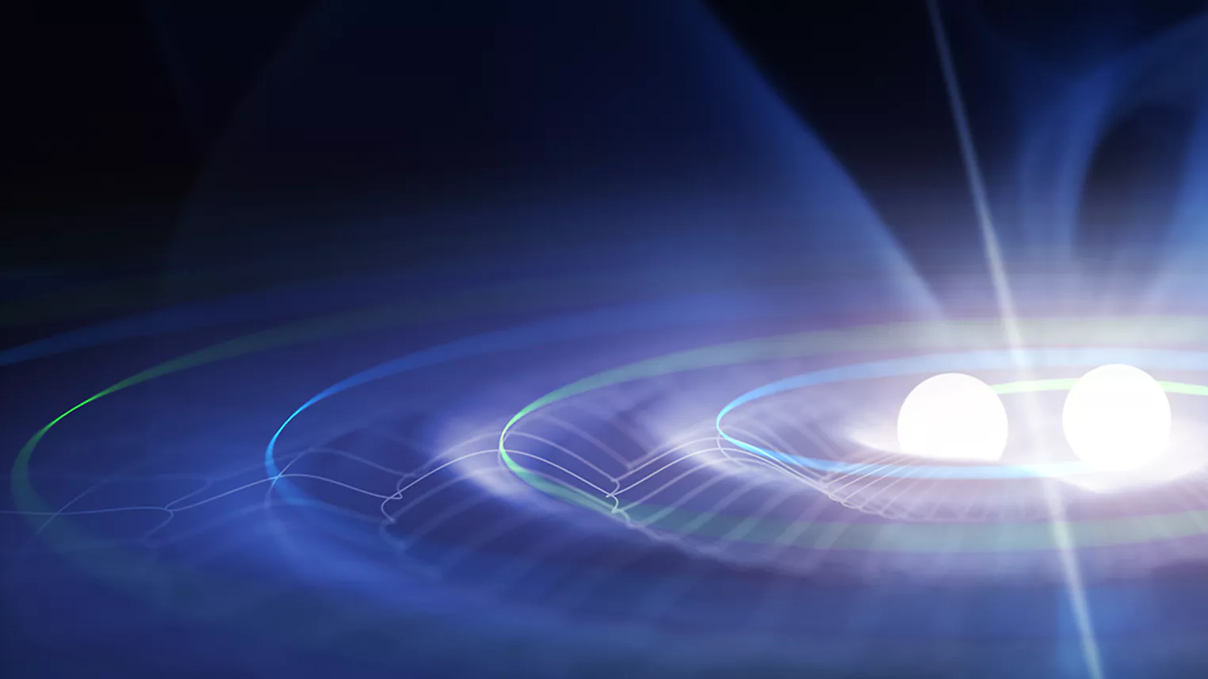


Scalable early-warning for binary neutron-star mergers in third-generation gravitational-wave detectors
Martin Gerini (martin.gerini@uclouvain.be)
Davide Gerosa (davide.gerosa@unimib.it)
Rodrigo Tenorio (rodrigo.tenorio.marquez@gmail.com)

Slide 2


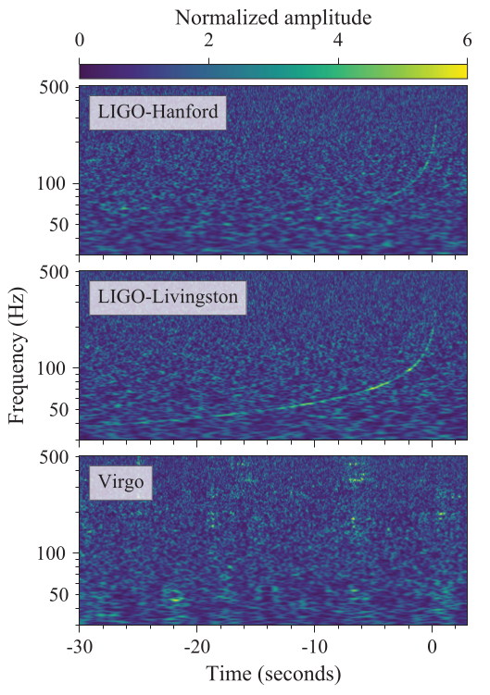
Introduction
GWs are ripples in the fabric of spacetime produced by accelerating masses (e.g, binary neutron star coalescence BNS)
Routinely detected by ground-based LIGO-Virgo-KAGRA (LVK) interferometers network
The observable duration is dictated by the interferometers’ minimum frequency limit
Current (LVK):
Einstein Telescope (ET):
several hours
Cosmic Explorer (CE)
What configuration? Triangle? Double L-shaped?
What minimum frequency? 2, 3, 4, 5 Hz?
https://doi.org/10.1103/PhysRevLett.119.161101
martin.gerini@uclouvain.be

Slide 3
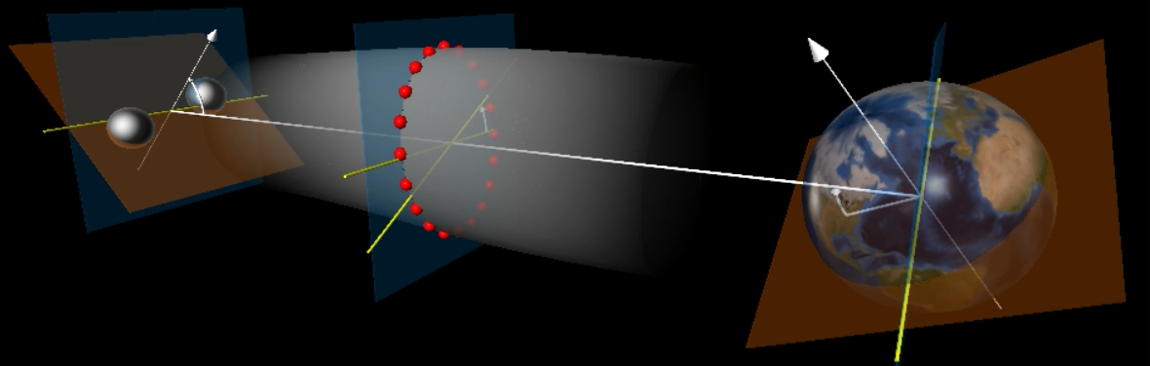


Signal Model
Masses
Sky location
Inclination
Spins
Polarization
Røemer delay + Doppler effect
Graham Woan - https://www.glowscript.org/#/user/grahamwoan/folder/Public/program/gwgw
Antenna response
+
Colored Gaussian
Noise (ET PSD)
GW polarizations
martin.gerini@uclouvain.be

Slide 4
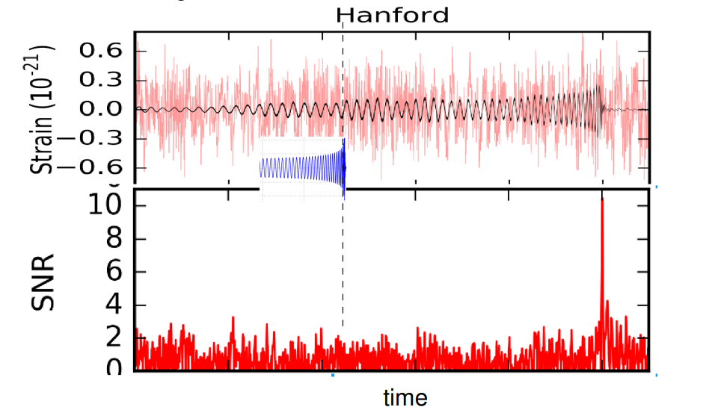

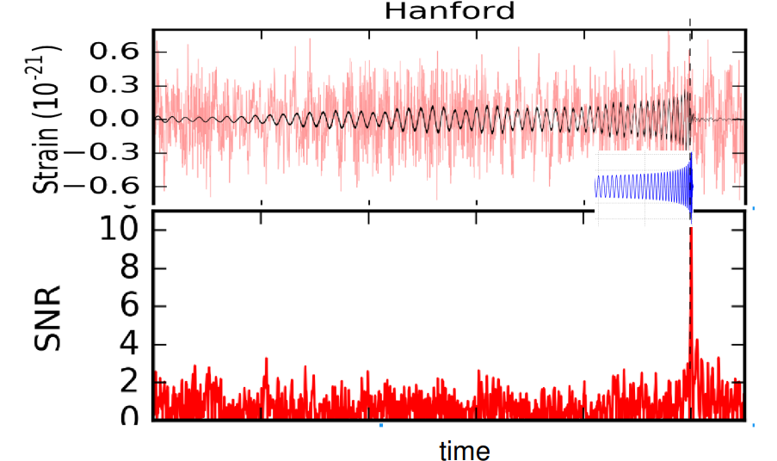


How to detect? Matched Filtering
https://www.kiss.caltech.edu/workshops/LISA/presentations/Babak.pdf
This is the true waveform (a template)
But in a real application we don’t know what the true parameters are!
We need a TEMPLATE BANK
For short signals,
requires sampling from the reduced parameter space
martin.gerini@uclouvain.be

Slide 5

The problem
Doppler shifts
Hours-long signals
Antenna Pattern
modulations
Full parameter space
Computing time $>$ Event time
EARLY WARNING
MULTI-MESSENGER ASTRONOMY
martin.gerini@uclouvain.be

Slide 6

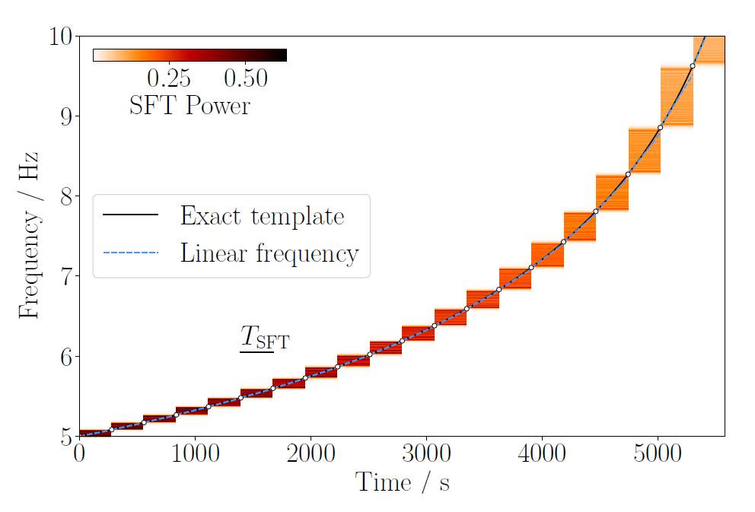





SFT-based Matched Filtering
The Matched Filtering statistic… a bit slow
Tenorio & Gerosa, arXiv:2502.11823
GPU-acceleration
Still requires to sample from the full parameter space!
martin.gerini@uclouvain.be

Slide 7
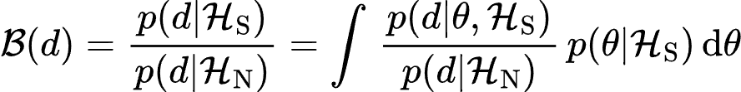
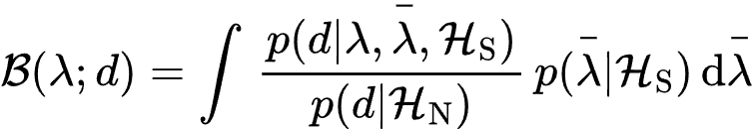




Amortized Inference
Computationally
intractable at inference
To reduce this computational burden, we propose marginalizing over the extrinsic parameters using deep learning
Binary Cross-Entropy (BCE) loss computes this integral
martin.gerini@uclouvain.be

Slide 8
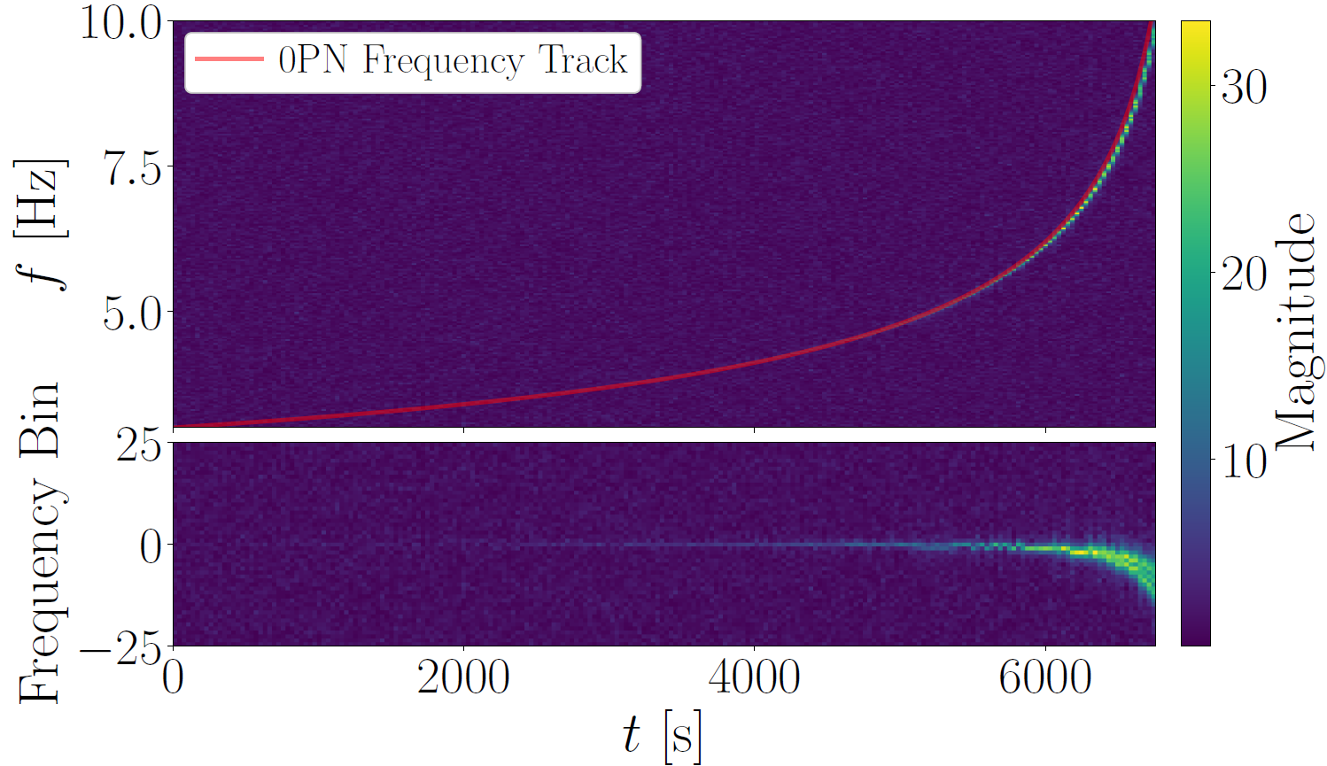

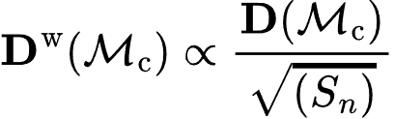
CNN – training step
Sample a batch of parameters
Generate a matched pair of samples
Signal Hypothesis
Crop the SFT data around
the approximated frequency track
(0PN approximation)
Re / Im decomposition
Noise Hypothesis
Crop the SFT data using the same frequency track and same parameters of the signal sample
Generate an indipendent realization of colored noise
Whitening
martin.gerini@uclouvain.be

Slide 9
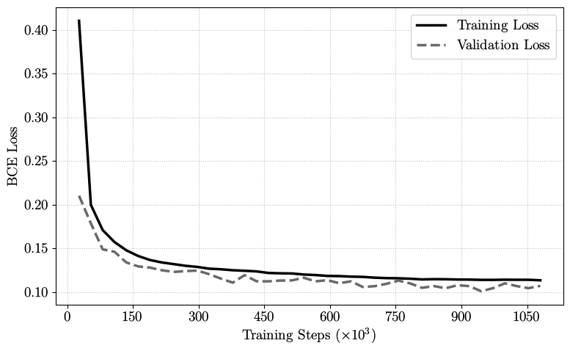


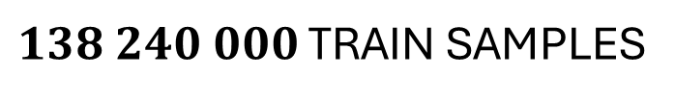
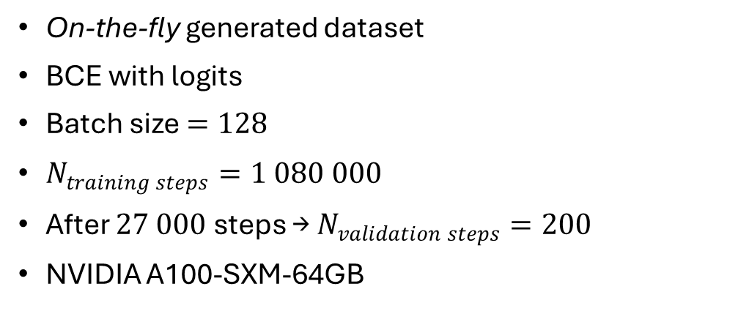

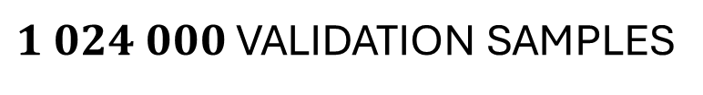
CNN – training
On-the-fly generated dataset
BCE with logits
Batch size $=128$
$N_{training steps}=1 080 000$
After $27 000$ steps → $N_{validation steps}=200$
NVIDIA A100-SXM-64GB
$138 240 000$ TRAIN SAMPLES
$1 024 000$ VALIDATION SAMPLES
$$t_{train}≈24 hrs$$
martin.gerini@uclouvain.be

Slide 10





CNN – inference
→ Template bank generation
1D parameter space!
Track computation →
Tensor construction →
Whitening
→ For each template
CNN
martin.gerini@uclouvain.be

Slide 11
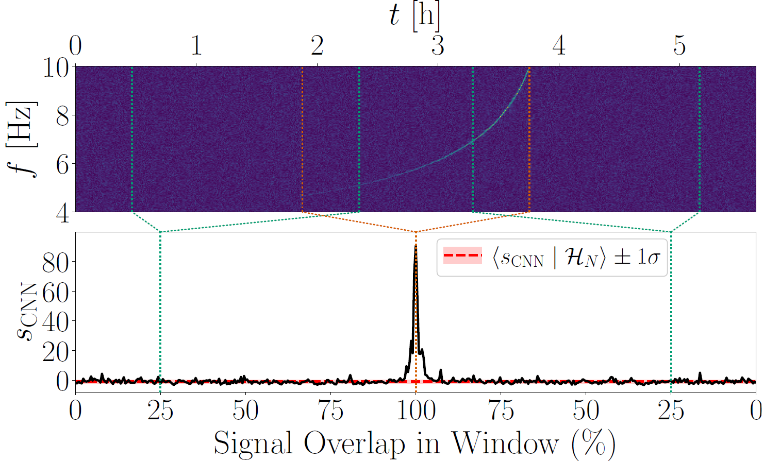
CNN – inference (rolling window test)
martin.gerini@uclouvain.be

Slide 12









Simulation setup
13 distance steps
Source Distance
Simulation grid
Bank Size
In each iteration:
Uniform population
Sample generation
Search
Output
Signal
Noise
+ colored gaussian noise realization
Indipendent colored gaussian noise realization
Generate random template bank
martin.gerini@uclouvain.be

Slide 13

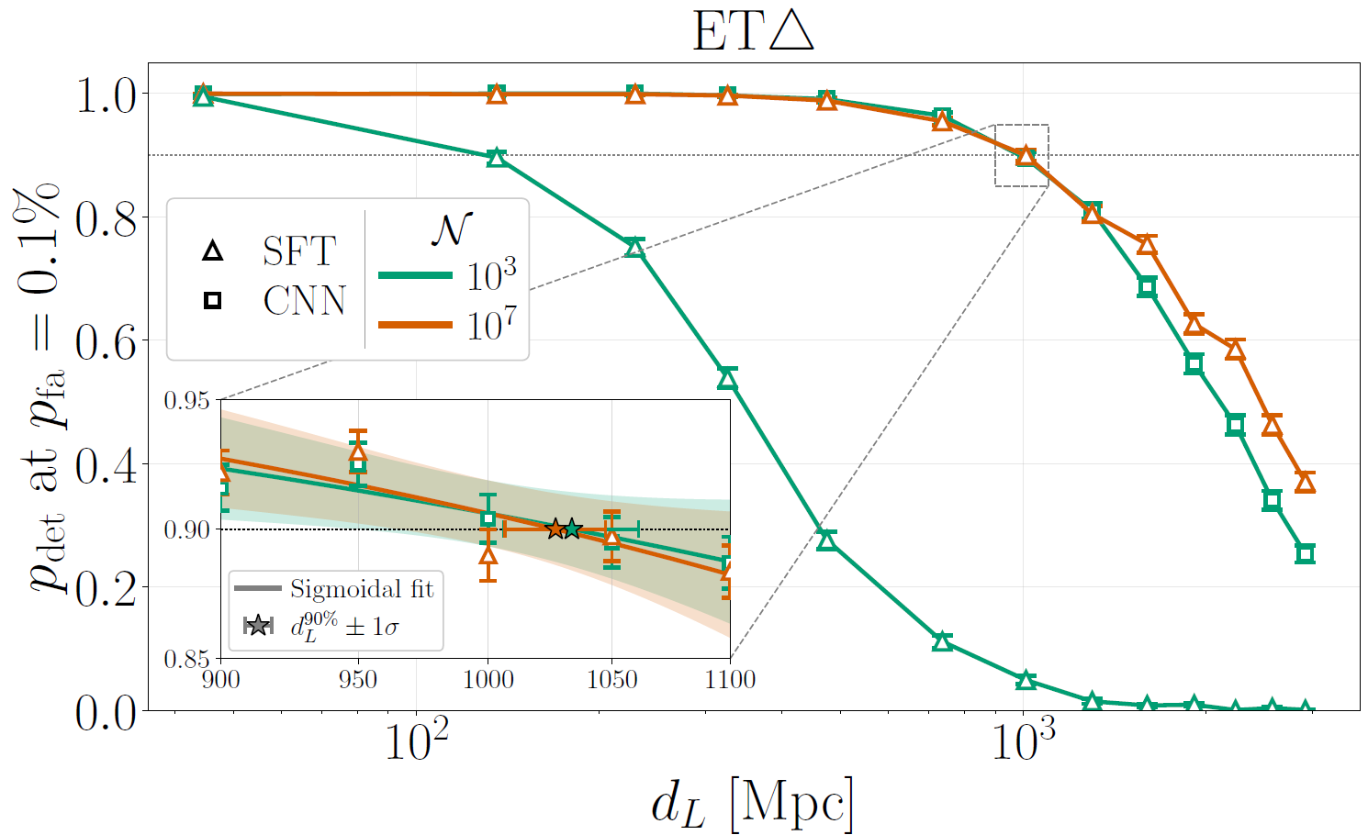
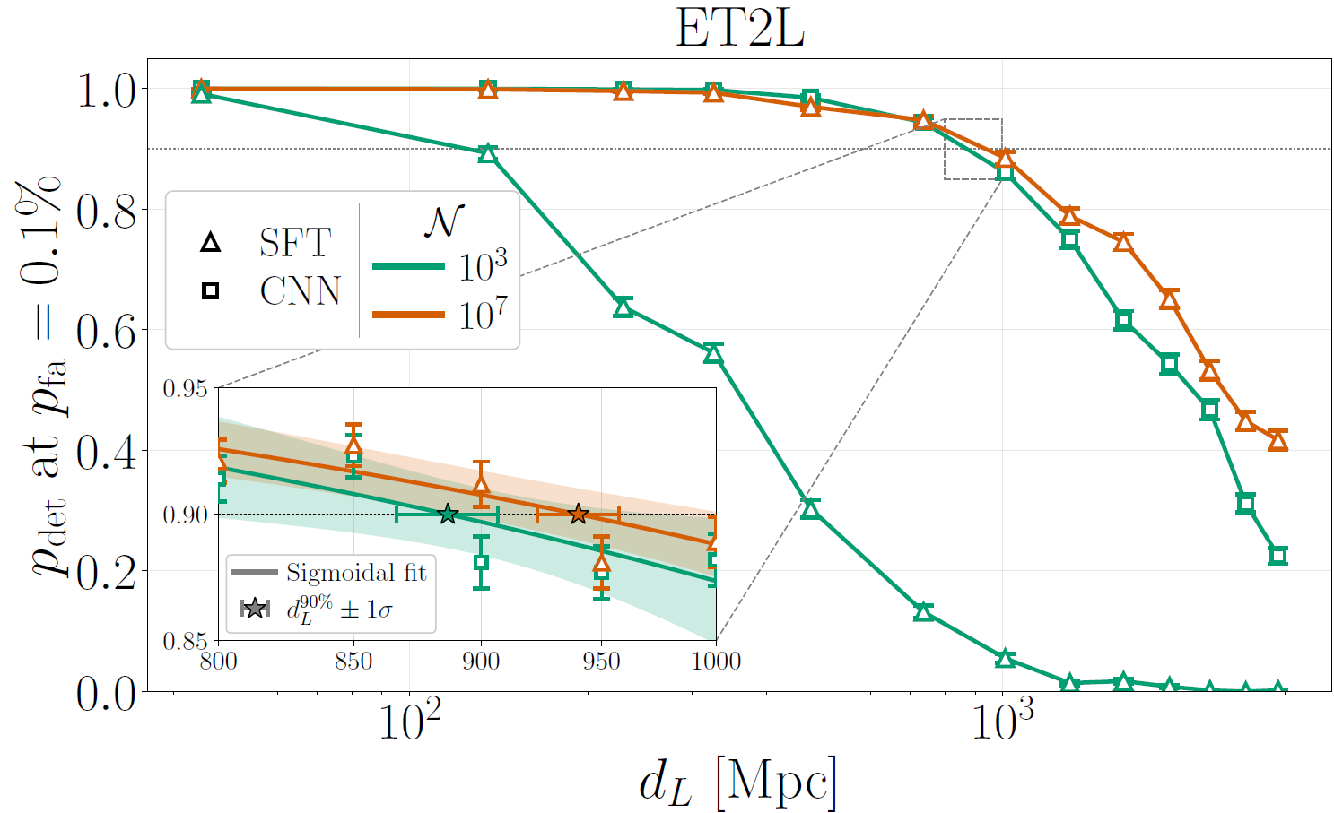
Results ( )
martin.gerini@uclouvain.be

Slide 14
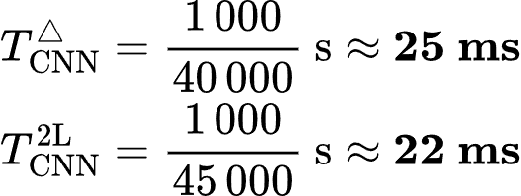
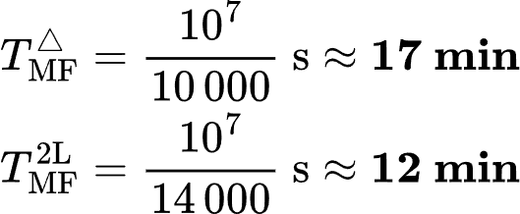
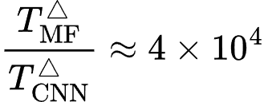
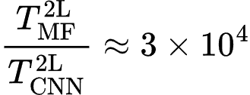
Results – Execution time
CNN
SFT Matched Filtering
martin.gerini@uclouvain.be

Slide 15
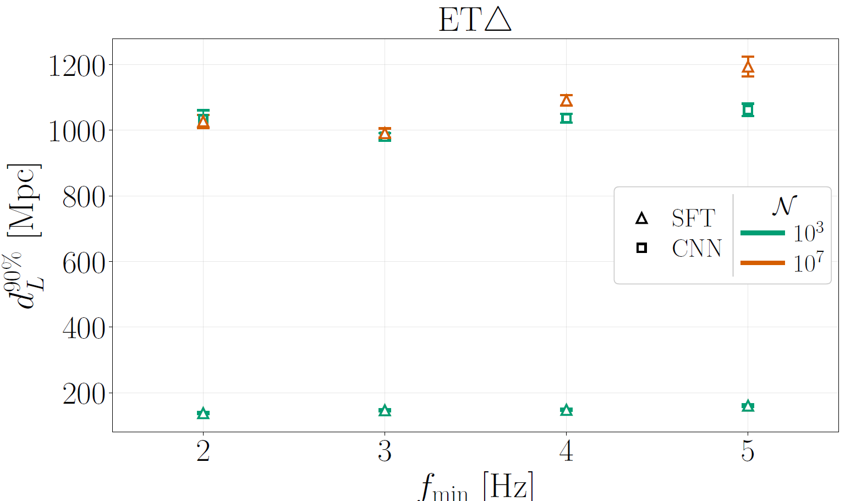
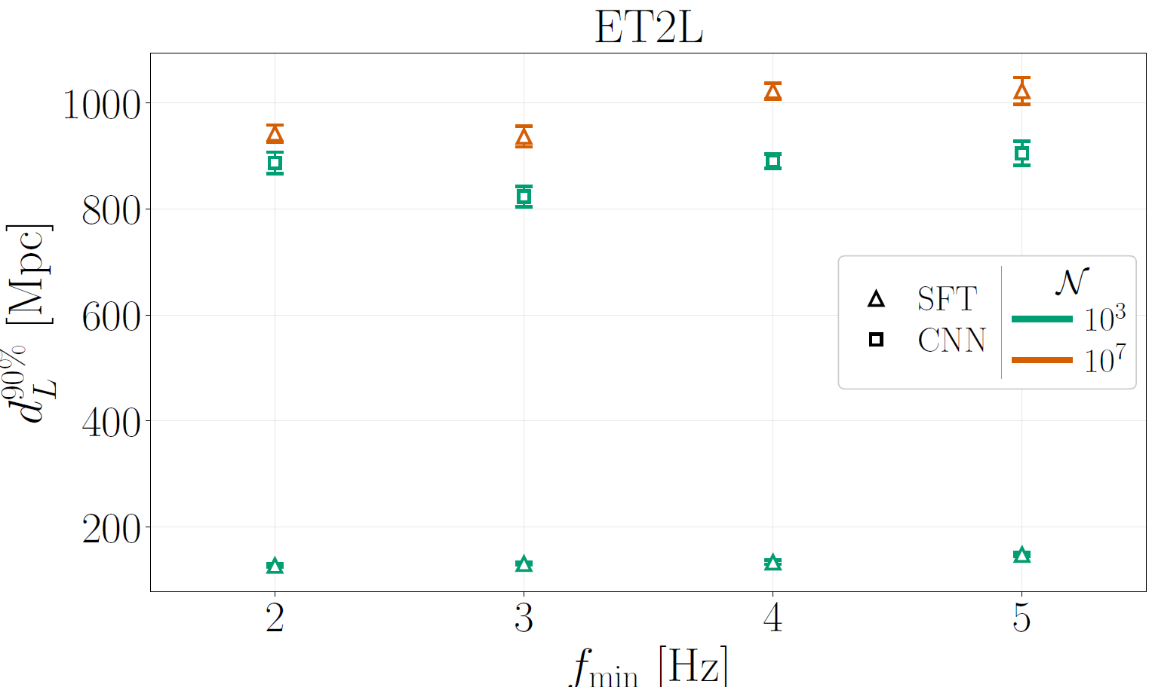

Results – different signal lenghts
martin.gerini@uclouvain.be

Slide 16
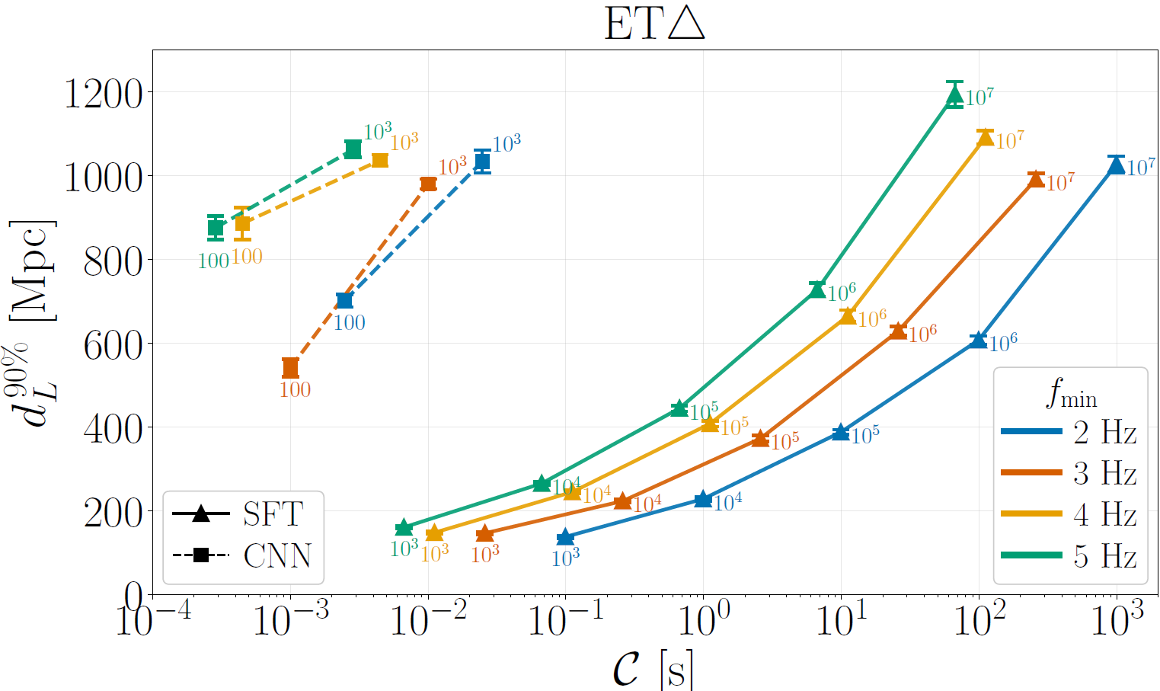
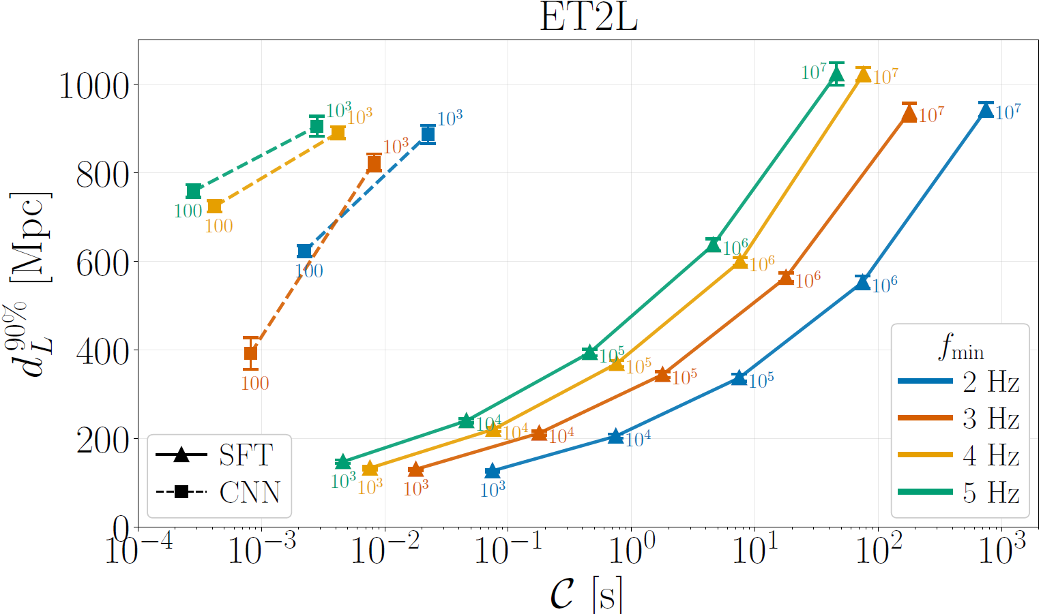


Results – different signal lenghts
martin.gerini@uclouvain.be

Slide 17
Conclusions
GPU-optimized SFT Matched Filtering
Optimal sensitivity
But high computational costs
CNN
Sensitivity comparable to SFT Matched FIltering
Efficiency gain of over four orders of magnitude
Low-latency triggering of long-duration GW signals
What’s next?
- Overlapping signals
- Skylocation with flowmatching exploiting the chirpmass estimation of this detection pipeline
martin.gerini@uclouvain.be

Slide 18
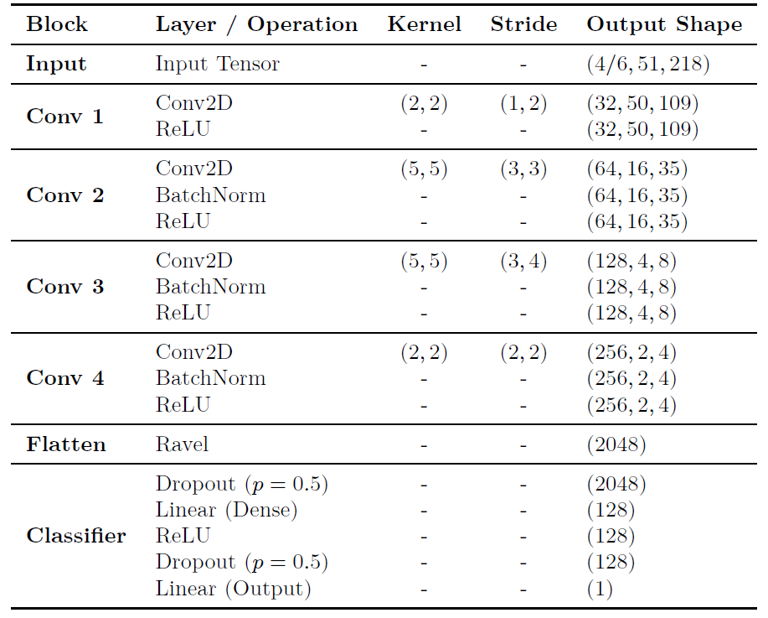

Slide 19
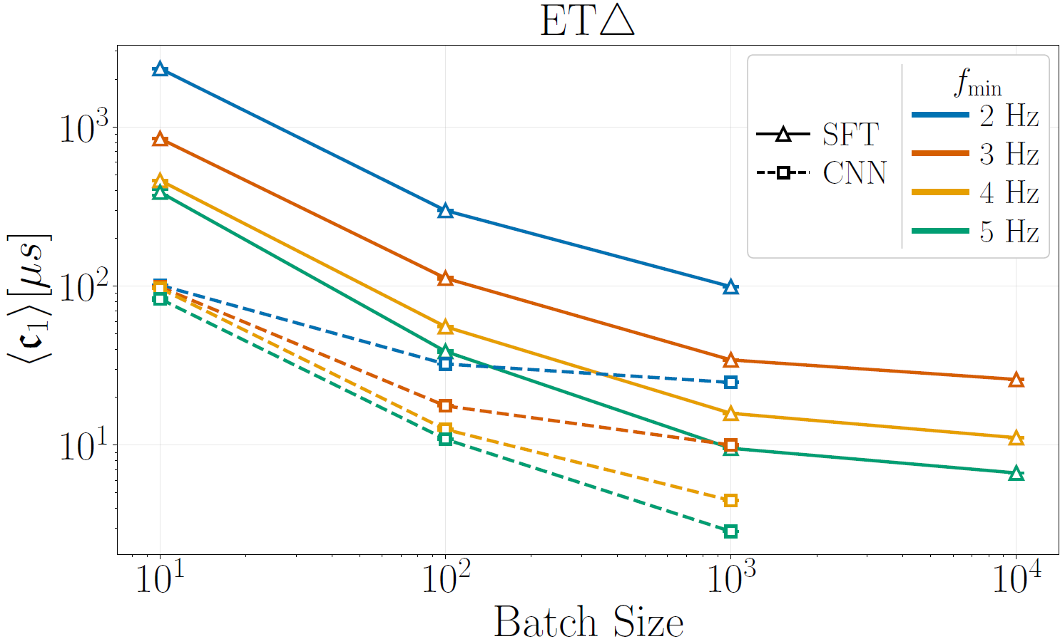
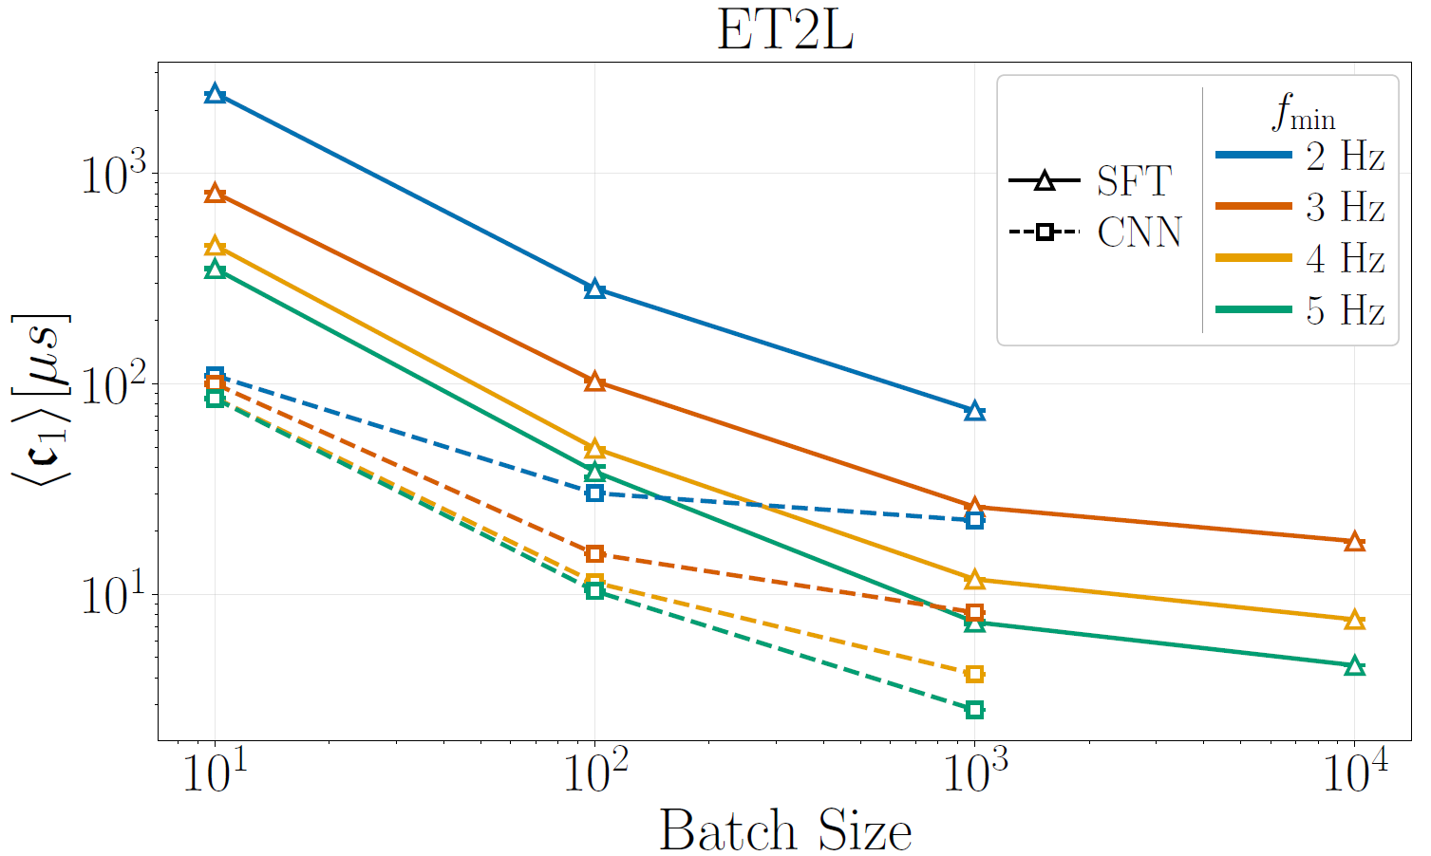

Slide 20
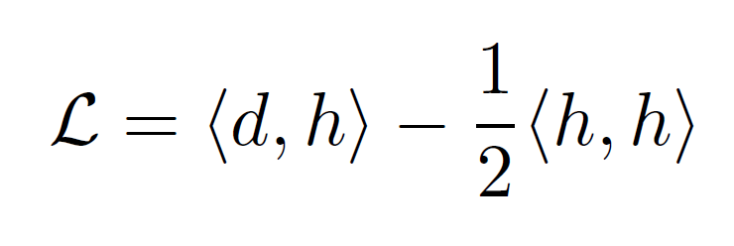
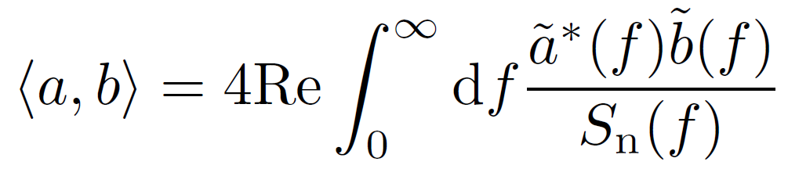
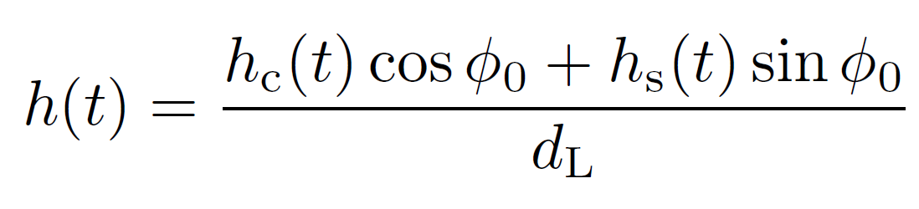
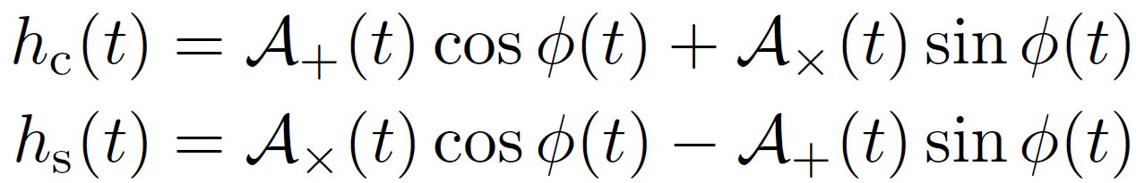
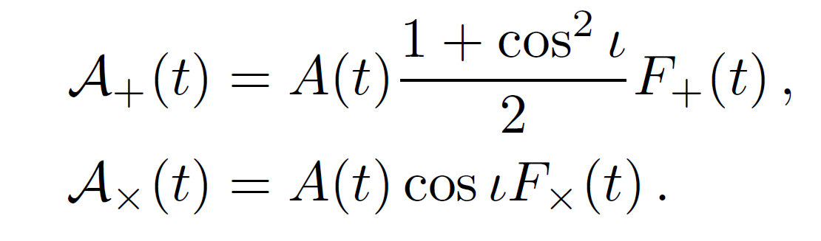
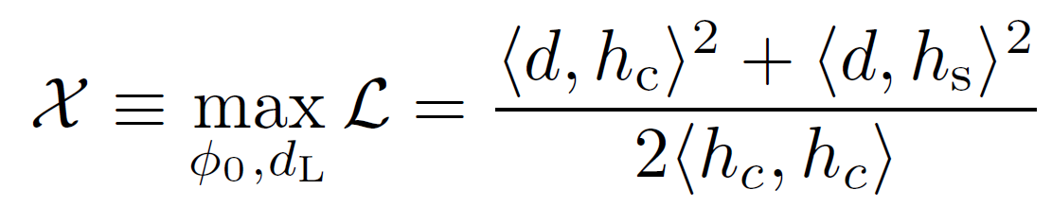
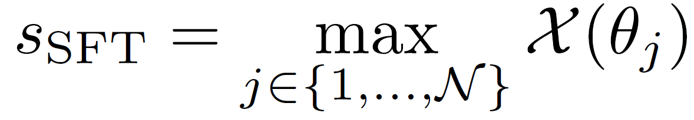
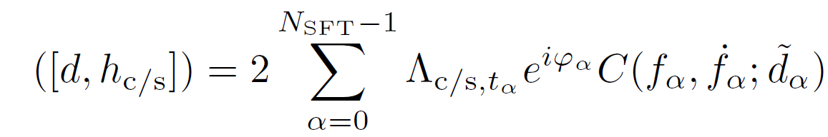
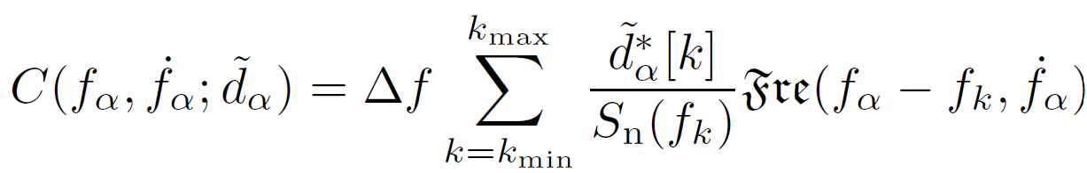
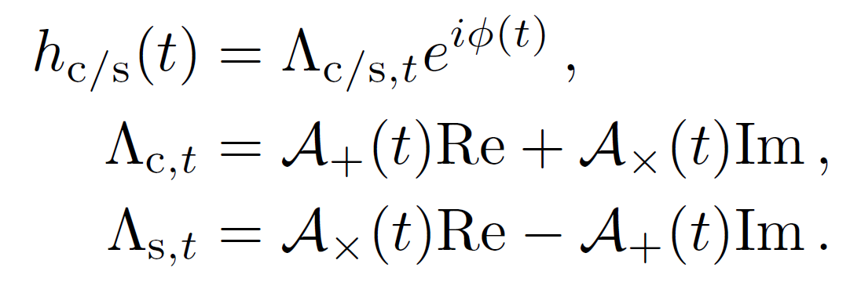
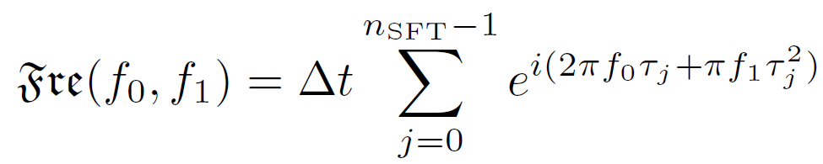
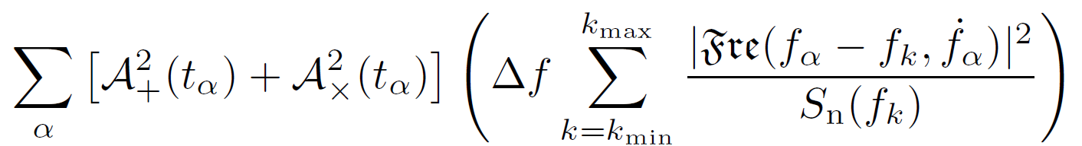
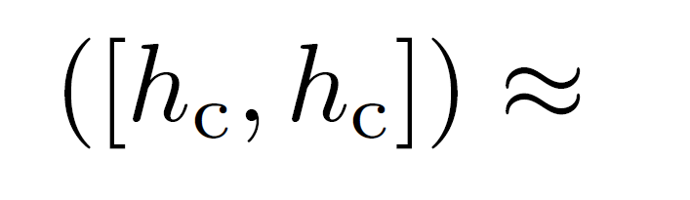

Slide 21


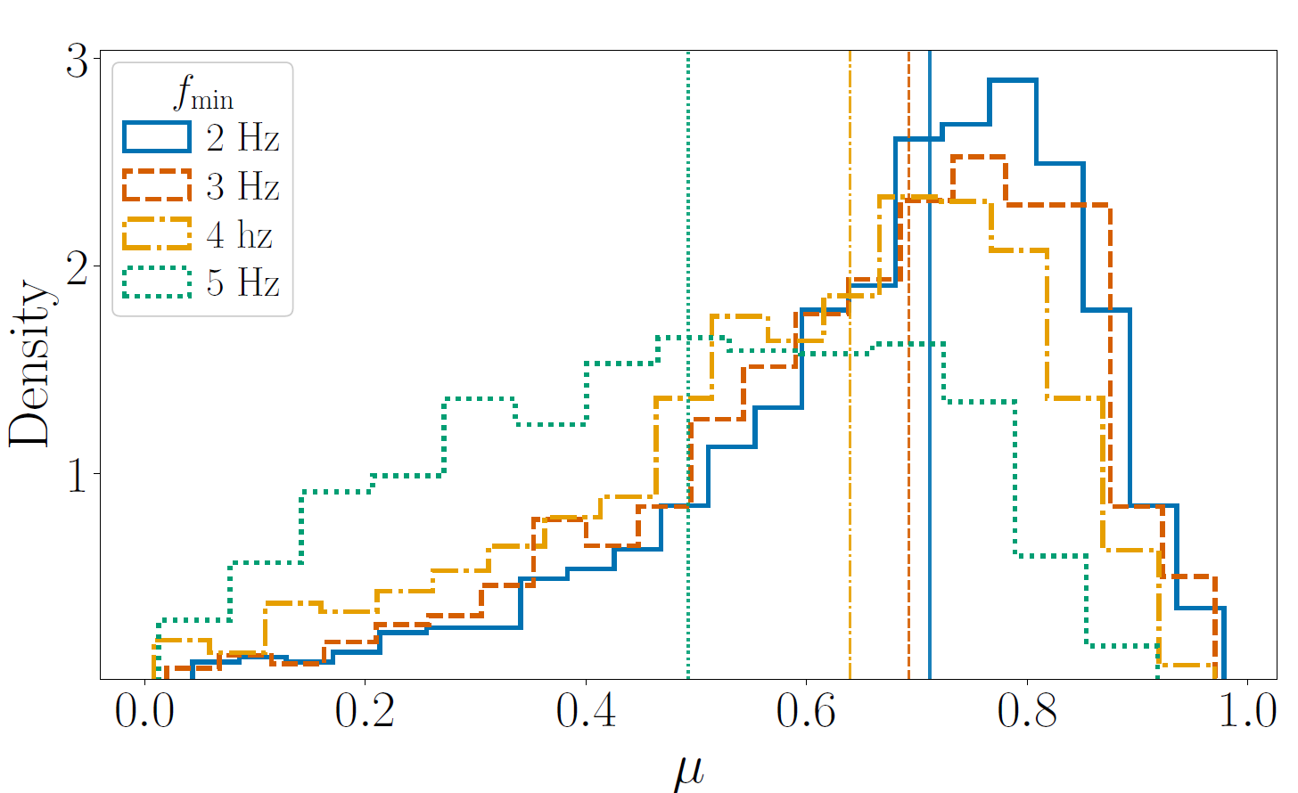
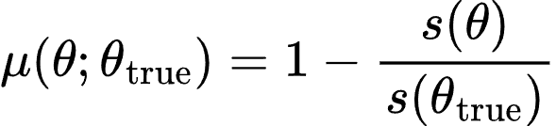
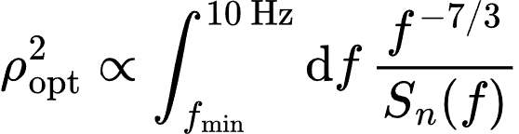




Lowering from 5 Hz to 2 Hz yelds an increase in of
Median mismatch increases from
to
The expected detection statistic decreases to of its original value

