Slide 1
Cryogenic Interferometric Inertial Sensors for next-generation Gravitational-Wave Detectors
Morgane Zeoli, T. Giordano, B. Thibaut, M. Teloi, L. Jacques,
G. Bruno, J. van Heijningen, C. Collette
Belgian-Dutch Gravitational-Wave Meeting 2026 – Louvain-la-Neuve

Slide 2

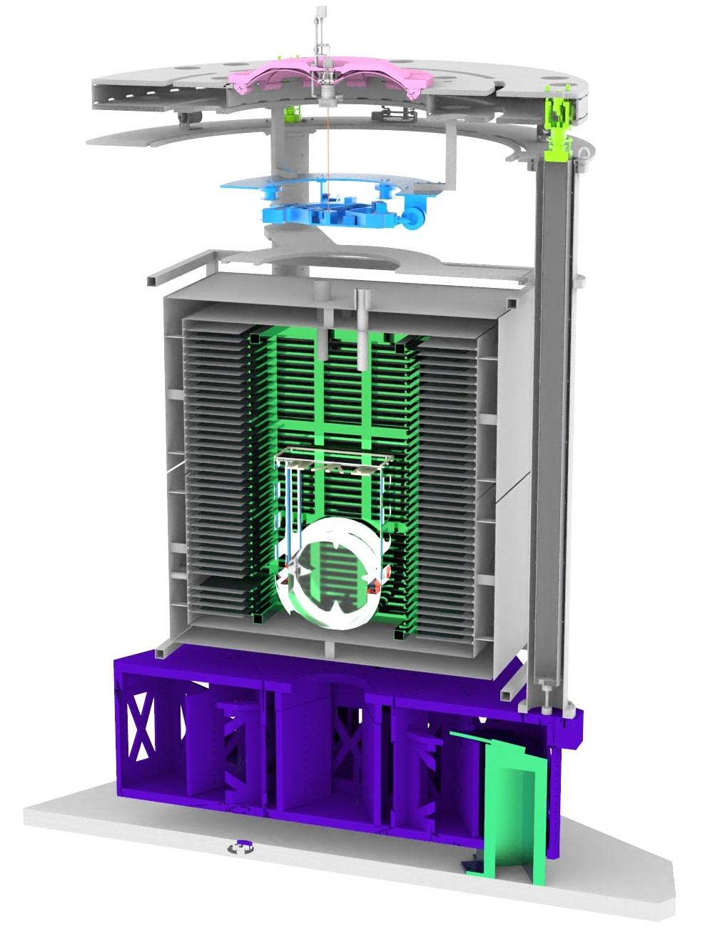
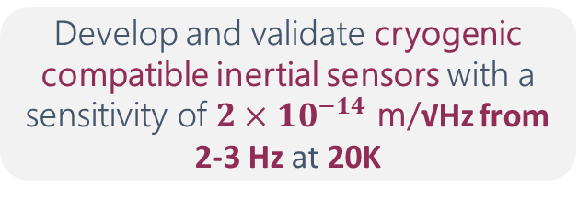
Goal and requirements
Monitor residual motion at the last isolation stage, in the cryostat
E-TEST is a prototype suspension, combining passive and active isolation techniques, of a 100 kg silicon mirror cooled down radiatively to 25 K in a suspended cryostat
Develop and validate cryogenic compatible inertial sensors with a sensitivity of $2×{10}^{−14}$ m/√Hz from 2-3 Hz at 20K
Typical ground motion
Target residual motion at E-TEST mirror level
Commercial sensor (not vacuum nor cryo compatible)
PML legacy (not cryo compatible)
VINS (Binlei Ding): PhD thesis
EVINS (Anthony Amorosi): G2502591
Objective resolution for the cryogenic sensor

Slide 3
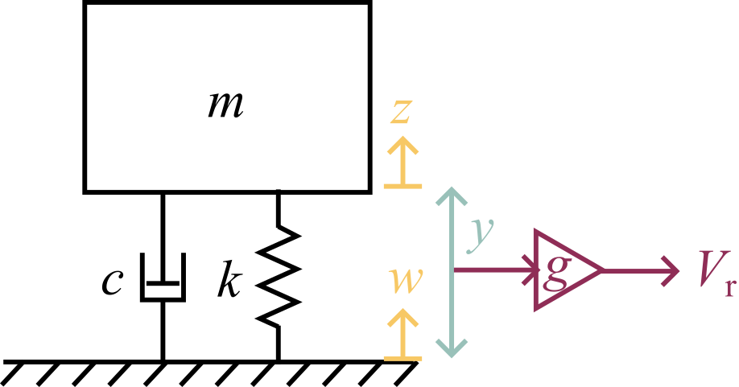
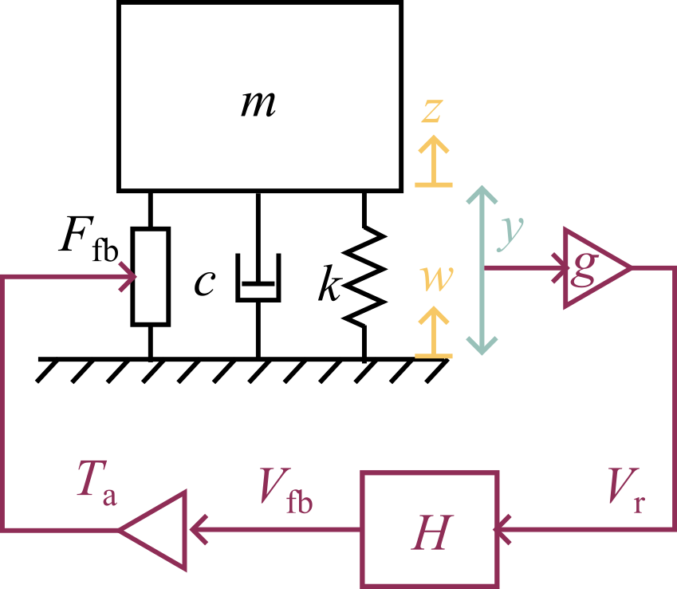
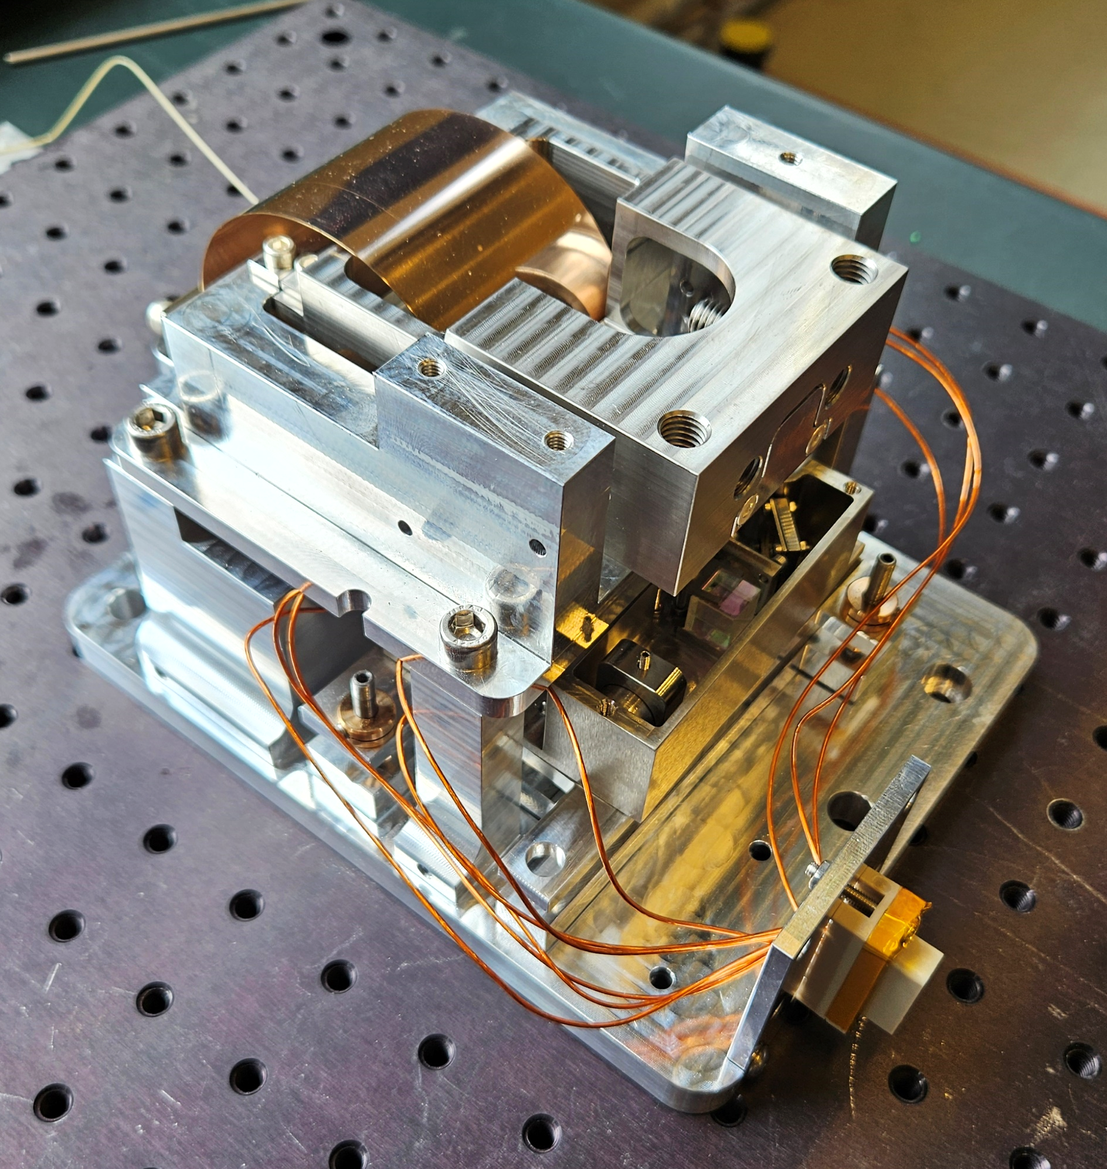
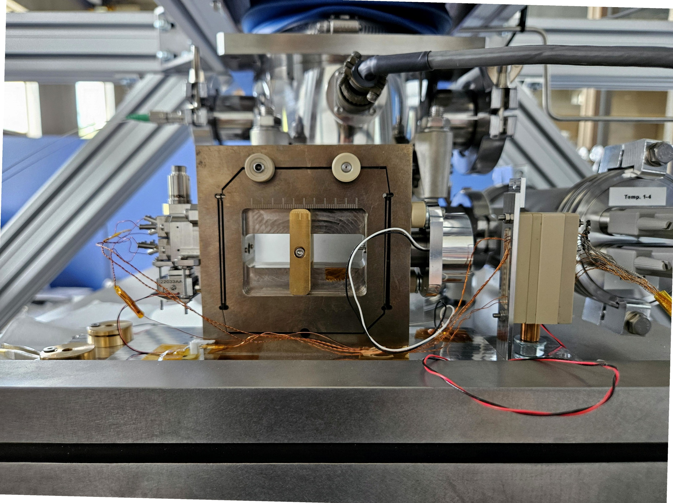
High-resolution cryogenic inertial sensor suite combining passive and active architectures
Vertical cryogenic inertial sensor
Horizontal cryogenic inertial sensor
Passive sensing
Active sensing
Not cryogenic
Leaf-spring suspension (BeCu)
Frame
Double-clamped blade hinge (BeCu)
Monolithically suspended Ti₆Al₄V mass
Inertial mass
Corner cube
Interferometric readout
Homodyne quadrature interferometric readout
Amorosi 2025
Current injector
Voice-coil actuator
Cryo-V
Cryo-H

Slide 4
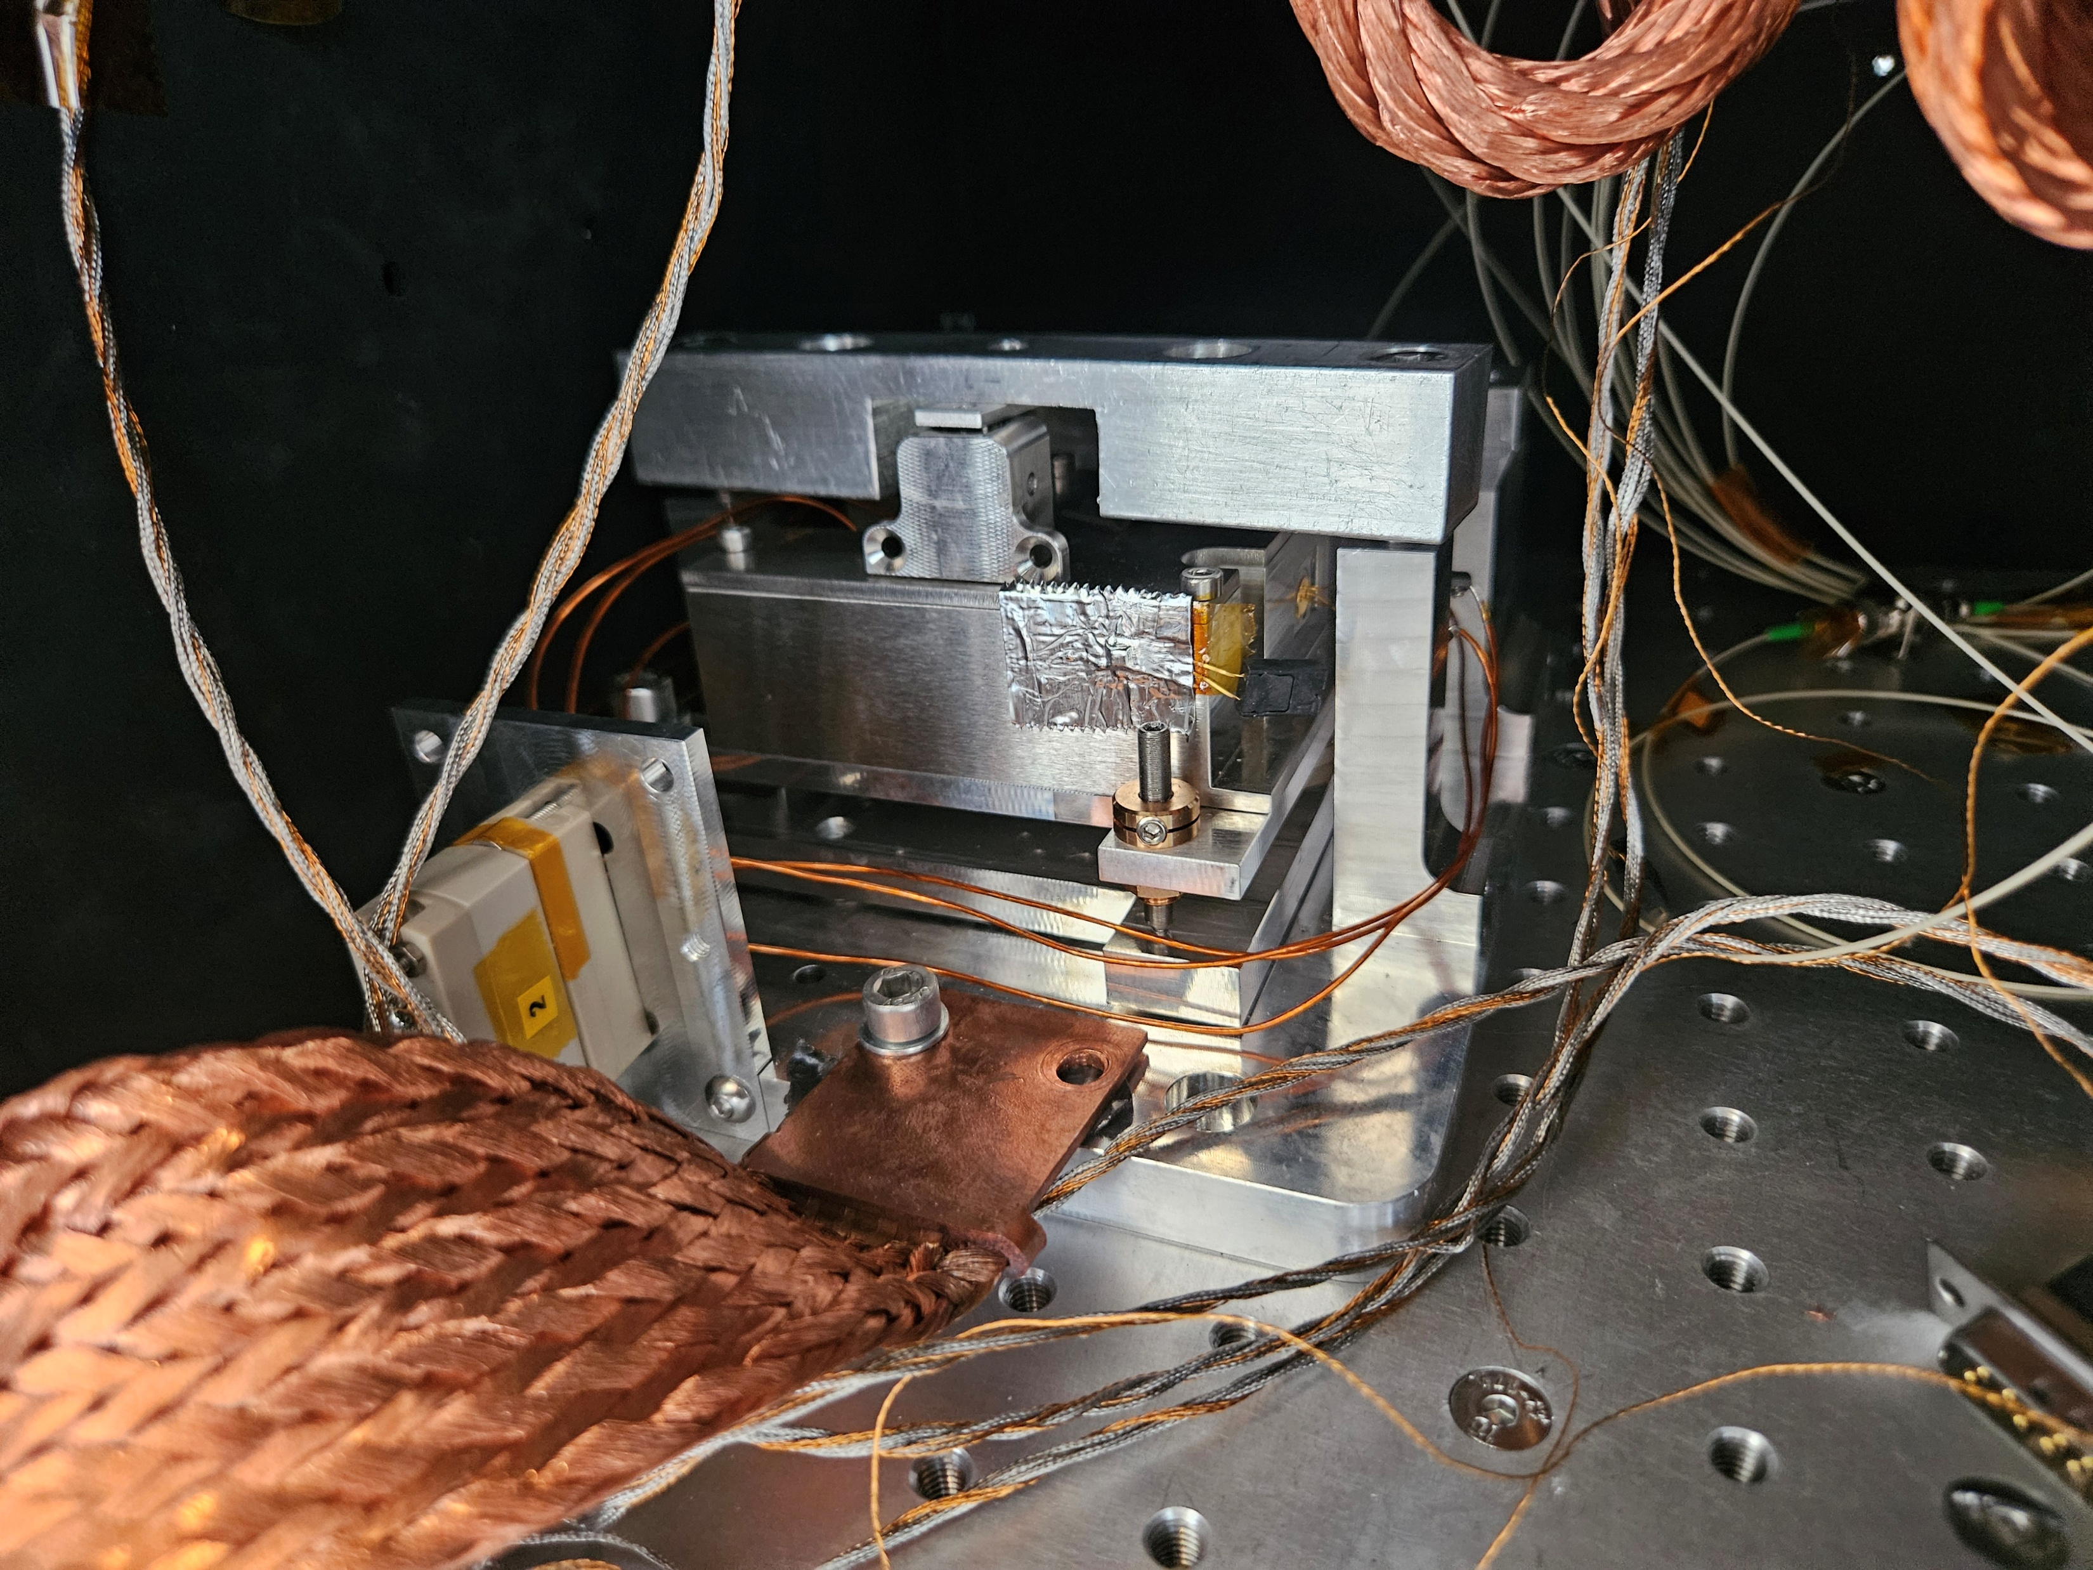
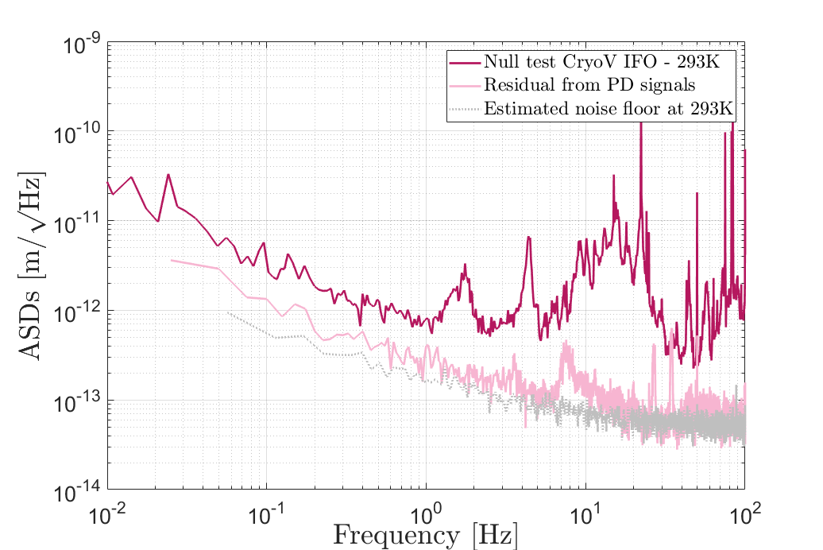
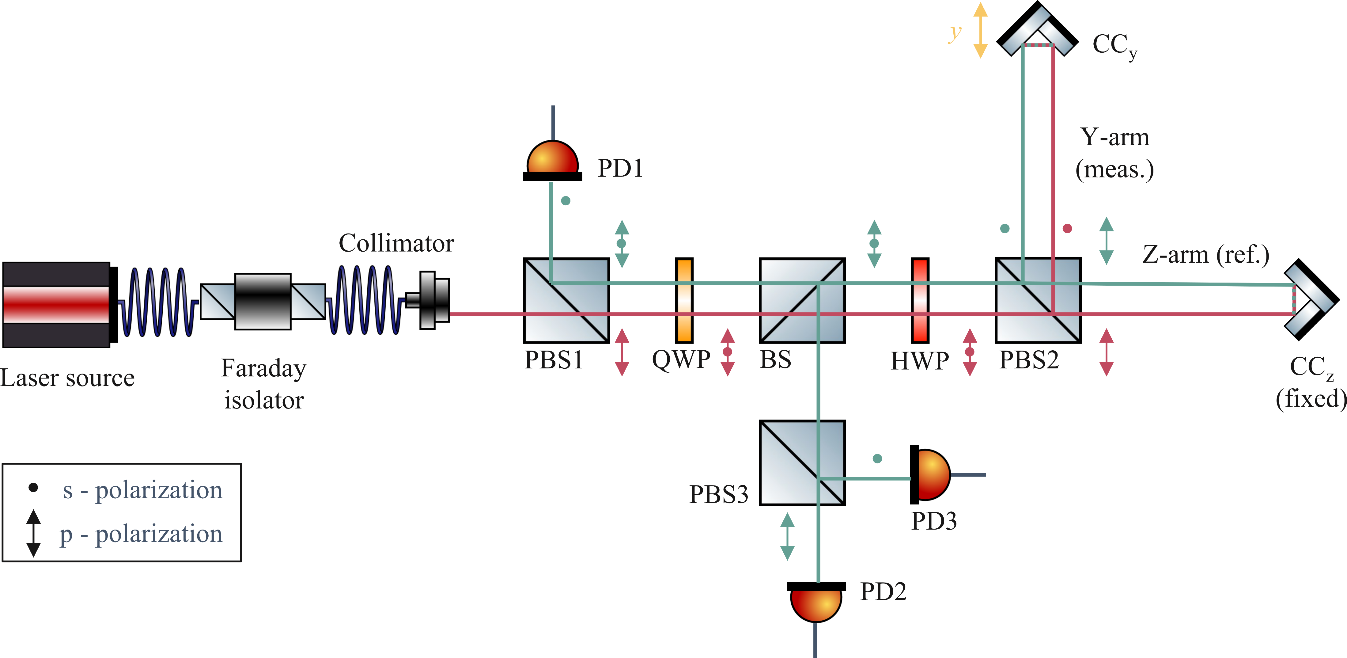
Homodyne quadrature interferometric readout sub pm/√Hz resolution from 0.1Hz at 293K
Null measurement: the corner cube is clamped to the interferometer to cancel relative motion between the measuring and reference arm
Homodyne quadrature interferometer
Remove the remaining vibration by removing the coherent signals
Limited by dark current noise
Fixed!
Shot noise: ~50 fm/√Hz

Slide 5
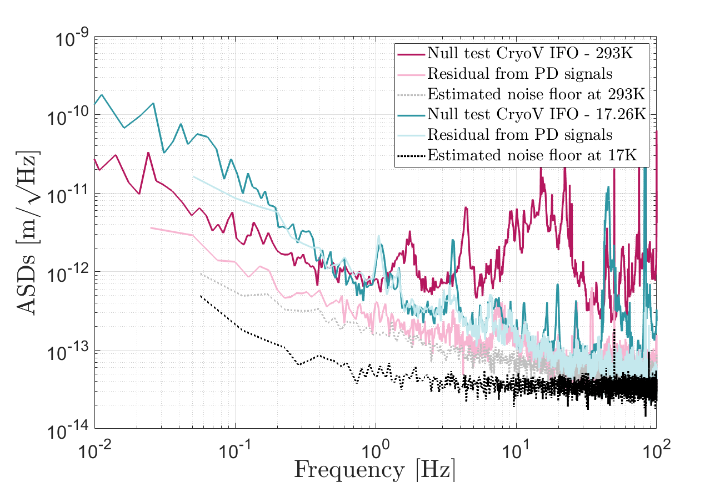
Homodyne quadrature interferometric readout sub pm/√Hz resolution from 0.4Hz at 17K
Alignment quality: less than 10% of relative fringe visibility loss from 293K to 17K
Can be used as a standalone cryogenic sub-pm/√Hz sensitivity relative displacement sensor
Thermal-induced drift
Electronics limited
Shot noise: ~50 fm/√Hz

Slide 6
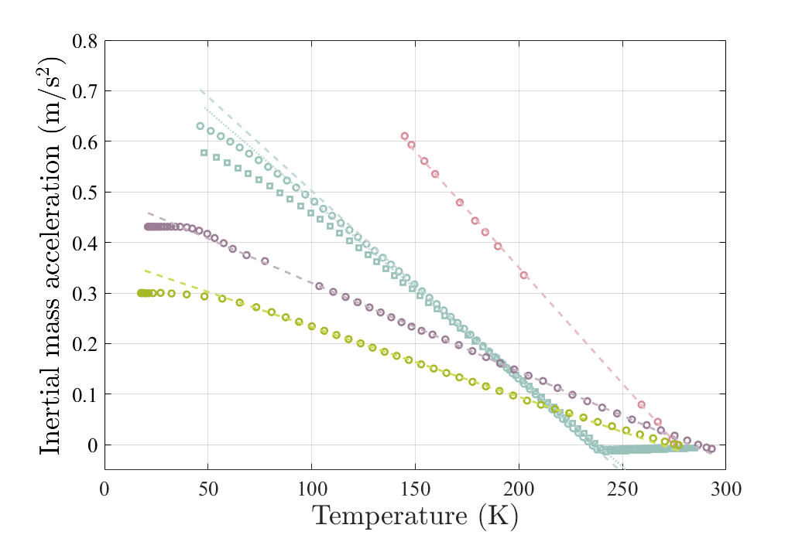
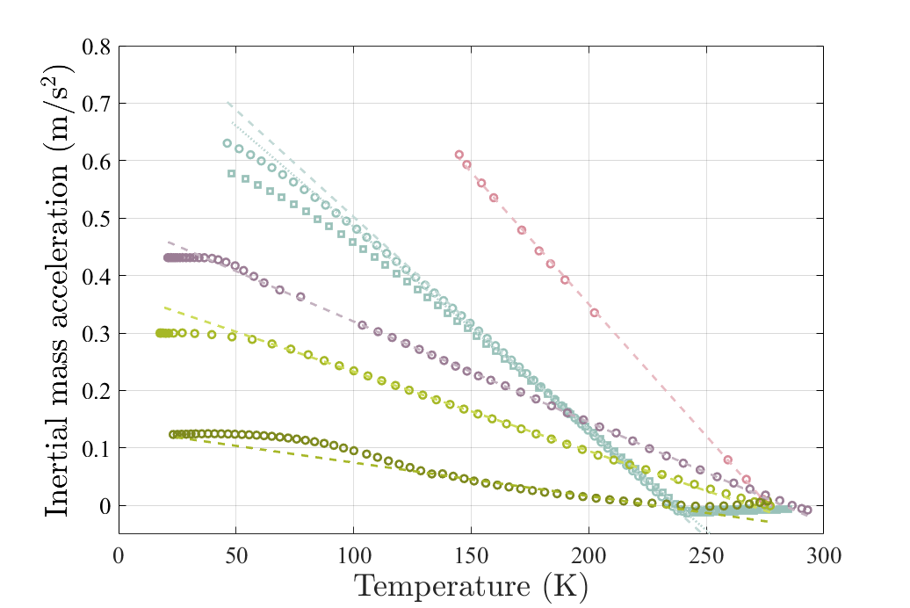
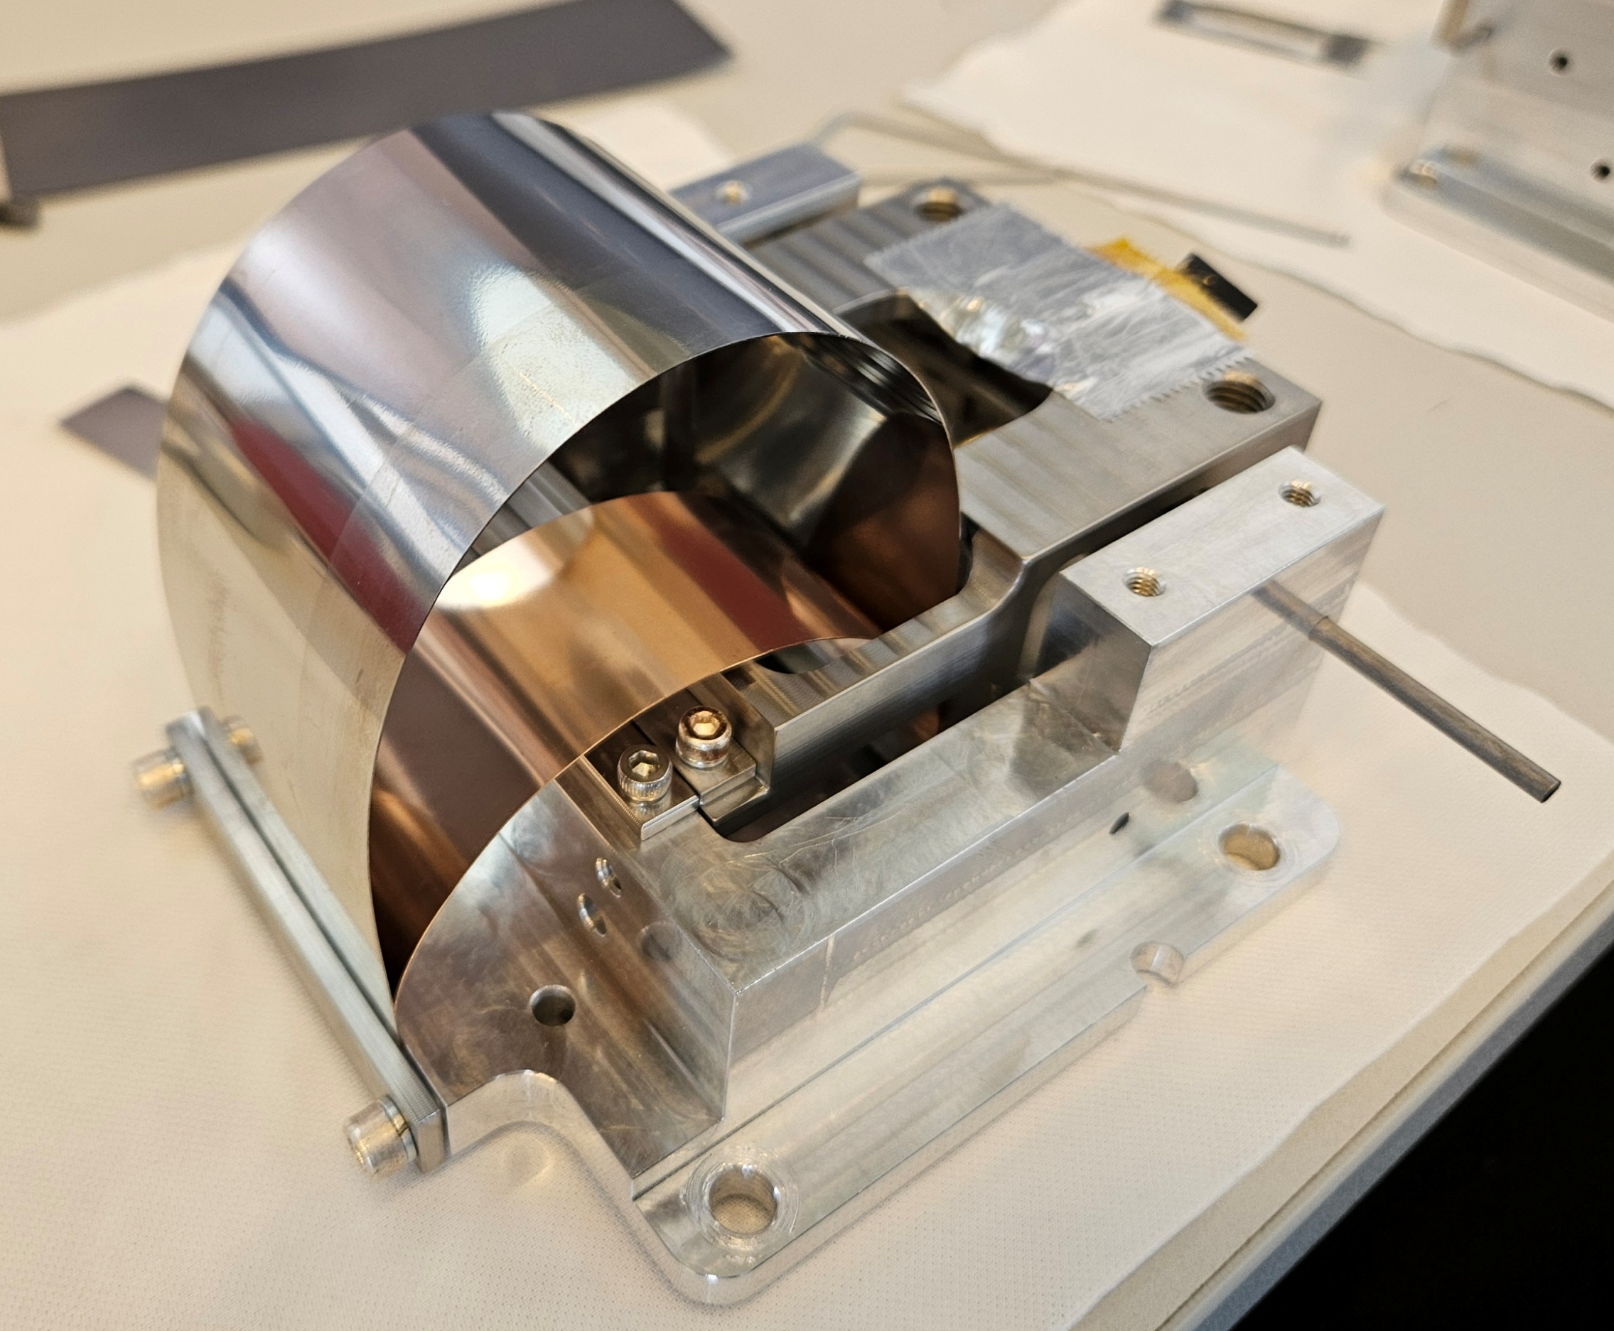
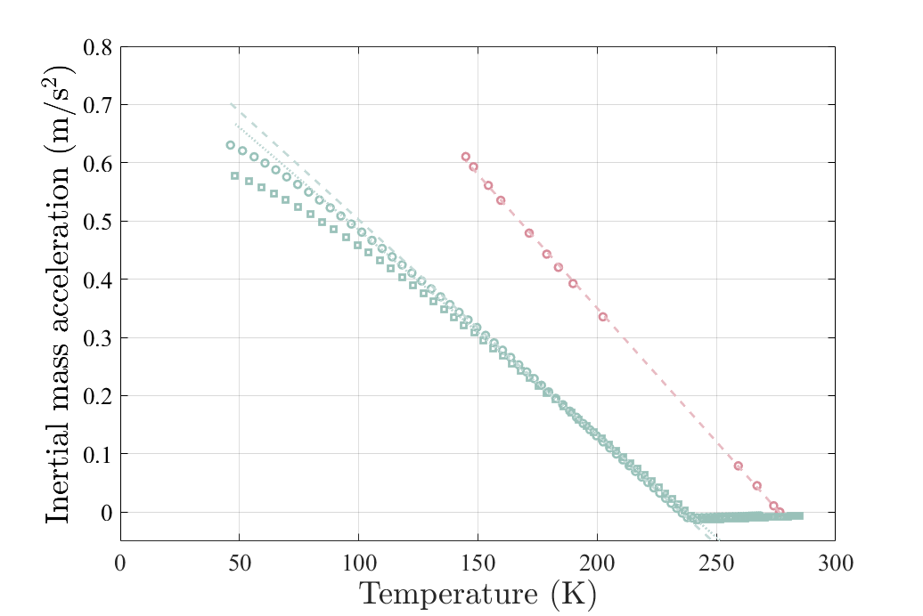
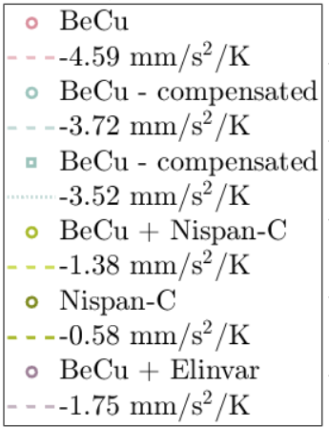
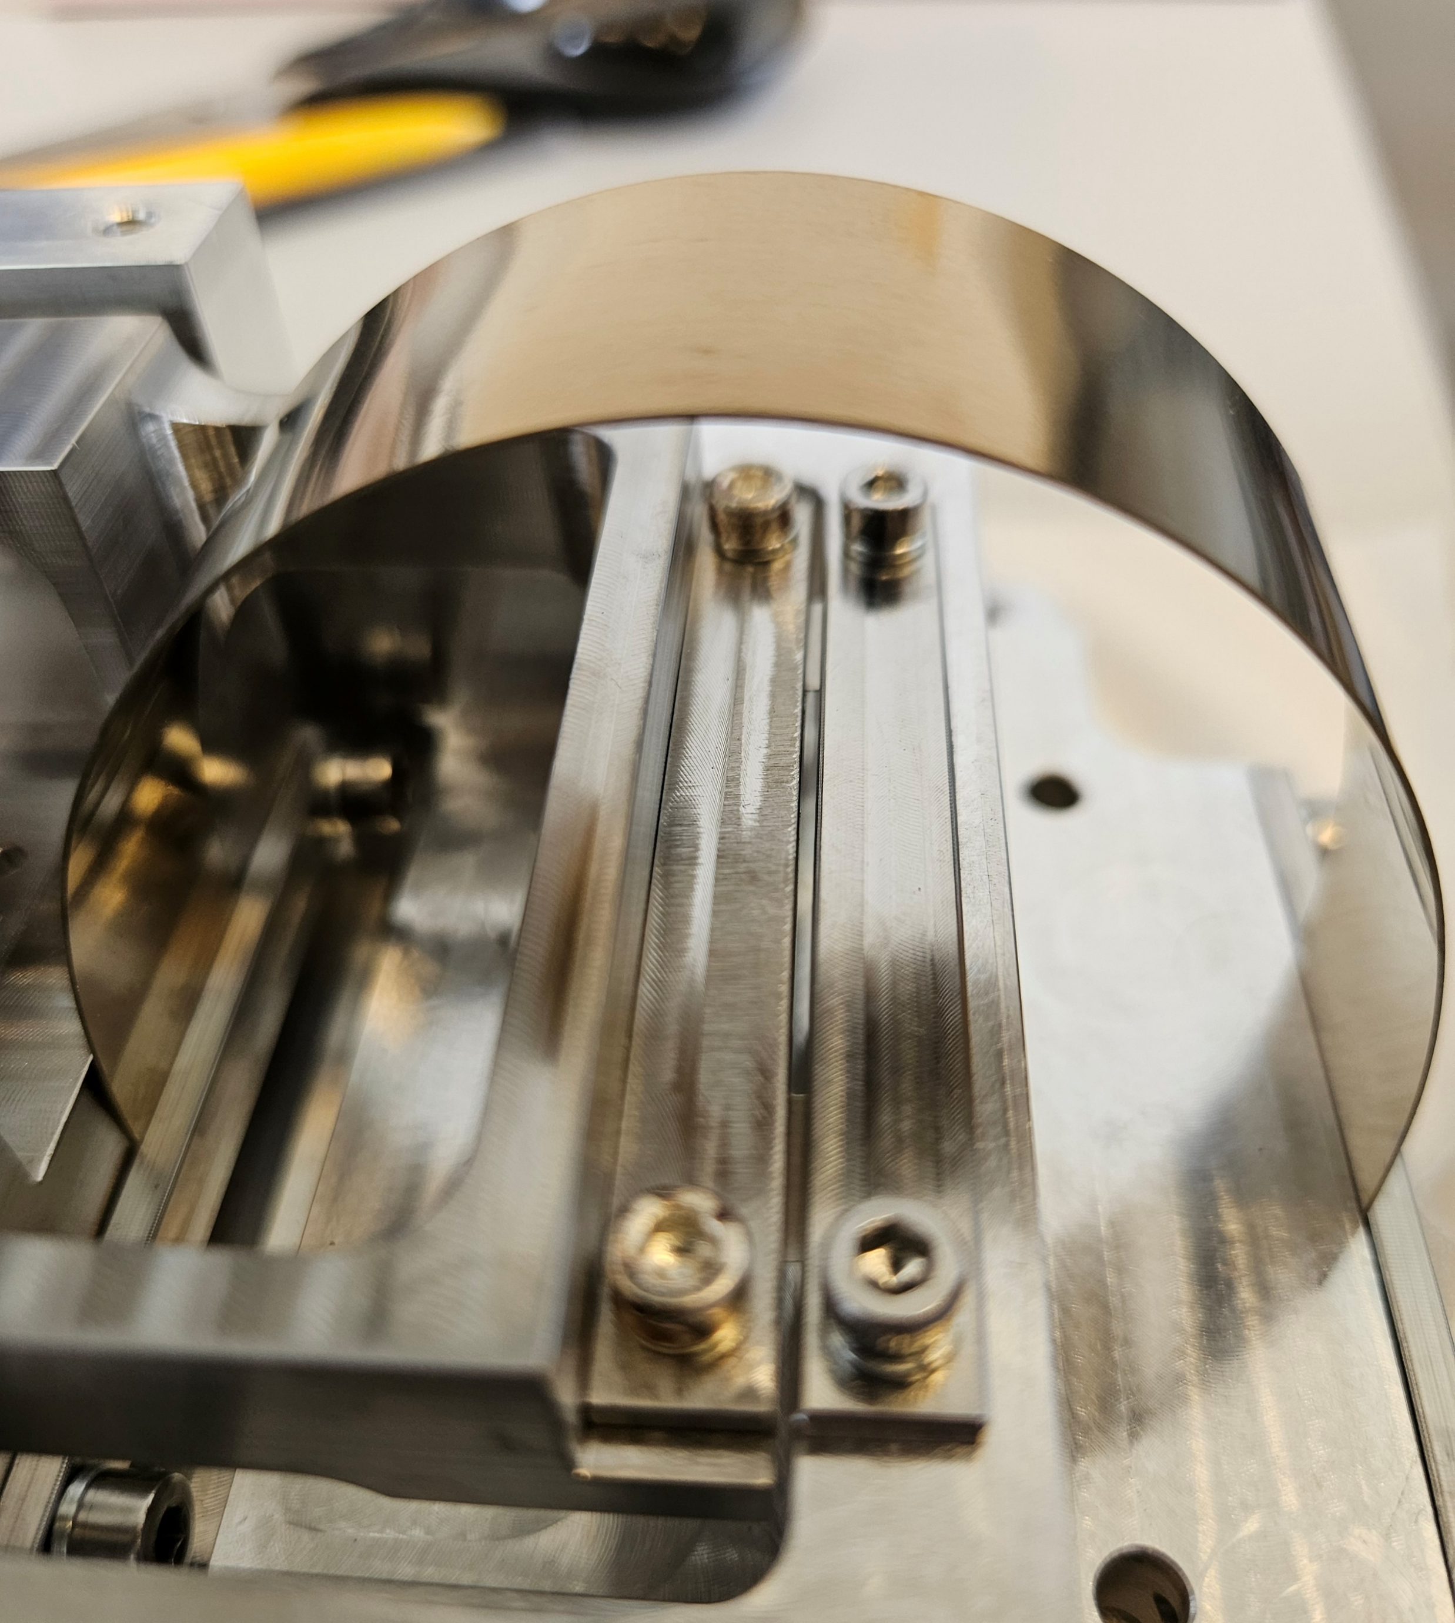

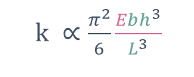

Cryo-V gravity-compensation spring:
Elinvar alloys decrease the sensor sensitivity to temperature
increase$ω_{0}^{2}$
Decrease measurement bandwidth
Drift(T) $∝1/ω_{0}^{2}$
$k ∝\frac{π^{2}}{6}\frac{Ebh^{3}}{L^{3}}$
Have a suspension with a low thermoelastic coefficient (TEC) and low coefficient of thermal expansion (CTE)
Nispan-C limits the sensor sensitivity to thermal fluctuations
Combine materials with opposite TEC
Thermal treatment to get an almost-zero TEC

Slide 7
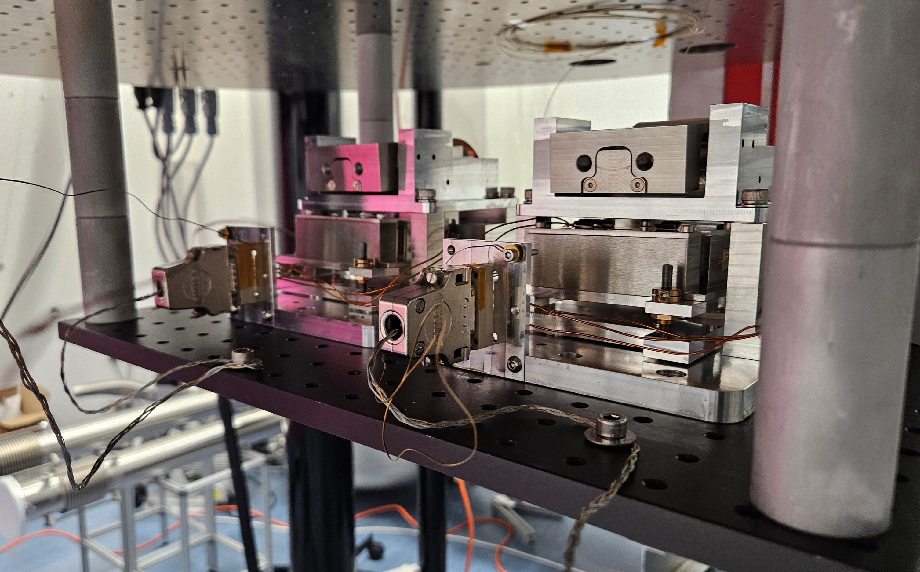
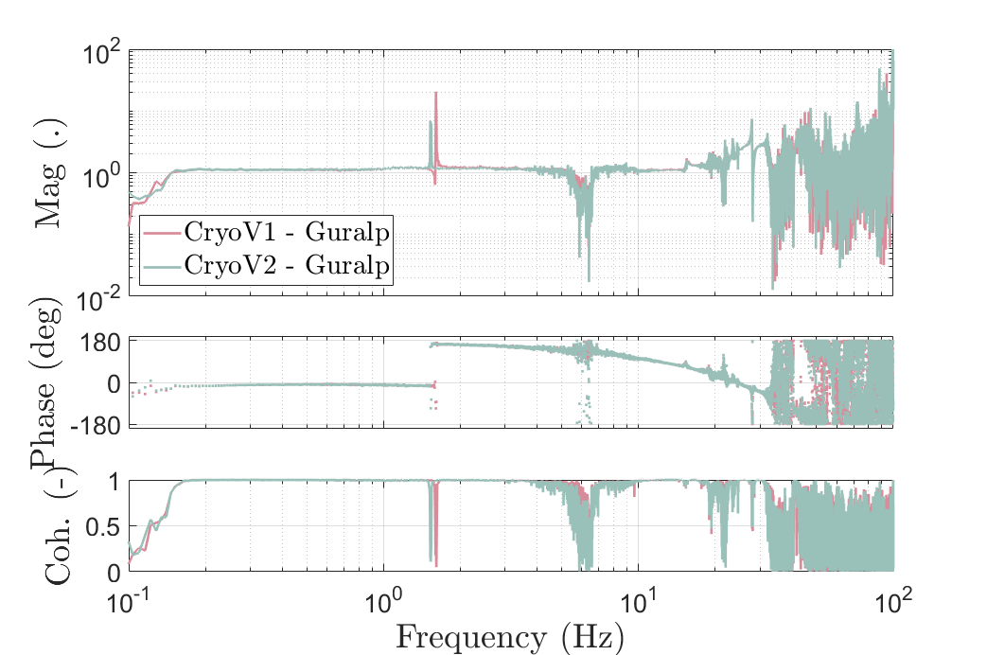
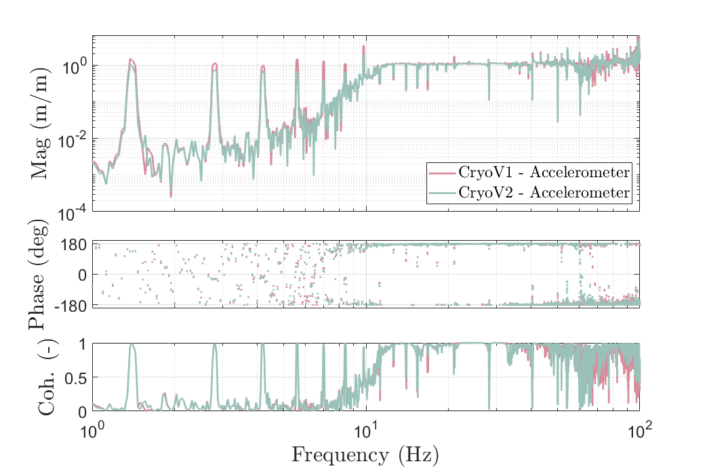

Cryo-V operation at 5.17 K compared to commercial sensors
Guralp
Accelerometer
Cryo-Vs
4K Cold plate
T =
= Coherent from 0.1 to 30Hz
Vacuum tank
Cryo-V operation assessed at 5K from 0.1 to 50Hz
= Coherent from 12 to 50Hz
T =

Slide 8
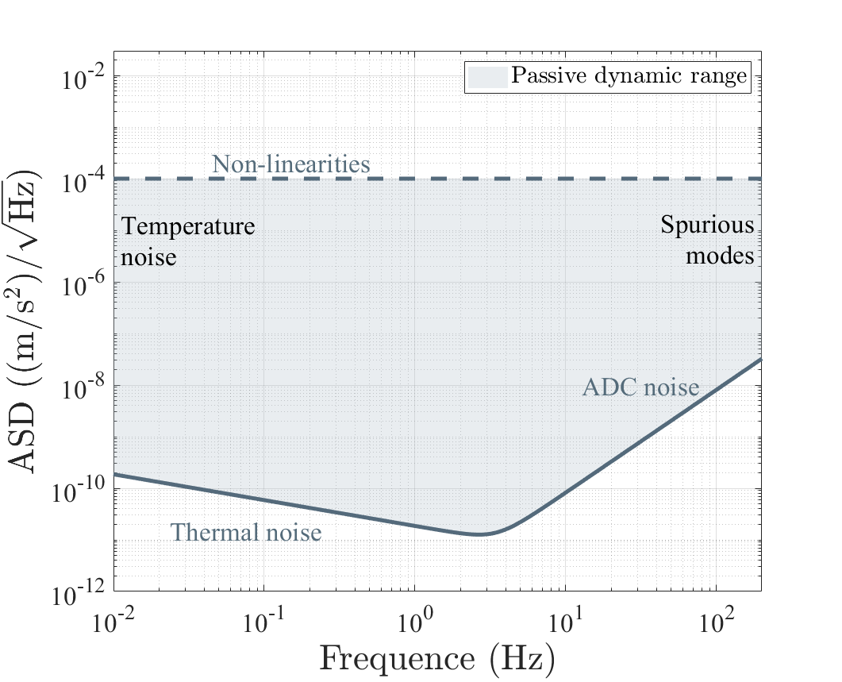
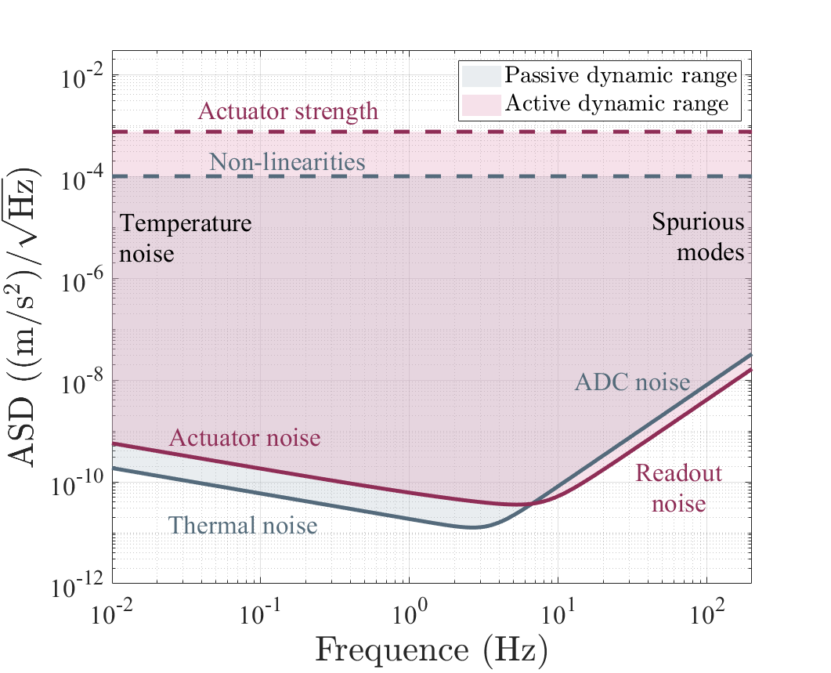
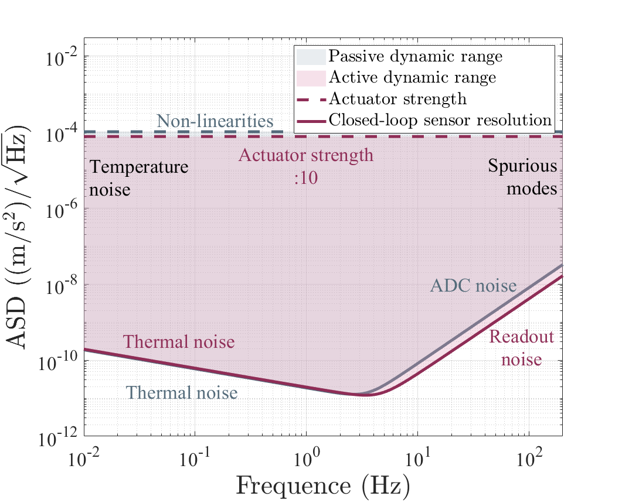
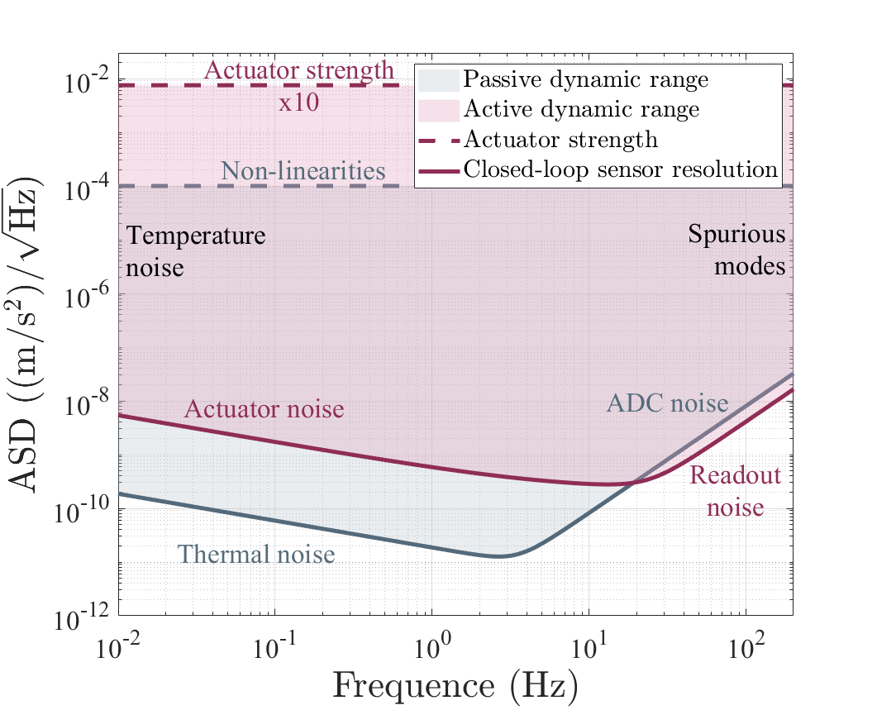
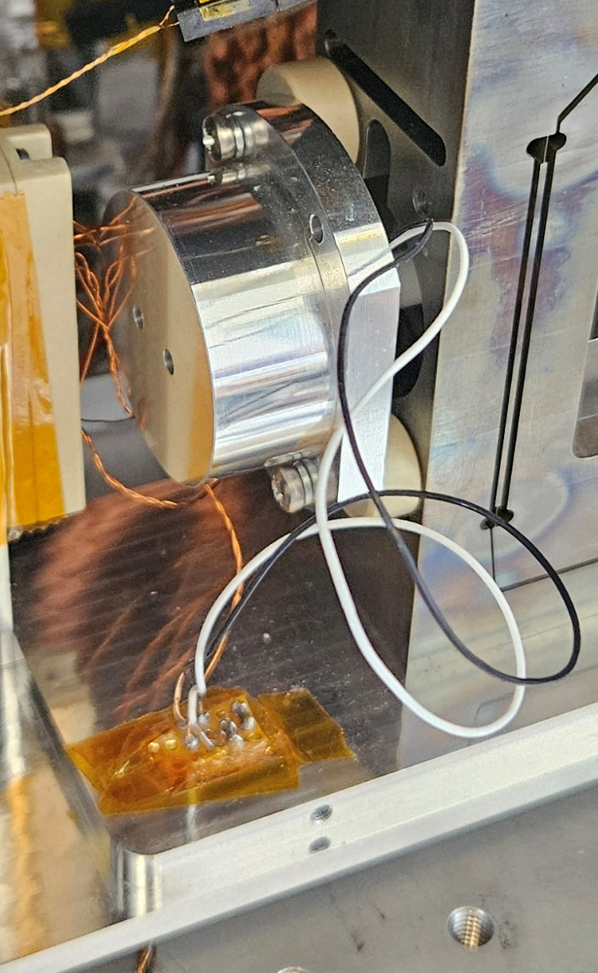
Cryo-H actuation chain adaptation to cryogenic temperature
VCA with copper coil and neodymium magnet
Low-noise voltage buffer made with MELF resistors

Slide 9
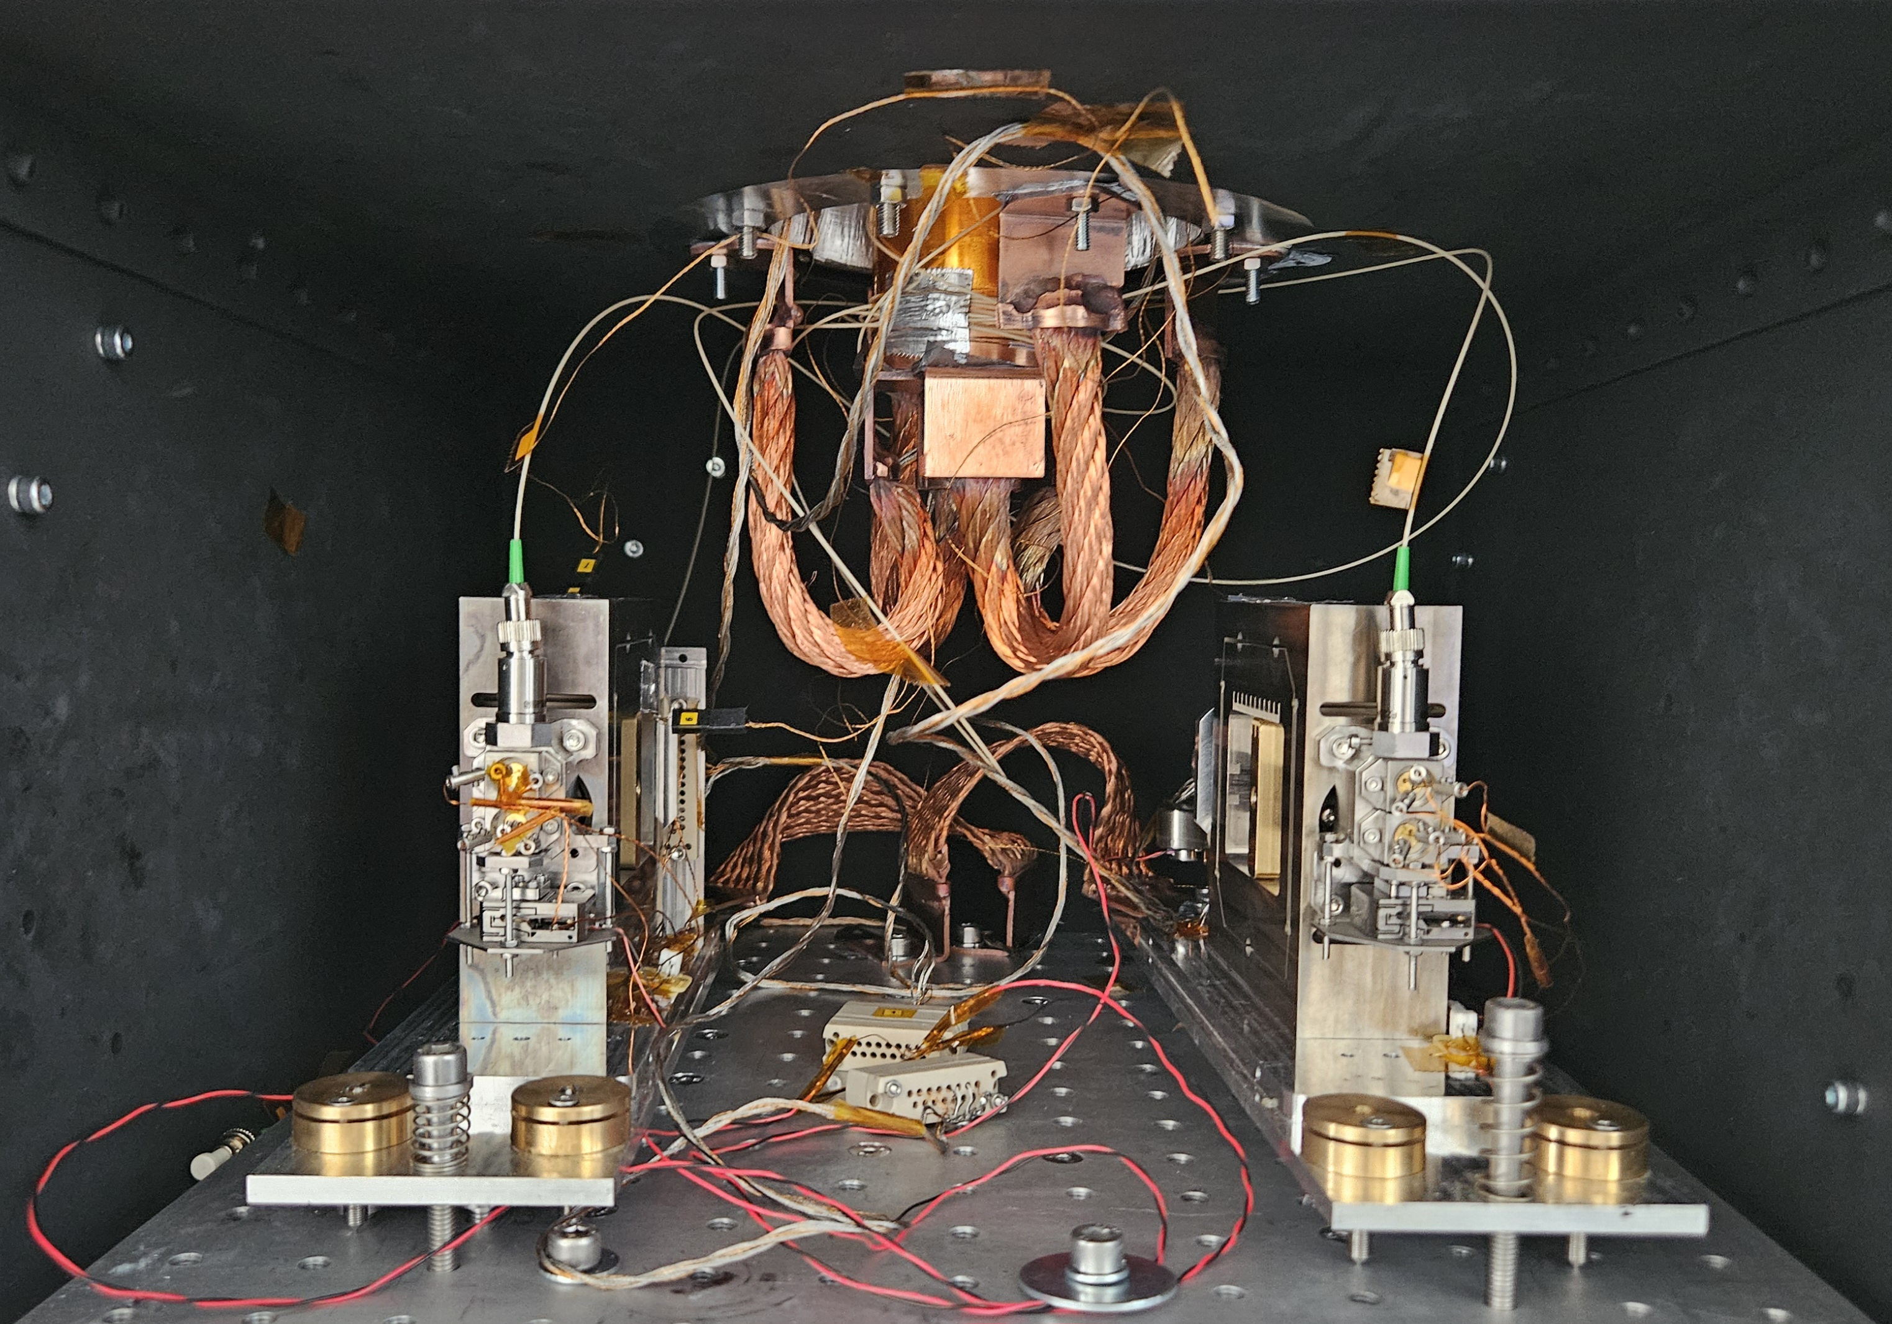
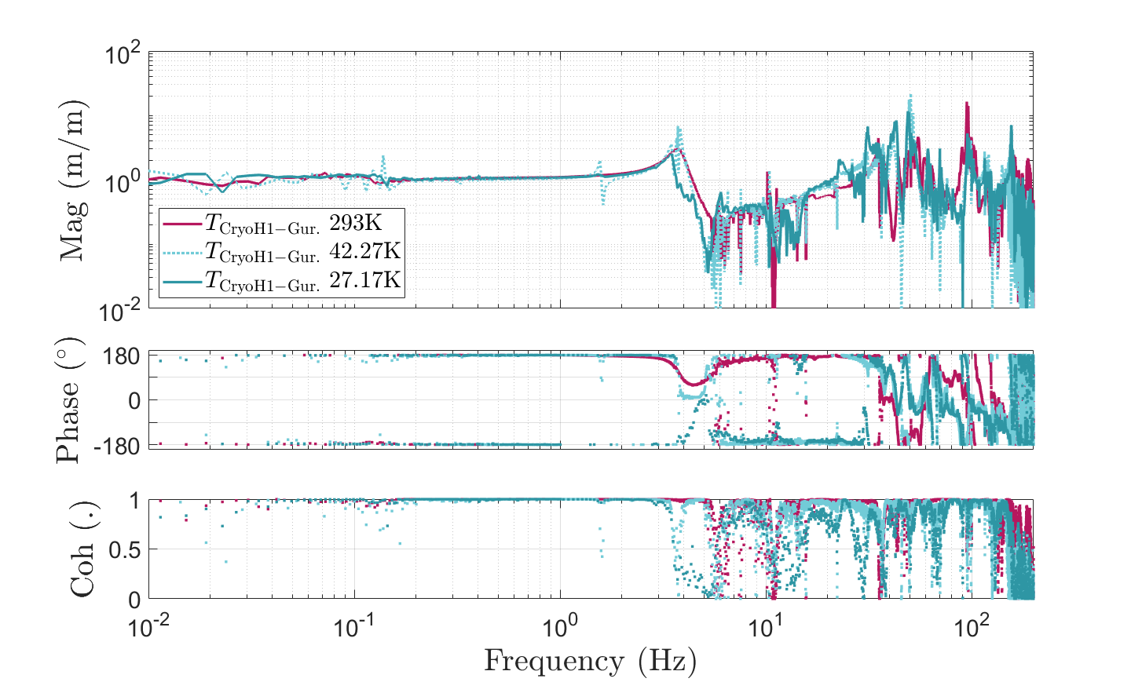
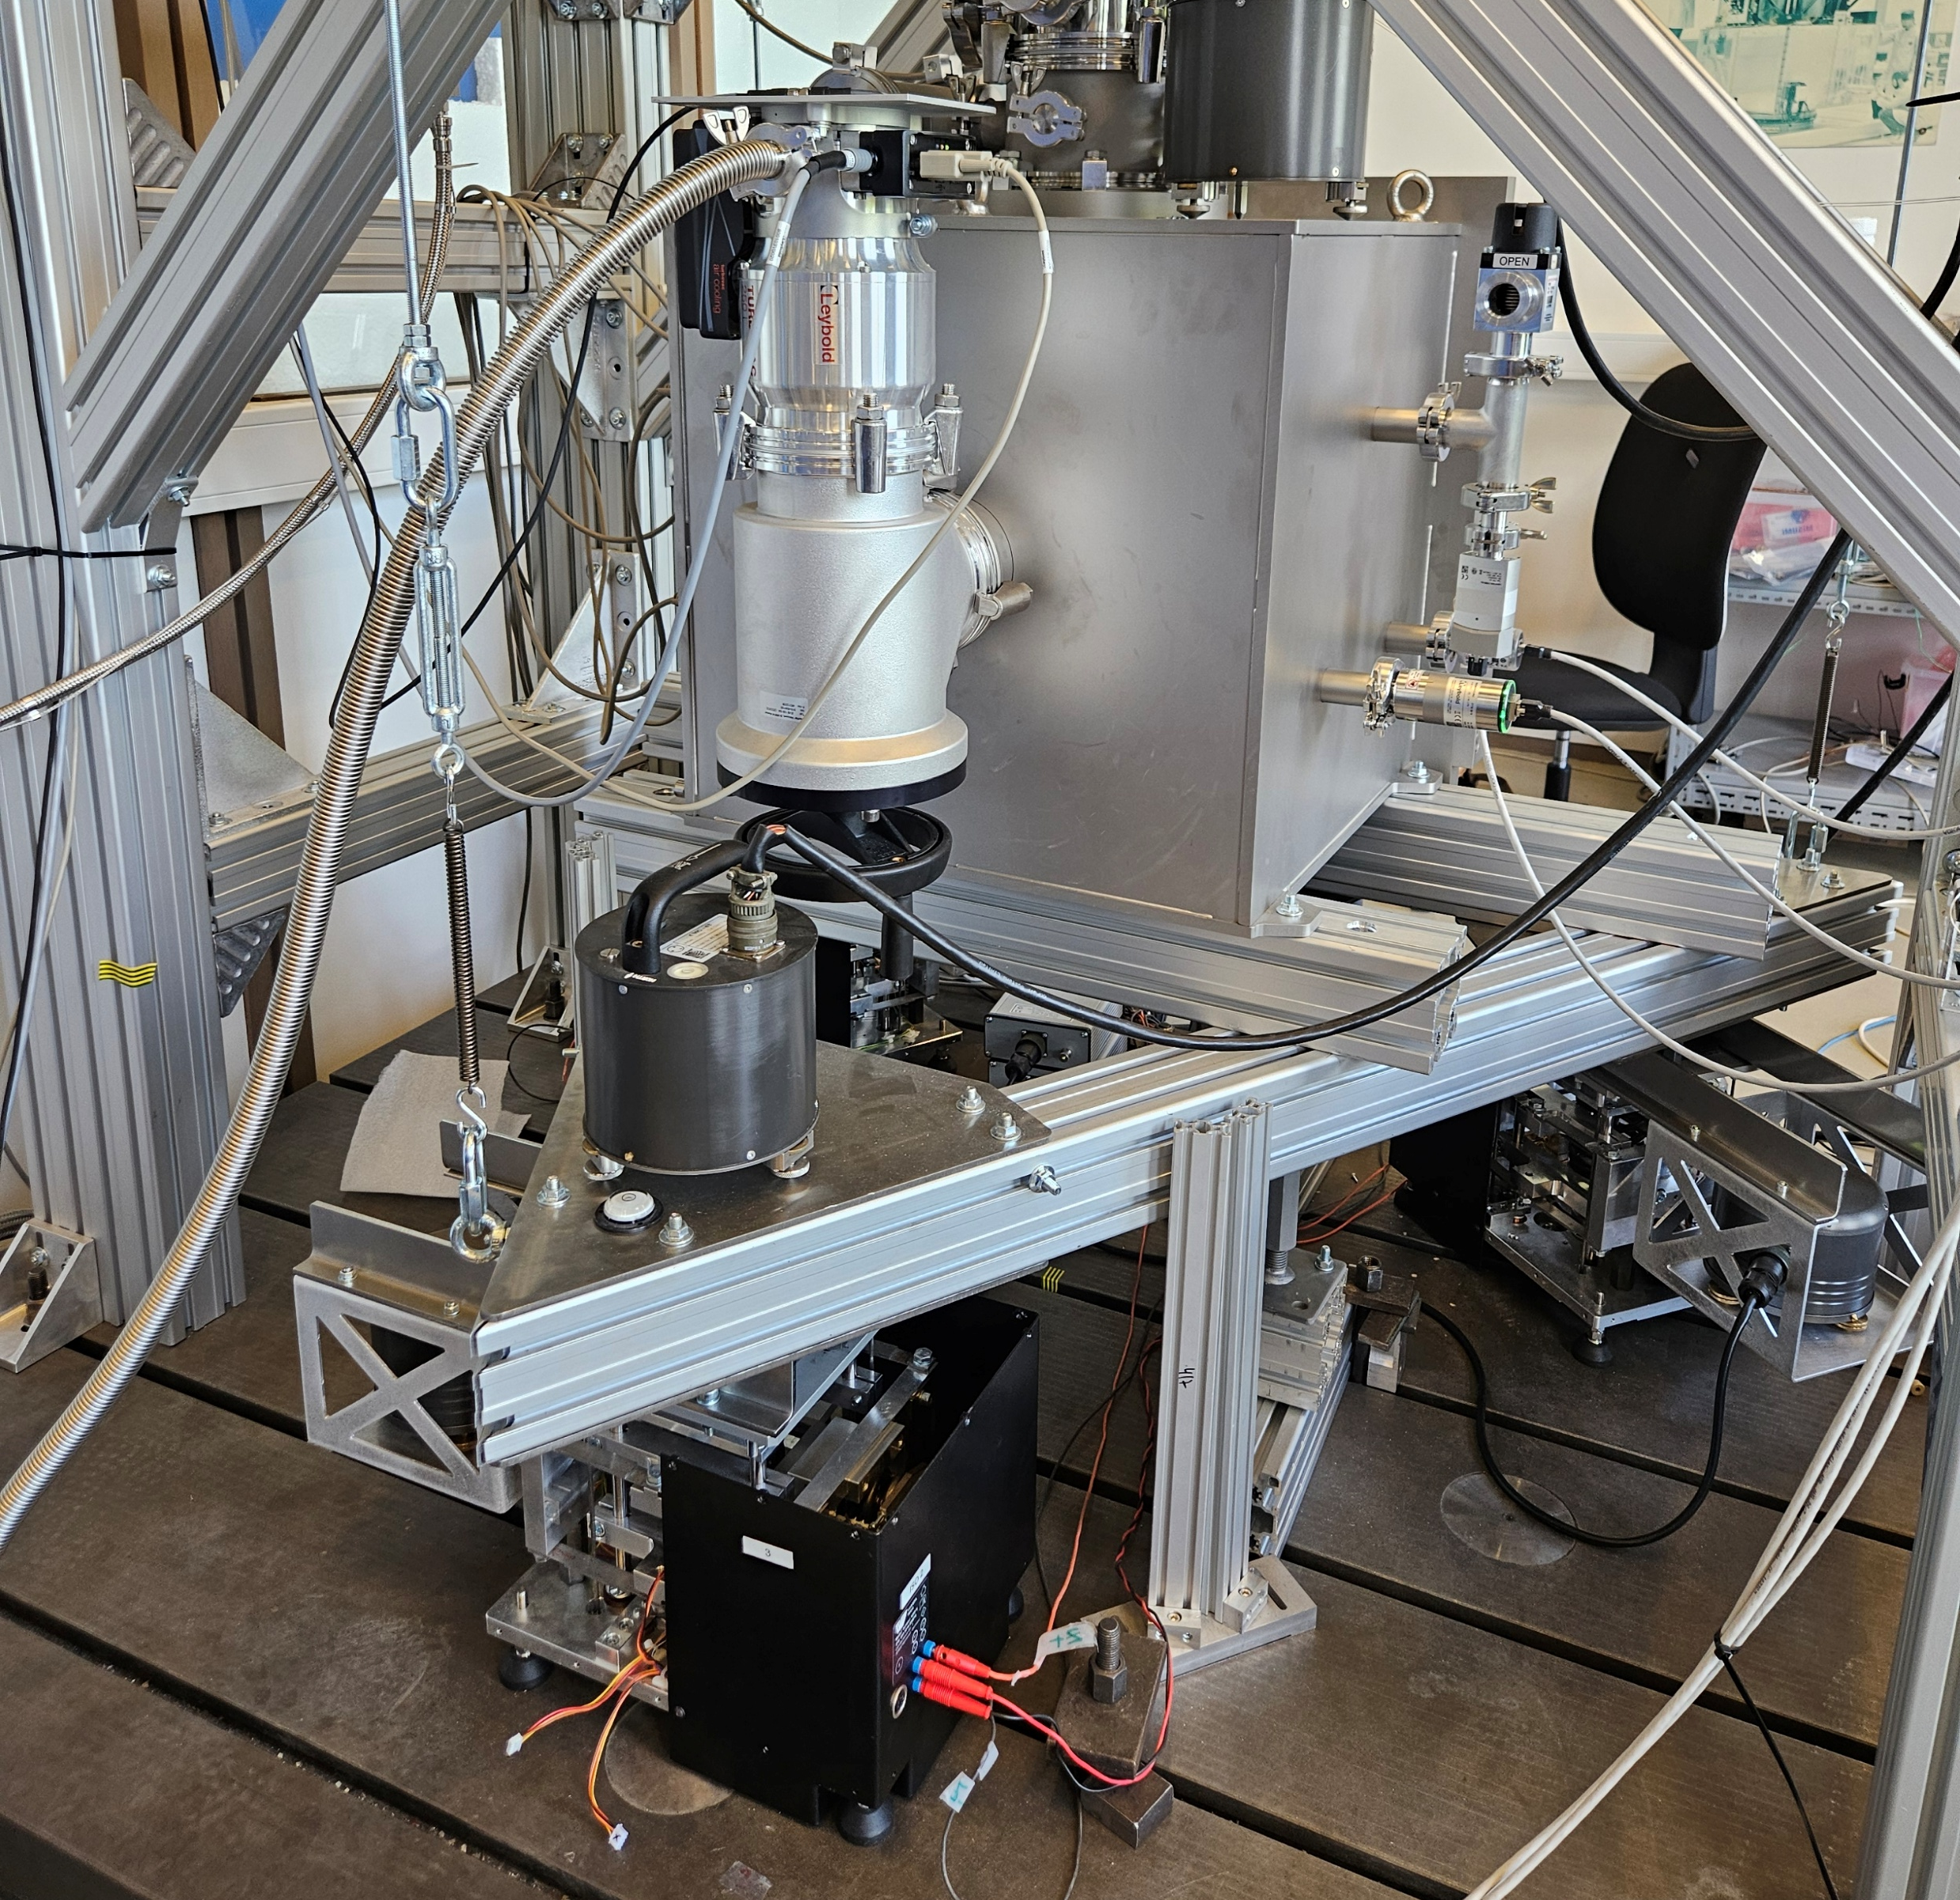
Cryo-H operation at 27.17 K compared to commercial sensors
Coherent from 20 mHz to 150Hz
Test bench dynamics
Cryo-H
T =
Guralp
Cryo-H operation assessed at 27K from 20mHz to 150Hz
Homemade low-vibration cryogenic testbench

Slide 10
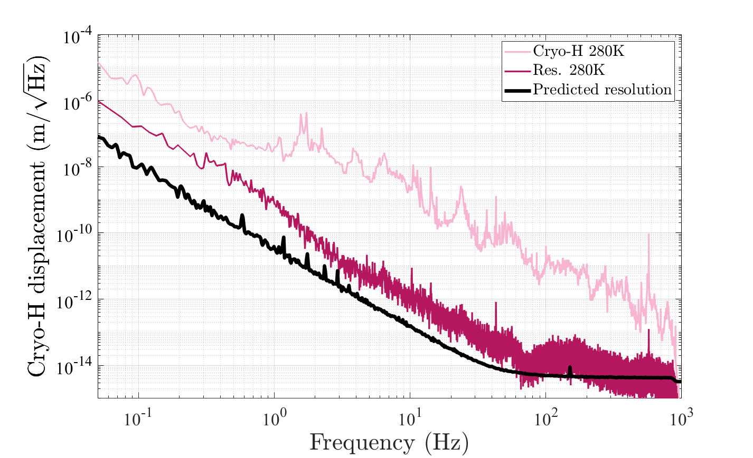
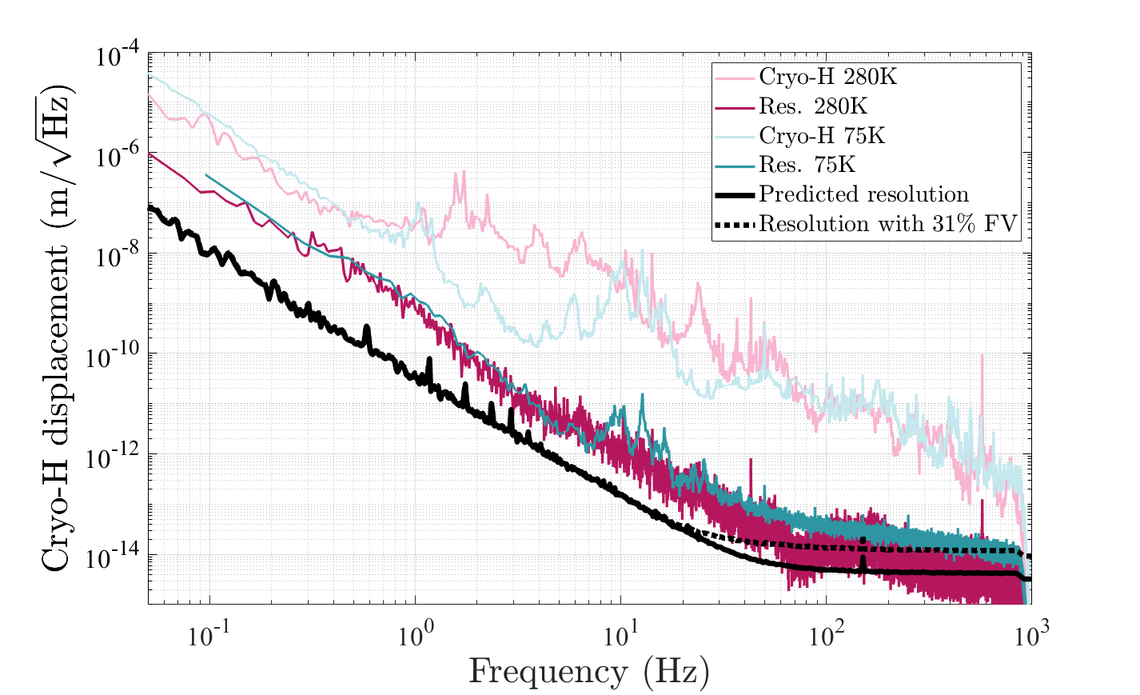
Horizontal cryogenic inertial sensor resolution at 75 K reaches sub-pm level from 5 Hz
Capacitive and cross coupling
-
Huddle test
= coherent subtraction
Actuator noise
Mitigated by decreasing the actuator strength
Shot noise < 10 fm/√Hz
(alignment- and input-power-dependent)

Slide 11
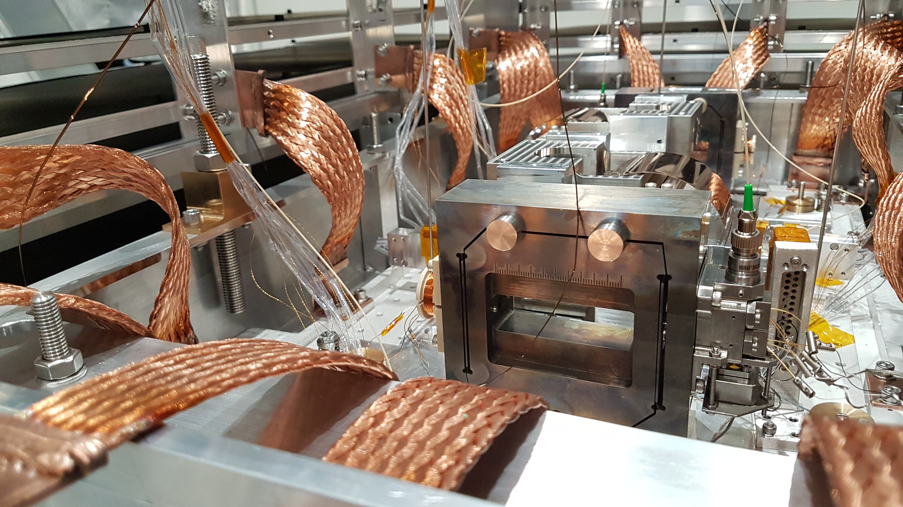
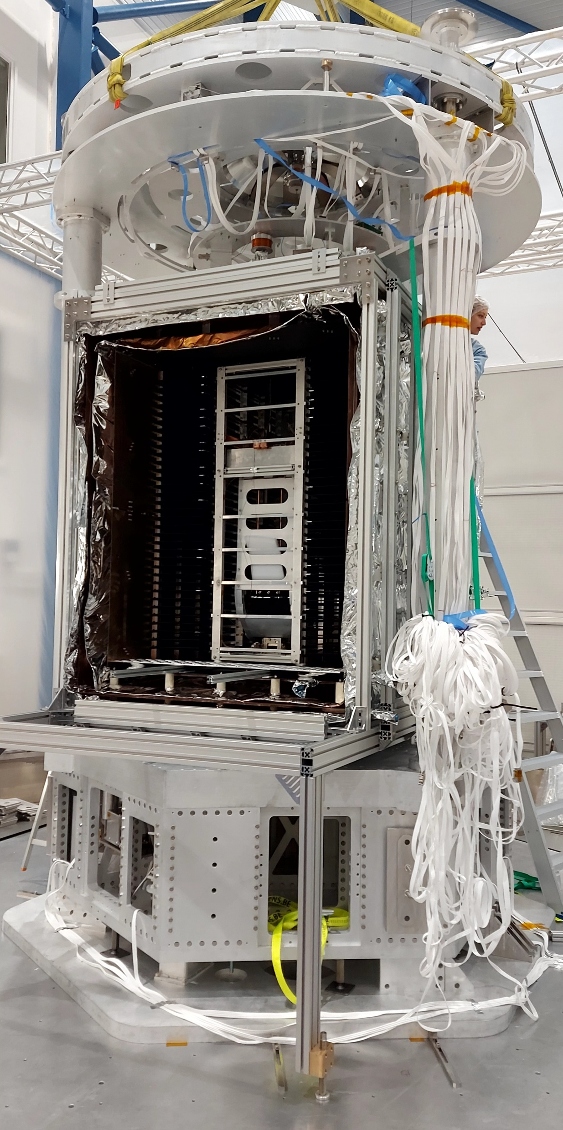

Conclusion and ongoing activities
We have redesigned and adapted state-of-the-art sensors to cryogenic conditions
Checked the cryogenic compatibility of sub-components
The homodyne quadrature interferometer can be used as a standalone cryogenic sub-pm/√Hz sensitivity relative displacement sensor
The vertical cryogenic inertial sensor is operating at 5K from 0.1 to 50Hz
The horizontal cryogenic inertial sensor is operating at 27K from 30 mHz to 150Hz with a sub-pm resolution from 5 Hz
Integration in large facilities (E-TEST)

Slide 12
Backup slides

Slide 13


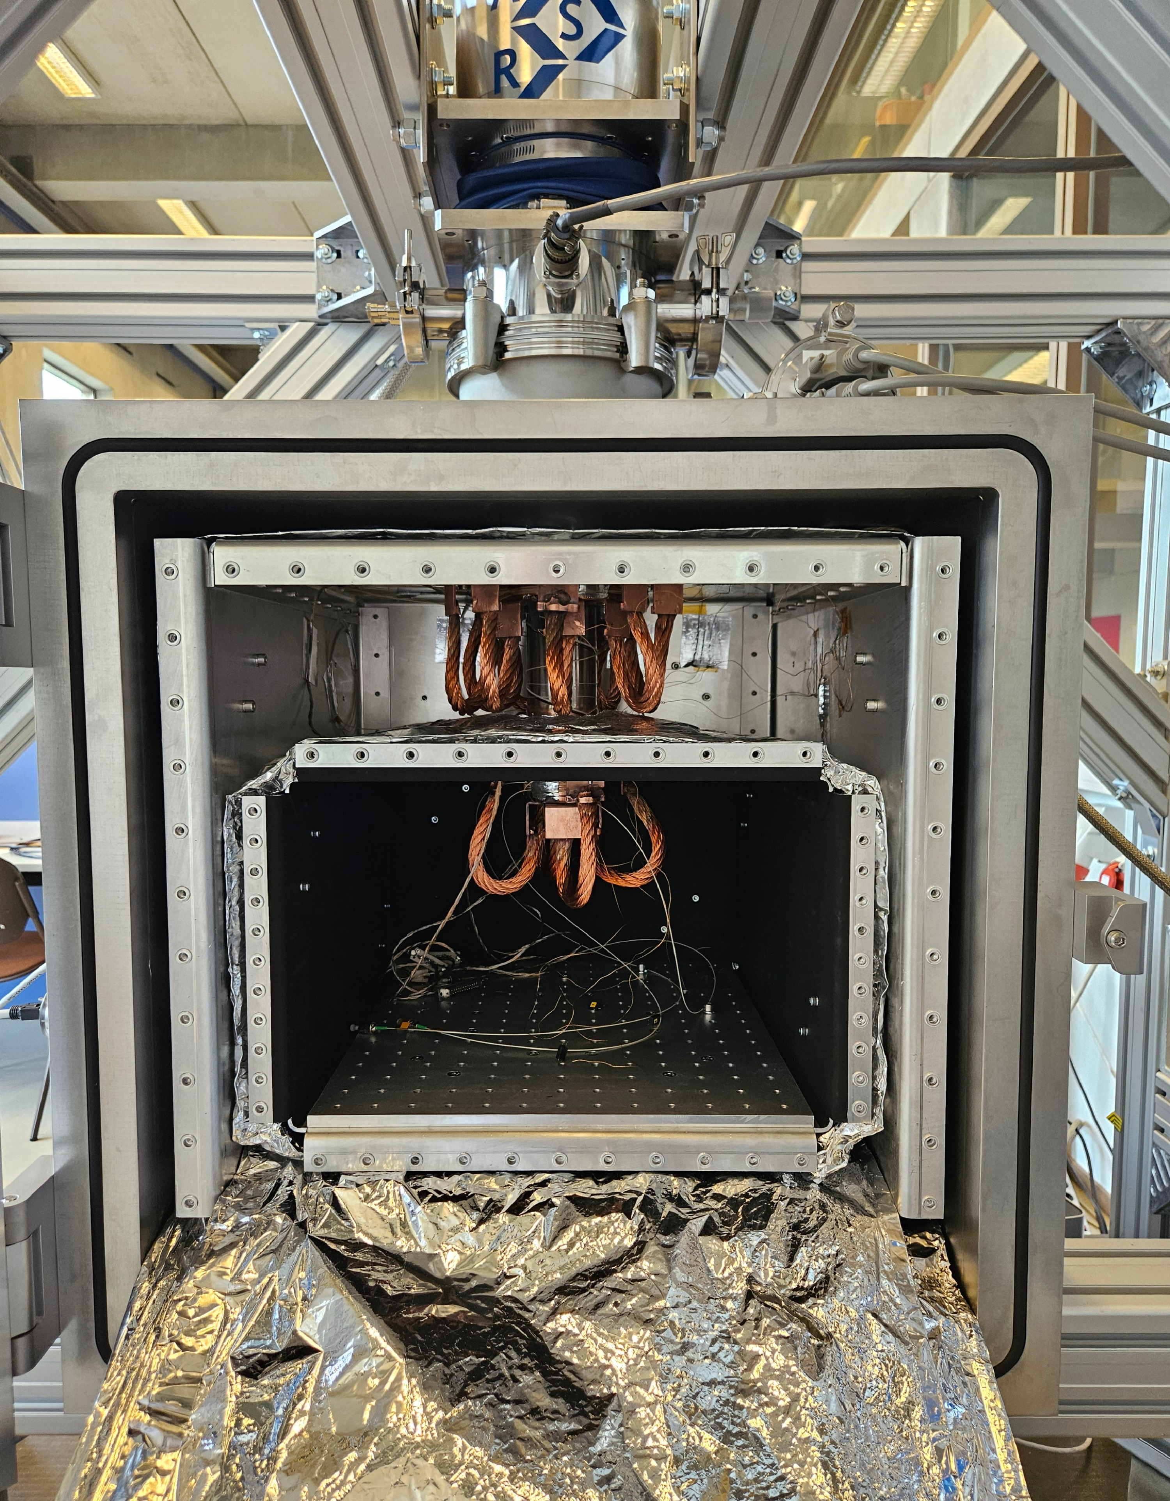
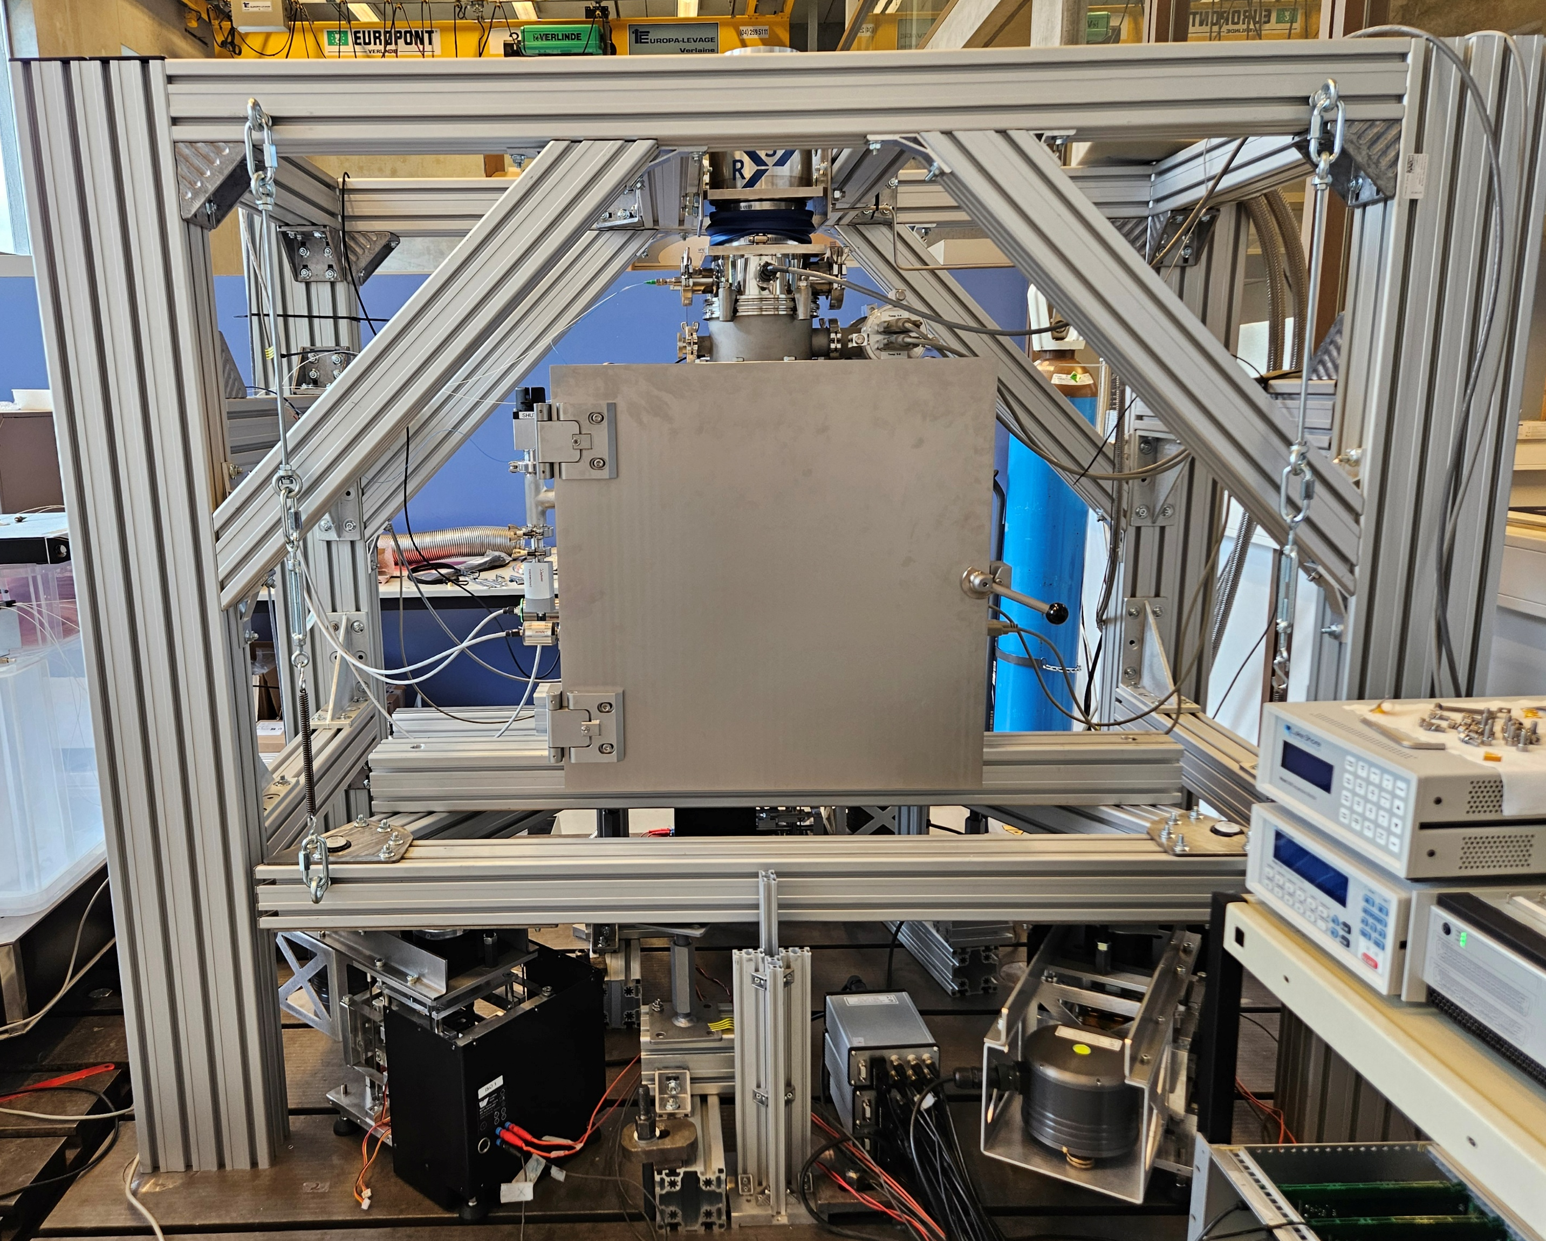
Low-vibration cryogenic testbench
10 nm RMS in [0.01-10] Hz
pm/√Hz level from 3 Hz
15-20 K
CS210-GMX-20B
cryocooler
Cryocooler support
Rubber bellow
gHe-filled heat exchanger
Vacuum chamber
Cryocooler 45K stage
Intermediate thermal shield
Soft OFC thermal braids
Cryocooler 4K stage
Suspension and actuator
Geophones (custom Theta from GaiaCode)
Cold thermal shield
Active platform

Slide 14

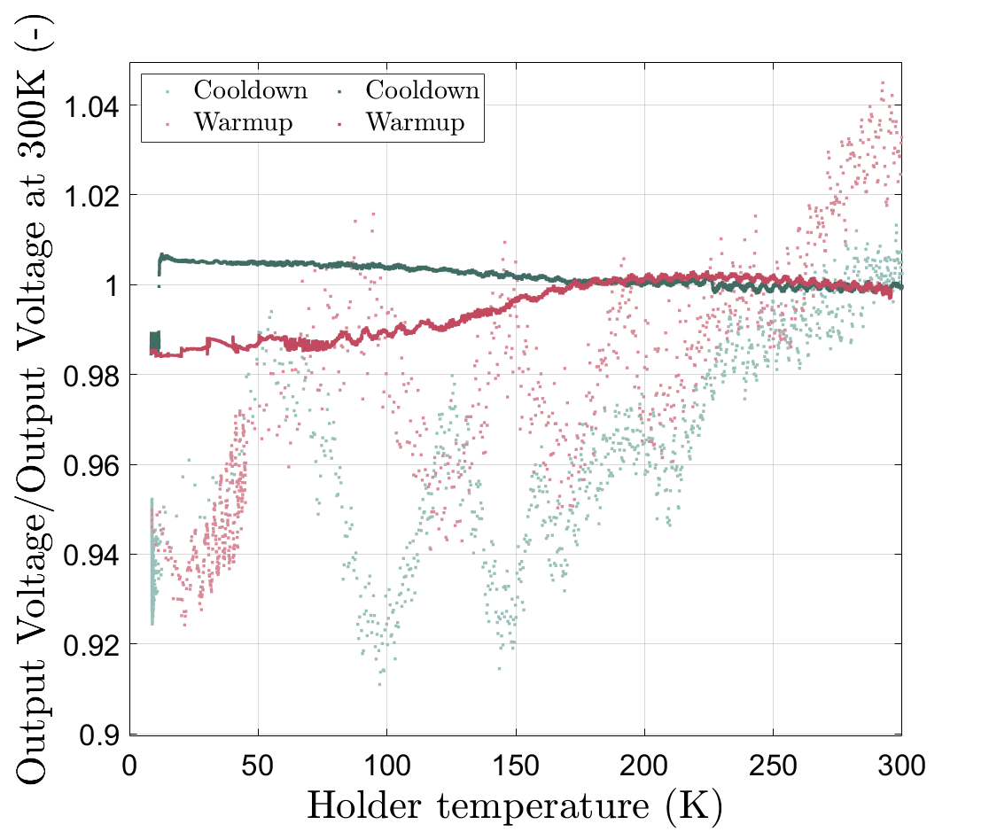
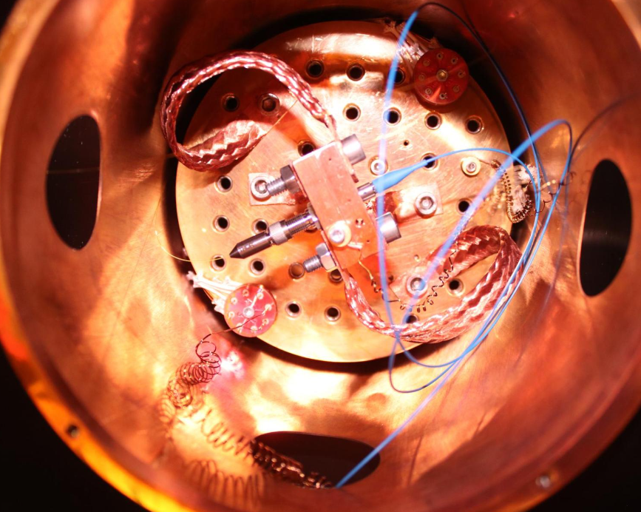
Interferometric readout cryogenic compatibility:
Critical optical elements selection for 1550nm
Kulbusch, Zeoli et al (2024)
Collimators
Homodyne quadrature interferometer
Relative decrease in voltage <2.2%

Slide 15
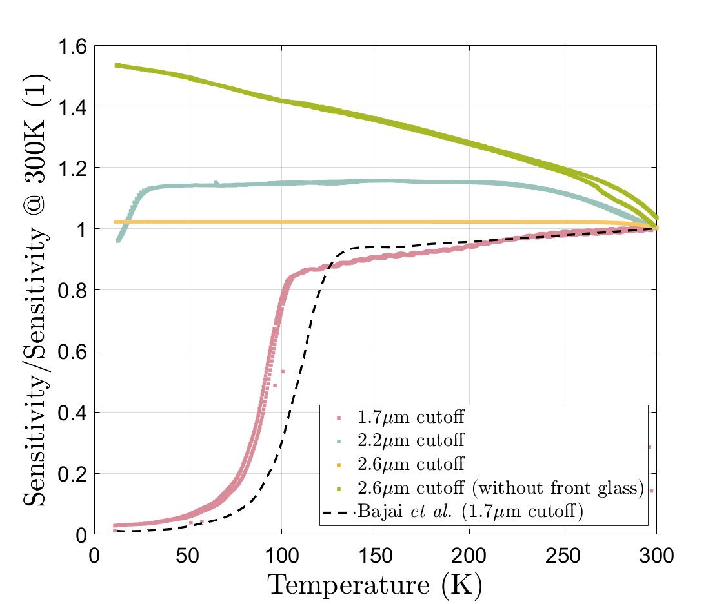
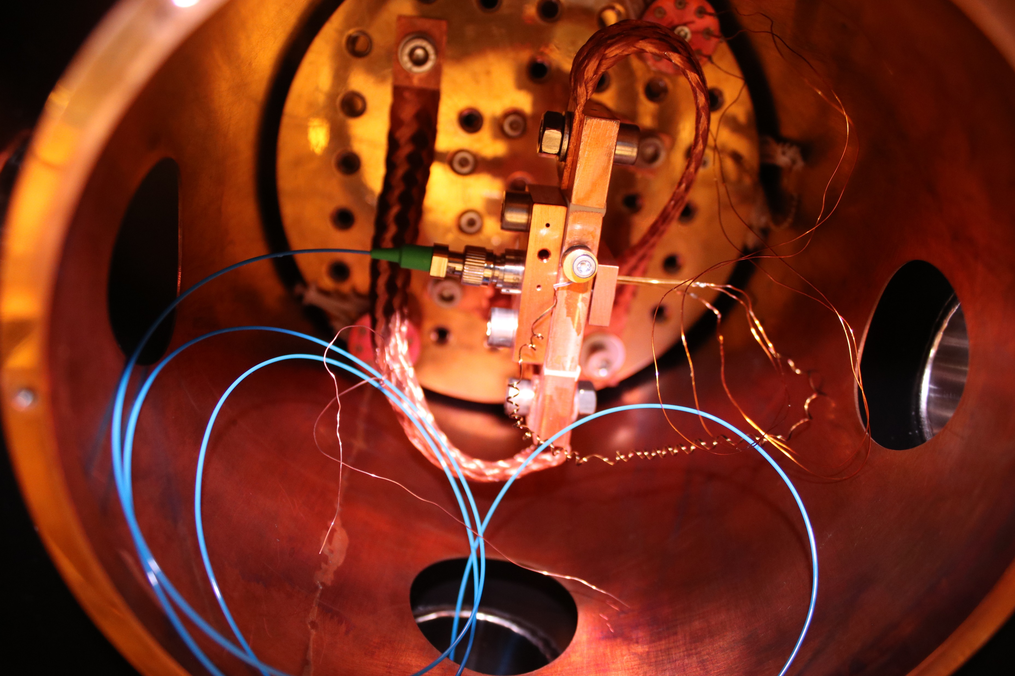
Interferometric readout cryogenic compatibility:
Critical optical elements selection for 1550nm
Kulbusch, Zeoli et al (2024)
Photodiodes
InGaAs ++ without front glass
InGaAs +
InGaAs ++
Homodyne quadrature interferometer
InGaAs
Bajpai (2022)

Slide 16
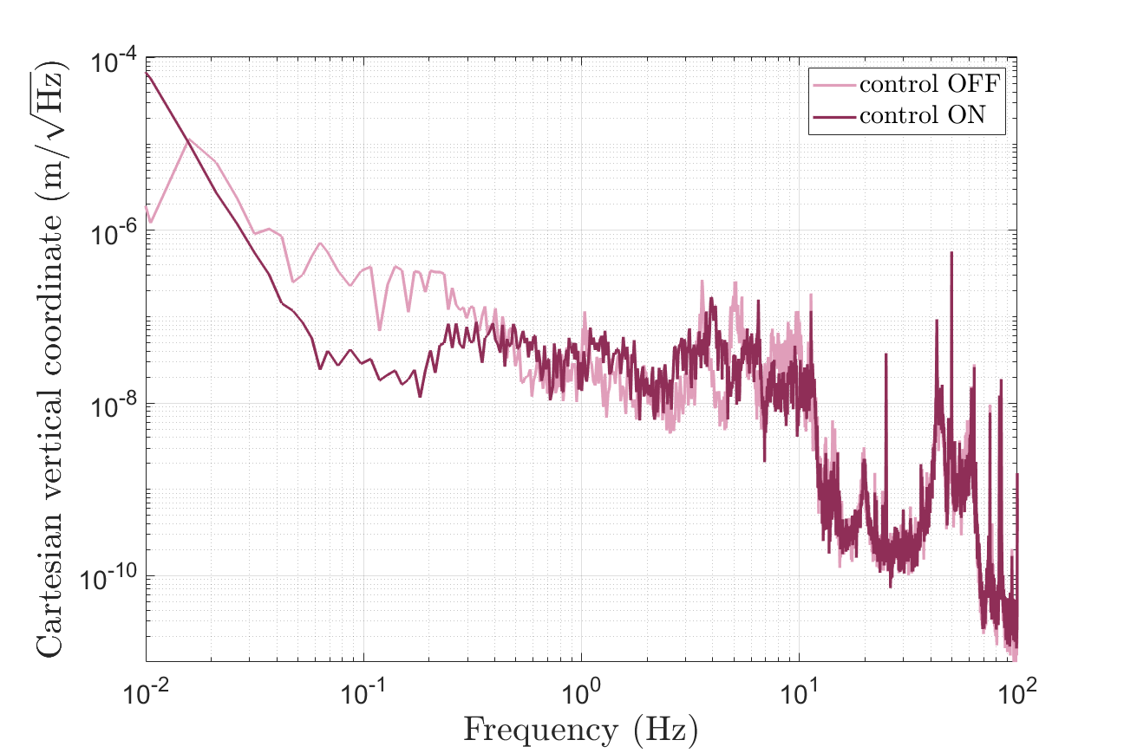
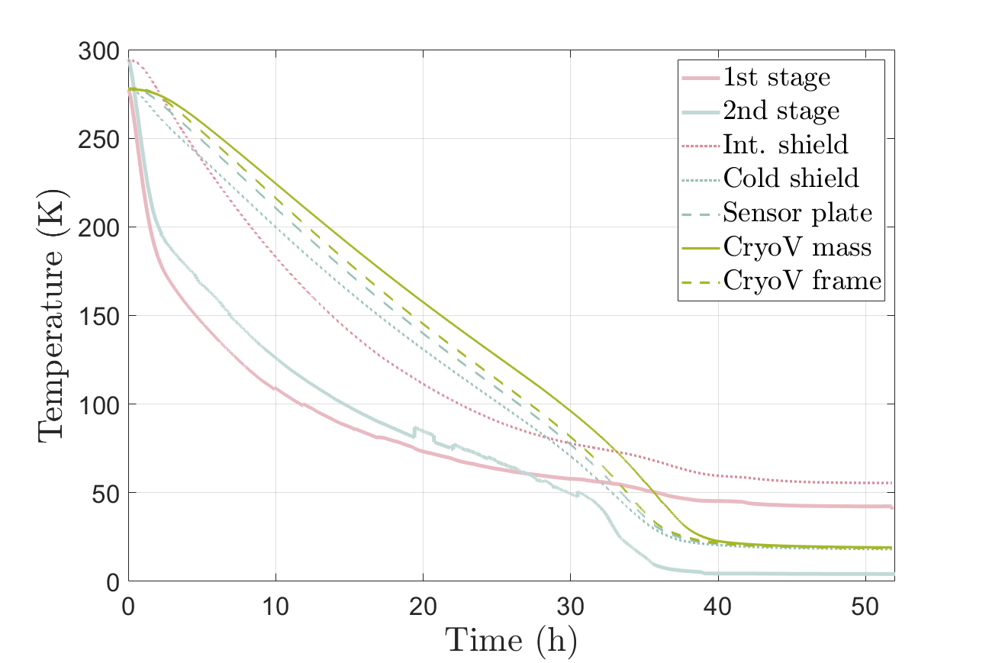
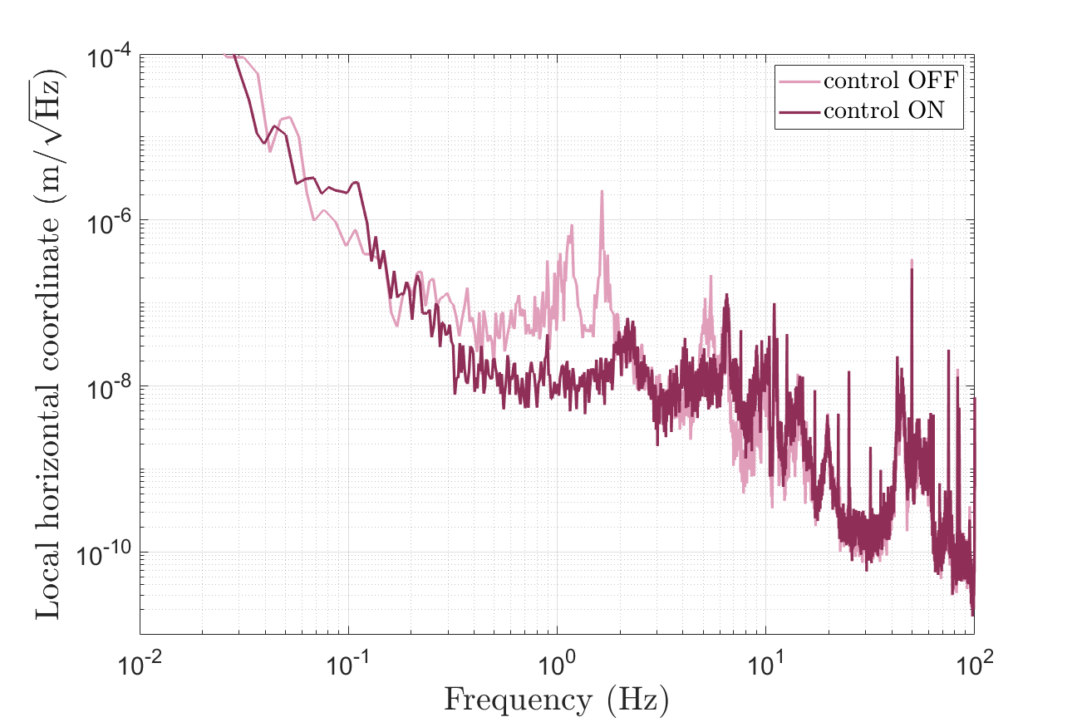
Low-vibration cryo testbench
1 order of magnitude at 0.1 Hz
19K

Slide 17
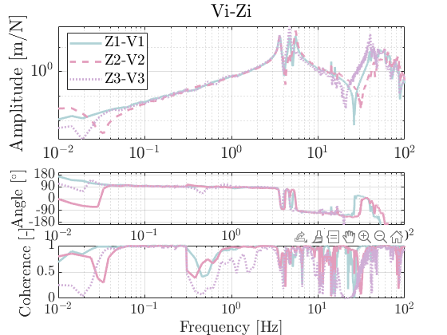
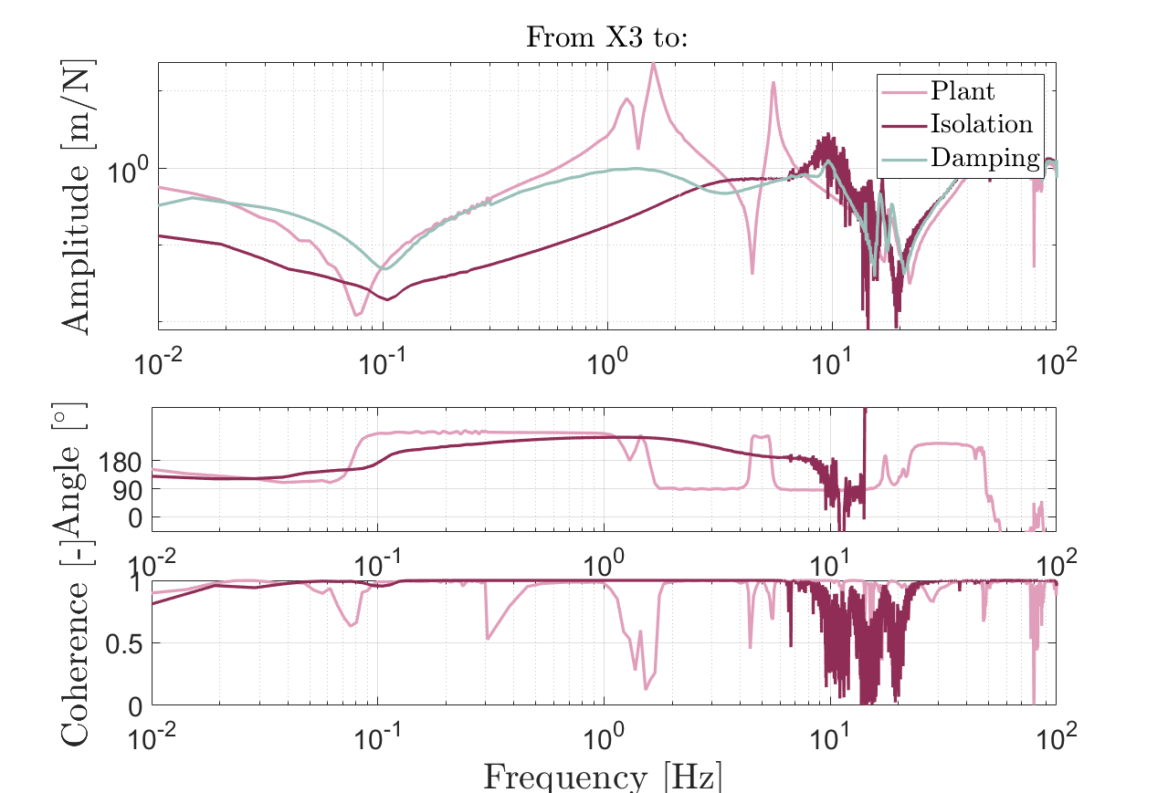
Active isolation

Slide 18
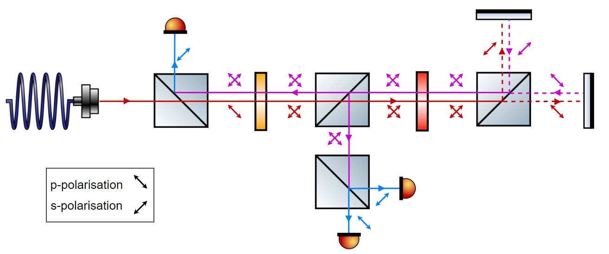







Vertical cryogenic inertial sensor
Common-mode noise rejection
$$Q_{1}=P_{PD1}−P_{PD3}$$
$$Q_{2}=P_{PD1}−P_{PD2}$$
$$P_{PD1}=\frac{P_{0}}{8}\left(1+\cos{2φ_{y}}\right)$$
$$y$$
Online-ellipse fitting and normalization
$$P_{PD3}=\frac{P_{0}}{8}\left(1−\sin{2φ_{y}}\right)$$
$$P_{PD2}=\frac{P_{0}}{8}\left(1+\sin{2φ_{y}}\right)$$
Fringe demodulation
$$y=\frac{λ}{4πρ}\left(\arctan\left(\frac{Q_{2}}{Q_{1}}\right)−\frac{π}{4} \right)$$
B. Ding, G. Zhao, J. Watchi, A. Sider and C. Collette, “An interferometric inertial sensor for low-frequency sensing,” Sensors and Actuators: A. Physical 335, 2021.

Slide 19
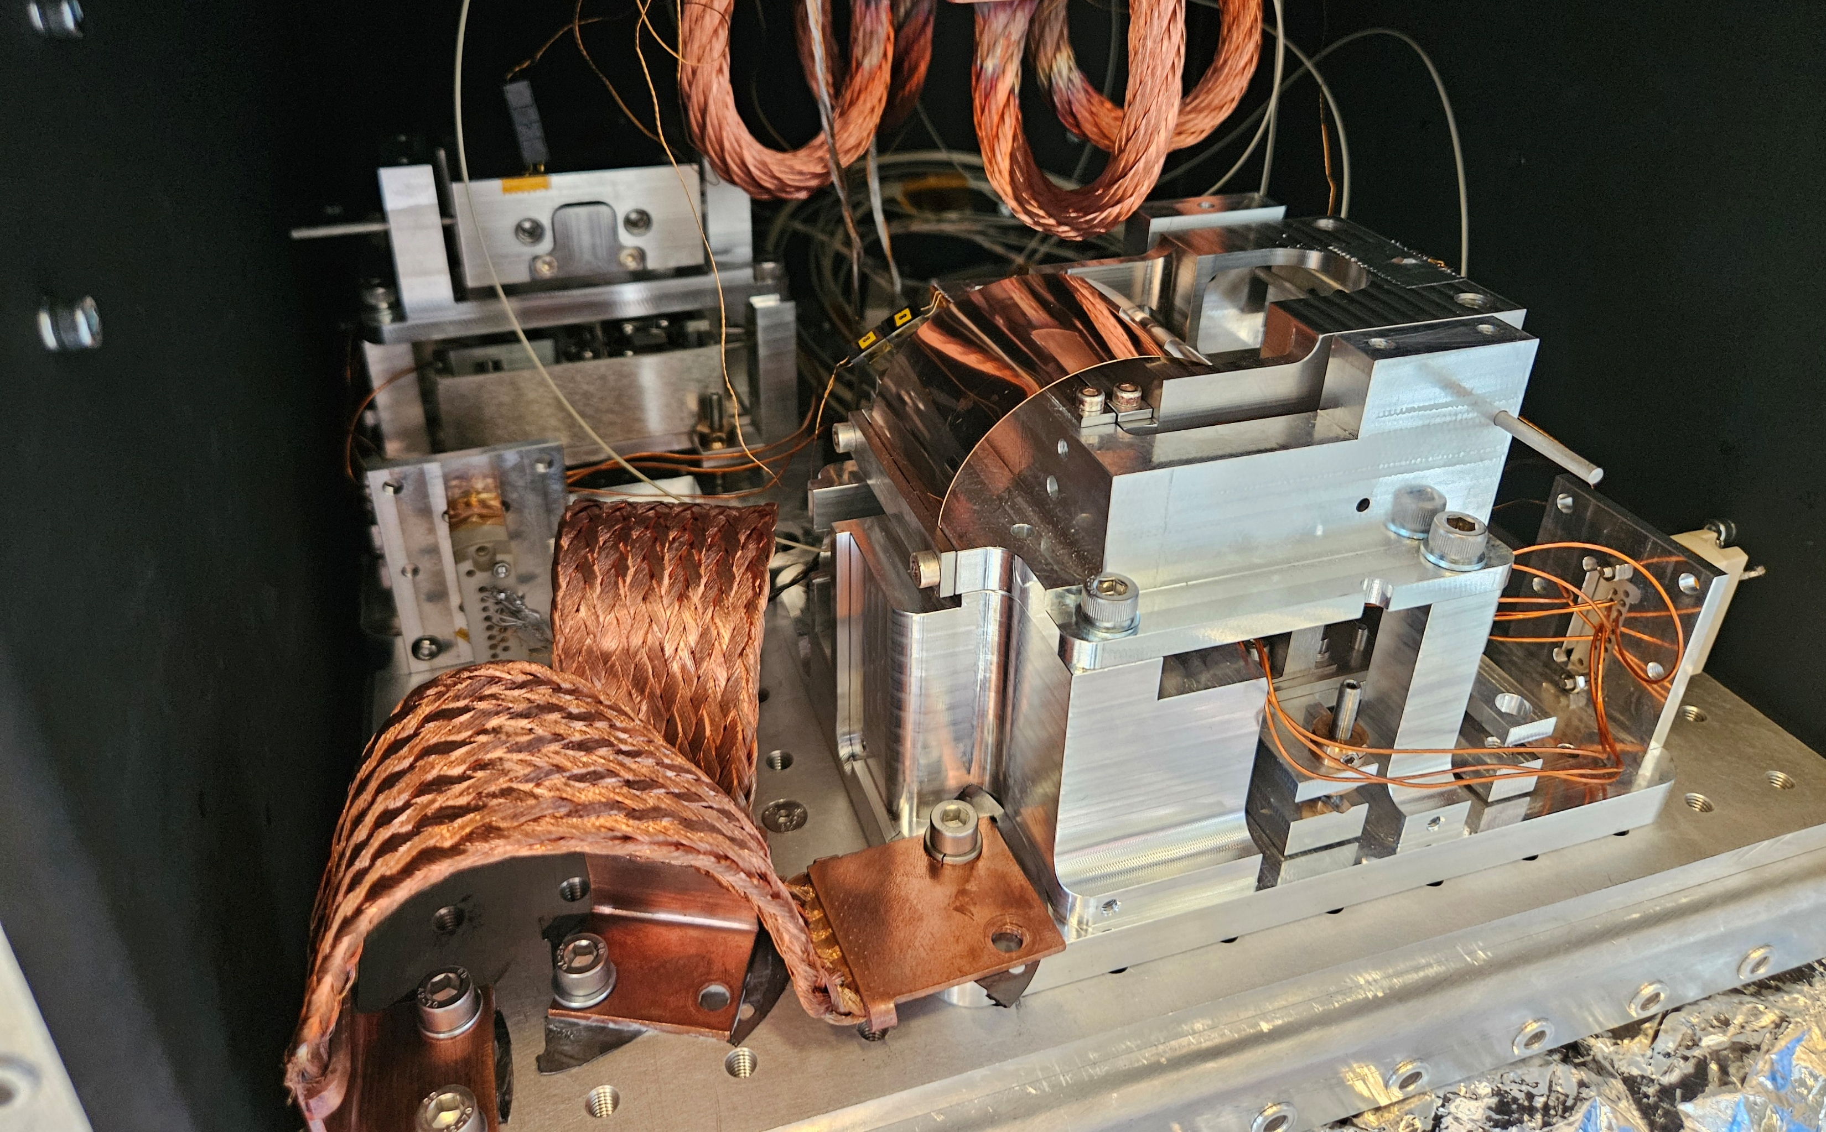
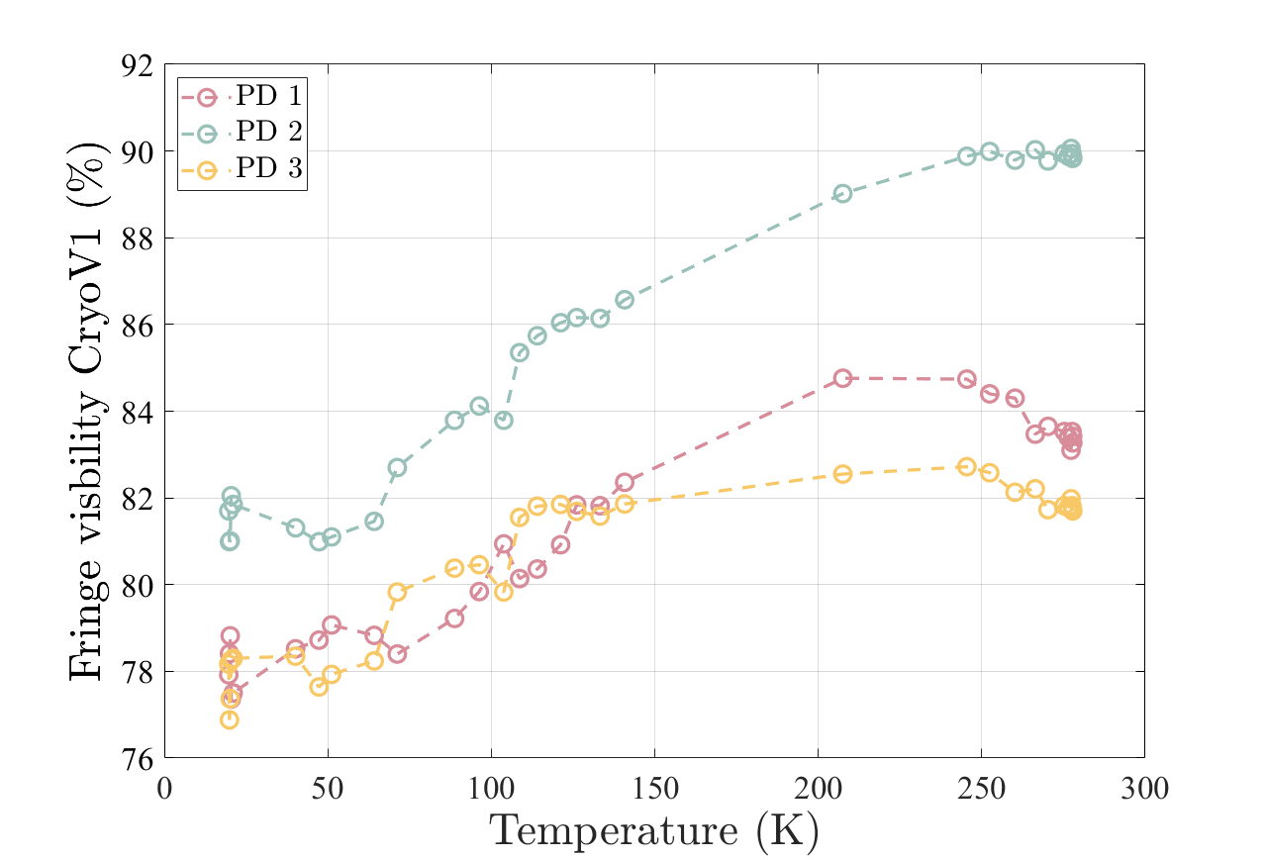
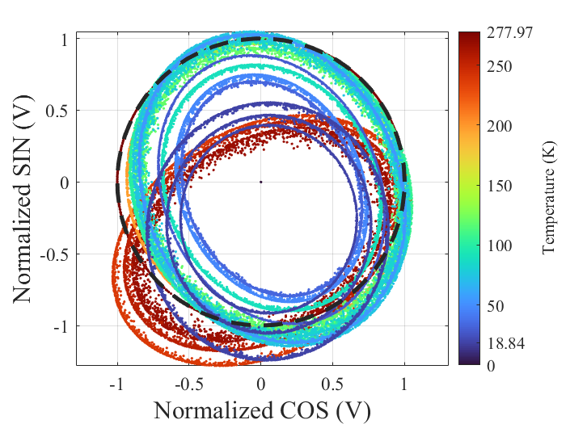

Interferometric readout – Alignment & compatibility
Alignment quality figure of merit:
Fringe visibility (FV) of the raw fringes measured by each photodiode
Cryo-V
Temperature sensors
Blocking rod
$$FV= \frac{V_{PD}\left(max\right) −V_{PD}(min)}{V_{PD}\left(max\right)+V_{PD}(min)}$$
The interferometer alignment is maintained down to 20K
Interferometric readout
Thermal link
  <10% relative fringe visibility loss!
Graphite layer
Fitted and normalized ellipse

