Slide 1




The τ g-2 at future collider
ZeQiang Wang
UCLouvain, CP3

Slide 2
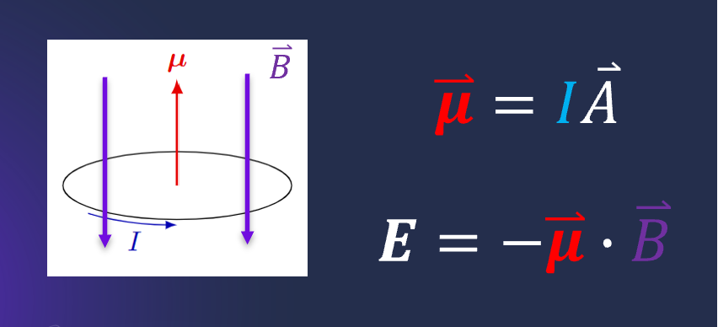
What is g-2?

Slide 3
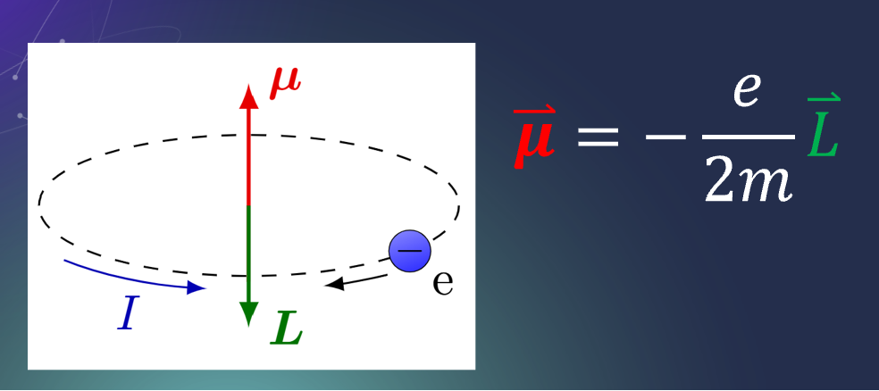
What is g-2?

Slide 4
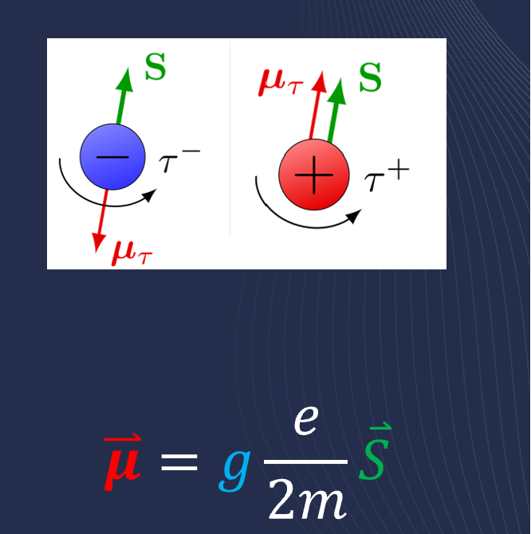
What is g-2?
The g-factor relates the magnetic dipole moment and its spin angular momentum

Slide 5
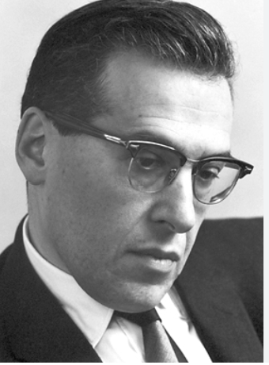
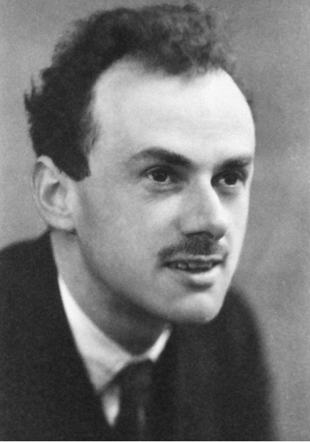
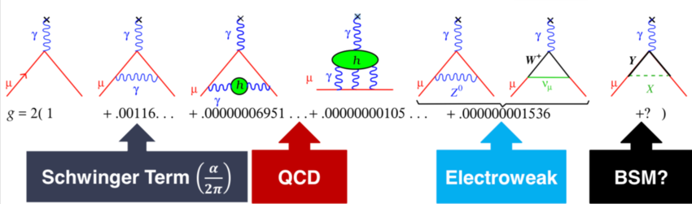

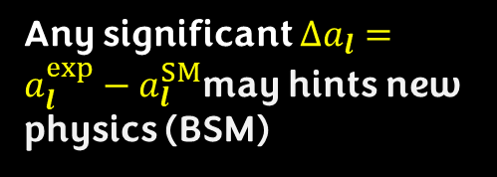
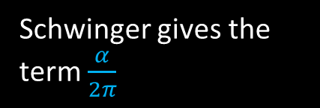
What is g-2?
Higer-order quantum effects(QED, electroweak and hadronic contributions) slightly modify g, defining the anomalous magnetic moment :
$$a_{l}=(g−2)/2$$
Dirac predicts g=2
Schwinger gives the term $\frac{α}{2π}$
Any significant $Δa_{l}=a_{l}^{exp}−a_{l}^{SM}$may hints new physics (BSM)

Slide 6
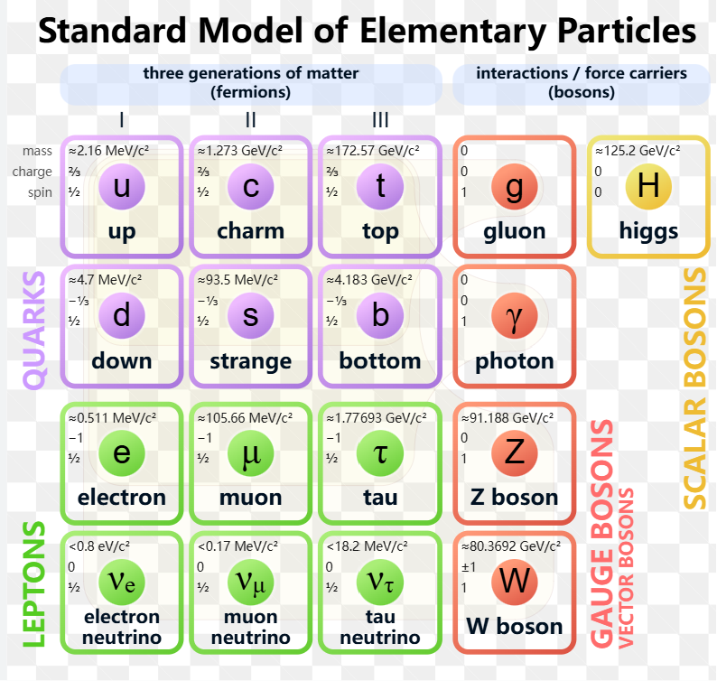
g-2 for charged lepton

Slide 7
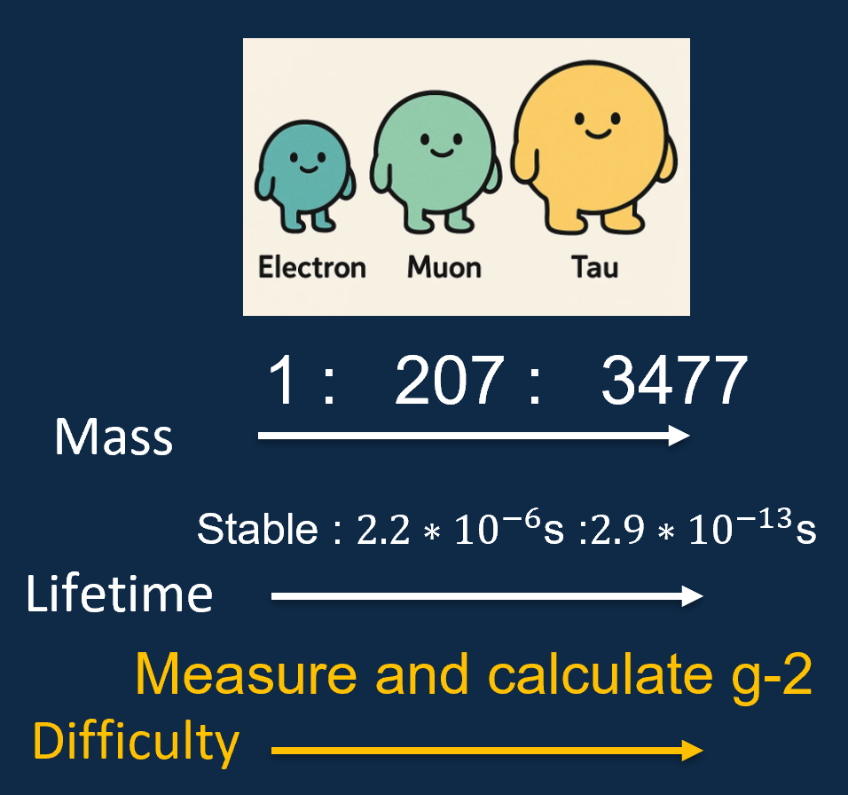
g-2 for charged lepton

Slide 8



The current state of g-2 of charged Lepton
$a_{e}^{SM}$= 0.001159652182032(720)
$a_{e}^{Exp}$= 0.00115965218059(13)

Slide 9
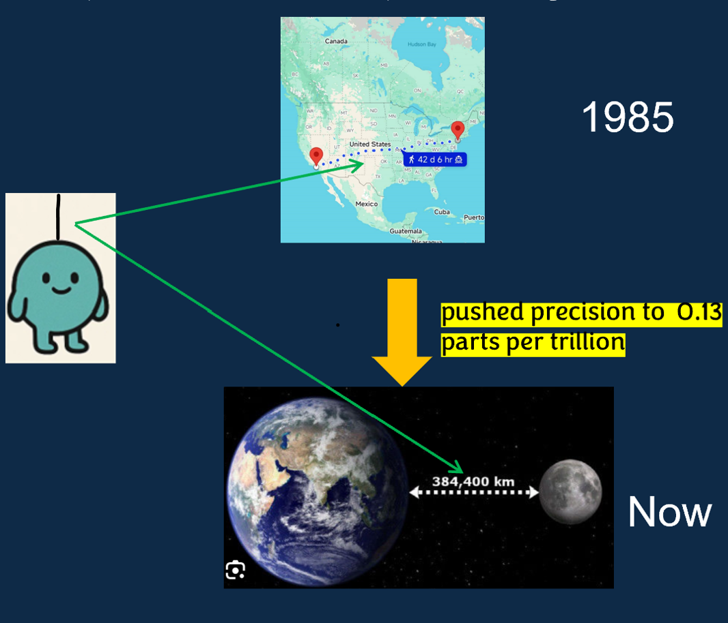
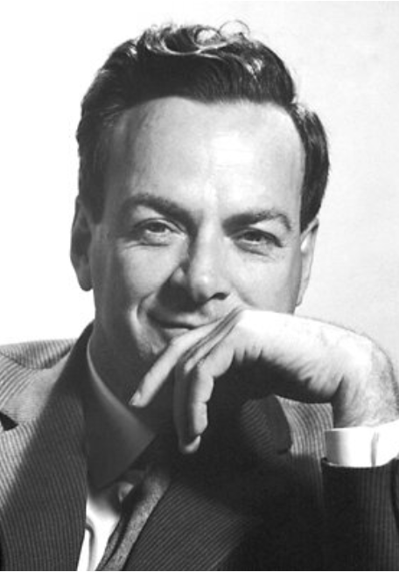
The current state of g-2 of charged Lepton
$a_{e}^{SM}$= 0.001159652182032(720)
$a_{e}^{Exp}$= 0.00115965218059(13)
“The precision of AMM like using the width
of a human hair to measure the distance
from Los Angeles to New York—over 3,000 miles”

Slide 10
The current state of g-2 of charged Lepton
$a_{e}^{SM}$= 0.001159652182032(720)
$a_{e}^{Exp}$= 0.00115965218059(13)
“The precision of AMM like using the width
of a human hair to measure the distance
from Los Angeles to New York—over 3,000 miles”
The most precise measurement in
fundamental particle’s property.

Slide 11

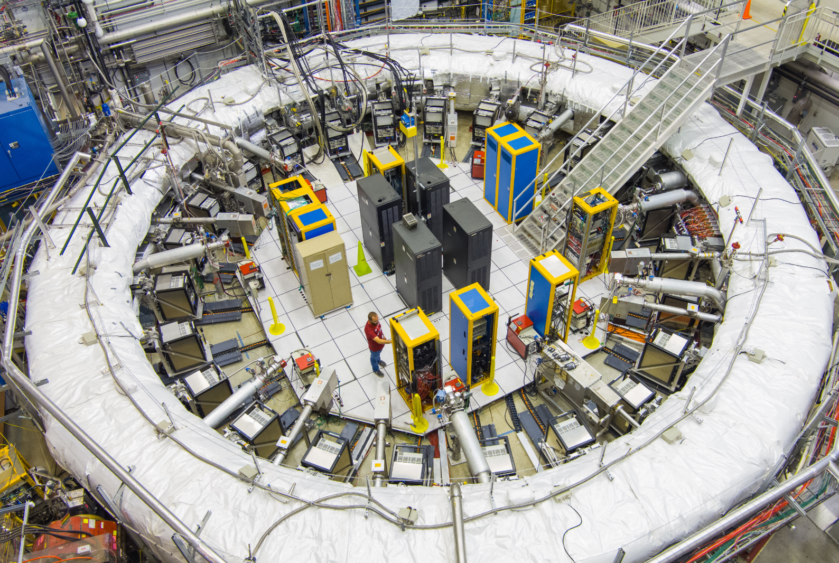

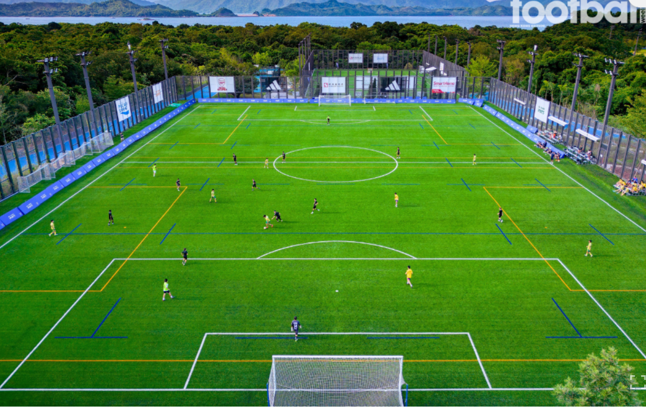


The current state of g-2 of charged Lepton
“This is equivalent to measuring the length
of a football field to a precision of one-tenth
the thickness of a human hair”
$a_{μ}^{SM}$= 0.00116591810(43)
measure
$a_{μ}^{Exp}$= 0.00116592059(22)
precision to up to 0.2
parts per million

Slide 12
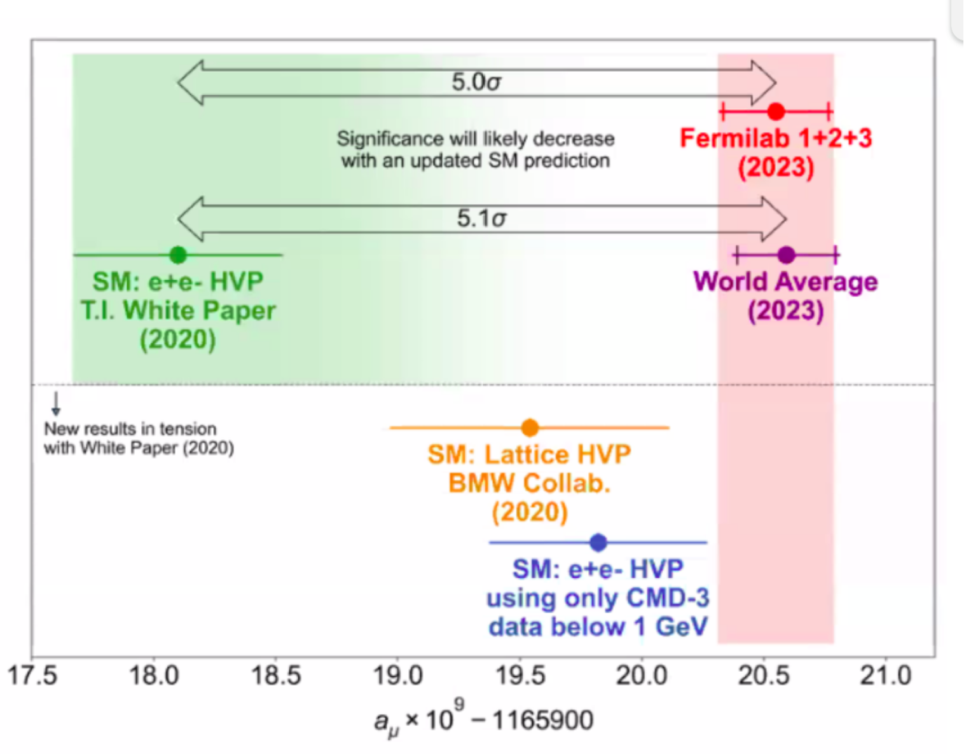
The current state of g-2 of charged Lepton
“This is equivalent to measuring the length
of a football field to a precision of one-tenth
the thickness of a human hair”
$a_{μ}^{SM}$= 0.00116591810(43)
measure
$a_{μ}^{Exp}$= 0.00116592059(22)
precision to up to 0.2
parts per million
Hints possible New Physics

Slide 13




The current state of g-2 of charged Lepton
“Short lifetime prevented precise measurements of its g-2,
but large mass hints larger $Δa_{l}$deviations may anticipate”
$a_{τ}^{SM}$= 0.00117721(5)
$a_{τ}^{Exp}$= ${0.0009}_{\text{−0.0031}}^{\text{+0.0032}}$​

Slide 14
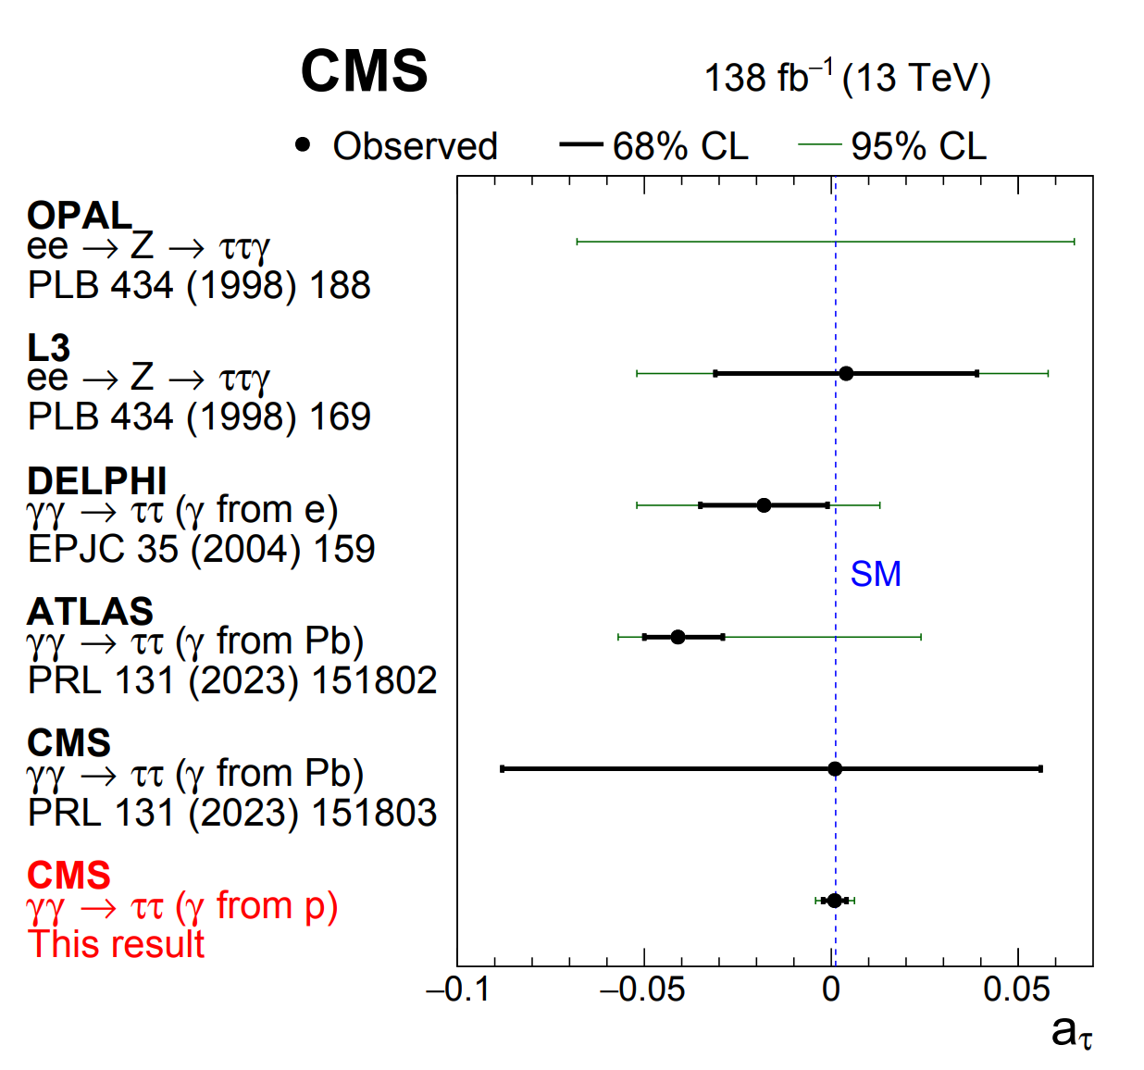
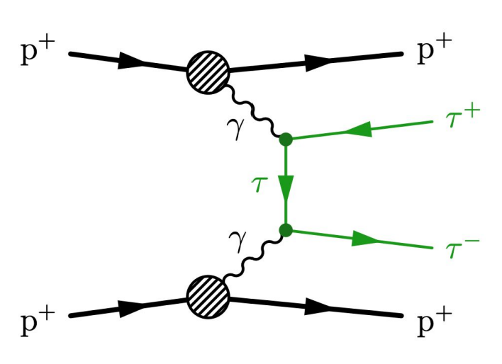
The current state of g-2 of charged Lepton
“Short lifetime prevented precise measurements of its g-2,
but large mass hints larger $Δa_{l}$deviations may anticipate”
LHC probes magnetic
moments through γγ→ττ
Improving LEP limits on
tau g-2 by a factor of five!!
$a_{τ}^{SM}$= 0.00117721(5)
$a_{τ}^{Exp}$= ${0.0009}_{\text{−0.0031}}^{\text{+0.0032}}$​

Slide 15
The current state of g-2 of charged Lepton
“Short lifetime prevented precise measurements of its g-2,
but large mass hints larger $Δa_{l}$deviations may anticipate”
LHC probes magnetic
moments through γγ→ττ
Improving LEP limits on
tau g-2 by a factor of five!!
$a_{τ}^{SM}$= 0.00117721(5)
$a_{τ}^{Exp}$= ${0.0009}_{\text{−0.0031}}^{\text{+0.0032}}$​
High-energy and luminosity future colliders will offer huge improvements in tau
production and precision.

Slide 16
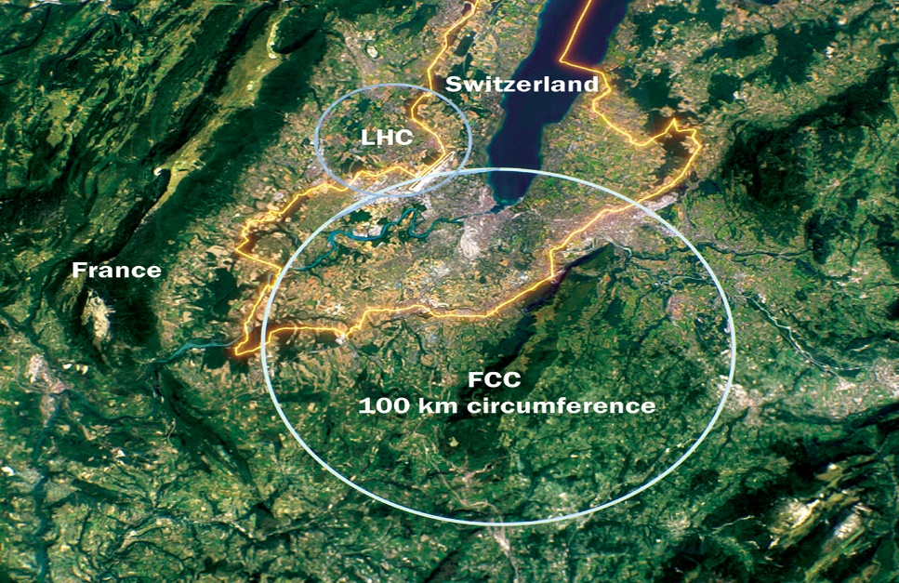
The future collider
Why FCC-ee?
Super high Luminosity at GeV scale
High Precision Measurements
Relatively Mature Technology
Low hadronization background
Clean experimental environment
EPA(Equivalent Photon Approximation)
……….

Slide 17
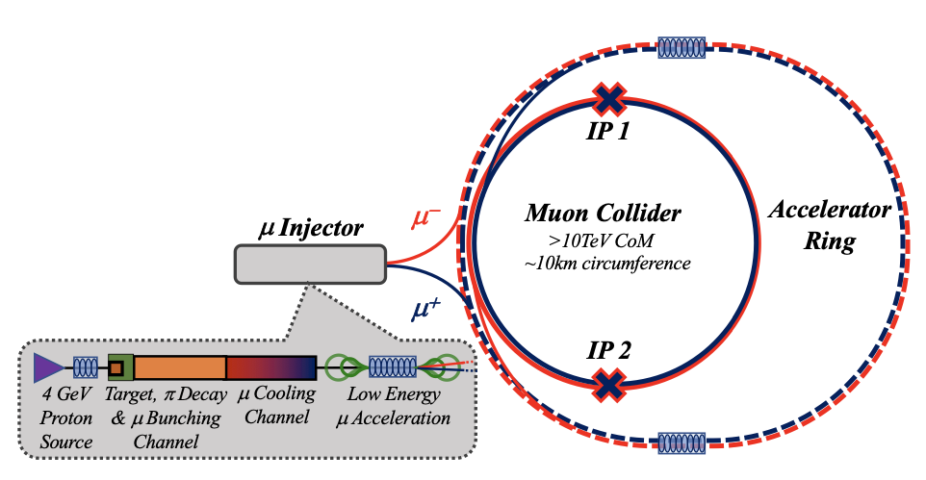
The future collider
Why Muon Collider?
High-energy and Luminosity
A promising candidate for the energy frontier at TeV scale
ECM efficient in 𝛍+𝛍- annihilation
Less radiation than e+e- collider
Much smaller beam-energy spread
A smaller and a circular machine is possible
…….
Why FCC-ee?
Super high Luminosity at GeV scale
High Precision Measurements
Relatively Mature Technology
Low hadronization background
Clean experimental environment
EPA(Equivalent Photon Approximation)
……….

Slide 18
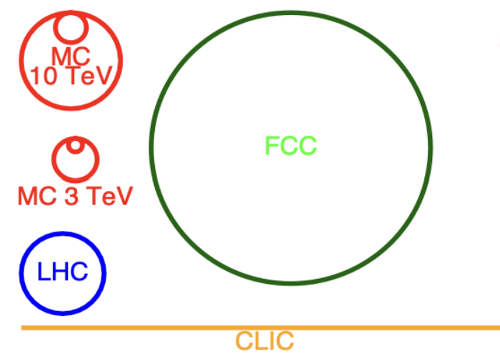
The future collider
Both high luminosity FCC-ee and high energy muon collider can offer a stronger sensitive environment to investigate new physics affecting the tau anomalous magnetic moment.

Slide 19

The tau g-2 based on SMEFT framework
$e^{+}e^{−}→τ^{+}τ^{−}$
$γ^{}γ^{}→τ^{+}τ^{−}(EPA)$
Process Electron Colliders（FCC-ee）

Slide 20

The tau g-2 based on SMEFT framework
$e^{+}e^{−}→τ^{+}τ^{−}$
$γ^{}γ^{}→τ^{+}τ^{−}(EPA)$
Process Electron Colliders（FCC-ee）
All possible high-energy processes at Muon Collider:
$μ^{+}μ^{−}→τ^{+}τ^{−}$
$μ^{+}μ^{−}→τ^{+}τ^{−}h（μ^{+}μ^{−}→τ^{+}τ^{−}z)$
$μ^{+}μ^{−}→μ^{+}μ^{−}τ^{+}τ^{−}$
$μ^{+}μ^{−}→τ^{+}τ^{−}\overset{‾}{ν}ν$
$μ^{+}μ^{−}→$ $μ^{+}τ^{−}$ ${\overset{‾}{ν}}_{τ}ν_{μ}$($μ^{−}τ^{+}$ ${\overset{‾}{ν}}_{μ}ν_{τ}$)
Offer a direct and highly sensitive
for measuring for tau g-2
Large cross-section driven by VBF

Slide 21
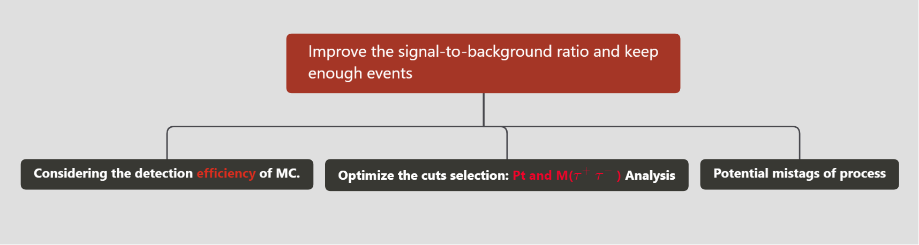

The tau g-2 based on SMEFT framework
$e^{+}e^{−}→τ^{+}τ^{−}$
$γ^{}γ^{}→τ^{+}τ^{−}(EPA)$
Process Electron Colliders（FCC-ee）
All possible high-energy processes at Muon Collider:
$μ^{+}μ^{−}→τ^{+}τ^{−}$
$μ^{+}μ^{−}→τ^{+}τ^{−}h（μ^{+}μ^{−}→τ^{+}τ^{−}Z)$
$μ^{+}μ^{−}→μ^{+}μ^{−}τ^{+}τ^{−}$
$μ^{+}μ^{−}→τ^{+}τ^{−}\overset{‾}{ν}ν$
$μ^{+}μ^{−}→$ $μ^{+}τ^{−}$ ${\overset{‾}{ν}}_{τ}ν_{μ}$($μ^{−}τ^{+}$ ${\overset{‾}{ν}}_{μ}ν_{τ}$)
Offer a direct and highly sensitive
for measuring for tau g-2
Large cross-section driven by VBF

Slide 22
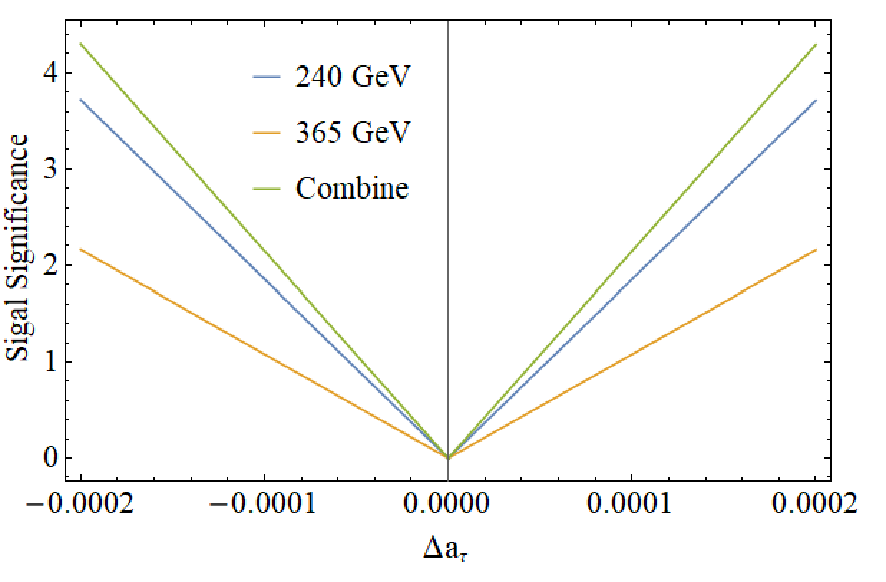
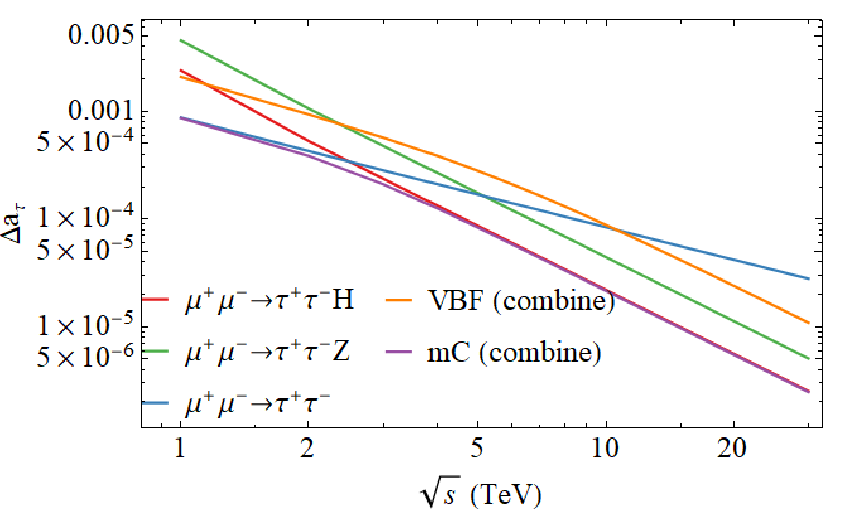
The g-2 of Tau at future collider
The combination of multiple processes and the sensitivity of $Δa_{τ}$
FCC-ee
Muon collider

Slide 23
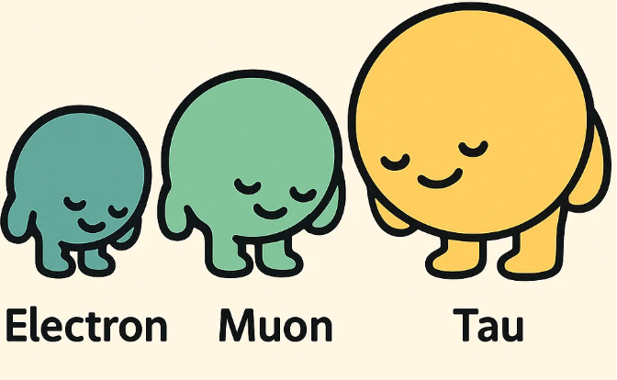
Thanks!

