Slide 1



Design of a new amorphous Silicon-based
Flat Panel Detector for Particle Therapy
¹Khalil El Achi, ¹Eduardo Cortina Gil,
²Alexis Warnier, ²Victor De Beco, ²Severine Rossomme
¹Université Catholique de Louvain, Louvain-la-Neuve, Belgium
²IBA Dosimetry, Louvain-la-Neuve, Belgium

Slide 2
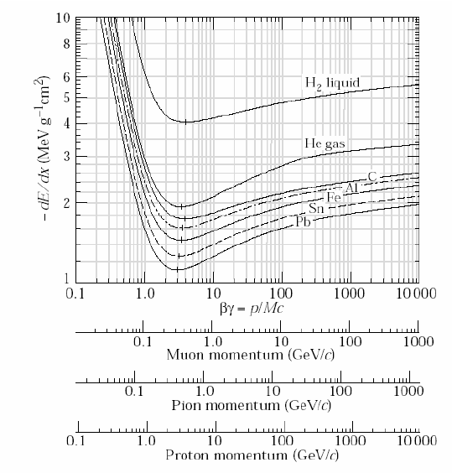
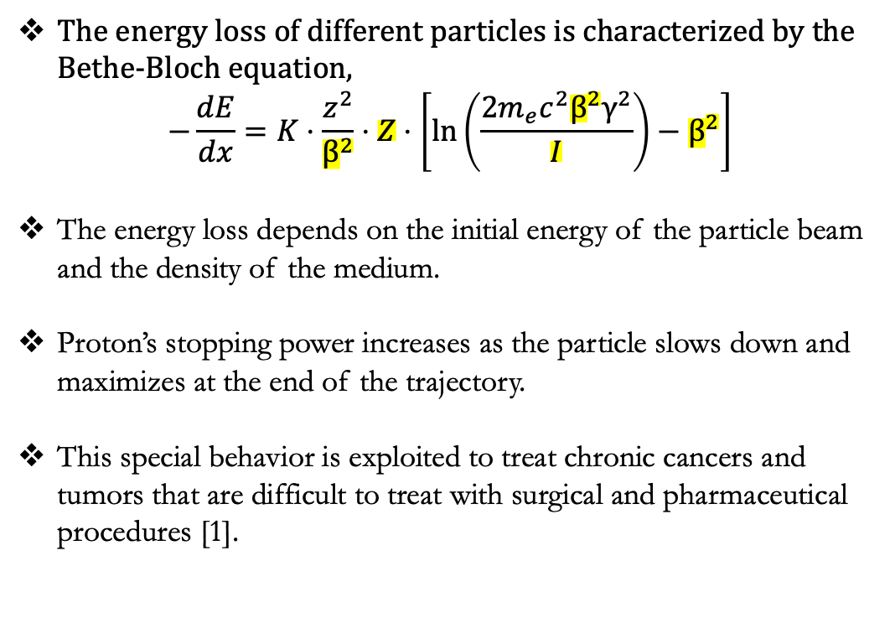
Proton Stopping Power
The energy loss of different particles is characterized by the Bethe-Bloch equation,
$$−\frac{dE}{dx}=K⋅\frac{z^{2}}{β^{2}}⋅Z⋅\left[\ln\left(\frac{2m_{e}c^{2}β^{2}γ^{2}}{I}\right)−β^{2}\right]$$
The energy loss depends on the initial energy of the particle beam and the density of the medium.
Proton’s stopping power increases as the particle slows down and maximizes at the end of the trajectory.
This special behavior is exploited to treat chronic cancers and tumors that are difficult to treat with surgical and pharmaceutical procedures [1].
[1] Durante, M., Orecchia, R., & Loeffler, J. S. (2017). Charged-particle therapy in cancer: clinical uses and future perspectives. Nature Reviews Clinical Oncology, 14(8), 483-495.

Slide 3
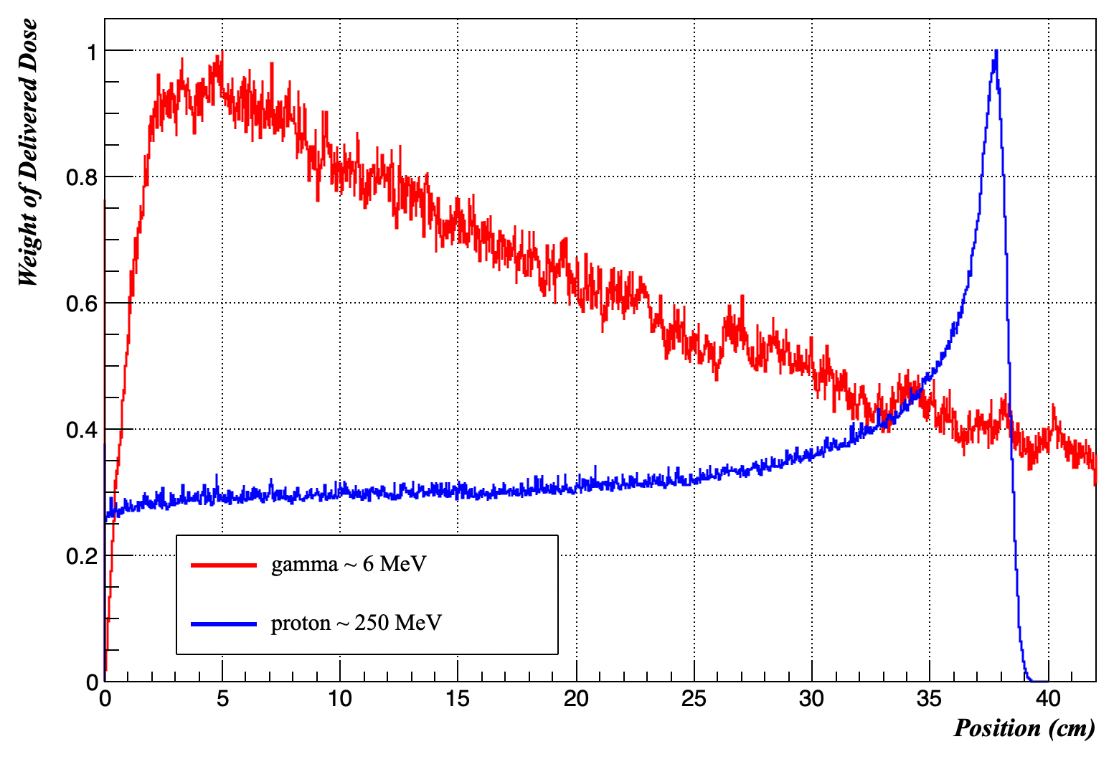
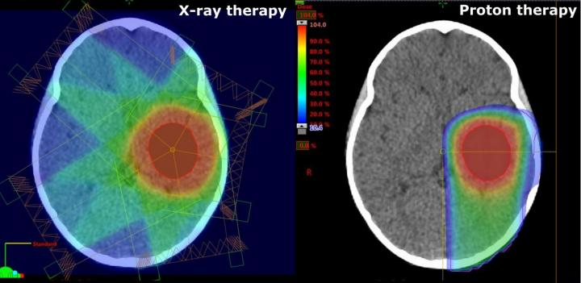
Proton Therapy (PT) and Conventional Radiotherapy (RT)
Proton therapy:
Utilizing highly accelerated protons of range 60 – 250 MeV
Particles penetrate the tissue and deposit the lethal dose to a small region
Preserving healthy cells located around the tumor
Conventional Radiotherapy
Ɣ-rays of energy range 6 – 25 MeV
Most common form of radiation treatment
Dose delivered around the tumor
Significant non-lethal dose delivered all around the tumor [2]
[2] E. C. Halperin, “Particle therapy and treatment of cancer,” The lancet oncology, vol. 7, no. 8, pp. 676–685, 2006.

Slide 4
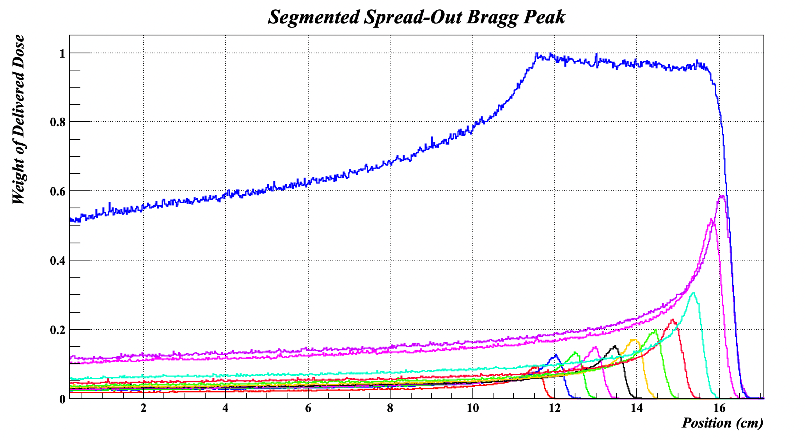
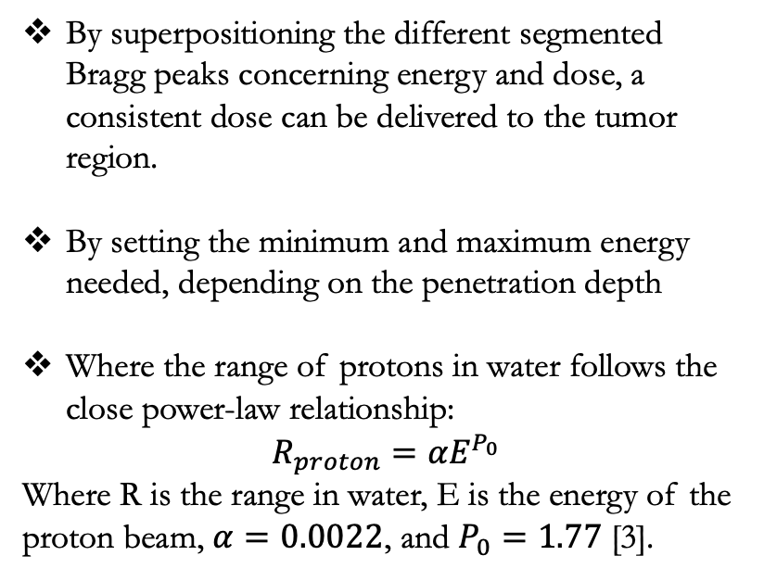
Spread Out Bragg Peak (SOBP)
By superpositioning the different segmented Bragg peaks concerning energy and dose, a consistent dose can be delivered to the tumor region.
By setting the minimum and maximum energy needed, depending on the penetration depth
Where the range of protons in water follows the close power-law relationship:
$$R_{proton}=αE^{P_{0}}$$
Where R is the range in water, E is the energy of the proton beam, $α=0.0022$, and $P_{0}=1.77$ [3].
Healthy cells receiving a non-lethal dose
Tumor
[3] Jette, D., & Chen, W. (2011). Creating a spread-out Bragg peak in proton beams. Physics in Medicine & Biology, 56(11), N131.

Slide 5
Proton therapy delivery techniques – Pencil Beam Scanning (PBS)
The modern proton therapy delivery technique, where the proton beam is magnified and steered by a set of magnets.
Has the capacity for Ultra-High-Dose Rate (UHDR) proton FLASH therapy [4]
Scanning Magnets
Tumor
Proton
Beam
The pencil beam traced the irradiated area layer by layer
X- direction
Y- direction
Patient
[4] B. Lin, D. Huang, F. Gao, et al., “Mechanisms of flash effect,” Frontiers in Oncology, vol. 12, p. 995 612, 2022.

Slide 6
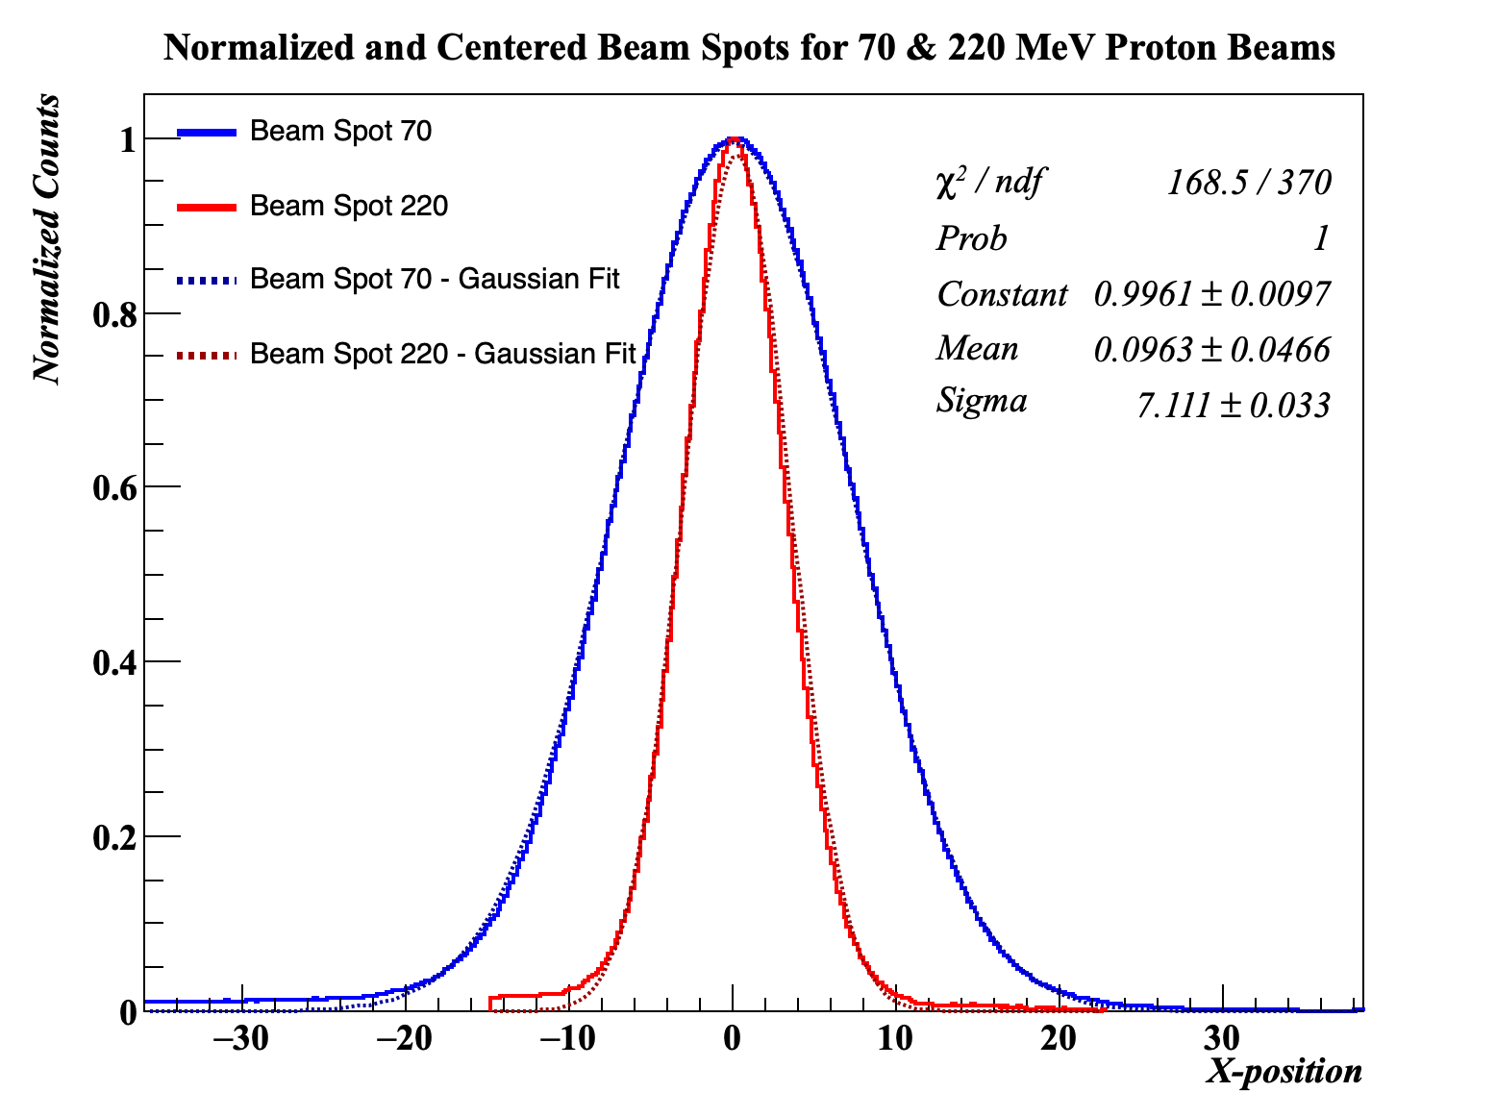
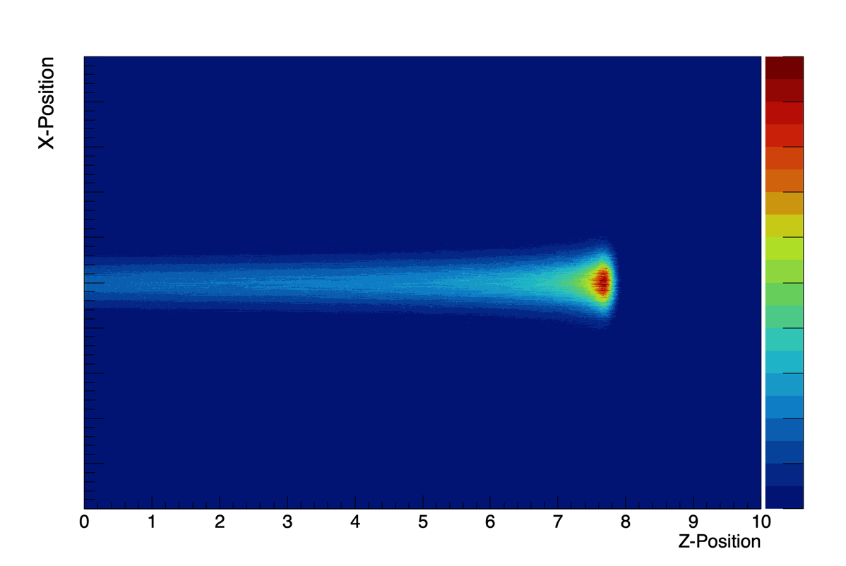
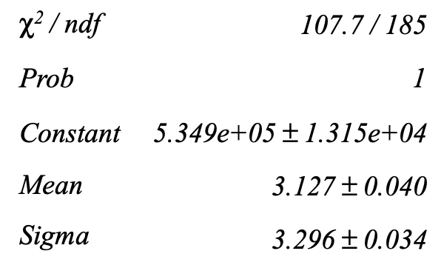
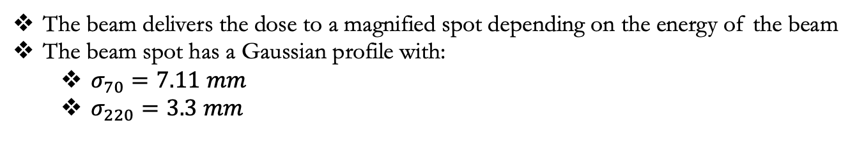
Proton therapy delivery techniques – Pencil Beam Scanning (PBS)
The beam delivers the dose to a magnified spot depending on the energy of the beam
The beam spot has a Gaussian profile with:
$σ_{70}=7.11 mm$
$σ_{220}=3.3 mm$
Proton Pencil Beam Scanning Dose Distribution
70 MeV Spot
220 MeV Spot
X-position (mm)
*acquired by IBA Sphinx Compact Detector
*Simulated with Geant4

Slide 7
Patient-Specific Quality Assurance (PSQA) - Ionization Chambers
To accurately deliver the dose, quality assurance practices have to be done
Medical Dosimetry:
Irradiating a particle detector with the treatment plan, to verify the delivered dose
PBS flat field scanning
Detector Placement
water

Slide 8
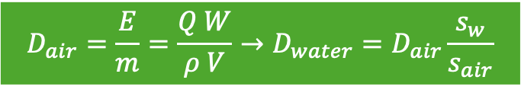
Patient-Specific Quality Assurance (PSQA) - Ionization Chambers
To accurately deliver the dose, quality assurance practices have to be done
Medical Dosimetry:
Irradiating a particle detector with the treatment plan, to verify the delivered dose
PBS flat field scanning
Detector Placement
Ionization Chamber
p-beam
Anode
High Voltage
e⁺ e⁻
Cathode
R
$$D_{air}=\frac{E}{m}=\frac{Q W}{ρ V}→D_{water}=D_{air}\frac{s_{w}}{s_{air}}$$
C
D: dose, E: energy, m: mass, Q: charge in detector, W: energy needed to create one electron/ion pair in air, s: stopping power
water
Readout Circuit

Slide 9
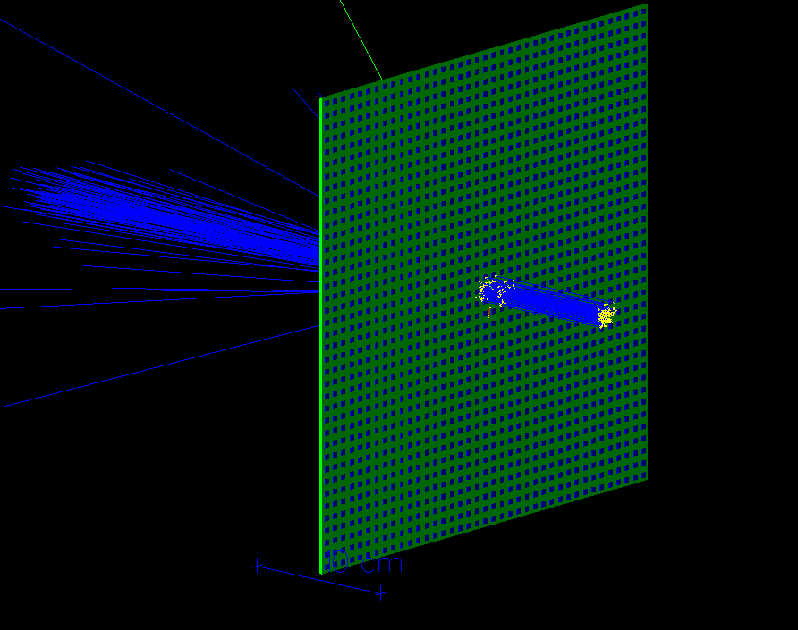
Patient-Specific Quality Assurance (PSQA) - Ionization Chambers
To accurately deliver the dose, quality assurance practices have to be done
Medical Dosimetry:
Irradiating a particle detector with the treatment plan, to verify the delivered dose
PBS flat field scanning
Detector Placement
Flat-panel detectors, made of segmented air cylinders, provide both dosimetry and dose map construction.
But with a limited resolution of ~ 6 mm
PBS
30 cm
water
30 cm

Slide 10
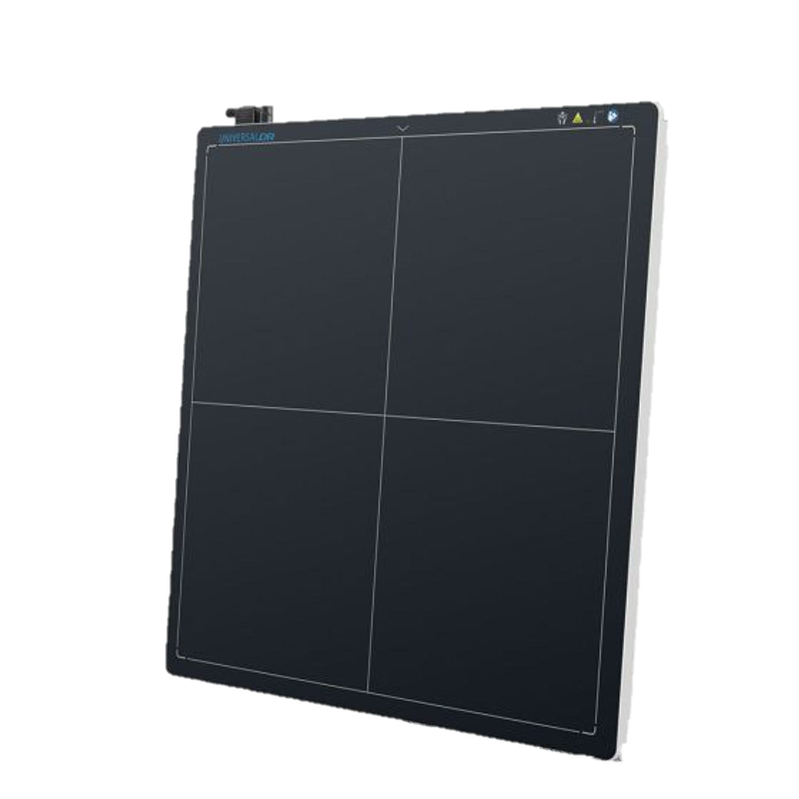
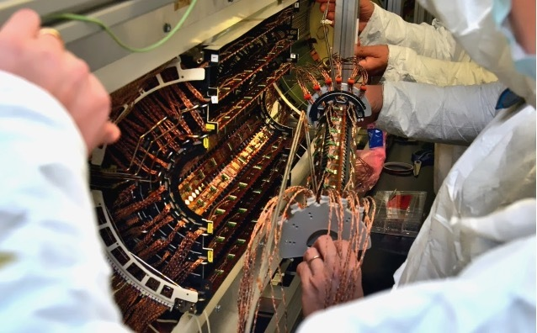
Semiconductor-based Detectors
Semiconductor detectors are characterized by:
High radiation resistance
Increase image resolution ~ 0.2 mm
Fast acquisition and signal generation [5]
CMS Silicon Pixel Tracker
aSi Flat Panel Detectors
for X-ray Imaging
[5] N. Wyrsch and C. Ballif, “Review of amorphous silicon based particle detectors: The quest for single particle detection,” Semiconductor Science and Technology, vol. 31, no. 10, p. 103 005, 2016.
[6] H. Schindler, R. Veenhof, Garfield++ | simulation of ionisation based tracking detectors, 2018, URL http://garfieldpp.web.cern.ch/garfieldpp/

Slide 11
Amorphous Silicon (a-Si) based TFT Flat Panel Detectors
a-Si Thin-Film-Transistor (TFT) Array consists of:
PIN Photodiode, which produced the current signal on the bottom electrode
Connects to the source of the TFT. When the insulating gate activates, the charges drift towards the drain and charge into a storage capacitor
Simulated in COMSOL, interfaced with Garfield++ [6], for understanding the specific characteristics of the pixel
aSi TFT Array
G
Gate
drivers
D
S
photodiode
Photodiode
TFT
particle
TFT
Bias
p-doping
-
-
-
-
+
+
+
+
Drain
Source
n+ a-Si
SiN_{x}
n+ a-Si
a-Si intrinsic layer
Signal acquisition system
a-Si
Data Lines
SiN_{x}
gate
n-doping
SiN_{x}
Electrode
[5] N. Wyrsch and C. Ballif, “Review of amorphous silicon based particle detectors: The quest for single particle detection,” Semiconductor Science and Technology, vol. 31, no. 10, p. 103 005, 2016.
[6] H. Schindler, R. Veenhof, Garfield++ | simulation of ionisation based tracking detectors, 2018, URL http://garfieldpp.web.cern.ch/garfieldpp/

Slide 12
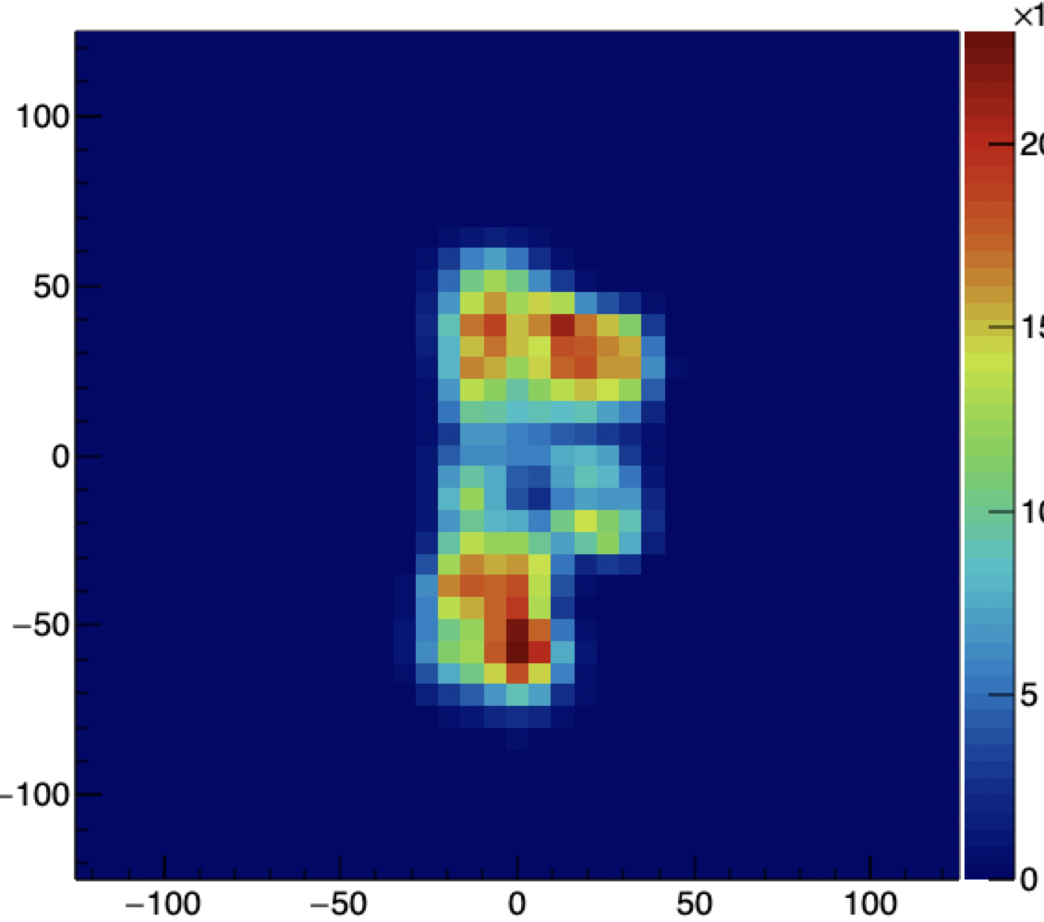
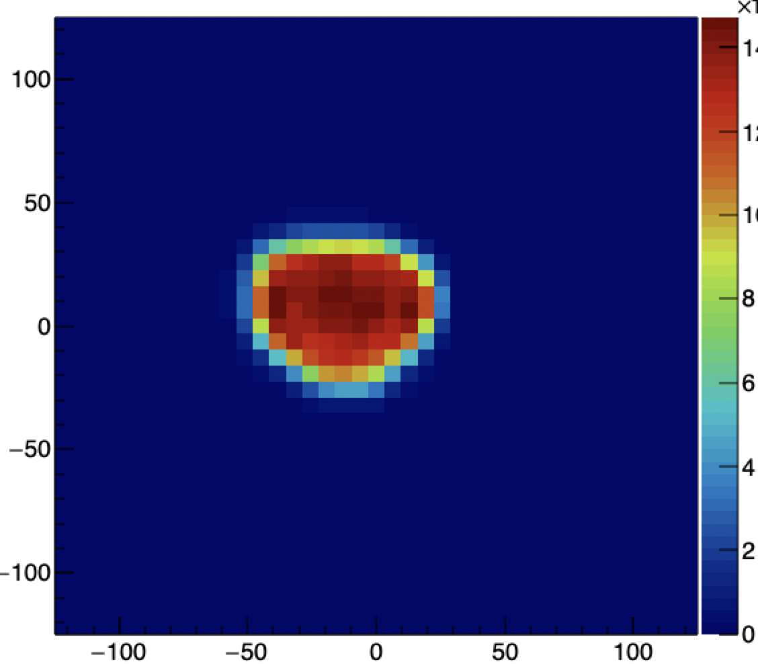
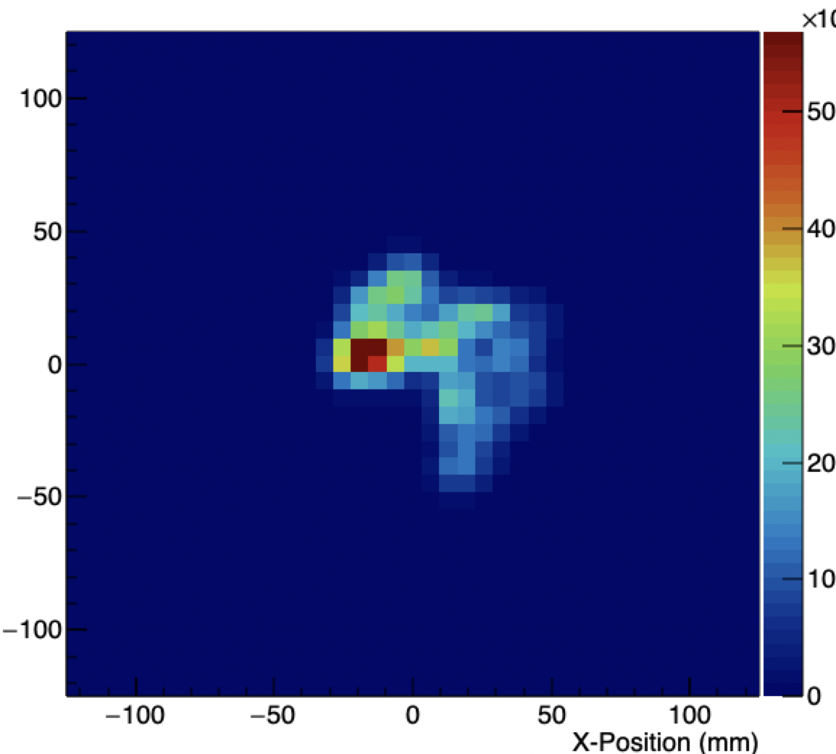
Improved resolution of Ionization Chambers to Silicon Pixel Detectors
Clinical Map 1
Clinical Map 2
Clinical Map 3
Image acquired by
IBA MatriXX Resolution
Array of Ionization chambers

Slide 13
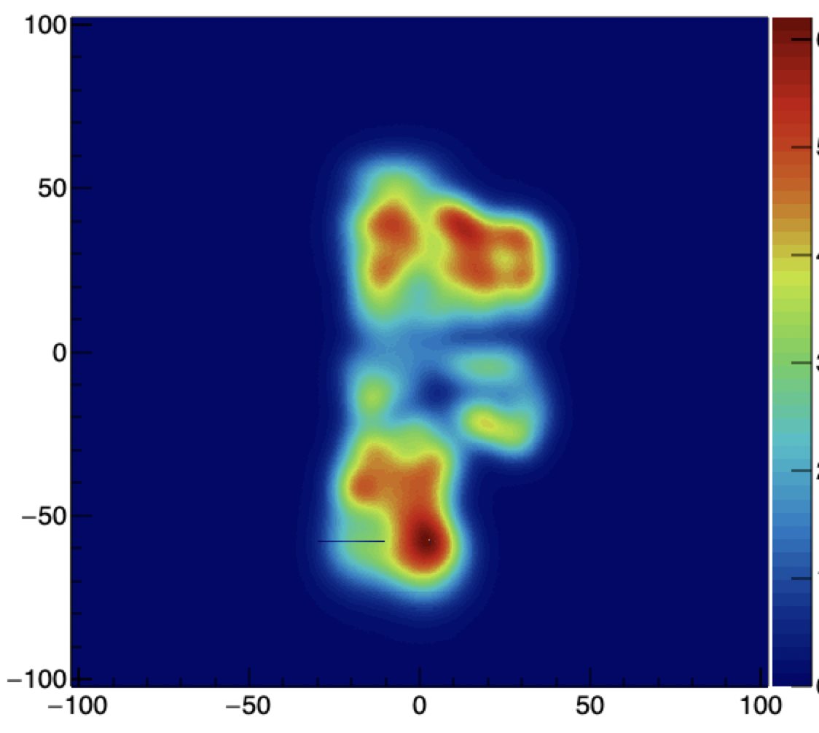
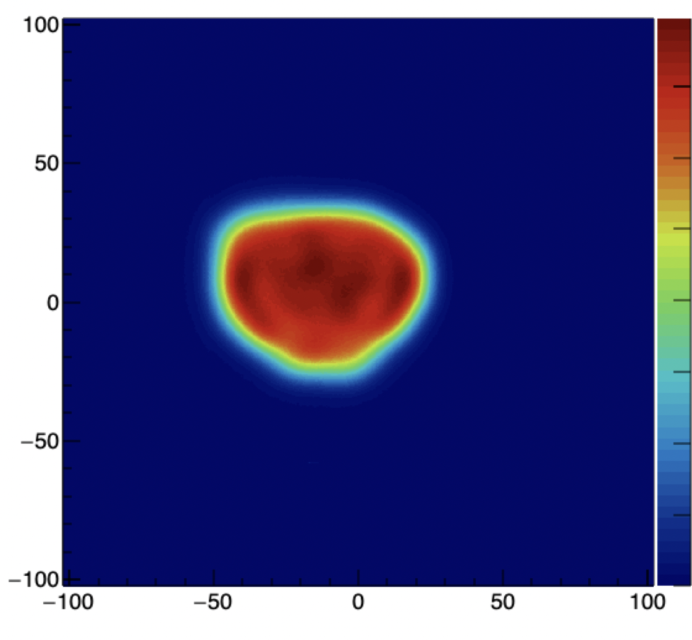
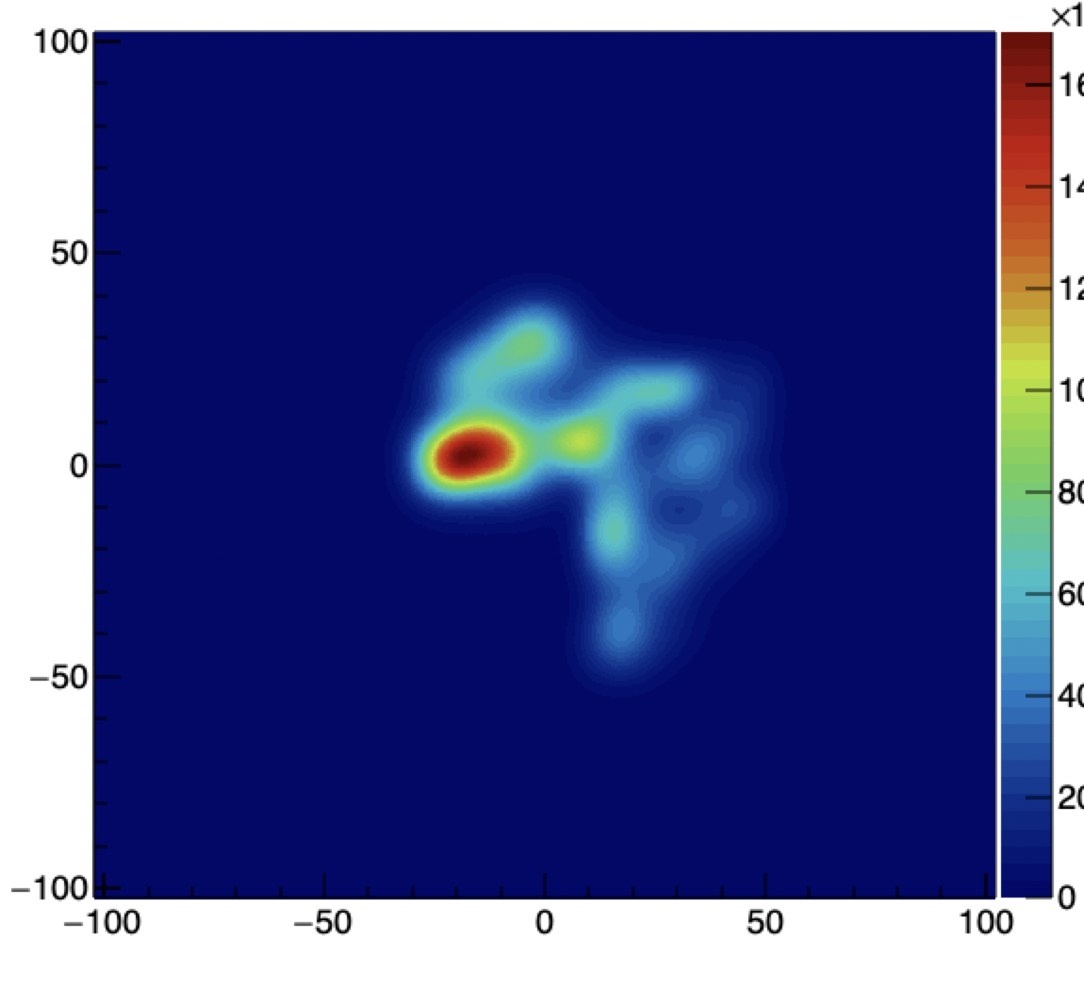
Improved resolution of Ionization Chambers to Silicon Pixel Detectors
Clinical Map 1
Clinical Map 2
Clinical Map 3
Image acquired by
IBA MatriXX Resolution
Array of Ionization chambers
Images acquired by
IBA Sphinx Compact
aSi TFT Panel

Slide 14
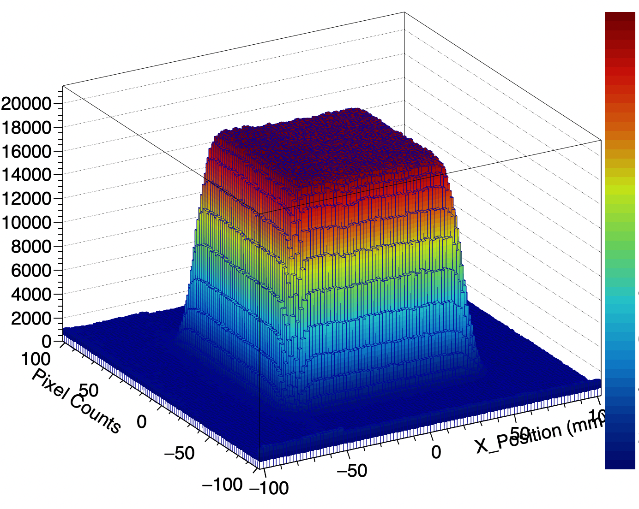
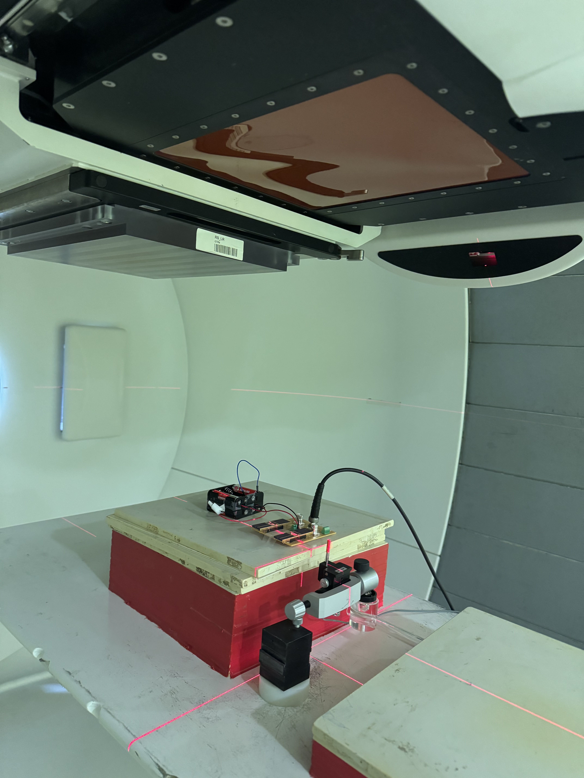
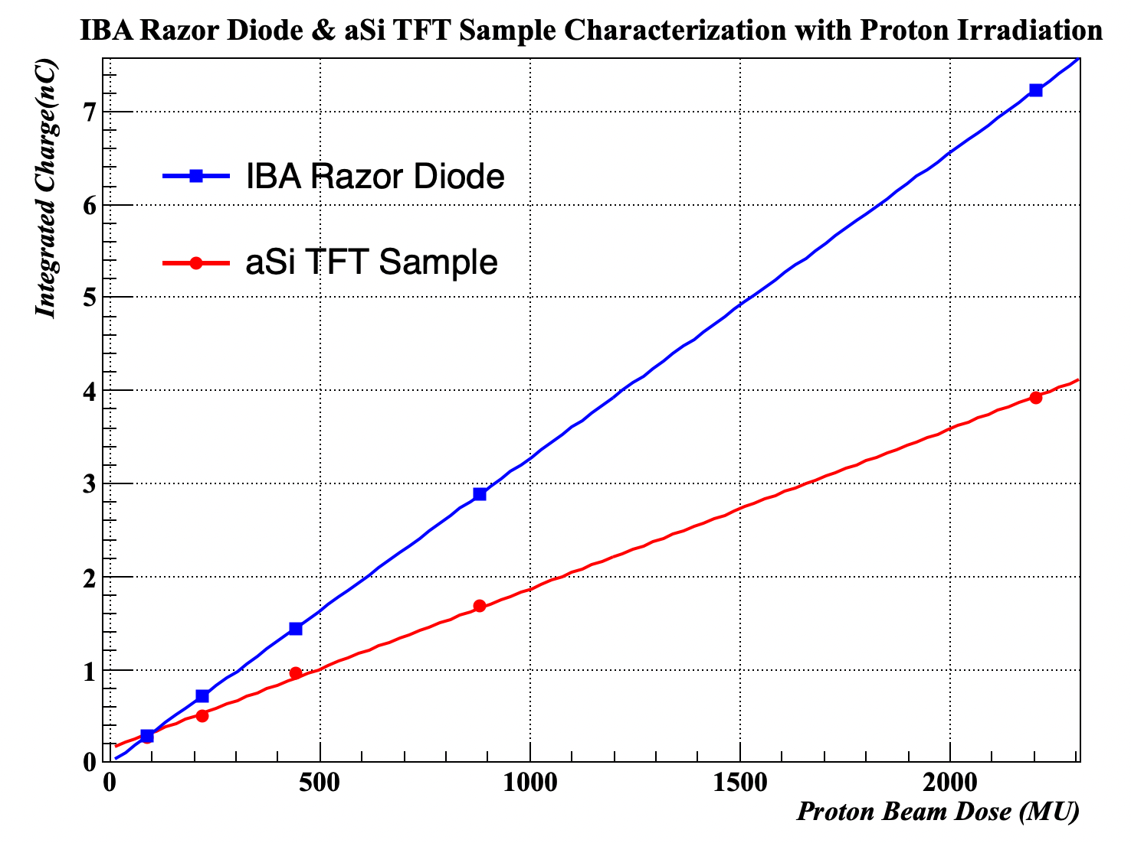
Comparison of small field dosimetry detectors
To understand the different behavior of crystalline-based (c-Si) and amorphous-based (a-Si) silicon detectors under different particle beams.
The IBA Razor Diode and a small a-Si TFT array were irradiated with a flat 10 x 10 proton PBS with different doses.
Both diodes exhibited pristine charge linearity, without showing any saturation at high-proton doses.
Diodes will be further tested with proton and electron FLASH dose levels.
Dose Map of a flat 10 x 10 PBS field
Proton beam gantry
Razor
aSi Pixels

Slide 15
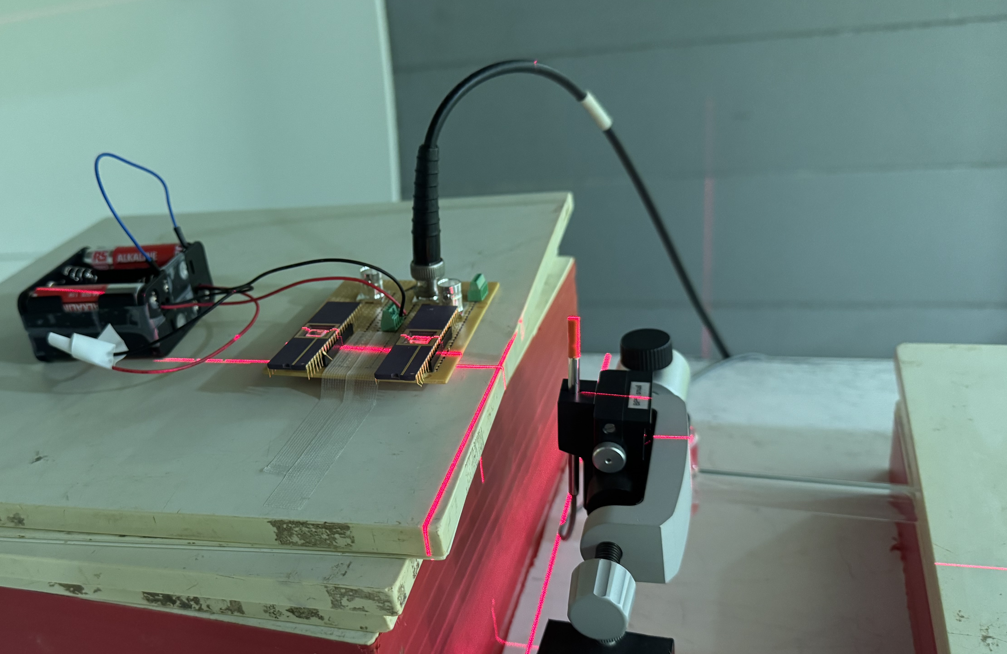
Comparison of small field dosimetry detectors
To understand the different behavior of crystalline-based (c-Si) and amorphous-based (a-Si) silicon detectors under different particle beams.
The IBA Razor Diode and a small a-Si TFT array were irradiated with a flat 10 x 10 proton PBS with different doses.
Both diodes exhibited pristine charge linearity, without showing any saturation at high-proton doses.
Diodes will be further tested with proton and electron FLASH dose levels.
Dose Map of a flat 10 x 10 PBS field
Proton beam gantry
aSi Pixels
Razor

Slide 16
BACK-UP SLIDES

Slide 17
Proton therapy delivery techniques – Conventional Scattering
A monoenergetic Proton Beam operates at the highest energy, while the modulator changes the energy per delivered dose. Where a compensator is placed, according to the shape of the tumor
Energy/Range
Modulator
Collimator
Tumor
Proton
Beam
Compensator
Scatterer
Irradiated Zone
Patient

Slide 18
Silicon-based Pixel detectors
PN – Diodes
PIN – Diodes
Al
SiO₂
particle
p+
- V_{bias}
Bias
p-doping
-
-
-
-
-
-
-
+
+
+
+
n- bulk
+
+
+
a-Si intrinsic layer
depleted region
neutral region
n-doping
Electrode
n+ ohmic contact
0 V
p-beam

