Slide 1



Charge asymmetry: a theory appraisal
Germán Rodrigo
Brugge, May 31 - June 4, 2010

Slide 2

The top quark
The top quark is the heaviest known elementary particle: it plays a fundamental role in many extensions of the Standard Model (SM) / alternative mechanisms of EWSB.
Huge statistics from top-antitop quark pair production
Tevatron: σ = 7.6 (5) pb
Integrated luminosity of 10 fb⁻¹: 7x10⁴ top quark pairs
LHC @14 TeV: σ = 940 (80) pb
with 10 fb⁻¹/year: millions of top pairs per year
LHC @7 TeV: σ = 160 (10) pb
200 pb⁻¹ (1fb⁻¹) by the end of 2010 (2011): 10⁵ top quark pairs
Production and decay channels are promising probes of new physics.

Slide 3
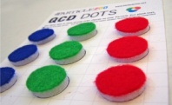

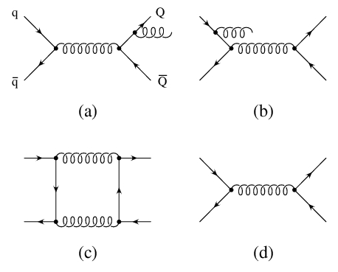
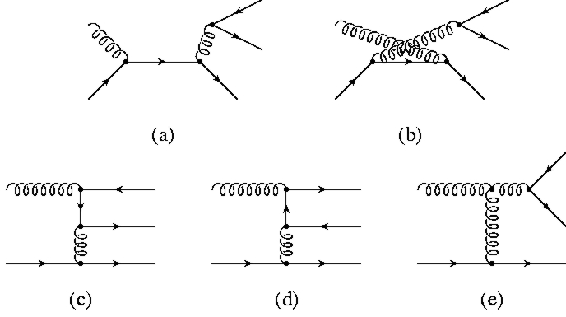
Charge asymmetry in QCD
At O(α_{S}²): top and antitop quarks have identical angular distributions
A charge asymmetry arises at O(α_{S}³)
Interference of ISR with FSR
LO for ttbar+jet
negative contribution
Interference of box diagrams with Born
positive contribution
● color factor d_{abc}² : pair in color singlet
● Loop contribution larger than tree level
top quarks are preferentially emitted in the direction of the incoming quark
Flavor excitation (qg channel) much smaller
[Kühn, GR,1998]

Slide 4
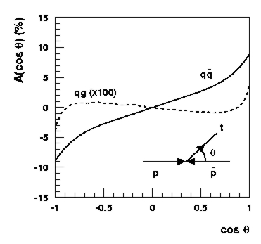
Inclusive asymmetry at Tevatron
Charge conjugation symmetry ( )
⇨ Forward-backward
■ mixed QCD-EW interference: factor 1.09 included
■ stable to NLL threshold resummations (one per mille) [Almeida,Sterman,Vogelsang, 2008 ]
■ NNLL threshold resummations [Ahrens,Ferroglia,Neubert,Pecjak,Yang, 2010]
Not expanding the asymmetry in α_{S} : the asymmetry decreases by 20% at NLO (K factor), but only by 5% at NLO+NNLL
[Kühn, GR,1998; Antuñano, Kühn, GR, 2008]

Slide 5
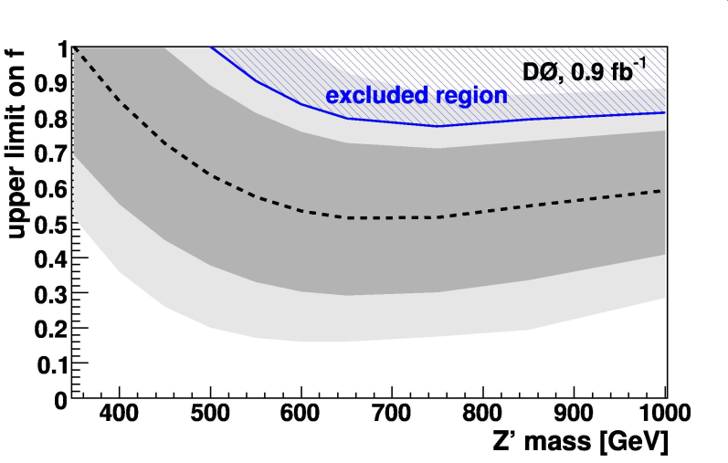
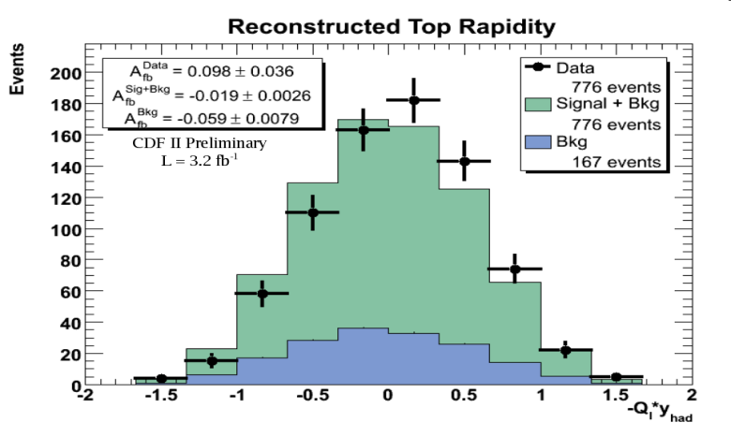
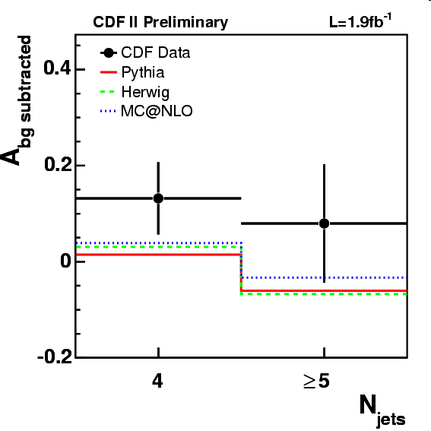
Asymmetry measurements at Tevatron
D0 [PRL101(2008)202001] uncorrected
A_{FB}^{ppbar} = 0.12 ± 0.08 (stat) ± 0.01 (syst) 0.9 fb⁻¹
Limits as a function of the fraction (f) of ttbar events
produced via a topcolor leptophobic Z′ resonance
CDF [Conf. Note 9724, PRL101(2008)202001]
ppbar rest frame
A_{FB}^{ppbar} = 0.193 ± 0.065 (stat) ± 0.024 (syst) 3.2 fb⁻¹
A_{FB}^{ppbar} = 0.17 ± 0.07 (stat) ± 0.04 (syst) 1.9 fb⁻¹
ttbar rest frame
A_{FB}^{ttbar} = 0.24 ± 0.13 (stat) ± 0.04 (syst) 1.9 fb⁻¹
At least 4 jets: A_{FB}^{ttbar} = 0.119 ± 0.064 (stat)
Exact 4 jets: A_{FB}^{ttbar} = 0.132 ± 0.075 (stat)
At least 5 jets: A_{FB}^{ttbar} = 0.079 ± 0.123 (stat)
2.8σ from zero, (A^{exp} – ASM)_{ppbar} =0.142 ± 0.069
room for BSM within 2σ

Slide 6

Which model BSM

Slide 7
Chiral Color Models
[Pati , Salam, PLB58(1975)333; Hall,Nelson, PLB153(1985)430;
Frampton, Glashow, PLB190(1987)157; PRL58(1987)2168]
Extend the standard color gauge group to
SU(3)_{L} x SU(3)_{R} → SU(3)_{C}
● different implementations with new particles in varying representations (anomaly cancellation requires extra fermions), but
● model-independent prediction: existence of a massive color-octet axial-vector gauge boson: axigluon
⇨ couples to quarks with an axial-vector structure
and the same strong interaction coupling strength as QCD
⇨ the charge asymmetry that can be generated is maximal.
● because of parity a single axigluon do not couple to gg
● Asymmetric Chiral Color [Cuypers, ZPC48(1990)639]: chiral color with different couplings ξ₁, ξ_{2:} g_{V}= g_{S} cot 2 θ, g_{A}= g_{S} / sin 2 θ

Slide 8
Colorons
[Hill, PLB266(1991)419; Hill, Parke, PRD 49(1994)4454;
Chivukula, Cohen, Simmons, PLB380(1996)92]
Extend the standard color gauge group to
SU(3)₁ x SU(3)₂ → SU(3)_{C}
● with gauge couplings ξ₁, ξ₂ and ξ₁ << ξ₂
● massive gluons / color-octet vector boson (colorons)
● coupling to quarks g_{S} cot θ = g_{S} (ξ₂/ ξ₁) > g_{S}
● no charge asymmetry

Slide 9
GUT theories
● Grand Unified Theories (GUT) based on larger gauge groups,
e.g., E6 and SO(10), or left-right symmetric models
often introduce additional gauge bosons, such as W′ and Z′,
which decay to f fbar´ and f fbar, respectively.
● The E6 GUT model also predicts the
presence of a diquark (colored scalars) which decays to qq or qbar qbar.
● colored scalars (singlet, triplet, sextet and octet) in SU(5) GUT
5_{H}=H₁+T=(1,2,1/2)+(3,1,-1/3)
24_{H}=Σ_{i}=(8,1,0)+(1,3,0)+(3,2,-5/6)+(3bar,2,5/6)+(1,1,0)
45_{H}= (8,2,1/2) +(6bar,1,-1/3)+(3,3,-1/3)+(3bar,2,-7/6)+(3,1,-1/3)+(3bar,1,4/3)+(1,2,1/2)
● e.g., scalar color-octet in Adjoint SU(5) [Fileviez et al.,2008]
Φ₁ = (8,2,1/2) ⊂ 45_{H}
Unification and proton decay M_{Φ1} < 440 TeV

Slide 10
Top color assisted technicolor (TC2)
[Hill, PLB345(1995)483; Lane, Ramana, PRD 44 (1991) 2678;
Lane, Mrenna, PRD67(2003) 115011]
Combine extended technicolor and topcolor assisted technicolor
G_{ETC} x [SU(3)₁ x U(1)₁] x [SU(3)₂ x U(1)₂] x SU(2)_{L}→SU(3)_{C} x U(1)_{EM}
● where SU(3)₁ x U(1)₁ couples preferentially to
the third generation, and the weaker
SU(3)₂ x U(1)₂ to the first and second
● Z´ (leptophobic or not), 8 colorons
and 4 color-octet technirho
vector mesons (ρ_{T8}) which
decays to qqbar or gg

Slide 11
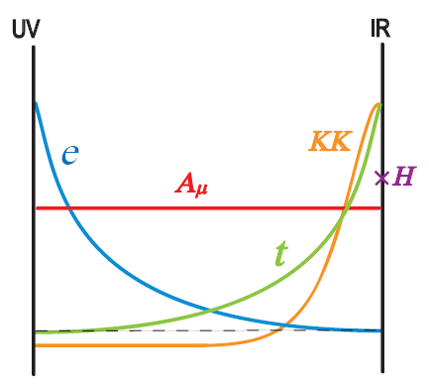
Warped extra dimensions
[Randall, Sundrum, PRL 83, 3370 (1999);
Dicus, McMullen, Nandi, PRD65 (2002) 076007]
● The RS model of a warped extra dimension offers a solution for the hierarchy between the electroweak scale and Planck scale M_{Pl} by introducing an extra spacial dimension. Predicts a Kaluza-Klein tower of graviton states (RS gravitons) which decay to ffbar or gg.
● RS Kaluza-Klein gauge bosons (KK g*, Z´,W´): explains mass hierarchy between top and light quarks, with preferential couplings to top quarks, no couplings to gg (odd number of g*), suppression of FCNC
Interactions are given by wave function overlap
■ The top quark: close to Higgs profile
■ KK modes have masses O(1 TeV): localized near the IR brane too: preferential couplings to top quarks
■ EW precision measurements: M_{Z´} >3TeV [Agashe et al. 2003]

Slide 12
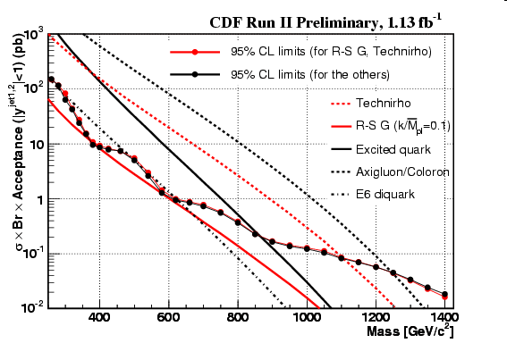
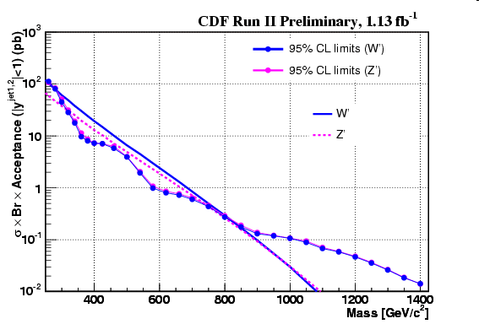
Mass exclusion from Tevatron
Dijet channel CDF arXiv:0812.4036
260-870 GeV/c² | Excited quark (f=f'=fs=1)
260-1100 GeV/c² | Color-octet technirho [top-color-assisted technicolor (TC2) couplings, M'₈=0, M(pi₂₂⁸)=5M(rho)/6, M(pi₂₂¹)=M(pi₂₂⁸)/2, M₈=5M(rho)/6]
260-1250 GeV/c² | Axigluon and flavor-universal coloron (mixing of two SU(3)'s, cot(theta)=1)
290-630 GeV/c² | E₆ diquark
280-840 GeV/c² | W' (SM couplings)
320-740 GeV/c² | Z' (SM couplings)
* Low mass window for axigluons also excluded [Doncheski,Robinet, 97] from hadronic Z-decays
Other channels CDF
WW/WZ (eνjj) | m_{Z'} > 545 GeV m_{W'} > 515 GeV m_{graviton} > 606 GeV | 2.9 fb⁻¹
ZZ | m_{graviton} > 491 GeV ( k/M_{Pl} = 0.1) | 3.0 fb⁻¹
tb | m_{W'} > 800 GeV for m_{W'} > m_{νR} m_{W'} > 825 GeV for m_{W'} < m_{νR} | 1.9 fb⁻¹

Slide 13
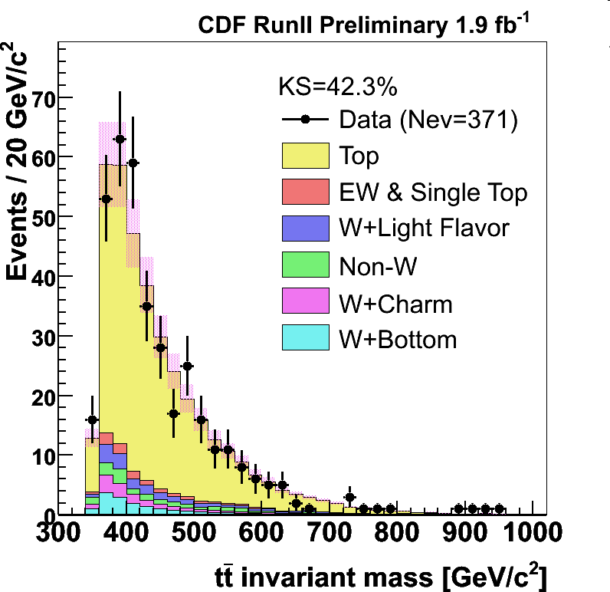
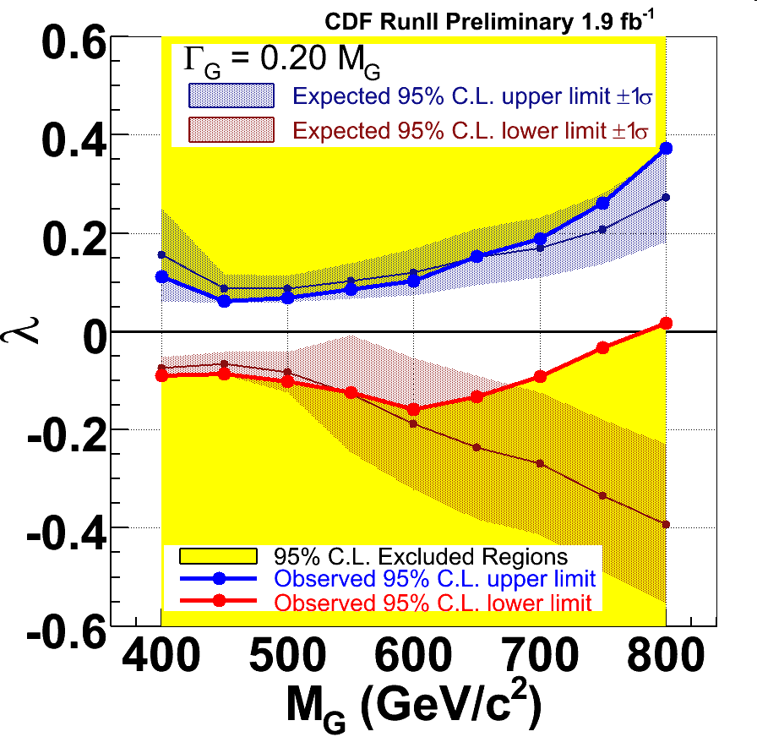
ttbar channel at Tevatron
D0 | Lepton+jet | topcolor-assisted technicolor, leptophobic m_{Z'} > 820 GeV | 3.6 fb⁻¹
CDF | All hadronic | m_{Z'} > 805 GeV (SM couplings) | 2.8 fb⁻¹
CDF | Lepton+jet | Topcolor leptophobic m_{Z'} > 720 GeV Out of range of sensitivity to SM Z´ | 1 fb⁻¹
CDF | Lepton+jet | Limits on massive gluon coupling λ = g_{V}^{q} g_{V}^{t} as a function of width | 1.9 fb⁻¹

Slide 14
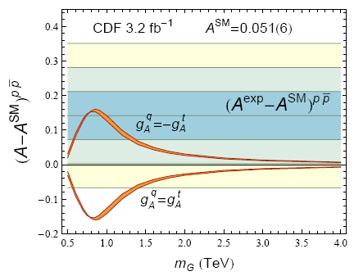
save the axigluon
■ The FB asymmetry disfavour at 2σ vanishing or negative contributions (axigluons or colorons)
m_{G} > 1.6 TeV at 99%C.L. (g_{V}=0,g_{A}=1)
■ Larger exclusion limit than dijet channel.
■ It is still possible to generate a positive asymmetry if sign(g_{A}^{q} )= -sign(g_{A}^{t} )
[Ferrario, GR, arXiv:0906.5541] [Frampton,Shu,Wang, arXiv:0911.2955]

Slide 15
Massive gluon diff cross section
Resonances might produce
Charge asymmetry at LO
Gluon-resonance interference
● generates charge asymmetry → FB
● vanishes upon integration over charge symmetric regions of phase space
● changes sign (s-m_{G}²)
● probes axial couplings
● Quark-antiquark annihilation
where
● gluon-gluon fusion at tree-level the same as in the SM
(gauge invariance, parity, orthonormality of field profiles in extra dimensions)
resonance-resonance amplitude
● generates charge asymmetry too

Slide 16
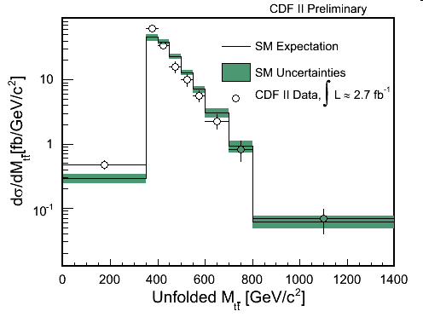
save the axigluon
■ while keeping dσ/dM_{ttbar} small [PRL102 (2009) 22203]
The last bin is the most sensible to masses of O(1TeV): sets lower bound on the mass
* RS graviton M=600 GeV, κ/M_{Pl} > 0.16 at 95%C.L.

Slide 17
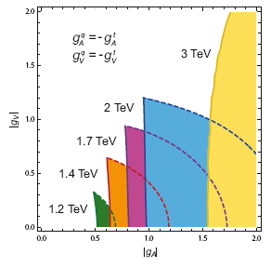
Flavour universal and non-universal axigluon
[Ferrario, GR, arXiv:0906.5541]
■ Combining limits on the charge asymmetry (solid lines) and the invariant mass distribution (dashed)
■ Flavour Universal
no overlapping region @ 90 % C.L. m_{G}>1.2 TeV @ 95 % C.L.
■ Flavour non-Universal
Fixing the couplings sets lower and upper bounds on the mass

Slide 18
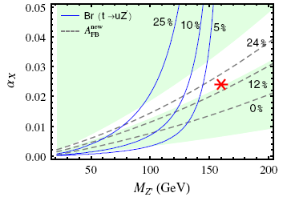
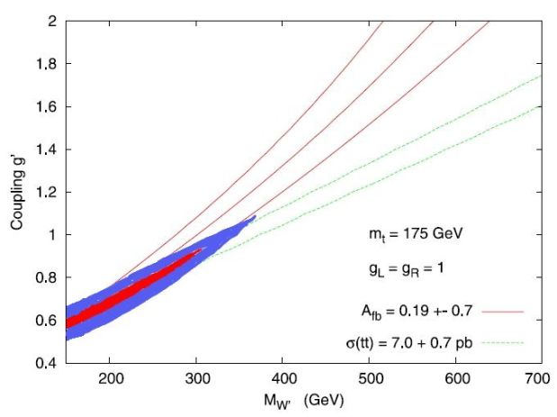
Z’ and W’ in the t-channel
Flavour violating weak vector bosons in the t-channel (mostly):
■ [Jung,Murayama,Pierce,Wells, arXiv:0907.4112]
best fit: m_{Z´} = 160 GeV , α_{X}=0.024
light to avoid uu→ tt (same sign dileptons)
ε_{X}≠0 to suppress uubar→ Z´Z´ (like sign tt)
■ [Cheung,Keung,Yuan, arXiv:0908.2589]
■ Third generation enhanced LR model SU(2)_{L} x SU(2)_{R} x U(1)_{B-L}: uubar → Z´ →ttbar [Cao,Heng,Wu,Yang, arXiv:0912.1447] No u_{R}-t_{R} mixing (s-channel) ✘ , with mixing (t-channel) ✔
■ Asymmetric LR model SU(2)_{L} x (SU(2)´x U(1)´ →U(1)_{Y}): Z´ (s-channel) and W´ (t-channel) [Barger,Keung,Yu, arXiv:1002.1040]: m_{Z´} = 190 GeV , m_{W´} = 175 GeV
■ [Cao,McKeen,Rosner,Saughnessy,Wagner, arXiv:1003.3461]: W´ large couplings and large amount of fine tuning
Requires light Z´ and W´: O(200 GeV)
or large flavour violating couplings

Slide 19
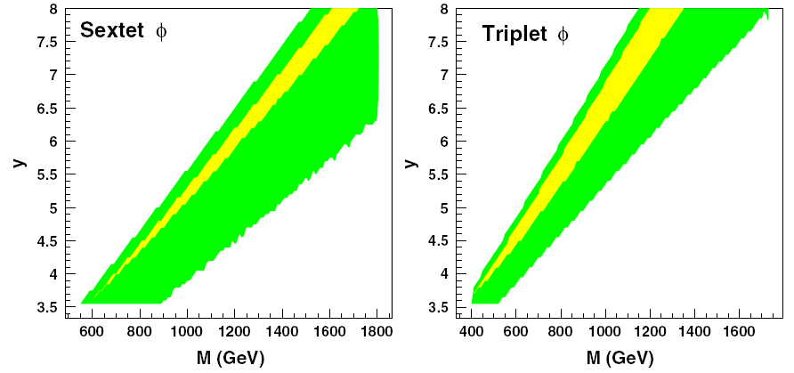
Scalars in the t-channel
Flavour violating scalars in the t-channel: uubar→ ttbar
■ Singlet (1,2,-1/2) ✘
■ Triplet (3bar,1,4/3) ✔
■ Sextet (6,1,4/3) ✔
■ Octet (8,2,-1/2) ✘
* (6,3,1/3) and (3bar,3,1) more constrained from flavour observables
[Shu,Tait,Wang, arXiv:0911.3237]
Requires large flavour violating couplings
Potential uu→ tt (same sign dileptons): singlet and octet; sextet in the s-channel
R-parity violating MSSM: sleptons (singlet) ✘, and squarks (triplet) ✔, in ddbar→ ttbar
[Cao,Heng,Wu,Yang, arXiv:0912.1447]
GUT: triplet (3bar,1,4/3) ✔ (M_{ttbar} → m_{Φ} < O(TeV)), octet (8,2,-1/2) ✘ [Dorsner et.al. arXiv:0912.0972]
Triplet ✔ and sextet ✘ [Arhrib,Benbrik,Chen,arXiv:0911.4875]
EFT: singlet ✔, triplet ✘, sextet ✘, octet ✔ [Jung,Ko,Lee,Nam,arXiv:0912.1105]

Slide 20
Charge asymmetry at LHC
LHC is symmetric no forward-backward
But suppose that there is a charge asymmetry at parton level
(QCD predicts that tops are preferentially emitted in the direction of incoming quark, resonance asymmetry positive/negative on (s-m_{G}) and relative sign of couplings)
quarks carry more momenta than antiquarks
■ Excess of tops (or antitops) in the forward and backward regions
Opposite in sign to the parton asymmetry
■ However, top cross section is gg dominated, which is symmetric; but gg can be suppressed by selecting pairs with large invariant mass
cms rest frame
LAB frame

Slide 21
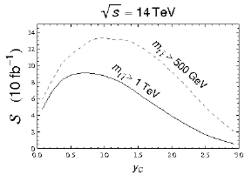
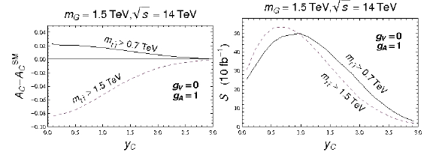
ttbar@ LHC
[Ferrario, GR, arXiv:0809.3354]
■ Charge asymmetry suppressed by gg-fusion (90% @14TeV) but statistical significance can be maximized by tuning y_{C} and m_{tt}^{min}
■ smallness of QCD asymmetry compensated by statistics at low m_{tt}^{min}
■ Color-octet resonance: maximum statistical significance at about m_{G}/2 (less boosted tops)

Slide 22
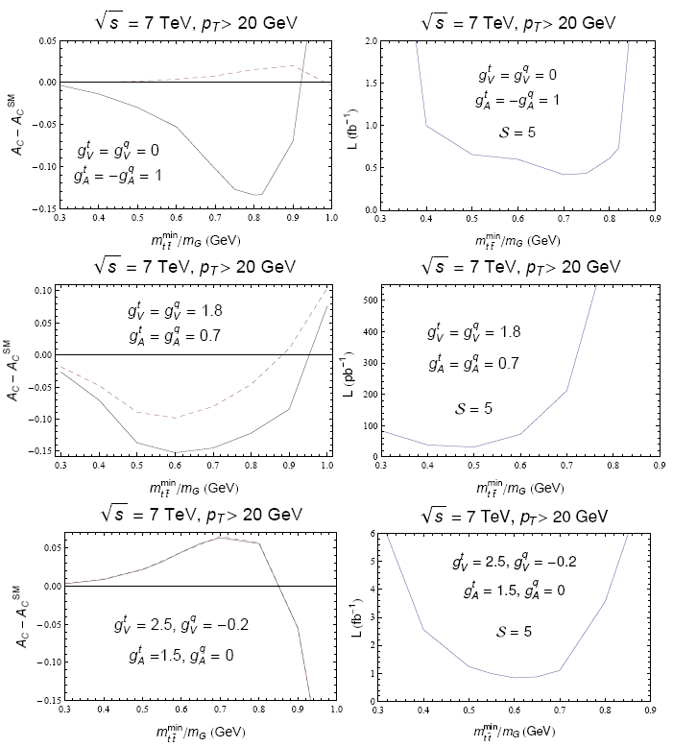
ttbar + jet @ LHC
[Ferrario, GR, arXiv:0912.0687]
■ QCD asymmetry washed out in ttbar+jet @ NLO
[Dittmaier, Uwer, Weinzierl, 2007]
■ f_{abc}² contributions (color octet state) too in ttbar+jet
m_{G}=1.5 TeV

Slide 23
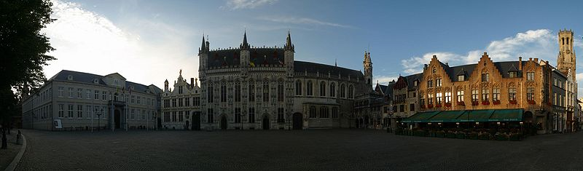
Conclusions
■ room for BSM within 2σ at the Tevatron from the measurement of the top quark charge asymmetry (forward-backward), early to claim new physics, but, together with dσ/dM_{ttbar}, allows to set constrains in the top quark sector
✔ Flavour Universal axigluons with large vector couplings
✔ Flavour non-Universal axigluons: sign(g_{A}^{q} )= -sign(g_{A}^{t} )
✔ Flavour violating Z´ and W´ relatively light O(200 GeV)
✔ Flavour violating scalars in the t-channel: triplet or sextet
(see also Degrande´s poster on top compositeness)
statistically dominated, new measurements soon ??
■ The charge asymmetry can be measured at the LHC too, and is a good observable to discriminate among different models

Slide 24
Backup

Slide 25
