Slide 1

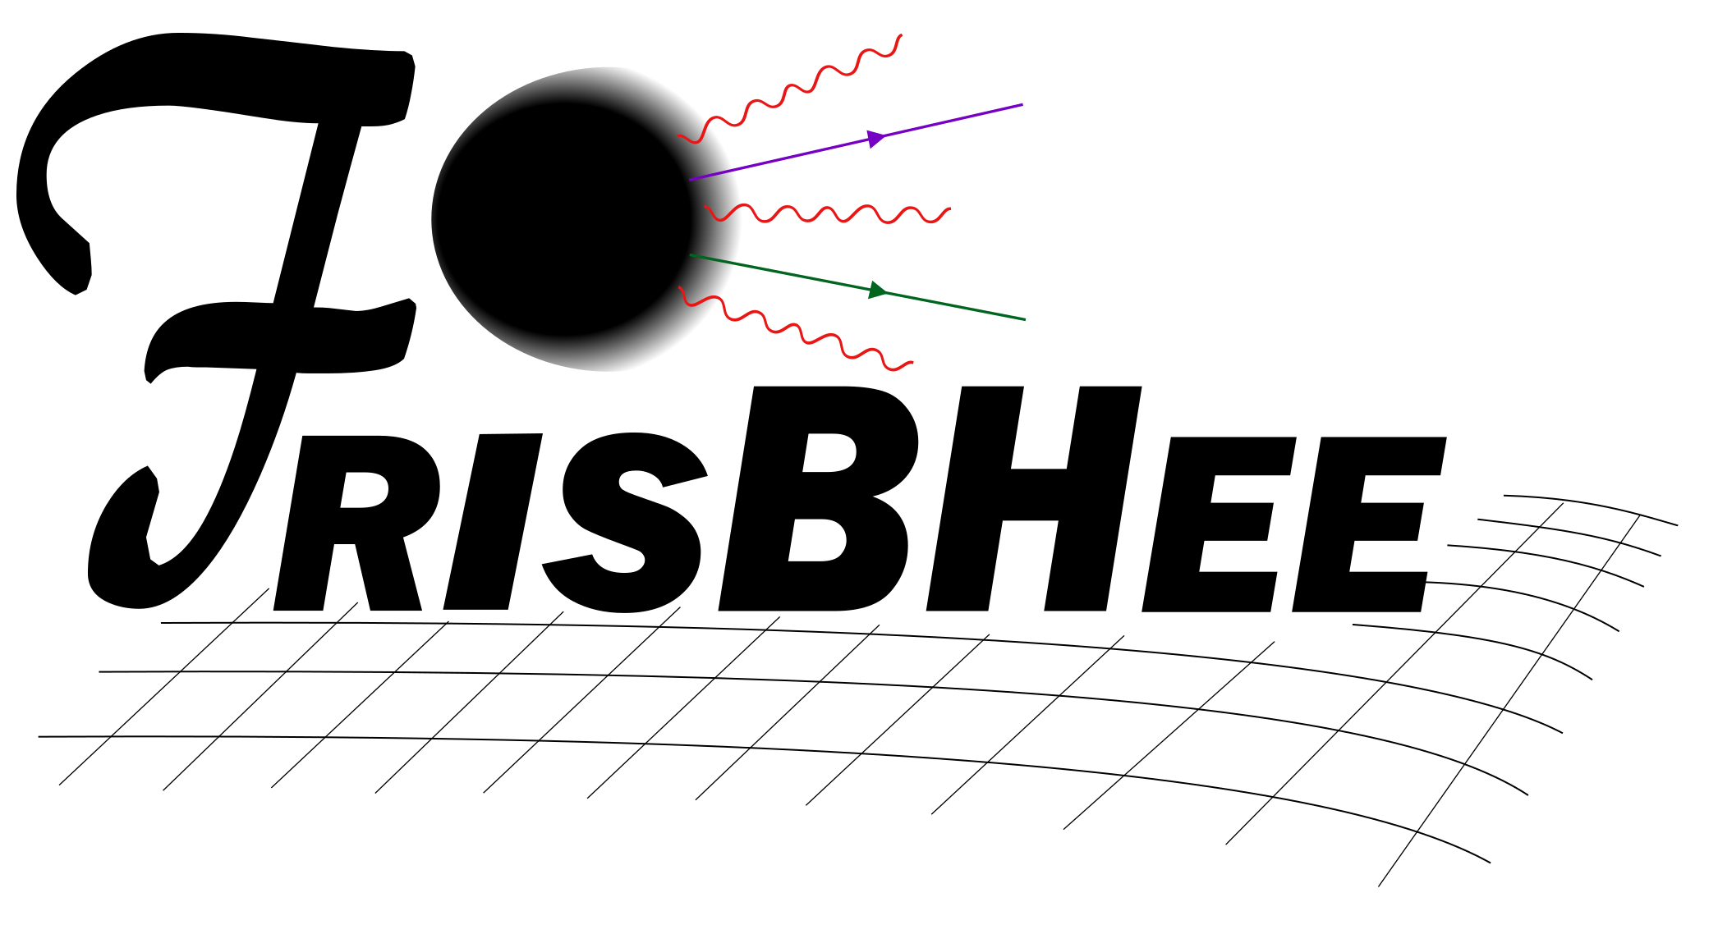
:a code for evaporating black holes
Darktools 2025
Andrew Cheek,
based on arXiv:2212.03878, arXiv:2207.09462, arXiv:2107.00013, arXiv:2107.00016
in collaboration with L. Heurtier, Y. F. Perez-Gonzalez, J. Turner
https://github.com/yfperezg/frisbhee

Slide 2
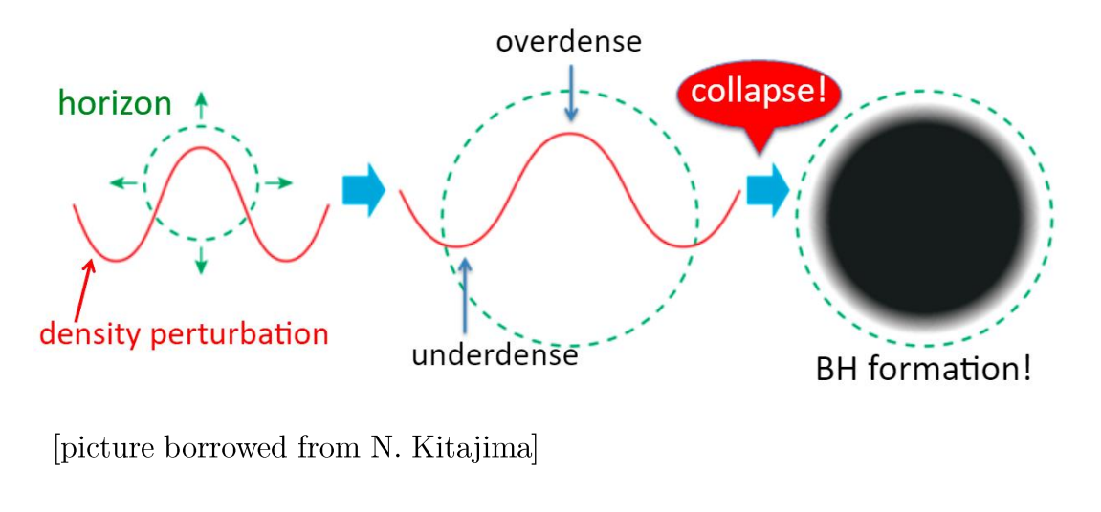
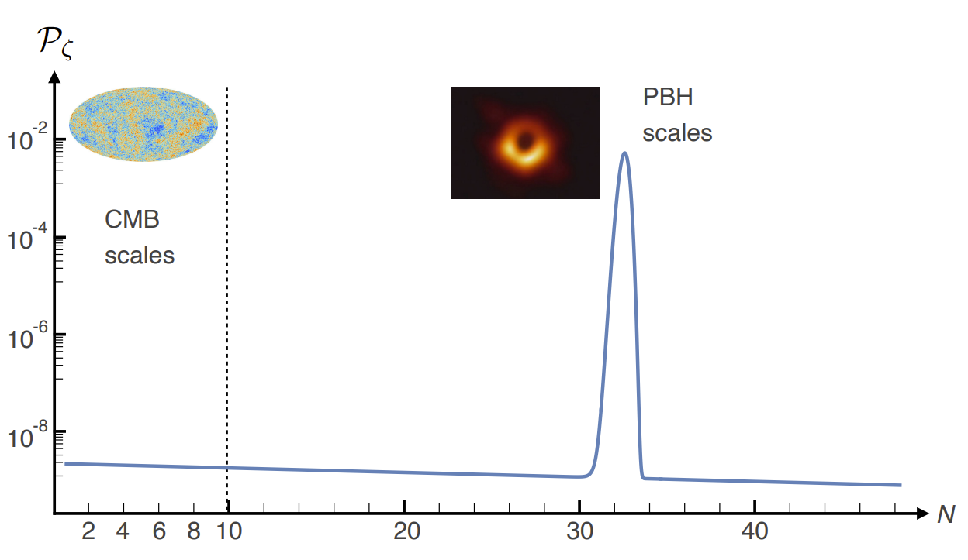
Primordial Black Holes
Hypothetical black holes formed before stellar formation.
Come from extremely dense matter fluctuations in the early Universe.
Not predicted from vanilla slow-roll inflation, but requires a big extrapolation
No shortage of primordial black hole (PBH) production mechanisms:
Ultra slow-roll inflation, cosmological phase transitions, pre-heating… etc

Slide 3
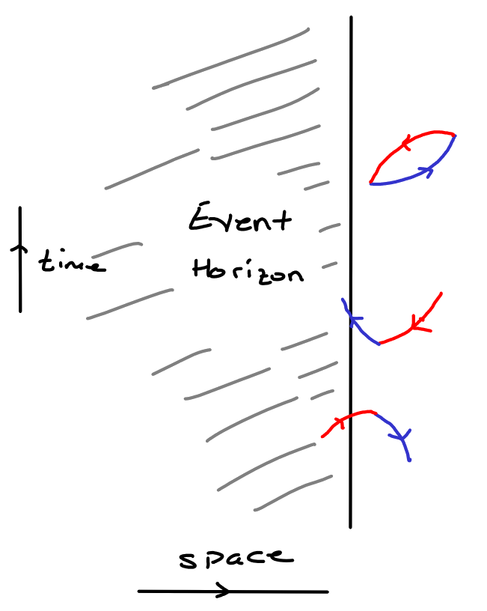
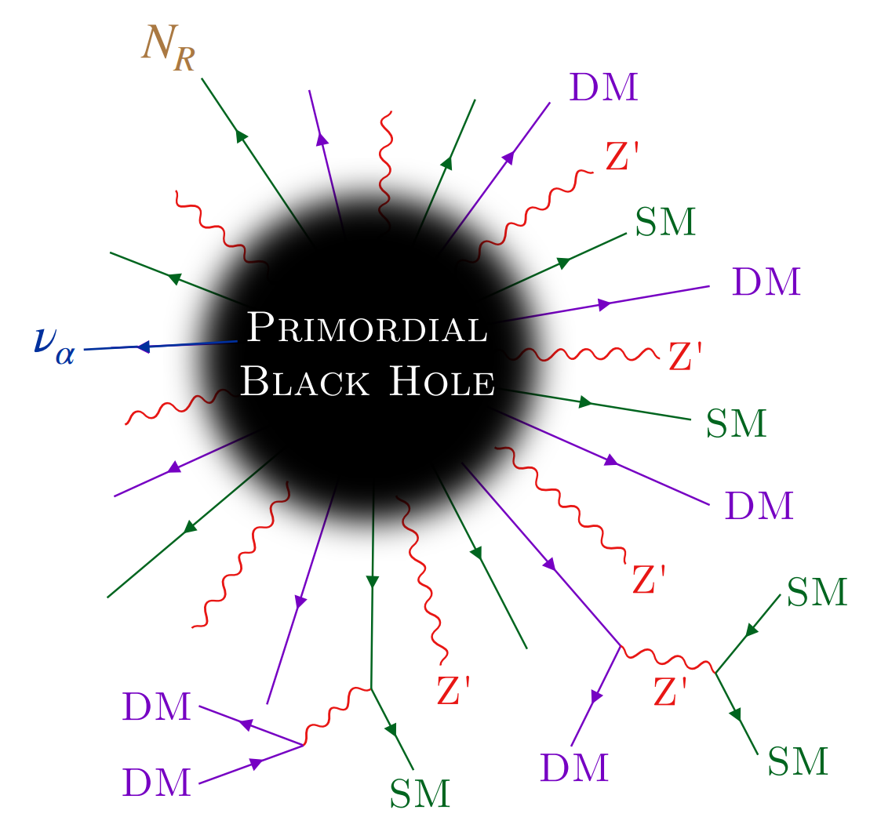
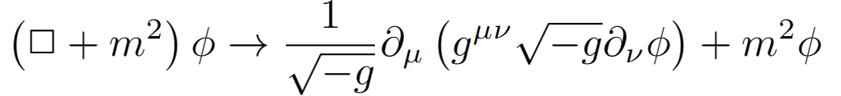
Black holes evaporate
Hawking (1970s) showed that by solving the equation of motion for quantum fields in a curved spacetime
You get particle emission from a black hole!
The production rate is insensitive to other particle interactions. So will happen for all particles, known or unknown.
One tool for calculating this is BlackHawk.
[Image: L. Heurtier & Y. Perez-Gonzalez]
https://blackhawk.hepforge.org/

Slide 4
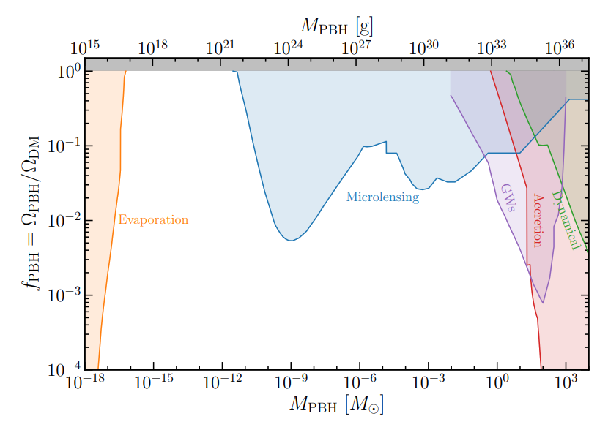

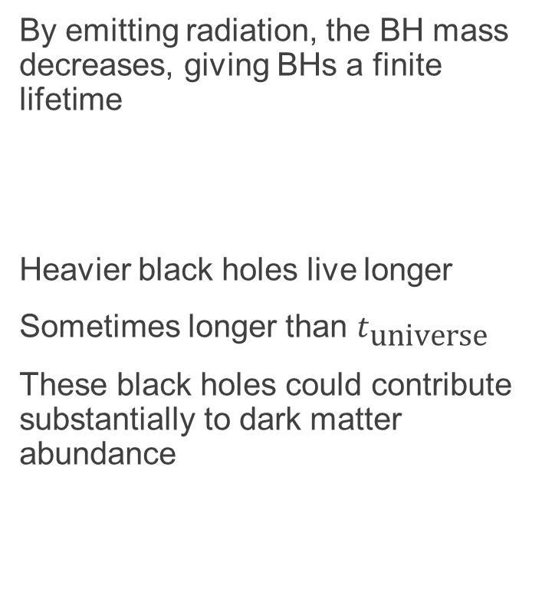

Evaporation means finite lifetime
By emitting radiation, the BH mass decreases, giving BHs a finite lifetime
Heavier black holes live longer
Sometimes longer than $t_{\text{universe}}$
These black holes could contribute substantially to dark matter abundance
[B. Kavanagh and A. Green 2022]
$$f_{\text{PBH}}=\frac{Ω_{\text{PBH}}}{Ω_{\text{DM}}}$$

Slide 5
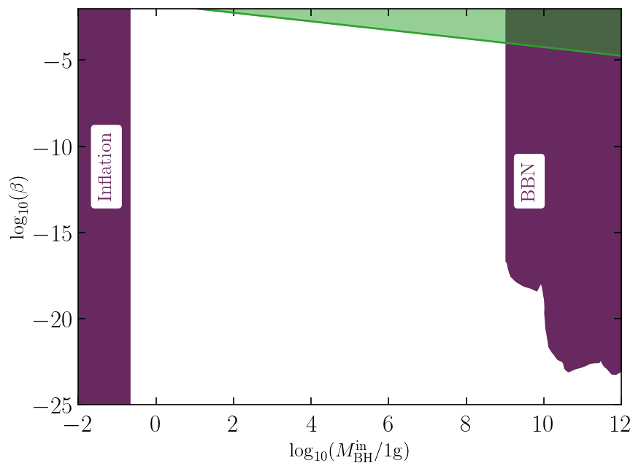
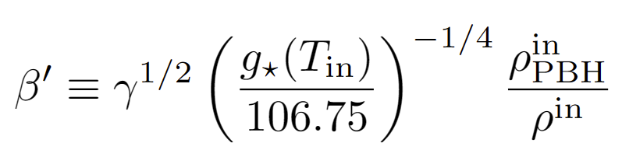
Evaporated BHs parameter space
Big Bang Nucleosynthesis (BBN) and inflation provide constraints but lots of space in between!
In green GW constraints
Evidence for evaporated PBHs would be interesting in of itself.
Implications for topics on the edge of our understanding, inflation, extra dimensions GR at Planck scale, …
[G. Domenech et. al 2020]

Slide 6
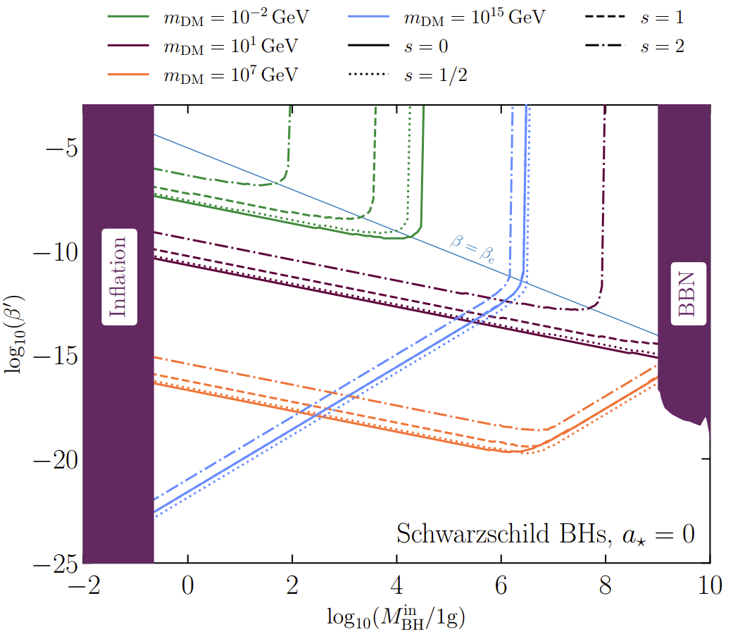
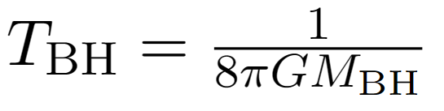
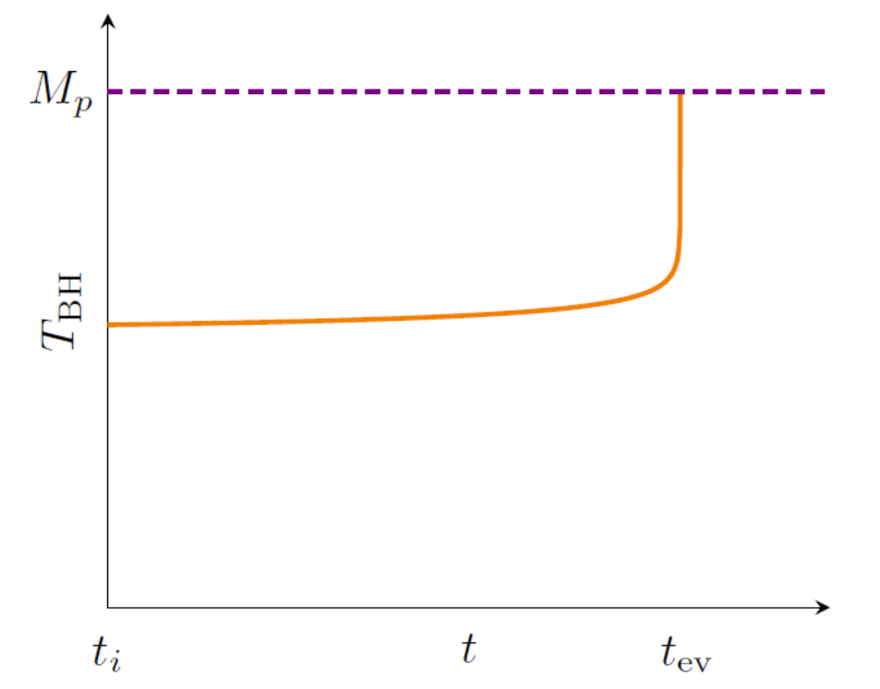
Hawking radiation and BSM
Black hole temperature increases as mass decreases
Very efficient production of dark matter!
Heavy DM?
SUSY?
GUTs?
RH neutrinos?
`light DM’?

Slide 7

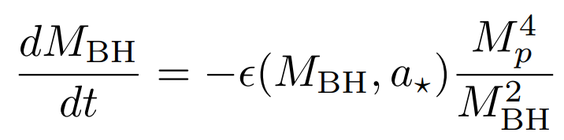
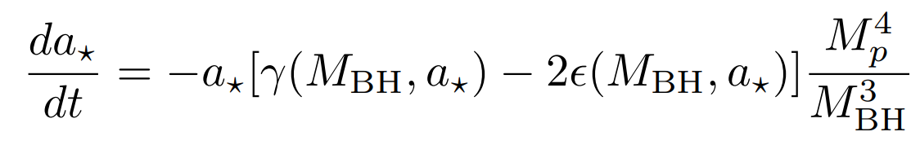
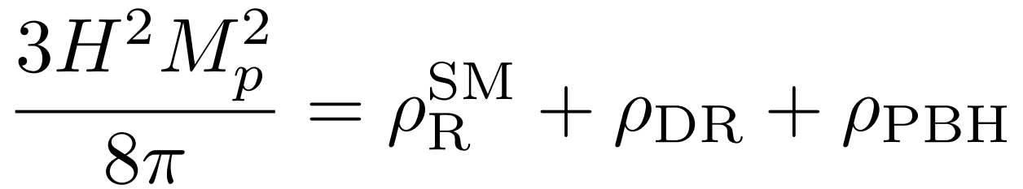
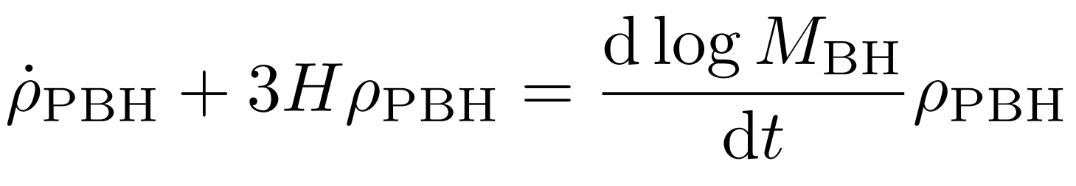
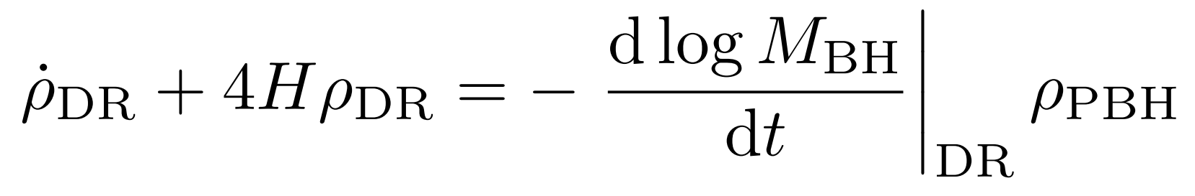
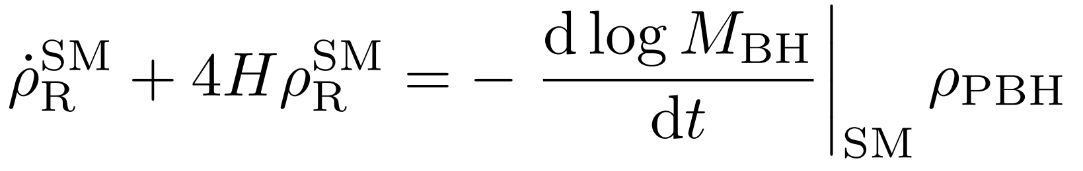
We created
Our code FRISBHEE, FRIedmann Solver for Black Hole Evaporation in the Early universe, solves the system of coupled Friedmann and Boltzmann equations fully.
Publicly available on GitHub and ready to use!

Slide 8
We created
Our code FRISBHEE, FRIedmann Solver for Black Hole Evaporation in the Early universe, solves the system of coupled Friedmann and Boltzmann equations fully.
Publicly available on GitHub and ready to use!
Black hole dynamics

Slide 9
We created
Our code FRISBHEE, FRIedmann Solver for Black Hole Evaporation in the Early universe, solves the system of coupled Friedmann and Boltzmann equations fully.
Publicly available on GitHub and ready to use!
Friedmann

Slide 10
We created
Our code FRISBHEE, FRIedmann Solver for Black Hole Evaporation in the Early universe, solves the system of coupled Friedmann and Boltzmann equations fully.
Publicly available on GitHub and ready to use!
Boltzmann

Slide 11
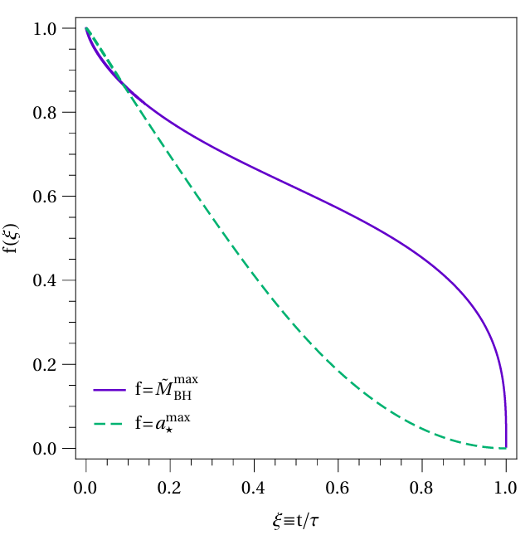
Successes of FRISBHEE
  Tracking the spin evolution proved to be an important use case for FRISBHEE.
  Been known for half a century that Kerr black holes shed angular momentum more quickly than their mass.
  For maximally spinning black holes, only around 40% of mass has been lost when 90% of the spin has gone.
[D. Page 1976]

Slide 12
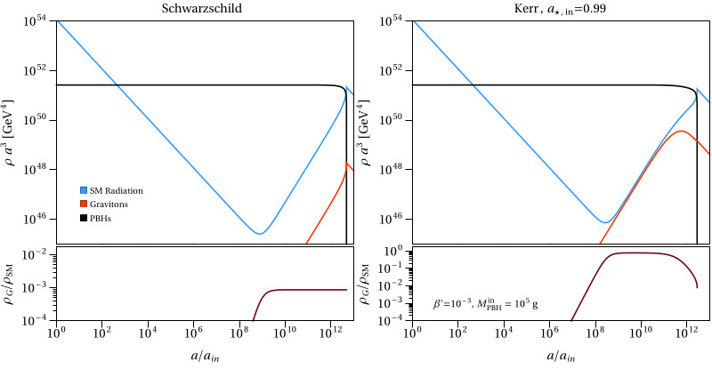

Successes of FRISBHEE
This results in an entropy injection after $a_{∗}\sim 0$ diluting high spin radiation

Slide 13
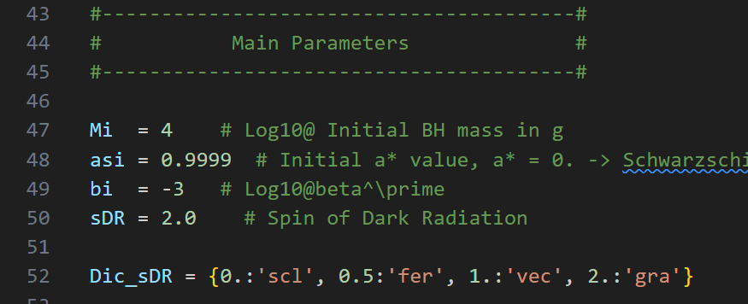

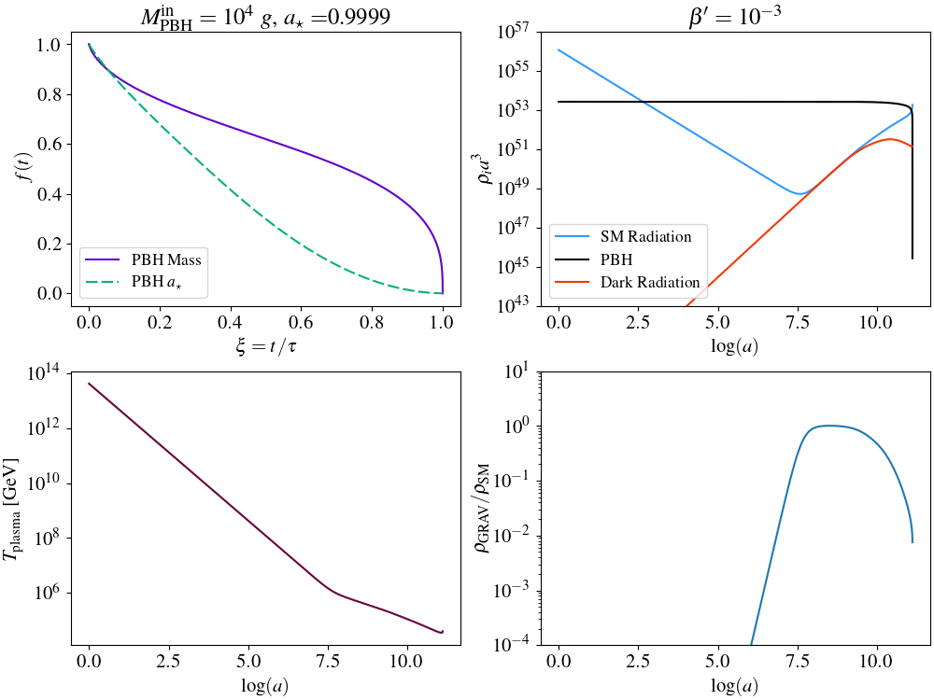
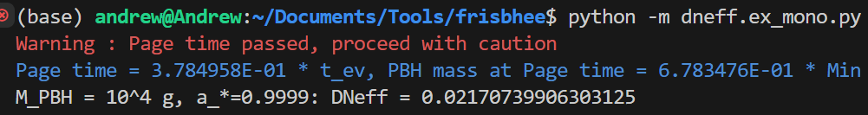



Using FRISBHEE (dark radiation)
dneff/ex_mono.py
  How do you generate these plots yourself?

Slide 14
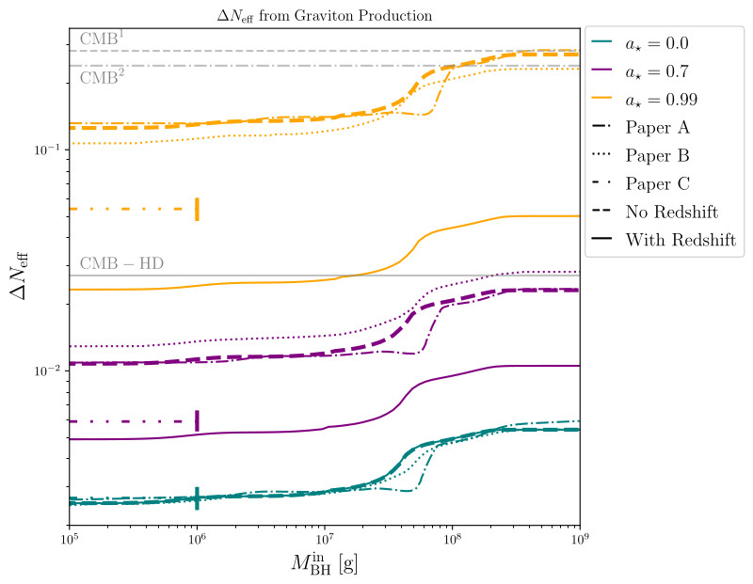
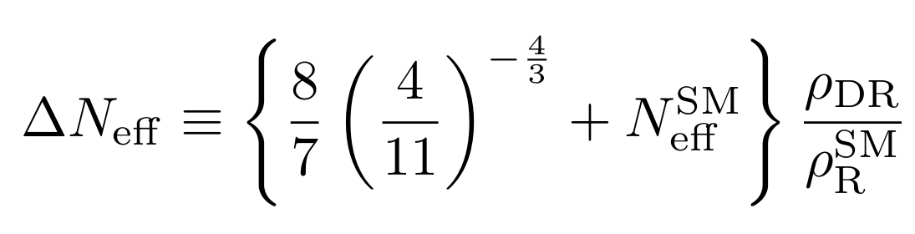
Results from PBH domination
Previous studies overestimated the graviton contribution to the relativistic degrees of freedom at recombination.
Paper A = Hooper et. al. arXiv:2004.00618
Paper B = Arbey et. al. arXiv:2104.04051
Paper C = Masina arXiv:2103.13825
The prospects for future CMB probes become less optimistic.

Slide 15
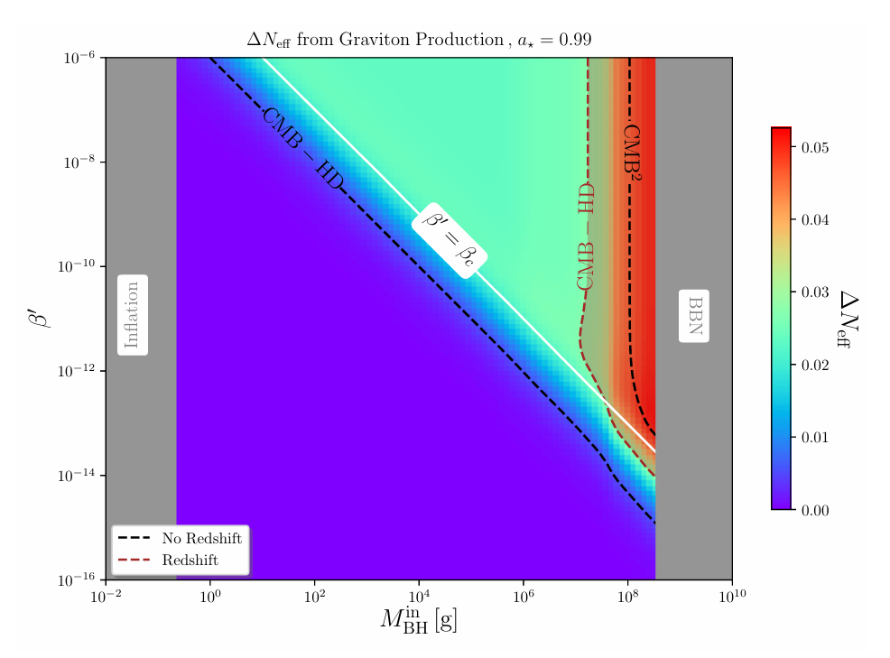
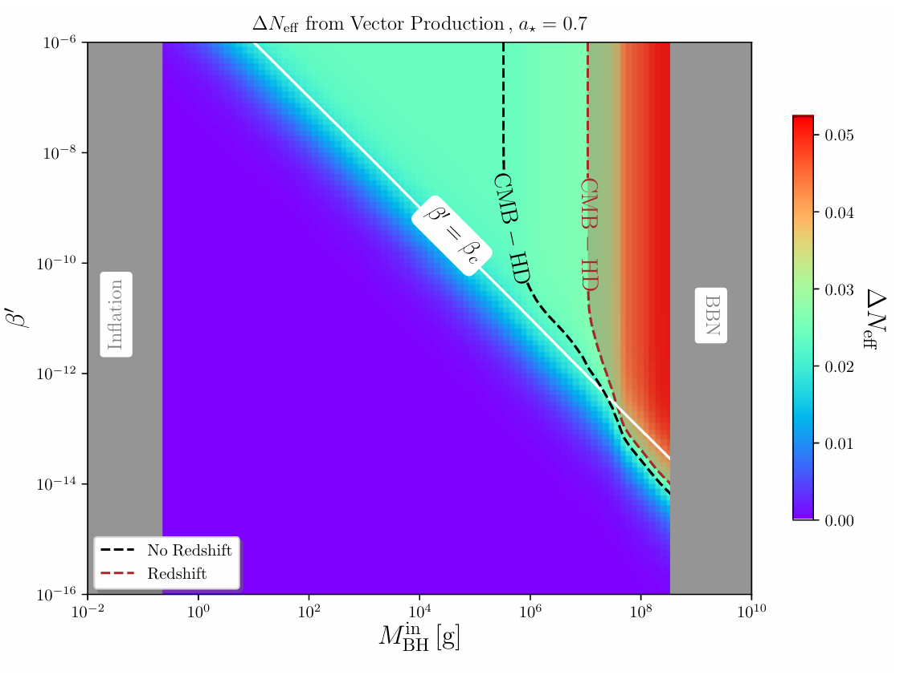
Scan results for graviton and vector
  With FRISBHEE we can perform full scans even when black holes don’t dominate.

Slide 16
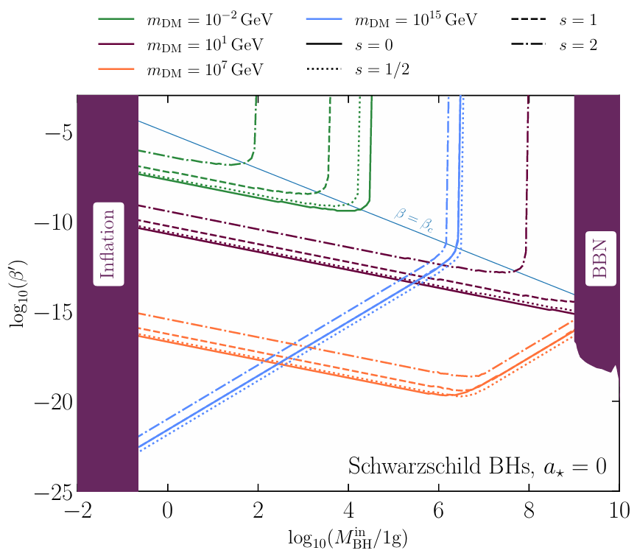
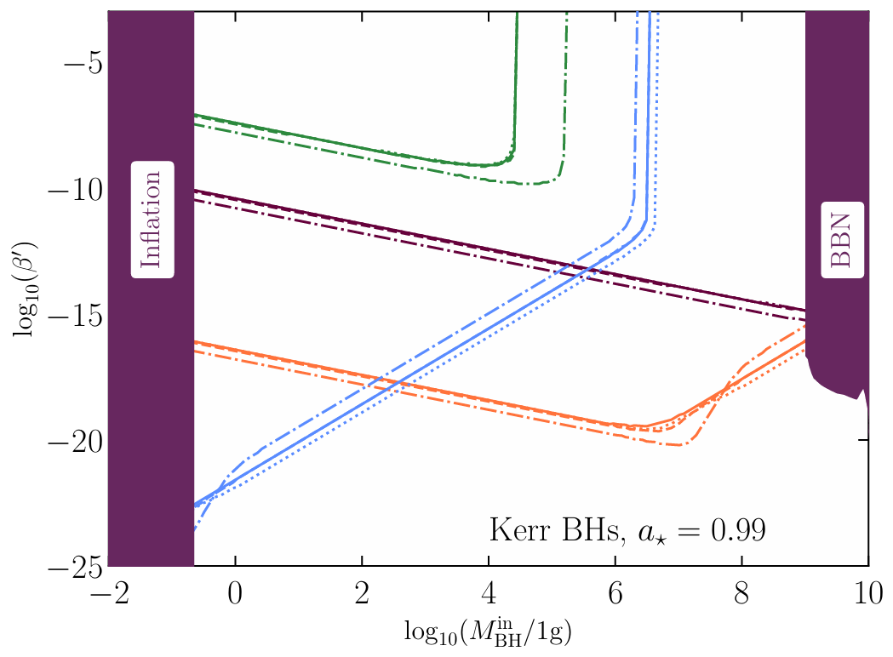

Dark matter relic abundance
  Making precise calculation of $Ω_{\text{DM}}$ for different particles and BH spins

Slide 17
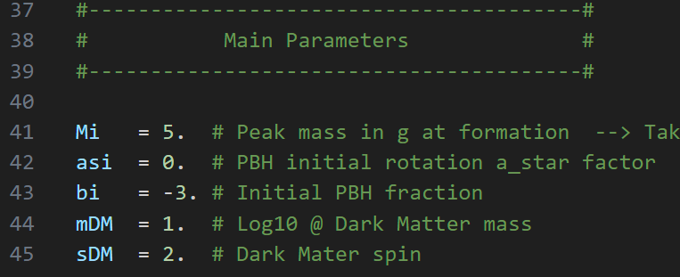
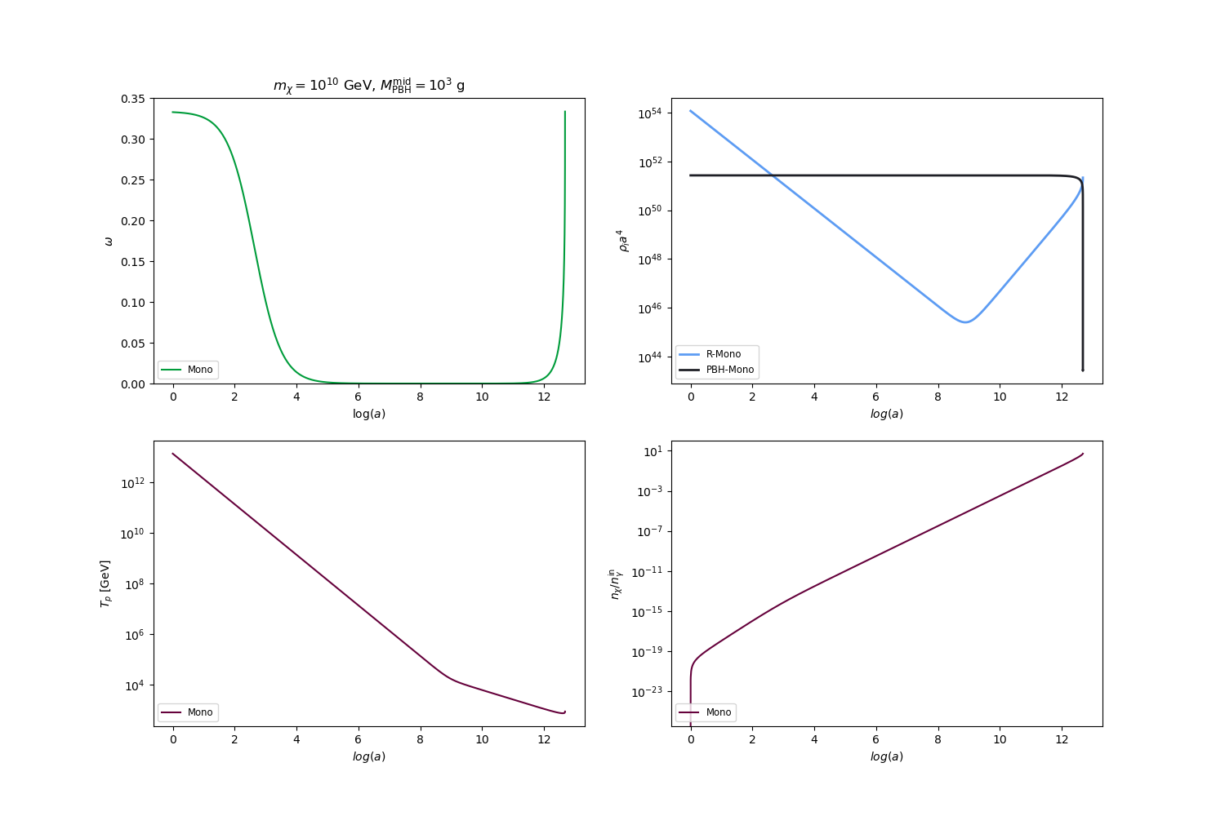
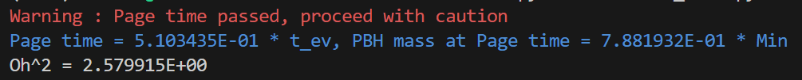

Using FRISBHEE (dark matter)
dm/ex_mono.py
  How to get the dark matter abundance yourself?

Slide 18
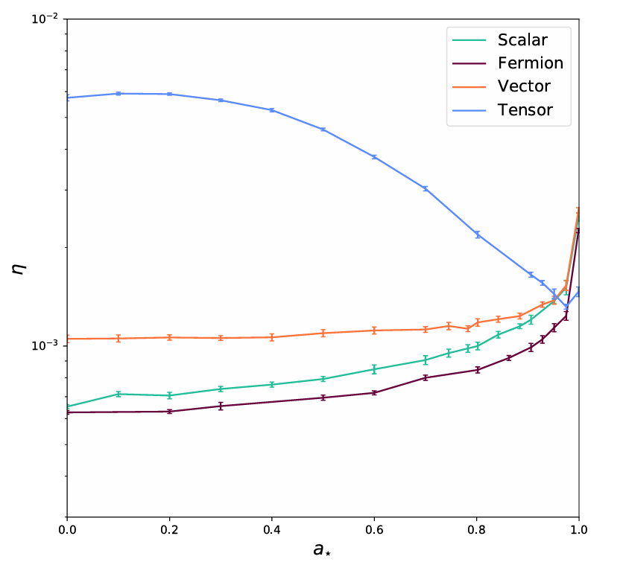
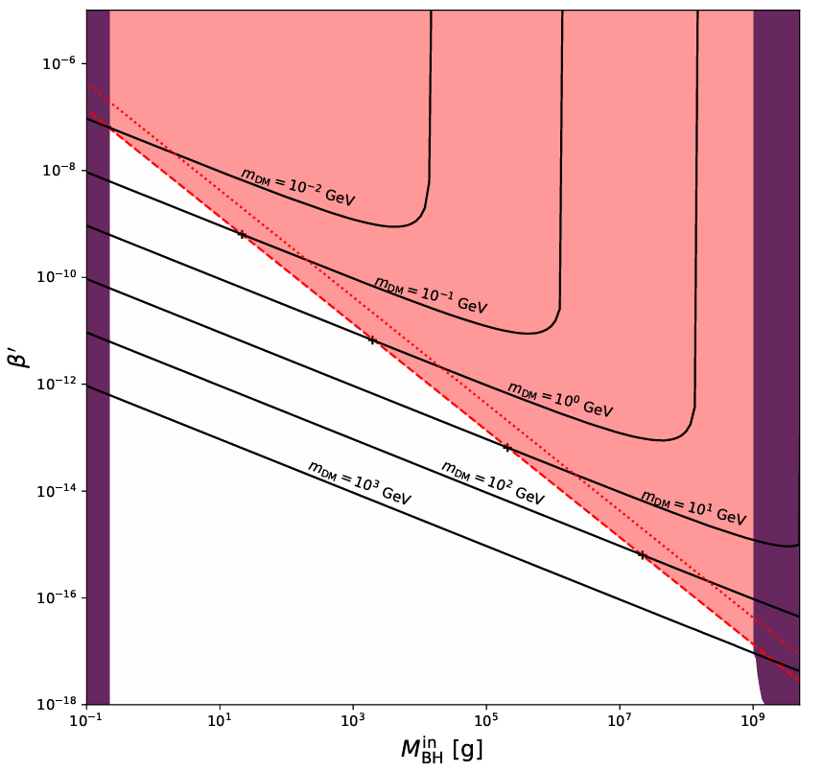
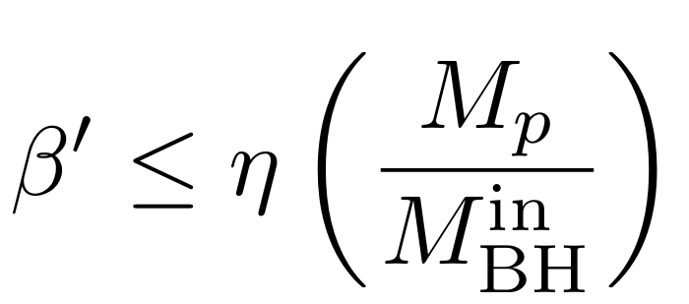
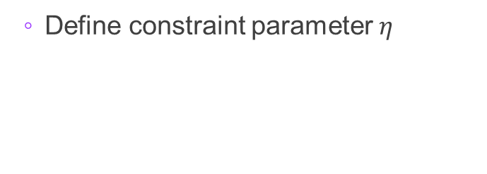

Warm dark matter constraints
  We can use FRISBHEE to generate the output for structure formation codes like CLASS
  The main constraint we use is from Lyman-$α$ forest
  Define constraint parameter $η$

Slide 19
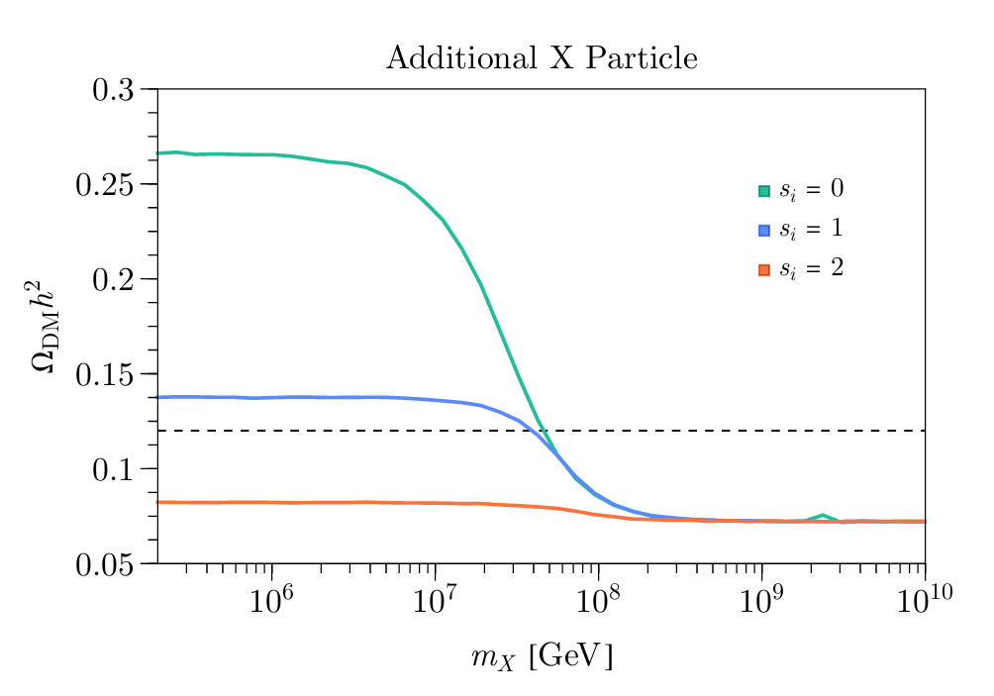
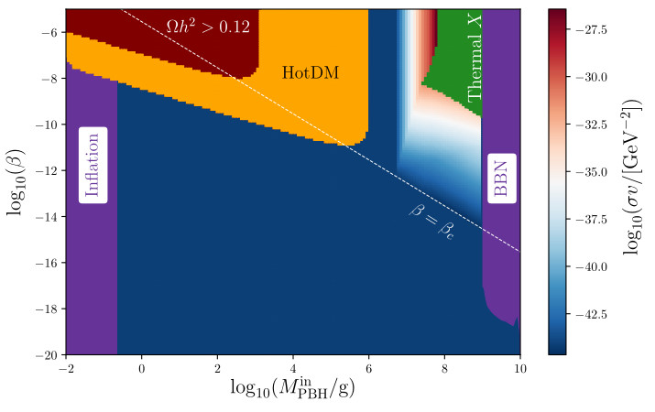
Dark sectors
  We have created the framework that allows for more complicated dark sectors
Non-interacting
Interacting

Slide 20
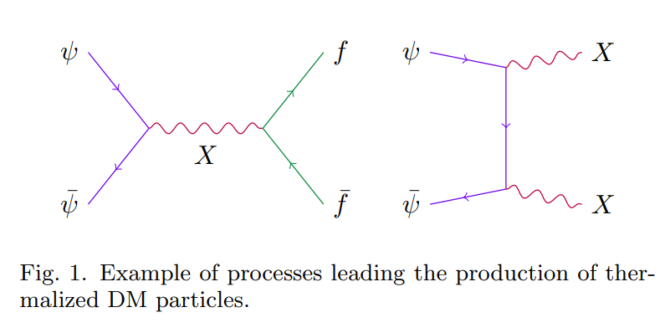


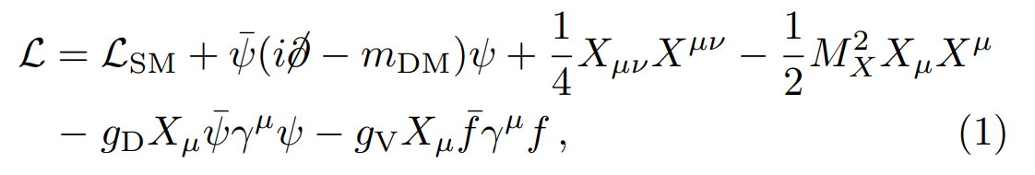
Interacting DM

Slide 21
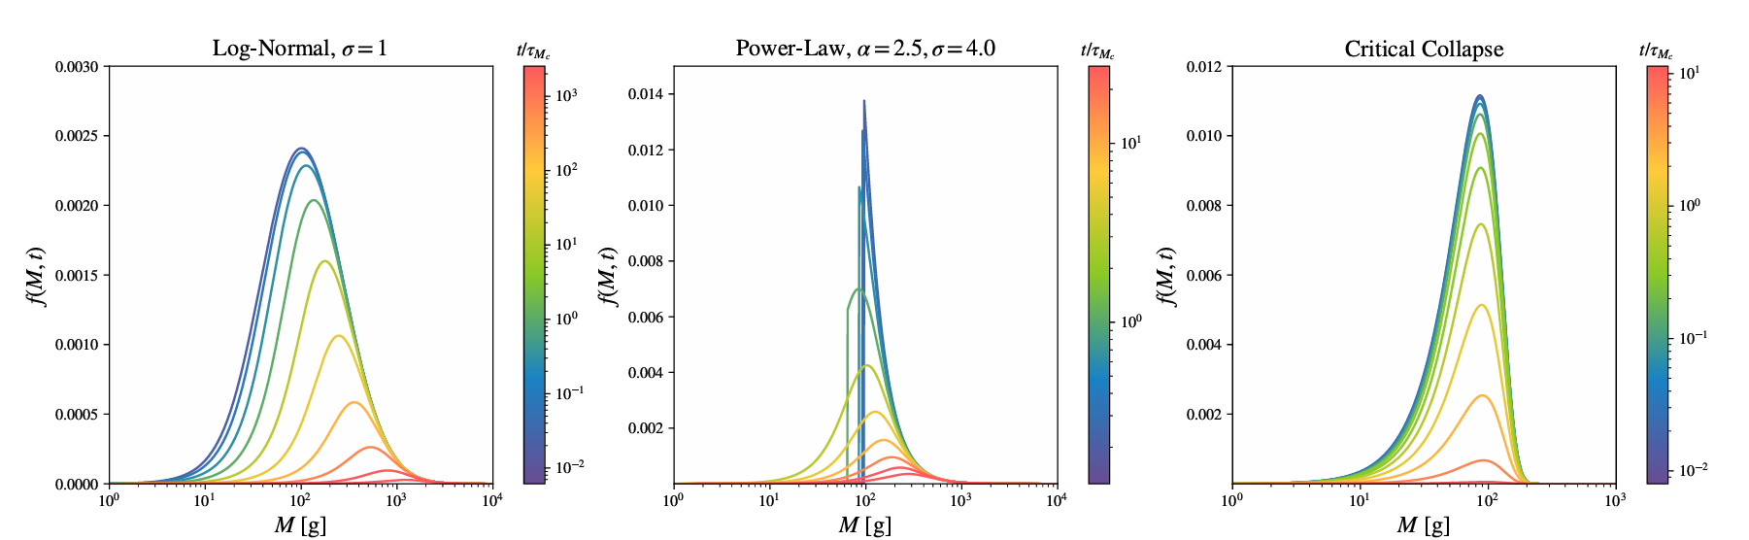
PBH distributions
  All results above have shown monochromatic distributions in mass and spin.
  Many production mechanisms lead to broader distributions.
  FRISBHEE can deal with distributions

Slide 22
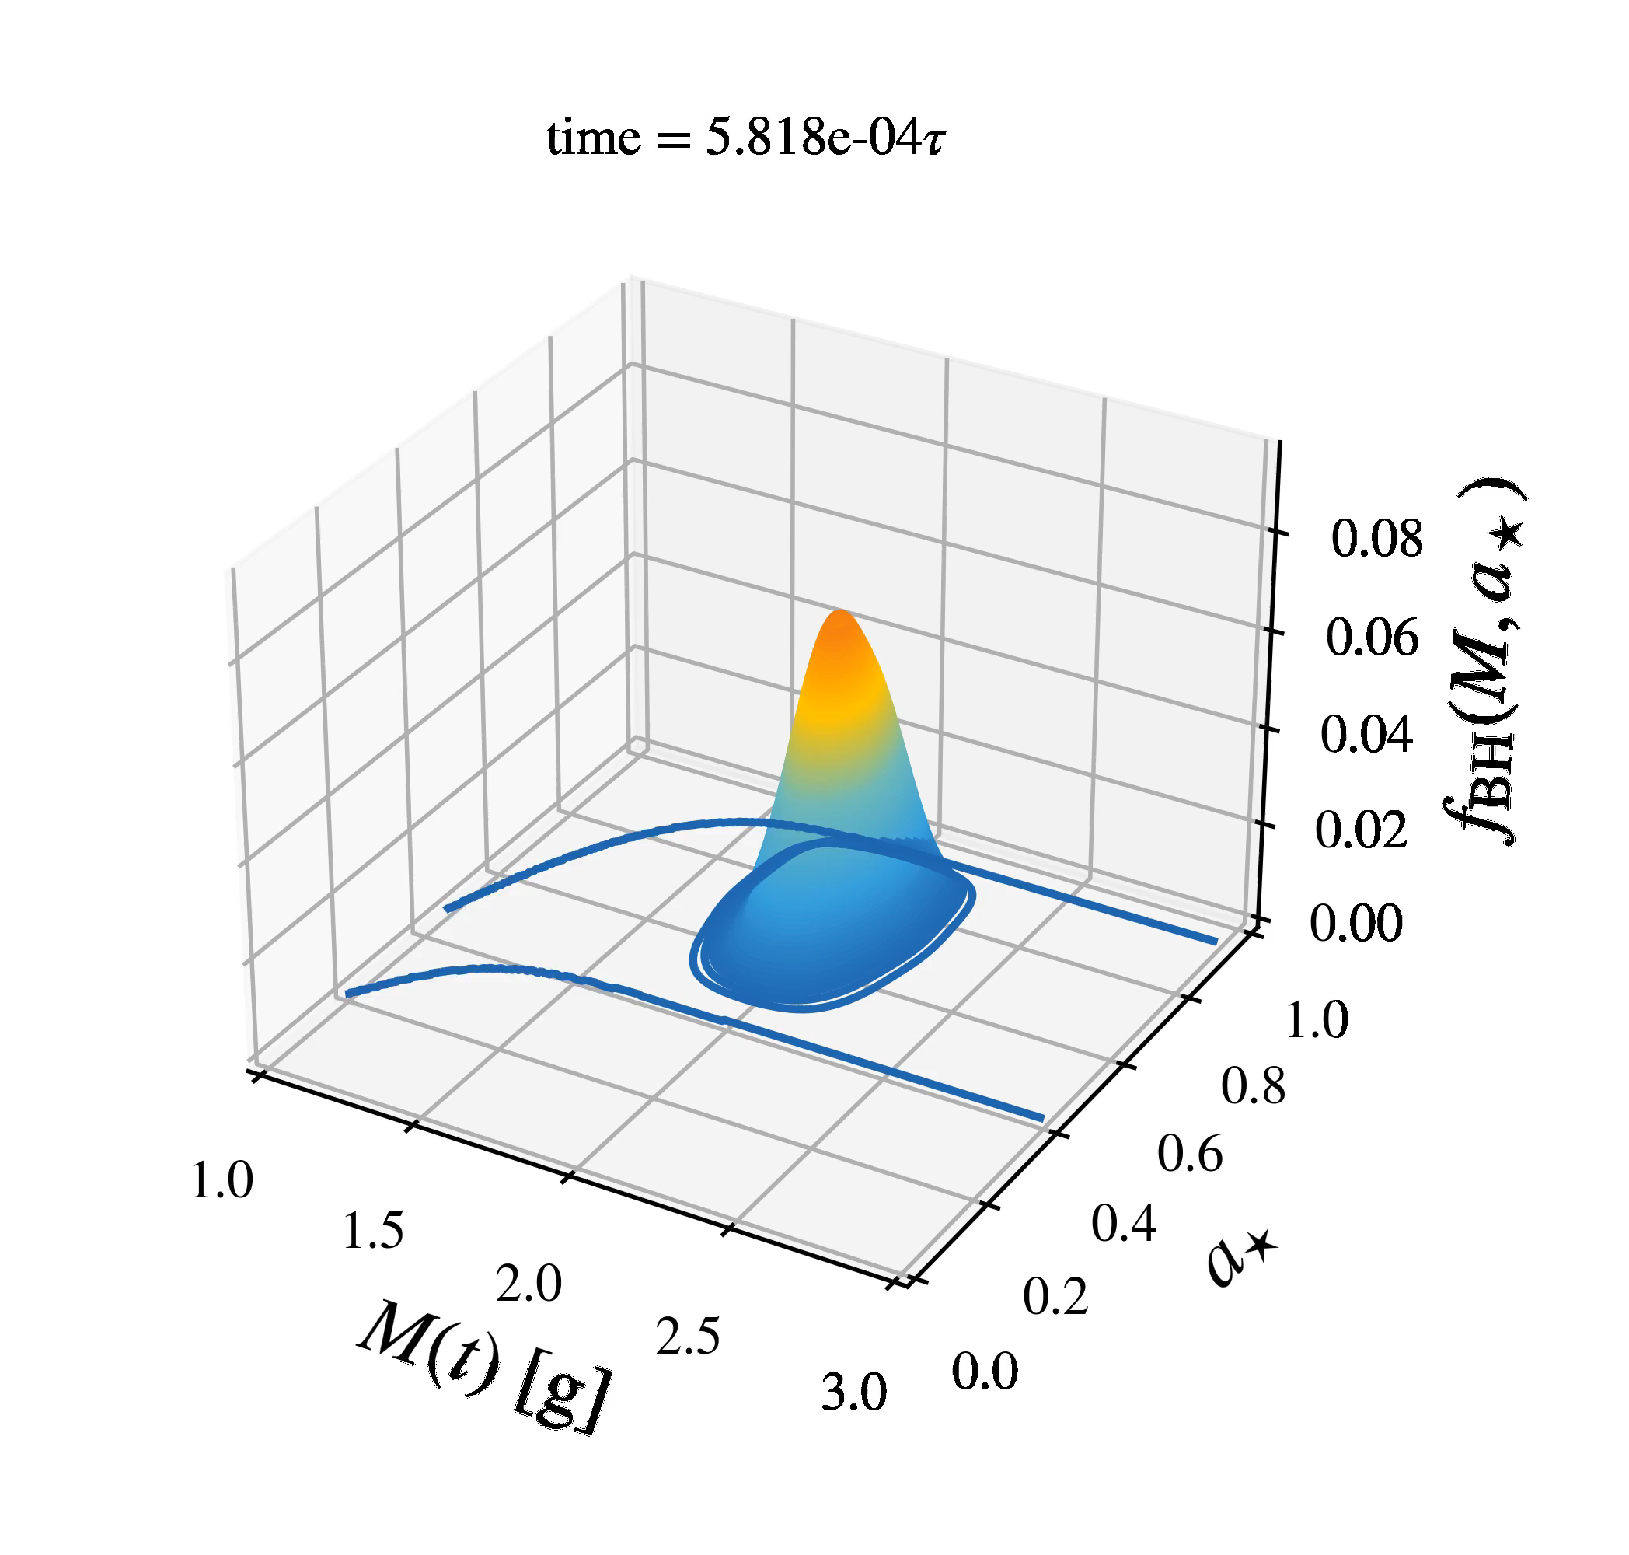
PBH distributions
  All results above have shown monochromatic distributions in mass and spin.
  Many production mechanisms lead to broader distributions.
  FRISBHEE can deal with distributions

Slide 23




FRISBHEE now
  There is an updated branch of the code with many examples, what I’ve presented here and others!
  The “big update” branch will soon become “main”
  We are working on other more updates on the physics side.
  Implementing evaporation variation at late stages of evaporation.

Slide 24
Summary
  FRISBHEE is code that solves the coupled equations for evaporating black holes in the early universe. It is public and available for all.
  We show that the accurate tracking of the coupled Friedmann-Boltzmann equations is vital.
  CMB probes of the additional relativistic degrees of freedom are less constraining than we previously thought.
  Dark matter will be produced by PBH evaporation so there will be an interplay with interacting models.
  Our code can handle distributions of black holes.

