Slide 1
From HEP Simulations to Humanitarian Relief
Johan Alwall
CP3, UCL, Belgium
October 9, 2023

Slide 2
Me: Researcher turned Humanitarian
Ph.D. in Uppsala, Sweden, 2005
Postdoc / Visiting Researcher 2005-2013
University of Louvain (Belgium)
Stanford University (California)
Fermi National Laboratory (Illinois)
National Taiwan University (Taiwan)
2008: Started volunteering with Buddhist Tzu Chi Foundation
Since 2013: Full-time Tzu Chi volunteer/staff

Slide 3
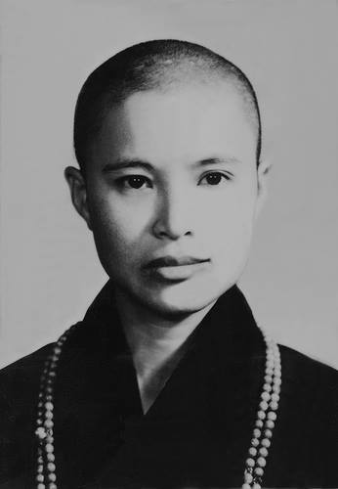
Buddhist Tzu Chi Foundation
Founded in Taiwan in 1966 by 29-year old Buddhist nun Dharma Master Cheng Yen
“Tzu Chi” means Compassion and Relief
Mission to relieve suffering in all its forms around the world

Slide 4
Tzu Chi today
Offices in 66 countries
Assistance provided to 128 countries around the world
8 hospitals in Taiwan, 1 hospital in Indonesia, clinics in US, Malaysia, Philippines, Turkey, and other countries
Full education system from kindergarten through PhD
Built 242 schools, 7 hospitals, and 21,117 homes in 25 countries
Notes:
Today, Tzu Chi has offices in 66 countries, and has provided assistance to 128 countries around the world.
….

Slide 5
Haiti Earthquake Relief
January, 2010
Notes:
I will take three case studies that illustrate Tzu Chi’s efforts.

Slide 6
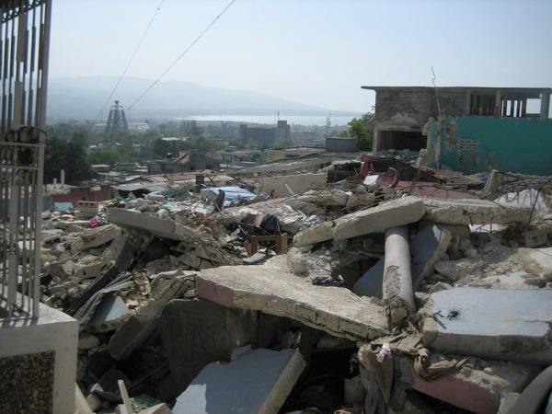
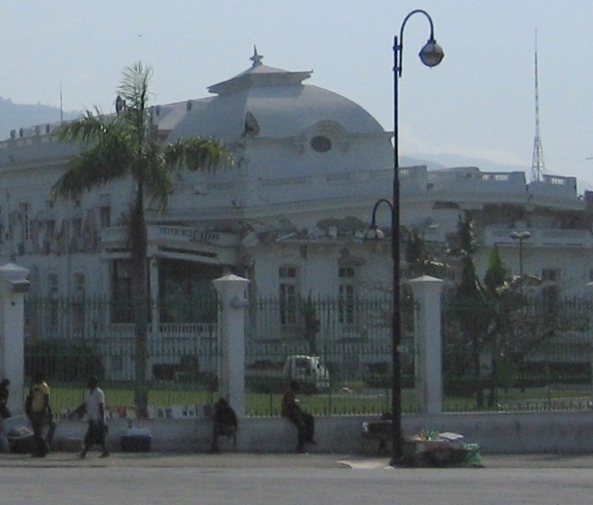
Jan 2010 Haiti Earthquake

Slide 8
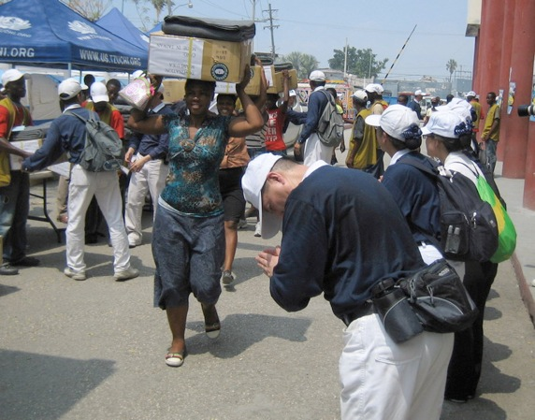
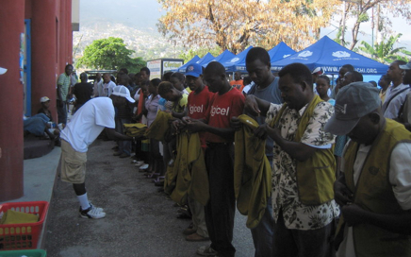
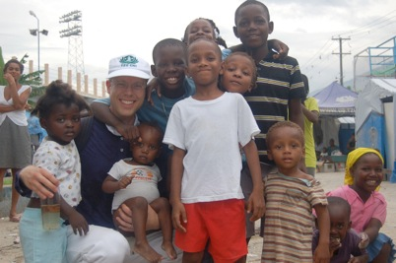

Slide 9
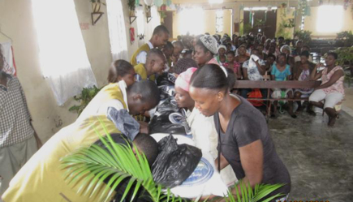
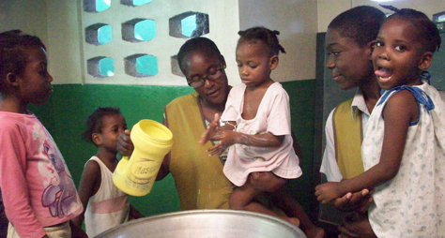
Local Volunteers

Slide 10
Typhoon Haiyan Relief
November, 2013
Notes:
I will take three case studies that illustrate Tzu Chi’s efforts.

Slide 11
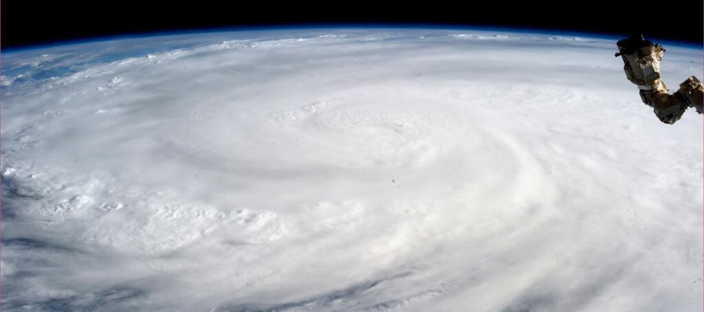
Nov 8, 2013: Typhoon Haiyan strikes the Philippines
The largest recorded cyclone ever to make landfall

Slide 12
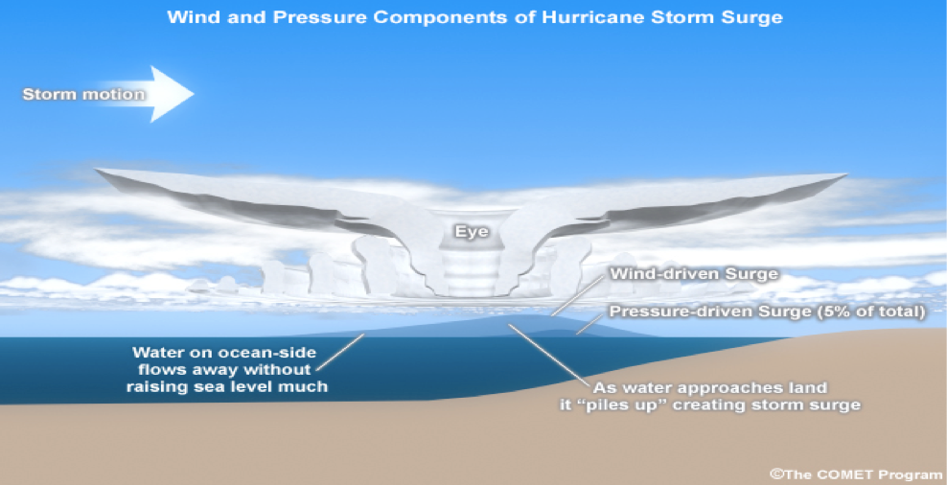
Like a giant tornado + a tsunami
Wind speeds: 315 km/h Storm surge height: 6 m

Slide 13
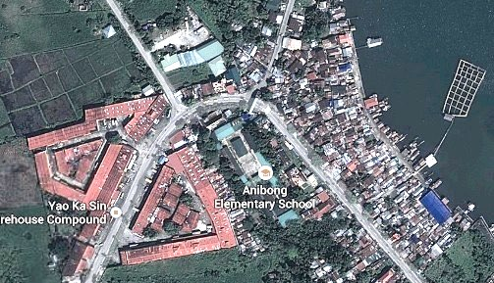
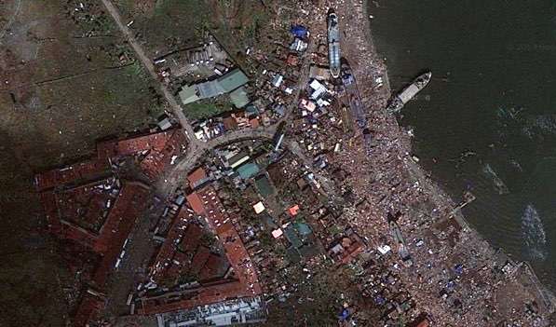
Before and after the typhoon
Nov 8, 2013, 10 am:
Typhoon Haiyan hits Philippine island of Leyte
Community of Anibong,
Northern Tacloban

Slide 14
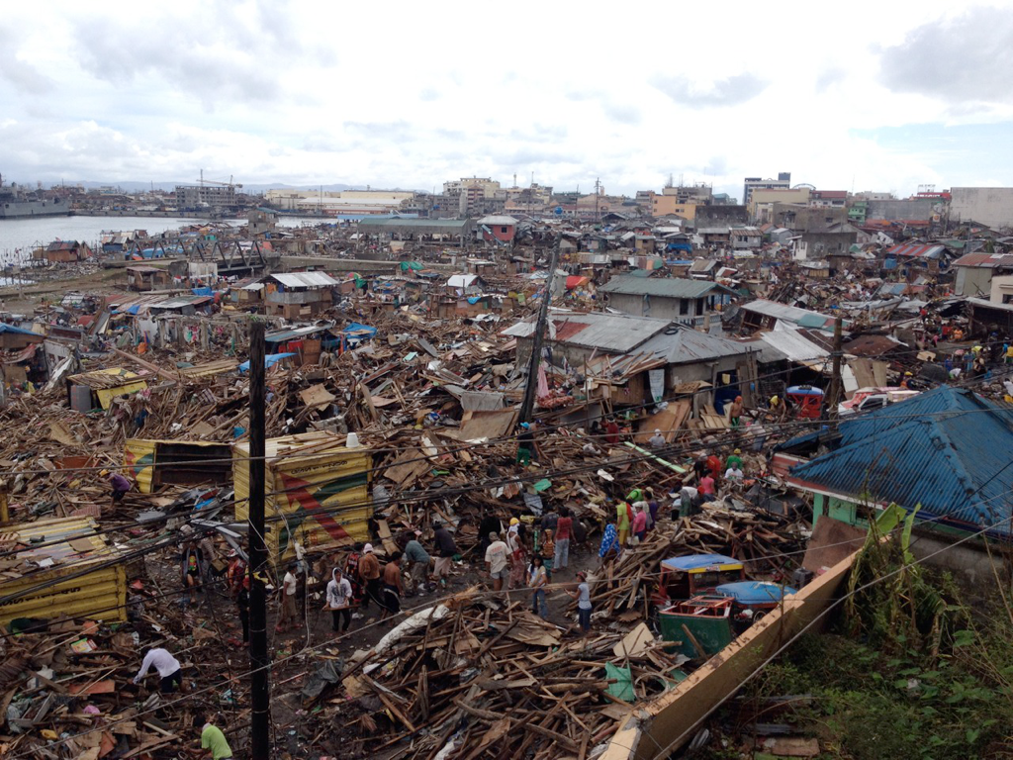

Slide 15
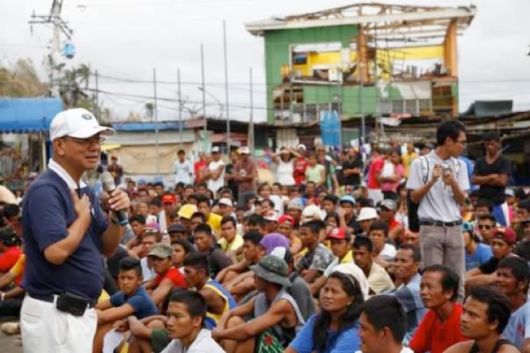
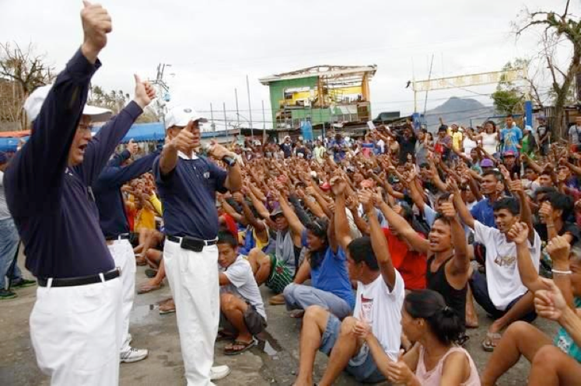
Giving hope

Slide 16
San Jose district, Tacloban – 12,000 participants

Slide 17
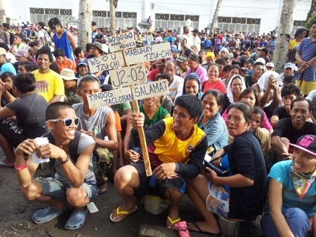
Pure Joy!

Slide 18
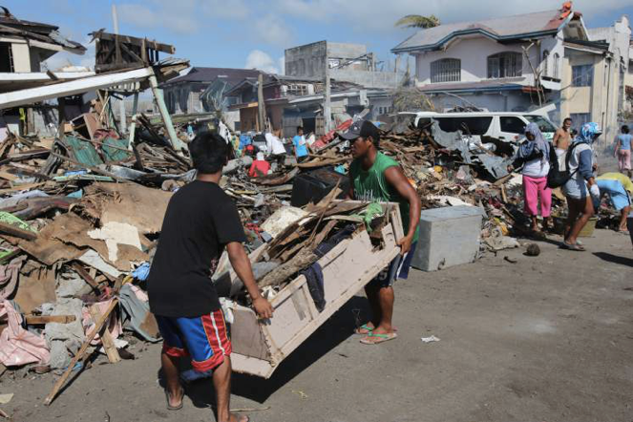
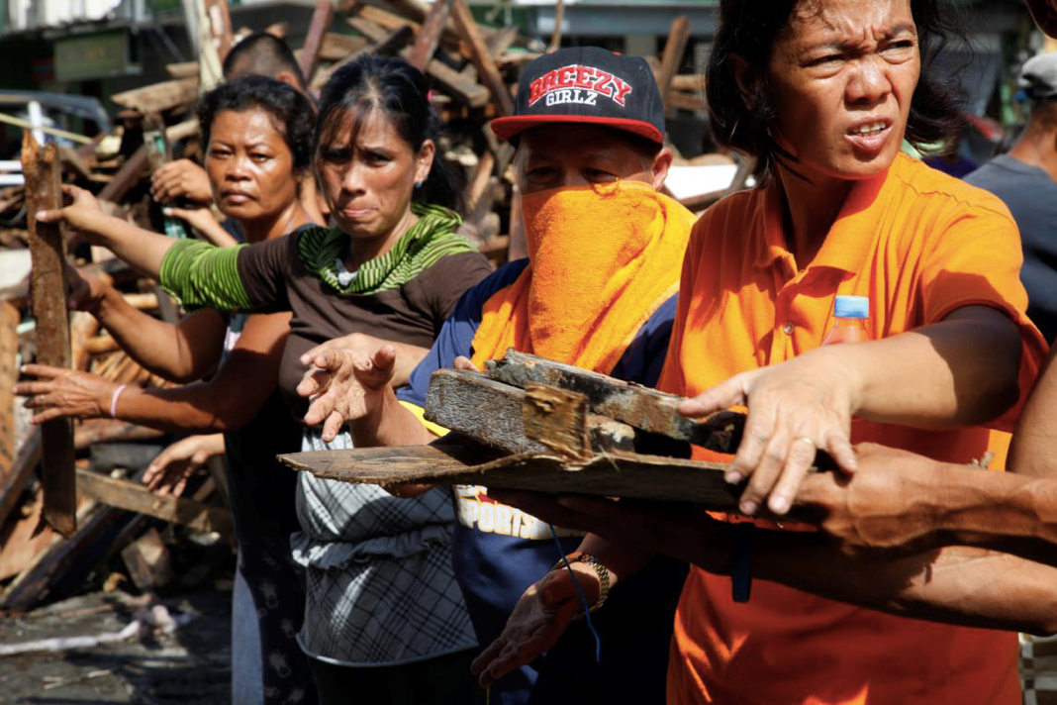
Cleanup work

Slide 19
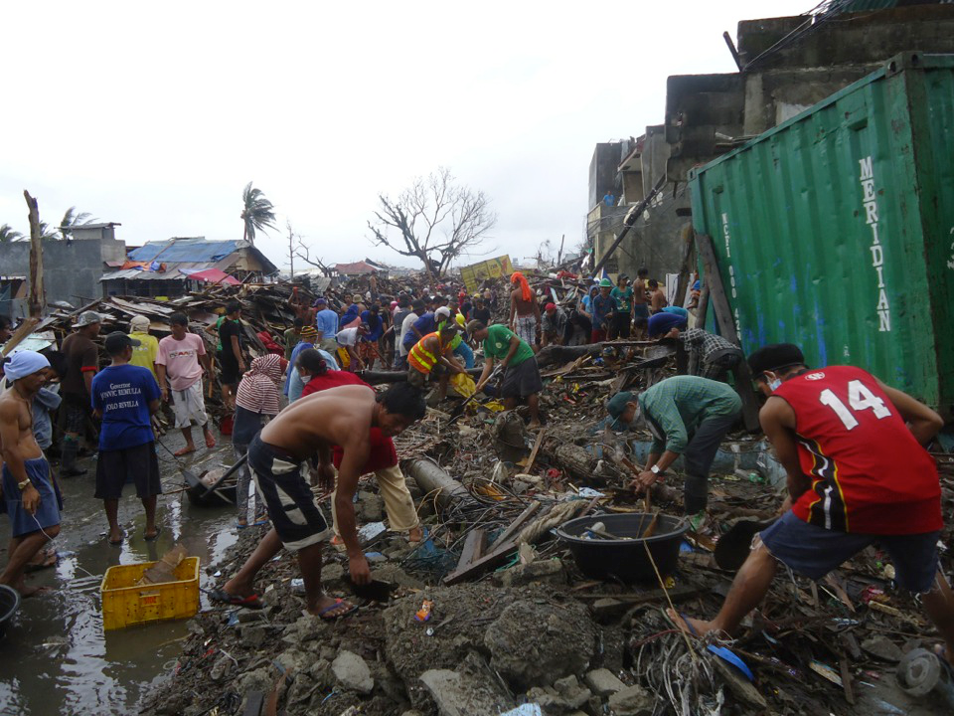

Slide 20
Before cleanup...

Slide 21
... after cleanup

Slide 22
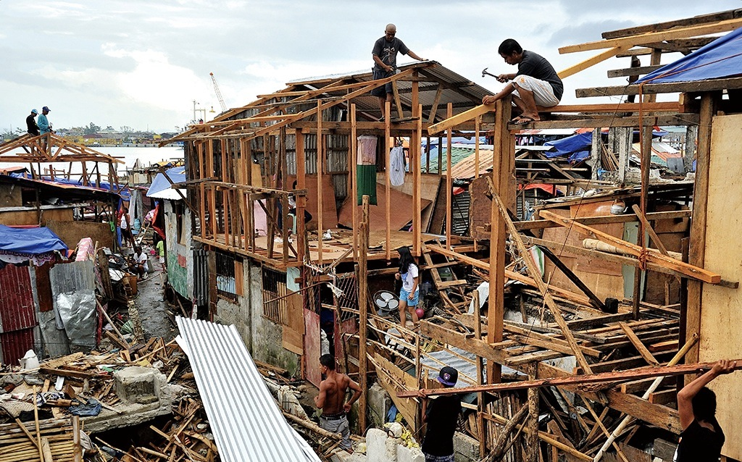
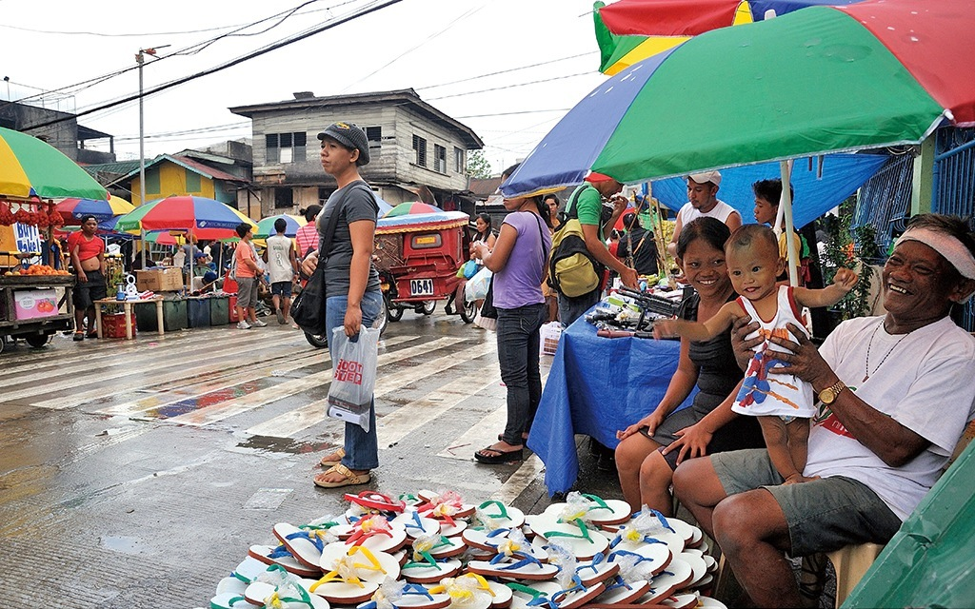
Life returns to Tacloban
Early December
Three weeks after start of cash-for-work

Slide 23
Summary of Tzu Chi’s Haiyan Relief
Material aid as of January 22, 2014: PHP 1.1 Bn (EUR 23 million)
Cash-for-work program:
PHP 500 (US$ 11)/day
Up to 31,000 participants/day, total 289,000 day shifts
Emergency cash relief:
PHP 8,000/12,000/15,000 (US$ 178-334) depending on family size
64,000 families in Tacloban, Ormoc, Tunga, Palo, Tanauan
128 temporary classrooms (life span 3-5 years)
Medical services to 8,700 patients
428,000 portions of hot food to survivors (Tzu Chi Instant Rice)
Mid- and long-term: 1,800 temporary homes, reconstruction of church

Slide 24
Ukraine Crisis
February, 2022

Slide 25
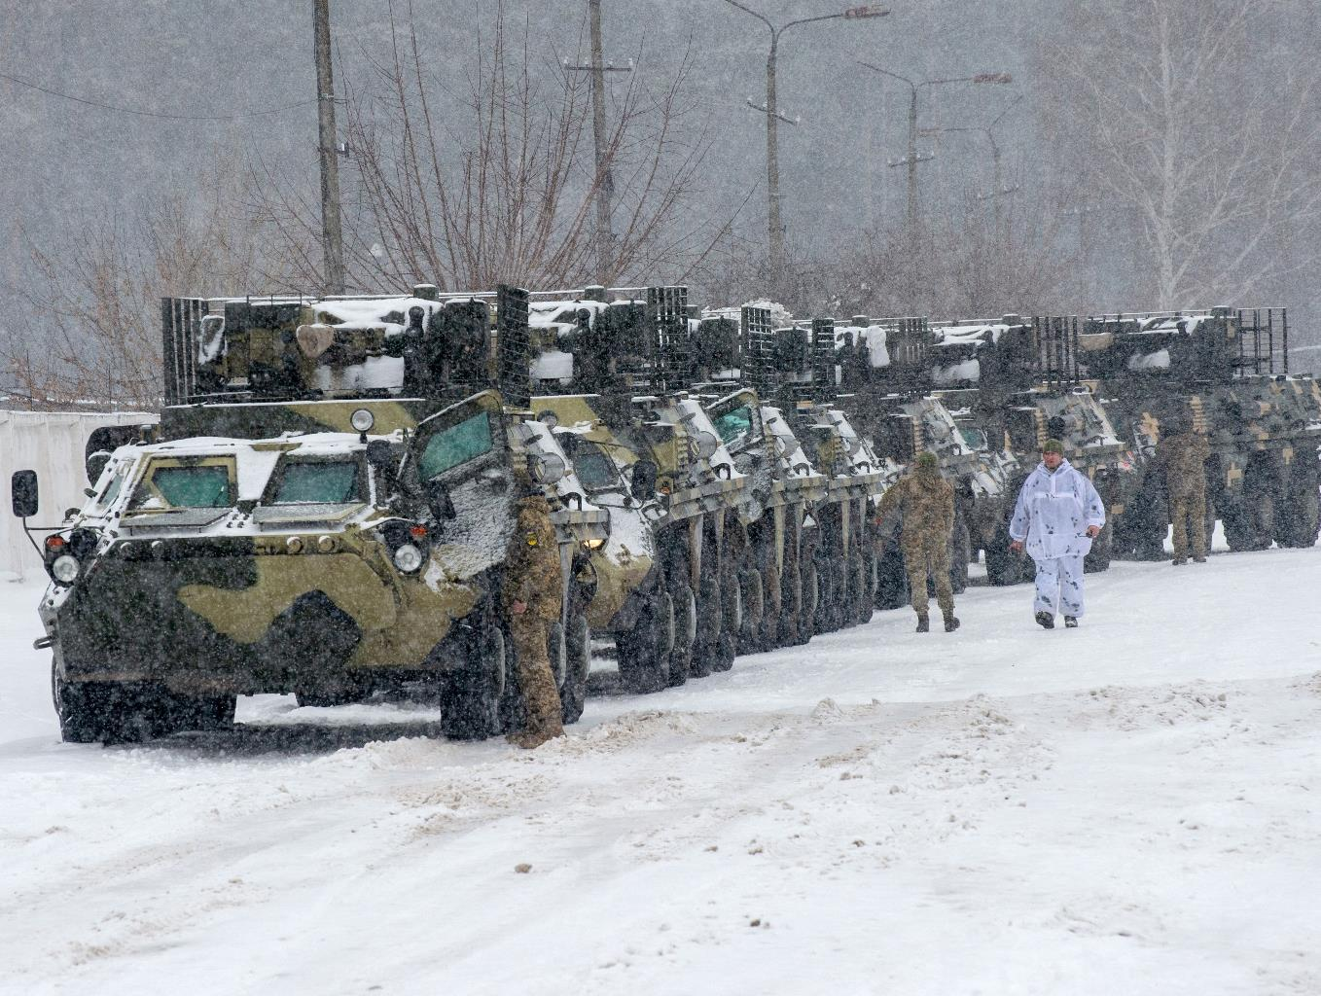
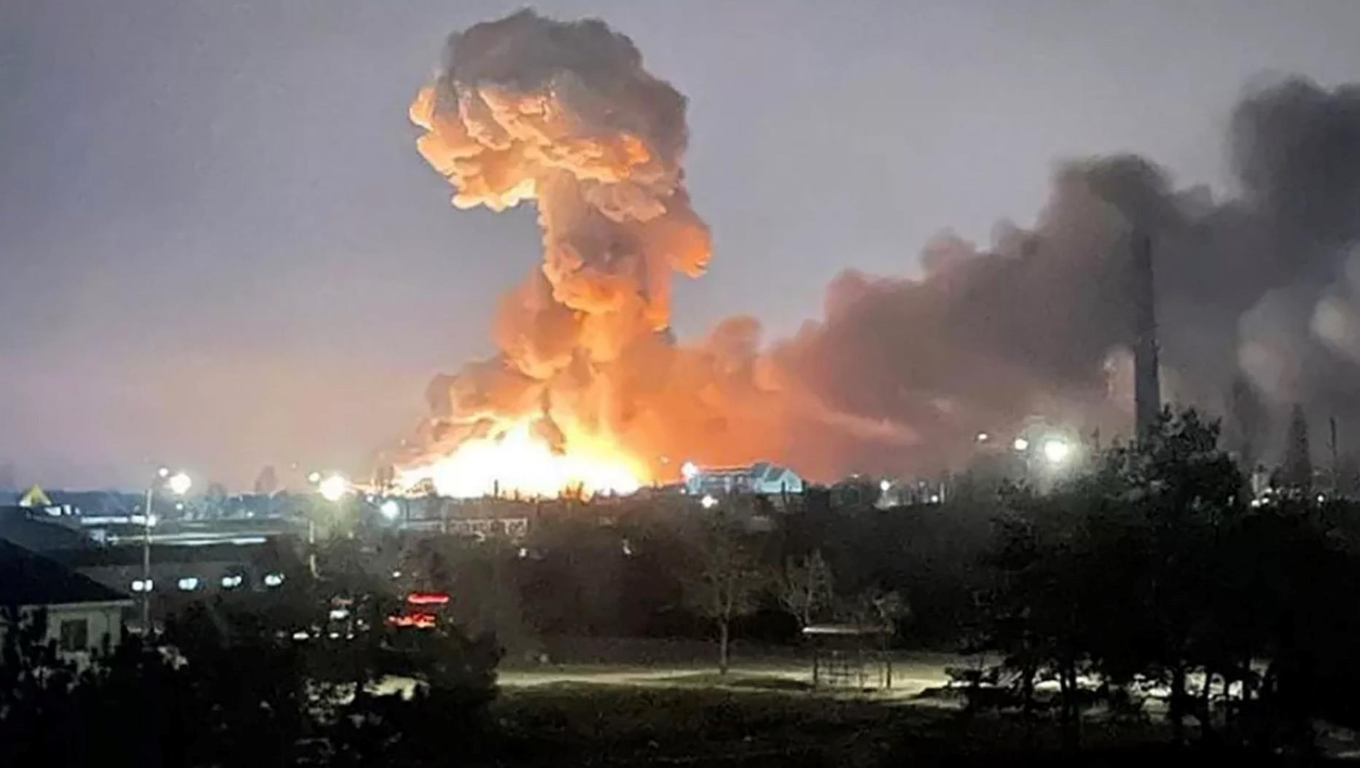
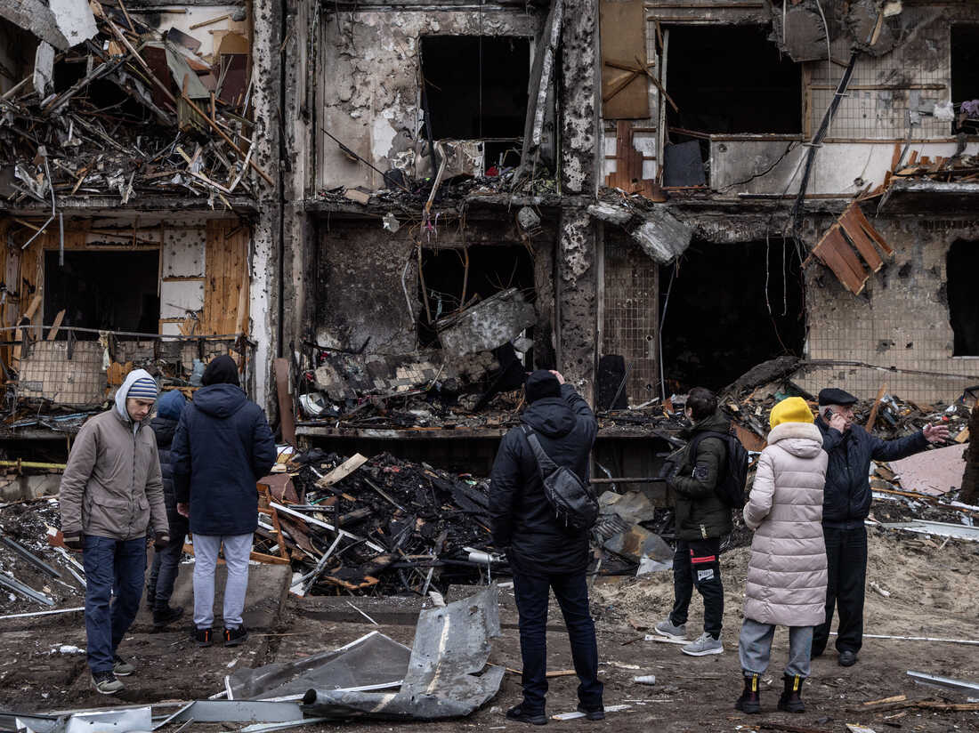

Slide 26
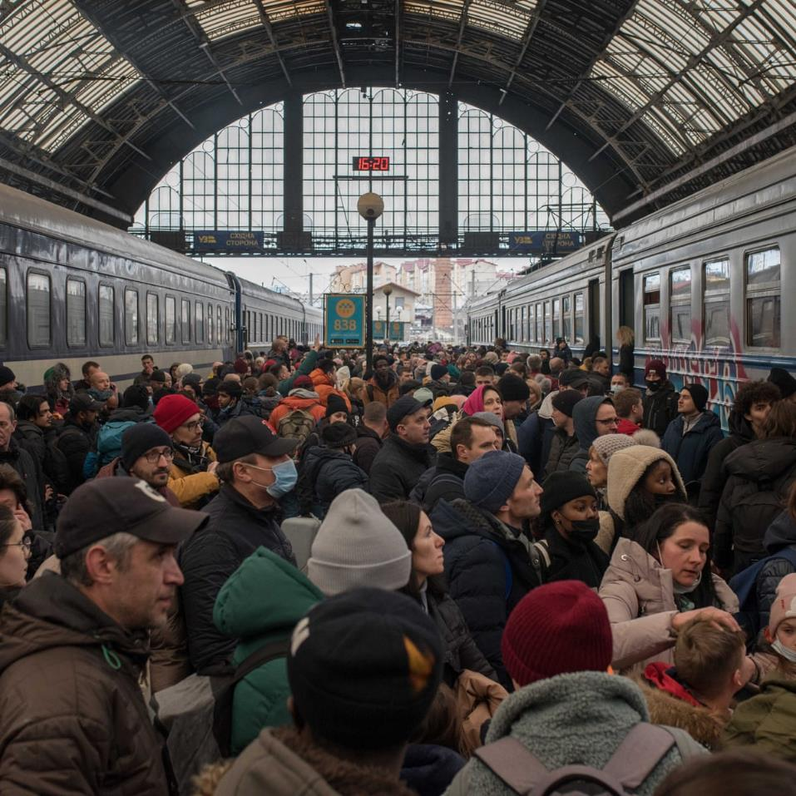
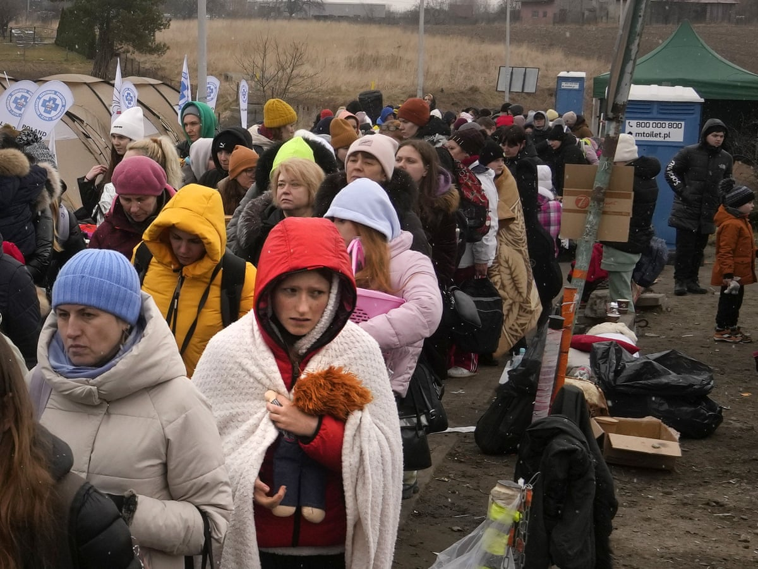
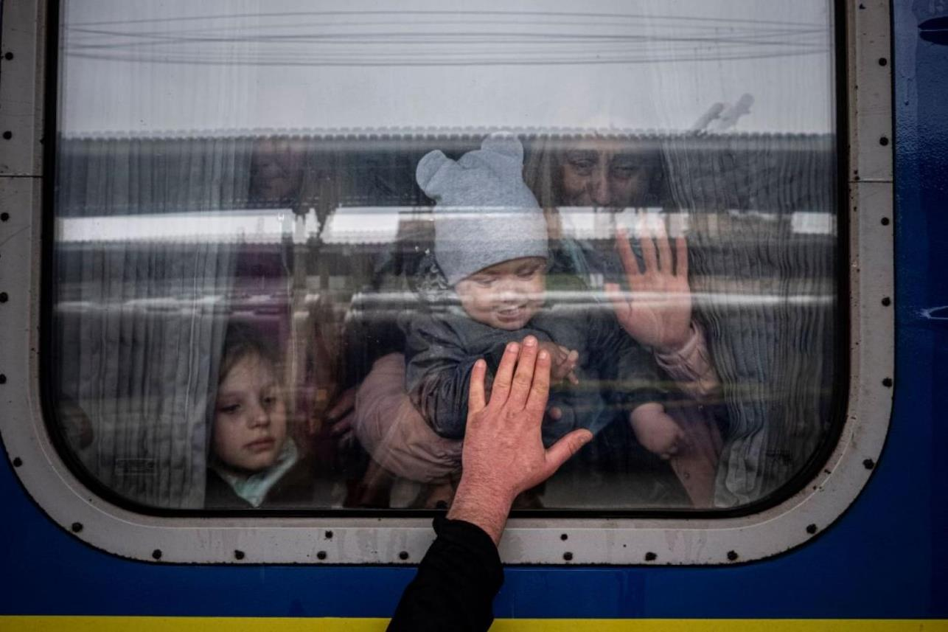

Slide 27
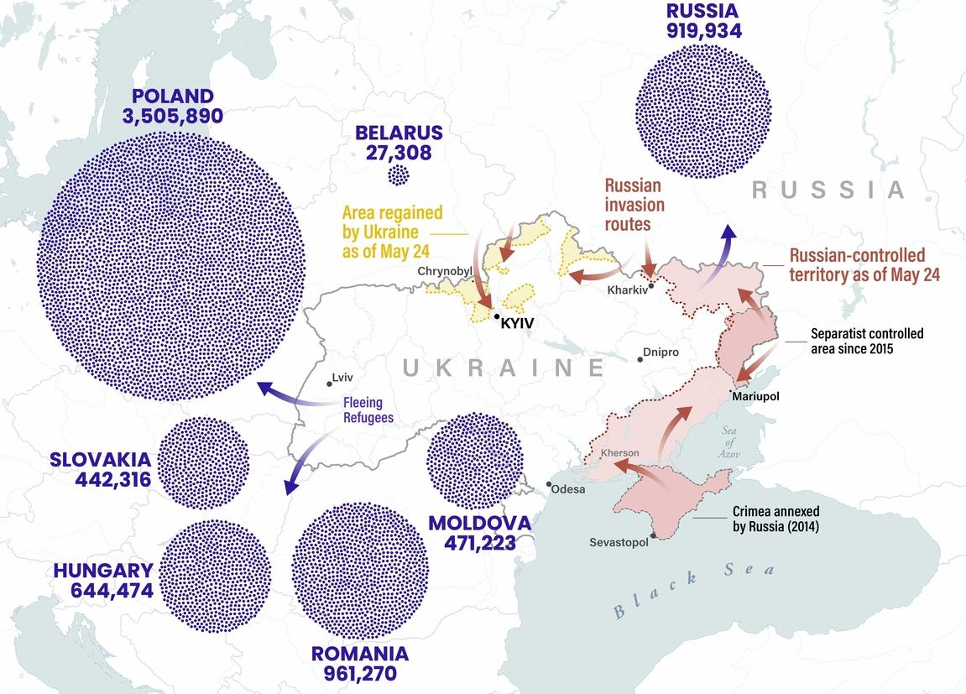

Slide 28
Evolving Needs of Refugees

Slide 29
Long-term Family Care
Job opportunities
Language training, integration activities
Long-term housing
Medical care, vaccinations, rehabilitation therapy
Emergency cash / gift card assistance
Psychosocial assistance (for adults and children)
Emergency shelter
Information, Protection, Food, Water
February 2022
March 2022
April 2022
May 2022
June 2022
July 2022
August 2022
October 2022
September 2022

Slide 30
Tzu Chi’s Specialties
Emergency Cash
Family Care

Slide 31
Poland Emergency Relief Phase (March-August 2022)
Refugees assisted: 81,317
Cash value cards (EUR200-400): 38,994
Eco-blankets: 42,166
Cash-for-work assistance: 1,290 days
International Tzu Chi volunteers: 1,987 visits
Notes:
In our emergency relief work, we were able to reach 80,000 refugees in Poland, providing significant and decisive assistance that gave them the peace of mind they needed to focus on settling in their new country, looking for job opportunities, and so on.

Slide 32
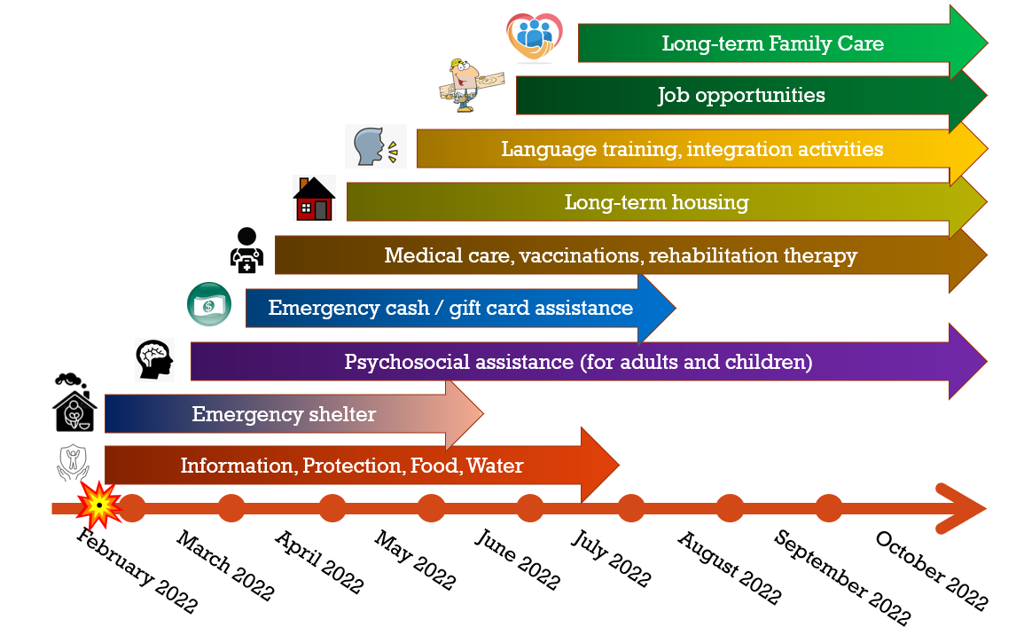

Slide 33
Tzu Chi’s Partners in Ukraine Relief

Slide 34
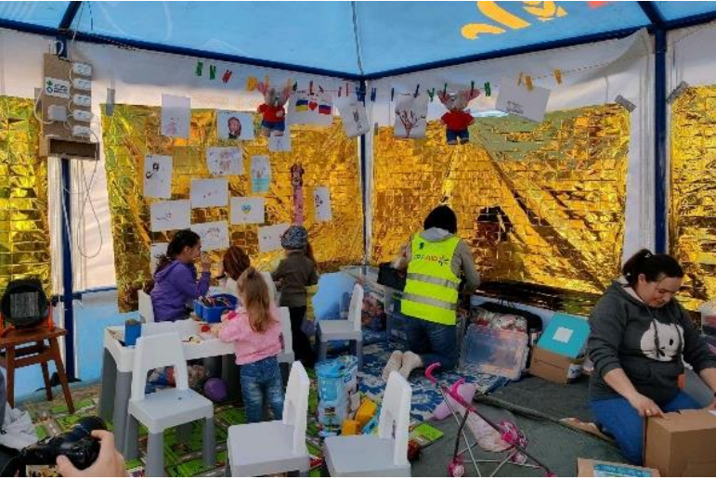
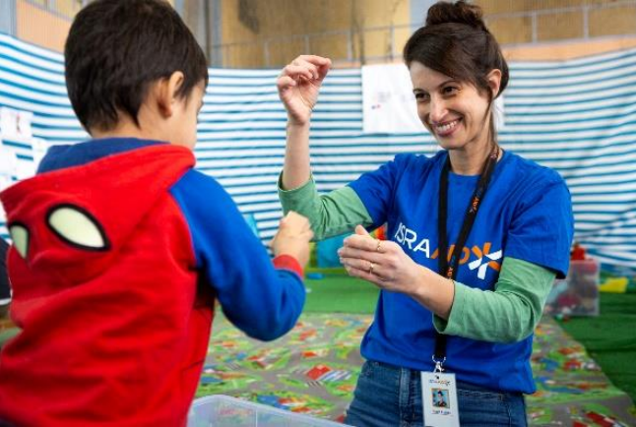
ISRAAID
Protection spaces for children and mothers
Psychosocial support for children and adults
Images © IsraAid

Slide 35
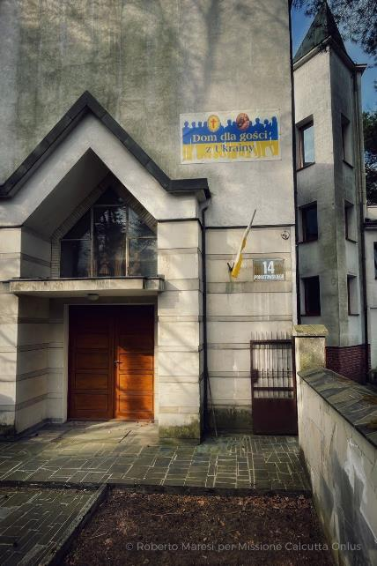
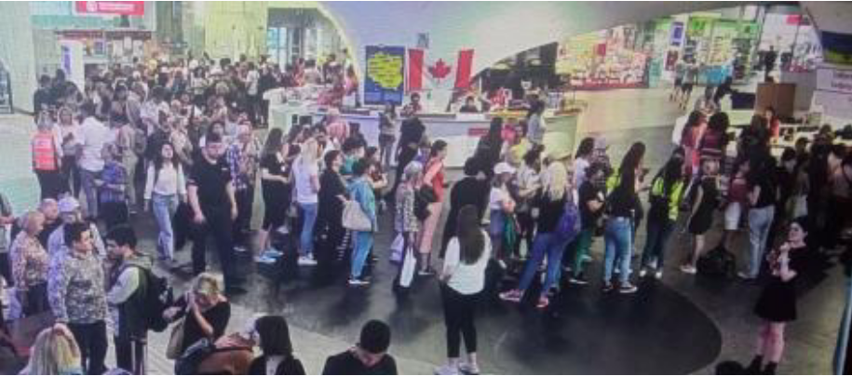
Camillians
Originally homelessness services
Information services
Housing, psychosocial support, job training and placement
Images © CADIS

Slide 36
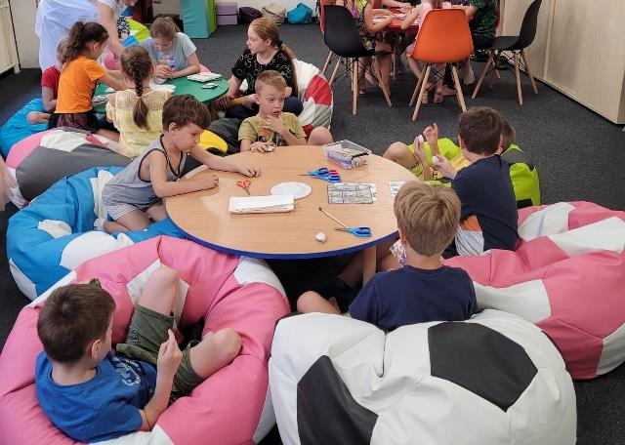
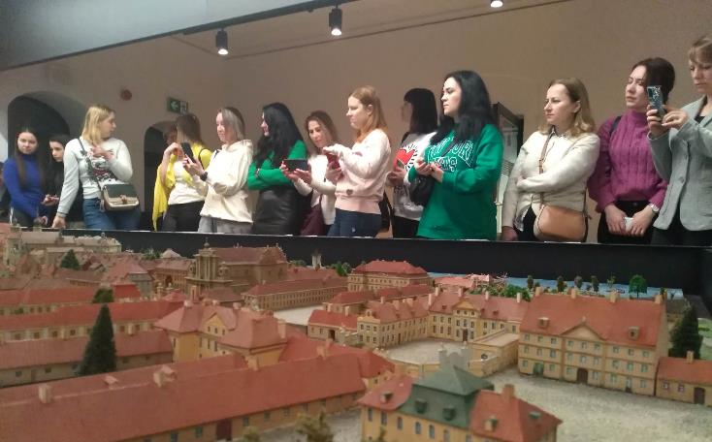
Polish Women Can Foundation
Originally foster family services
Psychotherapy, Polish language classes, legal services, children’s activities
Medical care in collaboration with AMEDS Medical Clinics
Images © FPMW

Slide 38
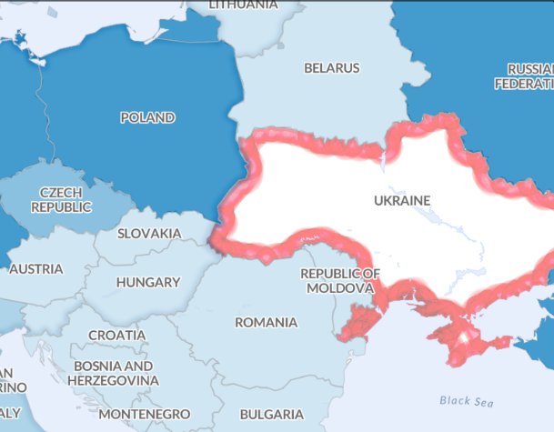

Slide 39
Summary of Ukraine Relief (2022)
Relief type | Services | Organization(s) | Notes
Information | 255,210 | CADIS | In Poland
Shelter | 11,832 | CADIS | In Poland
Food packs, WASH | 273,430 | CADIS, IsraAid | For IDPs in Ukraine
Child protection | 310,892 | UNICEF, IsraAid | In 8 countries
Medical equipment | 478,659 | Airlink consortium | In Ukraine and Moldova
Medical services | 2,608 | FPMW+AMEDS | In Poland
Integration (mental health, language etc.) | 27,491 | FPMW | In Poland
Cash cards | 86,702 | Tzu Chi, CADIS | In Poland
Total Services: | 1,360,122
Notes:
Together with our partners, we have been able to bring life-saving relief to over 1.3 million people. It is important to realize that the majority of these programs would not have existed if not for Tzu Chi’s involvement.

Slide 40
What I brought from Physics
Ask the right questions
Research and develop solutions
Lay out an argument
Work with sprawling collaborations of people with vastly different backgrounds from around the world toward a common goal

Slide 41
Thank you!
Q&A time!

Slide 42
Backup Slides

Slide 43
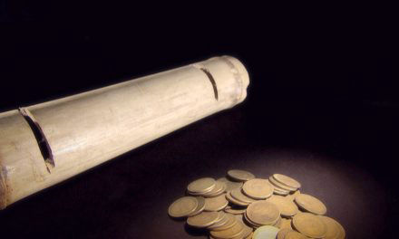
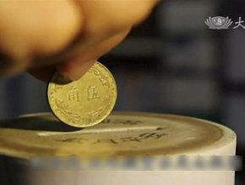
The Bamboo Banks
50 cents per day before going to the grocery market
Why not $15/month?
A daily thought of love!
Tzu Chi founded on May 14, 1966

Slide 44
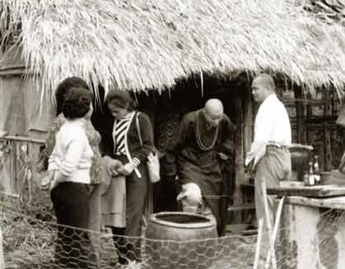
The Early Years
Charity started from an elderly women living near the grocery market
Master personally visited all charity recipients around Taiwan for the first six years of Tzu Chi
Found that poverty is closely connected to lack of medical resources

Slide 45
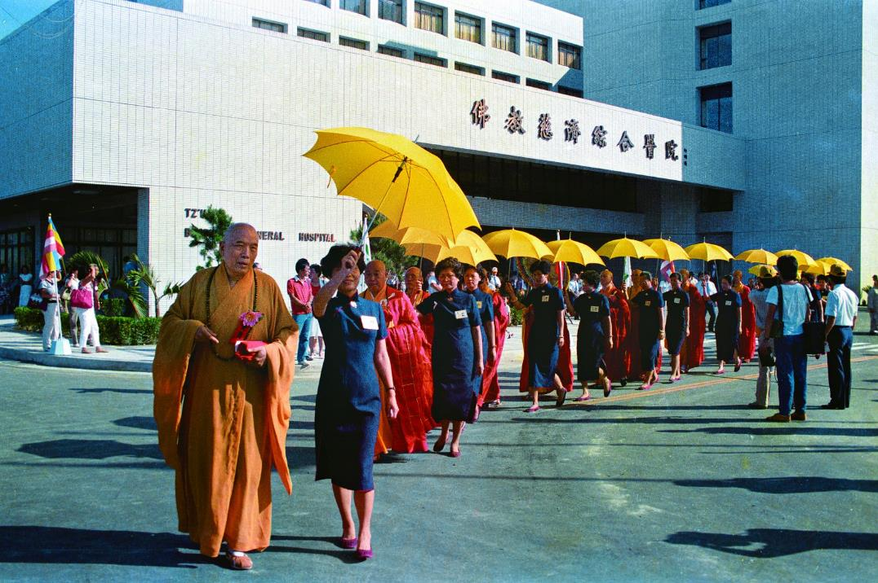
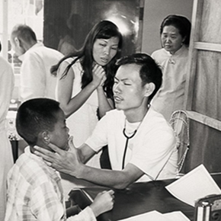
Free Medical Clinics and Hospital
Twice-weekly free clinic in Hualien 1972-1986
Tzu Chi’s first hospital in Hualien opened 1986 after 7 years of fundraising and construction

Slide 46
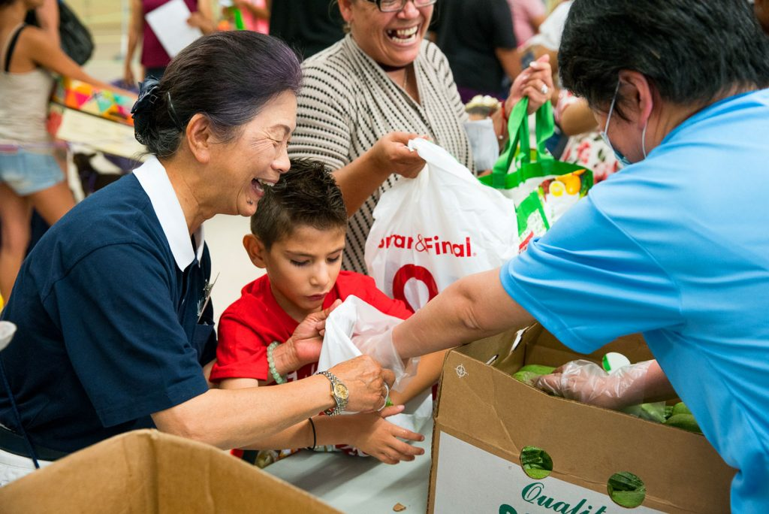
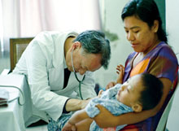
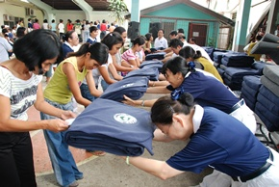
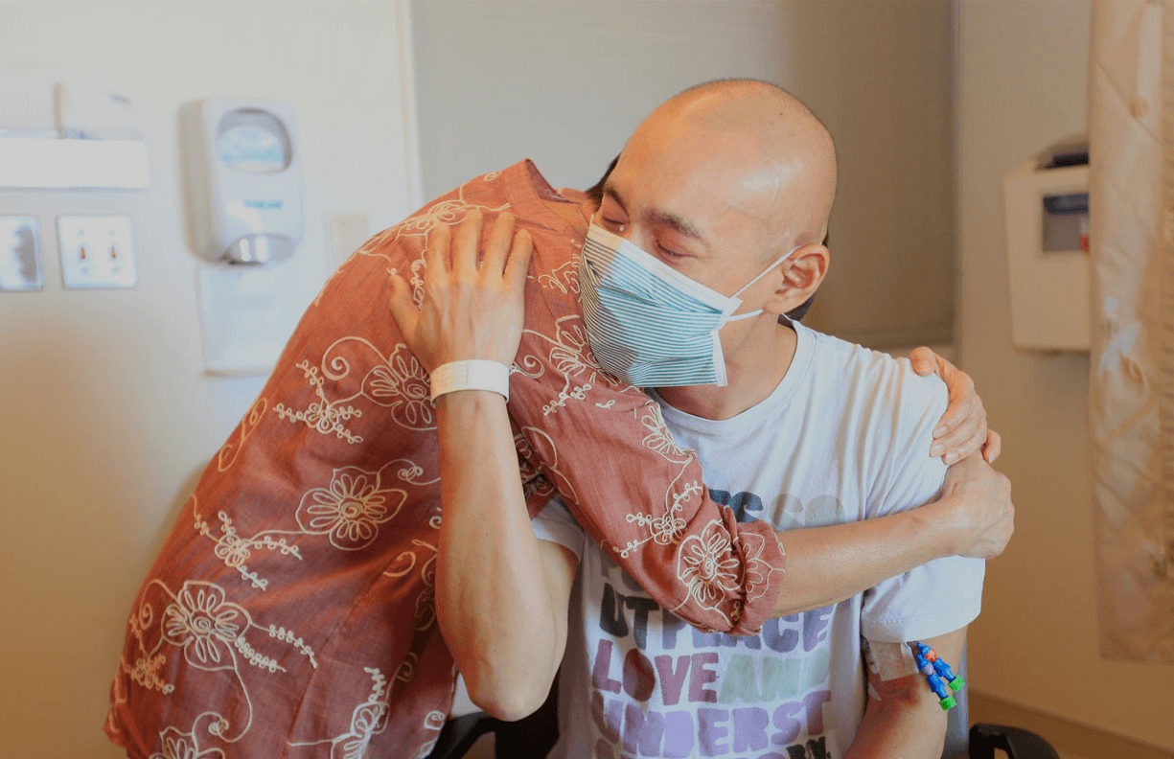
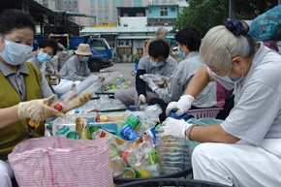
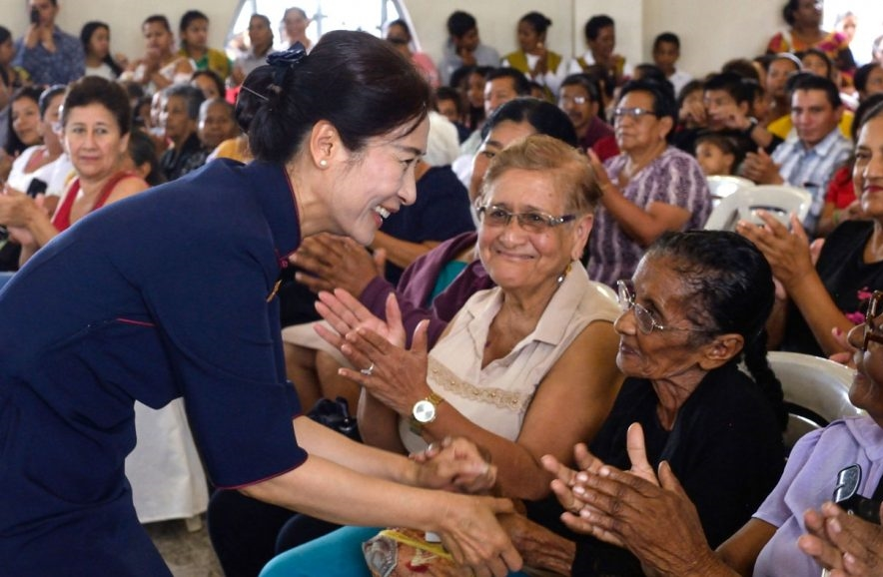
Eight Main Missions
Charity
Medicine
Education
Humanistic Culture
International Disaster Relief
Bone Marrow Registry
Environmental Protection
Community Volunteerism

Slide 47
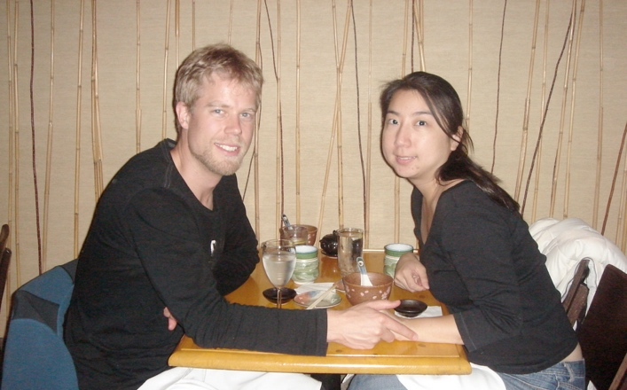
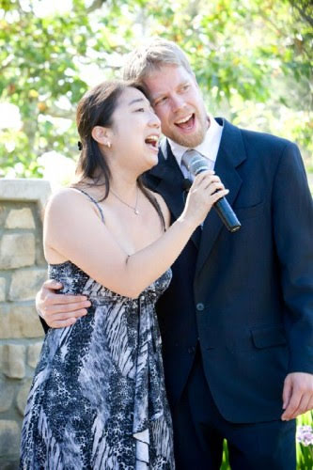
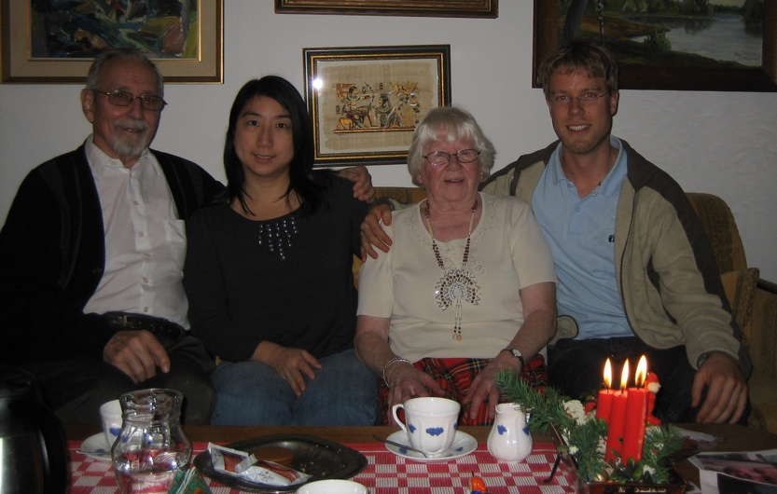
2008 Met Grace Chen 陳伊瑩

Slide 48
Volunteering with Grace一起當慈濟志工

Slide 49
2011 Leukemia 白血病

Slide 54
Jing Si Abode 靜思精舍

Slide 55
Spiritual Practice 修行生活

