Slide 1
High-Energy Physics
More than 10 years a priority for Flanders
Dr. Hans Willems, Secretary-General

Slide 2
FWO mission
Funding of fundamental & strategic research
Funding programmes
Individual researchers (pre-, post-doc, mobility)
Research teams (projects, SBO, TBM, brain gain Odysseus,…)
Research infrastructure
Scientific prizes
Bottom-up in all disciplines
Scientific excellence and interuniversity competition
Transparent and equal opportunities

Slide 3
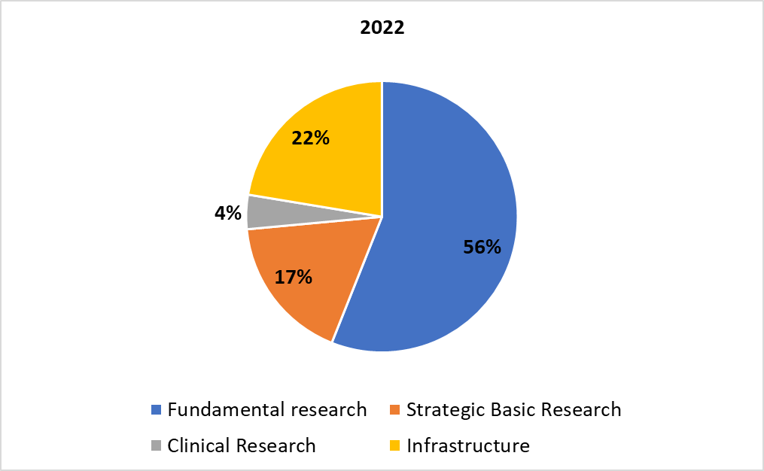
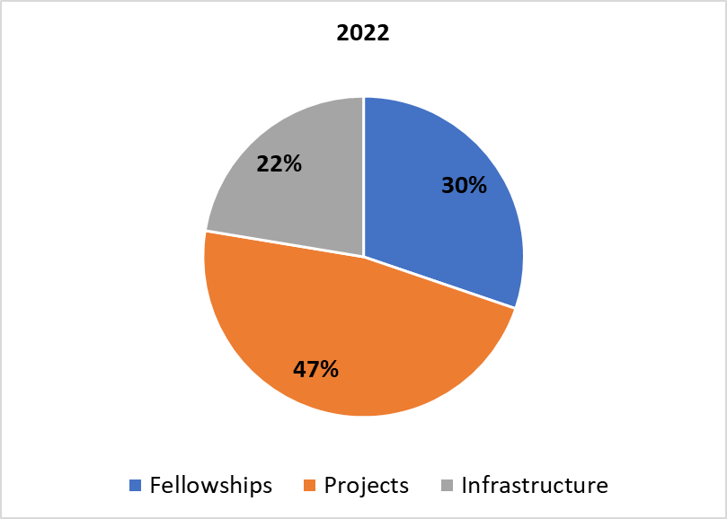
The FWO by numbers
Budget 2022: 470 MEUR
1652 PhD fellows
785 Postdocs
1500 Projects
79% PhD fellows 21%
51% Postdocs 49%
28,6% PhD fellows
24,8% Postdoc JR (180)
28,3% Postdoc SR (89)
21,9 % Projects
50% PhD-fellows 50%
45% Postdocs 55%
Call 2022

Slide 4
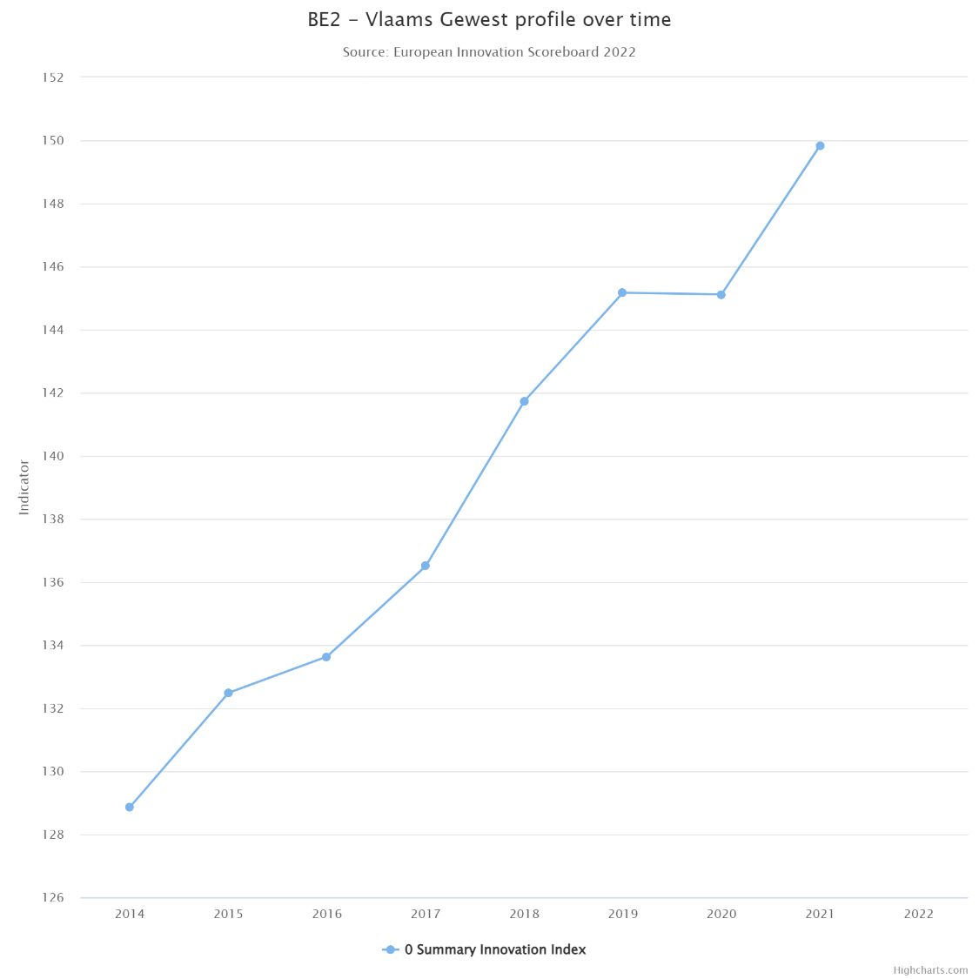
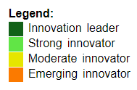
R&D intensity in Flanders
Map shows the regional’ performance in 2021, using the most recent data for 32 indicators.
Source: https://ec.europa.eu/research-and-innovation/en/statistics/performance-indicators/european-innovation-scoreboard

Slide 5
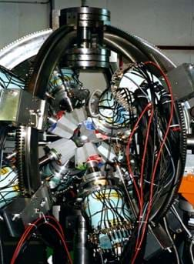
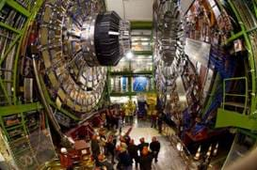
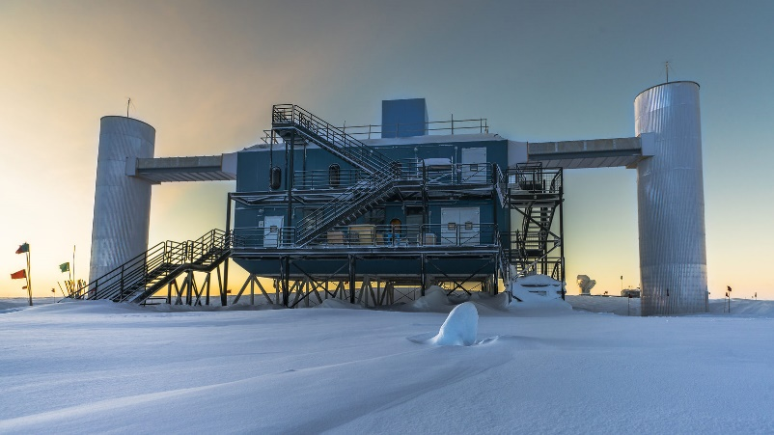
The importance of High-Energy Physics
Combined efforts leading to some of the largest scientific collaborations in the world.
Using some of the most sensitive detectors in the world.
Looking for answers to some of the biggest questions about our universe:
What is it made of?
What forces govern it?
How did become the way it is today?

Slide 6
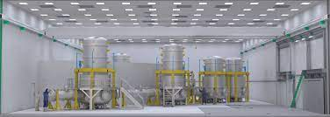
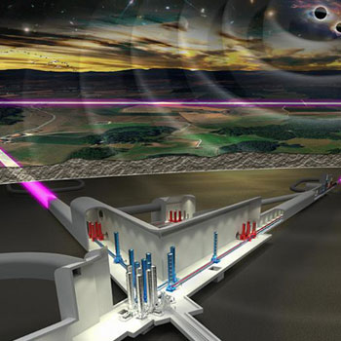
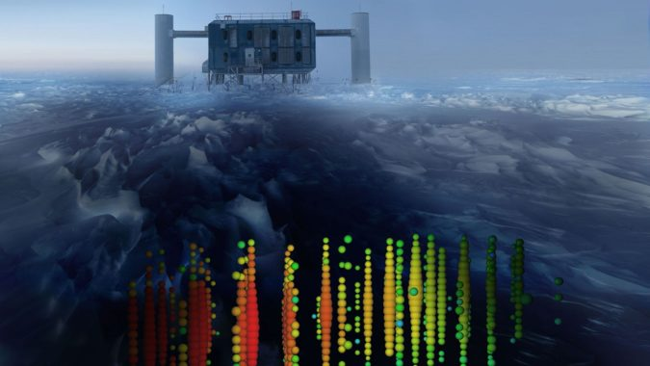
The relevance to Flanders
10.000+ publications
1.500+ researchers
1.000+ projects

Slide 7
Flanders’ funding of High Energy Physics
Funding programs since 2012:
PhD fellowships funding : € 1.760.000
Postdoc funding: € 5.760.000
Project funding: € 9.132.452
Infrastructure funding: 42 460 254 €

Slide 8
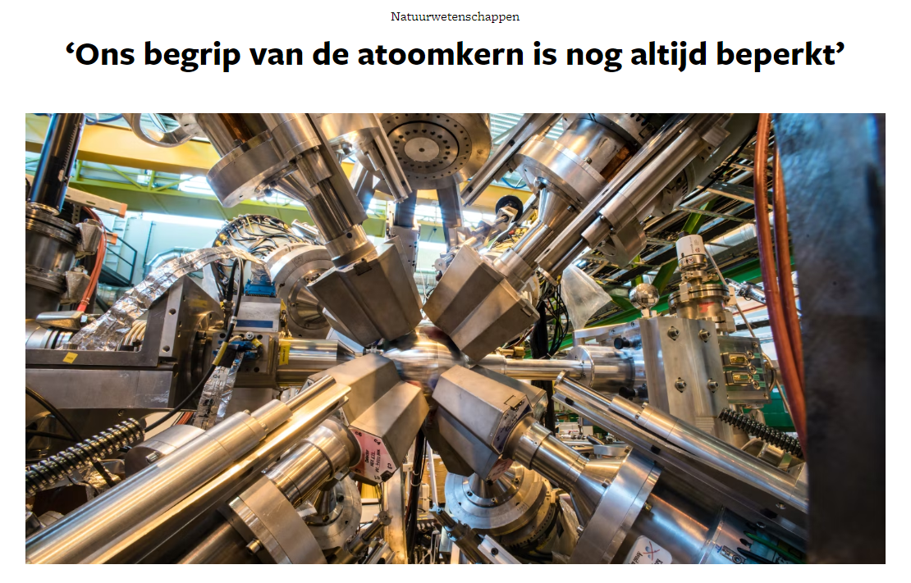
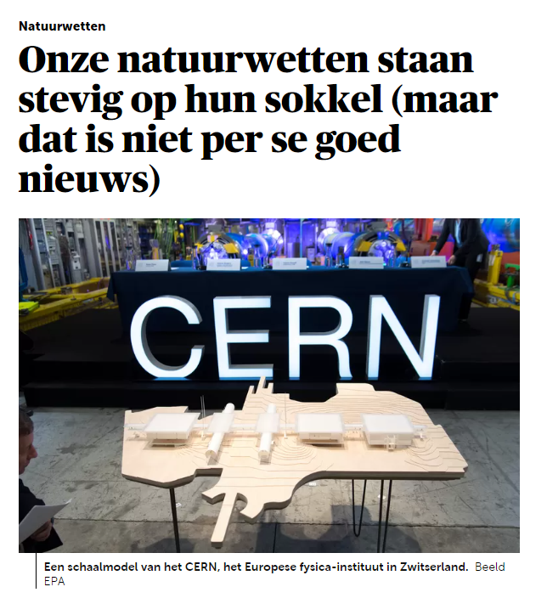
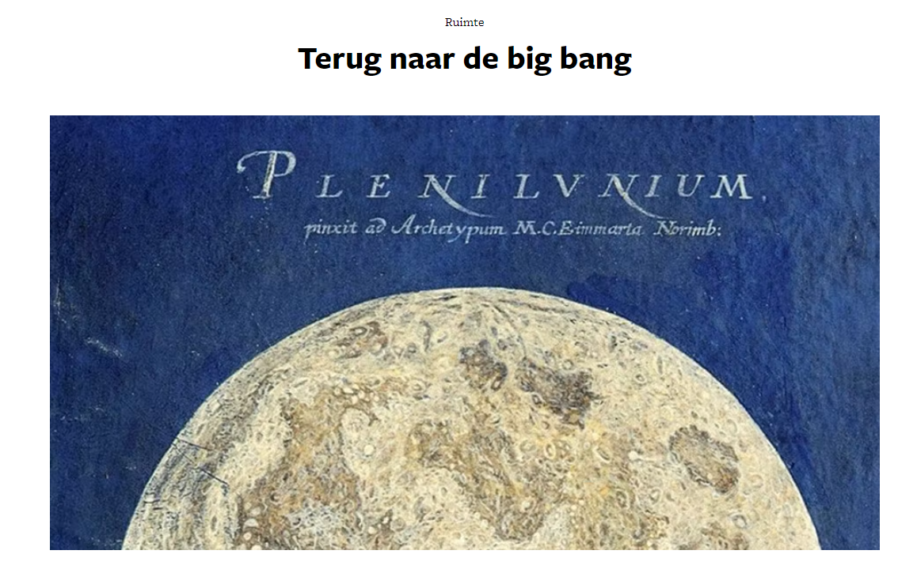
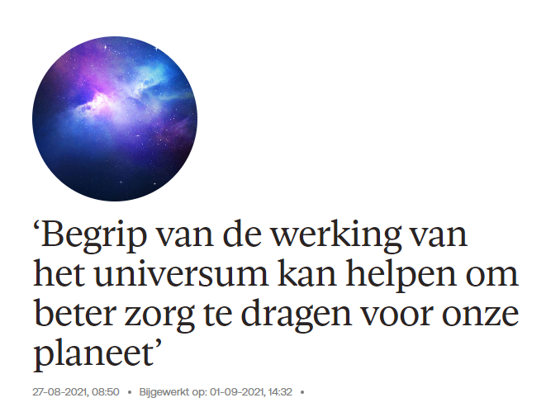
Project in the spotlight - CERN
Notes:
With the 27 km circumference Large Hadron Collider (LHC) at CERN and the monumental detectors around it, scientists from all over the world have access to the most advanced tools to continue this exploration.
The Compact Muon Solenoid (CMS) detector allows to investigate and test many theoretical ideas that are being proposed to answer these questions.

Slide 9
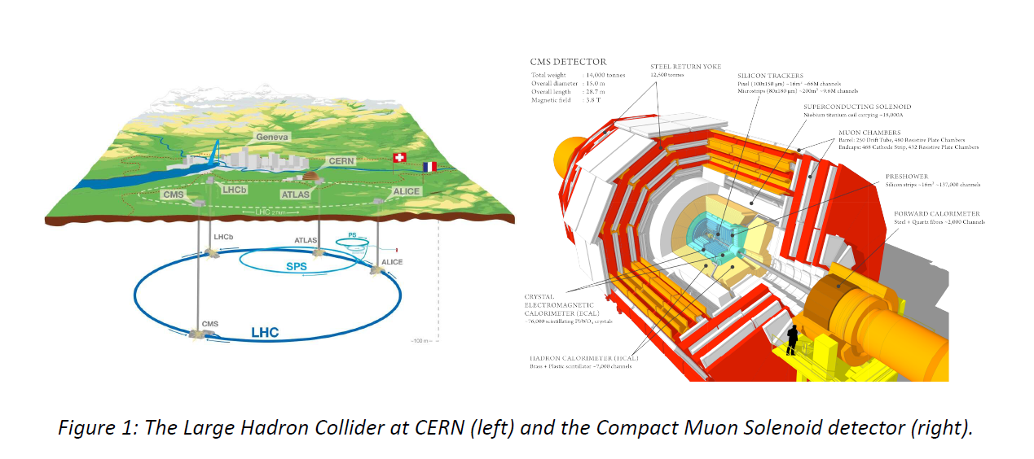
Project in the spotlight - CERN
Notes:
ISOLDE at CERN and SPIRAL2 at GANIL are two complementary accelerator facilities, where nuclei are delivered as radioactive ion beams and studied for their fundamental properties or as probes to investigate their environment.
MEDICIS at CERN is a facility to research and develop methods for the production and collection of radioisotopes of interest for medical applications.

Slide 10
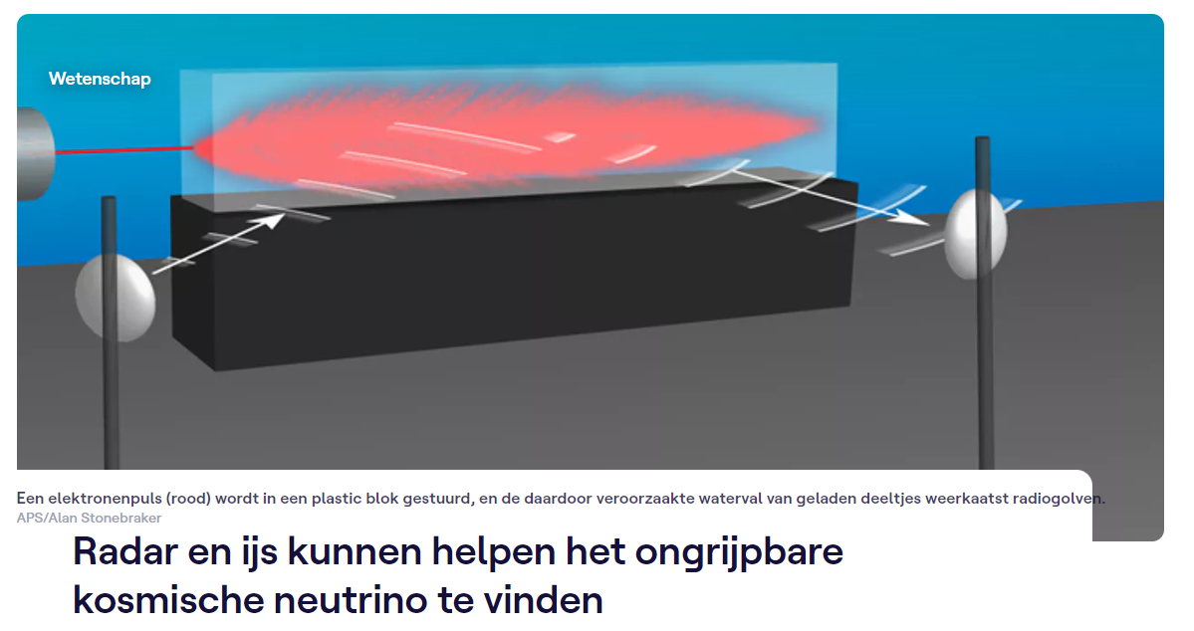
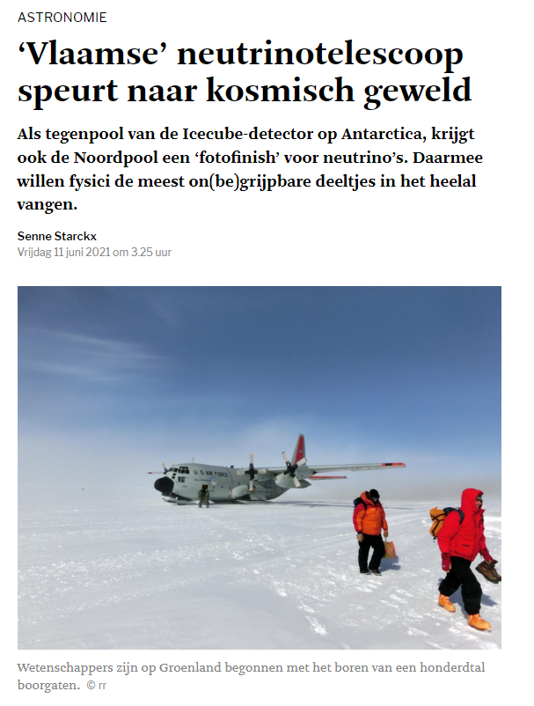
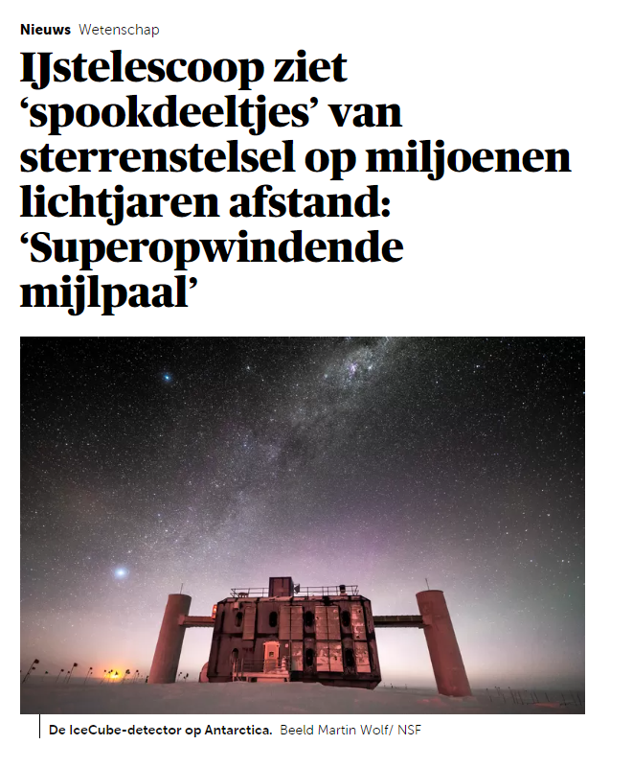
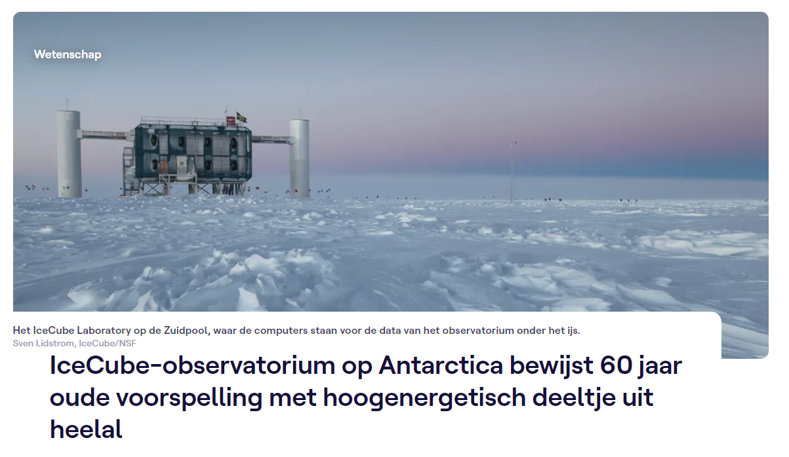
Project in the spotlight - ICECUBE
Notes:
The discovery of cosmic high-energy neutrinos by IceCube has opened a new era, dubbed neutrino astronomy and announced as the “breakthrough of 2013”.
The sources of the cosmic neutrinos still remain a mystery, but one expects that they originate from the same cataclysmic phenomena as the cosmic rays.
As such, cosmic high-energy neutrinos will enable us to identify the sources of cosmic rays and obtain insight in the inner engines of cosmic phenomena.
The IceCube observations have indicated that to achieve this.

Slide 11
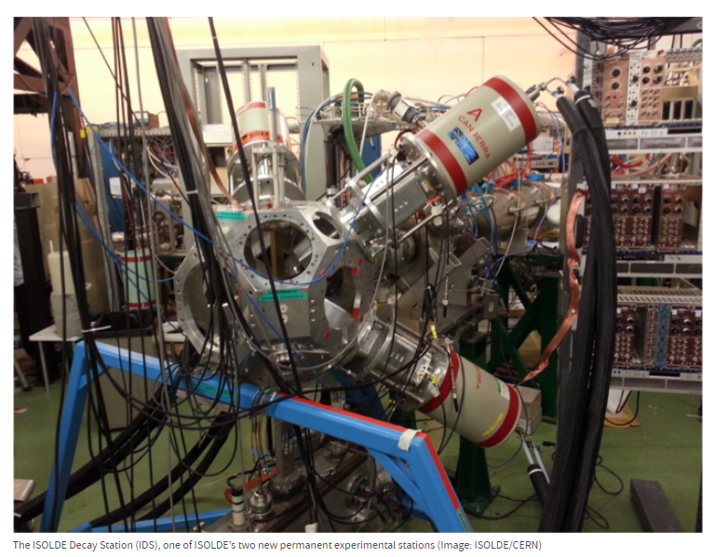
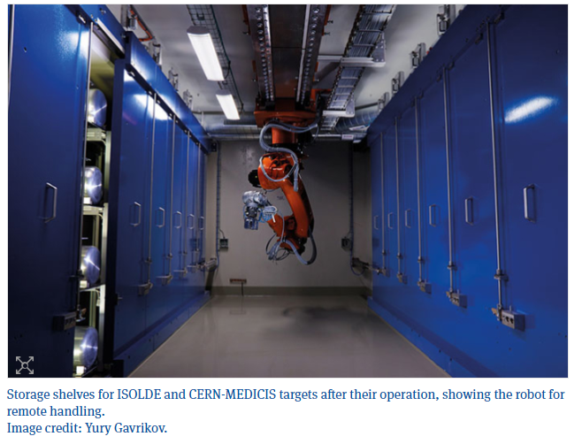
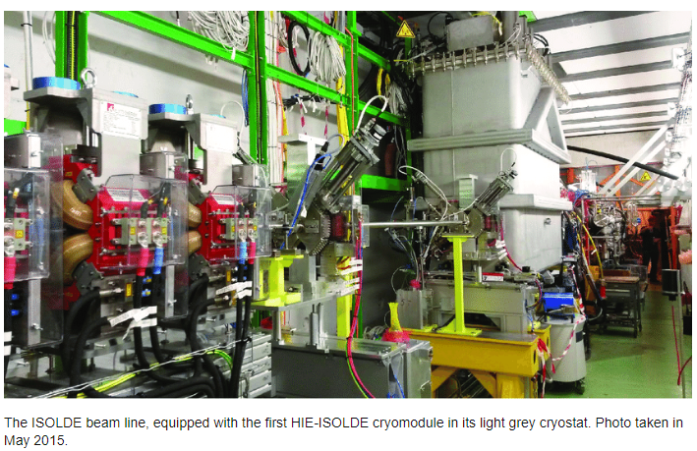
Project in the spotlight – ISOLDE-SPIRAL 2

Slide 12
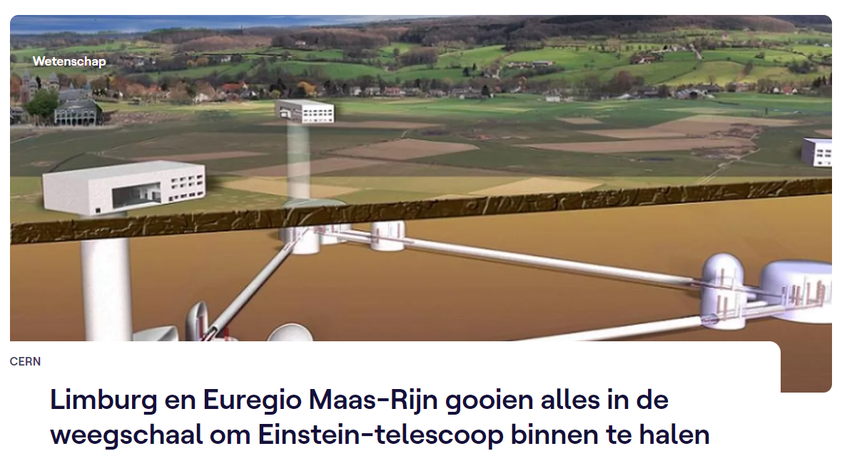
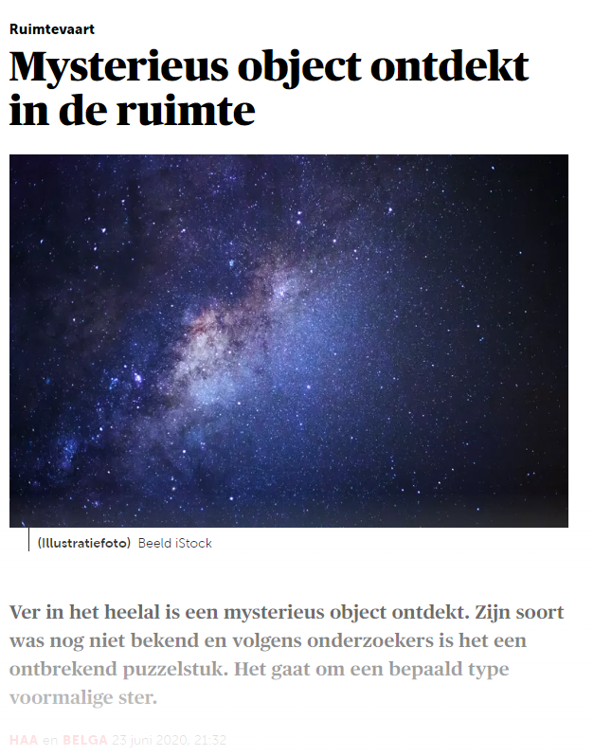
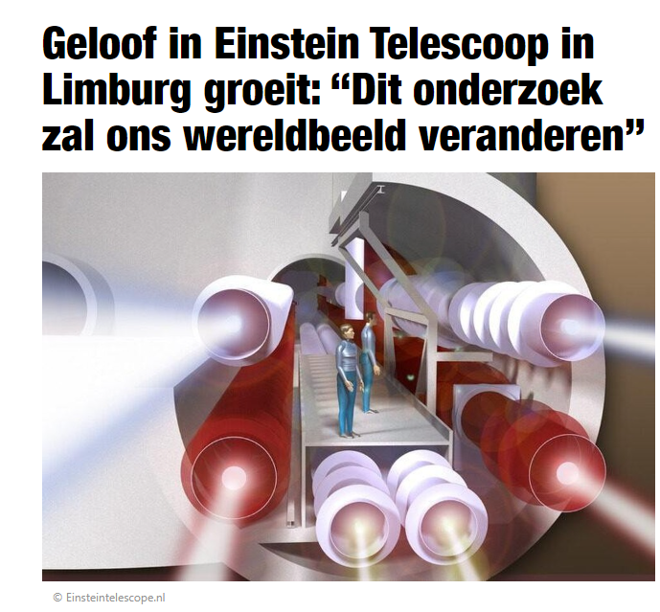
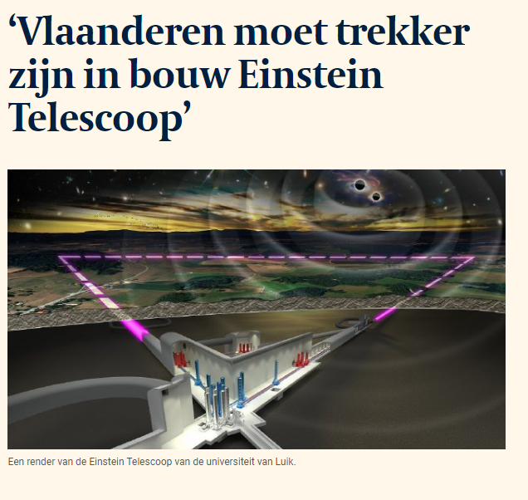
Project in the spotlight - Einstein telescope
Notes:
The first detections of gravitational waves since 2015 and the dawn of the multi-messenger astronomy era have demonstrated the enormous scientific potential of gravitational-wave observatories and provided a solid basis for the future of gravitational-wave (astro-)physics.
The Einstein Telescope is envisioned as the pioneer of a new generation of gravitational wave detectors designed to realize this potential.
The Belgian-Dutch-German border area is identified as a promising location to site the Einstein Telescope.

