Slide 1
High-Energy Physics in Belgium Fund for Scientific Research – FNRS Véronique Halloin, Secretary General March 9, 2023
Notes:
Maxime

Slide 2
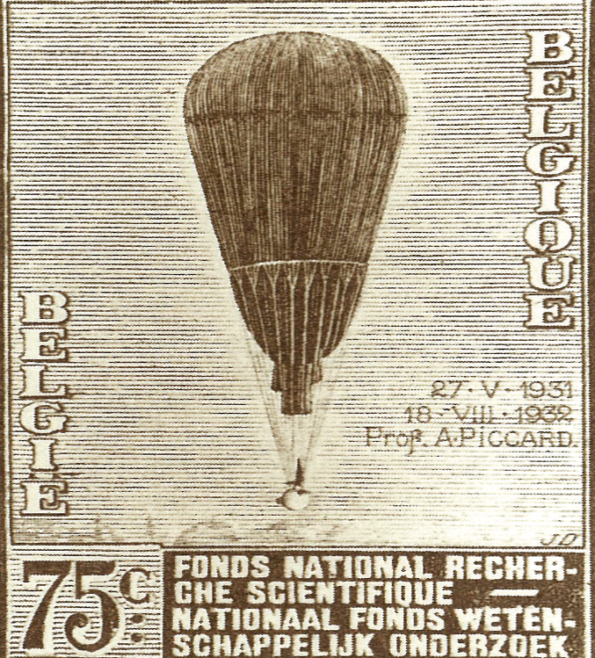
BELGIUM & FNRS:
A PIONEERING ROLE IN HIGH-ENERGY PHYSICS
1928

Slide 3
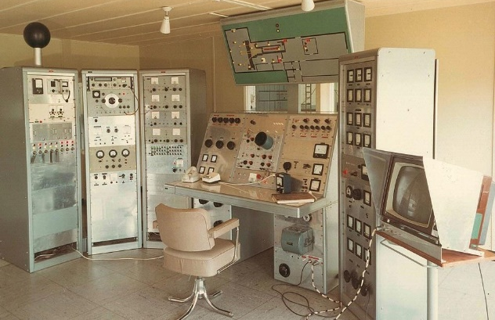
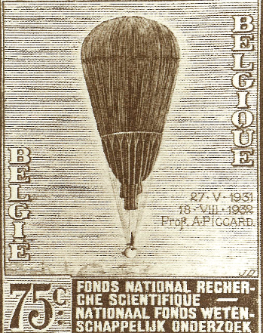
BELGIUM & FNRS:
A PIONEERING ROLE IN HIGH-ENERGY PHYSICS
1928
1947

Slide 4
BELGIUM & FNRS:
A PIONEERING ROLE IN HIGH-ENERGY PHYSICS
Belgium: one of the
12 founding States
1928
1947
1954

Slide 5
BELGIUM & FNRS:
A PIONEERING ROLE IN HIGH-ENERGY PHYSICS
1928
1947
1954
1939

Slide 6
BELGIUM & FNRS:
A PIONEERING ROLE IN HIGH-ENERGY PHYSICS
1928
1947
1954
1939
1952

Slide 7
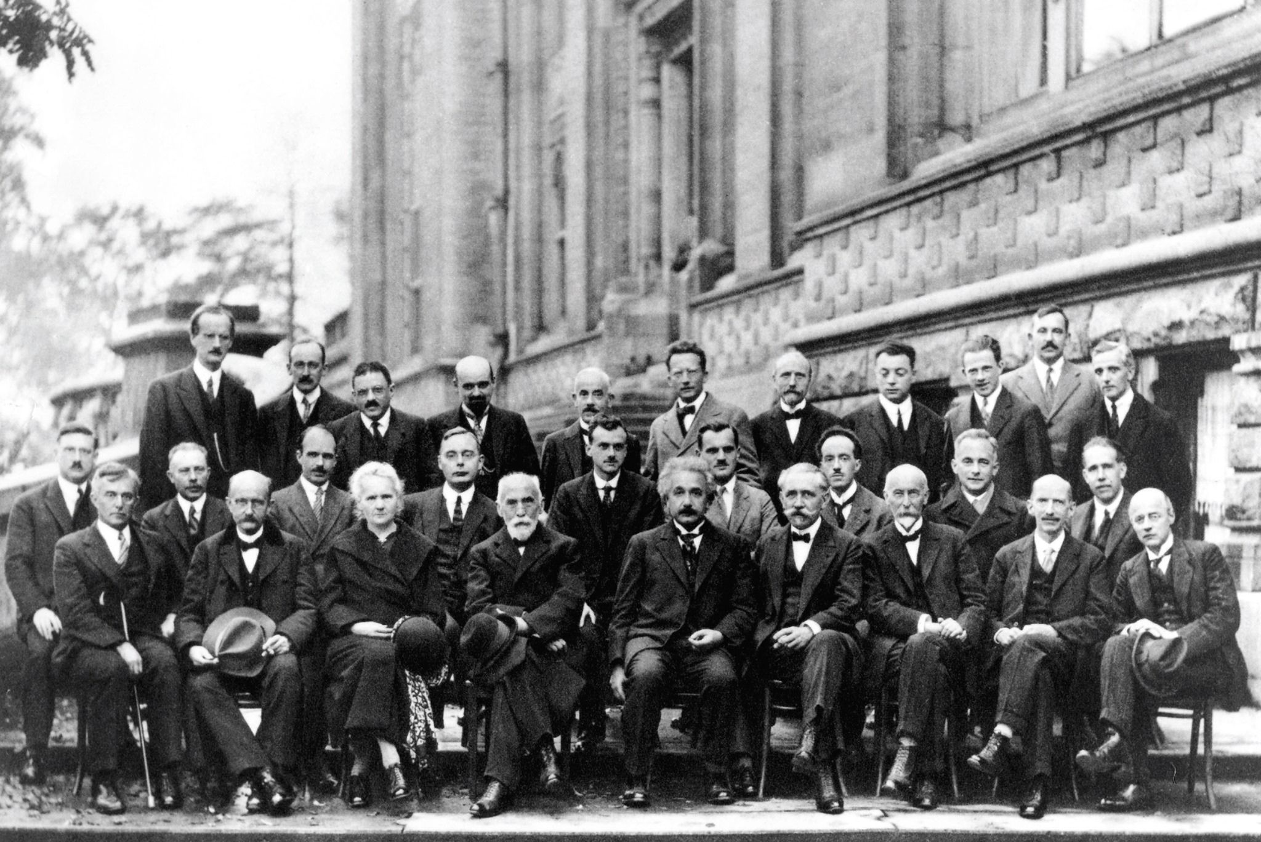
BELGIUM & FNRS:
A PIONEERING ROLE IN HIGH-ENERGY PHYSICS
International Solvay Institutes
for Physics
1912
1928
1947
1954
1939
1952

Slide 8
BELGIAN RESEARCH IN PHYSICS /ASTRONOMY: SOURCES OF FUNDING
Most frequently acknowledged sources of funding in Belgian publications
in physics / astronomy (2011-2021 / Scopus)
# citations
Notes:
Most frequently acknowledged sources of funding in Belgian publications in physics / astronomy
(2011-2021

Slide 9
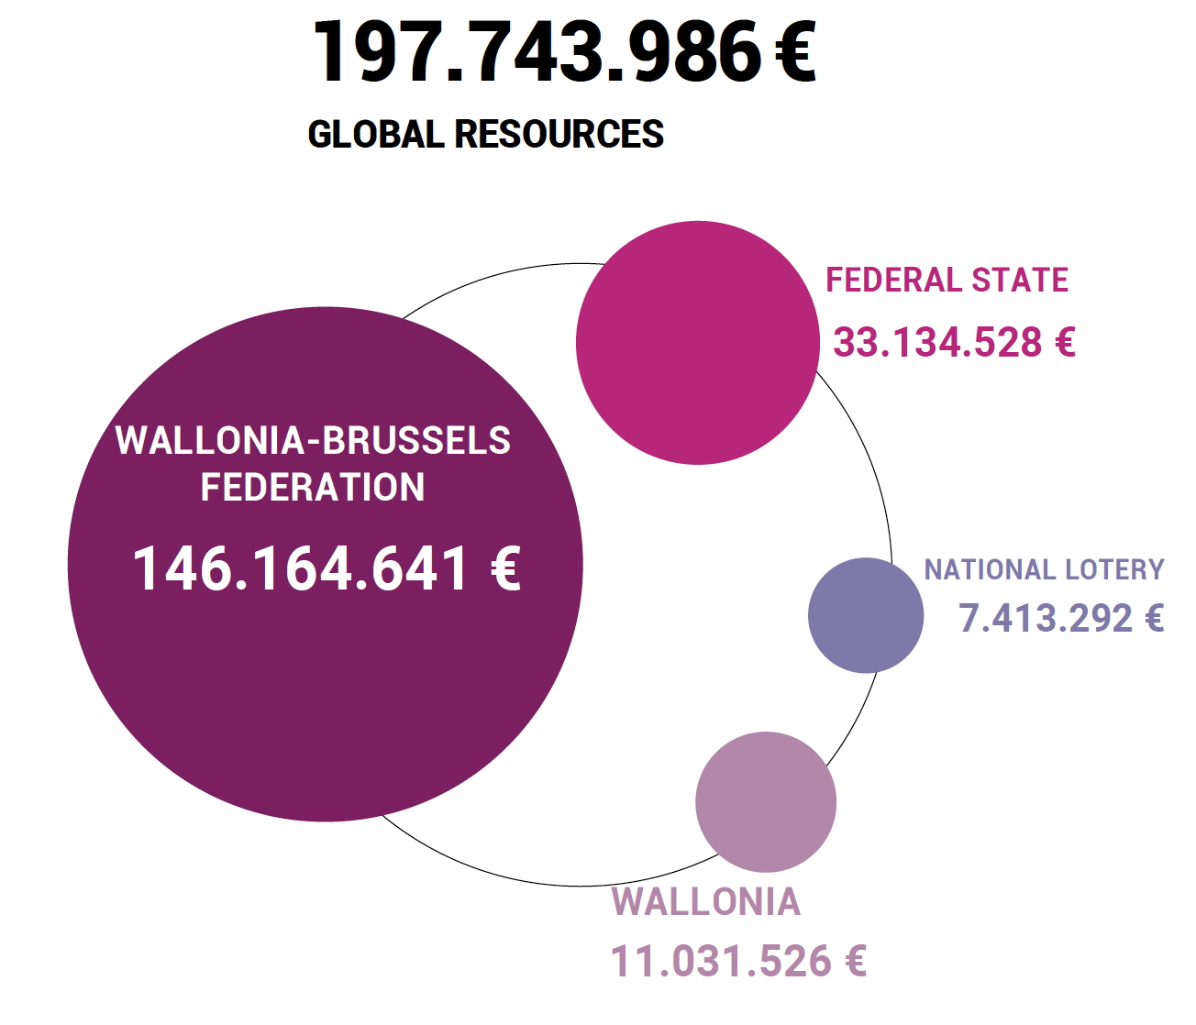
FNRS FUNDING SOURCES (2021)
16,8 %
3,7 %
73,9 %
5,6 %

Slide 10
FNRS FUNDING INSTRUMENTS FOR HEP
IISN.fnrs (Interuniversity Institute for Nuclear Sciences)
PhD grants and Fellowships
EOS

Slide 11
FNRS SUPPORT TO HEP RESEARCH
1. IISN.fnrs
Virtual institute :
5 to 7 M€/year (WBF and Federal Funding)
A dedicated international scientific committee
Long-term funding of recurrent and renewable projects, in particle physics, astro-particle physics and fundamental theoretical research

Slide 12
FNRS SUPPORT TO HEP RESEARCH
1. IISN.fnrs
Examples of contributions & projects funded:
CERN (LHC/CMS - BEH Boson & others + SCOAP initiative)
IceCube, JUNO (Neutrino Physics)
Einstein Telescope, VIRGO (Gravitational Waves)

Slide 13
FNRS SUPPORT TO HEP RESEARCH
2. PhD Grants and Fellowships – FNRS
(Inter-university competition in all scientific fields)
154 Grants and Fellowships 2013-2023 IISN promoters or co-promoters | #
Research Fellows (ASP) | 32
FRIA doctoral grants (FRIA) | 53
Postdoctoral Researchers (CR) | 50
Scientific collaborators | 5
Permanent Researchers (CQ, MR, DR) | 14

Slide 14
FNRS SUPPORT TO HEP RESEARCH
3. EOS – Excellence of Science
Follows former BELSPO Interuniversity Attraction Poles Program
A 120 million € budget (4 years)
Jointly managed by FNRS and FWO since 2017, to foster joint research between the two Communities (all fields of science)
Highly competitive calls (every 4 years): ~280 applications/call, success rates ~13 %
15 IISN (co-)promoters have benefitted from EOS funding over the 2 funding periods
Example: « The H boson gateway to physics beyond the Standard Model»
(Fabio Maltoni et al. , 2018 – 2021) : 3,7 M€

Slide 15
BELGIUM IS A KEY PLAYER IN RESEARCH IN PHYSICS (1)
Part of physics / astronomy amongst 2021 publications (scopus)

Slide 16
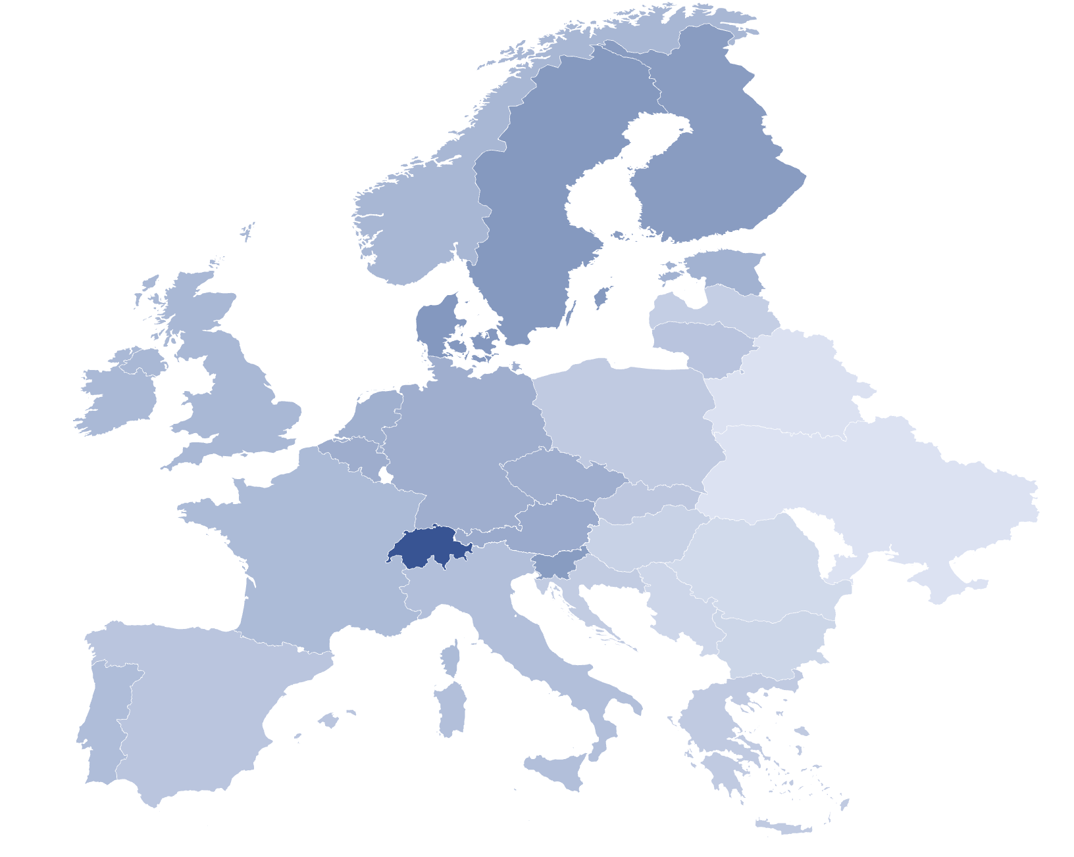
BELGIUM IS A KEY PLAYER IN RESEARCH IN PHYSICS (2)
Publications in physics / astronomy from 2011 to 2021 (scopus), per 1000 inhabitants
Switzerland: 8,73
Belgium: 3,90
Germany: 3,83
UK: 3,34
France: 3,18
Publications/1.000 inhabitants
8,73
Belgium
7th position in Europe
8th position in the world
0,98

Slide 17
ChatGPT “Belgium has been a significant contributor to high energy physics research over the last decade, both through its membership in major international collaborations and through its own domestic research efforts… Belgian researchers have played an important role in advancing our understanding of the fundamental building blocks of the universe and their interactions through their contributions to the LHC experiments and other high energy physics research”
Notes:
Maxime

