Slide 1
Observing the Universe
with Gravitational Waves
Livia Conti
Istituto Nazionale di Fisica Nucleare

Slide 2
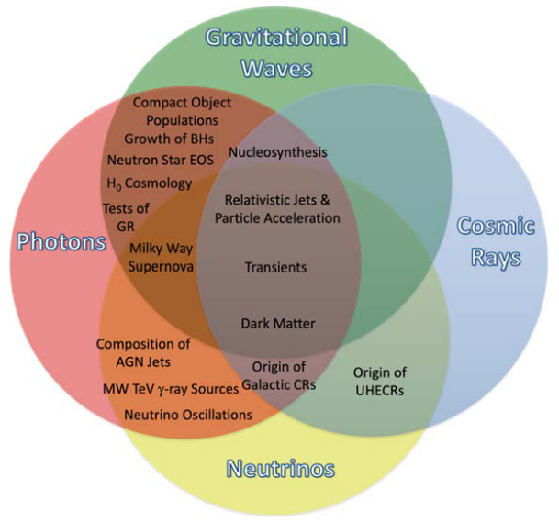
Multiple messengers to solve long standing questions
2015: birth of GW astrophysics
2017: birth of multimessenger astronomy:
BNS merger observed with GWs and sGRB
neutrino detected during a blazar flare
To enable discoveries
and answer questions:
build powerful observatories
Pathways to Discovery in Astronomy and
Astrophysics for the 2020s (2021)
DOI 10.17226/26141
Notes:
neutrino detected by IceCube during a blazar flare
TXS 0506+056 is a very high energy blazar – a quasar with a relativistic jet pointing directly towards Earth

Slide 3
Outline
From GW150914 to a full catalog of GW events: highlights
How we can learn more with GWs
The instruments for the future

Slide 4
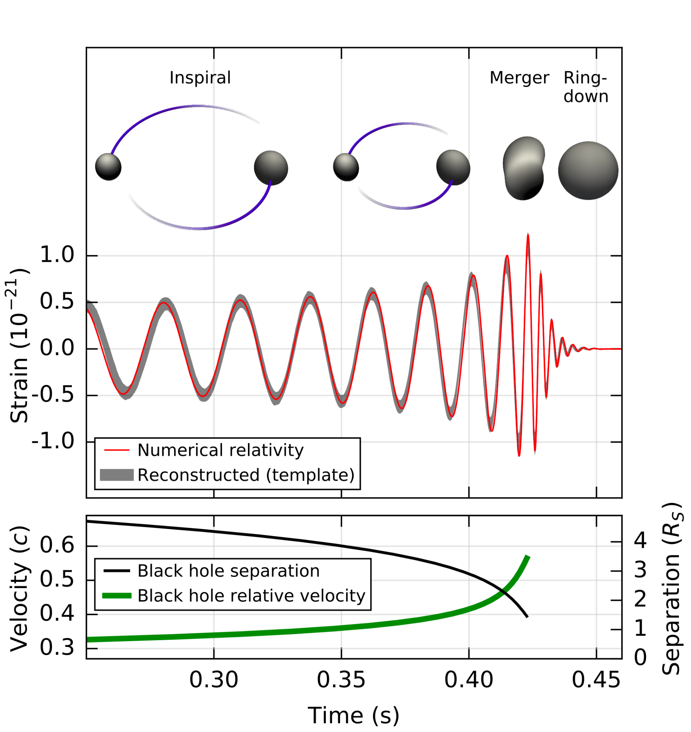
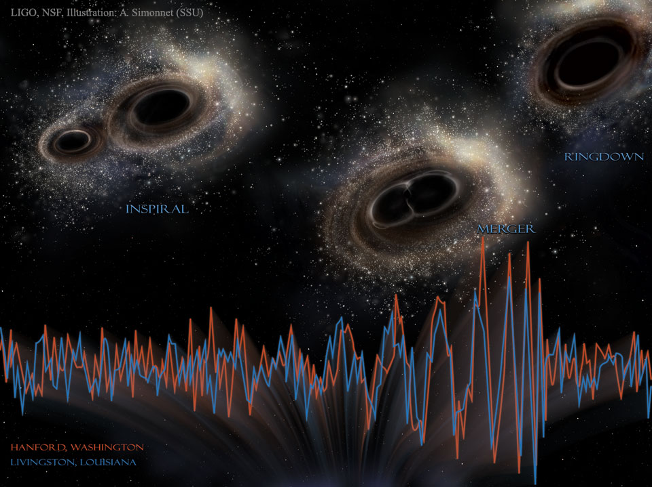
GW150914
The first direct observation of a Gravitational Wave
The coalescence of a binary system of black holes, 1.3 billion years ago
Phys. Rev. Lett. 116, 061102

Slide 5
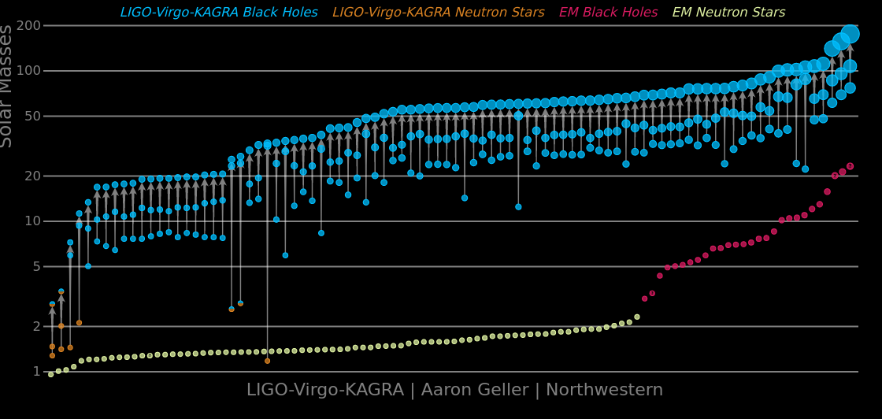
GWTC-3 : 3rd catalog of GW observations! 90 events

Slide 6
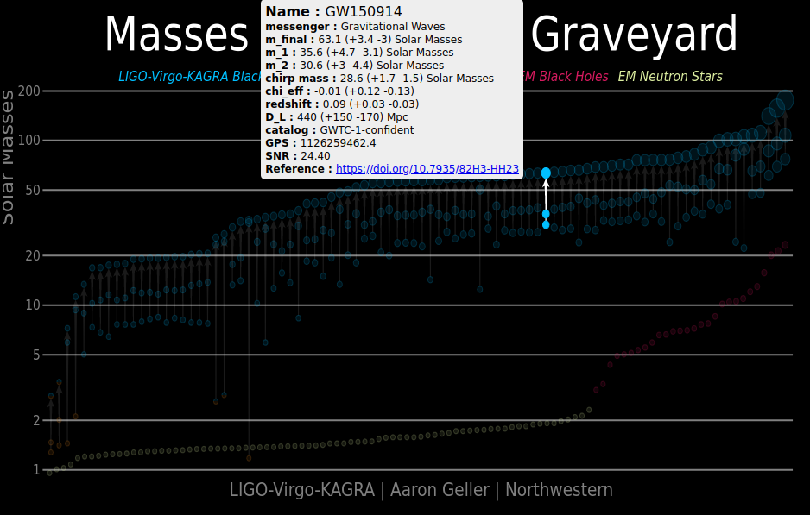
GW150914
A Binary Black-Hole merger
confirms a key prediction of Einstein's theory of general relativity
demonstrates the existence of stellar-mass black holes more massive than ≃25M⊙
establishes that binary black holes can form in nature
provides the first direct evidence that black holes merge within a Hubble time.

Slide 7
GW170817
Localisation capabilities of a GW source (28 deg²)
First cosmic event viewed in both GW and light.
First direct evidence that at least a fraction of sGRB have BNS system as progenitor
Led to largest astronomical observation campaign
Binary neutron star mergers produce kilonova explosions that generate heavy elements
Constraining EOS of NS
Measurement of the GW propagation speed
Test of GR
Alternative measurement of H_0
..
A Binary Neutron Star merger
Notes:
Subsequent kilonova proves BNS mergers as an origin of heavy elements
The source was localized within a sky region of 28 deg2 (90% probability)

Slide 8
GW200115_042309
First confirmed detection of NSBH merger
Finally found the missing type of binary! In fact NSBH were predicted to exist, but convincing observational evidence was missing
Consistent with any plausible formation channels
first direct measurements of the NSBH merger rate
Notes:
we have found the missing type of binary. We can finally begin to understand how many of these systems exist, how often they merge, and why we have not yet seen examples in the Milky Way
NSBH mergers can, in principle, produce light across the electromagnetic spectrum. Unfortunately, the sky direction of the sources could be measured only very imprecisely, to an area of sky between 2,400-29,000 times the size of the full moon. Together with the large distance to the source (discussed in more detail below), this made observation of electromagnetic light unlikely, and none was observed.
how did these NSBH systems form? There are two main possibilities:
*“isolated binary evolution”, in which stellar progenitors evolve together
*The other possibility is that the neutron star and black holes form from separate stars in unrelated supernova explosions, and only afterwards find each other. This is called “dynamical interaction” and can occur in dense stellar environments such as globular clusters. To distinguish between these two possibilities, the spin orientations of the black holes give a strong hint.
for GW200115, we find that the black hole spin direction is likely to be opposite to the direction of the binary orbit. For example, if the neutron star orbits the black hole clockwise, then the black hole would rotate on its axis counterclockwise. This hints that the source of GW200115 could have formed in a dense environment, such as a globular cluster.
Predicted rates of NSBH mergers in the local universe vary by orders of magnitude across the various formation channels. Higr rate for isolated binary evolution channel.
Spin information encoded in GWs from binaries are a probe of the their evolutionary history. evidence that the primary BH spin in GW200115 is negatively aligned with respect to the orbital angular momentum axis. This negative alignment is consistent with dynamical formation channels, which typically form binaries with random spin orientations. However, a misaligned spin in the primary of GW200115 would not necessarily rule
out any of the plausible NSBH formation channels.
first direct measurements of the NSBH merger rate. Both estimates are broadly consistent with the rate predicted from NSBH formation in isolated binaries or young star clusters. Formation channels in dense star clusters (globular or nuclear) and in triples predict
lower rates than those inferred from the two events and are unlikely to be the dominant NSBH formation chanNels.
The observations of GW200105 and GW200115 are
consistent with predictions for merging NSBHs and ob-
servations of BHs and NSs in the Milky Way. Given their
significantly unequal component masses, future observa-
tions of NSBH systems will provide new opportunities to
study matter under extreme conditions, including tidal
disruption, and search for potential deviations from GR.

Slide 9
GW190814
Best localised source (22 deg² )
Mass asymmetric GW event:
Primary is a BH;
secondary is in the lower mass gap: massive NS or very small BH?
Compact objects exist with masses between 2-5 Msun
Strongest evidence for higher-multipoles of Gravitational radiation
Test of GR on strongly asymmetric mass distribution
So good localization allows H_0 measurement only with GW signal (+ galaxies catalogues): best dark siren to date
The most mass asymmetric GW event
Notes:
As in the case of GW190412, we are able to measure the presence of higher multipoles in the gravitational radiation, and a set of tests of general relativity with the signal reveal no deviations from the theory. GW190814 exhibits stronger evidence for higher-order multipoles: GW190814ʼs stronger evidence for higher multipoles is expected given its more asymmetric masses and the larger network S/N.
With significant evidence for multipoles other than the dominant (ℓ, m)=(2, 2) quadrupole, we gain an independent measurement of the inclination of the source. This allows for the distance-inclination degeneracy to be broken. Measuring higher-order multipoles therefore gives more precise measurements of source parameters
The asymmetric nature of a system excites the higher multipole moments of the gravitational signal, which allows us to test the multipolar structure of gravity. The addition of information from the higher harmonics of a signal also breaks certain degeneracies in the description of the source, and could potentially enable us to place stronger constraints on certain deviations from GR

Slide 10
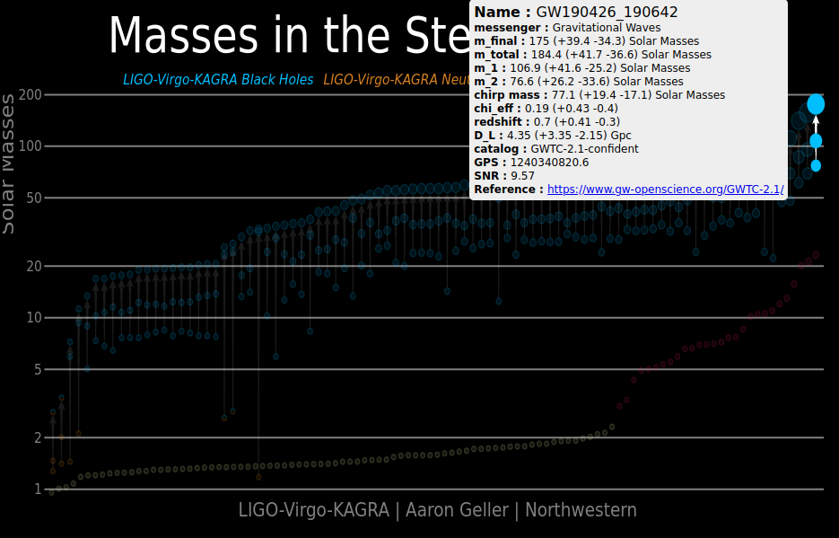
GW190426_190642
Most massive system detected with GWs
The highest mass of all binary mergers reported by LVK
Both components fall in the mass gap predicted by isolated evolution (pair-instability supernova theory)
Final body is IMBH
Notes:
with both components more massive than predicted by isolated evolution
When a star is very massive, the gamma rays produced in its core can become so energetic that some of their energy is drained away into production of particle and antiparticle pairs. The resulting drop in radiation pressure causes the star to partially collapse under its own huge gravity. After this violent collapse, runaway thermonuclear reactions (not shown here) ensue and the star explodes: no leftover

Slide 11
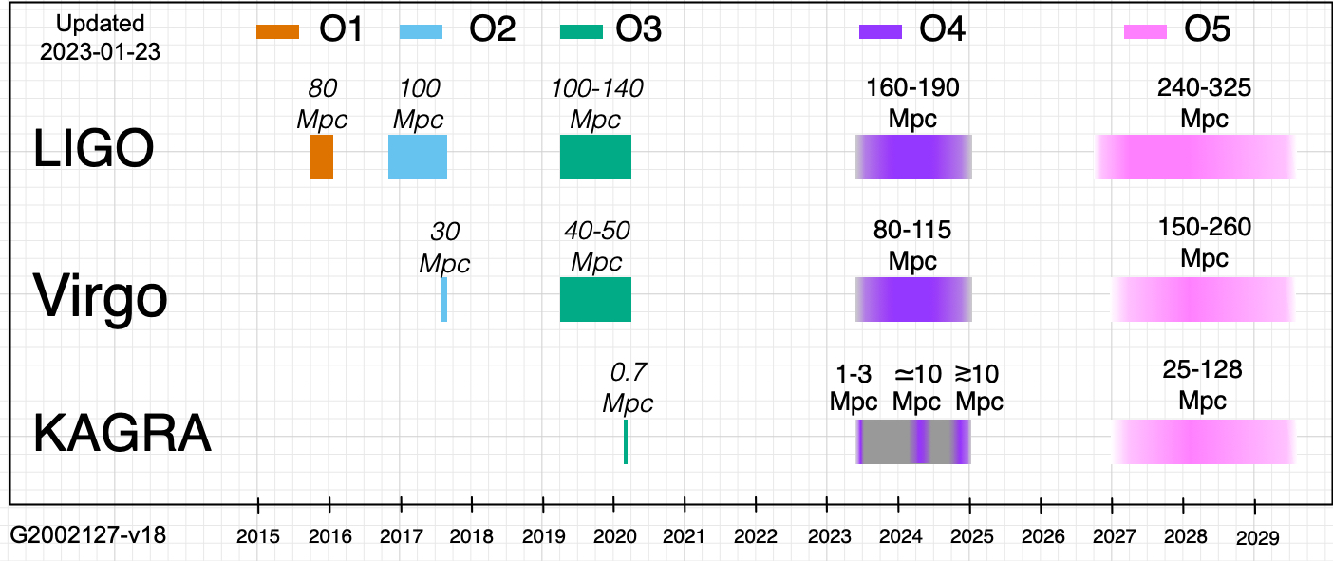
Near future
Current detectors have a well defined plan of upgrades and science runs

Slide 12
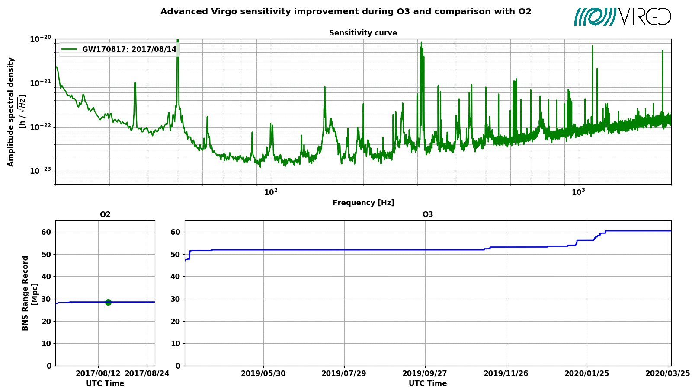
Evolution in sensitivity
Continuous effort to improve the detector performances over time

Slide 13
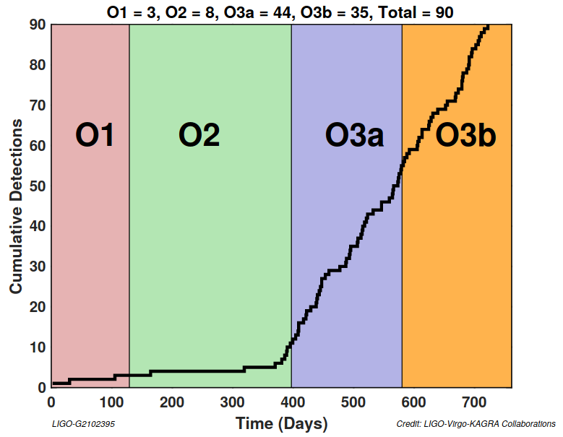
The past observing runs
Number of detectable events is the product of the event rate times the Time x Volume of reachout
More advantageous strategy is to increase the reachout (ie the sensitivity) than keep observing with a sensitivity that can be improved

Slide 14
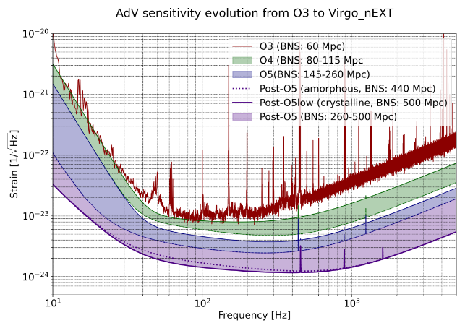
Evolution in sensitivity
Advanced Virgo after O3:
Phase I: reduce quantum noise, reach thermal noise limit.
BNS range: ~100 Mpc -> O4
Phase II: lower the thermal noise wall.
BNS range: ≳200 Mpc -> O5
VIR-0497A-22

Slide 15
From 2nd to 3rd generation GW detectors
Advanced LIGO and Advanced Virgo have already achieved awesome results, even with a sensitivity below the nominal one.
This is only a first step toward our exploration of the Universe with GWs
Even pushed to their (infrastructural) limits, LIGO-Virgo-KAGRA can only explore the local Universe.
To extend investigation to the cosmological scale and address more scientific questions, a major change is necessary:
this is the target of 3rd generation GW detectors, such as the Einstein Telescope and Cosmic Explorer

Slide 16
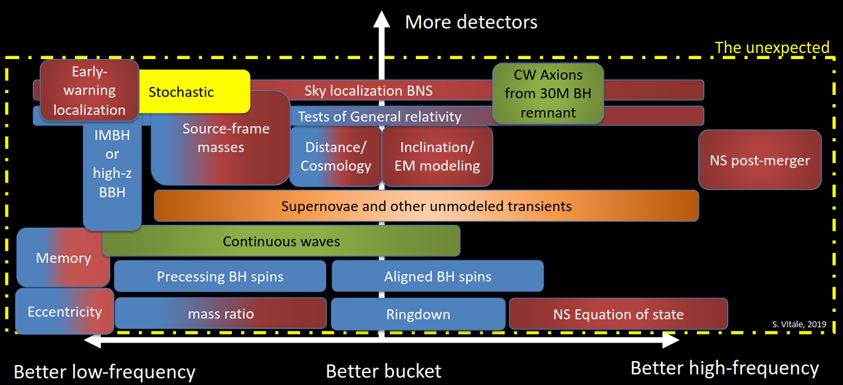
The optimal network configuration depends on the scientific question to be addressed
DCC G1900660

Slide 17
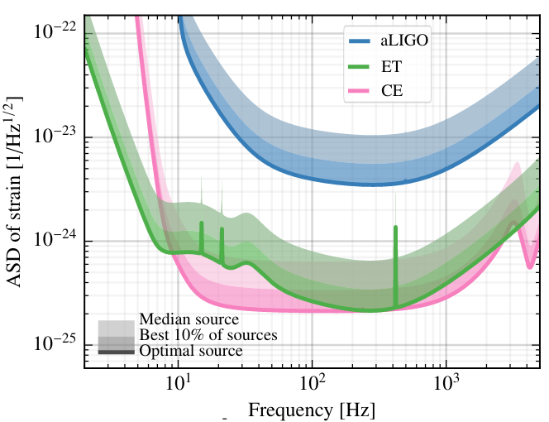
3rd generation GW detectors
3rd generation detectors will improve both the frequency range and the sensitivity
an order of magnitude better sensitivity
a wider accessible frequency band
Discovery machines !
ET-0007B-20

Slide 18
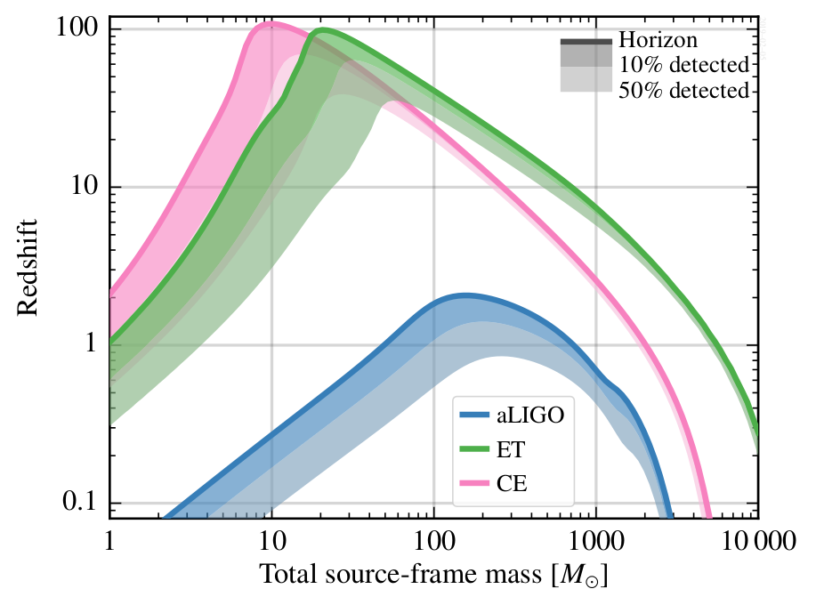
Reach out
3rd generation:
BBH up to z > 10 (up to primordial origin)
BNS up to z > 1
increase the accessible BBH mass range up to >10³ M_{sun} out to z ∼ 1 − 5.
ET-0004A-20
Notes:
Maximum redshift (vertical axis) at which an equal-mass binary of given source-frame total mass (horizontal axis)
can be observed with a signal-to-noise ratio of 8. Different curves represent different detectors. For
binary neutron stars (total mass ∼3M_sun), CE will give access to redshifts larger than 1, where most of the
mergers are expected to happen. For binary black holes, it will enable the exploration of redshifts of 10
and above, where mergers of black holes formed by either the first stellar population in the universe (Pop
III stars) or by quantum fluctuations shortly after the Big Bang (primordial black holes) might be found.
comparing the redshift dependence of the BH-BH merger rate with the cosmic star formation rate it will
be possible to disentangle the contribution of BHs of stellar origin from that of possible BHs of primordial
origin (whose merger rate is not expected to be correlated with the star formation density)

Slide 19
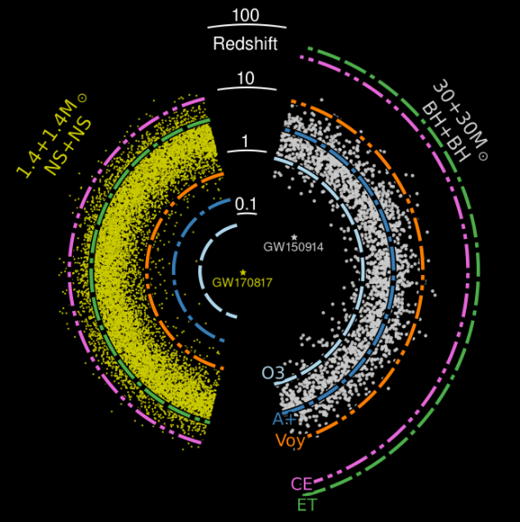
Binary mergers
Distribution of mergers as a function of redshift
binary merger detections will likely exceed 100,000 per year, enabling detailed inferences about stellar remnant populations.
Individual merger signals, especially those in the local universe, will be detected with greatly enhanced signal-to-noise ratio, sometimes exceeding 1000 in amplitude, enabling precision observation of the dynamics at play in these systems.
https://doi.org/10.3390/galaxies10040090

Slide 21
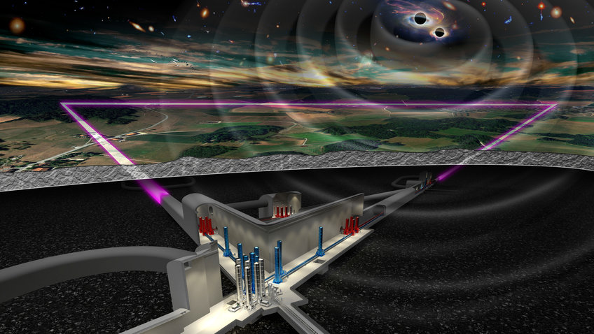
Einstein Telescope
A new infrastructure capable to host future upgrades for decades without limiting the observation capabilities
ET is an observatory:
3 nested detectors in a triangular arrangement.
Each detector consisting in two interferometers:
a room T, HF one
a cryogenic, LF one
This is the multi-band configuration (also called ‘xylophone’)
10 km armlength, approx 200 m underground

Slide 22
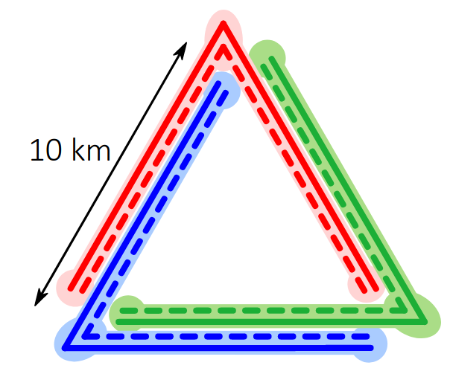
ET: three detectors in a single triangular site
The Einstein Telescope design has three detectors hosted in a single triangular site, providing a near-optimal configuration for a single-site observatory in a cost-efficient and prominent infrastructure.
Advantages:
each side of the triangle can be deployed twice to build three V-shaped interferometers, 60 deg angle
virtually complete sky coverage, with no blind spots
equally sensitive to both polarizations of the GW
redundancy and more uptime
a null-stream in the sum of the responses of the three detectors in a triangle
Notes:
the smallest layout for a single-site observatory that is equally sensitive to both polarizations of the gravitational wave
signal
The advantage of a triangular topology is that each side of the triangle can be deployed
twice to build, in effect, three V-shaped interferometers with an opening angle of 60 degrees and
rotated relative to each other by 120 degrees (see the panel on the left in Fig. 1). An opening
angle of 60 degrees means that the sensitivity reduces to √3/2 that of an L-shaped detector; the
three detectors in the triangle enhance the sensitivity by a factor of √3 and so an overall gain in
sensitivity of 3/2. The panel on the right in Fig. 1 shows the antenna pattern of the triangular
network. The triangular ET has virtually complete sky coverage and it has no blind spots. Its
reach to sources lying in the plane of the triangle will be a third of its reach to sources lying
overhead!
The three V-shaped interferometers are, of course, equivalent in sensitivity to two L-shaped
interferometers with arms that are only three-quarters in size of the triangular arms and rotated
relative to each other by 45 degrees. However, the responses of the three detectors in a triangle
can be used to construct a null stream that is not possible with the two L-shaped interferometers.
It turns out that the sum of the responses of the three detectors in a triangle (for that matter
any closed topology) is completely devoid of any gravitational wave. This is the closest that
one can get to measuring the “dark current” in interferometers. The null stream will be an
invaluable tool to characterize the background.

Slide 23
ET site selection
Currently there are two sites in Europe, candidate to host ET:
• Italy, in the Sardinia island
• the EU Regio Rhine-Meusse area, close to the NL-B-D border
Both sites geologically and seismically suited. Investigations ongoing.
A third option in Saxony (Germany) is under discussion

Slide 24
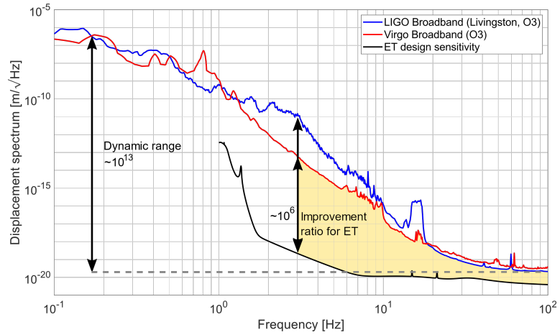
The challenge of low frequency sensitivity
At low freq ET needs to be million times better than 2nd generation ITF
→underground to reduce seismic and Newtonian noise
ET-0119A-22
Notes:
the lower edge of the frequency band of any terrestrial detector is dictated by the seismic motion of the detector and by Newtonian noise,
the coupling of seismic and atmospheric fluctuations through direct Newtonian gravity. Since seismic and Newtonian noise are displacement noises, the low-frequency strain sensitivity can be improved by lengthening the detector arms.

Slide 25
Punturo, Sept 2022

Slide 26
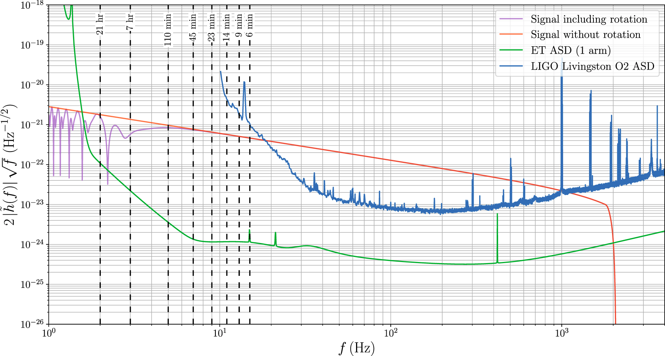
Enabling multimessenger observations, eg BNS
Thanks to the long time spent in the detector bandwidth at ET, the BNS localization can be improved by exploiting the rotation of the Earth.
If we are able to accumulate enough SNR before the merging phase, we can trigger e.m. observations before the emission of photons.
F Iacovelli et al 2022 ApJ 941 208
Notes:
Comparison between the amplitude of a BNS signal analogous to GW170817, as seen by a single instrument of the ET triangular detector (whose sensitivity curve is shown in green) accounting for the effect of Earth's rotation (violet curve) and without accounting for it (orange curve). The dashed vertical lines indicate the amount of time left before coalescence, and the amplitude is computed using the waveform model IMRPhenomD_NRTidalv2. For comparison, we also report in blue a representative LIGO Livingston sensitivity curve during the second observing run,

Slide 27
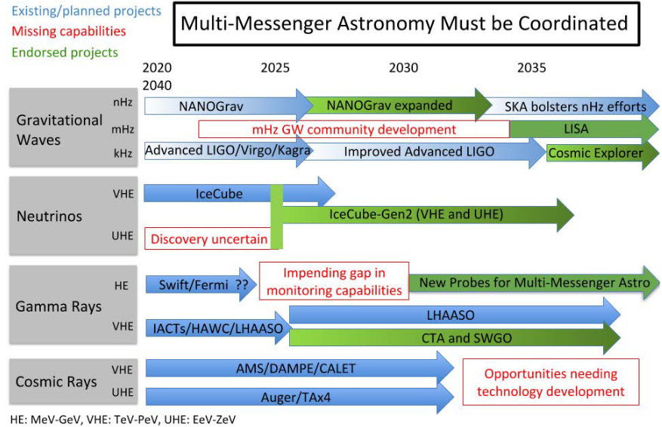
Multimessenger science requires a great coordination!
Pathways to Discovery in Astronomy and Astrophysics for the 2020s (2021) - DOI 10.17226/26141

Slide 28
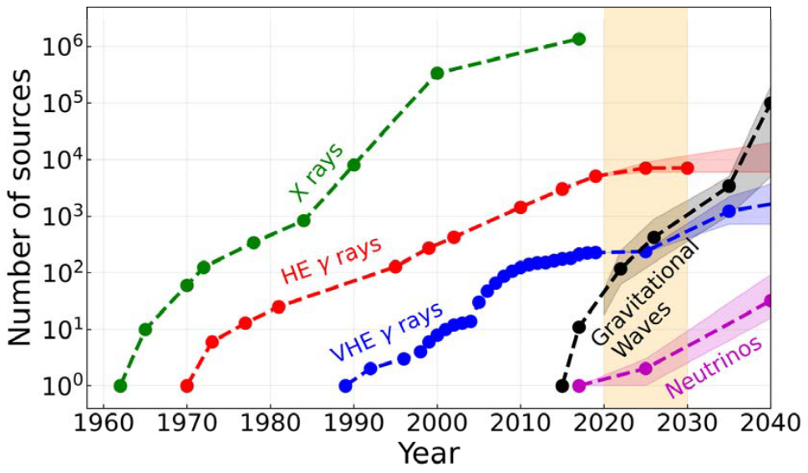
New astronomies for the future
Building on past successes, new astronomies can be opened now. The fields of X-ray and gamma-ray astronomy were built over decades, with the number of observed sources increasing by orders of magnitude.
GW astronomy has just started and holds the promise of a flourishing growth.
Pathways to Discovery in Astronomy and
Astrophysics for the 2020s (2021)
DOI 10.17226/26141

Slide 29
Thank you !

Slide 30
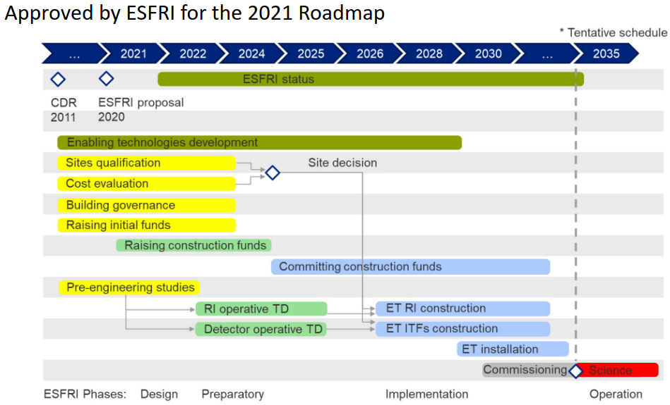
ET project Timeline approved by ESFRI (2021 roadmap)

Slide 31
Opening the low frequency region
1)How, when and where do the first massive black holes form, grow and assemble, and what is the connection with galaxy formation?
(2)What is the nature of gravity near the horizons of black holes and on cosmological scales?
Two key questions:
Laser Interferometry used to detect minute distance variations between free flying Test Masses
Launch: 2037
Lifetime: 4 years, with possible 6-year extension
scan the entire sky by orbiting behind the Earth, obtaining both polarisations of the GW
measure source parameters in the band 10⁻⁴ Hz - 10⁻¹ Hz

Slide 32
LISA science
The majority of individual LISA sources will be binary systems covering a wide range of masses, mass ratios, and physical states
The Gravitational Universe objectives:
Trace the formation, growth, and merger history of massive black holes
Explore stellar populations and dynamics in galactic nuclei
Test GR with observations
Probe new physics and cosmology
Survey compact stellar-mass binaries and study the structure of the Galaxy
LISA L3 proposal document (2017)

Slide 33
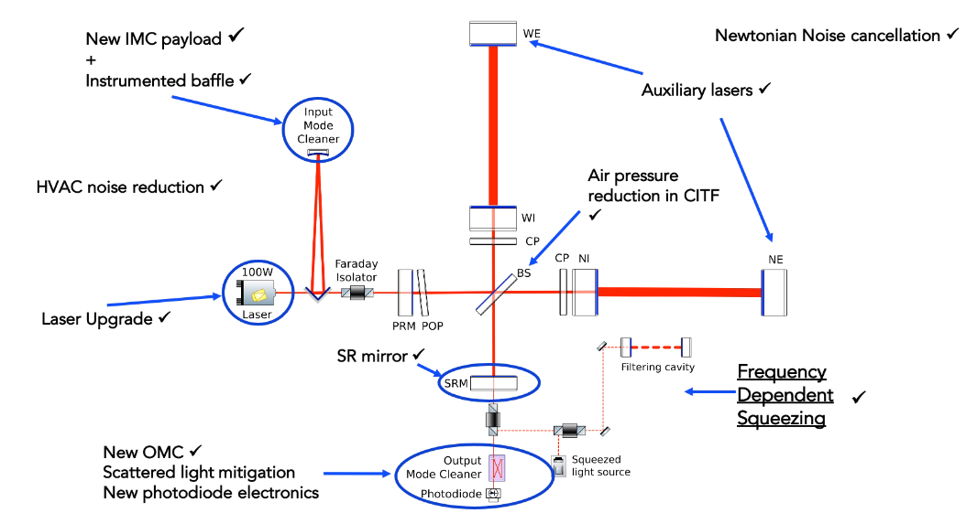
Advanced Virgo Phase I

Slide 34
Advanced Virgo Phase II

Slide 35
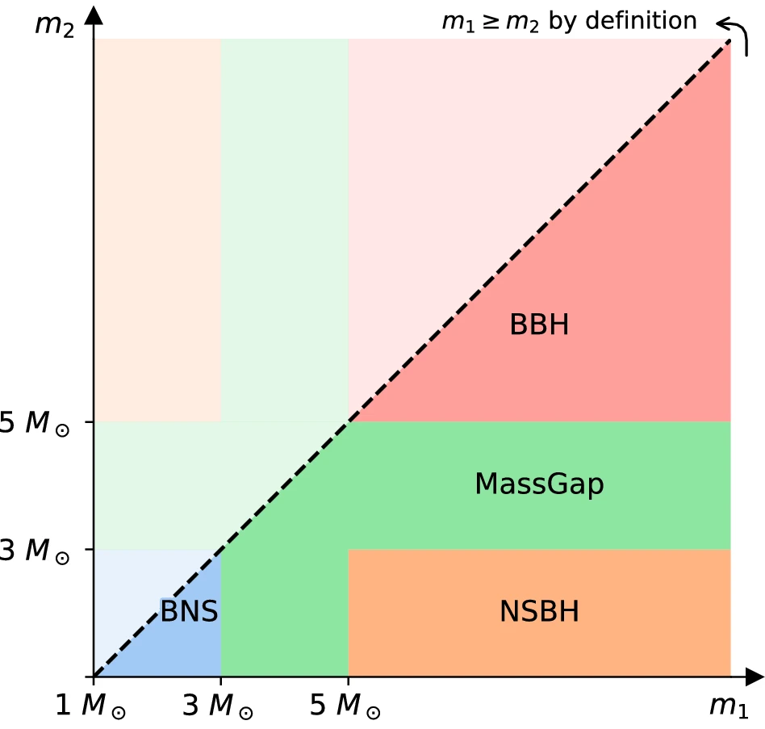

Slide 36
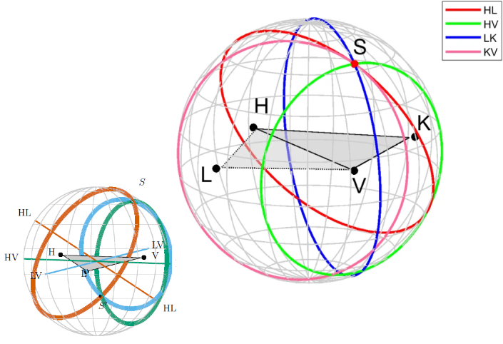
The locus of constant time delay (with associated timing uncertainty) between two detectors forms an annulus on the sky concentric about the baseline between the two sites (labeled by the two detectors).
Here the HK and LV combinations are omitted for clarity.
Degeneracy along the rings can be reduced by using variability of antenna pattern
For four or more detectors there is a unique intersection region, S.
3 detector case: 2 regions S

Slide 37
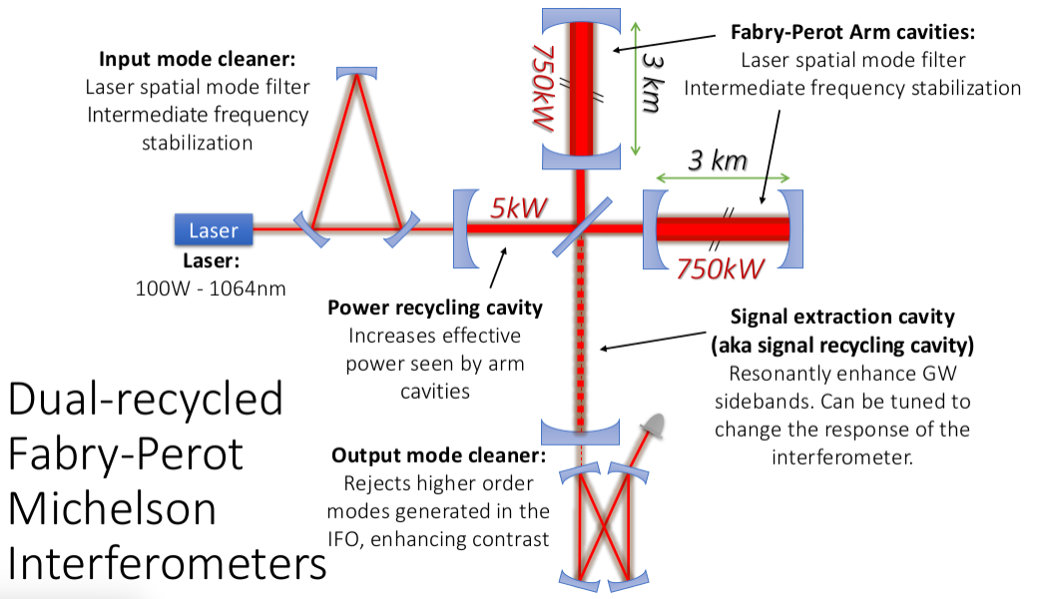

Slide 38
Timeline di sviluppo (da NSF) con anche altri segnali
Slide di BNS segnale nel tempo
Accenno a lisa
Segnali lisa -> terra

