Slide 1
Introduction to longitudinal beam dynamics II

Slide 2
Longitudinal phase space
As in the case of transverse beam dynamics, where it is more convenient to work in phase space because we can answer in one go what is the position and energy of the system at any moment …
we also prefer to work in phase space when dealing with the longitudinal motion
In this case we can answer in one go what is the phase difference and energy difference between the ideal particle and the real particle
angle
energy
?
position
phase
Ellipse area = invariant = emittance
TRANSVERSE BEAM DYNAMICS
LONGITUDINAL BEAM DYNAMICS

Slide 3
In the phase space plane ($w,∆φ$) or ($\frac{∆p}{p_{s}},∆φ$) the synchronous particle is at the origin of coordinates and the real particle describes a given trajectory around it.
Expressing the longitudinal phase space in terms of ($\frac{∆p}{p_{s}},∆φ$) is usually more convenient because $\frac{∆p}{p_{s}}$ determines by how much the closed orbit will be different from the ideal one thanks to the Eq. 5: $\frac{{Δl}_{ΔE}}{l_{s}}=α\frac{∆p}{p_{s}}$.
The stability condition will determine the range of initial values such ($w,∆φ$) or ($\frac{∆p}{p_{s}},∆φ$) will be bounded during the movement.
As we said in Part I, in order to obtain the first equation of motion, Eq. 25, we have assumed that the beam energy can be changed only by the applied RF field, and we have neglected any other energy variation due to interaction with the environment or the synchrotron radiation.
We are dealing with a conservative system and therefore there has to be an invariant and this is usually the energy. Let’s calculate the invariant.
From Part I:
$$w=\frac{∆W}{W_{s}}=\frac{W−W_{s}}{W_{s}}$$ | Eq. 20
$$∆φ=φ−φ_{s}$$ | Eq. 21

Slide 4
To obtain the invariant we cross multiply the first and second equation of motion, and we integrate:
$$\dot{w}=\frac{qV_{max}Ω_{s}}{2πW_{s}} (sin⁡(Δφ+φ_{s})−sinφ_{s})$$ | Eq. 25
FIRST EQUATION OF MOTION
$$\dot{Δφ=}\frac{δ(Δφ)}{δt}={hΓ_{s}Ω}_{s}w$$ | Eq. 34
SECOND EQUATION OF MOTION
$${hΓ_{s}Ω}_{s}wdw=\frac{qV_{max}Ω_{s}}{2πW_{s}}\left(\sin\left(Δφ+φ_{s}\right)−sinφ_{s}\right)dφ$$ | Eq. 45
Now we integrate Eq. 45 and define as integration constant, C, the one that for $∆φ$=w=0 ➔ Total Energy = 0:
$$\int{wdw−}\int_{φ_{s}}^{φ}{\frac{qV_{max}}{2π{hΓ_{s}W}_{s}}\left(\sin\left(Δφ+φ_{s}\right)−sinφ_{s}\right)dφ}=C$$ | Eq. 46
$${\frac{1}{2}w^{2}}_{}+\frac{qV_{max}}{2πh{{Γ_{s}W}_{s}}_{}}\left(\cos\left(Δφ+φ_{s}\right)−cosφ_{s}+Δφsinφ_{s}\right)=Total Energy=Hamiltonian$$ | Eq. 47
Kinetic energy
Potential energy
➔ for a sinusoidal RF field
The value of the energy of the system is given by the initial conditions

Slide 5
For a general RF field, the Hamiltonian is:
$${\frac{1}{2}w^{2}}_{}−\int_{φ_{s}}^{φ}{\frac{q}{2πh{{Γ_{s}W}_{s}}_{}}\left[V\left(φ^{′}\right)−V\left(φ_{s}\right)\right]dφ^{′}}=Total Energy=Hamiltonian$$ | Eq. 48
Remember: the potential energy is “minus” the integral of the RF voltage

Slide 6
The voltage function can be single harmonic (one RF system):
$$V\left(φ\right)=V_{max}sinφ$$
The voltage function can be double harmonic (two RF systems):
$$V\left(φ\right)=V_{max}^{A}sinφ+V_{max}^{B}sin⁡(nφ+∅)$$
where n is the frequency ratio of both RF systems and $∅$ is the relative phase between them.
e.g. SPS: the main RF system is 200 MHz and the second system is 800 MHz

Slide 7
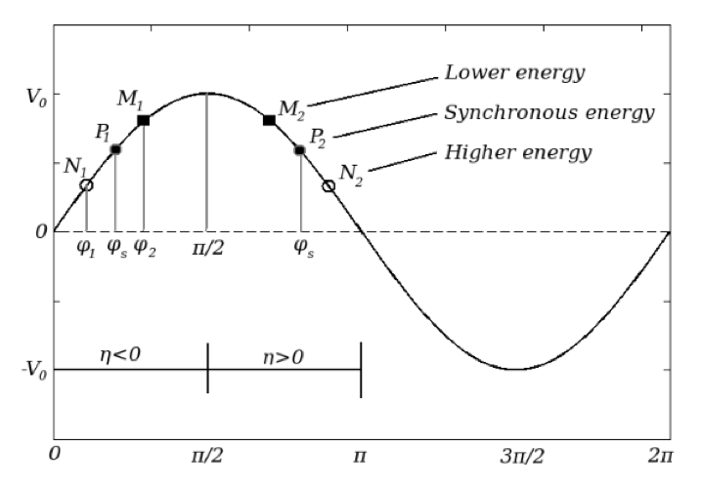
The stability of the particle motion can be better understood from the plot of the RF potential.
Let’s plot the potential energy of the Hamiltonian of Eq. 47
$$U\left(Δφ\right)=\frac{qV_{max}}{2πh{{Γ_{s}W}_{s}}_{}}\left(\cos\left(Δφ+φ_{s}\right)−cosφ_{s}+Δφsinφ_{s}\right)$$ | Eq. 51
CASE 1: NO ACCELERATION (ABOVE TRANSITION) ➔ STATIONARY BUCKET
No acceleration and we are above transition ➔ $φ_{s}=π (cosπ=−1)$
$$U\left(Δφ\right)=\frac{qV_{max}}{2πh{{Γ_{s}W}_{s}}_{}}\left(1−cos{Δφ}\right)=\frac{qV_{max}}{2πh{{Γ_{s}W}_{s}}_{}}\left(1+cos{φ}\right)$$ | Eq. 52
with $∆φ=φ−φ_{s}$
$$[\frac{π}{2},π]$$

Slide 8
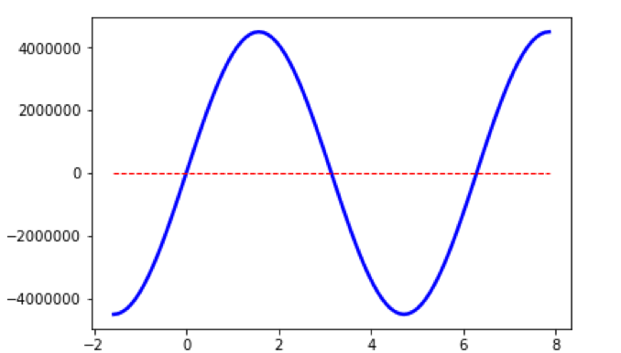
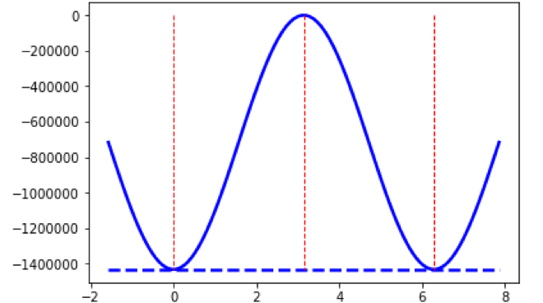
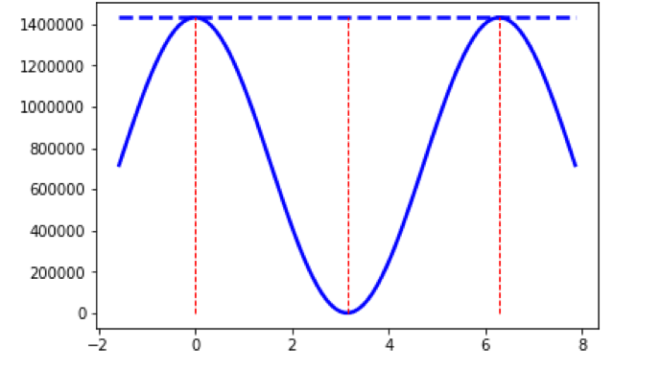
# case 1: SPS protons above transition, no acceleration, q = 1, V_{max} = 4.5e6 V
$V\left(φ\right)$ (V)
$$V\left(φ\right)=V_{max}sinφ$$
$$V\left(φ_{s}\right)=V_{max}sinφ_{s}=0$$
➔ “no acceleration”
$U\left(φ\right)$ (eV)
$$\int_{φ_{s}}^{φ}{\frac{q}{2πh{{Γ_{s}W}_{s}}_{}}\left[V\left(φ^{′}\right)−V\left(φ_{s}\right)\right]dφ^{′}}$$
The potential energy is “minus” the integral of the RF voltage
$$U\left(φ\right)=−\int_{φ_{s}}^{φ}{\frac{q}{2πh{{Γ_{s}W}_{s}}_{}}\left[V\left(φ^{′}\right)−V\left(φ_{s}\right)\right]dφ^{′}}$$
$U\left(φ\right)$ (eV)
$$φ_{s}=π$$
$$π−φ_{s}$$
$$φ_{s}=π$$
$$U\left(φ\right)=\frac{qV_{max}}{2πh{{Γ_{s}W}_{s}}_{}}\left(1+cos{φ}\right)$$
$$φ$$

Slide 9
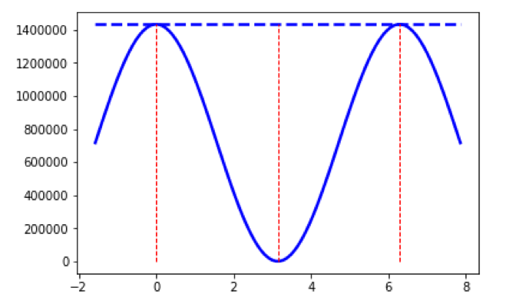
$$U\left(φ\right)=\frac{qV_{max}}{2πh{{Γ_{s}W}_{s}}_{}}\left(1+cos{φ}\right)$$
Near the synchronous phase the particles feel a restoring force which allows them to execute oscillations around it. In phase space these oscillations translate into closed trajectories which have an angular frequency called the synchrotron frequency.
$U\left(φ\right)$ (eV)
In the case of small amplitude oscillations, i.e. when $∆φ=φ−φ_{s}≪1$ the angular synchrotron frequency can be analytically calculated:
$$φ_{s}=π$$
$$Ω_{sy}^{}=\sqrt{−\frac{q{hΓ_{s}V}_{max}cosφ_{s}}{2πW_{s}}}Ω_{s}^{}$$ | Eq. 35’
$$φ_{s}=π$$
$$φ$$
However, quite a number of particles in the beam have large amplitude oscillations and then behave non-linear due to the shape of the potential produced by the sinusoidal RF voltage.
# case 1: SPS protons above transition, no acceleration, q = 1, V_{max} = 4.5e6 V, single RF system
And for very large amplitudes they may even scape from the stable region, leading to particle losses
The division of the phase space into regions of bounded and unbounded motion in synchrotrons is the reason of grouping the particles into bunches.
The boundary between both regions is called the SEPARATRIX.
The phase space area enclosed by the separatrix is called the BUCKET.

Slide 10
Let’s now calculate the trajectories in phase space that correspond to the plotted potential below:
$U\left(φ\right)$ (eV)
$$φ_{s}=π$$
$$U\left(φ\right)=\frac{qV_{max}}{2πh{{Γ_{s}W}_{s}}_{}}\left(1+cos{φ}\right)$$
# case 1: SPS protons above transition, no acceleration, q = 1, V_{max} = 4.5e6 V, single RF system
$$φ$$
First let’s calculate the Hamiltonian or total energy of the system, which is a constant:
$$Hamiltonian=Total Energy=Kinetic energy+ U\left(φ\right)={\frac{1}{2}w^{2}}_{}+\frac{qV_{max}}{2πh{{Γ_{s}W}_{s}}_{}}\left(1+cos{φ}\right)$$ | Eq. 53
The simplest thing to do is to calculate the total energy when the kinetic energy is 0, i.e. w=0, and the potential energy is maximum. The potential energy is maximum when $φ=0$.
$$Hamiltonian=Total Energy=0+ U\left(0\right)=\frac{qV_{max}}{πh{{Γ_{s}W}_{s}}_{}}$$ | Eq. 54
We put Eq. 54 in Eq. 53 and solve for w:

Slide 11
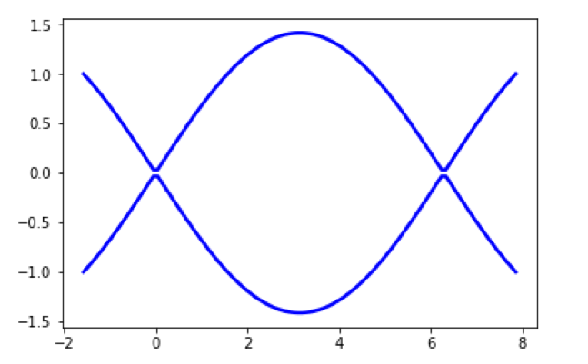
$$Hamiltonian=Total Energy=\frac{qV_{max}}{πh{{Γ_{s}W}_{s}}_{}}={\frac{1}{2}w^{2}}_{}+\frac{qV_{max}}{2πh{{Γ_{s}W}_{s}}_{}}\left(1+cos{φ}\right)$$ | Eq. 55
$$w=±\sqrt{\frac{qV_{max}}{πh{{Γ_{s}W}_{s}}_{}}\left(1−cos{φ}\right)}$$ | Eq. 56
$$U\left(φ\right)=\frac{qV_{max}}{2πh{{Γ_{s}W}_{s}}_{}}\left(1+cos{φ}\right)$$
Separatrix
$U\left(φ\right)$ (eV)
$$φ_{s}=π$$
$$π−φ_{s}$$
$$φ_{s}=π$$
Stationary bucket ➔ particles are not accelerated
$w\left(φ\right)$ (eV)
0
$$π−φ_{s}$$
Bucket
$$φ$$
$$φ$$
$φ=0$ ➔ Maximum potential, zero kinetic energy
$φ=π$ ➔ $U\left(φ\right)=0$, $K_{max}=\sqrt{\frac{2qV_{max}}{πh{{Γ_{s}W}_{s}}_{}}}$
In a stationary bucket, the synchronous particle is always at $w\left(φ\right)=0,φ=φ_{s}=0 or π \left(below or above transition\right) because V=qV_{max}sinφ_{s}=0!$

Slide 12
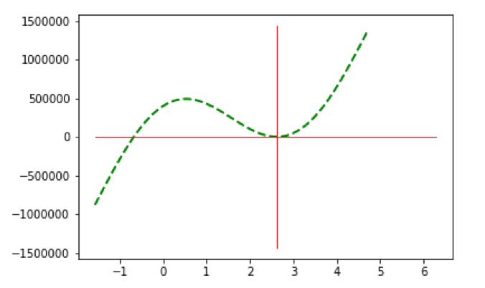
CASE 2: ACCELERATION (ABOVE TRANSITION)
$$φ_{s}=π−\frac{π}{6}$$
$$[\frac{π}{2},π]$$
$$U\left(Δφ\right)=\frac{qV_{max}}{2πh{{Γ_{s}W}_{s}}_{}}\left(\cos\left(Δφ+φ_{s}\right)−cosφ_{s}+Δφsinφ_{s}\right)$$ | Eq. 51
# case 2: SPS protons above transition, acceleration, q = 1, V_{max} = 4.5e6 V, $φ_{s}=π−\frac{π}{6}$
Bounded motion
$$φ_{u}$$
$U\left(φ\right)$ (eV)
$$φ_{s}=π−\frac{π}{6}$$
$$φ$$

Slide 13
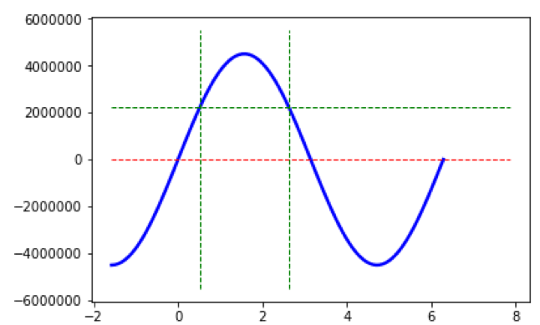
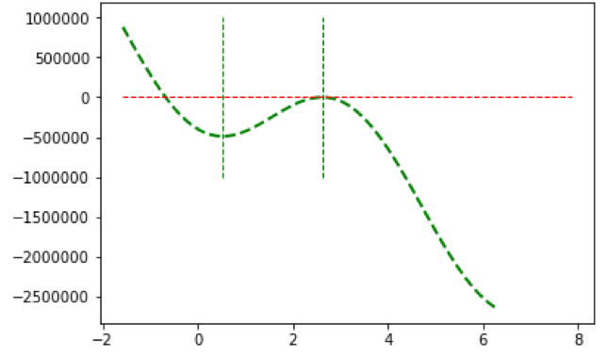
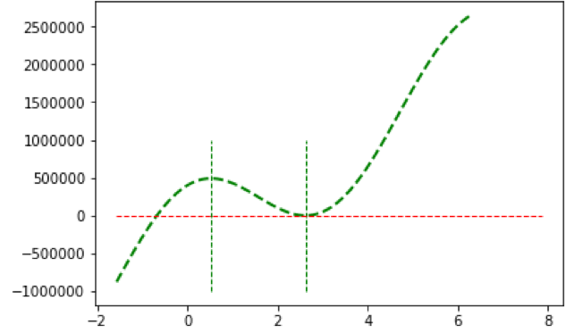
$$φ_{s}=π−\frac{π}{6}$$
$$V\left(φ_{s}\right)=V_{max}sinφ_{s}=V_{max}\sin\left(π−\frac{π}{6}\right)=4.5e6\sin\left(π−\frac{π}{6}\right)$$
$V\left(φ\right)$ (V)
$$φ_{s}=π−\frac{π}{6}$$
$$π−φ_{s}$$
$$V\left(φ\right)=V_{max}sinφ$$
$−U\left(φ\right)$ (eV)
$$\int_{φ_{s}}^{φ}{\frac{q}{2πh{{Γ_{s}W}_{s}}_{}}\left[V\left(φ^{′}\right)−V\left(φ_{s}\right)\right]dφ^{′}}$$
$$U\left(φ\right)=−\int_{φ_{s}}^{φ}{\frac{q}{2πh{{Γ_{s}W}_{s}}_{}}\left[V\left(φ^{′}\right)−V\left(φ_{s}\right)\right]dφ^{′}}$$
$U\left(φ\right)$ (eV)
$$φ_{s}=π−\frac{π}{6}$$
$$π−φ_{s}$$
$$U\left(Δφ\right)=\frac{qV_{max}}{2πh{{Γ_{s}W}_{s}}_{}}\left(\cos\left(Δφ+φ_{s}\right)−cosφ_{s}+Δφsinφ_{s}\right)$$ | Eq. 51
$$φ_{u}$$

Slide 14
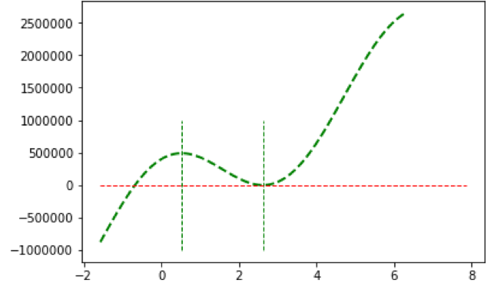
Let’s now calculate the trajectories in phase space that correspond to the plotted potential before
First let’s calculate the Hamiltonian or total energy of the system, which is a constant.
The simplest thing to do is to calculate the total energy when the kinetic energy is 0, i.e. w=0, and the potential energy is maximum. The potential energy is maximum when $φ=π−φ_{s}$.
First point where particles are still bounded within the separatrix
$U\left(φ\right)$ (eV)
$$φ_{s}=π−\frac{π}{6}$$
The second point where particles are still bounded is $φ_{u}$
$$π−φ_{s}$$
$$φ_{u}$$
$$U\left(π−φ_{s}\right)=U(φ_{u})$$
For single RF systems the total energy or separatrix can be calculated analytically by replacing $φ=π−φ_{s}$ in Eq. 51:
$$U\left(Δφ\right)=\frac{qV_{max}}{2πh{{Γ_{s}W}_{s}}_{}}\left(\cos\left(Δφ+φ_{s}\right)−cosφ_{s}+Δφsinφ_{s}\right)$$ | Eq. 51
First replace $Δφ$ by $φ−φ_{s}$, and then $φ=π−φ_{s}$ to obtain:

Slide 15
$$H_{sep}=U(π−φ_{s})=\frac{qV_{max}}{2πh{{Γ_{s}W}_{s}}_{}}\left(−2cos{φ_{s}}+(π−{2φ}_{s})sinφ_{s}\right)$$ | Eq. 57
The phase space trajectory is then:
$$H_{sep}=\frac{1}{2}w^{2}+U\left(φ\right)=\frac{1}{2}w^{2}+\frac{qV_{max}}{2πh{{Γ_{s}W}_{s}}_{}}\left(cosφ−cos{φ_{s}}+(φ−φ_{s})sinφ_{s}\right)$$ | Eq. 58
Solving for $w(φ)$ we get:
$${w\left(φ\right)=±\sqrt{2\left(H_{sep}−U(φ)\right)} }_{}$$ | Eq. 59
Coming back to the second point where particles are still bounded within the separatrix, denoted $φ_{u}$ in the previous figure, we know the energy deviation there should be zero, i.e. $ω=0$. In this case:
$$H_{sep}=\frac{1}{2}w^{2}+U\left(φ_{u}\right)=\frac{qV_{max}}{2πh{{Γ_{s}W}_{s}}_{}}\left(cosφ_{u}−cos{φ_{s}}+(φ_{u}−φ_{s})sinφ_{s}\right)=U(π−φ_{s})$$ | Eq. 60
=0
$$\left(cosφ_{u}−cos{φ_{s}}+(φ_{u}−φ_{s})sinφ_{s}\right)=\left(−2cos{φ_{s}}+(π−{2φ}_{s})sinφ_{s}\right)$$ | Eq. 61
$$cosφ_{u}+φ_{u}sinφ_{s}=\cos\left(π−φ_{s}\right)+\left(π−φ_{s}\right)sinφ_{s}$$ | Eq. 62
$$\left(φ_{u}−\left(π−φ_{s}\right)\right)sinφ_{s}=\cos\left(π−φ_{s}\right)−cosφ_{u}$$ | Eq. 63

Slide 16
The term $φ_{u}−\left(π−φ_{s}\right)$ is called the bucket width
The bucket height at $φ_{s}$ can be evaluated from Eq. 59:
$${w\left(φ\right)=±\sqrt{2\frac{qV_{max}}{2πh{{Γ_{s}W}_{s}}_{}}\left(\left(π−φ_{s}−φ\right)sinφ_{s}−(cosφ+cosφ_{s})\right)} }_{}$$ | Eq. 64
$${w\left(φ=φ_{s}\right)=+\sqrt{2\frac{qV_{max}}{2πh{{Γ_{s}W}_{s}}_{}}\left(\left(π−2φ_{s}\right)sinφ_{s}−2cosφ_{s}\right)} }_{}$$ | Eq. 65
bucket height at $φ_{s}$
$φ_{u}−\left(π−φ_{s}\right)$ = bucket width
First point where particles are still bounded within the separatrix
$U\left(φ\right)$ (eV)
$$φ_{s}=π−\frac{π}{6}$$
The second point where particles are still bounded is $φ_{u}$
$$π−φ_{s}$$
$$φ_{u}$$
$$U\left(π−φ_{s}\right)=U(φ_{u})$$

Slide 17
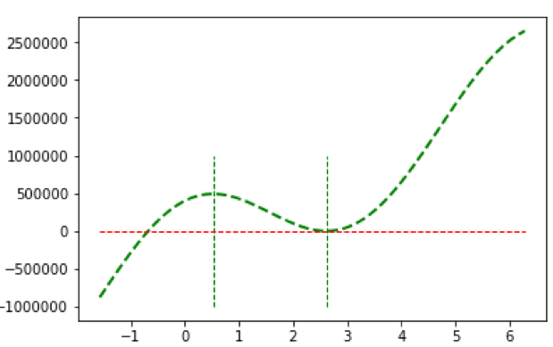
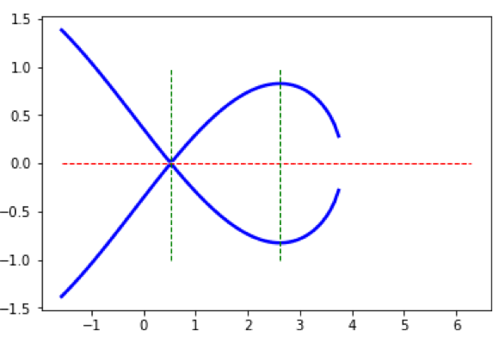
RF bucket parameters
Phase space area
Phase space area enclosed by the particle trajectory is:
$U\left(φ\right)$ (eV)
$${A=\oint{wdφ}}_{}$$ | Eq. 65
$$π−φ_{s}$$
$$φ_{s}=π−\frac{π}{6}$$
$$φ_{u}$$
Since $(φ,w)$ are canonical conjugate variables, the integral is the action or Poincare invariant, therefore a constant of motion.
The units of this area are (energy x time) ➔ (eVs)
The phase space area enclosed by the separatrix is the
$$φ_{s}=π−\frac{π}{6}$$
bucket area
$w\left(φ\right)$ (eV)
$$π−φ_{s}$$
Bucket height (=maximum energy deviation of the separatrix) ➔ Eq. 65
$$φ_{u}$$
The local maximum of the potential at $π−φ_{s}$ is an unstable fixed point in the longitudinal phase space, while the local minimum gives a stable fixed point, $φ_{s}$, which corresponds to the centre of the bucket. At the stable and unstable fixed point the energy deviation is zero.
Synchronous particle
$$φ_{u}−\left(π−φ_{s}\right)$$
Bucket witdth

Slide 18
Using Eq. 59 and the symmetry around the $φ$ axis, one can write for the bucket area:
bucket area
or longitudinal acceptance
$$A=2\int_{φ_{1}}^{φ_{u}}{w\left(φ\right)dφ}{=2\int_{φ_{1}}^{φ_{u}}{\sqrt{2\left(H_{sep}−U(φ)\right)}dφ} }_{}$$ | Eq. 66
where $φ_{1}=π−φ_{s}$, and $φ_{u}$ can be found from Eq. 63
In the special case of a stationary bucket ($φ_{s}=0$ or $π$), the bucket area and height can be calculated analytically ➔ exercise

Slide 19
LONGITUDINAL EMITTANCE AND BUNCH CHARACTERISTICS
All calculated variables in the previous slides, where calculated to the full extend of the stable area.
In practice, in order to avoid particle losses only a fraction of the stable area is usually occupied by the beam, enclosed by a single particle trajectory in phase space.
This area is called single particle emittance.
single particle longitudinal emittance
The trajectory of this particle can be derived from Eq. 59, but now we replace H_{sep} by the new value of the Hamiltonian at a phase where the trajectory crosses the horizontal axis. We call this phase $φ_{1}$ and the Hamiltonian $H_{c}=U(φ_{1})$.
The second point at $φ_{2}$ also satisfies that the energy deviation is 0, therefore:
$$U\left(φ_{1}\right)=U\left(φ_{2}\right)$$ | Eq. 67
For a single RF system this means:
$$cosφ_{1}+φ_{1}sinφ_{s}=cosφ_{2}+φ_{2}sinφ_{s}$$ | Eq. 68
After identifying the two turning points, the area under a given trajectory can be calculated from the integral:
$$ε_{l}{=2\int_{φ_{1}}^{φ_{2}}{\sqrt{2\left(H_{c}−U(φ)\right)}dφ} }_{}$$ | Eq. 69
single particle longitudinal emittance

Slide 20
Summary

Slide 21
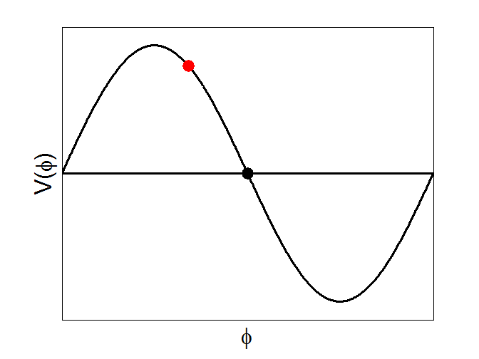
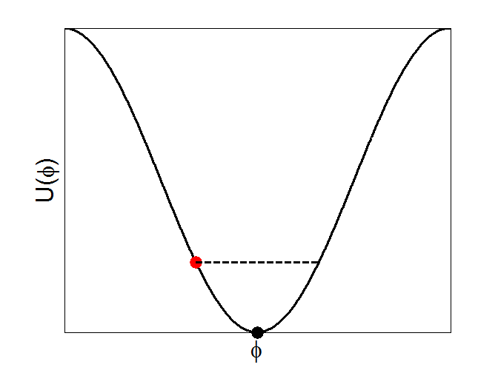
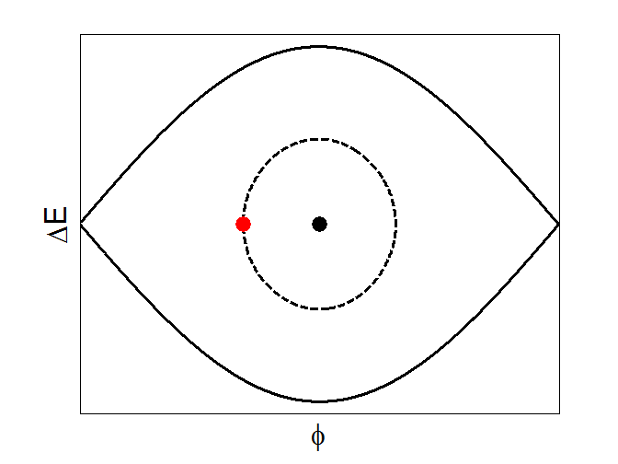
Single particle synchrotron motion – no acceleration
All particles are oscillating around the synchronous one with frequencies called synchrotron frequencies $f_{s}\left(φ\right)$.
Stationary case: In the LHC $φ_{s}=$ $π$ (above transition) → $V\left(π\right)={eV}_{max}\sin{(π)}=0$ → synchronous particle does not gain any energy
RF potential energy
$$U\left(φ\right)=\frac{qV_{max}}{2πh{{Γ_{s}W}_{s}}_{}}\left(1+cos{φ}\right)$$
RF voltage $V\left(φ\right)={eV}_{max}\sin{(φ)}$
Longitudinal phase space ($φ$,$w$)
$${\hat{V}}_{RF}$$
$V\left(φ\right)$ (eV)
RF period
$U\left(φ\right)$ (eV)
$w\left(φ\right)$ (eV)
Synchronous particle, $φ_{s}$
Synchronous particle, $φ_{s}$
Synchronous particle, $φ_{s}$
$$φ$$
$$φ$$
$$φ$$
The state of any particle, at every moment is represented by a single point ($φ$,$w$) in the Longitudinal phase-space.

Slide 22
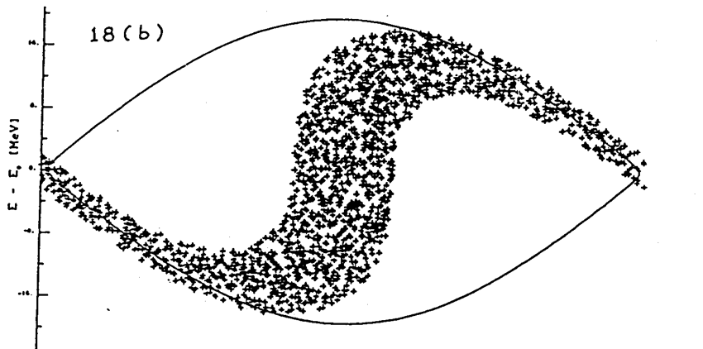
Large Amplitude Oscillations
For larger phase (or energy) deviations from the reference (i.e. synchronous) the second order differential equation is non-linear:
$$\dot{w}=\frac{qV_{max}Ω_{s}}{2πW_{s}} (sin⁡(Δφ+φ_{s})−sinφ_{s})$$ | Eq. 25
FIRST EQUATION OF MOTION
$$\dot{Δφ=}\frac{δ(Δφ)}{δt}={hΓ_{s}Ω}_{s}w$$ | Eq. 34
SECOND EQUATION OF MOTION
$$\ddot{Δφ}={hΓ_{s}Ω}_{s}\dot{w}$$ | Eq. 36
The restoring force cannot be linearised anymore and the differential equation has no analytic solution

Slide 23
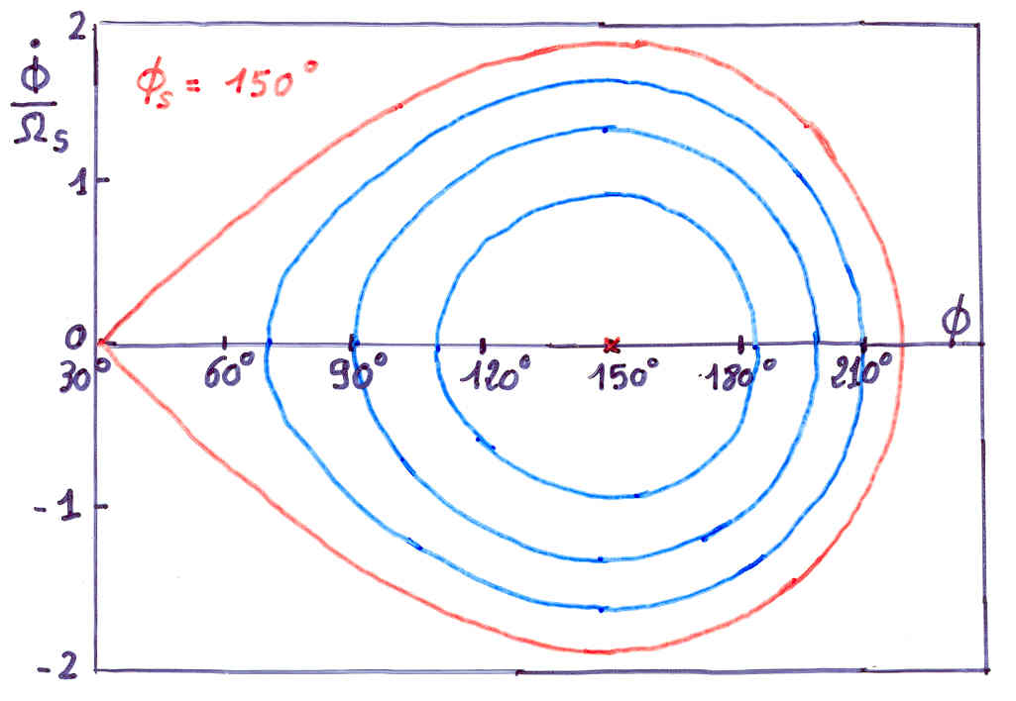
$$\dot{w}=\frac{qV_{max}Ω_{s}}{2πW_{s}} (sin⁡(Δφ+φ_{s})−sinφ_{s})$$ | Eq. 25
FIRST EQUATION OF MOTION
For $φ=π−φ_{s}$ : unstable fixed point
$$\left(\sin{φ}−sinφ_{s}\right)=>\sin\left(π−φ_{s}\right)−sinφ_{s}$$
$$sinπcosφ_{s}−cosπsinφ_{s}−sinφ_{s}=0$$
0 -1 sin $φ_{s}$
$$\ddot{Δφ}={hΓ_{s}Ω}_{s}\dot{w}=0$$ | Eq. 36
No restoring force!! for 𝛗 = π – 𝛗_{s} and for 𝛗 = 𝛗 _{s} (trivial case) … and for 𝛗_{u}
The synchrotron frequency ➔ 0

Slide 24
Single particle synchrotron motion – no acceleration
Stationary case: In the LHC $φ_{0}=φ_{s}=$ $π$ (above transition) → $V\left(π\right)={eV}_{max}\sin{(π)}=0$ → synchronous particle does not gain any energy
Bucket Height,$w\left(φ_{s}\right)$: defines the bucket acceptance,
$$w\left(φ_{s}\right)=ΔE_{bucket}∝\sqrt{{\hat{V}}_{RF}}$$
Longitudinal phase space ($φ$,$w$)
Separatrix: defines the Bucket and corresponds to the trajectory of the particle with maximum offset from $φ_{s}$
$$w\left(φ_{s}\right)=ΔE_{bucket}$$
Bucket Length: determined by the RF frequency $ω_{RF}$.
In time units: $Δτ=\frac{2π}{ω_{RF}}=T_{RF}$
$w\left(φ\right)$ (eV)
bucket length
The area enclosed by the separatrix is known as Bucket Area. It is measured in electronvolt-seconds (eVs)
$$φ$$

Slide 25
Single particle synchrotron motion – no acceleration
Stationary case: In the LHC $φ_{s}=$ $π$ (above transition) → $V\left(π\right)={eV}_{max}\sin{(π)}=0$ → synchronous particle does not gain any energy
Longitudinal phase space ($φ$,$w$)
The area enclosed by the single particle trajectory gives the single particle emittance. It is measured in eVs.
$$w=ΔE_{particle}$$
$w\left(φ\right)$ (eV)
$$φ$$

Slide 26
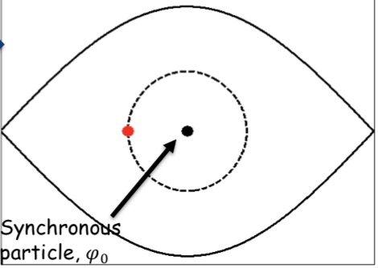
SYNCHROTRON FREQUENCY
As discussed before, particles bounded within the bucket are performing oscillations around the stable phase.
The synchrotron oscillation period is the time that takes to travel all around the closed trajectory (defined by the initial conditions) in phase space.
Particles at different distances from the synchronous particle (synchronous phase) will oscillate with different synchrotron frequencies in the longitudinal phase space.
The longer the bunch the larger the spread of synchrotron frequencies.
Large synchrotron frequency spreads within the bunch (i.e. large bunches) provide a self-stabilizing mechanism against coherent beam instabilities, called Landau damping.
f3
f2
$w\left(φ\right)$ (eV)
f1
$$φ$$

Slide 27
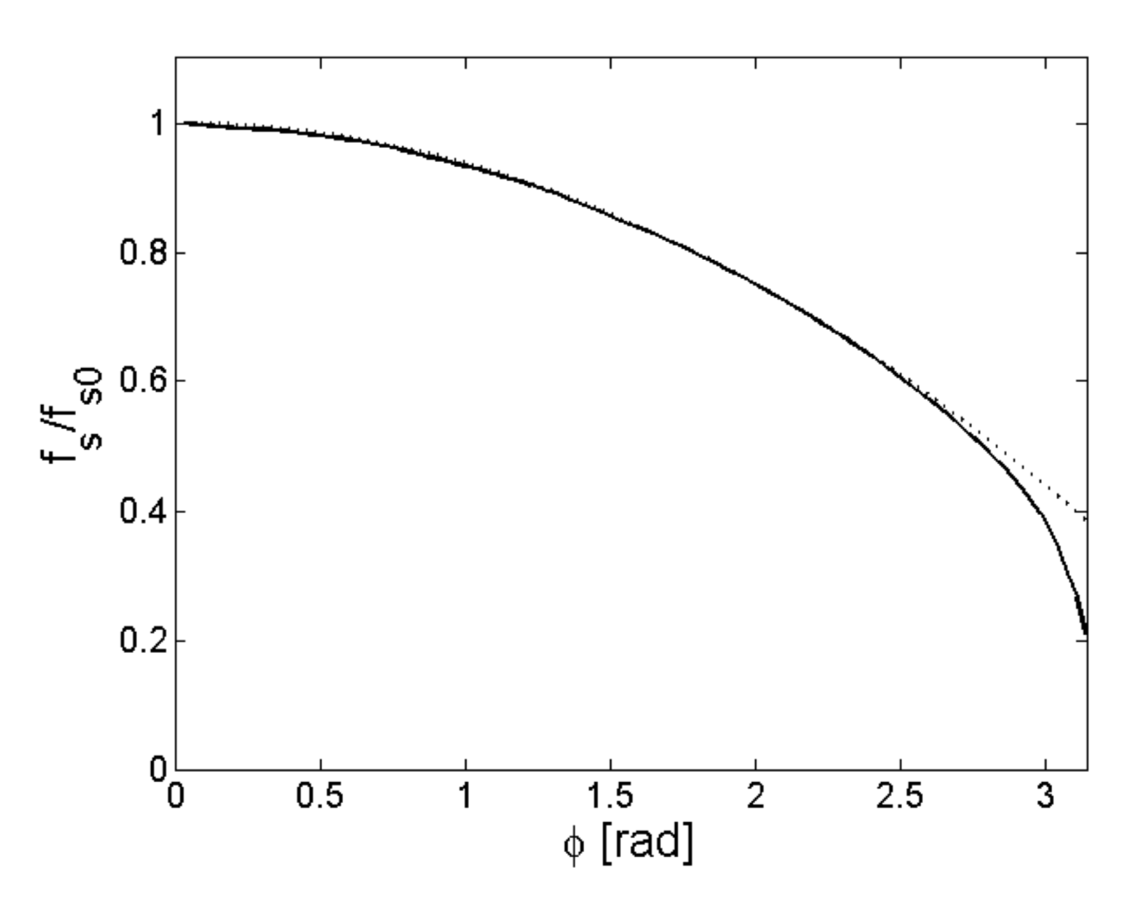
Synchrotron frequency spread
The synchrotron frequency versus the phase in the case of a single RF system and a stationary bucket
(The exact curve is the solid line, the approximate solution is the dashed line)
Every particle in the bunch has a different synchrotron frequency
Solid line is the exact solution (Eq. 73)
Dotted line is the approximation (Eq. 74)
$$Δφ_{}$$

Slide 28
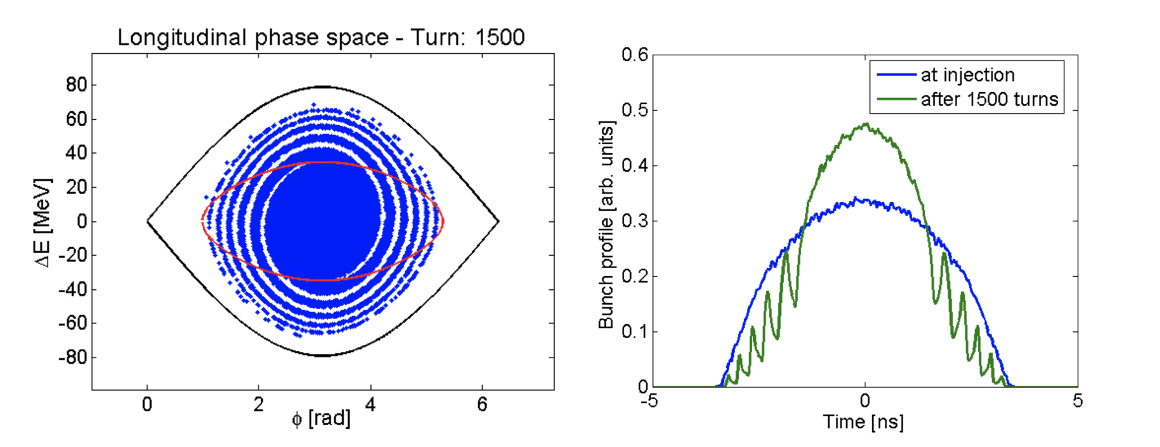
FILAMENTATION
The spread in synchrotron frequency is the responsible for the beam filamentation.
E.g. in case of a large bunch (occupies substantial fraction of the bucket area) that it is not matched to the bucket, for example the bunch is injected into another machine, the difference in frequencies leads to beam filamentation.
This process causes the mismatched bunch distribution to evolve into spirals, diluting the phase space density of the beam:
Filamentation after 1500 turns
Injected beam from a previous machine
Bucket from the receiving machine
For this machine 1500 turns = 11 synchrotron periods

Slide 29
Filamentation after 1500 turns
Injected beam from a previous machine
Bucket from the receiving machine
For this machine 1500 turns = 11 synchrotron periods
The w≡($∆p/p_{s}$)_{max} that we need to take into account when calculating the horizontal displacement of the reference closed orbit ($x_{∆E}\left(s\right)=D(s)\frac{∆p}{p_{s}}$) is not the initial energy deviation (red arrow) but the energy deviation after filamentation (green arrow)

Slide 30
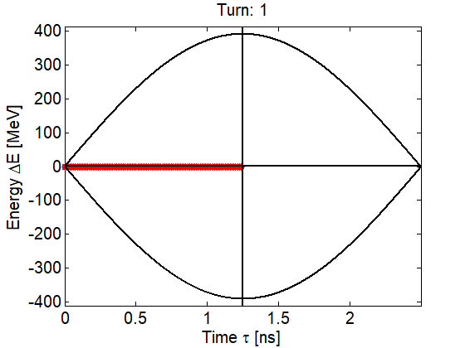
Single particle synchrotron motion – Synchrotron frequency distribution
Particles closer to the synchronous one oscillate with higher frequency.
The zero (from $φ_{0}$) amplitude synchrotron frequency is given by:
$$ω_{sy}\left(0\right)=2πf_{sy}\left(0\right)=\sqrt{−\frac{hω_{s}^{2}ηcosφ_{s}qV_{max}}{2π{β_{s}^{2}}^{}W_{s}}}$$

Slide 31
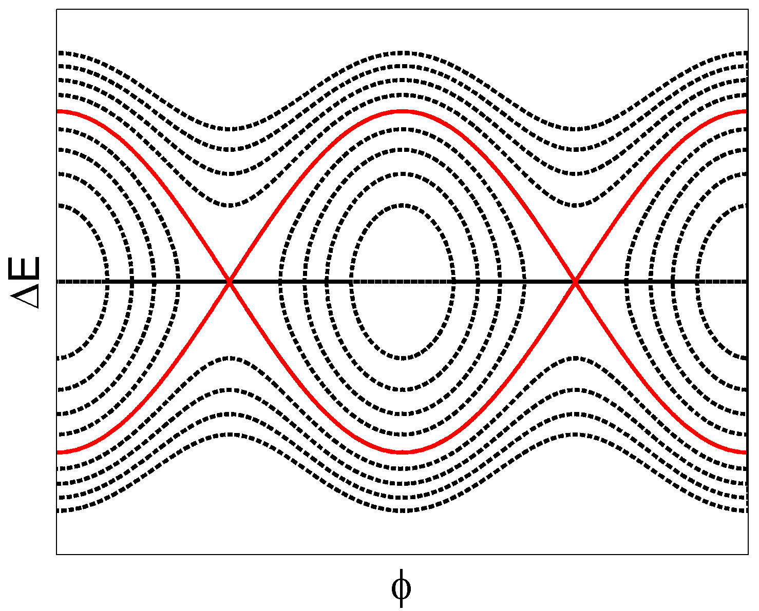
Single particle synchrotron motion – bucket losses
Particles with phases outside the bucket length will be captured by the adjacent buckets.
Particles with ${ΔE}_{particle}>{ΔE}_{bucket}$ will not be captured in the bucket. They will follow the open dotted lines (shown in the plot) and finally will be lost when the acceleration starts.
Trajectories of uncaptured
particles
The separatrix separates the open and the closed trajectories. Particles that are inside the bucket are grouped into Bunches.
$$ΔE_{bucket}$$
bucket length
RF cavities are used to accelerate and to bunch the particle beams.

Slide 32
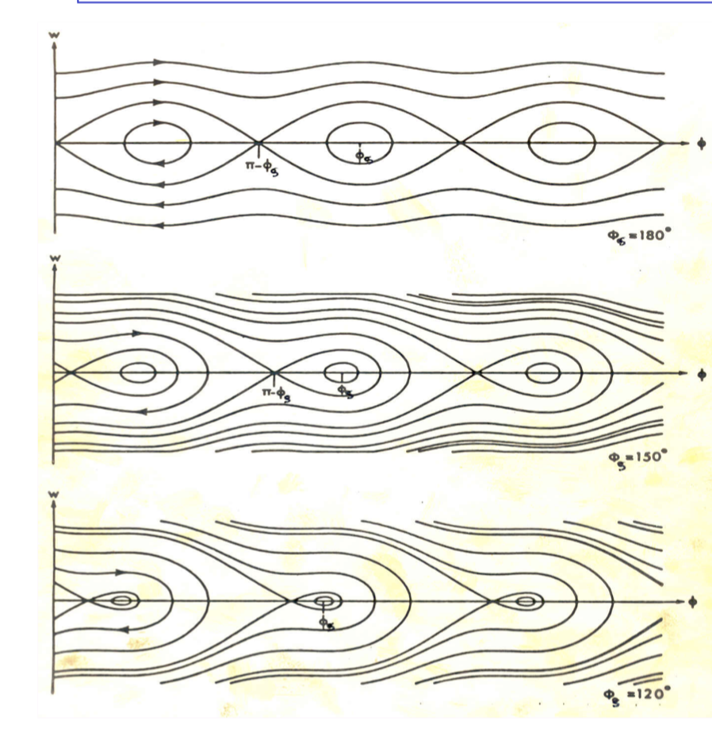

Slide 33
Single particle synchrotron motion – bucket losses
Example of bound and unbound motion of the particles in the longitudinal phase space.
Note that particles with ${ΔE}_{particle}>{ΔE}_{bucket}$ do not stay within the bunch but are moving along the separatrices and thus along the ring, forming the un-bunched circulating beam.
Bound and unbound particle motion
H. Timko, Simulations with BLonD

Slide 34
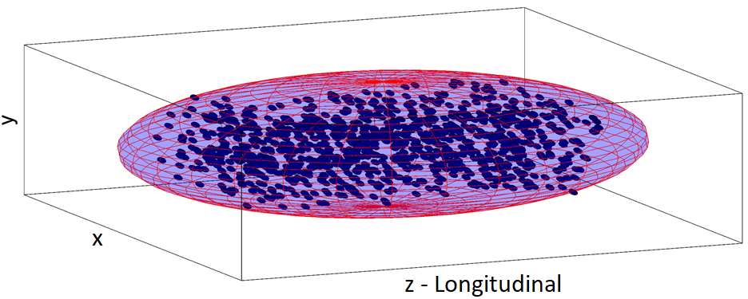
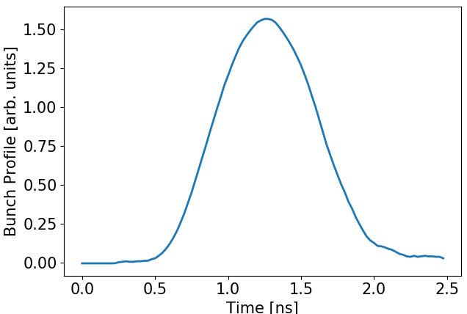
Bunch parameters
Bunches are formed from many particles (10⁹ – 10¹⁵ particles) → the description of the bunch and its motion is represented by statistical quantities.
Bunch position (usually in seconds): position of the centroid of the
bunch.
Bunch length (usually in seconds): size of the bunch.
Bunch emittance (in eVs): area in the longitudinal phase-space
enclosed by a limiting single particle trajectory.
In the longitudinal plane we use the wall-current-monitors and a fast sampling
oscilloscope to measure the bunch profile which is the projection
of the bunch to the z-axis.
The statistical nature of the bunch parameters imply a strong dependence
on the particle distributions → different conventions of defining the
bunch parameters are used in the accelerators.
Projection to the z-axis
Bunch position
No direct measurement on the energy distribution ($ΔE$=w) of the particles within the bunch.
Bunch length

Slide 35
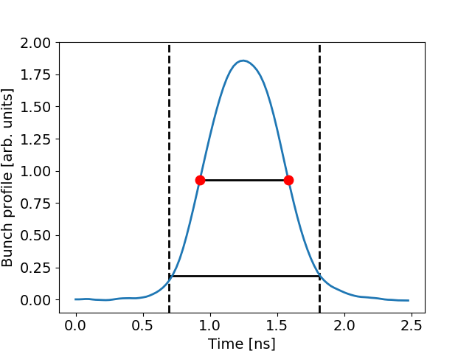
Bunch parameters
Usually the bunch parameters (position, length or σ) are obtained after fitting the bunch profiles → different fitting functions can be used (Gaussian, parabolic, binomial, q-Gaussian etc.)
However, fitting algorithms are time consuming and cannot be efficiently applied in the operational tools. Especially in the case of
LHC with large number of bunches and long duration of the fills.
Alternative algorithm based on the measurement of the Full-Width-Half-Maximum (FWHM) is applied in the LHC (and the SPS).
The FWHM of each bunch is quickly measured from the acquired beam profiles and then the standard deviation σ of the bunch is obtained assuming a Gaussian distribution, according to the equation:
$$σ=\frac{FWHM}{2\sqrt{2ln2}}$$
The bunch length is then defined as: $τ=4σ$
FWHM
Bunch length
$$τ=4σ$$

Slide 36
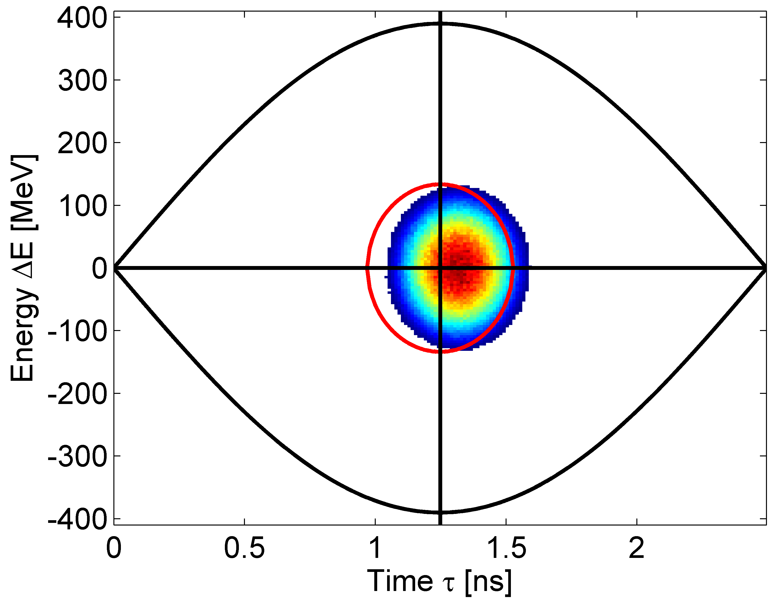
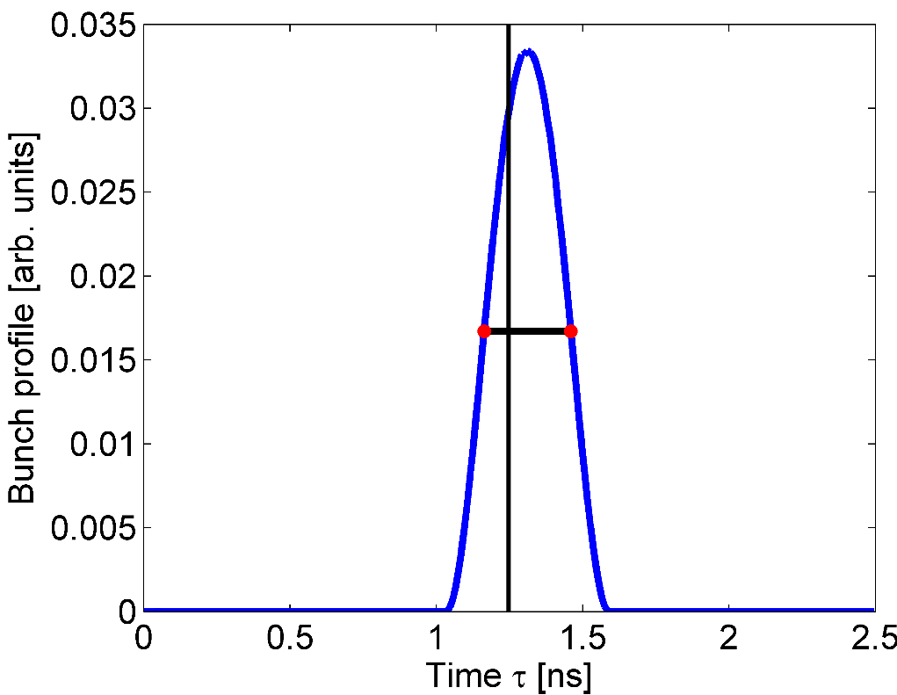
Phase error at injection
Injection of a bunch into the RF bucket with a phase error $φ_{err}=10°$ (or ${Δτ}_{err}={φ_{err}}/{ω_{RF}}=$ 0.07 ns in time)
$φ_{err}=10°$
$$σ=\frac{FWHM}{2\sqrt{2ln2}}=0.126 ns$$
⇨ $τ=4σ=0.5 ns$
$$FWHM=0.3 ns$$
$φ_{err}=$ 10°
Note that the size of the bunch in this example is much smaller than the one that is normally injected from the SPS into the LHC ($τ_{4σ}\sim 1.4−1.6 ns$)

Slide 37
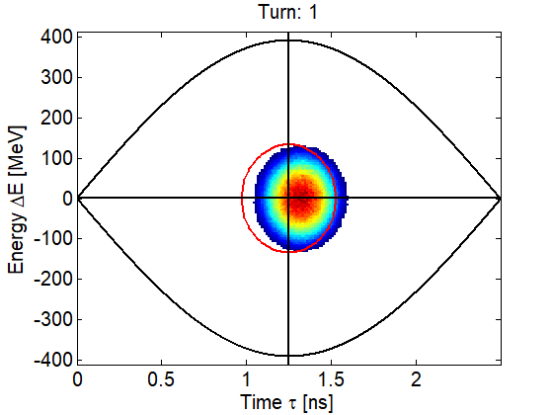
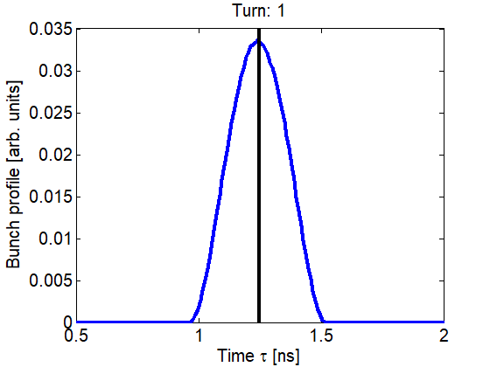
Phase error at injection – Dipole oscillations
The bunch will initially start to oscillate as a whole with frequency close to the zero amplitude synchrotron frequency $f_{s0}$.
This bunch motion is called dipole oscillation
Projection into the Time axis. This is what can be measured in the machine using a wall-current monitor and a fast sampling oscilloscope.

Slide 38
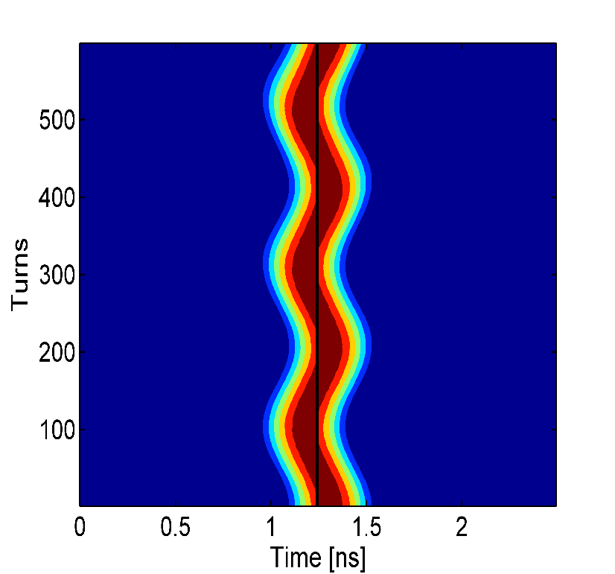
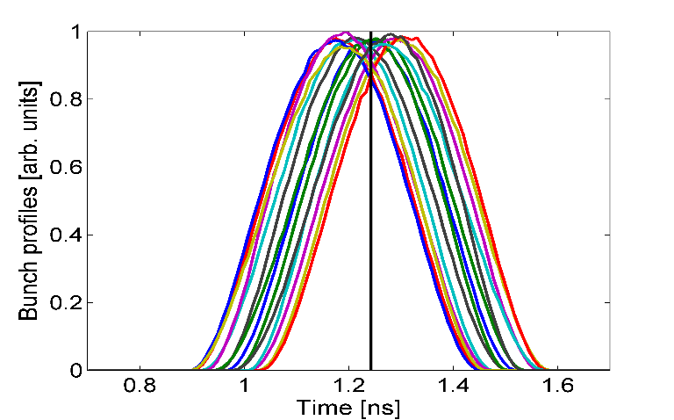
Phase error at injection – Dipole oscillations
Summary plots of the bunch profiles are used to illustrate the bunch oscillations. The black lines on the plots show the centre of the RF bucket.
Waterfall plot: Each horizontal line corresponds to one acquisition of the same bunch. The colour code depicts the bunch profile density in arb. units.
Overlaying of all bunch profiles. Different colours correspond to different turns.

Slide 39
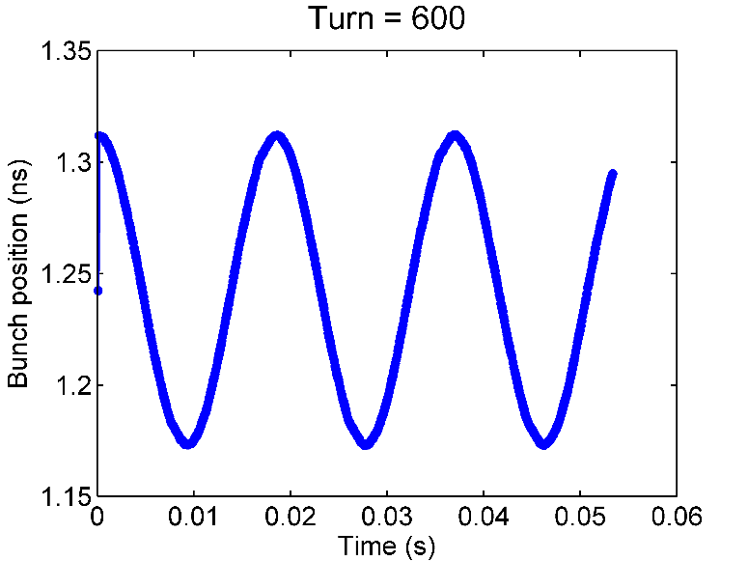
Phase error at injection – Dipole oscillations
After analysing the profiles i.e. fitting the bunches and getting the bunch parameters for each acquisition, we can plot the motion of the centroid of the bunch.
$$φ_{err}=10° or$$
$$Δτ=0.07 ns$$
The motion of the bunch centroid after injection into the RF bucket with a phase error shows a clear harmonic oscillation with frequency close to the zero amplitude synchrotron frequency $f_{s0}$.
Centre of the RF bucket
$$T_{s}\sim$$
$$1/f_{s0}$$

Slide 40
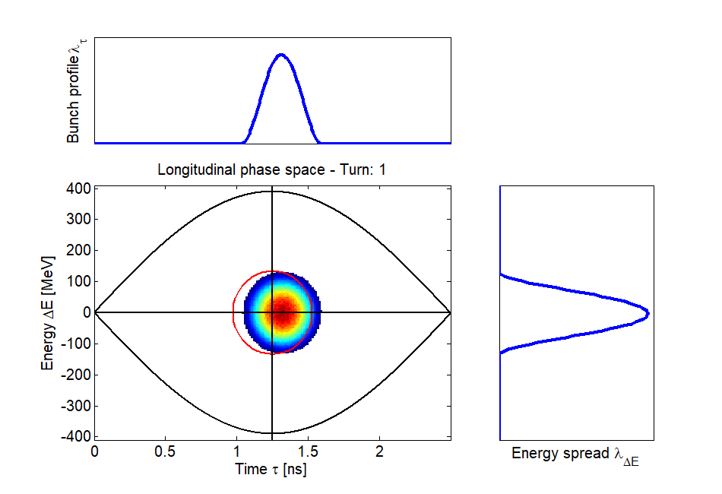
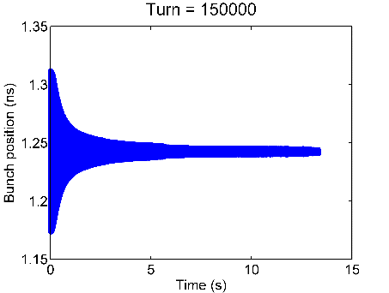
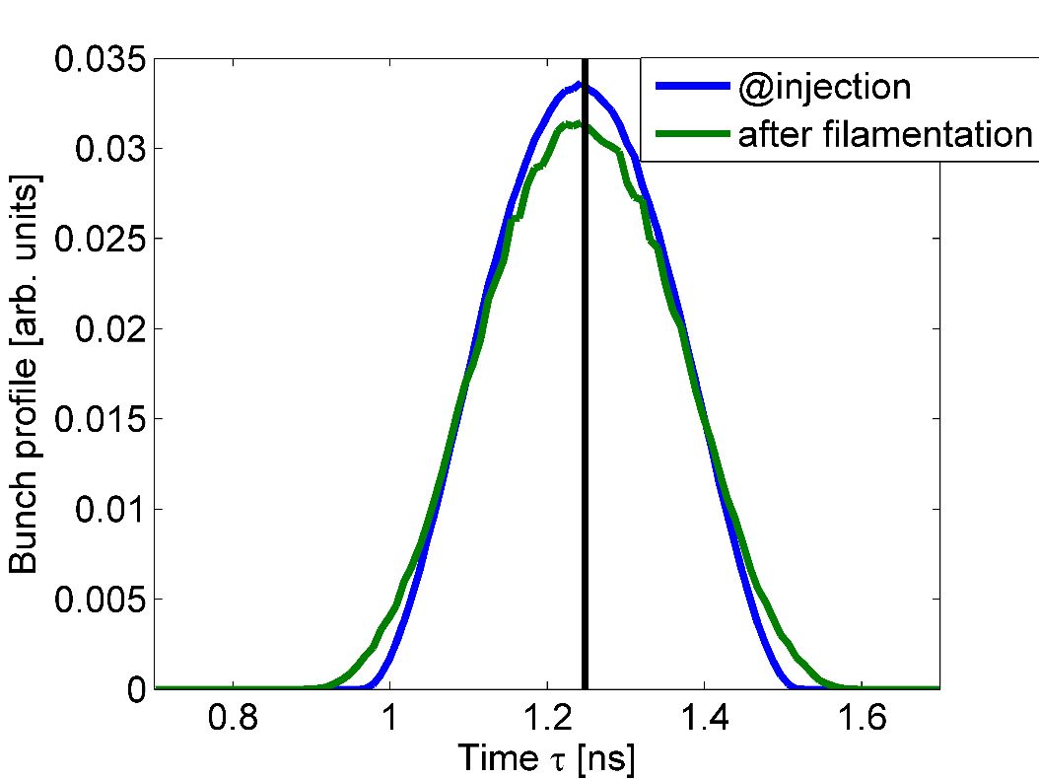
Phase error at injection – bunch filamentation
Particles having different synchrotron frequencies (fast for the particles around the centre of the bucket and slow for the ones injected close to the separatrix) will lead to the filamentation of the bunch and finally to the de-coherence of the bunch motion. Particles will adapt to the corresponding trajectories in the phase-space at the moment of injection resulting to observation of an emittance bunch blow-up.
After filamentation the bunch blows-up.
Larger initial phase error leads to bigger blow-up
De-coherence of the bunch motion → amplitude of the dipole oscillations damps to zero
$$τ_{4σ}=0.5 ns$$
$$τ_{4σ}=0.521 ns$$

Slide 41
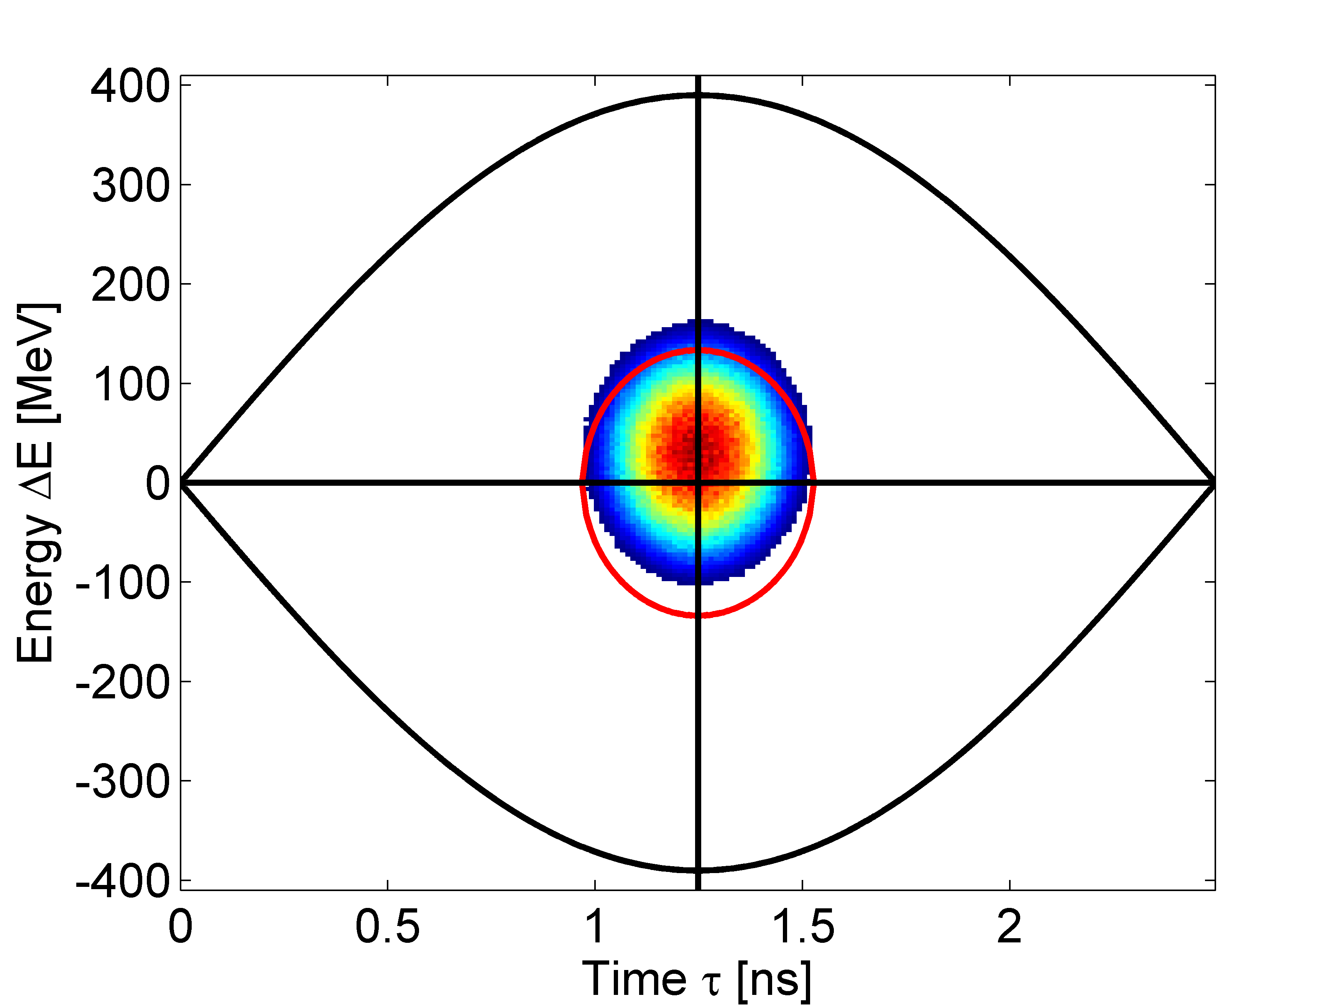
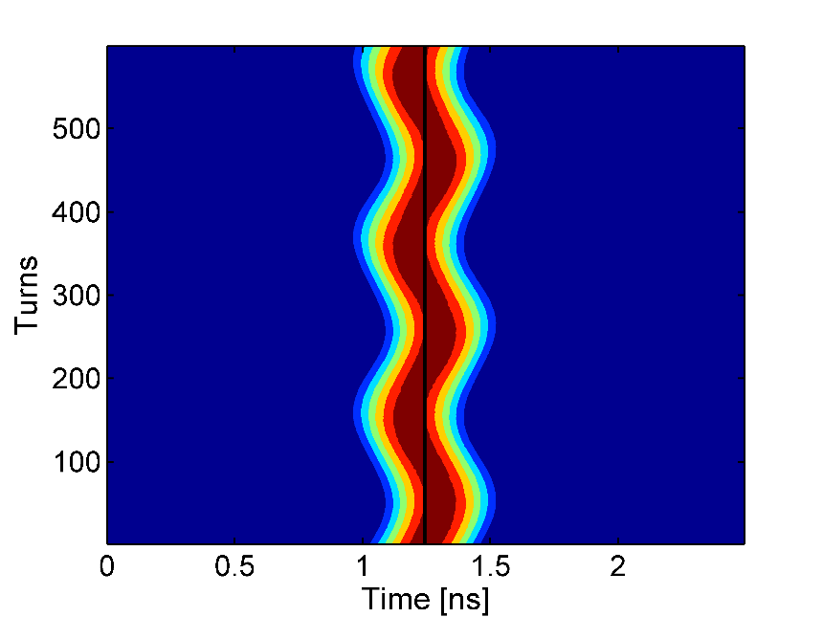
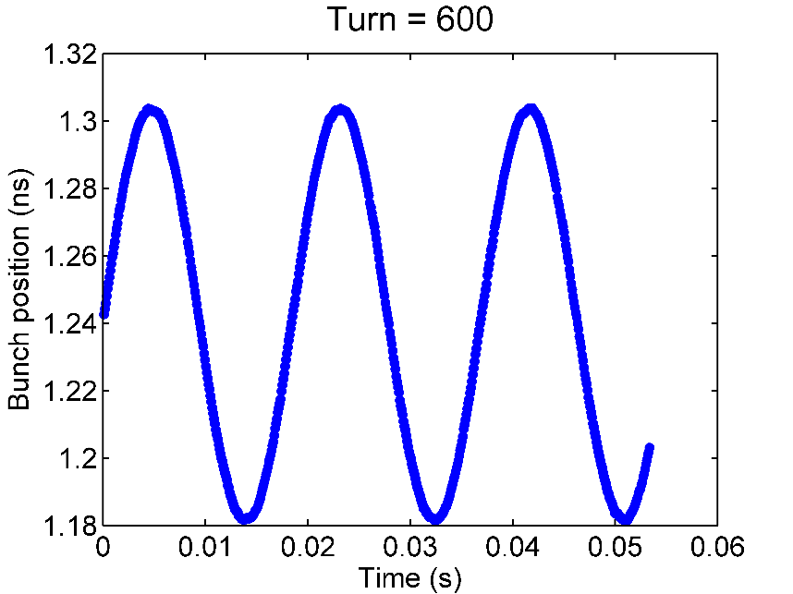
Energy error at injection
Injection into the RF bucket with 30 MeV energy error → effect on the bunch is similar to the phase error case.
${ΔE}_{err}=30 MeV$
Note that the bunch is initial injected into the centre of the bucket (no phase error). These kind of plots can be used to distinguish between energy and phase errors.

Slide 42
Frequency Change during acceleration
During the energy ramping, the particle velocity increases
(… which is why we call it an accelerator)
Which means the revolution frequency of the particles increases (except for e- which are fully relativistic)
And we have to adjust the external RF frequency in order to stay synchronised.
Revolution frequency and RF frequency are related by the “harmonic number”.
The harominic number is the number of RF wavelengths that fit around the ring.
hence :

Slide 43
Frequency Change during acceleration
The RF frequency must follow the variation of the B field with the law :
At relativistic energies, (as soon as …)
We can treat f_{r} as constant.
which is true for LHC at high energy and for electrons from the start

Slide 44
Spares

Slide 45
$$\frac{∂Hamiltonian}{∂∆φ}=−\frac{δ}{δt}\left(\frac{ΔW}{Ω_{s}}\right)$$ | Eq. 49
It can be shown that:
$$\frac{∂Hamiltonian}{∂\left(\frac{ΔW}{Ω_{s}}\right)}=\frac{δ}{δt}∆φ$$ | Eq. 50
Canonical Hamiltonian equations
$$\dot{w}=\frac{qV_{max}Ω_{s}}{2πW_{s}} (sin⁡(Δφ+φ_{s})−sinφ_{s})$$ | Eq. 25
FIRST EQUATION OF MOTION
$$\dot{Δφ=}\frac{δ(Δφ)}{δt}={hΓ_{s}Ω}_{s}w$$ | Eq. 34
SECOND EQUATION OF MOTION

