Slide 1
Introduction to transverse beam dynamics III
Restricted to the LINEAR BEAM OPTICS ➔ THE IDEAL WORLD

Slide 2
Content of the course
TBD 1
TUTO 1
Charge particle motion in a magnetic field
Equations of motion ➔ derivation and assumptions
Type of magnets
Rigidity formula
Relativistic equations
Create a storage ring with the Earth Magnetic field
TBD 2
TUTO 2
Particle trajectory
Transfer Matrices
Thin lens approximation
Betatron oscillations
Betatron tune
Dispersion
Application of transfer matrices
Thin lens
FoDo cell
TBD 3
TUTO 3
Phase space ellipse
Emittance
Beam size
Aperture
Beta function evolution
Periodic lattices
Beam size and aperture calculations
TBD 4
TUTO 4
Effect field errors
Resonances
Coupling
Chromaticity
How the tune changes from a quadrupole defect
Optimize beta beating
Orbit bumps

Slide 3


Phase space ellipse
In the previous lecture we introduced the following:
Second we replace the amplitude factor A by $\sqrt{ε}$ ➔ a constant term called emittance
$$x\left(s\right)=\sqrt{εβ(s)}cos⁡(ψ\left(s\right)+φ)$$
Hill’s equation solution
Let’s try to understand what emittance is by going to phase space

Slide 4
Why is convenient to work in phase space?

Slide 5
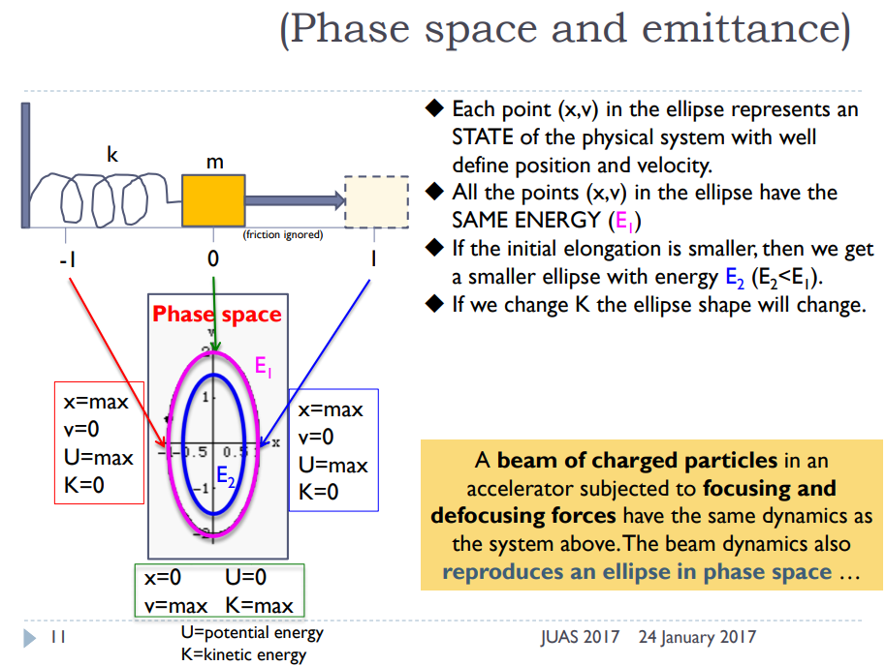
:spring constant
(In linear approximation)

Slide 6
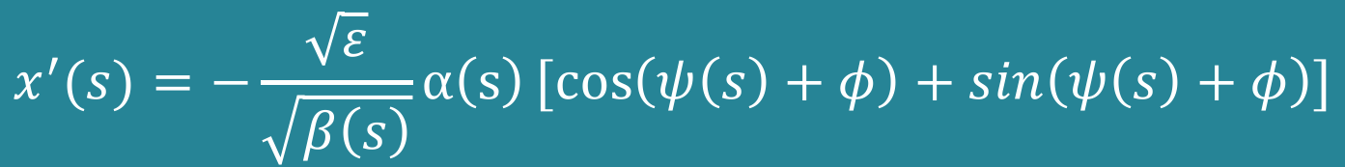





We take the position and its derivative (angle$≡$velocity)
$$x\left(s\right)=\sqrt{εβ(s)}cos⁡(ψ\left(s\right)+φ)$$
$$x^{′}(s)=−\frac{\sqrt{ε}}{\sqrt{β\left(s\right)}}α\left(s\right)[cos\left(ψ\left(s\right)+φ\right)+sin\left(ψ\left(s\right)+φ\right)]$$
Where $α\left(s\right)≡−\frac{β^{′}(s)}{2}$
To arrive to an expression describing the phase space motion (x,x’) we have to eliminate the terms which depend on phase advance $ψ\left(s\right)$
$$\cos\left(ψ\left(s\right)+φ\right)=\frac{x(s)}{\sqrt{εβ(s)}}$$
$$\sin\left(ψ\left(s\right)+φ\right)=\frac{\sqrt{β(s)}x′(s)}{\sqrt{ε}}+\frac{α\left(s\right)x(s)}{\sqrt{εβ(s)}}$$
If we now use the general relation $\sin^{2}θ+\cos^{2}θ=1$

Slide 7
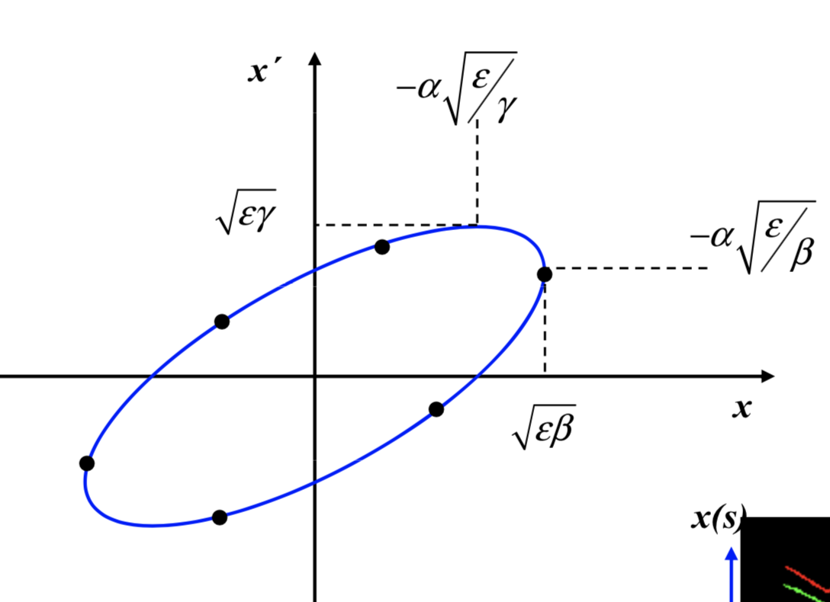
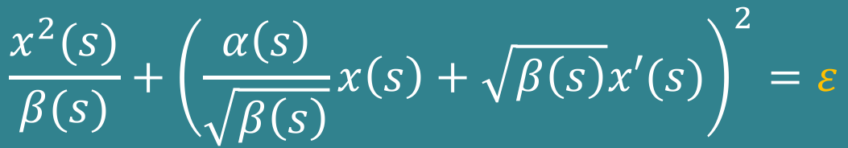

If we now use the general relation $\sin^{2}θ+\cos^{2}θ=1$
$$\frac{x^{2}(s)}{β(s)}+{\left(\frac{α\left(s\right)}{\sqrt{β\left(s\right)}}x\left(s\right)+\sqrt{β\left(s\right)}x′(s)\right)}^{2}=ε$$
If we introduce the definition $γ\left(s\right)≡\frac{1+α^{2}(s)}{β(s)}$ (Attention this is not relativistic gamma)
$$γ\left(s\right)x^{2}\left(s\right)+2α\left(s\right)x\left(s\right)x^{′}\left(s\right)+β\left(s\right)x^{′2}\left(s\right)=\frac{Area}{π}=ε$$
(Proof Appendix C of “The Physics of Particle Accelerators” K. Wille)
The emittance, $ε$, introduced originally as a constant of integration, has now an obvious meaning ➔ it is related to the area of the ellipse, and it is constant ⬅➔ if conservative system, like the one presented two slides ago, and in linear beam dynamics

Slide 8
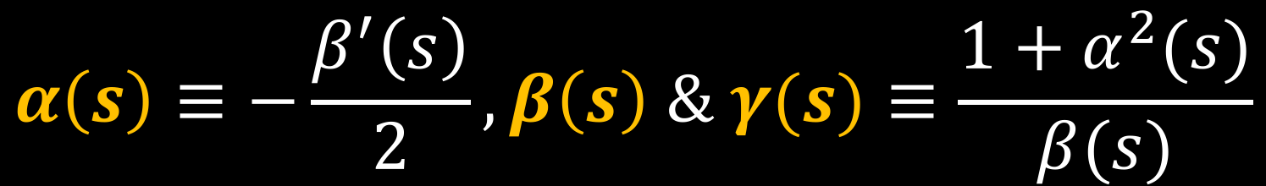
Twiss functions
$$α\left(s\right)≡−\frac{β^{′}\left(s\right)}{2}, β\left(s\right) \& γ(s)≡\frac{1+α^{2}(s)}{β(s)}$$

Slide 9

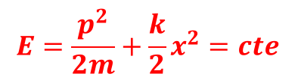
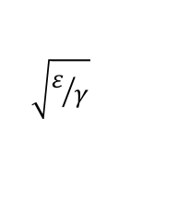
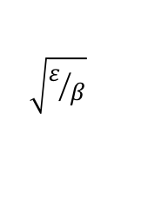
x’_{max} =
$$\sqrt{ε/β}$$
$$\frac{Area}{π}=ε$$
=x_{max}
$$\sqrt{ε/γ}$$
$$E=\frac{p^{2}}{2m}+\frac{k}{2}x^{2}=cte$$
In both cases, the energy is conserved, the area of the ellipse is conserved, is an invariant of motion over time.
In the case of the mass attached to the spring, the ellipse has always the same shape for a given initial conditions.
In the case of a particle in an accelerator, since k=k(s), as the particle moves along the closed orbit, the shape and position of the ellipse changes according to the amplitude function 𝛽(s). BUT THE AREA REMAINS CONSTANT.

Slide 10
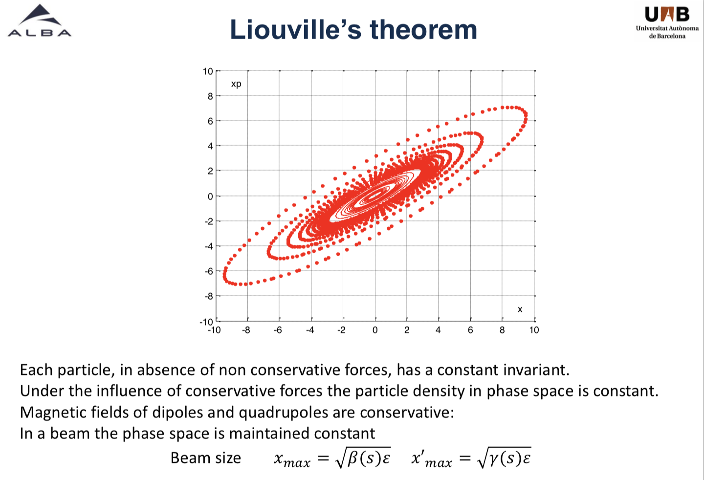

Slide 11
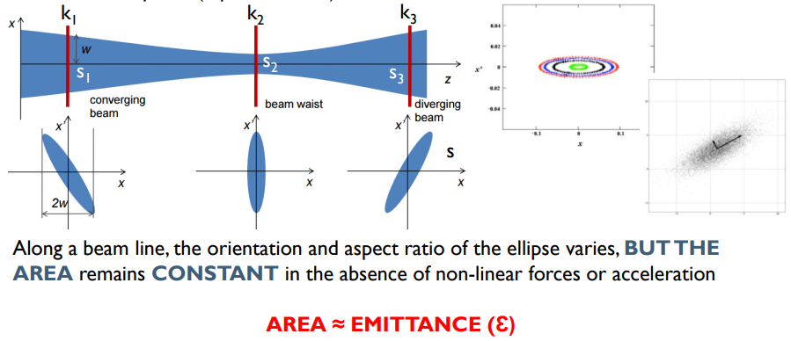

Slide 12
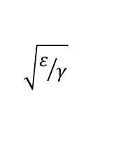
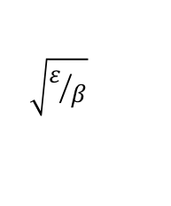




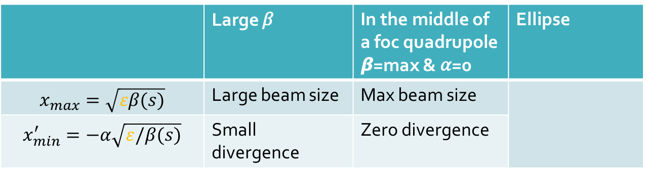

$$x\left(s\right)=\sqrt{εβ(s)}cos⁡(ψ\left(s\right)+φ)$$
=1
x’_{max} =
$$\sqrt{ε/β}$$
$$xmax\left(s\right)=\sqrt{εβ(s)}$$
=x_{max}
How much is x’(s) at this position? (put $xmax\left(s\right)$ in the ellipse equation and solve for x’)
$$\sqrt{ε/γ}$$
$$xmax\left(s\right)=\sqrt{εβ(s)}$$
$$x^{′}min\left(s\right)=−α\sqrt{ε/β(s)}$$
 | Large 𝛽 | In the middle of a foc quadrupole 𝞫=max & 𝛼=0 | Ellipse
$$x_{max}=\sqrt{εβ(s)}$$ | Large beam size | Max beam size
$$x_{min}^{′}=−α\sqrt{ε/β(s)}$$ | Small divergence | Zero divergence
x'
x

Slide 13





So far we have considered the trajectory of a single particle and defined the phase space ellipse and emittance
However, a beam is made of many particles (10¹¹ protons for LHC) each injected with different position and angle, and therefore moving with different amplitudes and describing different ellipses
This raises the question of what we mean by the AVERAGE EMITTANCE of a beam consisting of an assembly of many particles
To answer the question let’s think about the equilibrium distribution of particles in a beam
In most cases the Gaussian distribution is a good description of the transverse density function
$$ρ\left(x,y\right)=\frac{Ne}{2πσ_{x}σ_{y}}e^{\left(−\frac{x^{2}}{2σ_{x}^{2}}−\frac{y^{2}}{2σ_{y}^{2}}\right)}$$
N: number of particle of charge e in the beam
𝜎x,y: horizontal, vertical beam sizes
The horizontal distribution can be obtained by setting y=0
$$ρ\left(x\right)$$
All particles which lie exactly one standard deviation 𝜎 from the beam axis may be assigned a precise emittance 𝜀_{STD} via the relation
$$ρ0$$
$$e^{\left(−\frac{1}{2}\right)}ρ0=0.607ρ0$$
𝛔_{x}
1 STD
$$σ\left(s\right)=\sqrt{ε_{STD}β(s)}$$

Slide 14

$$ε_{STD}=\frac{σ^{2}(s)}{β(s)}$$
Emittance of the whole beam
=1

Slide 15
Aperture
When designing an accelerator is important to ensure that the beam has sufficient room available in the transverse phase space
Even particles undergoing extremely large betatron oscillations can then still circulate stably
This raises the question how large the phase space ellipse of a particle is allowed to be before it collides with the wall of the vacuum chamber and it is lost
x’
d
x
Vacuum chamber size at position s
Is this an acceptable solution?

Slide 16
Evolution of the 𝞫 function through the lattice
The 𝞫 function is an important quantity in linear beam dynamics
It allows to calculate the beam size along the magnet structure
It allows to calculate the phase advance of the betatron oscillations in between two points
Now we will learn how to calculate the evolution of the 𝞫 function itself through the storage ring
As usual we need initial conditions, in this case the value of the 𝞫 function at the starting point in the lattice 𝞫(s₀)
Starting from this initial value we can calculate step by step the evolution of 𝞫 by the use of appropriate transformations
There are two methods, we will briefly try to understand them

Slide 17






METHOD 1
We describe the trajectory of the particle by the vector X, which travels around the phase space ellipse during the motion of the particle around the orbit
At the beginning of the magnet structure, s=s₀=0, we have X=X₀
$$X_{0}=\left(\begin{matrix}x_{0} \\ x_{0}^{′}\end{matrix}\right)$$
$$X_{0}^{T}=\left(\begin{matrix}x_{0} & x_{0}^{′}\end{matrix}\right)$$
(Transpose matrix)
We define the beta matrix
$$B_{0}≡\left(\begin{matrix}β_{0} & {−α}_{0} \\ {−α}_{0} & γ_{0}\end{matrix}\right)$$
$$α\left(s\right)≡−\frac{β^{′}\left(s\right)}{2}, β\left(s\right) \& γ(s)≡\frac{1+α^{2}(s)}{β(s)}$$
Twiss functions
If we calculate the product $X_{0}^{T}B_{0}^{−1}X_{0}=γ_{0}x_{0}^{2}+2α_{0}x_{0}x_{0}^{′}+β_{0}x_{0}^{′2}=ε$
We also know that the trajectory vector at any position s can be calculated as
$$X_{1}=MX_{0}$$
Where $M^{−1}M=M^{T}{\left(M^{T}\right)}^{−1}=1$

Slide 18






Let’s now play with the matrices
$$ε=X_{0}^{T}B_{0}^{−1}X_{0}=X_{0}^{T}{M^{T}{\left(M^{T}\right)}^{−1}B}_{0}^{−1}M^{−1}MX_{0}$$
$$A^{T}B^{T}=({BA)}^{T}$$
$$\& A^{−1}B^{−1}=({BA)}^{−1}$$
$$ε=X_{0}^{T}B_{0}^{−1}X_{0}=X_{0}^{T}{M^{T}{(\left(M^{T}\right)}^{−1}(MB}_{0}^{})^{−1})MX_{0}$$
= $X_{0}^{T}M^{T}(MB_{0}M^{T})^{−1}MX_{0}$
          $$=(MX_{0})^{T}(MB_{0}M^{T})^{−1}MX_{0}$$
$$X_{1}^{T}$$
$$X_{1}^{}$$
$$ε=X_{0}^{T}B_{0}^{−1}X_{0}=X_{1}^{T}(MB_{0}M^{T})^{−1}X_{1}=X_{1}^{T}B_{1}^{−1}X_{1}$$
Since at point s=s1 the particle trajectory is given by X1 and the B1 matrix, then it follows
$$B_{1}=MB_{0}M^{T}$$

Slide 19
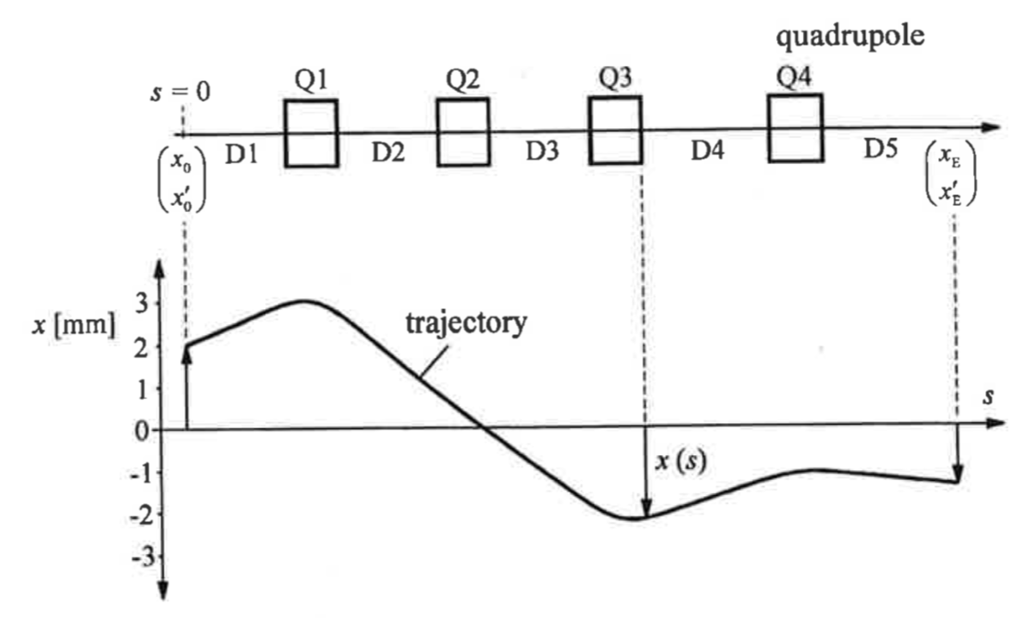


$$X_{1}=MX_{0}$$
$$B_{1}=MB_{0}M^{T}$$
Evolution of the beta function along the lattice uses the same cos(h), sin(h) matrices as the particle trajectory
M=

Slide 20






Example: calculate the beta function around a symmetry point in a field-free drift section
The symmetry point is s=s₀=0
All the coordinates at this point will have the label *
Here the gradient of the beta function is zero, i.e. $α^{∗}=0$
The beta function at this position is $β^{∗}$
=M
$$X_{1}=MX_{0}$$
$$β$$
$$\left(\begin{matrix}x(s) \\ x′(s)\end{matrix}\right)=\left(\begin{matrix}1 & s \\ 0 & 1\end{matrix}\right)\left(\begin{matrix}x_{0} \\ {x′}_{0}\end{matrix}\right)$$
DRIFT
k=0
$$B_{1}=MB_{0}M^{T}$$
s
s₀=0
$β^{∗}$, $α^{∗}=0$

Slide 21





Beta function around a symmetry point
$$B_{0}≡\left(\begin{matrix}β_{0} & {−α}_{0} \\ {−α}_{0} & γ_{0}\end{matrix}\right)$$
$$B_{1}\left(s\right)=\left(\begin{matrix}1 & s \\ 0 & 1\end{matrix}\right)\left(\begin{matrix}β^{∗} & 0 \\ 0 & \frac{1}{β^{∗}}\end{matrix}\right)\left(\begin{matrix}1 & 0 \\ s & 1\end{matrix}\right)=\left(\begin{matrix}β^{∗}+\frac{s^{2}}{β^{∗}} & \frac{s}{β^{∗}} \\ \frac{s}{β^{∗}} & \frac{1}{β^{∗}}\end{matrix}\right)$$
$$β$$
$$β_{1}=β^{∗}+\frac{s_{1}^{2}}{β^{∗}}$$
-𝛼 around a symmetry point
s
The beta function grows quadratically with the distance from the symmetry point and grows faster the smaller the 𝛽
s₀=0
s=s₁
$β^{∗}$, $α^{∗}=0$

Slide 22
LHC
Figure 1. β-functions and beam sizes σ at distance s from the interaction point at s0=0, for β∗=0.55,2,11 and 90 m up to L∗=±26 m, for the LHC design beam energy Eb=7TeV and normalized emittance ϵN=3.75μm.
Figure 1. β-functions and beam sizes σ at distance s from the interaction point at s0=0, for β∗=0.55,2,11 and 90 m up to L∗=±26 m, for the LHC design beam energy Eb=7TeV and normalized emittance ϵN=3.75μm.
β-functions and beam sizes σ at distance s from the interaction point at s₀=0, for β∗=0.55,2,11 and 90 m up to L∗=±26 m, for the LHC design beam energy Eb=7TeV and normalized emittance ϵ_{N}=3.75μm.

Slide 23








METHOD 2
We start with two trajectory vectors at different positions in the lattice, s₀ and s, and its optical functions at s₀ and s
$$X_{0}=\left(\begin{matrix}x_{0} \\ x_{0}^{′}\end{matrix}\right)$$
$$X_{}=\left(\begin{matrix}x_{} \\ x_{}^{′}\end{matrix}\right)$$
$$β_{0}, α_{0}, γ_{0}$$
$$β_{}, α_{}, γ_{}$$
At s₀ and s we have the same invariant of motion
$$ε=βx^{′2}+2αxx^{′}+γx^{2}=β0{x0}^{′2}+2α0x0{x0}^{′}+γ0{x0}^{2}$$
$$M=\left(\begin{matrix}m_{11} & m_{12} \\ m_{21} & m_{22}\end{matrix}\right)$$
We also know
$$X_{}=MX_{0}$$
with
$$M^{−1}=\left(\begin{matrix}m_{22} & {−m}_{12} \\ {−m}_{21} & m_{11}\end{matrix}\right)$$
$$X_{0}=M^{−1}X_{}$$
with
Solving for X₀ and bringing x₀ and x’_{o} as a function of X and the matrix elements to the invariant equation we obtain

Slide 24
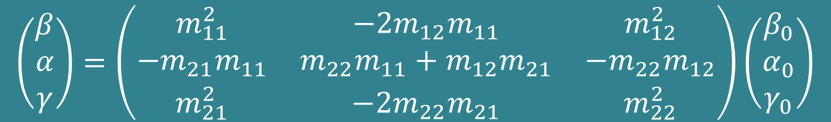

$$ε=βx^{′2}+2αxx^{′}+γx^{2}=β_{0}(−m_{21}x+m_{11}x^{′})^{2}$$
              $+2α_{0}(m_{22}x−m_{12}x^{′})$($−m_{21}x+m_{11}x^{′})$
              $$+γ_{0}(m_{22}x−m_{12}x^{′})^{2}$$
Rearranging terms we end up
$$β=m_{11}^{2}β_{0}−2m_{12}m_{11}α_{0}+m_{12}^{2}γ_{0}$$
$$α=−m_{21}m_{11}β_{0}+\left(m_{22}m_{11}+m_{12}m_{21}\right)α_{0}−m_{22}m_{12}γ_{0}$$
$$γ=m_{21}^{2}β_{0}−2m_{22}m_{21}α_{0}+m_{22}^{2}γ_{0}$$
$$\left(\begin{matrix}β \\ α \\ γ\end{matrix}\right)=\left(\begin{matrix}m_{11}^{2} & −2m_{12}m_{11} & m_{12}^{2} \\ −m_{21}m_{11} & m_{22}m_{11}+m_{12}m_{21} & −m_{22}m_{12} \\ m_{21}^{2} & −2m_{22}m_{21} & m_{22}^{2}\end{matrix}\right)\left(\begin{matrix}β_{0} \\ α_{0} \\ γ_{0}\end{matrix}\right)$$

Slide 25
Calculate transfer matrices from optical functions
Up to now we have used the transfer matrix M to calculate uniquely optical functions at the end of a magnet structure from known initial conditions
Now we want to use the known values of the optical functions at the beginning and end of the magnet structure to calculate how the particle trajectory evolves
This has the advantage that many of the characteristics of the beam transport system can be discussed without knowing in detail the magnet structure
I will save you the mathematics (see page 88 in K. Wille)
I just bring you directly to the results, which is the useful thing

Slide 26
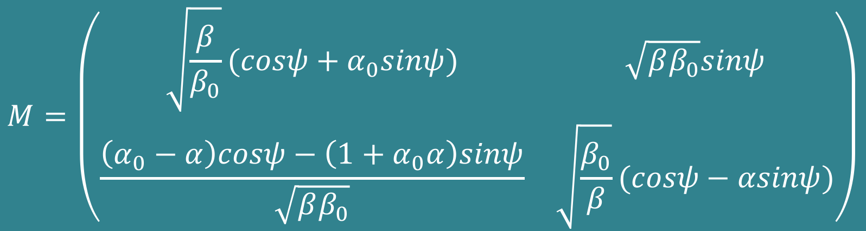
$$X_{1}=MX_{0}$$
$$M=\left(\begin{matrix}\sqrt{\frac{β}{β_{0}}}(cosψ+α_{0}sinψ) & \sqrt{ββ_{0}}sinψ \\ \frac{\left(α_{0}−α\right)cosψ−\left(1+α_{0}α\right)sinψ}{\sqrt{ββ_{0}}} & \sqrt{\frac{β_{0}}{β}}(cosψ−αsinψ)\end{matrix}\right)$$
𝛙 is the phase advance of the betatron oscillation between s₀ and s

Slide 27





Periodic lattices
Very simple, solve the matrix below for one turn, i.e. s₀=s
=1
$$M=\left(\begin{matrix}\sqrt{\frac{β}{β_{0}}}(cosψ+α_{0}sinψ) & \sqrt{ββ_{0}}sinψ \\ \frac{\left(α_{0}−α\right)cosψ−\left(1+α_{0}α\right)sinψ}{\sqrt{ββ_{0}}} & \sqrt{\frac{β_{0}}{β}}(cosψ−αsinψ)\end{matrix}\right)$$
=0
$$Mturn=\left(\begin{matrix} cosψ_{turn}+α_{s}sinψ_{turn} & β_{s}sinψ_{turn} \\ \frac{−\left(1+α_{s}^{2}\right)sinψ_{turn}}{β_{s}} & cosψ_{turn}−α_{s}sinψ_{turn}\end{matrix}\right)$$
$$ψ_{turn}=\int_{s}^{s+L}{\frac{ds}{β(s)}}$$
$$Q_{x,y}=\frac{1}{2π}\int_{s}^{s+L}{\frac{ds}{β(s)}}$$
Betatron tune
Number of oscillations per turn
$$ψ_{turn}=2πQ$$

Slide 28
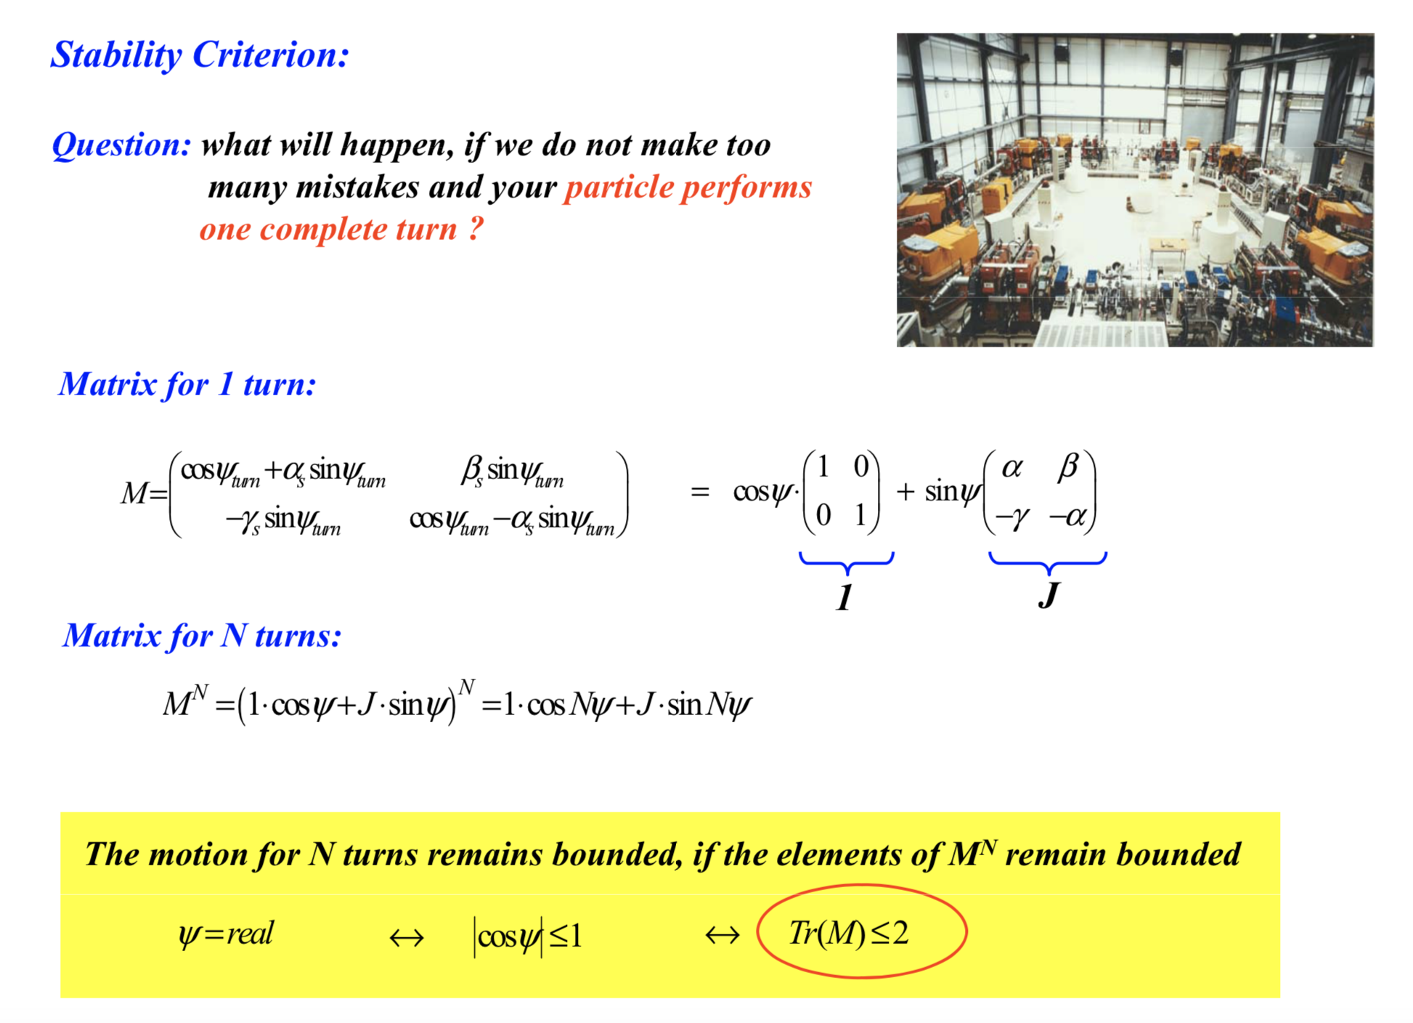

Slide 29
Spares

Slide 30
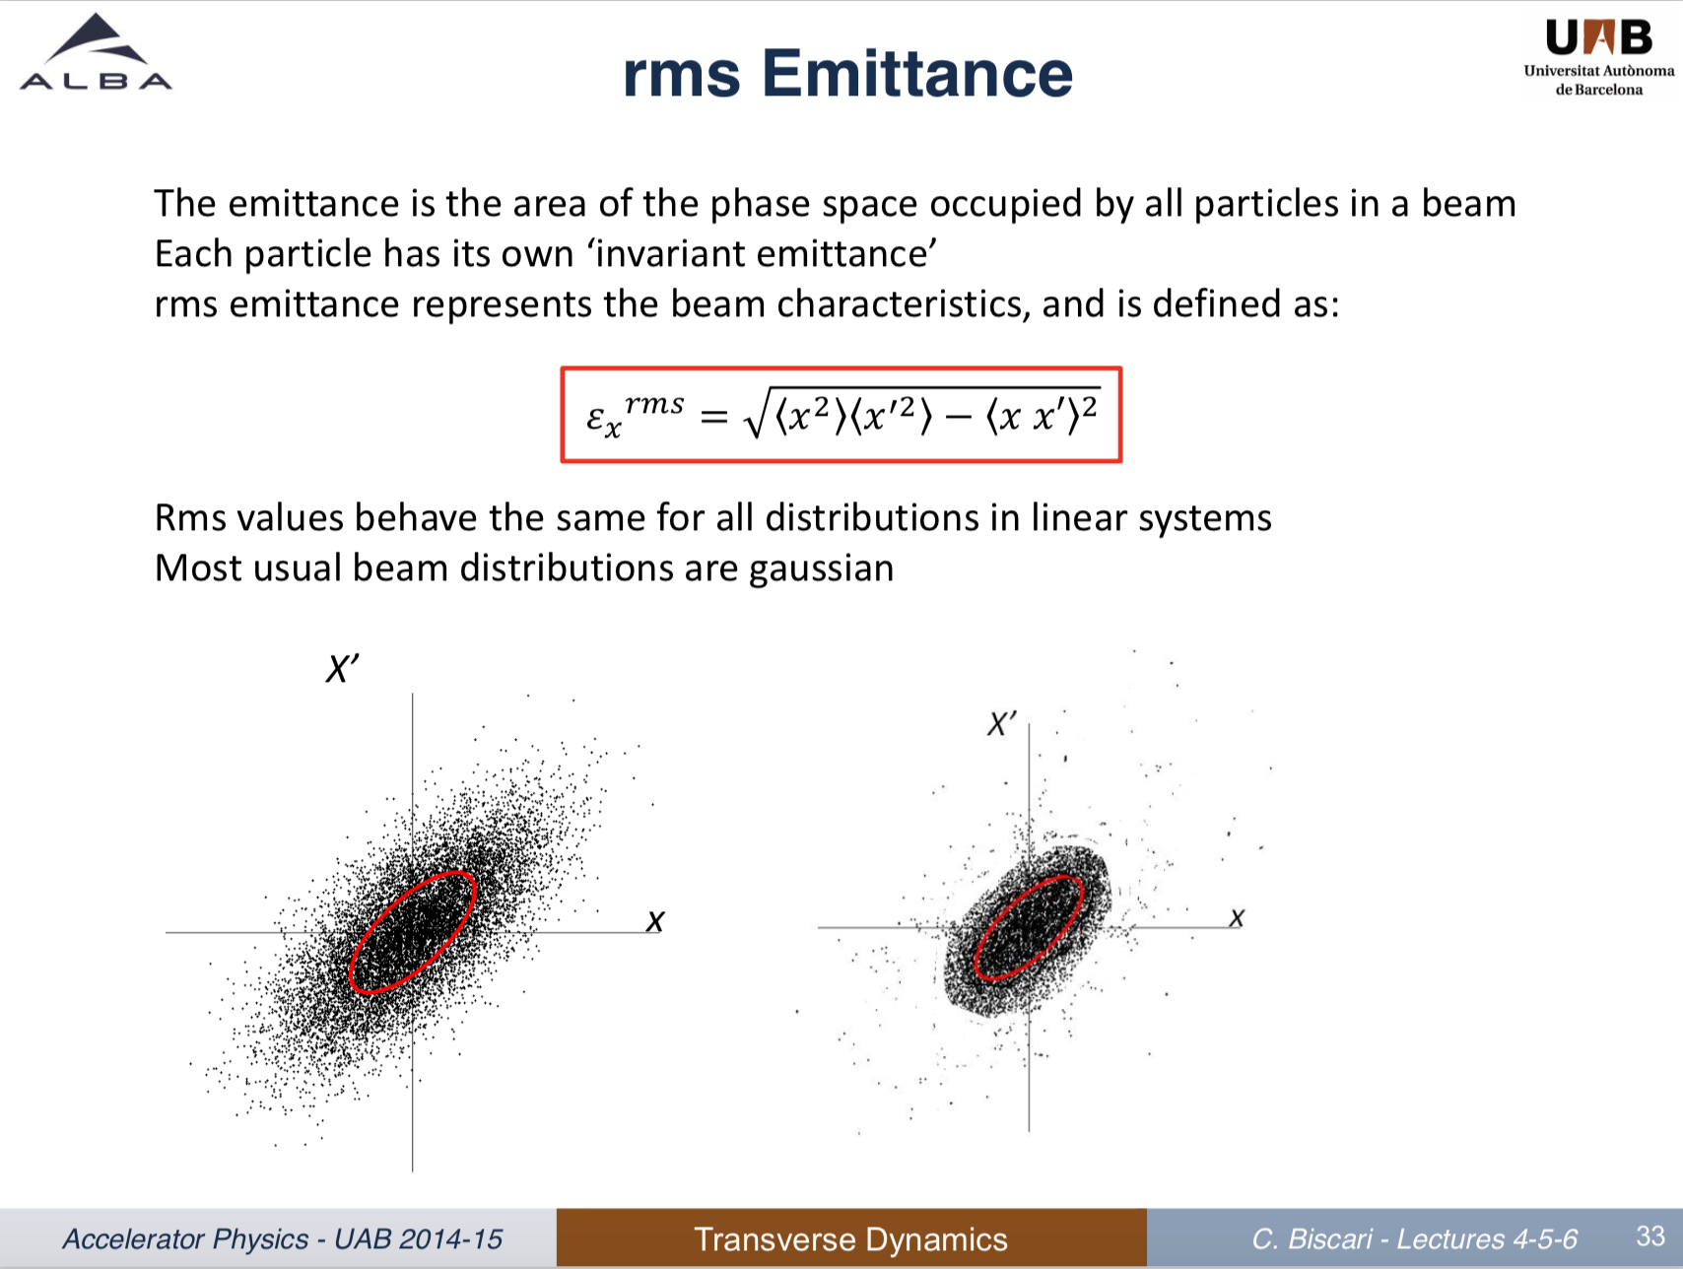

Slide 31
