Slide 1
Introduction to transverse beam dynamics IV
Restricted to the LINEAR BEAM OPTICS ➔ THE IDEAL WORLD

Slide 2
Content of the course
TBD 1
TUTO 1
Charge particle motion in a magnetic field
Equations of motion ➔ derivation and assumptions
Type of magnets
Rigidity formula
Relativistic equations
Create a storage ring with the Earth Magnetic field
TBD 2
TUTO 2
Particle trajectory
Transfer Matrices
Thin lens approximation
Betatron oscillations
Betatron tune
Dispersion
Application of transfer matrices
Thin lens
FoDo cell
TBD 3
TUTO 3
Phase space ellipse
Emittance
Beam size
Aperture
Beta function evolution
Periodic lattices
Beam size and aperture calculations
TBD 4
TUTO 4
Effect field errors
Resonances
Coupling
Chromaticity
How the tune changes from a quadrupole defect
Optimize beta beating
Orbit bumps

Slide 3
Effect of magnetic field errors on beam optics
Ideal magnets that agree with the hard-edge model cannot be built
Manufacture tolerances, not perfect pole ends, etc, produce a non-perfect magnetic field and introduce field errors
We’ll study two types of errors:
    Dipole errors ➔ Orbit distortion and emittance growth
    Quadrupole errors ➔ Orbit distortion and emittance growth
                ➔ Tune shift
                ➔ Beta beating
                ➔ Chromaticity

Slide 4


Dipole field error ➔ extra dipole kick
Assume a dipole field error of strength ∆B acting over a length l
$∆α=∆x^{′}=\frac{∆Bl}{p/q}$
In general
arc=l
𝛂
Particle trajectory in a magnetic field, B
𝛒
For small angles: arc=𝛂 x 𝛒
So the angle described by the particle is 𝛂=arc/𝛒
If we multiply and divide by B:
$α=\frac{Bl}{Bρ}$ ➔Rigidity formula ➔ $α=\frac{Bl}{p/q}$

Slide 5

Dipole field error ➔ extra dipole kick
$∆α=∆x^{′}=\frac{∆Bl}{p/q}$
If l is not too long, the disturbance can be described by a localized angular kick right in the middle of the disturbing field, i.e. l/2, and we can approximate it to a infinitesimally short field disturbance
Consider a particle travelling exactly along the orbit in front of the disturbance with the trajectory vector (x, x’) = (0, 0)

Slide 6
(x, x’) = (0, 0) ➔ this particle has, therefore, zero emittance
But immediately after the field disturbance, it travels at an angle ∆x’ w.r.t. orbit
The trajectory vector is now (0, ∆x’)
This deflection will lead to betatron oscillations as a result of the focusing elements in the lattice
And now the particle emittance is not zero but

Slide 7

And now the particle emittance is not zero but
Remember
$$γ\left(s\right)x^{2}\left(s\right)+2α\left(s\right)x\left(s\right)x^{′}\left(s\right)+β\left(s\right)x^{′2}\left(s\right)=\frac{Area}{π}=ε$$
(x=0, ∆x’)
$$β\left(s\right){∆x}^{′2}\left(s\right)=εerror$$
For a given field error, the increase in emittance is proportional to the beta function at the point of the disturbance!!!!

Slide 8
It is a fundamental property of beam optics that the effect of a field error increases with the beta function

Slide 9
Therefore, special care has to be taken when designing magnets that will be placed in regions of large beta ➔ e.g. the LHC inner triplets ➔ very very high quality magnets (with collision optics beta = 4.5 km) ➔ very very expensive
In circular accelerators the beam passes over and over again through the same disturbance and it is deflected with the same angle each time
After many revolutions a stable equilibrium is established resulting in a new distorted orbit ➔ a static betatron oscillation about the unperturbed ideal orbit, with a phase or angular shift as follows
x’-∆x’
x’
x
∆x’
distorted orbit
x
Ideal orbit
s0
s

Slide 10

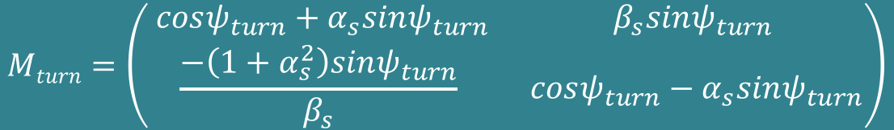
In equilibrium the perturbed orbit has a displacement x from the ideal orbit at s₀
The angle right before de perturbation is x’-∆x’, and x’ after the perturbation
Hence at s₀ the vector trajectory is (x,x’)
After one revolution the particle passes again through the same disturbance and arrives with a trajectory vector (x, x’-∆x’), the distorted orbit can be evolved using
x’-∆x’
x’
x
∆x’
distorted orbit
x
Ideal orbit
s
s0
(TBD 3)
$$Mturn=\left(\begin{matrix} cosψ_{turn}+α_{s}sinψ_{turn} & β_{s}sinψ_{turn} \\ \frac{−\left(1+α_{s}^{2}\right)sinψ_{turn}}{β_{s}} & cosψ_{turn}−α_{s}sinψ_{turn}\end{matrix}\right)$$
$$\left(\begin{matrix}x \\ \text{x}\text{’−∆}\text{x}\text{’}\end{matrix}\right)=M_{turn}\left(\begin{matrix}x \\ x′\end{matrix}\right)$$

Slide 11



$ψ_{turn}=2πQ$
Because of the periodicity condition the beta function and its derivative are the same at the beginning and end of a revolution
$$Mturn=\left(\begin{matrix} cos2πQ+α(s_{0})sin2πQ & β(s_{0})sin2πQ \\ −γ\left(s_{0}\right)sin2πQ & cos2πQ−α(s_{0})sin2πQ\end{matrix}\right)$$
Putting this matrix in the equation of the trajectory, we get for x and x’
$$x=∆x^{′}\frac{β(s_{0})}{2tanπQ}$$
Distorted orbit at any point, s, around the ring
$$x′=\frac{∆x^{′}}{2}\left(1−\frac{α(s_{0})}{tanπQ}\right)$$
For integer tunes the orbit distortion grows without bound ➔ INTEGER RESONANCES
Don’t design your accelerator with an integer tune

Slide 12
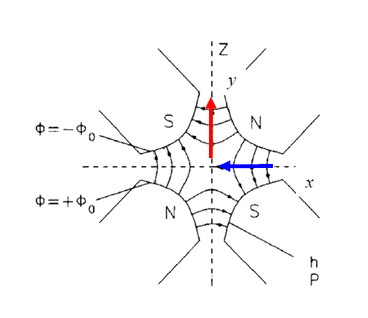
Effect of quadrupole field errors
The simplest case of a quadrupole field error is a transverse misalignment
Horizontal focusing quadrupole
Magnetic field
y
∆y
Magnet axis
Beam axis
∆x

Slide 13




$${\frac{q}{p}B}_{y}\left(s\right)= {\frac{q}{p}B}_{y0}+\frac{q}{p}\frac{dB_{y}}{dx}x+\frac{1}{2!}\frac{q}{p}\frac{d^{2}B_{y}}{dx^{2}}x^{2}+\frac{1}{3!}\frac{q}{p}\frac{d^{3}B_{y}}{{dx}^{3}}x^{3}+…$$
For a quadrupole with a gradient $g=\frac{∂B_{y}}{∂x}$
At the point where the error is located, there is the following error field
$$\left(\begin{matrix}∆B_{x} \\ ∆B_{y}\end{matrix}\right)=g\left(\begin{matrix}∆y \\ ∆x\end{matrix}\right)$$
This leads to a deflection in both planes of ➔
$∆α=∆x^{′}=\frac{∆Bl}{p/q}$
(slide 5)
$$\left(\begin{matrix}∆x′ \\ ∆y′\end{matrix}\right)=\frac{q}{p}l\left(\begin{matrix}∆B_{y} \\ ∆B_{x}\end{matrix}\right)=\frac{q}{p}gl\left(\begin{matrix}∆x \\ ∆y\end{matrix}\right)=kl\left(\begin{matrix}∆x \\ ∆y\end{matrix}\right)$$

Slide 14



This leads to a deflection in both planes of
$$\left(\begin{matrix}∆x′ \\ ∆y′\end{matrix}\right)=\frac{q}{p}l\left(\begin{matrix}∆B_{y} \\ ∆B_{x}\end{matrix}\right)=\frac{q}{p}gl\left(\begin{matrix}∆x \\ ∆y\end{matrix}\right)=kl\left(\begin{matrix}∆x \\ ∆y\end{matrix}\right)$$
Like a dipole field error, this misalignment causes an angular deflection of the trajectory in both planes
Therefore we have an orbit distortion that can be calculated
$$x=∆x^{′}\frac{β(s_{0})}{2tanπQ}$$
(And the equivalent equation for the y plane)
The orbit distortion is proportional to the size of the misalignment (∆x, ∆y) and the beta function at the quadrupole position
$$x′=\frac{∆x^{′}}{2}\left(1−\frac{α(s_{0})}{tanπQ}\right)$$

Slide 15
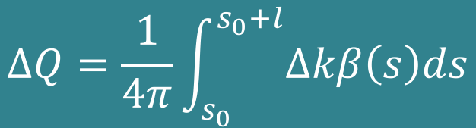

Quadrupole error: tune shift
A quadrupole misalignment gives an orbit distortion
What about an error in the quadrupole field?
  It changes the focusing properties and therefore the beta function and therefore it changes the tune
  It can be demonstrated (K. Wille page 116-118) that the tune shift due to a quadrupole of finite length l with a very small gradient error ∆k is
$∆Q$ is proportional to the 𝜷-function at the quadrupole
Field quality, power supply tolerances, etc are much tighter at places where the 𝜷-function is large: mini-beta quads 𝜷≈km, arc quads 𝜷≈ m
𝜷 is a measure for the sensitivity of the beam
$$∆Q=\frac{1}{4π}\int_{s_{0}}^{s_{0}+l}{∆kβ\left(s\right)ds}$$

Slide 16
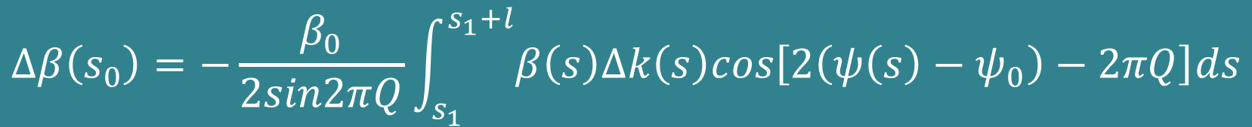
Quadrupole error: beta beat
On top of generating a tune shift, a quadrupole error changes the beta function (demonstration K. Wille pages 118-120)
$$∆β\left(s_{0}\right)=−\frac{β_{0}}{2sin2πQ}\int_{s_{1}}^{s_{1}+l}{β\left(s\right)∆k\left(s\right)cos\left[2\left(ψ\left(s\right)−ψ_{0}\right)−2πQ\right]ds}$$
We see that ∆𝛃 grows without bounds if sin2𝛑Q ➔0
The tune must NOT HAVE INTEGER OR HALF-INTEGER values
Unlimited growth of 𝛃 ➔ unlimited growth of beam size ➔ beam losses
s₀
observation
𝛙
s₁
distortion

Slide 17
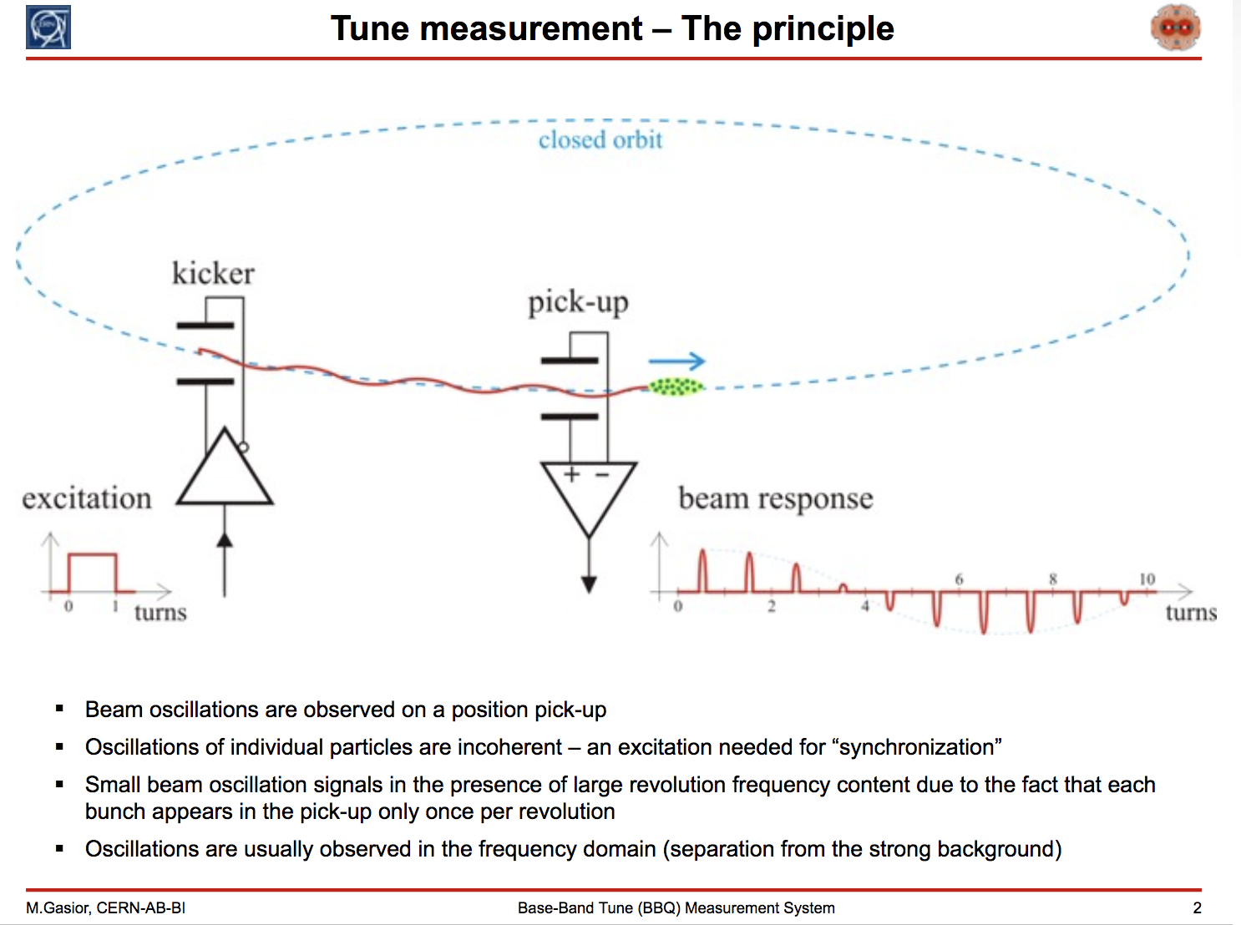
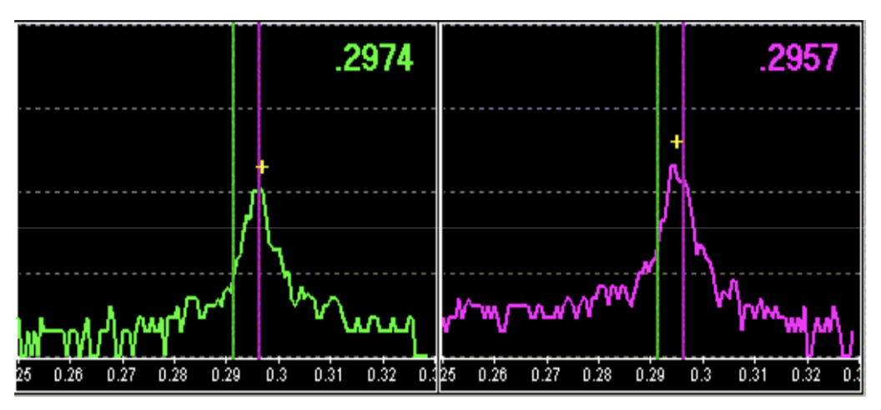
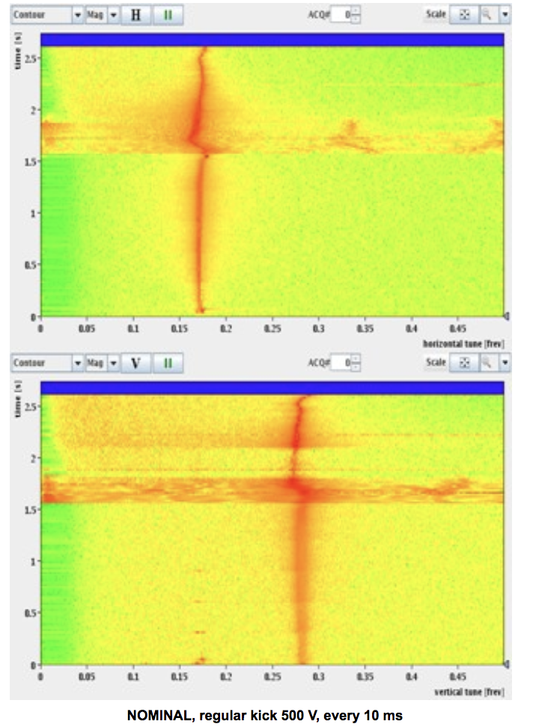
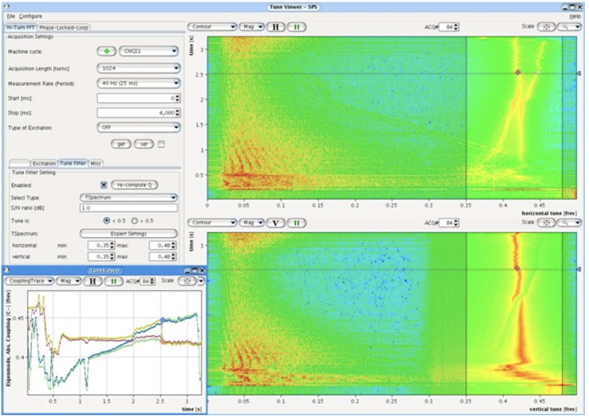
Tune measurement examples
HERA Q_{H}
HERA Q_{V}
LEIR
SPS
LHC

Slide 18
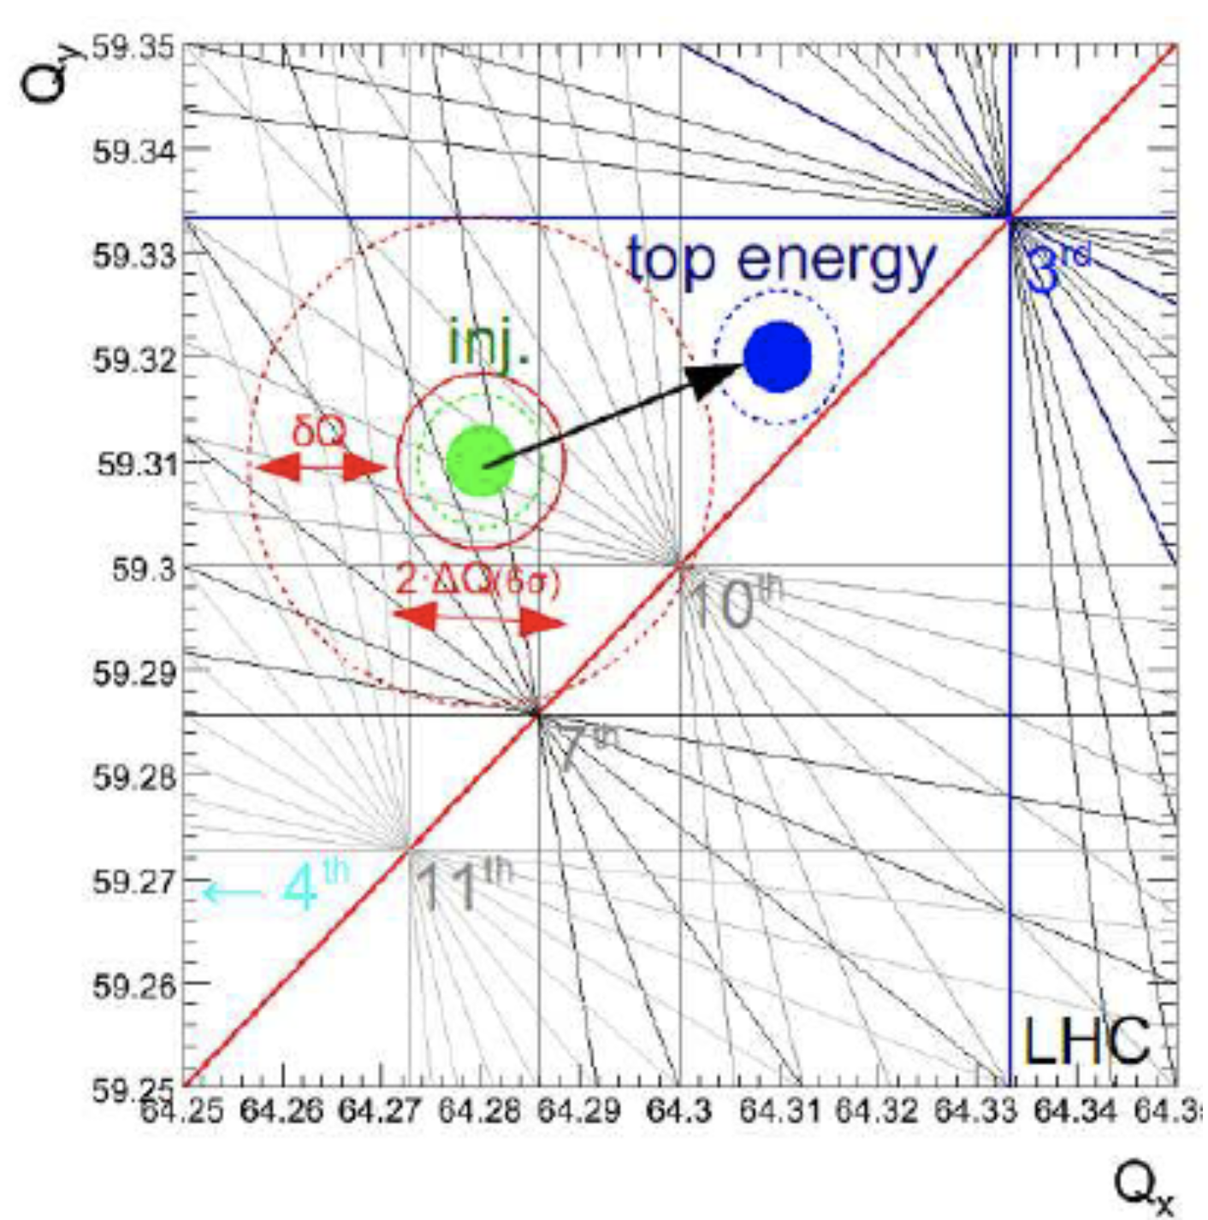
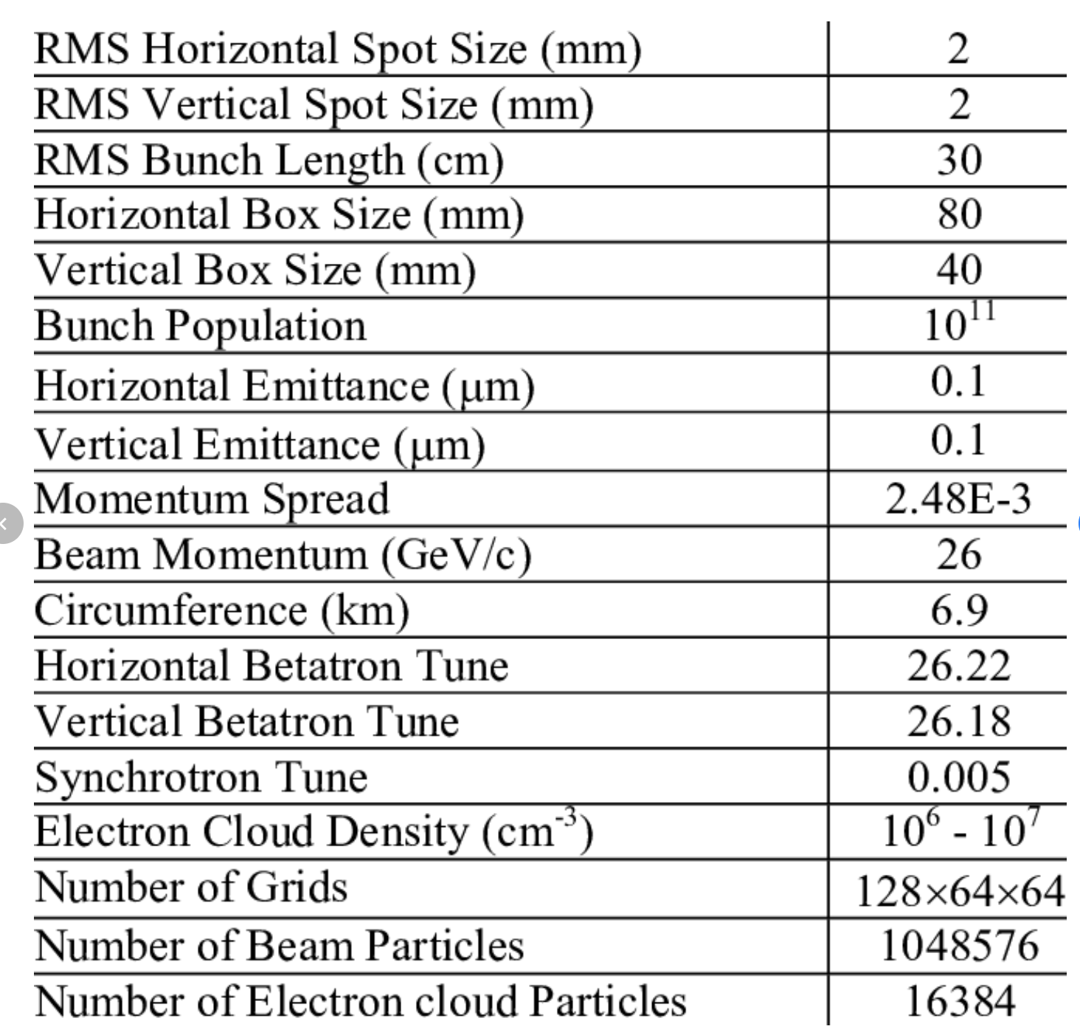
LHC tune diagram
SPS LHC protons parameters

Slide 19
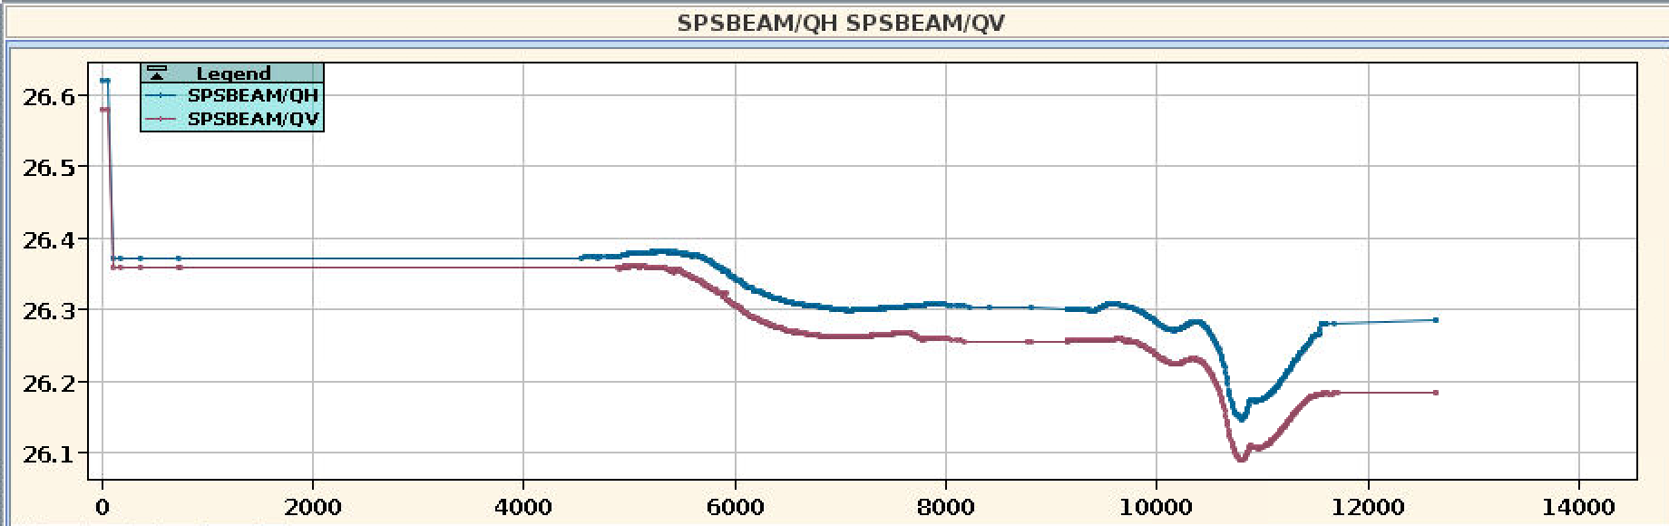
SPS LHC ions parameters with slip-stacking
Slip-stacking plateau
Ramp to 300 GeV
Ramp to 450 GeV
Injection plateau
Qh=26.3722
Qv=26.3591

Slide 20
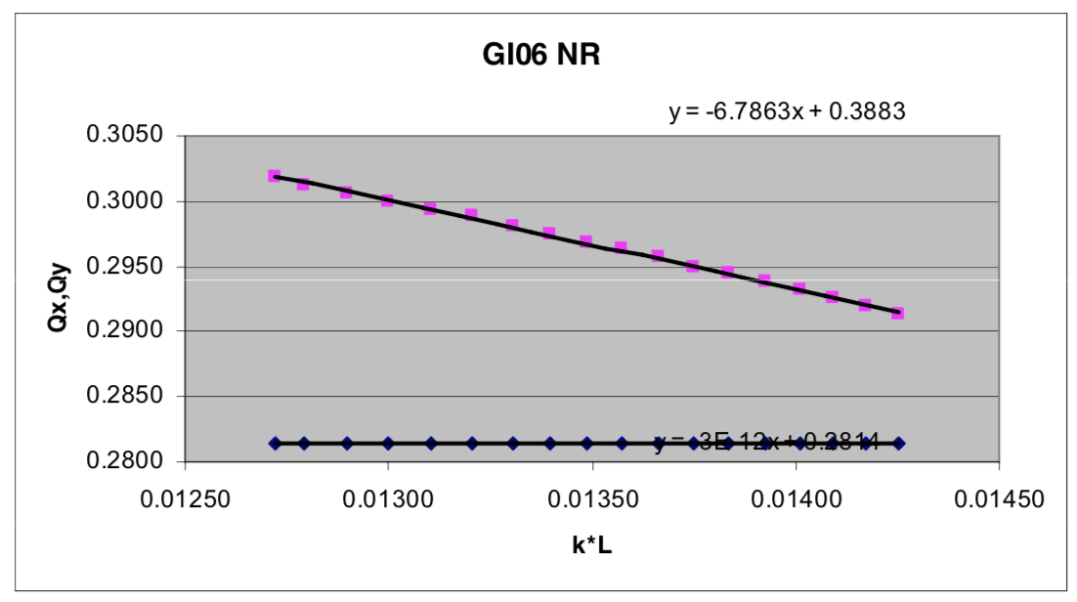
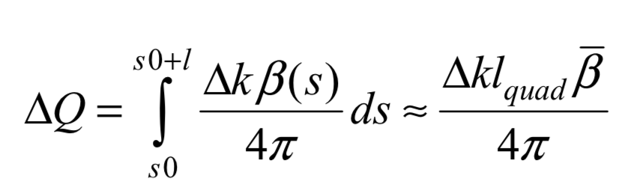
How could we measure the beta function?

Slide 21
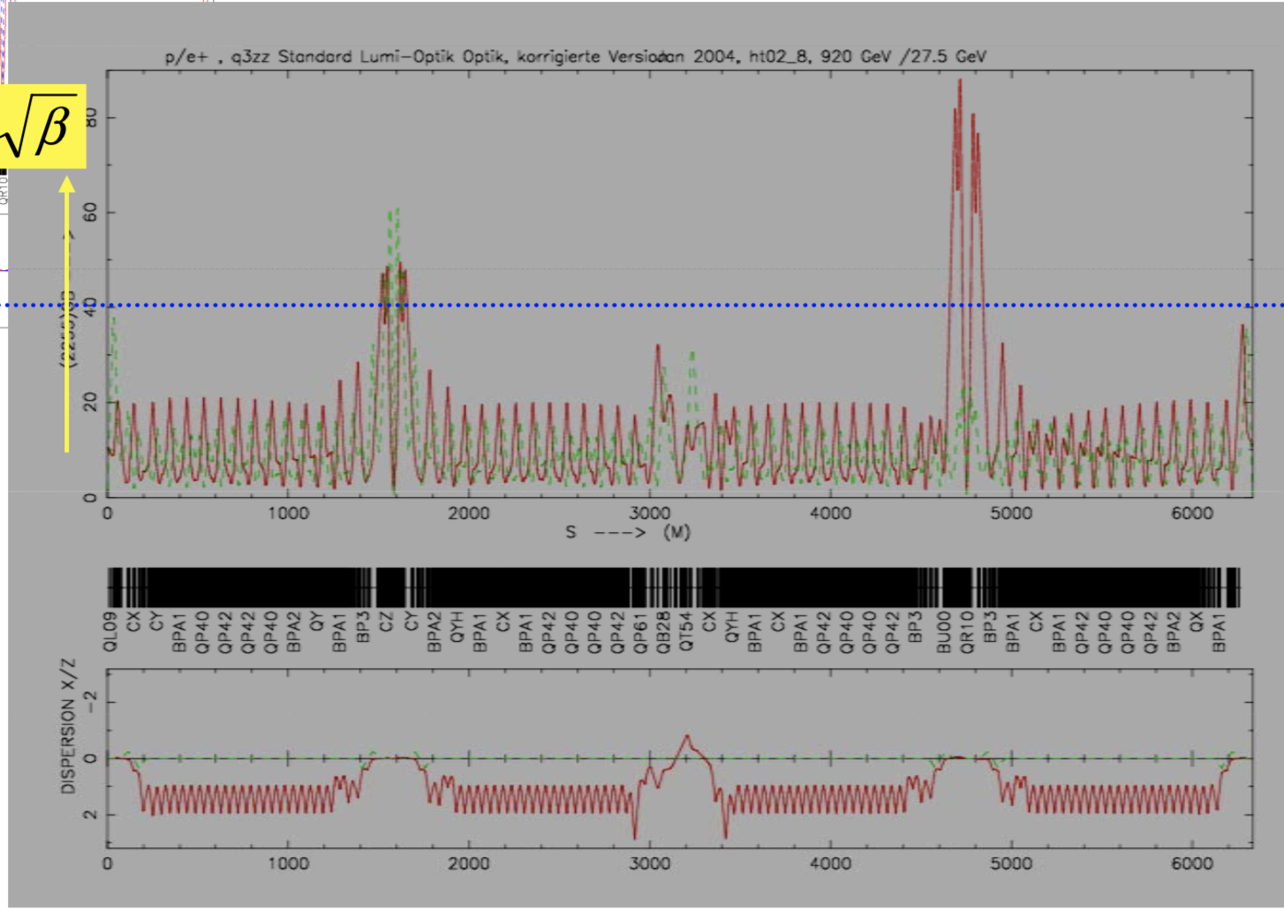
Examples of beta beat measurements
Green model beta
Red measured beta

Slide 22
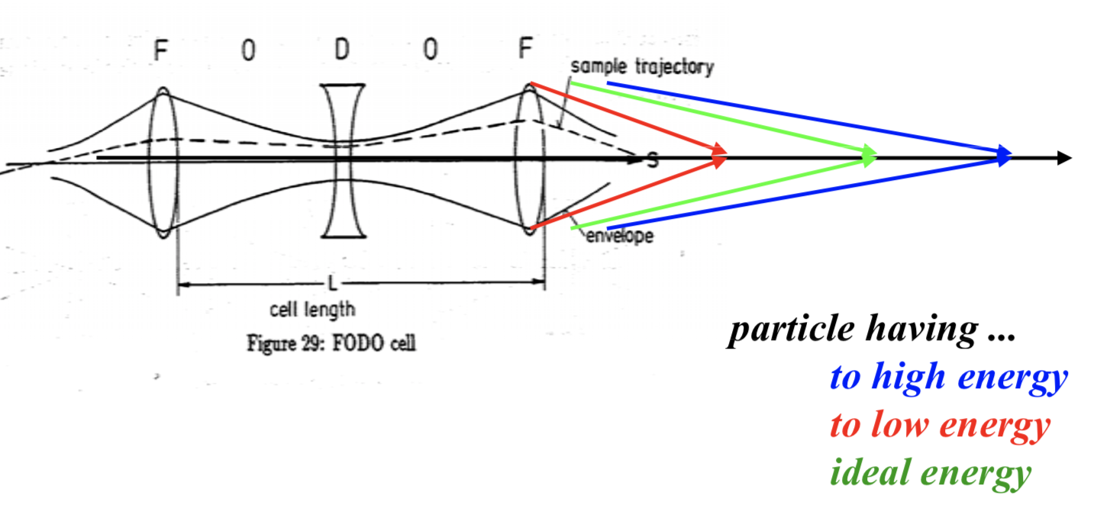

Quadrupole error: chromaticity
A quadrupole error when $\frac{∆p}{p}≠0$ is called CHROMATICITY
$$k=\frac{G}{p/q}$$

Slide 23






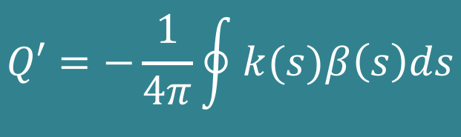

In case of momentum spread:
$$p=p_{o}+∆p$$
$$k=\frac{qG}{p_{o}+∆p }≈\frac{qG}{p_{o}}\left(1−\frac{∆p}{p}\right)=k_{o}+∆k$$
$$∆k=−k_{o}\frac{∆p}{p_{o}}$$
$$=k_{o}$$
$∆k$ acts as a quadrupole error in the machine and leads to a tune spread:
$$∆Q=\frac{1}{4π}\int_{s_{0}}^{s_{0}+l}{∆kβ\left(s\right)ds}$$
$$∆Q=−\frac{1}{4π}\int_{s_{0}}^{s_{0}+l}{k_{o}\frac{∆p}{p_{o}}β\left(s\right)ds}$$
Definition of chromaticity:
$$∆Q=Q′\frac{∆p}{p_{o}}$$
$$Q′=−\frac{1}{4π}\oint{k(s)β\left(s\right)ds}$$

Slide 24
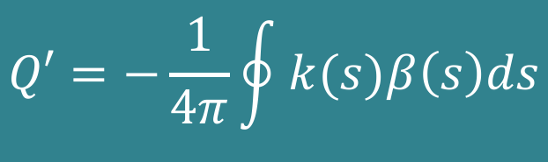
$$Q′=−\frac{1}{4π}\oint{k(s)β\left(s\right)ds}$$
Natural chromaticity
Chromaticity is generated by the lattice itself!!!
Q’ is a number indicating the size of the tune spot in the tune diagram
Q’ is always created if the beam is focused ➔ is determined by the focusing strength k of all quadrupoles
Because due to chromaticity the tune spot is a pancake, some particles get close to resonances and are lost

Slide 25
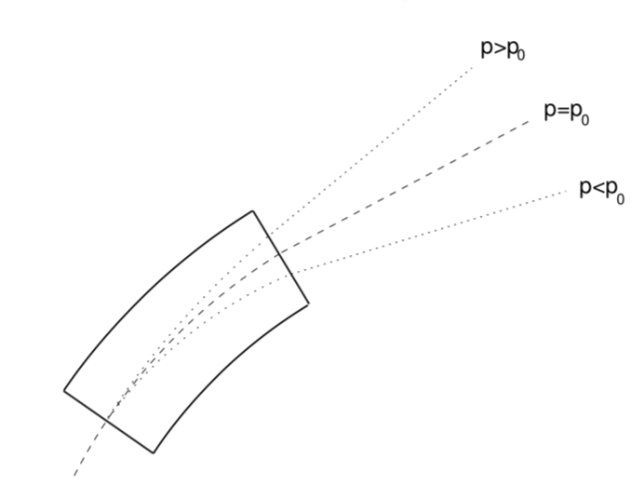


Chromaticity correction
We need to sort the particles as a function of the momentum:
We need additional quadrupole strength for each momentum deviation: $\frac{∆p}{p_{o}}$
$$x_{D}\left(s\right)=D(s)\frac{∆p}{p_{o}}$$
We have to apply a magnetic field that raises quadratically with increasing x ➔ sextupole

Slide 26
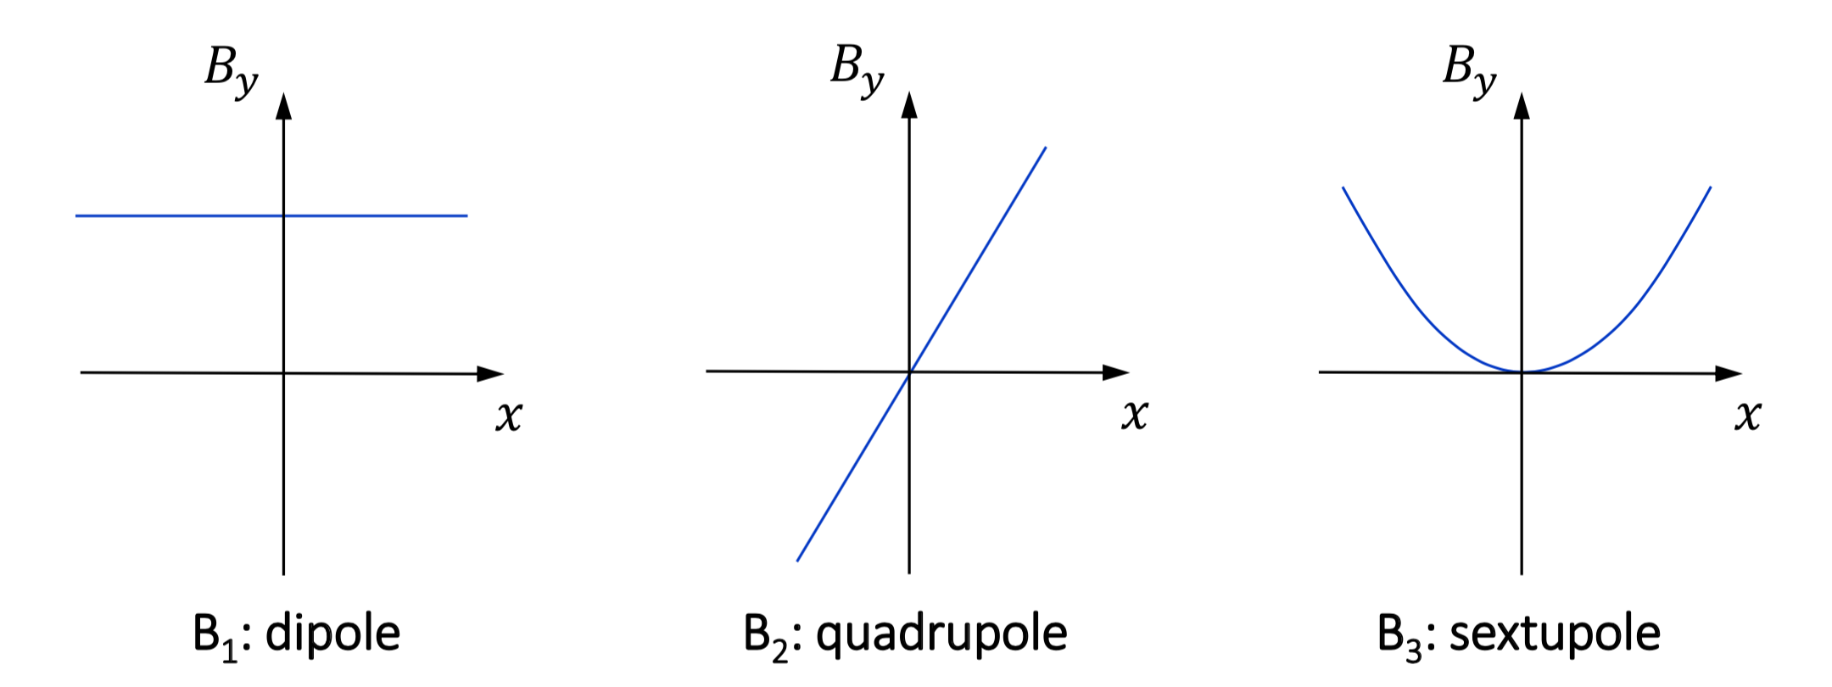



Type of magnets
$${\frac{q}{p}B}_{y}\left(s\right)= {\frac{q}{p}B}_{y0}+\frac{q}{p}\frac{dB_{y}}{dx}x+\frac{1}{2!}\frac{q}{p}\frac{d^{2}B_{y}}{dx^{2}}x^{2}+\frac{1}{3!}\frac{q}{p}\frac{d^{3}B_{y}}{{dx}^{3}}x^{3}+…$$
$$k_{0}=\frac{1}{ρ}=\frac{B}{Bρ}\left(\frac{1}{m}\right)$$
$$k_{1}=\frac{q}{p}\frac{dB_{y}}{dx}=\frac{1}{Bρ}\frac{dB_{y}}{dx}=\frac{1}{Bρ}g\left(\frac{1}{m^{2}}\right)$$
$$k_{2}=\frac{q}{p}\frac{d^{2}B_{y}}{dx^{2}}=\frac{1}{Bρ}\frac{d^{2}B_{y}}{dx^{2}}\left(\frac{1}{m^{3}}\right)$$

Slide 27
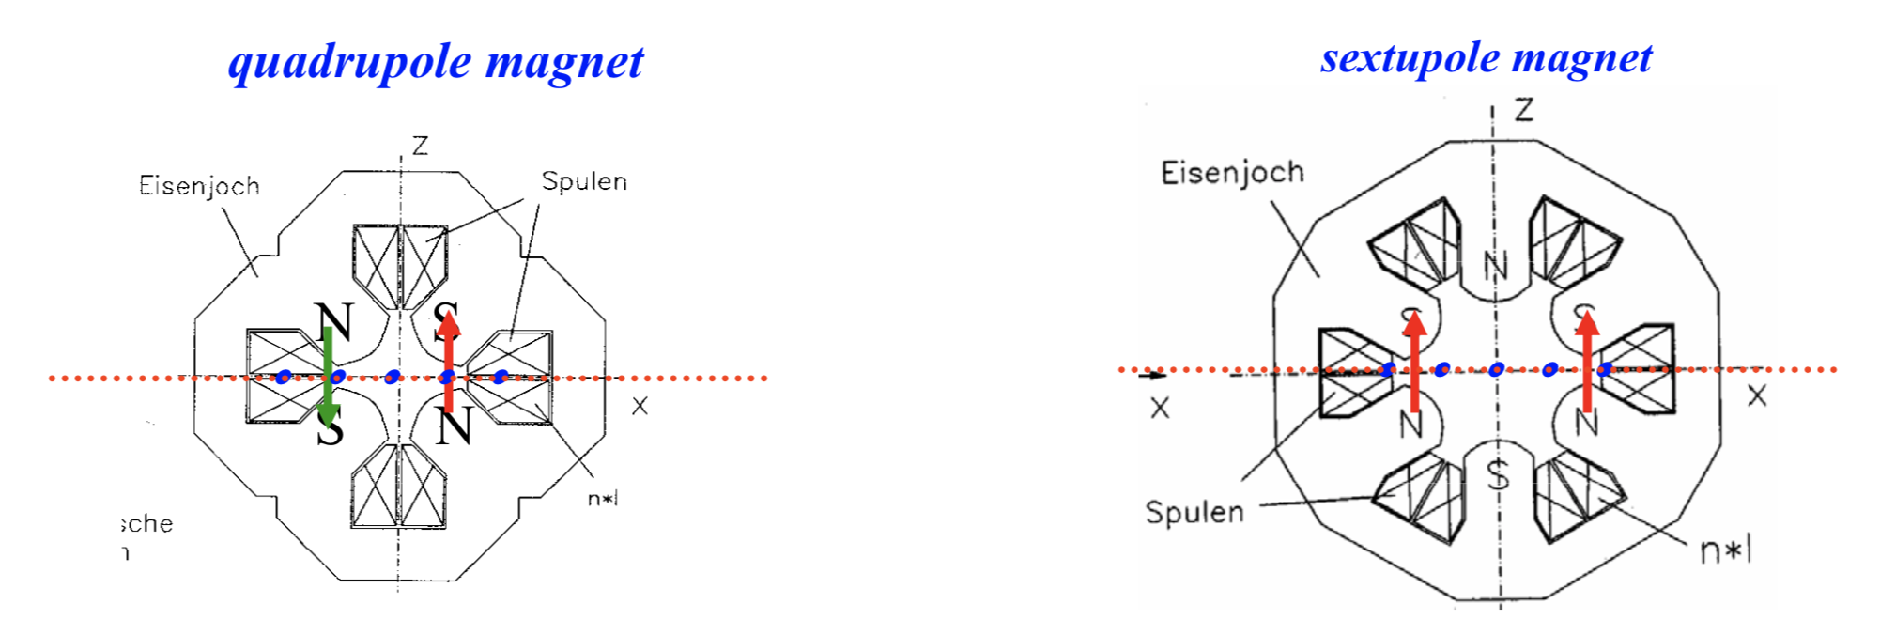
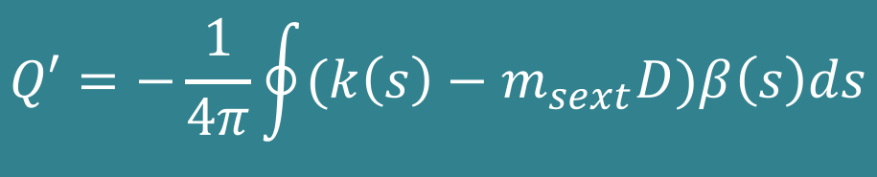

Normalized quadrupole strength for a sextupole:
$$k_{sext}=\frac{q}{p}\tilde{g}x=m_{sext}x=m_{sext}D\frac{∆p}{p_{o}}$$
$$Q′=−\frac{1}{4π}\oint{(k\left(s\right)−m_{sext}D)β\left(s\right)ds}$$
Corrected chromaticity
p<po
p>po
p<po
p>po

Slide 28
Resonances

Slide 29


x
1st turn
$$ψ_{turn}=2πQ$$
1
Q=1.25
2nd turn
L
s
After a certain number of turns around the machine the phase advance of the betatron oscillation is such that the oscillation repeats itself.
4th turn
-1
3rd turn
x’
(0,1)
Q=1.25 ➔ q (fractional tune) = 0.25
(-1,0)
x
(1,0)
4x0.25=1
(0,-1)

Slide 30

Resonances
Third order resonance betatron oscillation
Let’s have now a tune of Q=3.333 (3Q=10) ➔ q=0.333 ➔ Q=$\frac{ψturn}{2π}$
y
$$ψ_{turn}=2π∙0.33=2.0923={120}^{0}$$
The betatron oscillation will repeat itself after 3 turns = 3x120⁰=360⁰
0
2π
2nd turn
This could also be achieve by Q=2.333 ➔ 3Q=7
3rd turn
The order of the resonance is defined as:
n x Q = integer
1st turn
2πq = 2π/3

Slide 31
Dipole (deflection independent of position)
y’β
x’β
x’β
Q = 2.00
1st turn
Q = 2.50
2nd turn
x
x
3rd turn
For Q = 2.00: Oscillation induced by the dipole kick grows on each turn and the particle is lost (1st order resonance Q = 2).
For Q = 2.50: Oscillation is cancelled out every second turn, and therefore the particle motion is stable.

Slide 32
Quadrupole (deflection ∝ position)
Q = 2.50
Q = 2.33
1st turn
Q = 2.33
2nd turn
3rd turn
4th turn
For Q = 2.50: Oscillation induced by the quadrupole kick grows on each turn and the particle is lost
(2nd order resonance 2Q = 5)
For Q = 2.33: Oscillation is cancelled out every third turn, and therefore the particle motion is stable.

Slide 33
Sextupole (deflection ∝ position²)
Q = 2.33
1st turn
Q = 2.25
2nd turn
3rd turn
4th turn
5th turn
For Q = 2.33: Oscillation induced by the sextupole kick grows on each turn and the particle is lost
(3rd order resonance 3Q = 7)
For Q = 2.25: Oscillation is cancelled out every fourth turn, and therefore the particle motion is stable.

Slide 34
Resonance summary
Quadrupoles excite 2nd order resonances
Sextupoles excite 1st and 3rd order resonances
Octupoles excite 2nd and 4th order resonances
This is true for small amplitude particles and low strength excitations
However, for stronger excitations sextupoles will excite higher order resonance’s (non-linear)

Slide 35
Coupling
Coupling is a phenomena, which converts betatron motion from one plane (horizontal or vertical) into motion in the other plane.
Fields that will excite coupling are:
  Skew quadrupoles, which are normal quadrupoles, but tilted by 45º about it’s longitudinal axis.
  Solenoidal (longitudinal magnetic field)

Slide 36
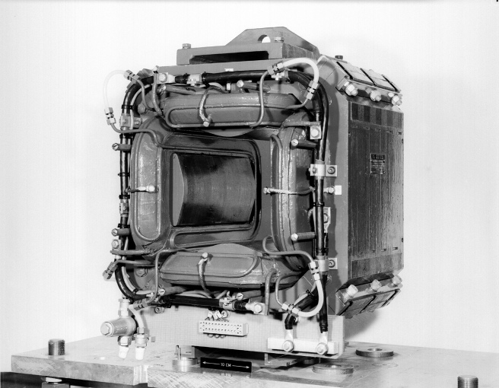
Skew Quadrupole
Magnetic field
S
N
N
Like a normal quadrupole, but then tilted by 45º
S

Slide 37
Solenoid; longitudinal field (2)
Particle trajectory
Magnetic field
Beam axis
Transverse velocity component

Slide 38
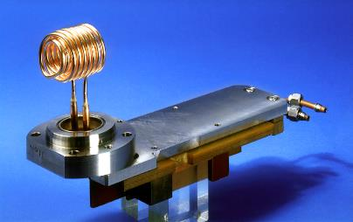
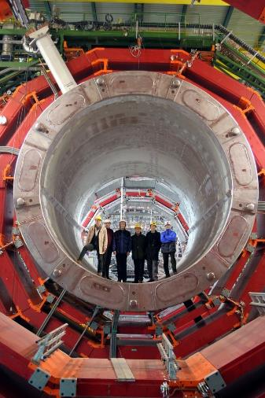
Solenoid; longitudinal field (2)
Above:
The LPI solenoid that was used for the initial focusing of the positrons.
It was pulsed with a current of 6 kA for some 7 υs, it produced a longitudinal magnetic field of 1.5 T.
At the right:
The somewhat bigger CMS solenoid

Slide 39
Coupling and Resonance
This coupling means that one can transfer oscillation energy from one transverse plane to the other.
Exactly as for linear resonances there are resonant conditions.
If we meet one of these conditions the transverse oscillation amplitude will again grow in an uncontrolled way.
nQ_{h} ± mQ_{v} = integer

Slide 40
A mechanical equivalent
A beautiful demonstration of how energy can be transferred from one oscillator to another is provided by two weakly coupled pendulums
We can transfer oscillation energy from one pendulum to the other depending on the strength ‘k’ of the spring

Slide 41
General tune diagram
2Q_{v} =5
Q_{v}
Q_{h} - Q_{v}= 0
2.75
2.5
4Q_{h} =11
2.25
2
2 2.25 2.5 2.75
Q_{h}
4Q=9
2.33
2.66

Slide 42
Realistic tune diagram
injection
During acceleration we change the horizontal and vertical tune
to a place where the beam is the least influenced by resonances.
ejection

Slide 43
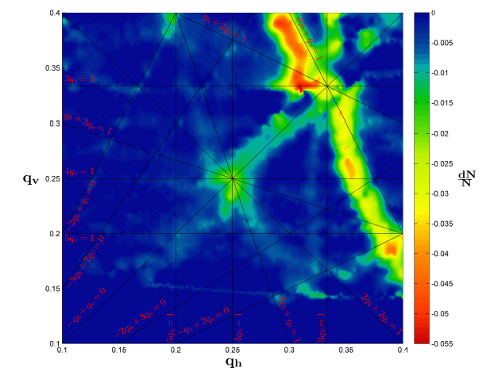
Measured tune diagram
Move a large emittance beam around in this tune diagram and measure the beam losses.
Not all resonance lines are harmful.

Slide 44
Conclusion
There are many things in our machine, which will excite resonances:
  The magnets themselves
  Unwanted higher order field components in our magnets
  Tilted magnets
  Experimental solenoids (LHC experiments)
The trick is to reduce and compensate these effects as much as possible and then find some point in the tune diagram where the beam is stable.

