Slide 1
Introduction to transverse beam dynamics I
Restricted to the LINEAR BEAM OPTICS ➔ THE IDEAL WORLD

Slide 2
Content of the course
TBD 1
TUTO 1
Charge particle motion in a magnetic field
Equations of motion ➔ derivation and assumptions
Type of magnets
Rigidity formula
Relativistic equations
Create a storage ring with the Earth Magnetic field
TBD 2
TUTO 2
Particle trajectory
Transfer Matrices
Thin lens approximation
Betatron oscillations
Betatron tune
Dispersion
Application of transfer matrices
Thin lens
FoDo cell
TBD 3
TUTO 3
Phase space ellipse
Emittance
Beam size
Aperture
Beta function evolution
Periodic lattices
Beam size and aperture calculations
TBD 4
TUTO 4
Effect field errors
Resonances
Coupling
Chromaticity
How the tune changes from a quadrupole defect
Optimize beta beating
Orbit bumps

Slide 3
Charge particle motion in a magnetic field
When we build an accelerator or storage ring, the NOMINAL TRAJECTORY of the particle BEAM is FIXED by design
The trajectory is a straight line if it is a linear accelerator, or very complicated shape if it is a circular accelerator
The BEAM follows the resulting CLOSED PATH over and over again
In LHC, 27 km circumference, the beams travel close to the speed of light for ~ 12 hours ➔ Do you have an idea of how many kilometers the beams travel?????

Slide 4
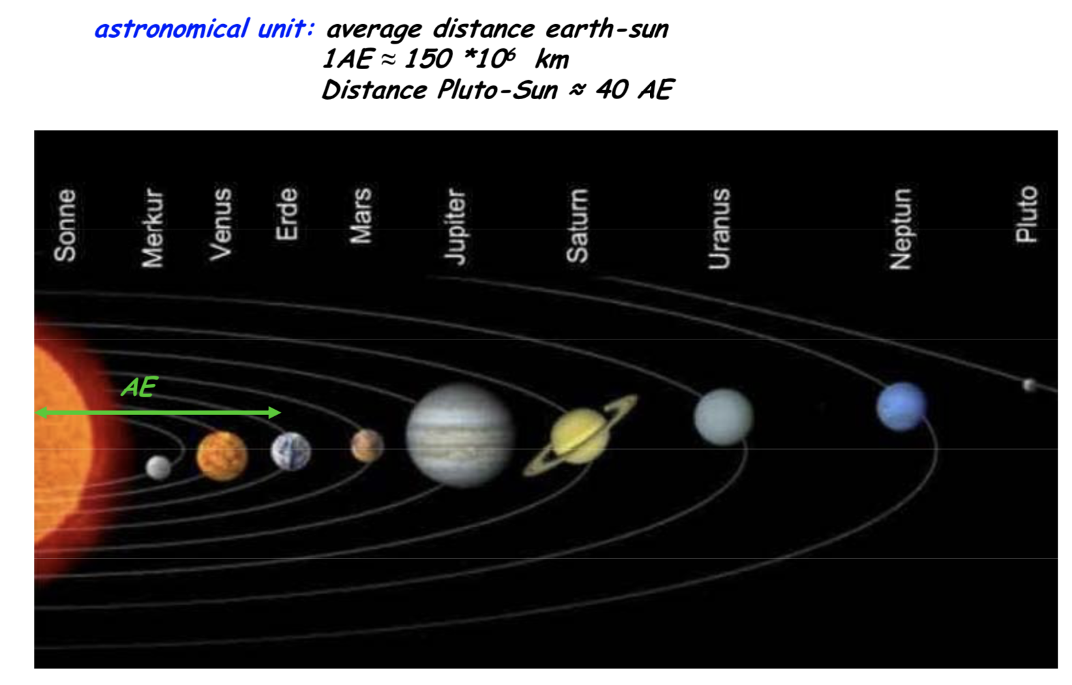
Velocity of protons in LHC ≈ 300000 km/s
12 hours circulating = 43200 s
L= v∙t ≈ 1.2 10¹⁰ km ≈ 86 AE

Slide 5
The TRAJECTORIES of INDIVIDUAL PARTICLES in the beam always have a certain angular divergence, and without further measures, they would finally hit the wall of the vacuum chamber
Therefore, the steps to follow are:
  Fix the NOMINAL trajectory
  Steer the divergent particles back to the NOMINAL trajectory
To steer the particles we usually use MAGNETS ➔ why?

Slide 6

Lorentz Force
$$v≈c≈3x{10}^{8}m/s$$
Typical velocity in high energy machines
At relativistic energies, the electric field and the magnetic field have the same effect if:
For B = 1 T = 1 Vs/m² and c = 3x10⁸ m/s ➔ E = 3x10⁸ V/m = 300 MV/m
The maximum achievable electric gradients with RF cavities technologies are ~ 100 MV/m
Seminar: Plasma Wake Accelerators ➔ achievable electric gradients > 100 000 MV/m

Slide 7
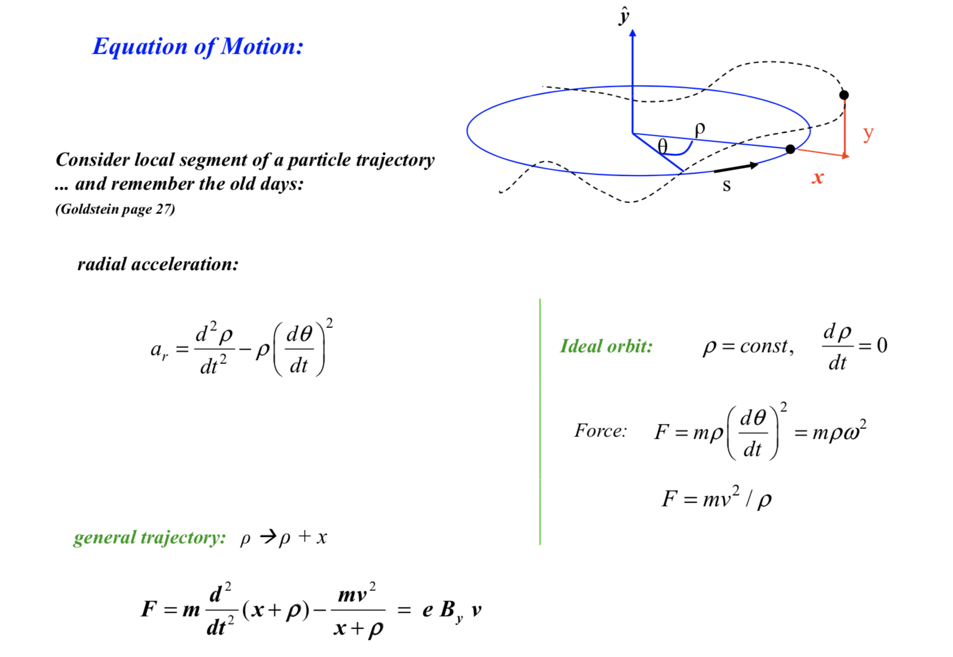
To describe the motion of a particle in the vicinity of the NOMINAL trajectory we use a Cartesian coordinate system K = (x,y,s) whose origin moves along the trajectory of the beam
For simplicity we assume:
  particles only move along the s direction: v = (0, 0, v_{s})
  The magnetic field only has transverse components: B = (B_{x}, B_{y}, 0)
NOMINAL trajectory
REAL trajectory

Slide 8
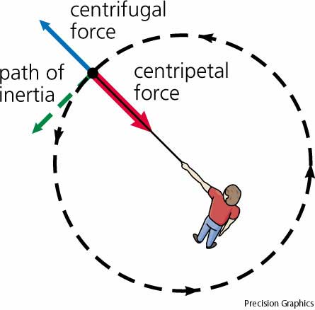



For a particle moving in the horizontal plane through the magnetic field there is a balance between the Lorentz force and the centrifugal force
$$q∙v_{s}∙B_{y}=\frac{m∙v_{s}^{2}}{ρ}$$
Lorentz force
$$p=m∙v$$
B
$$B_{y}ρ=\frac{p_{s}}{q}$$
Mechanical equivalent
Mechanical equivalent
Beam rigidity formula

Slide 9
Since the beam dimensions and beam displacement around the NOMINAL trajectory are usually much smaller than the curvature radius (e.g. LHC beam size ~ 1 mm to few 𝜇m, and the beam excursions around the NOMINAL orbit are of ~ 2 mm, while LHC curvature radius ~ 2.8 km) we can expand the magnetic field in the vicinity of the NOMINAL trajectory:

Slide 10

Multiplying by q/p:
$${\frac{q}{p}B}_{y}\left(s\right)= {\frac{q}{p}B}_{y0}+\frac{q}{p}\frac{dB_{y}}{dx}x+\frac{1}{2!}\frac{q}{p}\frac{d^{2}B_{y}}{dx^{2}}x^{2}+\frac{1}{3!}\frac{q}{p}\frac{d^{3}B_{y}}{{dx}^{3}}x^{3}+…$$
$${\frac{q}{p}B}_{y}\left(s\right)= \frac{1}{ρ}+kx+\frac{1}{2!}mx^{2}+\frac{1}{3!}ox^{3}+…$$
QUADRUPOLE
OCTUPOLE
DIPOLE
SEXTUPOLE

Slide 11

$${\frac{q}{p}B}_{y}\left(s\right)= \frac{1}{ρ}+kx+\frac{1}{2!}mx^{2}+\frac{1}{3!}ox^{3}+…$$
QUADRUPOLE
OCTUPOLE
DIPOLE
SEXTUPOLE
The magnetic field around the beam is a sum of multipoles;
each one has a different effect on the particles
High amplitude oscillation damping and field errors compensation
Beam steering
Beam focusing
LINEAR BEAM OPTICS
ONLY LINEAR TERMS ARE TAKEN INTO ACCOUNT
Chromaticity compensation

Slide 12
Equations of motion

Slide 13
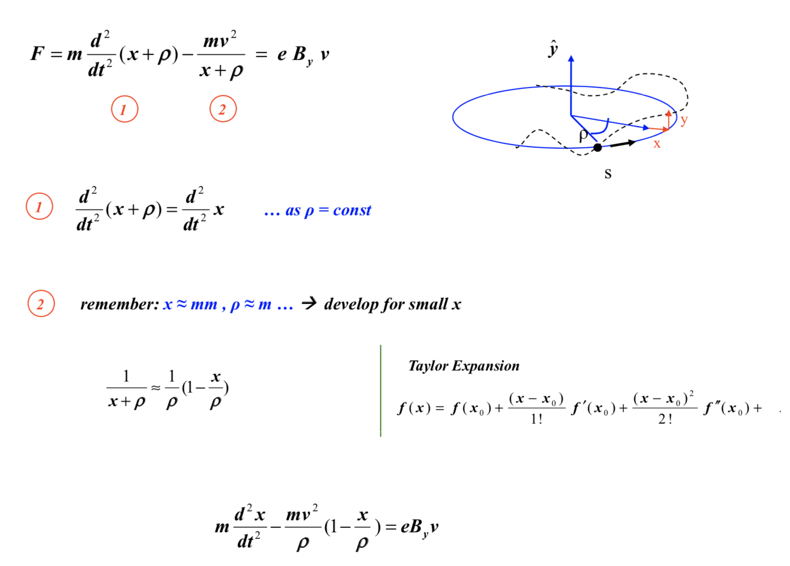

Slide 14
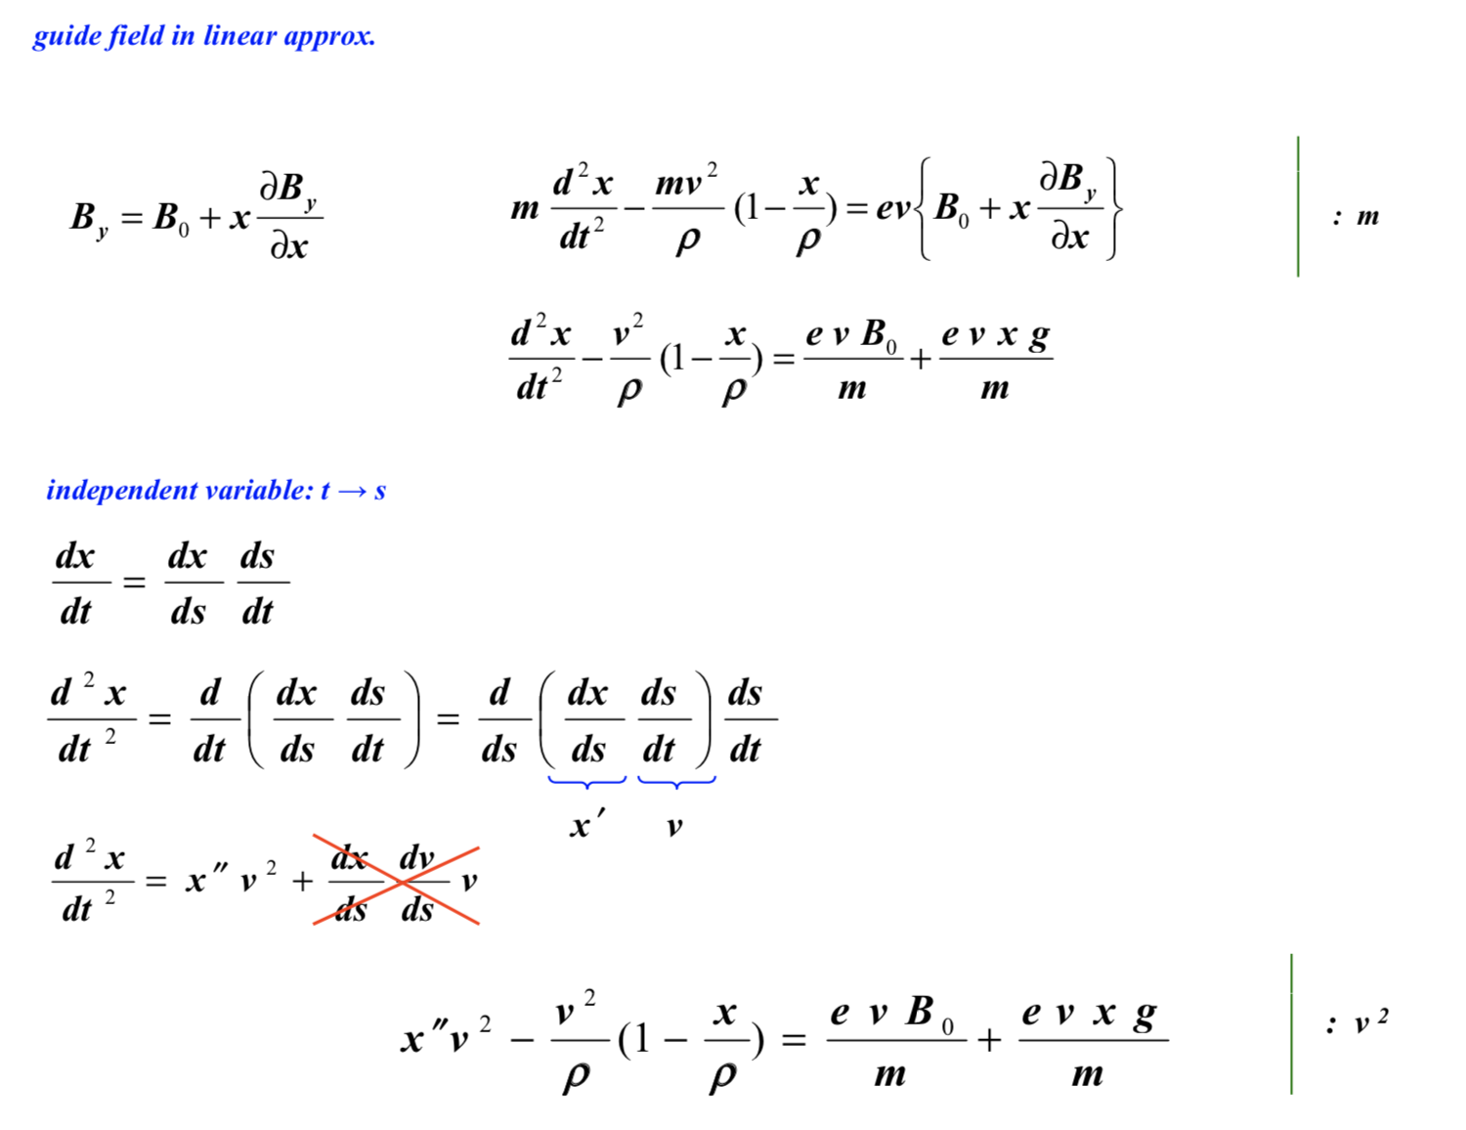

Slide 15
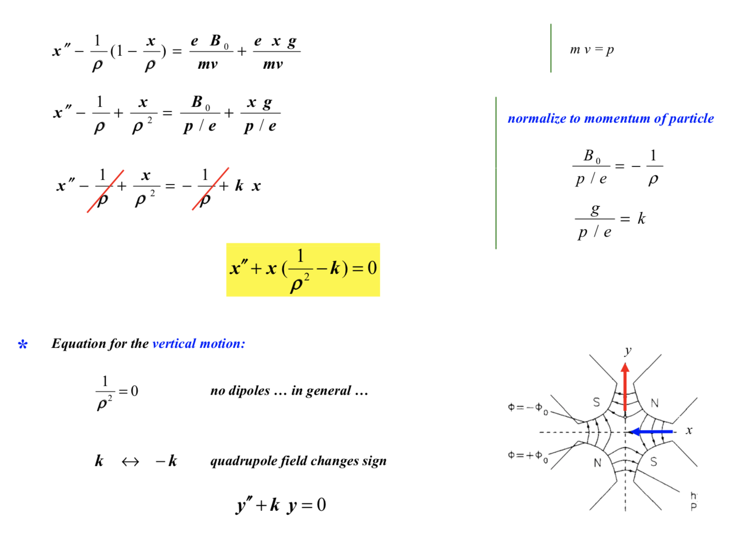

Slide 16


Equation of motion in the linear approximation
$$x^{′′}+\left(\frac{1}{ρ^{2}}−k\right)x=0$$
$$y^{′′}+ky=0$$

Slide 17
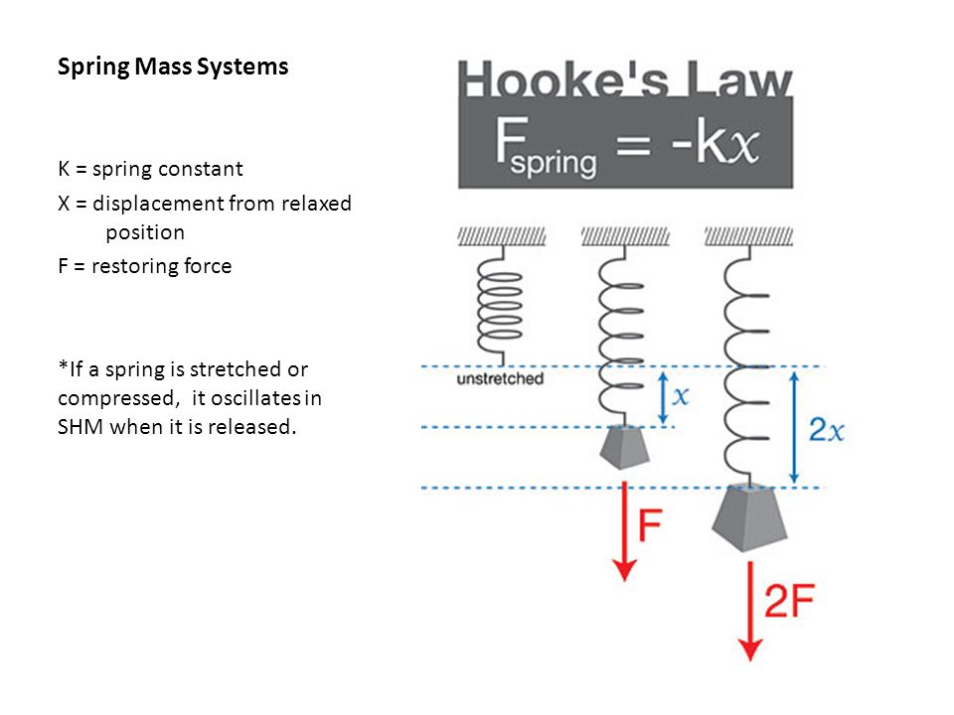
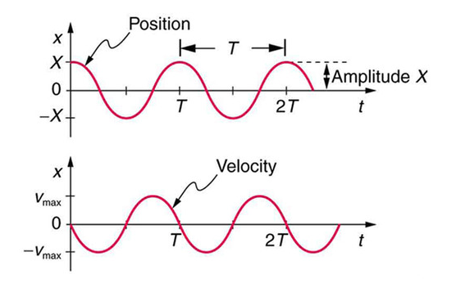
Simple Harmonic Motion

Slide 18
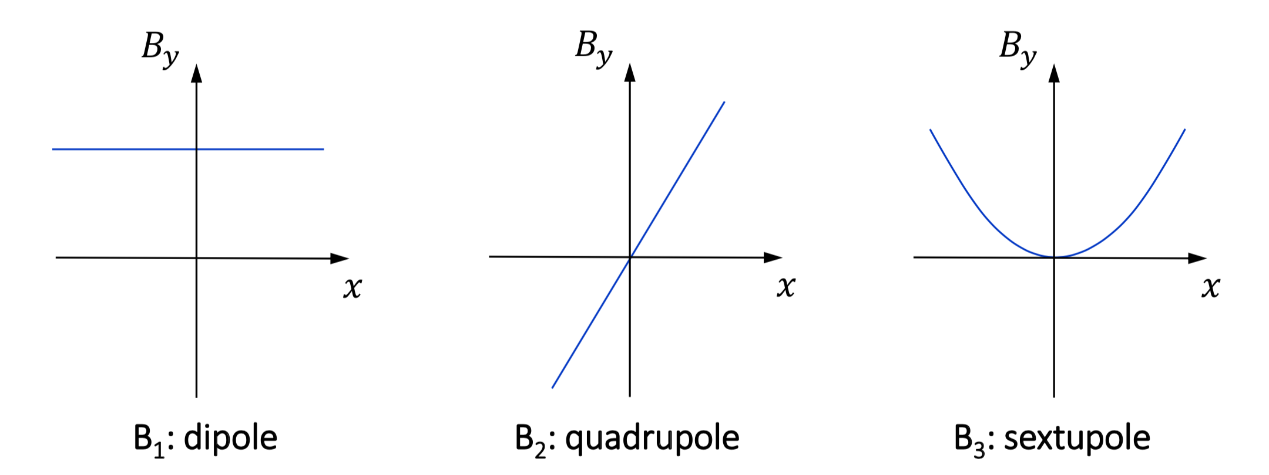



Type of magnets
$${\frac{q}{p}B}_{y}\left(s\right)= {\frac{q}{p}B}_{y0}+\frac{q}{p}\frac{dB_{y}}{dx}x+\frac{1}{2!}\frac{q}{p}\frac{d^{2}B_{y}}{dx^{2}}x^{2}+\frac{1}{3!}\frac{q}{p}\frac{d^{3}B_{y}}{{dx}^{3}}x^{3}+…$$
$$k_{0}=\frac{1}{ρ}=\frac{B}{Bρ}\left(\frac{1}{m}\right)$$
$$k_{1}=\frac{q}{p}\frac{dB_{y}}{dx}=\frac{1}{Bρ}\frac{dB_{y}}{dx}=\frac{1}{Bρ}g\left(\frac{1}{m^{2}}\right)$$
$$k_{2}=\frac{q}{p}\frac{d^{2}B_{y}}{dx^{2}}=\frac{1}{Bρ}\frac{d^{2}B_{y}}{dx^{2}}\left(\frac{1}{m^{3}}\right)$$

Slide 19
MAGNETS’ TYPE
CONVENTIONAL FERROMAGNETS
Poles are made of iron
Field is generated by current flowing through windings
SUPERCONDUCTING MAGNETS

Slide 20
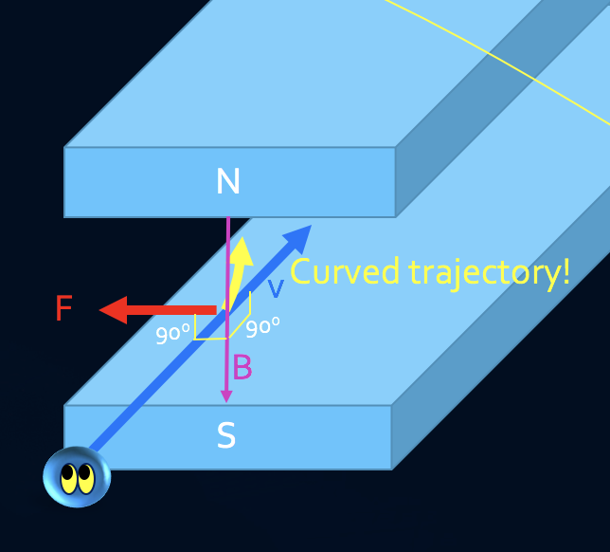


Conventional ferromagnets
DIPOLES
Dipole magnets bend charged particles around a circular path
Have a constant field along a given axis: if along the x(y)-axis ➔ horizontal(vertical) bending
N
Parallel iron poles
Equipotential surfaces
By
h
S
$k_{0}=\frac{1}{ρ}=\frac{B}{Bρ}\left(\frac{1}{m}\right)≈0.3\frac{B[T]}{p[\frac{GeV}{c}]}$
$$B_{y}=μ_{0}\frac{nI}{h}$$
Normalized bending strength

Slide 21
Conventional ferromagnets
Iron ➔ 𝜇_{r} >> 1
Air ➔𝜇_{r} = 1

Slide 22
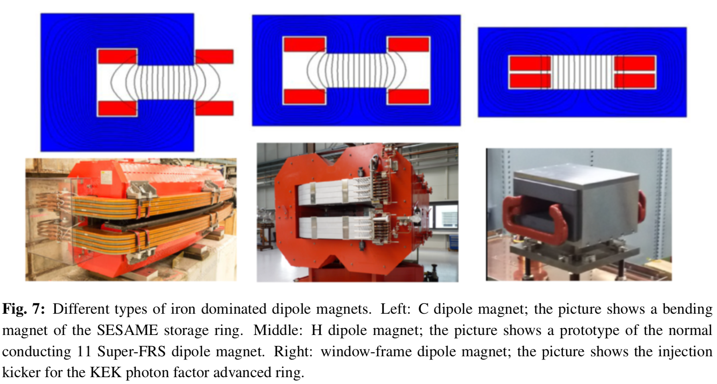

Slide 23
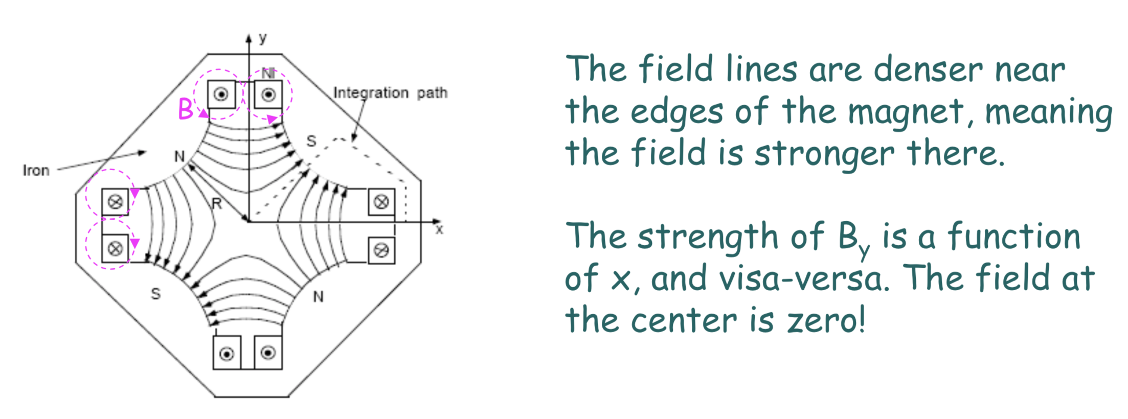


QUADRUPOLES
Gradient:
$$g=\frac{2μ_{o}nI}{r^{2}}$$
Normalized gradient strength:
$$k_{1}=\frac{q}{p}\frac{dB_{y}}{dx}=\frac{1}{Bρ}\frac{dB_{y}}{dx}=\frac{1}{Bρ}g\left(\frac{1}{m^{2}}\right)≈0.3\frac{g[\frac{T}{m}]}{p[\frac{GeV}{c}]}$$

Slide 24
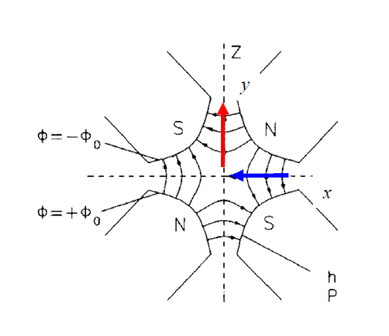
QUADRUPOLES
Horizontal focusing quadrupole
Vertical focusing quadrupole
Magnetic field
y
Magnetic field
x
Hyperbolic pole surfaces
y
x

Slide 25
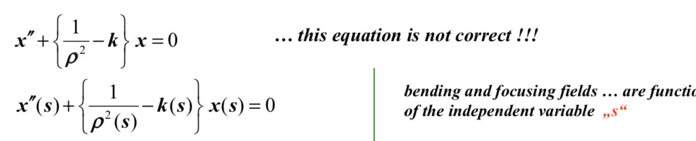
Useful field region due to edge field

Slide 26
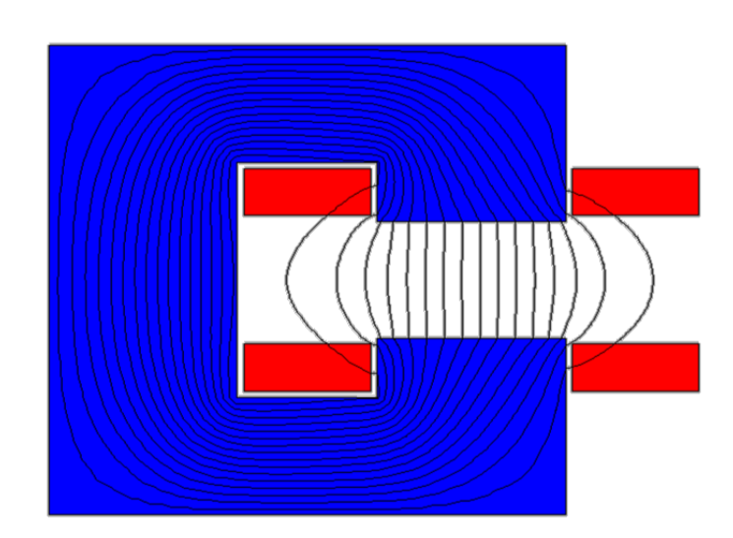


However, we normally assume, for fast calculations, that the field inside the magnet is constant
$$\frac{∆B}{B}$$
2x10⁻⁴
x
Shims
$$\frac{∆B}{B}$$
2x10⁻⁴
x

Slide 27
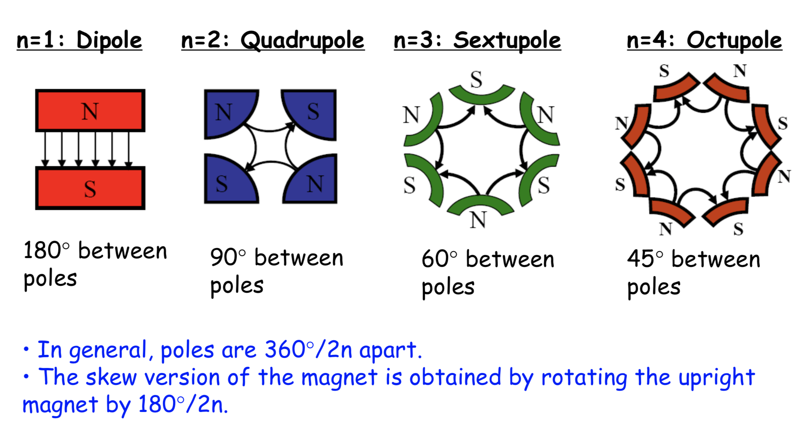

Slide 28
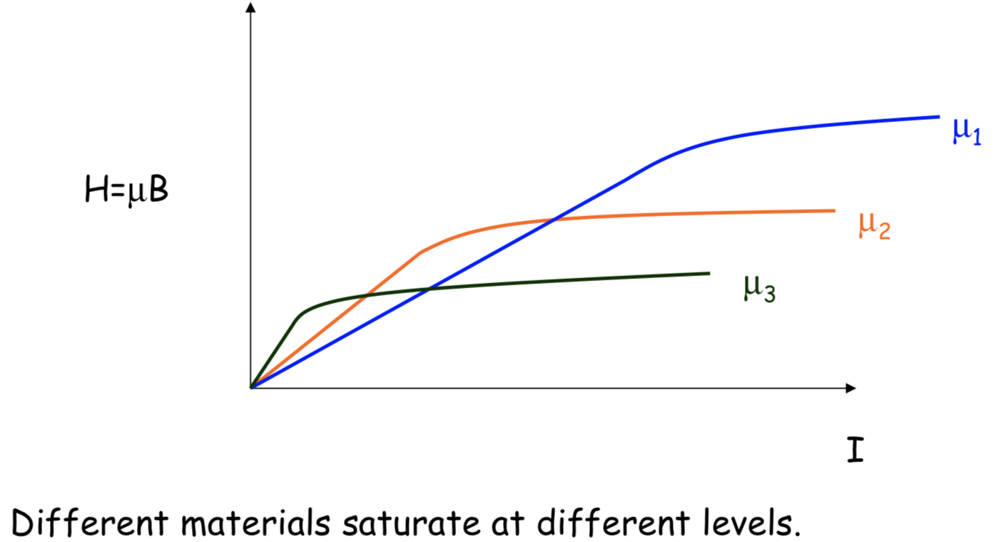
Saturation of magnetic materials
In a non-saturated field, the relationship between field strength, B, and driving current, I, is linear.
Above saturation, an increase in current does not generate a corresponding increase in field
2 T
Saturation is a problem ➔ our control system needs to know the beam transfer function curves for each magnet to calculate as precise as possible the current to be injected into the magnets as a function of the requested magnetic field.

Slide 29
SUPERCONDUCTING MAGNETS
The maximum magnetic field attainable with conventional iron magnets is ~ 2 T
Above this value the magnets enters in saturation
Another issue is that for higher magnetic fields, the current density transported by the filaments can be extremely high
For example, if we need a field of 5 T at a distance of 5 cm from a conductor, a current of I=1.25x10⁶ A is needed. If the conductor has a thickness of 3 cm this gives dI/da = 1700 A mm⁻².
Even with very effective water cooling, the maximum tolerable current density in cooper is ~ 100 A mm⁻².
Such a requirement cannot be achieved by normal conductors, the ohmic resistance of the material will heat enormously the conductor and it will eventually melt.

Slide 30
The solution to this problem was found in 1911 by Dutchman H. Kamerling Onnes ➔ SUPERCONDUCTORS
He observed that when mercury is cooled to very low temperatures its ohmic resistance suddenly disappears below a critical temperature T_{c}=4.2 K ➔ current flows without any losses.
Many other materials were discovered later to have the same property
Striking is, though, that the best normal conductors, cooper and silver, do not have this property
Today a widely used superconducting material is Niobium-Titanium ➔ LHC

Slide 31
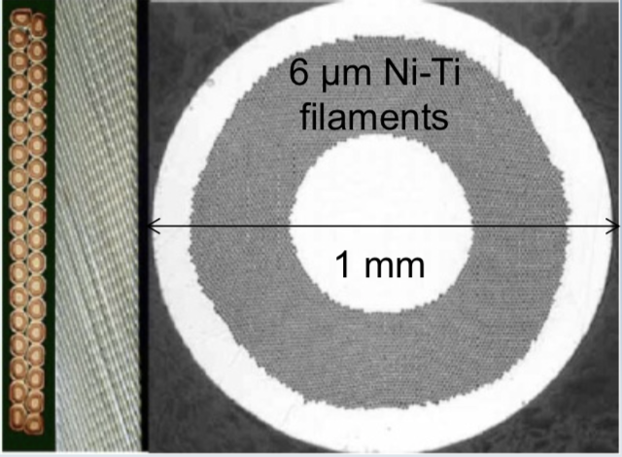
Superconductivity is also influenced by external magnetic field, and there is a so called critical B field, above which superconductivity cannot be reached even at 0 K
When superconducting regime is reached, B is pushed out of the conductor, therefore, the current only flows near the conductor surface
1.7 mm
This implies that large conductor areas are needed when building a cable
This is achieved by placing thousands of filaments within the cooper matrix
10 mm
Kapton and glass fiber tape

Slide 32
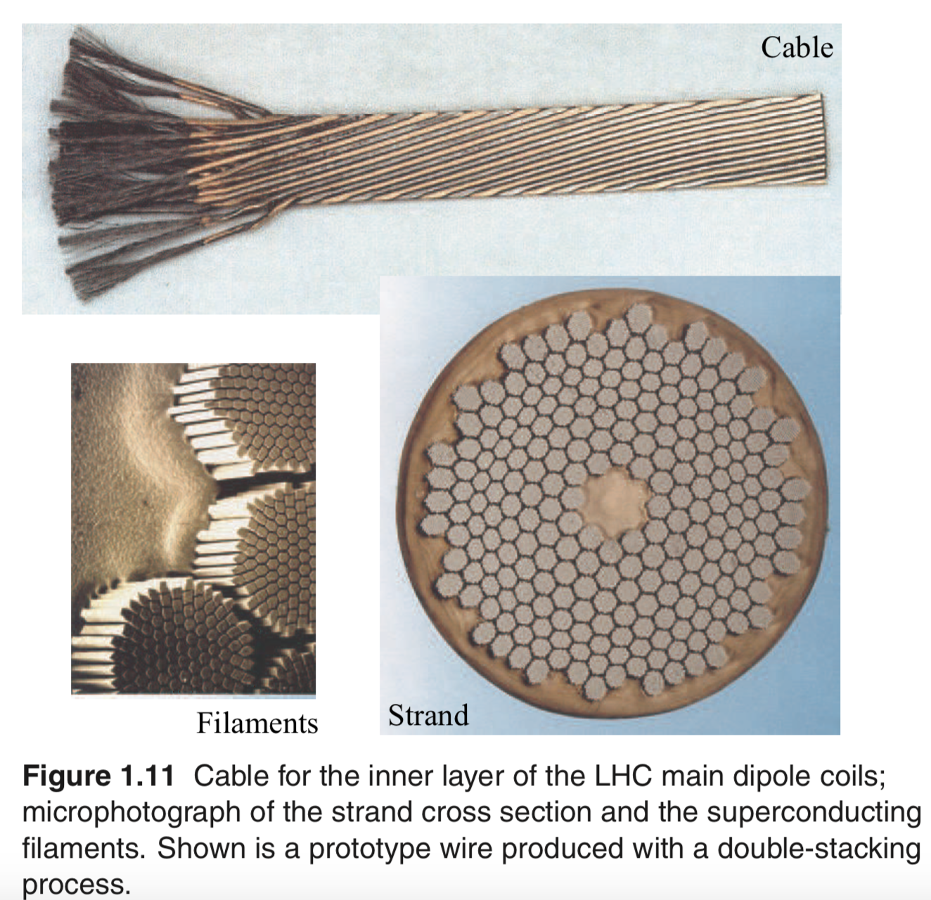
1.7 mm
10 mm
Cooper matrix
Kapton and glass fiber tape

Slide 33
Effects that perturb the field quality

Slide 34
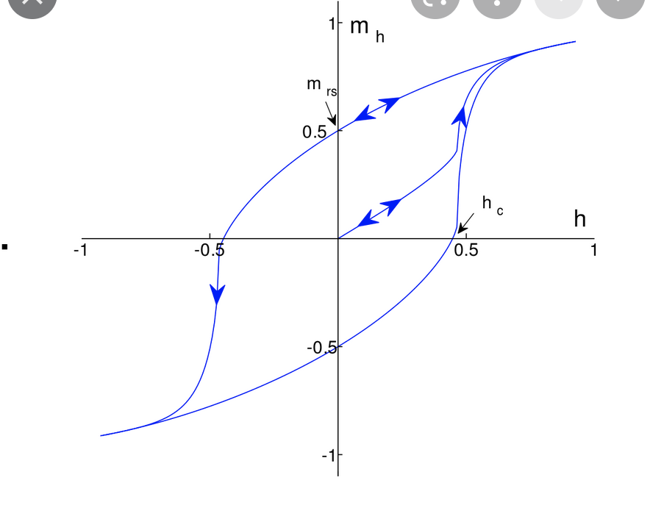
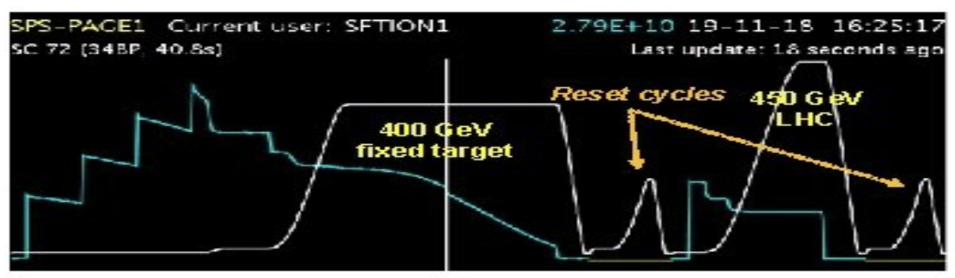
Magnet Hysteresis
One quadrant
PC
Magnetic hysteresis occurs when an external magnetic field is applied to a magnet such as iron and the atomic dipoles align themselves with it
Even when the field is removed, part of the alignment will be retained: the material has become magnetized
Once magnetized, the magnet will stay magnetized indefinitely
To demagnetize it requires heat or a given magnetic field

Slide 35
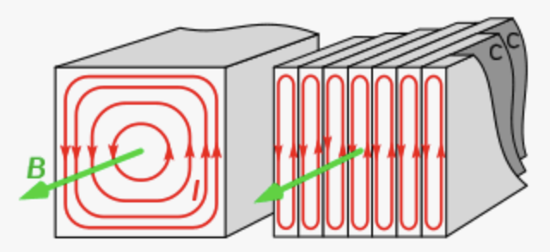
Eddy currents
Eddy currents (also called Foucault's currents) are loops of electrical current induced within conductors by a changing magnetic field in the conductor according to Faraday's law of induction
Eddy currents flow in closed loops within conductors, in planes perpendicular to the magnetic field
An eddy current creates a magnetic field that opposes the change in the magnetic field that created it, and thus eddy currents react back on the source of the magnetic field
Eddy currents therefore also modify the magnetic field for a given requested current ➔ we get less field
To prevent this effect as much as possible, pulsing magnets are machined in “laminated” and not in solid cores
Cancel each other

Slide 36
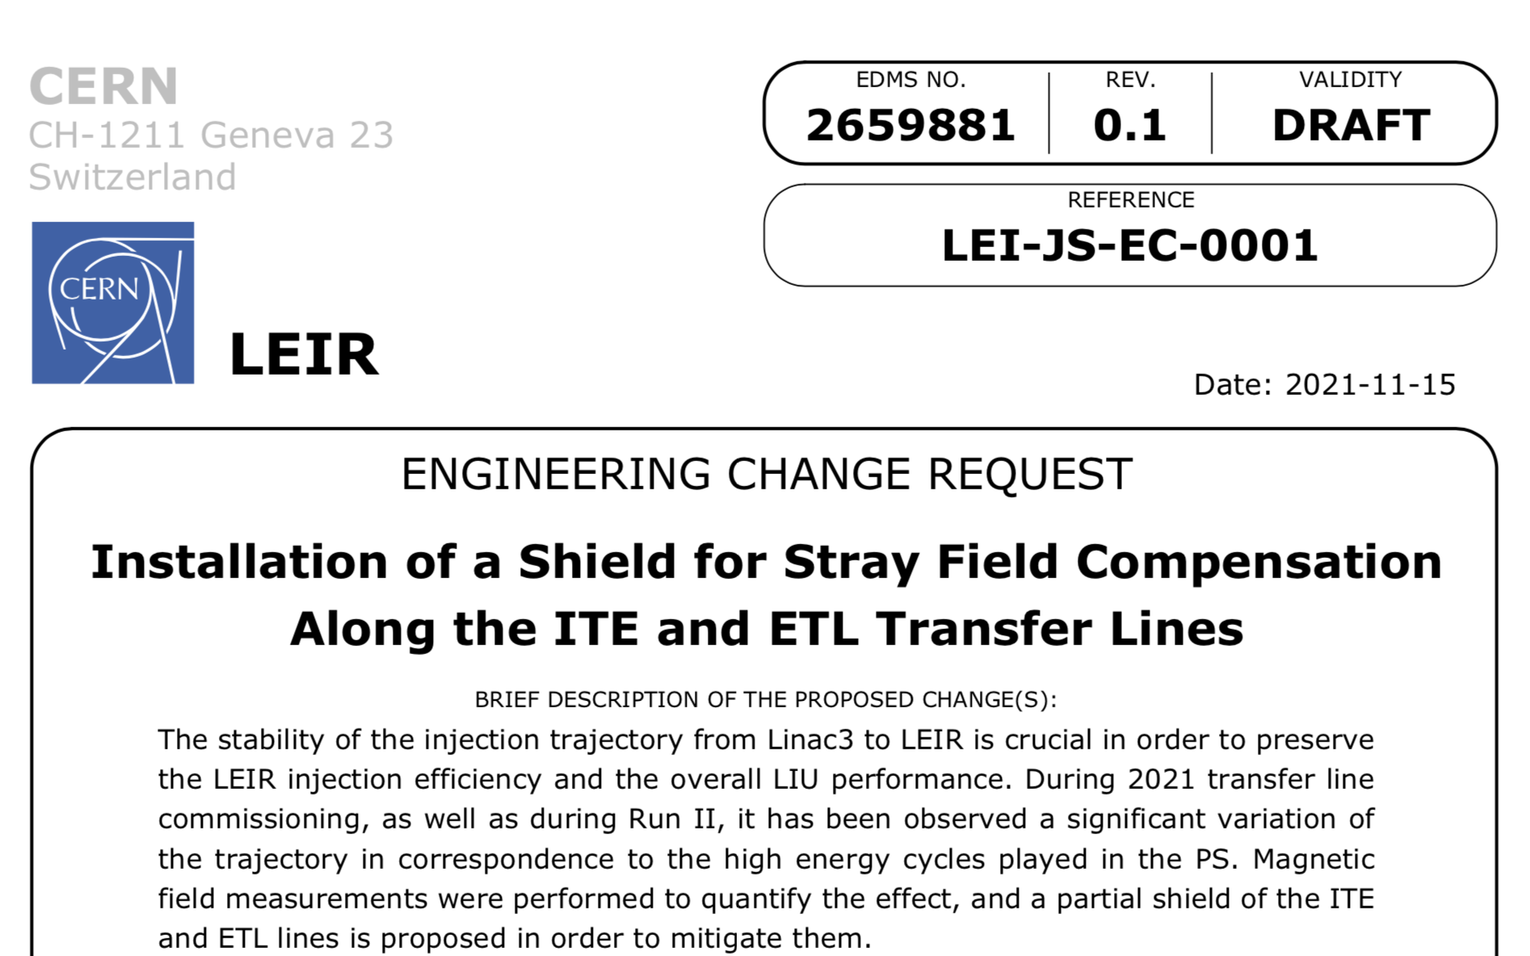
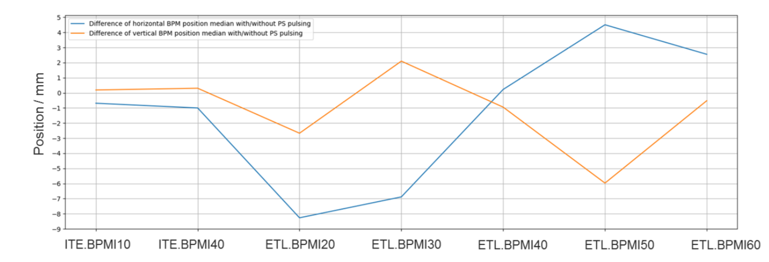
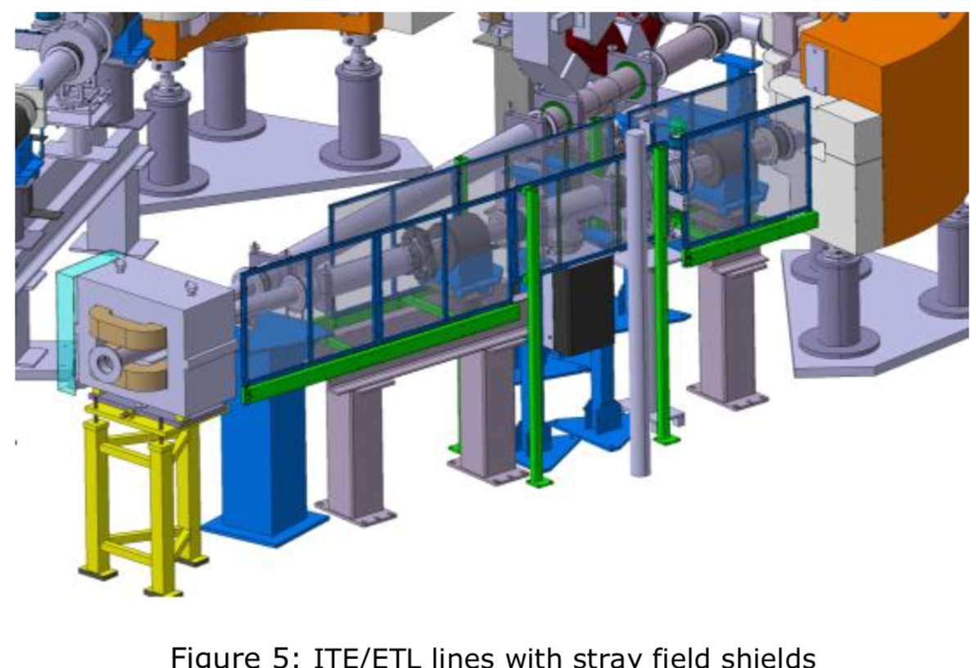
Stray fields from other magnets
The magnetic field leaking out from other surrounding magnets, can reach our magnets providing an extra B field which effect superimposes to the one requested by the operational applied current
The transfer line of LEIR suffers from the PS stray fields in such a way that the particle trajectory is different from the ideal one
With PS pulsing
Without PS pulsing
Transfer line beam trajectory

Slide 37
Spare slides

Slide 38
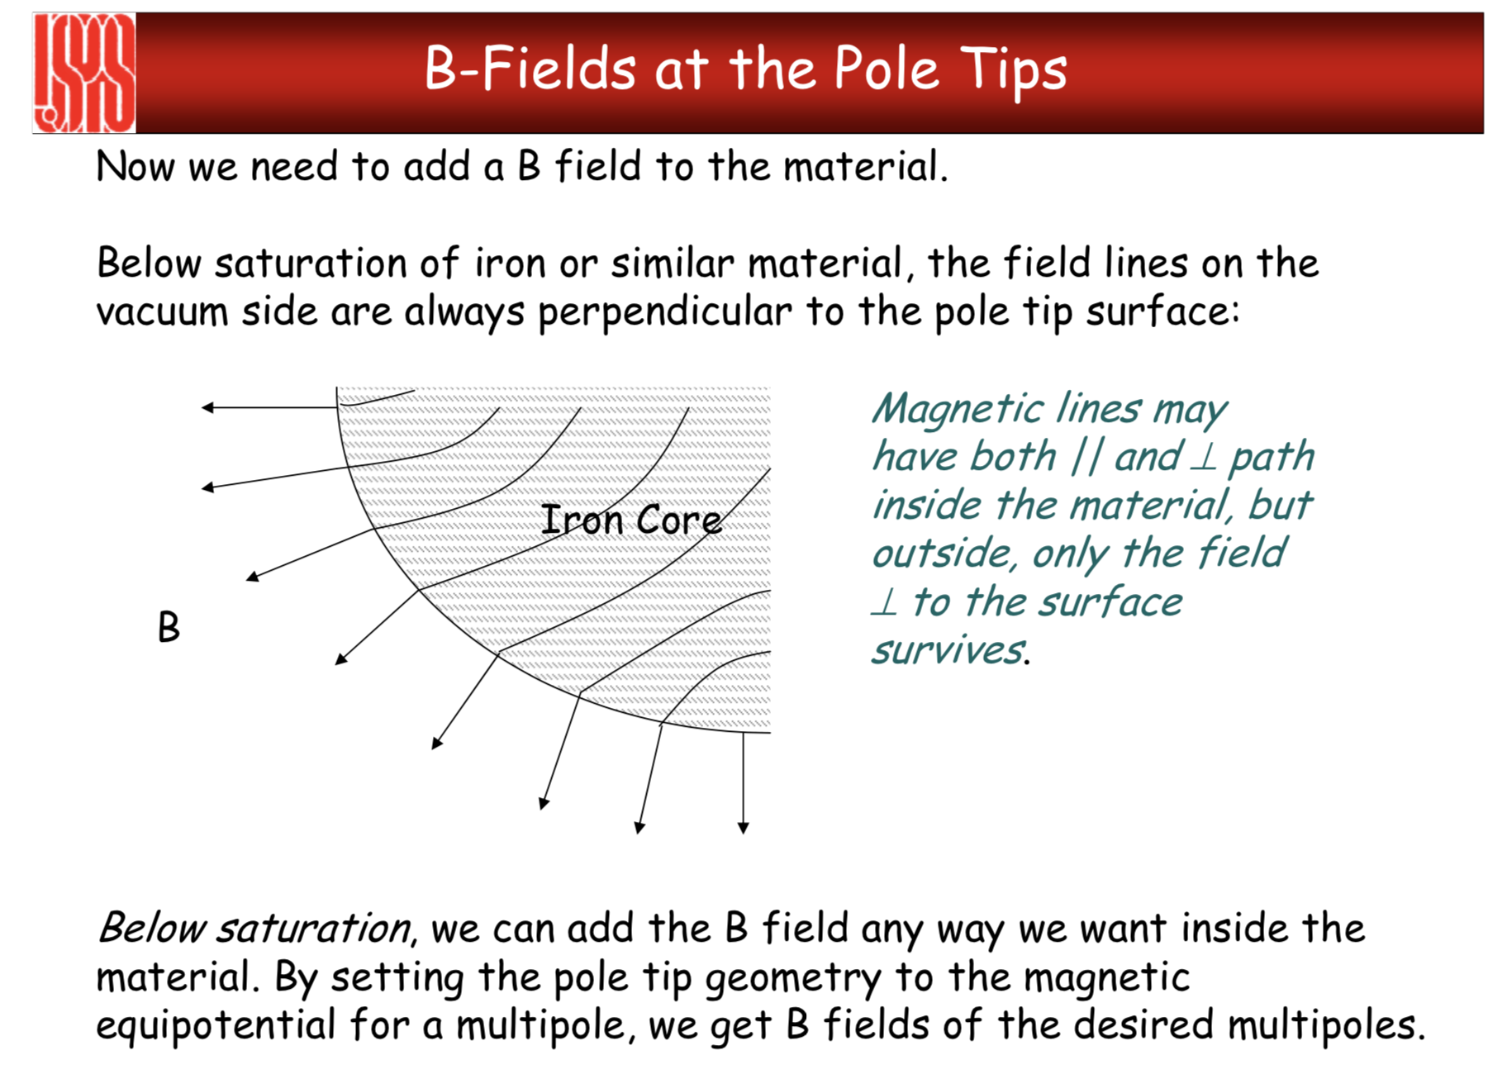

Slide 39









We need dipole magnets
N
S
A dipole with a uniform field deviates a particle by an angle θ
The bending angle θ depends on:
  the length L
  the magnetic field B
  the particle momentum
Curved trajectory!
F
v
90⁰
90⁰
B
$$arc≈angle∙radius$$
$$arc=L$$
$$angle=θ$$
$$radius=ρ$$
L$=θ∙ρ$
Dipole seen from the top
$$θ=\frac{L}{ρ}$$
$$∙\frac{B}{B}$$
$$θ=\frac{LB}{Bρ}=\frac{LB}{\frac{p}{q}}$$
$$LB=calibration factor(\frac{Tm}{A})∗I$$

