Slide 1
Introduction to transverse beam dynamics II
Restricted to the LINEAR BEAM OPTICS ➔ THE IDEAL WORLD

Slide 2
Content of the course
TBD 1
TUTO 1
Charge particle motion in a magnetic field
Equations of motion ➔ derivation and assumptions
Type of magnets
Rigidity formula
Relativistic equations
Create a storage ring with the Earth Magnetic field
TBD 2
TUTO 2
Particle trajectory
Transfer Matrices
Thin lens approximation
Betatron oscillations
Betatron tune
Dispersion
Application of transfer matrices
Thin lens
FoDo cell
TBD 3
TUTO 3
Phase space ellipse
Emittance
Beam size
Aperture
Beta function evolution
Periodic lattices
Beam size and aperture calculations
TBD 4
TUTO 4
Effect field errors
Resonances
Coupling
Chromaticity
How the tune changes from a quadrupole defect
Optimize beta beating
Orbit bumps

Slide 3


Equation of motion in the linear approximation
$$x^{′′}+\left(\frac{1}{ρ^{2}}−k\right)x=0$$
$$y^{′′}+ky=0$$

Slide 4
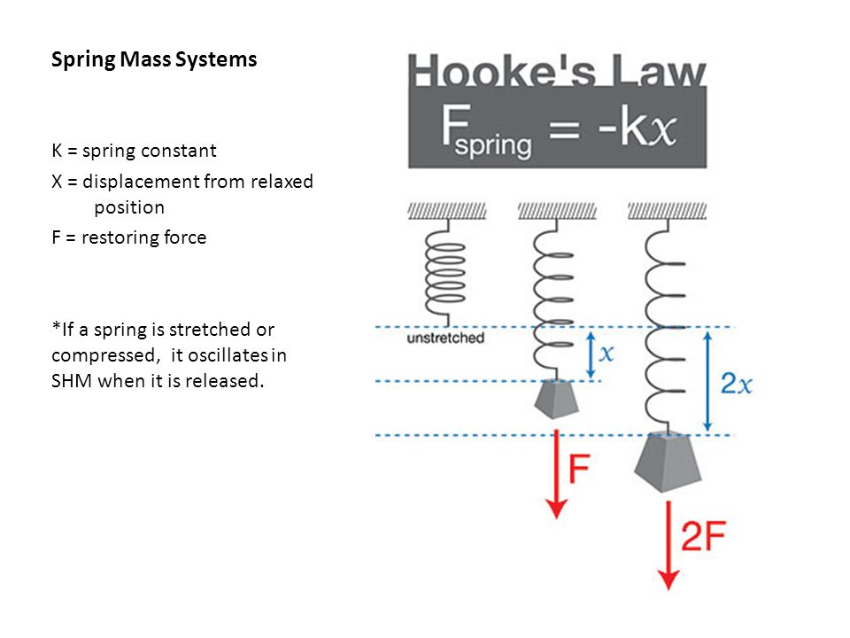
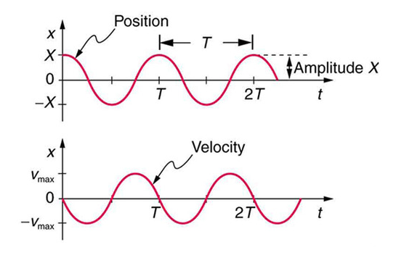




Simple Harmonic Motion
A simple harmonic oscillator is an oscillator that is neither driven nor damped. It consists of a mass m, which experiences a single force F, which pulls the mass in the direction of the point x = 0 and depends only on the position x of the mass and k.
$$x\left(t\right)=Acos(ωt+φ)$$
$$ω=\sqrt{\frac{k}{m}}$$
$$T=\frac{2π}{ω}$$
$$f=\frac{ω}{2π}$$

Slide 5
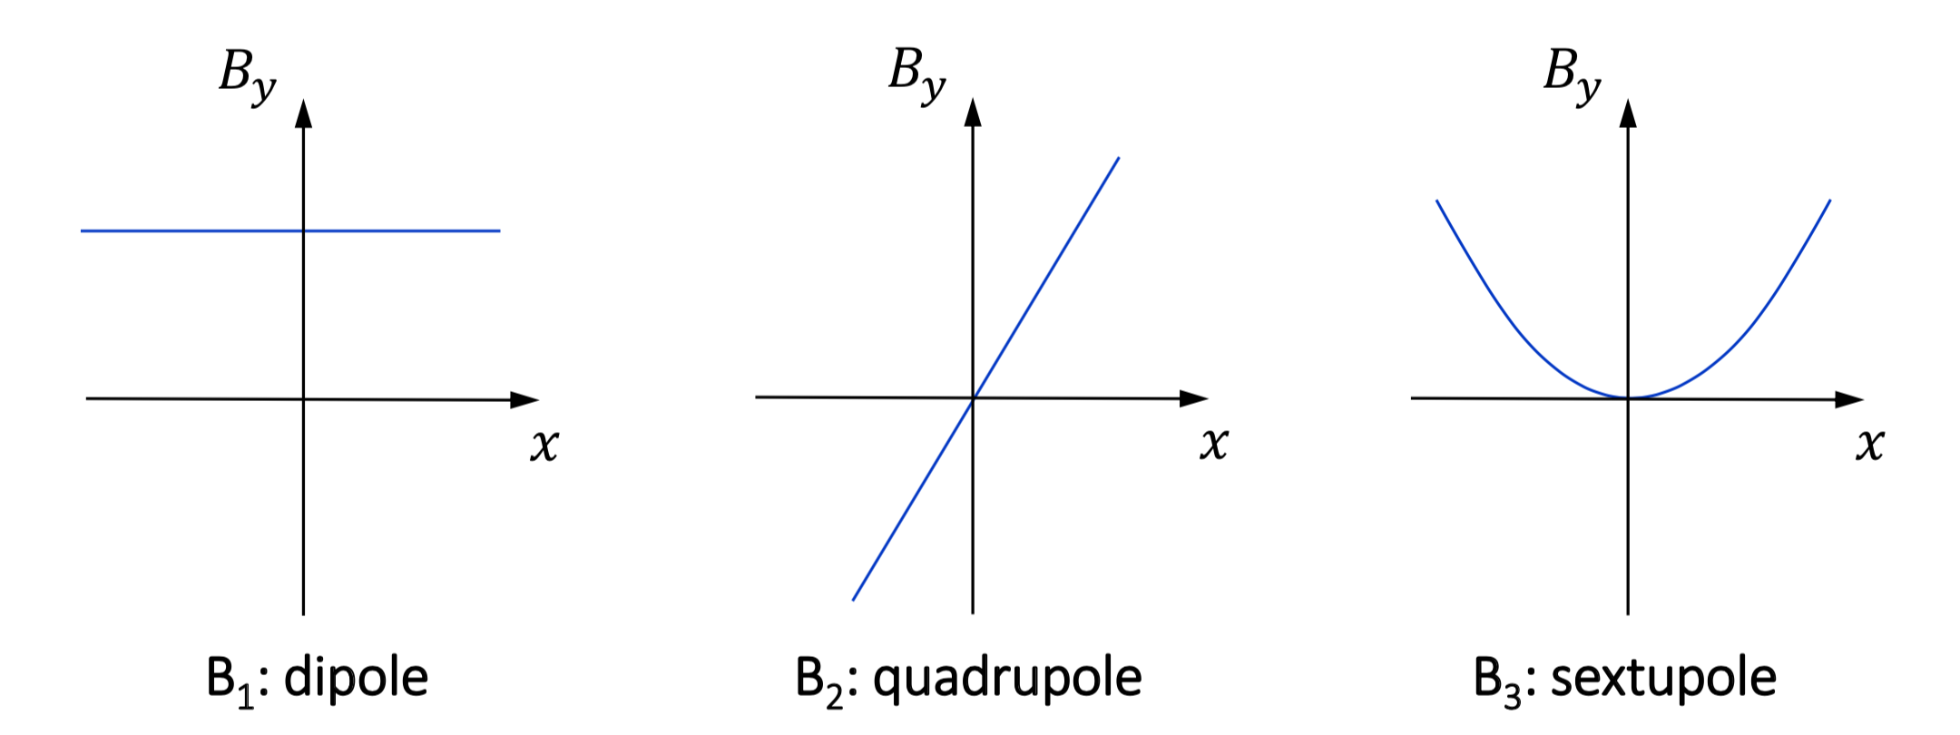



Type of magnets
$${\frac{q}{p}B}_{y}\left(s\right)= {\frac{q}{p}B}_{y0}+\frac{q}{p}\frac{dB_{y}}{dx}x+\frac{1}{2!}\frac{q}{p}\frac{d^{2}B_{y}}{dx^{2}}x^{2}+\frac{1}{3!}\frac{q}{p}\frac{d^{3}B_{y}}{{dx}^{3}}x^{3}+…$$
LINEAR BEAM DYNAMICS!!
$$k_{0}=\frac{1}{ρ}=\frac{B}{Bρ}\left(\frac{1}{m}\right)$$
$$k_{1}=\frac{q}{p}\frac{dB_{y}}{dx}=\frac{1}{Bρ}\frac{dB_{y}}{dx}=\frac{1}{Bρ}g\left(\frac{1}{m^{2}}\right)$$
$$k_{2}=\frac{q}{p}\frac{d^{2}B_{y}}{dx^{2}}=\frac{1}{Bρ}\frac{d^{2}B_{y}}{dx^{2}}\left(\frac{1}{m^{3}}\right)$$

Slide 6
Particle trajectories
We have seen in the previous course how to generate magnetic fields in the region of the beam
Let’s now find a solution for the equations of motion
In dipoles and quadrupole magnets there is no coupling (in first order) between the horizontal and vertical plane (we have two different equations for x and y)
Then, let’s solve just one plane, e.g. the x-s
To simplify even more, let’s assume the B field ends abruptly at the beginning and end of the magnets “hard-edge model” (we ignore the edge field issue)
Within the magnets we assume constant B field, i.e. 1/𝜌= cte and k=cte

Slide 7

We can solve this equation, section by section, either within a magnet or within a field-free region = drift region
$$x^{′′}+\left(\frac{1}{ρ^{2}}−k\right)x=0$$

Slide 8


Solution within a focusing quadrupole
A quadrupole is characterized by its strength, k, and its length, l
There is no bending ➔ 1/𝜌= 0
$$x^{′′}+\left(\frac{1}{ρ^{2}}−k\right)x=0$$
$$x^{′′}−kx=0$$
(k=cte)
Homogeneous and linear-second-order differential equation
Convention is that defocusing magnets k > 0 and focusing magnets k<0
For a focusing quadrupole the solution is
$$x\left(s\right)=Acos\sqrt{|k|}s+Bsin\sqrt{|k|}s$$
$$x^{′}(s)=−\sqrt{|k|}Asin\sqrt{|k|}s+\sqrt{|k|}Bcos\sqrt{|k|}s$$

Slide 9
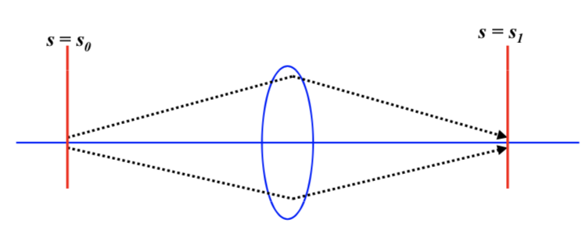

The integration constants A and B are determined by the initial conditions
Initial conditions ➔at the beginning of the magnet s=0, the particle trajectory has position x₀ and angle x’₀
Inserting these initial conditions in the solutions we get: A=x₀, B=x’₀/√k
We can also express the solution in a more elegant way using matrices:
$$\left(\begin{matrix}x(s) \\ x′(s)\end{matrix}\right)=\left(\begin{matrix}cos\sqrt{|k|}s & 1/{\sqrt{|k|}}sin\sqrt{|k|}s \\ −\sqrt{|k|}sin\sqrt{|k|}s & cos\sqrt{|k|}s\end{matrix}\right)\left(\begin{matrix}x_{0} \\ {x′}_{0}\end{matrix}\right)$$
FOCUSING
k<0

Slide 10
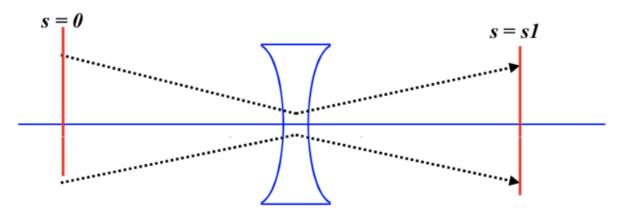


Solution within a defocusing quadrupole
$$x\left(s\right)=x0cosh\sqrt{k}s+{x^{′}0}/{\sqrt{k}}sinh\sqrt{k}s$$
$$x′\left(s\right)=x0\sqrt{k}sinh\sqrt{k}s+x^{′}0cosh\sqrt{k}s$$
$$\left(\begin{matrix}x(s) \\ x′(s)\end{matrix}\right)=\left(\begin{matrix}cosh\sqrt{k}s & 1/{\sqrt{k}}sinh\sqrt{k}s \\ \sqrt{k}sinh\sqrt{k}s & cosh\sqrt{k}s\end{matrix}\right)\left(\begin{matrix}x_{0} \\ {x′}_{0}\end{matrix}\right)$$
DEFOCUSING
k>0

Slide 11


Solution for a zero-field drift region
$$\left(\begin{matrix}x(s) \\ x′(s)\end{matrix}\right)=\left(\begin{matrix}cos\sqrt{|k|}s & 1/{\sqrt{|k|}}sin\sqrt{|k|}s \\ −\sqrt{|k|}sin\sqrt{|k|}s & cos\sqrt{|k|}s\end{matrix}\right)\left(\begin{matrix}x_{0} \\ {x′}_{0}\end{matrix}\right)$$
k=0, sin𝛼≌𝛼
$$\left(\begin{matrix}x(s) \\ x′(s)\end{matrix}\right)=\left(\begin{matrix}1 & s \\ 0 & 1\end{matrix}\right)\left(\begin{matrix}x_{0} \\ {x′}_{0}\end{matrix}\right)$$

Slide 12



Solution for a dipole
Dipole with constant bending radius 1/𝜌=cte and no gradient, k=0
$$x^{′′}+\left(\frac{1}{ρ^{2}}−k\right)x=0$$
$$x^{′′}+\frac{1}{ρ^{2}}x=0$$
The solution is like a focusing quadrupole
$$\left(\begin{matrix}x(s) \\ x′(s)\end{matrix}\right)=\left(\begin{matrix}coss/ρ & ρsins/ρ \\ −s/ρsins/ρ & coss/ρ\end{matrix}\right)\left(\begin{matrix}x_{0} \\ {x′}_{0}\end{matrix}\right)$$
DIPOLE
BEAM FOCUSING!!

Slide 13
How can a dipole with k=0 have a focusing effect?
Let’s consider again the trajectories of two particles within a 180⁰ dipole
180⁰ dipole
B
Weak focusing!!
𝞺
A
C
x
-x
In this magnet all trajectories are semicircles with same radius 𝜌
If we consider as reference trajectory the one described by YELLOW particle
And analyze the trajectory of the second GREEN particle displaced by +x:
  GREEN particle approaches the ideal trajectory and crosses it at point B
  Then runs inside the orbit and exits with a displacement of -x
Weak focusing in x
Drift in y (horizontal dipole)
x
B
-x

Slide 14




$$\left(\begin{matrix}x(s) \\ x′(s)\end{matrix}\right)=\left(\begin{matrix}cos\sqrt{|k|}s & 1/{\sqrt{|k|}}sin\sqrt{|k|}s \\ −\sqrt{|k|}sin\sqrt{|k|}s & cos\sqrt{|k|}s\end{matrix}\right)\left(\begin{matrix}x_{0} \\ {x′}_{0}\end{matrix}\right)$$
FOCUSING
k<0
$$\left(\begin{matrix}x(s) \\ x′(s)\end{matrix}\right)=\left(\begin{matrix}cosh\sqrt{k}s & 1/{\sqrt{k}}sinh\sqrt{k}s \\ \sqrt{k}sinh\sqrt{k}s & cosh\sqrt{k}s\end{matrix}\right)\left(\begin{matrix}x_{0} \\ {x′}_{0}\end{matrix}\right)$$
DEFOCUSING
k>0
$$\left(\begin{matrix}x(s) \\ x′(s)\end{matrix}\right)=\left(\begin{matrix}1 & s \\ 0 & 1\end{matrix}\right)\left(\begin{matrix}x_{0} \\ {x′}_{0}\end{matrix}\right)$$
k=0
DRIFT
$$\left(\begin{matrix}x(s) \\ x′(s)\end{matrix}\right)=\left(\begin{matrix}coss/ρ & ρsins/ρ \\ −s/ρsins/ρ & coss/ρ\end{matrix}\right)\left(\begin{matrix}x_{0} \\ {x′}_{0}\end{matrix}\right)$$
DIPOLE

Slide 15
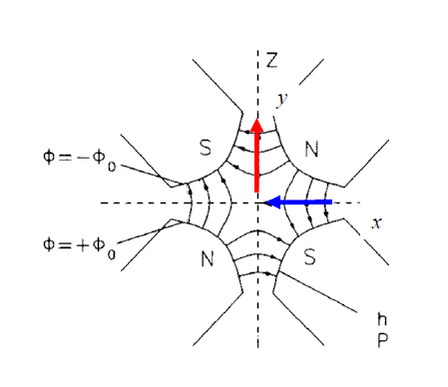







Four-dimensional trajectories
In general a particle travelling along the accelerator moves in x and y, therefore we need to deal with four-dimensional vectors and matrices
$$0$$
$$0$$
Magnetic field
y
$$0$$
$$0$$
$$MQF=$$
x
$$0$$
$$0$$
$$0$$
$$0$$
Defocus in y
Focus in x
Magnetic field
x
$$0$$
$$0$$
$$0$$
$$0$$
y
$$MQD=$$
$$0$$
$$0$$
$$0$$
$$0$$

Slide 16
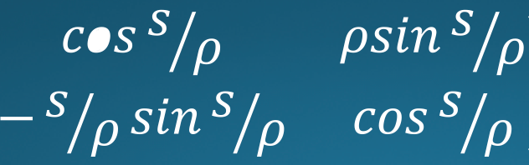


















$$0$$
$$0$$
$$0$$
$$0$$
$$MDRIFT=$$
$$0$$
$$0$$
$$0$$
$$0$$
$$0$$
$$0$$
$$0$$
$$0$$
$$MDIPOLE=$$
$$0$$
$$0$$
$$0$$
$$0$$

Slide 17






Thin lens approximation
In many practical situations we have that the focal length of the lens is much bigger than the length of the magnet
$$f=\frac{1}{kl_{q}}≫l_{q}$$
In this case we can make the following approximation
$$l_{q}→0 while kl_{q}=cte$$
The quadrupole matrix elements can then be reduced to
$$\left(\begin{matrix}1 & 0 \\ −\frac{1}{f} & 1\end{matrix}\right)$$
$$\left(\begin{matrix}cos\sqrt{|k|}s & 1/{\sqrt{|k|}}sin\sqrt{|k|}s \\ −\sqrt{|k|}sin\sqrt{|k|}s & cos\sqrt{|k|}s\end{matrix}\right)$$
FOCUSING
k<0
$$\left(\begin{matrix}1 & 0 \\ \frac{1}{f} & 1\end{matrix}\right)$$
$$\left(\begin{matrix}cosh\sqrt{k}s & 1/{\sqrt{k}}sinh\sqrt{k}s \\ \sqrt{k}sinh\sqrt{k}s & cosh\sqrt{k}s\end{matrix}\right)$$
DEFOCUSING
k>0

Slide 18
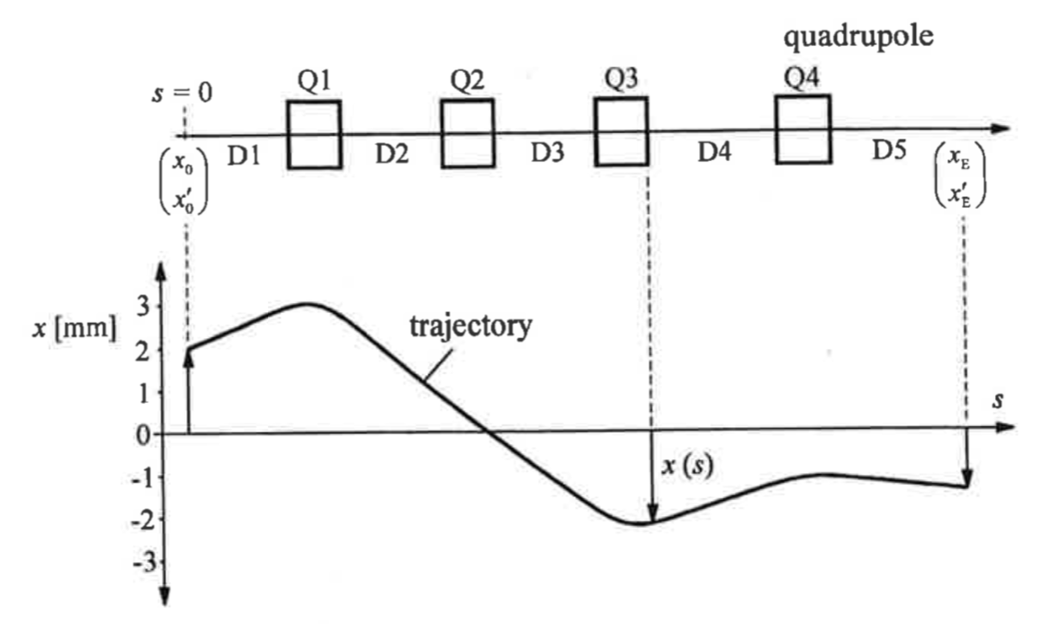
Particle trajectory calculation through a system of many beam steering magnets
So far we have only considered particle motion within one magnet
But a storage ring or transfer line is made of many magnets
The first approach would be:
  Take the first element, calculate the position and angle after the beam crosses the element
  Take the resulting position and angle and use it as initial position and angle through the next magnet
  And so on so forth …
D_{i}=drift sections
Q_{i} = quadrupoles

Slide 19
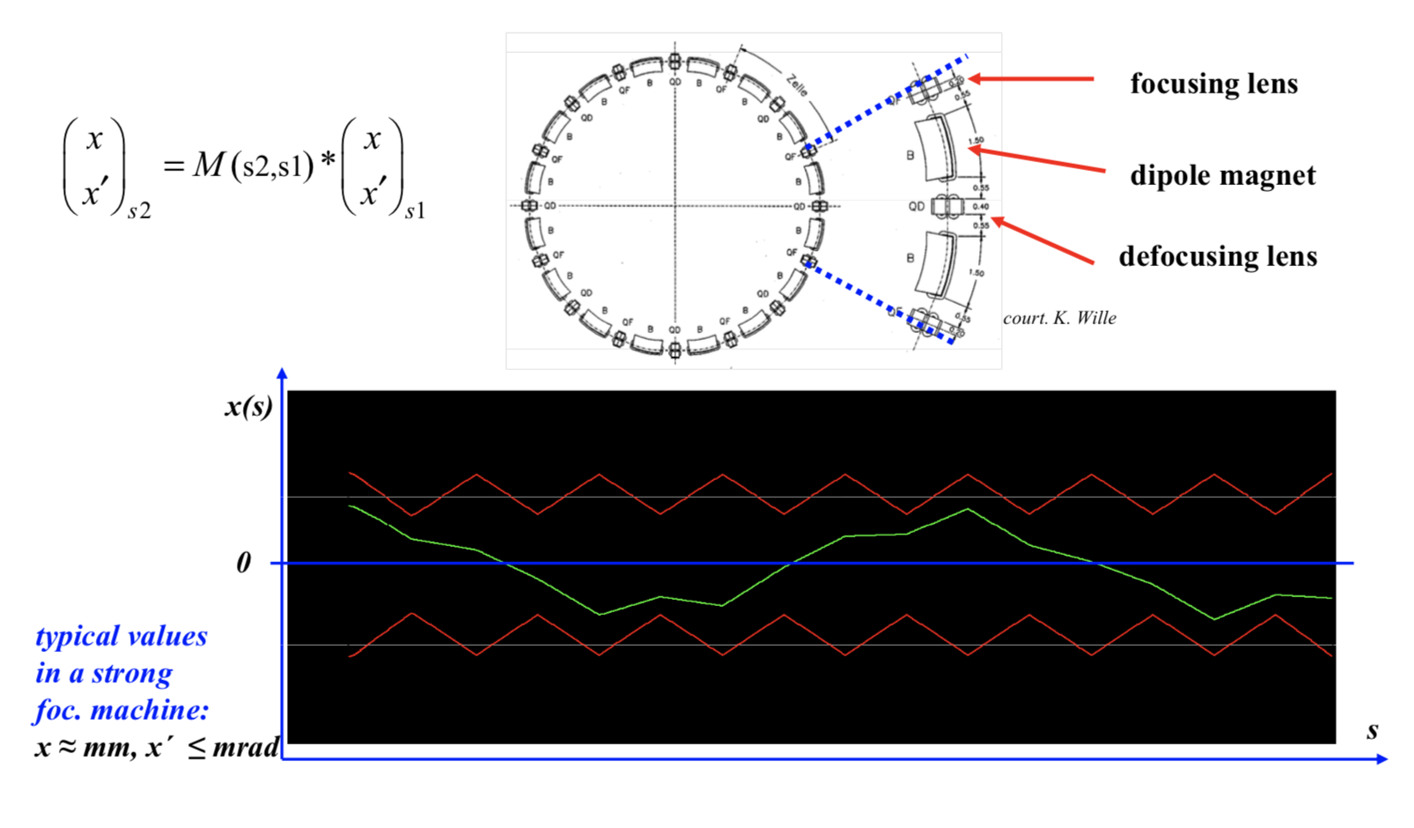
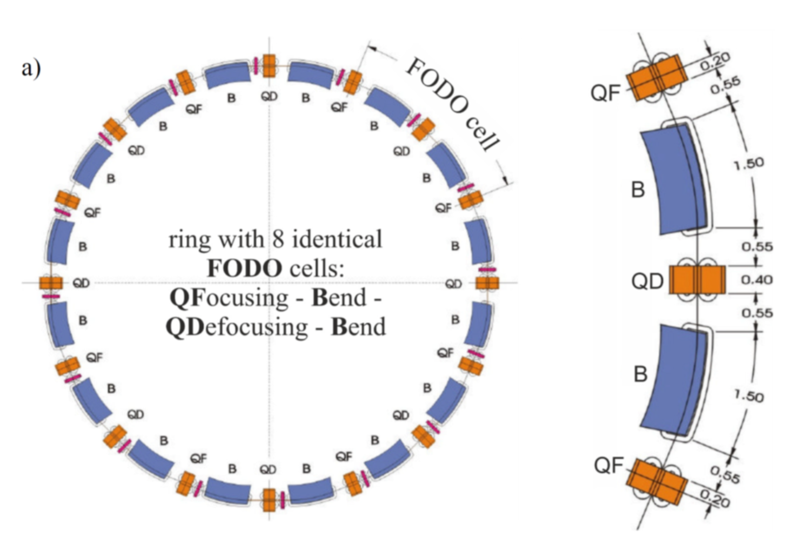
7
6
8
5
1
4
2
3
1
2
3
4
5
6
7
8

Slide 20
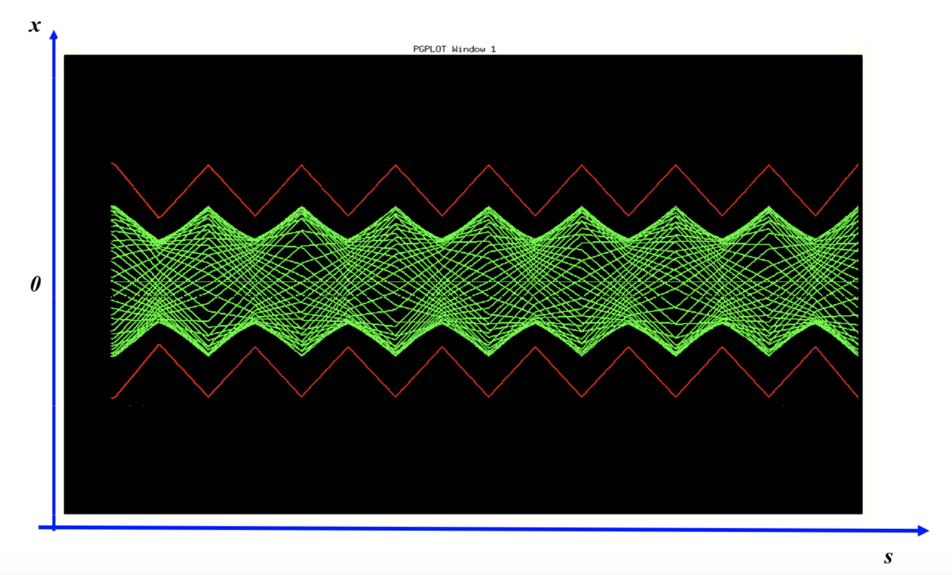
What will happen if the particle performs a second turn … and a third turn … and 10¹⁰ turns?

Slide 21


Hill’s equation
Up to now we have simplified our calculations assuming that k = cte within the quadrupole magnet
But when we have to use a set of magnets in an storage ring, each quadrupole can have a different strength ➔ the restoring force is not constant k=k(s)
More over, the particle crosses the magnets over and over again, therefore, k(s)=k(s+L), i.e. k(s) is periodic (L: accelerator circumference)
Therefore, the original equation of motion
$$x^{′′}−kx=0$$
(k=cte)
(slide 9)
Has to be generalized to k=k(s)
$${x(s)}^{′′}−k(s)x(s)=0$$
Hill’s equation of motion

Slide 22
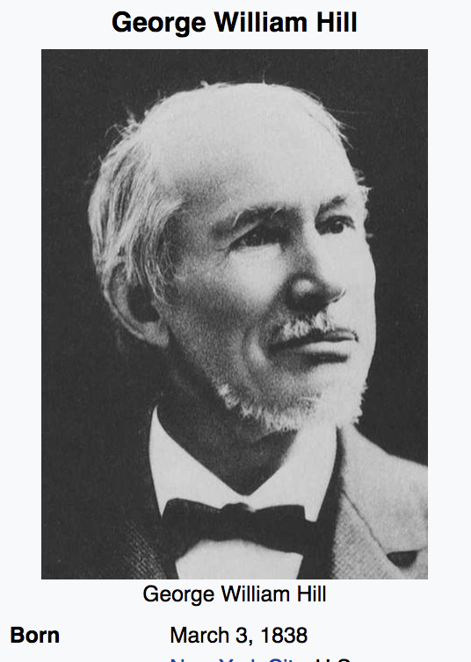


$${x(s)}^{′′}−k(s)x(s)=0$$
Hill’s equation of motion
The solution, x(s), describes a transverse oscillation about the ideal orbit known as betatron oscillation, whose amplitude and phase depend on the position s along the orbit
Hill’s equation owns his name from the Astronomer G. W. Hill
In 1878, Hill provided the first complete mathematical solution to the problem of the apsidal precession of the Moon's orbit around the Earth, a difficult problem in lunar theory first raised in Isaac Newton's Principia Mathematica of 1687.^{[2]} This same work also introduced what is now known in physics and mathematics as the "Hill differential equation", which describes the behavior of a parametric oscillator and which made an important contribution to the mathematical Floquet theory. (from Wikipedia)

Slide 23






The solution to this equation has the usual cosine form
$$x\left(s\right)=Au\left(s\right)cos⁡(ψ\left(s\right)+φ)$$
The constant amplitude factor A and the phase $φ$ are integration constants fixed by the initial conditions
Inserting the solution x(s) and its derivative x’(s) into the Hill’s equation we obtain
$$A[u^{′′}−uψ^{′2}−k\left(s\right)u]cos(ψ+φ) −A[2u^{′}ψ^{′}+uψ^{′′}]\sin\left(ψ+φ\right)=0$$
Since $ψ\left(s\right)$ has a different value at every point in the orbit, and A≠0, the equation above can only be satisfied if
$$u^{′′}−uψ^{′2}−k\left(s\right)u=0$$
$$2\frac{u^{′}}{u}+\frac{ψ^{′′}}{ψ^{′}}=0$$
$$ψ\left(s\right)=\int_{0}^{s}{\frac{dσ}{u^{2}(σ)}}$$
$$2u^{′}ψ^{′}+uψ^{′′}=0$$

Slide 24




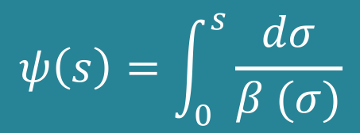

Non-linear differential equation with no general analytic solution ➔ numerical methods
How do we do with complicated magnet structures with many individual magnets?
$$u^{′′}−\frac{1}{u^{3}}−k\left(s\right)u=0$$
Forget about this, we’ll use the same approach as for a single particle trajectory, i.e. we’ll develop a matrix method to calculate the FULL BEAM OPTICS in the same simple way
First we introduce the beta function (also known as amplitude function)
$$β\left(s\right)≡u^{2}(s)$$
Second we replace the amplitude factor A by $\sqrt{ε}$ a constant term called emittance
$$ψ\left(s\right)=\int_{0}^{s}{\frac{dσ}{β (σ)}}$$
$$x\left(s\right)=\sqrt{εβ(s)}cos⁡(ψ\left(s\right)+φ)$$

Slide 25

We saw before that turn after turn the particles perform betatron oscillations around the orbit amplitude-position-dependent under the action of the quadrupoles. We see that this action has a net FOCUSING effect
$$x\left(s\right)=\sqrt{εβ(s)}cos⁡(ψ\left(s\right)+φ)$$
Beam envelope
Since all particle trajectories lie inside this envelope, it defines the BEAM SIZE
Oscillation amplitude

Slide 26
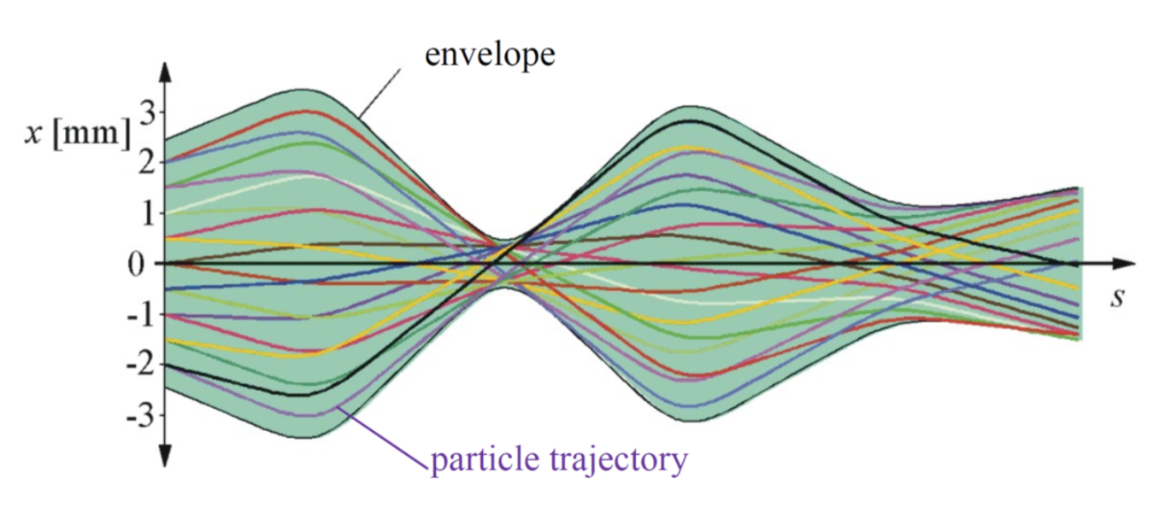
If we know how 𝛽(s) evolves step by step through the magnet structure, in the same way as the particle trajectory and we know the value of the EMITTANCE ➔ we can know the transverse beam size at any point in the accelerator
(We’ll come back to this)

Slide 27

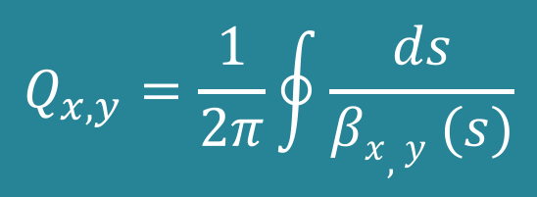
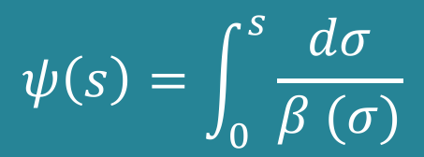
Betatron tune
$$ψ\left(s\right)=\int_{0}^{s}{\frac{dσ}{β (σ)}}$$
Let’s come back to the relation
PHASE ADVANCE
In a circular accelerator the integral $“0⟶s”$ is equivalent to a complete revolution
$$Q_{x,y}=\frac{1}{2π}\oint{\frac{ds}{βx,y (s)}}$$
BETATRON TUNE
Number of betatron oscillations the beam (each particle) performs after one turn

Slide 28
7
6
8
5
1
4
2
3
1
2
3
4
5
6
7
8
1 full betatron oscillation
½ betatron oscillation
1.5 betatron oscillations in x ➔ Tune = Q_{x} = 1.5

Slide 29
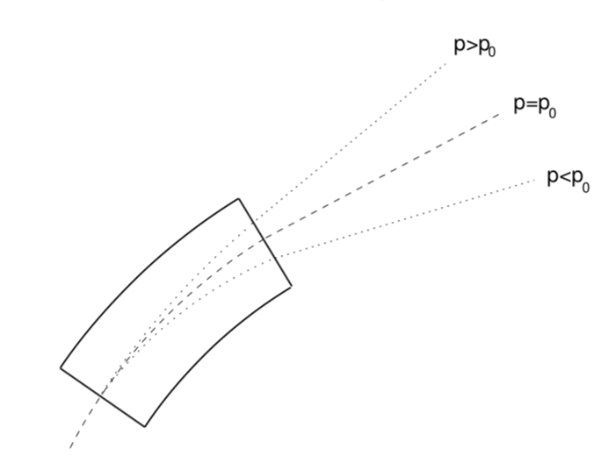

Dispersion D(s)
So far we have studied monochromatic beams of particles, but this is slightly unrealistic
We always have some small momentum spread among all particles: $∆p=p−p_{0}≠0$
Consider three particles with p respectively: less than, greater than, and equal to p₀ , traveling through a dipole
Remember Bρ = p /q
The system introduces a correlation of momentum with transverse position
This correlation is known as dispersion (an intrinsic property of the dipole magnets)

Slide 30
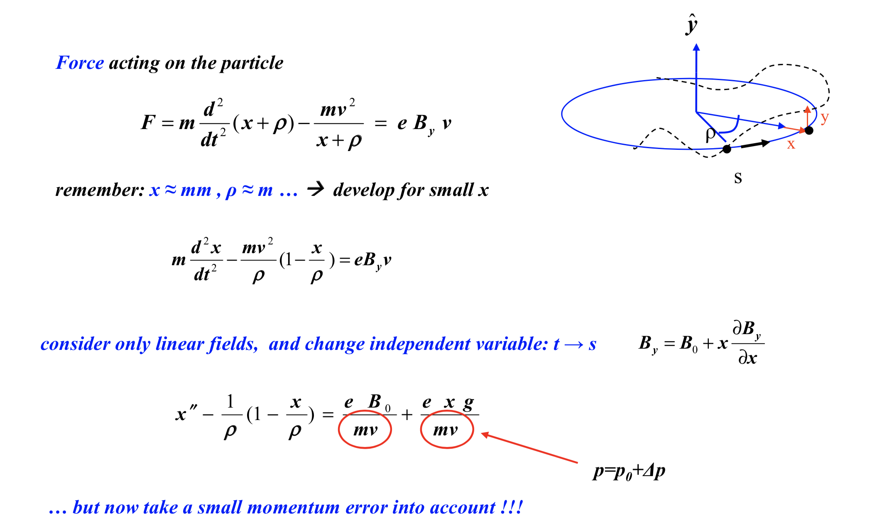

Slide 31
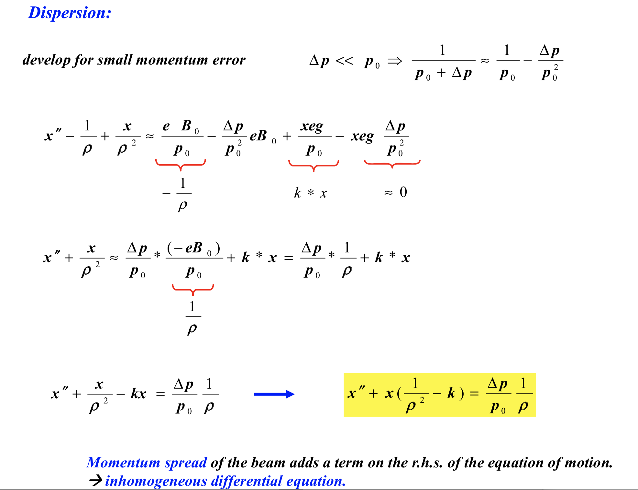

Slide 32
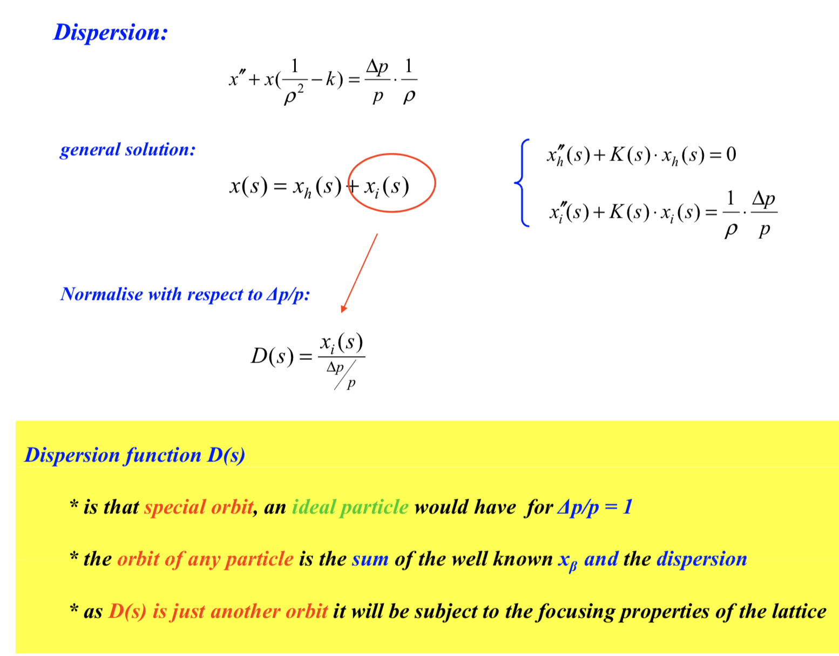

Slide 33
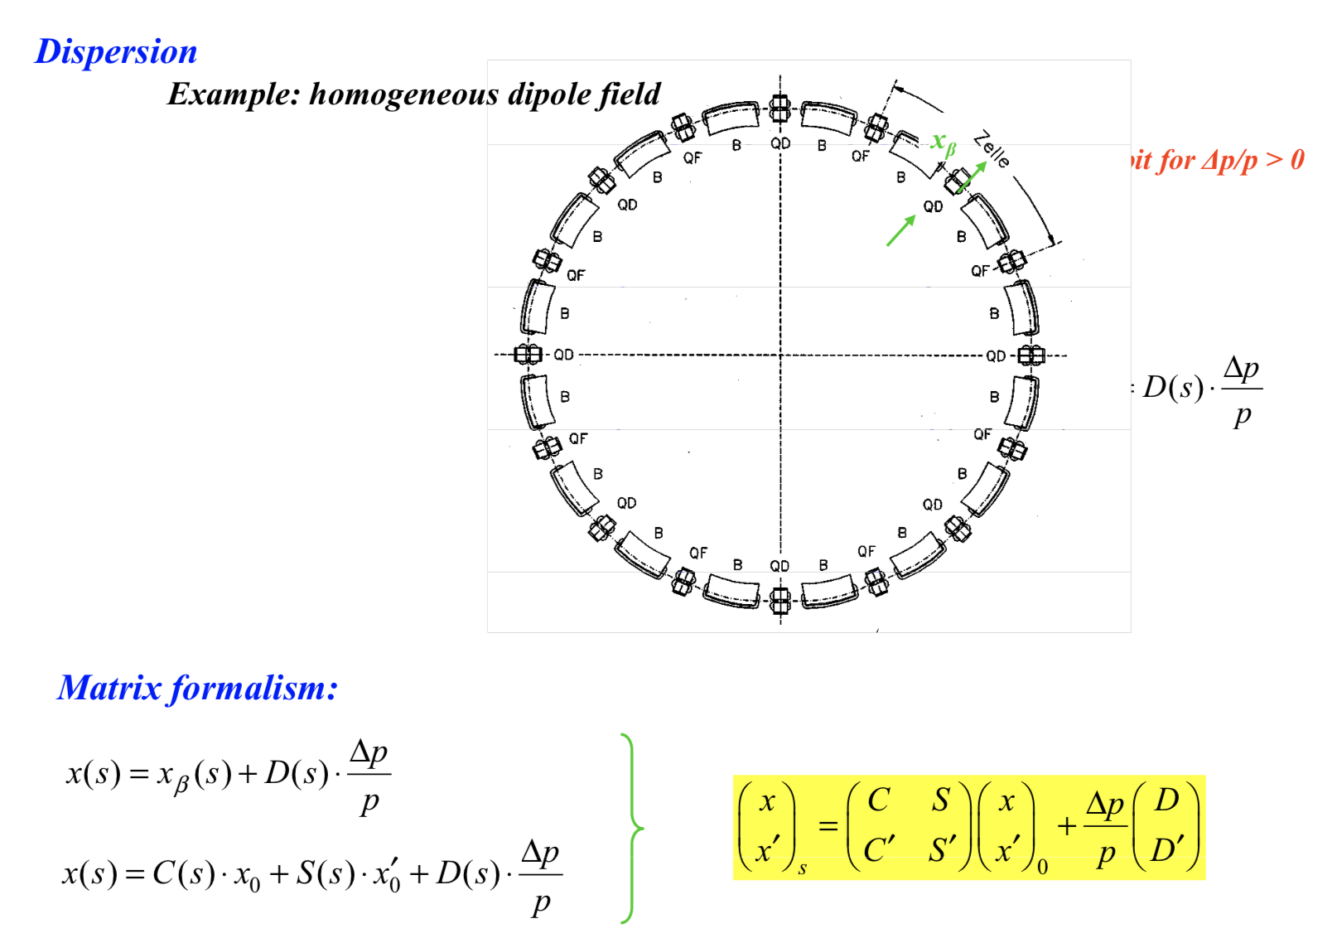

Slide 34
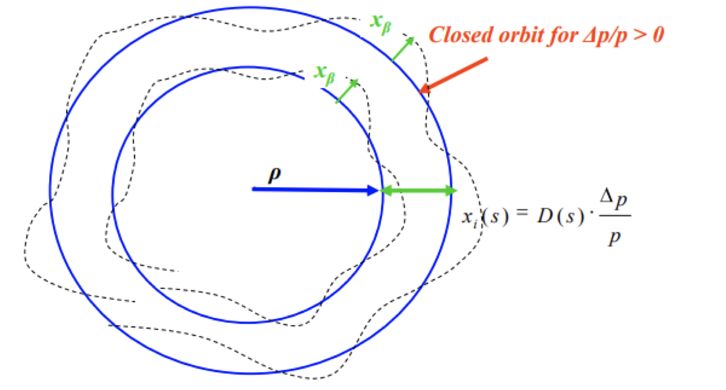
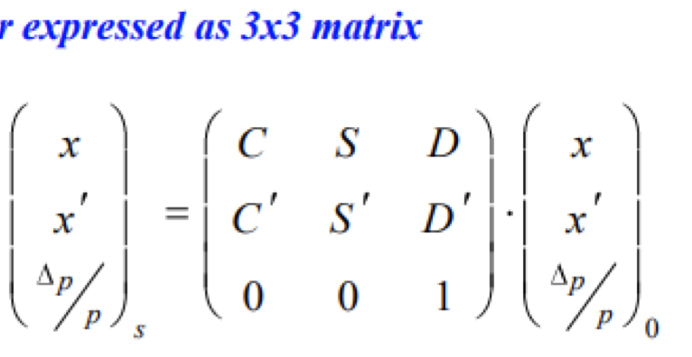

Slide 35
Examples of Twiss and dispersion functions
LEIR
SPS
LHC

Slide 36
HERA beta function in the arcs
β (m)
𝛃_{x}
𝛃_{y}
QF
QD
D (m)

Slide 37
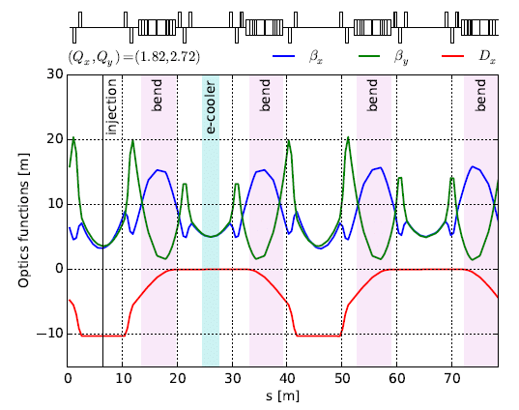
LEIR

Slide 38
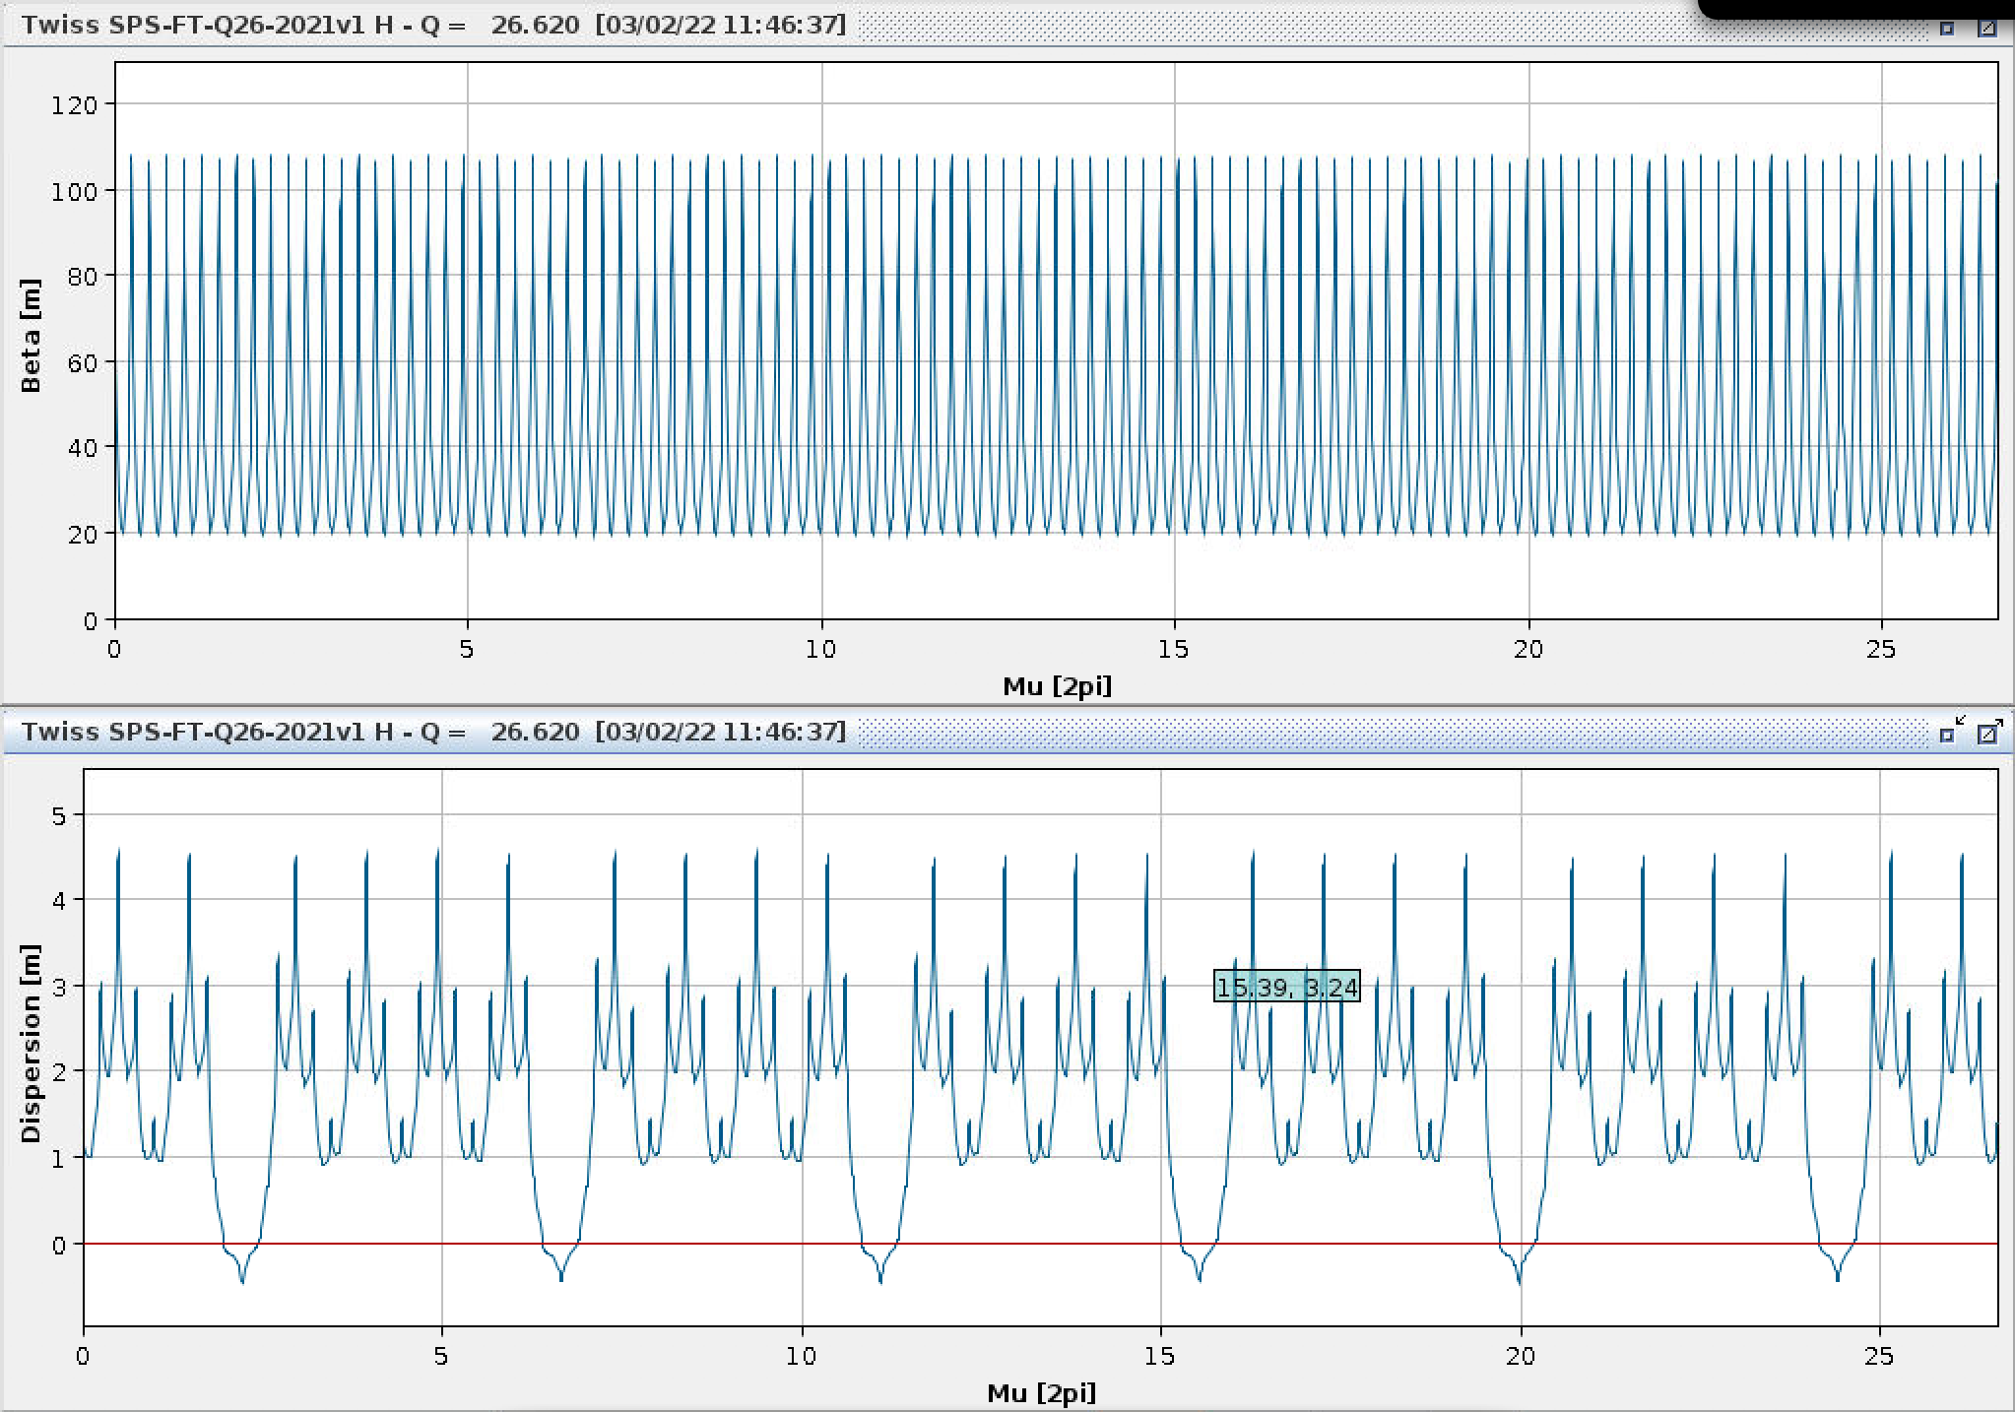
Horizontal axis is give in units of phase advance
SPS
26.62 x 2𝜋

Slide 39
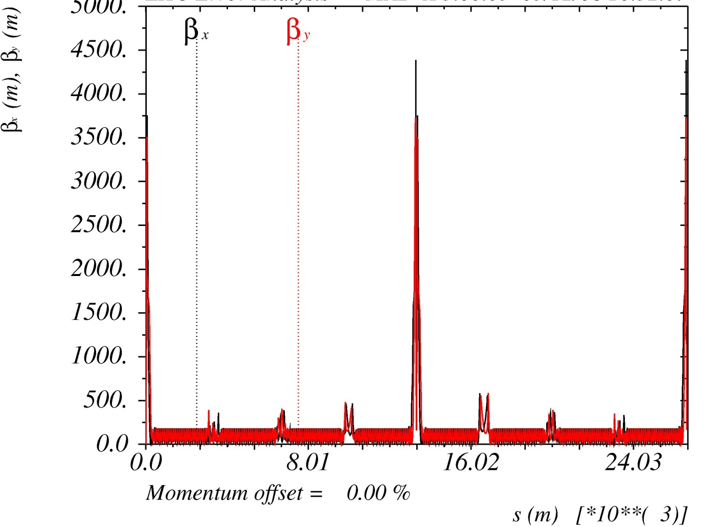
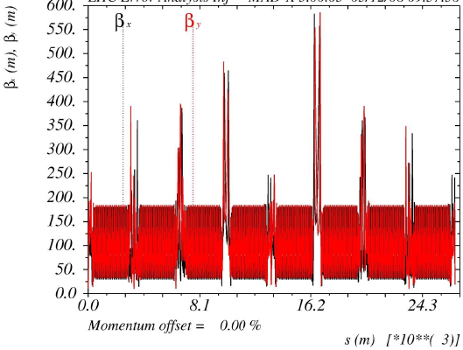
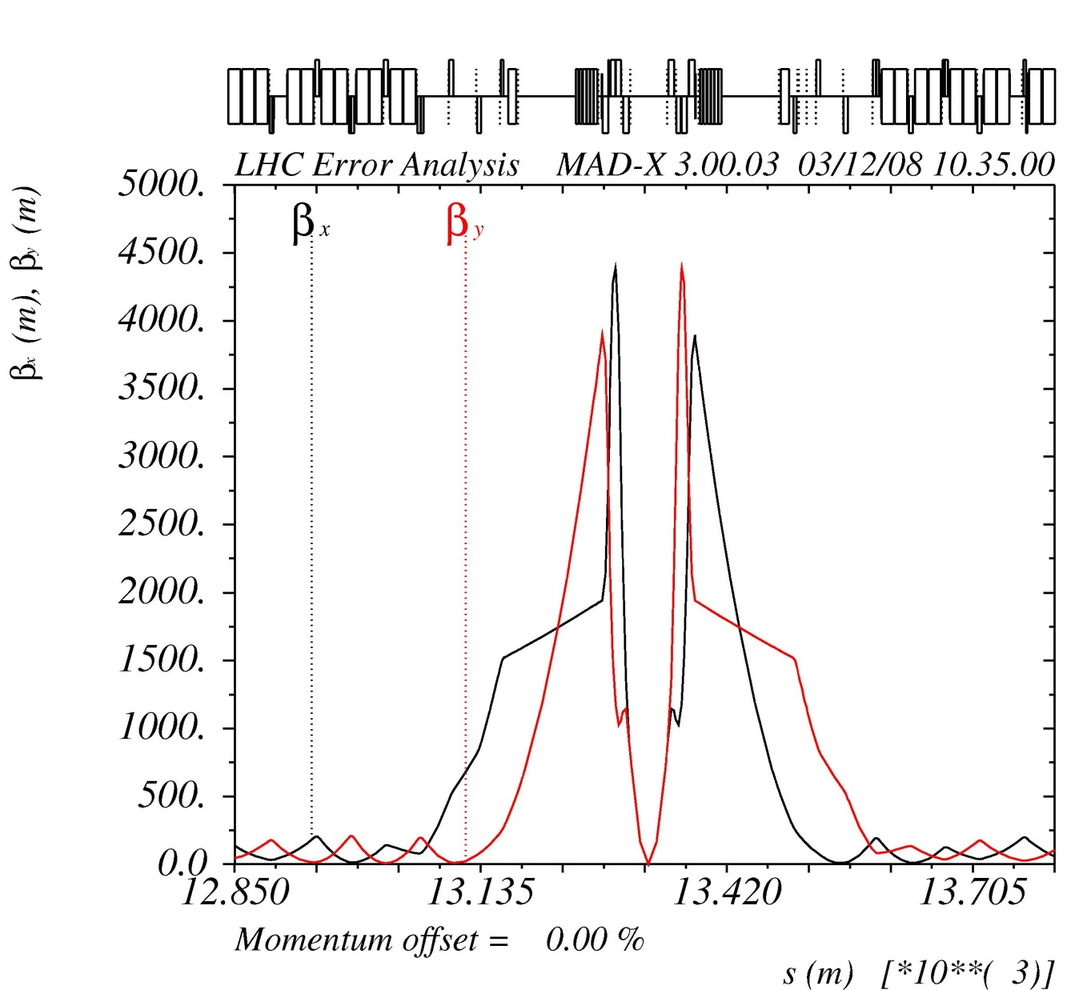
LHC Operational cycle:
Squeeze ➔ reduce β* (β @IP)
Beta function at Injection
Beta function at top energy and after squeeze
4500 m
IR1
IR5
IR1
180 m
250 m
180 m
IR5
IR2
IR3
IR4
IR6
IR7
IR8
@IP β*=0.5 m
IR1
IR2
IR3
IR4
IR6
IR7
IR8
IR1
Inner Triplets

Slide 40
Spares

Slide 41
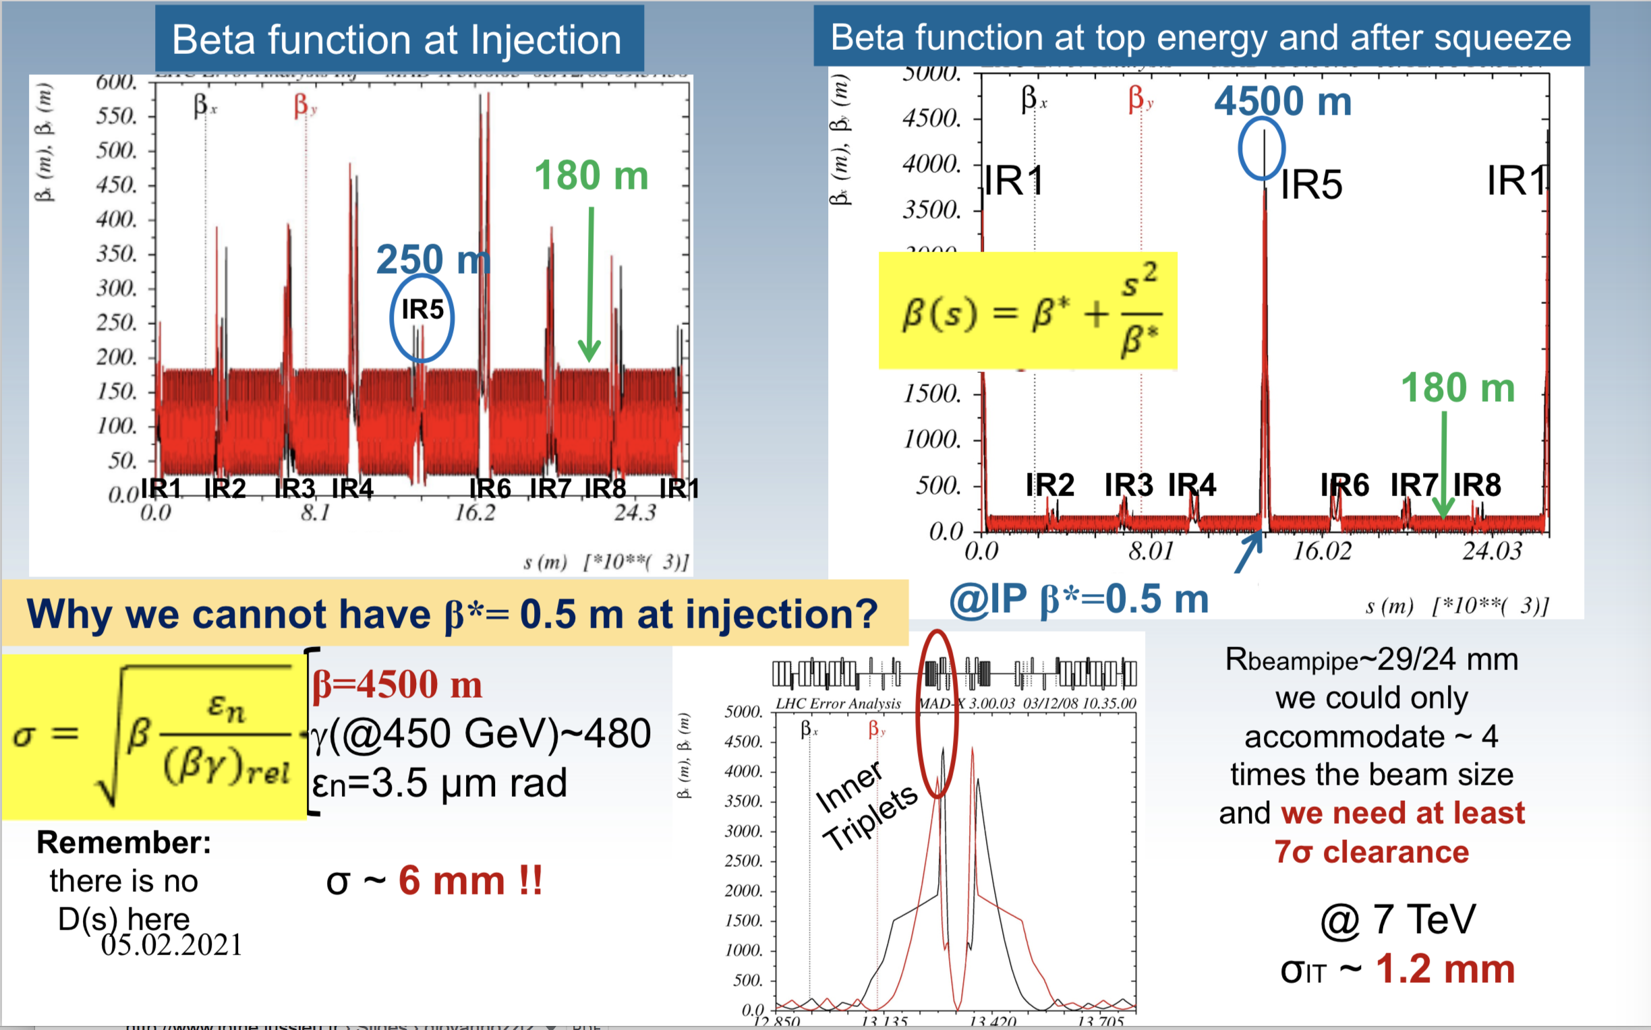
LHC

