Slide 1
Introduction to longitudinal beam dynamics I

Slide 2
Course objectives
Course objectives:
Give an overview of the longitudinal beam dynamics in accelerators
Understand the issue of synchronization between the particles and the accelerating cavity
The course will focused on synchrotrons and the synchrotron motion
We will discuss radio-frequency resonators and the transit time factor (?)

Slide 3
Part I covers:
SYNCRHONOUS PARTICLE or ON-MOMENTUM PARTICLE or IDEAL PARTICLE
OFF-MOMENTUM PARTICLE or REAL PARTICLE
MOMENTUM COMPACTION FACTOR
RELATIVISTIC AND NON-RELATIVISTIC REGIME
SLIP FACTOR
GAMMA TRANSITION
PHASE FOCUSING: NON-RELATIVISTIC REGIME
PHASE FOCUSING: RELATIVISTIC REGIME
SYNCHROTRON OSCILLATIONS
SYNCHROTRON MOTION & EQUATIONS OF MOTION
STABILITY CONDITION FOR THE CASE OF SMALL DEVIATIONS

Slide 4
Part 2 covers:
LONGITUDINAL PHASE SPACE AND SEPARATRIX
CASE 1: NO ACCELERATION (ABOVE TRANSITION):
  STATIONARY BUCKET
  SEPARATRIX
CASE 2: ACCELERATION (ABOVE TRANSITION)
RF BUCKET PARAMETERS
  PHASE SPACE AREA
  BUCKET AREA OR LONGITUDINAL ACCEPTANCE
  BUCKET WIDTH
  BUCKET HIGHT
  SINGLE PARTICLE LONGITUDINAL EMITTANCE

Slide 5
Part 1

Slide 6
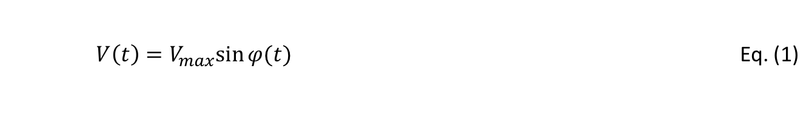
INTRODUCTION
In general particles gain energy from the electric field in the longitudinal direction.
The electric field can be generated by an electrostatic accelerator, but it is limited by the field breakdown and by the length of the accelerating column.
Electrostatic accelerators have been mainly used for low energy.
Alternatively, a radio-frequency (RF) cavity operating in a resonance condition can be used to provide the accelerating voltage:
$$V\left(t\right)=V_{max}sin⁡{φ(t)}_{}$$ | Eq. (1)

Slide 7

$$V\left(t\right)=V_{max}sin⁡{φ(t)}_{}$$ | Eq. (1)
1 RF period
V
time or phase
?
?
?
?
?
When is the best time or phase at which the particle has to enter the cavity to get the best accelerating performance???

Slide 8
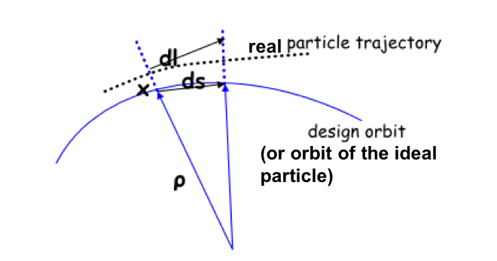

Let’s try to answer the question by concentrating our argumentation on the behavior of the IDEAL PARTICLE
The IDEAL particle has the design momentum which perfectly follows the magnetic field variation ➔ p_{s} = qBρ
The IDEAL particle goes through the center of the quadrupoles, and does not see any restoring force
The IDEAL particle has the design momentum and therefore does not have a dispersive orbit
The IDEAL particle runs on the design orbit defined by the dipole magnets and travel a distance ds with bending radius $ρ$ at a given moment in time

Slide 9

SYNCRHONOUS PARTICLE or ON-MOMENTUM PARTICLE or IDEAL PARTICLE
The IDEAL particle has the design momentum, therefore, it enters the RF cavity at the right time or phase
The IDEAL particle is synchronized with the RF phase ➔ has the so called synchronous phase, $φ_{s}$, at a revolution period $T_{s}=δt_{s}=T_{0}$(*) and its momentum is $p_{s}=p_{0}$
The IDEAL particle is the synchronous particle of charge q that gains energy every time it crosses the accelerating gap by this amount:
$$∆E=\int_{s_{1}}^{s_{2}}{F_{elec}ds=}\int_{s_{1}}^{s_{2}}{{qE}_{elec}ds=}qE∆s=qV=qV_{max}sinφ_{s}$$
(*) unfortunately, every author uses a different notation

Slide 10
But life is everything except IDEAL

Slide 11
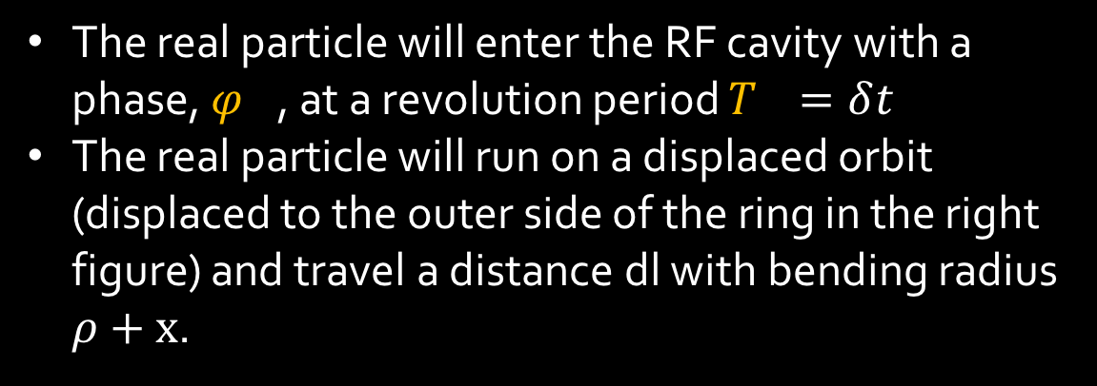
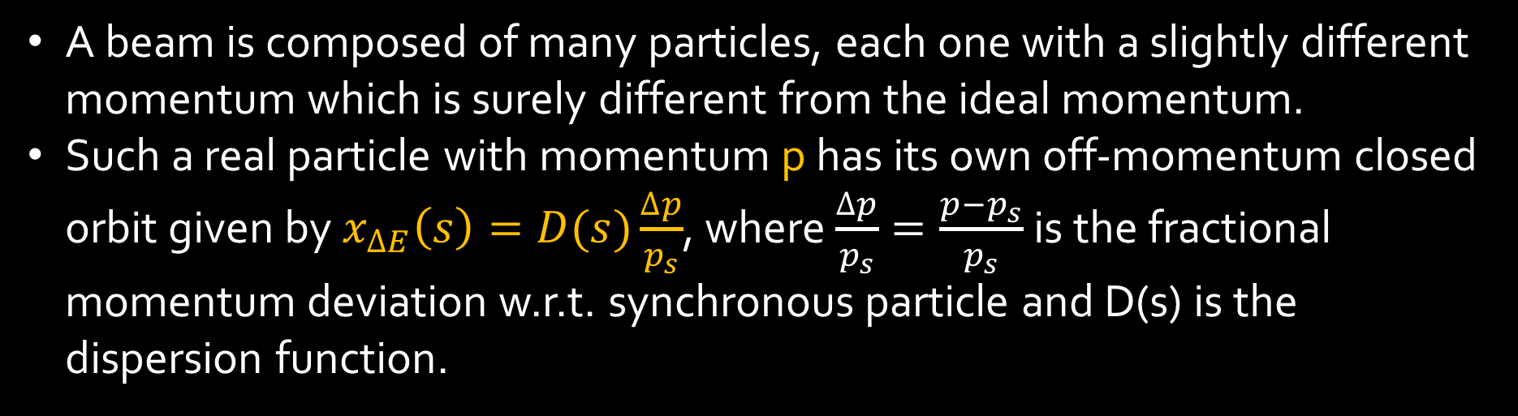
OFF-MOMENTUM PARTICLE or REAL PARTICLE
A beam is composed of many particles, each one with a slightly different momentum which is surely different from the ideal momentum.
Such a real particle with momentum p has its own off-momentum closed orbit given by $x_{∆E}\left(s\right)=D(s)\frac{∆p}{p_{s}}$, where $\frac{∆p}{p_{s}}=\frac{p−p_{s}}{p_{s}}$ is the fractional momentum deviation w.r.t. synchronous particle and D(s) is the dispersion function.
“s” of synchronous
“s” position in the accelerator
The real particle will enter the RF cavity with a phase, $φ_{}$, at a revolution period $T_{}=δt_{}$
The real particle will run on a displaced orbit (displaced to the outer side of the ring in the right figure) and travel a distance dl with bending radius $ρ+x$.

Slide 12
If the real particle trajectory is too wrong, it will take the particle longer (or shorter) time to get to the RF cavity, and therefore, it will see a different phase of the voltage and therefore a different voltage and will gain a … wrong energy
The synchronization of the motion in a synchrotron depends critically on the total path length

Slide 13
MOMENTUM COMPACTION FACTOR

Slide 14
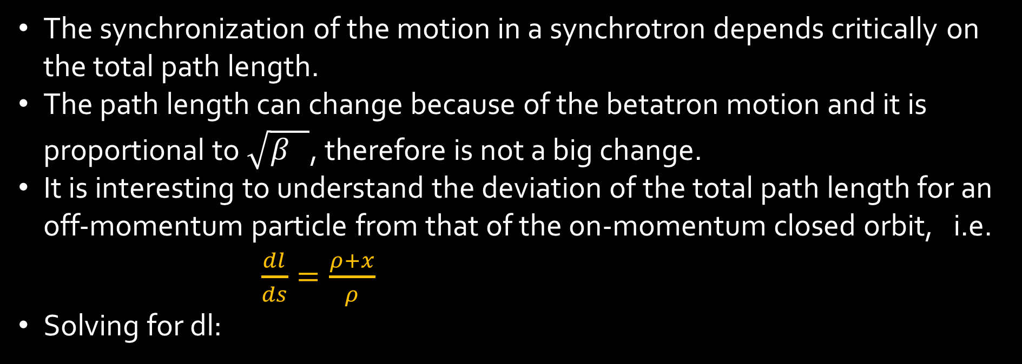
MOMENTUM COMPACTION FACTOR
The synchronization of the motion in a synchrotron depends critically on the total path length.
The path length can change because of the betatron motion and it is proportional to $\sqrt{β_{}}$, therefore is not a big change.
It is interesting to understand the deviation of the total path length for an off-momentum particle from that of the on-momentum closed orbit, i.e. $\frac{dl}{ds}=\frac{ρ+x}{ρ}$
Solving for dl:
$$dl=\left(1+\frac{x}{ρ(s)}\right)ds$$ | Eq. 2

Slide 15

Integrating around the machine we get the orbit length of the off-momentum particle, where x is the radial displacement caused by the momentum error and the dispersion function, i.e. $x_{∆E}\left(s\right)=D\left(s\right)\frac{∆p}{p_{s}}$.
$$l_{ΔE}=\oint{dl}=\oint{\left(1+\frac{x_{∆E}\left(s\right)}{ρ(s)}\right)ds}=l_{s}+\frac{∆p}{p_{s}}\oint{\frac{D(s)}{ρ(s)}ds}$$ | Eq. 3
Finally we obtain the expression for the difference in orbit length between the ideal particle and the real particle which is determined by the amount of momentum error and dispersion in the storage ring:
$${Δl}_{ΔE}=l_{ΔE}−l_{s}=\frac{∆p}{p_{s}}\oint{\frac{D(s)}{ρ(s)}ds}$$ | Eq. 4
From Eq. 4 we get a very important relationship between the relative orbit difference $\frac{{Δl}_{ΔE}}{l_{s}}$ and the relative momentum error $\frac{∆p}{p_{s}}$ called MOMENTUM COMPACTION FACTOR (α or α_{c} or α_{p} , depending on the author):
$$\frac{{Δl}_{ΔE}}{l_{s}}=α\frac{∆p}{p_{s}}$$ | Eq. 5
$$α=\frac{1}{l_{s}}\oint{\frac{D(s)}{ρ(s)}ds}$$ | Eq. 6

Slide 16
The synchronization of the motion in a synchrotron depends critically on the total path length
MOMENTUM COMPACTION FACTOR
$$\frac{{Δl}_{ΔE}}{l_{s}}=α\frac{∆p}{p_{s}}$$ | Eq. 5
$$α=\frac{1}{l_{s}}\oint{\frac{D(s)}{ρ(s)}ds}$$ | Eq. 6

Slide 17
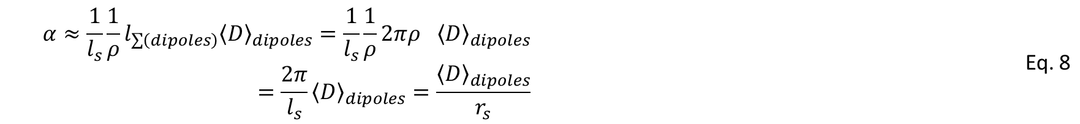
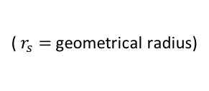




How much the momentum compaction factor is?
For first estimates we assume equal bending radii in all dipoles such $\frac{1}{ρ}$ is constant, and we replace the integral of the dispersion around the ring by a sum over the average dispersion in the dipole magnets (outside the dipoles $\frac{1}{ρ}=0$)
$$\oint_{dipoles}{D\left(s\right)ds}≈l_{\sum{(dipoles)}}{\left\langle D\right\rangle }_{dipoles}$$ | Eq. 7
$$α≈\frac{1}{l_{s}}{\frac{1}{ρ}l}_{\sum{\left(dipoles\right)}}{\left\langle D\right\rangle }_{dipoles}=\frac{1}{l_{s}}{\frac{1}{ρ}2πρ}_{}{\left\langle D\right\rangle }_{dipoles}=\frac{2π}{l_{s}}{\left\langle D\right\rangle }_{dipoles}=\frac{{\left\langle D\right\rangle }_{dipoles}}{r_{s}}$$ | Eq. 8
$$α≈\frac{{\left\langle D\right\rangle }_{dipoles}}{r_{s}}$$ | Eq. 9
( $r_{s}=$geometrical radius)
It can be demonstrated that for well behaving optics:
$$α≈\frac{1}{Q_{x}^{2}}$$ | Eq. 9’
SPS Q_{x} = 26 ➔ $α$ ~ 2・10⁻³
PS Q_{x} =6.2 ➔ $α$ ~ 2.7・10⁻²

Slide 18
RELATIVISTIC AND NON-RELATIVISTIC REGIME

Slide 19


$η$ = SLIP FACTOR
Velocity
$γ_{tr}$= GAMMA TRANSITION
SPS/LHC
c
PS
EINSTEIN REGIME
Increase in energy ➔ increase relativistic mass
NEWTON REGIME
In a circular accelerator:
Increase in relativistic mass➔ decrease in revolution frequency
Booster
Increase in energy ➔ increase in velocity
Energy
In a circular accelerator:
Increase in velocity ➔ increase in revolution frequency

Slide 20


RELATIVISTIC AND NON-RELATIVISTIC REGIME
The revolution period of a particle is $T=\frac{L}{v}$.
The relative difference between the revolution period of the real and the ideal particle is:
$$\frac{∆T}{T_{s}}=\frac{{Δl}_{ΔE}}{l_{s}}−\frac{∆v}{v_{s}}$$ | Eq. 10
For relativistic particles where $v≈c$, the ideal and real particle have the same velocity and therefore Eq. 10 simplifies to:
$$\frac{∆T}{T_{s}}≈\frac{{Δl}_{ΔE}}{l_{s}}$$ | Eq. 11
Recalling Eq. 5
$$\frac{∆T}{T_{s}}≈α\frac{∆p}{p_{s}}$$ | Eq. 12
Therefore the problem of synchronization can be solved by dealing with the relative momentum error.
For non-relativistic beams, the problem of synchronization requires a more detailed treatment. The parameter of interest is the ratio between the relative momentum error and the relative frequency deviation of the particle:
$$\frac{∆f}{f_{}}=η\frac{∆p}{p_{s}}$$ | Eq. 13
The ratio is called the slip factor η
$η$ = SLIP FACTOR

Slide 21

SLIP FACTOR
Let’s express the revolution frequency as a function of the machine radius and particle velocity:
$Ω=2πf \& Ω=\frac{v}{r}=\frac{βc}{r}$ ➔ $f=\frac{βc}{2πr}$ | Eq. 14
Let’s calculate the derivative:
$$df=\frac{c}{2π}d\left(\frac{β}{r}\right)=\frac{c}{2π}\frac{rdβ−βdr}{r^{2}}$$ | Eq. 15
Let’s calculate the relative frequency error:
$$\frac{df}{f}=\frac{dβ}{β}−\frac{dr}{r}$$ | Eq. 16
Remember Eq. 5, the equation of the momentum compaction factor that relates a change in radius or path length with the relative momentum error via the compaction factor, therefore, $\frac{dr}{r}=α\frac{Δp}{p}$
The particle momentum is related to the particle energy and velocity:
$$p=mv=βγ\frac{E_{0}}{c}⟹\frac{dp}{p}=\frac{dβ}{β}+\frac{{d\left(1−β^{2}\right)}^{−\frac{1}{2}}}{{\left(1−β^{2}\right)}^{−\frac{1}{2}}}={(1−β^{2})}^{−1}\frac{dβ}{β}$$ | Eq. 17

Slide 22
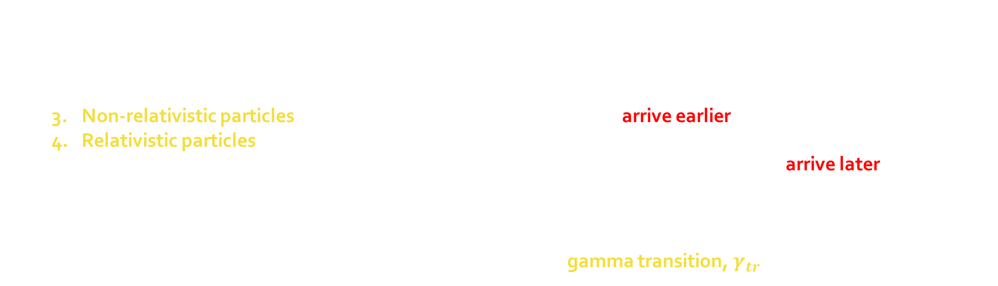

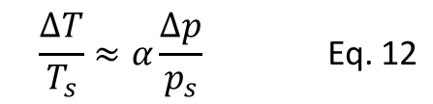
Introducing the last equations in Eq. 16 we get:
$\frac{df}{f}=\frac{dβ}{β}−\frac{dr}{r}=\left(\frac{1}{γ^{2}}−α\right)\frac{dp}{p}=−\left(α−\frac{1}{γ^{2}}\right)\frac{dp}{p}$ ➔ $η=α−\frac{1}{γ^{2}}$ | Eq. 18
$η$ = SLIP FACTOR
Eq. 16
$$\frac{∆T}{T_{s}}≈α\frac{∆p}{p_{s}}$$ | Eq. 12
Which for relativistic particles, reduces to Eq. 12 ($γ^{2}$ >>>>>>) ➔
IMPORTANT REMARKS about Eq. 18:
  The change of revolution frequency depends on the particle energy, $γ$.
  It can change sign during acceleration.
  Non-relativistic particles will get faster at the beginning and will arrive earlier at the accelerating cavity.
  Relativistic particles, $v≈c$, will not get faster anymore but rather get more massive and they will be pushed to dispersive orbits. Therefore the path length will be bigger and bigger and they will arrive later to the cavity.
  The boundary between the two regimes is defined for the case where there is no frequency dependence on the relative momentum error, i.e. $η=0$. In this case the velocity variation is exactly compensated by the trajectory variation and the corresponding energy is called gamma transition, $γ_{tr}$
$$γ_{tr}=\frac{1}{\sqrt{α}}$$ | Eq. 19
In general accelerators are designed to avoid crossing transition as it involves RF phase changes, otherwise particles lose their longitudinal focusing and the bunch profile will dilute and get lost.
SPS Q_{x} = 26 ➔ $α$ ~ 2・10⁻³ ➔ $γ_{tr}$ = 22.36 ➔ E_{tr}(p+) = $γ_{tr}$*E₀/q ~ 21 GeV
The transition energy is determined by the choice of the lattice
PS Q_{x} =6.2 ➔ $α$ ~ 2.7・10⁻² ➔$γ_{tr}$ = 6.1 ➔ E_{tr}(p+) = $γ_{tr}$*E₀/q ~ 5.8 GeV

Slide 23
PHASE FOCUSING:
NON-RELATIVISTIC REGIME
RELATIVISTIC REGIME

Slide 24
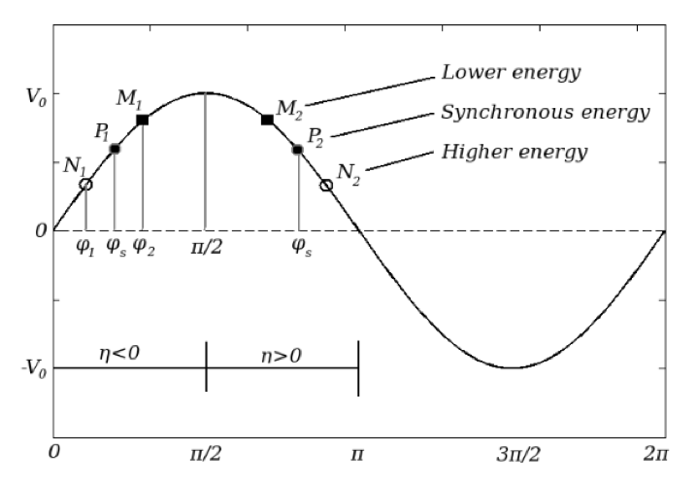
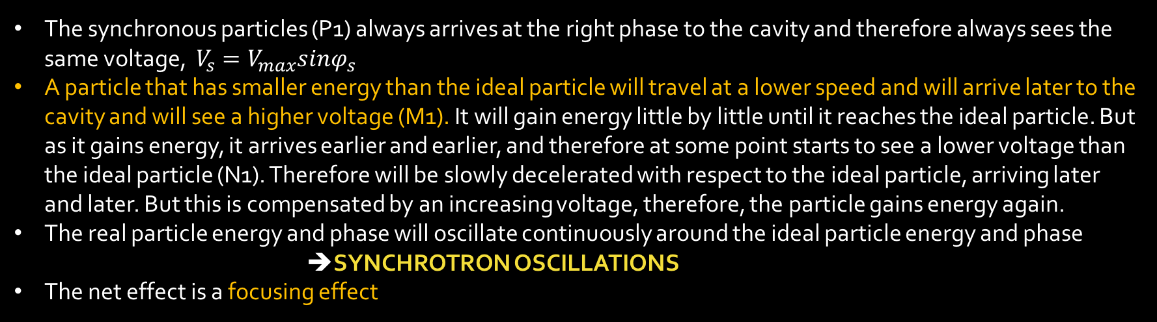
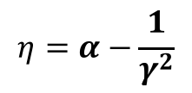



PHASE FOCUSING: NON-RELATIVISTIC REGIME
$$η=α−\frac{1}{γ^{2}}$$
$$[0,\frac{π}{2}]$$
$$η<0$$
$$η>0$$
The synchronous particles (P1) always arrives at the right phase to the cavity and therefore always sees the same voltage, $V_{s}=V_{max}sinφ_{s}$
A particle that has smaller energy than the ideal particle will travel at a lower speed and will arrive later to the cavity and will see a higher voltage (M1). It will gain energy little by little until it reaches the ideal particle. But as it gains energy, it arrives earlier and earlier, and therefore at some point starts to see a lower voltage than the ideal particle (N1). Therefore will be slowly decelerated with respect to the ideal particle, arriving later and later. But this is compensated by an increasing voltage, therefore, the particle gains energy again.
The real particle energy and phase will oscillate continuously around the ideal particle energy and phase
            ➔SYNCHROTRON OSCILLATIONS
The net effect is a focusing effect

Slide 25





PHASE FOCUSING: RELATIVISTIC REGIME
$$η=α−\frac{1}{γ^{2}}$$
$$[\frac{π}{2},π]$$
$$η<0$$
$$η>0$$
For relativistic particles, $v≈c$, the same effect exists but based now on the relativistic mass increase with energy.
The high energy particle (N2) will, due to its higher mass than the ideal particle, run on a longer orbit and it will arrive later to the cavity and will see a smaller voltage than the ideal one.
Little by little the particle will catch the ideal particle relativistic mass and, little by little will arrive sooner and sooner until overpass the ideal particle (M2), but meaning it has less energy than the ideal one. However, this will be compensated by the fact that the real particle will see a higher voltage.
The real particle energy and phase will oscillate continuously around the ideal particle energy and phase ➔SYNCHROTRON OSCILLATIONS
The net effect is a focusing effect
As a consequence the synchronous phase has to be chosen depending on whether we are running the accelerator below or above transition.
Accelerators crossing transition will have to perform a phase jump to keep the particles bunched.

Slide 26
$$V\left(t\right)=V_{max}sin⁡{φ(t)}_{}$$ | Eq. (1)
1 RF period
V
time or phase
?
?
?
?
?
When is the best time or phase at which the particle has to enter the cavity to get the best accelerating performance???

Slide 27
SYNCHROTRON MOTION
Every time particles cross the cavity they gain or lose energy performing synchrotron oscillations or ENERGY-PHASE oscillations around the ideal particle or synchronous particle.
V
Below transition
Above transition
The energy and phase variations can be described by differential equations of motion
∆V≈∆E
time or phase
0
∆𝜑
𝛑/2
𝛑

Slide 28
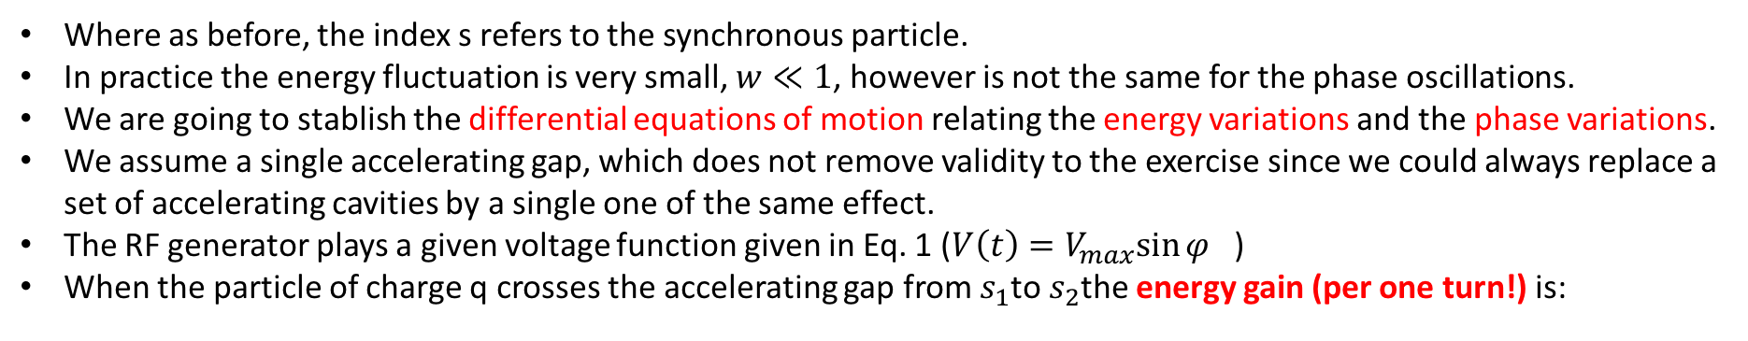
SYNCHROTRON MOTION
Every time particles cross the cavity they gain or lose energy performing synchrotron oscillations or phase oscillations around the ideal particle or synchronous particle.
We will call the relative energy difference:
$$w=\frac{∆W}{W_{s}}=\frac{W−W_{s}}{W_{s}}$$ | Eq. 20
And the phase difference:
$$∆φ=φ−φ_{s}$$ | Eq. 21
Where as before, the index s refers to the synchronous particle.
In practice the energy fluctuation is very small, $w≪1$, however is not the same for the phase oscillations.
We are going to stablish the differential equations of motion relating the energy variations and the phase variations.
We assume a single accelerating gap, which does not remove validity to the exercise since we could always replace a set of accelerating cavities by a single one of the same effect.
The RF generator plays a given voltage function given in Eq. 1 ($V\left(t\right)=V_{max}sin⁡φ_{}$)
When the particle of charge q crosses the accelerating gap from $s_{1}$to $s_{2}$the energy gain (per one turn!) is:
$$W=\int_{s_{1}}^{s_{2}}{\vec{F}d\vec{s}=}\int_{s_{1}}^{s_{2}}{q{\vec{E}}_{field}d\vec{s}=}qE_{field}∆s=qV=qV_{max}sinφ$$ | Eq. 22
$$W−W_{s}=qV_{max}(sinφ−sinφ_{s})$$ | Eq. 23

Slide 29

ADIABATIC PROCESS
In practice, the particle energy varies slowly in comparison with the synchrotron oscillations period, it is a smooth function of t
The relative energy difference is:
$$w=\frac{∆W}{W_{s}}=\frac{qV_{max}}{W_{s}} (sinφ−sinφ_{s})$$ | Eq. 24
Since $T=δt=\frac{2π}{Ω}$ (period=time takes to give one turn) and $\dot{w}≈\frac{δw}{δt}$ we can write (Note 1):
FIRST EQUATION OF MOTION
$$\dot{w}=\frac{qV_{max}Ω_{s}}{2πW_{s}} (sin⁡(Δφ+φ_{s})−sinφ_{s})$$ | Eq. 25
where $\sin\left(Δφ+φ_{s}\right)=sin⁡φ$

Slide 30
Note 1: We are ignoring higher order terms to keep the discussion in the linear regime and assuming $Ω≈Ω_{s}$, i.e.:
$$\dot{w}=\frac{d}{dt}\left(\frac{∆W}{W_{s}}\right)=\frac{\dot{ΔW}W_{s}−ΔW\dot{W_{s}}}{{W_{s}}^{2}}=\frac{\dot{ΔW}}{W_{s}}−\frac{ΔW\dot{W_{s}}}{{W_{s}}^{2}}≅\frac{\dot{ΔW}}{W_{s}}$$
Note 2: in literature (e.g. S.Y. Lee) you’ll find the equation written in this mode:
$$\frac{d}{dt}\left(\frac{∆W}{Ω_{s}}\right)=\frac{1}{2π}qV_{max}\left(\sin\left(Δφ+φ_{s}\right)−sinφ_{s}\right) or\frac{d}{dt}\left(\frac{Δp}{p_{s}}\right)=\frac{Ω_{s}}{2πβ_{s}^{2}W_{s}}qV_{max}\left(\sin\left(Δφ+φ_{s}\right)−sinφ_{s}\right)$$
Where ($Δφ,$ $\frac{ΔW}{Ω_{s}}$) or ($Δφ,\frac{Δp}{p_{s}}$) are pairs of conjugate phase-space coordinates.

Slide 31
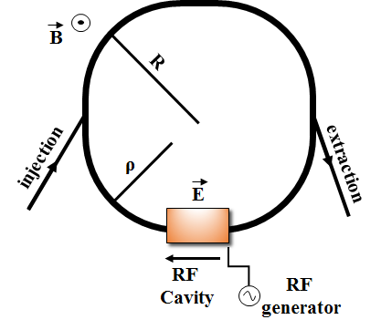




Synchrotrons
Particles follow a constant orbit with mean radius $R$ ($ρ$ is the dipole bending radius)
Acceleration by longitudinal electric field provided by the RF cavities. The RF cavities are placed in a specific
point in the ring. In every turn, after each passage through the RF cavities, the particles gain energy:
$${\left(ΔE\right)}_{turn}=q{\hat{V}}_{RF}sinφ$$
The magnetic field $\vec{B}$ follows the energy change to keep particles in orbit:
$$B\left(t\right)ρ=\frac{p\left(t\right)}{q}⇒\frac{dp}{dt}=qρ\frac{dB}{dt}$$
After one turn: dp ➔ ∆p & dt ➔ ∆t=T
$∆p=qρ\dot{B}T$ with T the revolution period: $T=\frac{2πR}{v}$
${\hat{V}}_{RF}$=Vmax: RF voltage amplitude
$ω_{RF}$: angular RF frequency
$φ_{0}=φ_{s}$: RF synchronous/stable phase
$p$ : particle momentum
q : charge of particle
Using the basic relation: $\dot{vp=}\dot{E}$ , with v the particle velocity, after one turn we have:
$$v\frac{∆p}{∆t}=\frac{\left(∆E\right)turn}{∆t}$$
$${\left(ΔE\right)}_{turn}=q{\hat{V}}_{RF}sinφ=v∆p=vqρ\dot{B}\frac{2πR}{v}$$

Slide 32



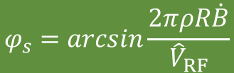


$${\left(ΔE\right)}_{turn}=q{\hat{V}}_{RF}sinφ=v∆p=2πRqρ\dot{B}$$
$sinφ_{s}=\frac{2πρR\dot{B}}{{\hat{V}}_{RF}}$ or $sinφ_{s}=\frac{{\left(ΔE\right)}_{turn}}{q{\hat{V}}_{RF}}$
$$φ_{s}=arcsin\frac{2πρR\dot{B}}{{\hat{V}}_{RF}}$$
$$φ_{s}=arcsin\frac{{\left(ΔE\right)}_{turn}}{q{\hat{V}}_{RF}}$$
➔
As particles gain energy their angular revolution frequency ${Ω=ω}_{rev}$ changes → ${Ω_{RF}=ω}_{RF}$ should be synchronised with $ω_{rev}=Ω_{s}$
Synchronism condition ➔ $Ω_{RF}=hΩ_{s}$
$h$ - harmonic number:
an integer number indicating the RF cycles per revolution period
$h$ synchronous particles equally spaced along the ring following the
nominal (designed) orbit and having the nominal (designed) energy

Slide 33
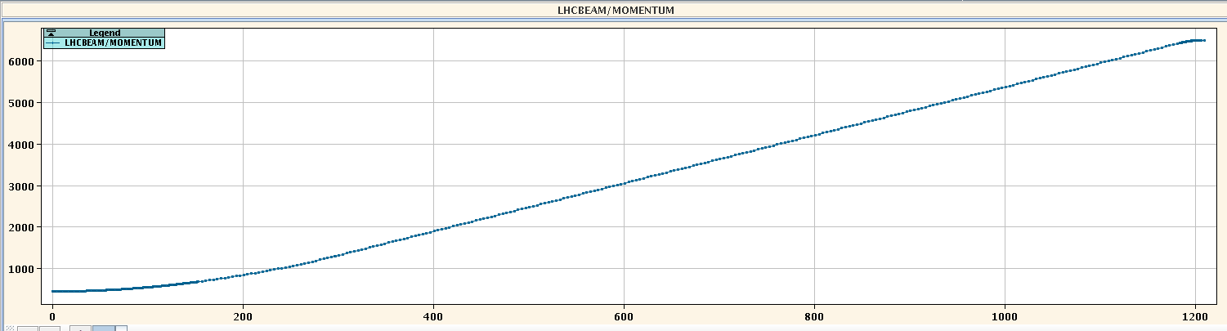
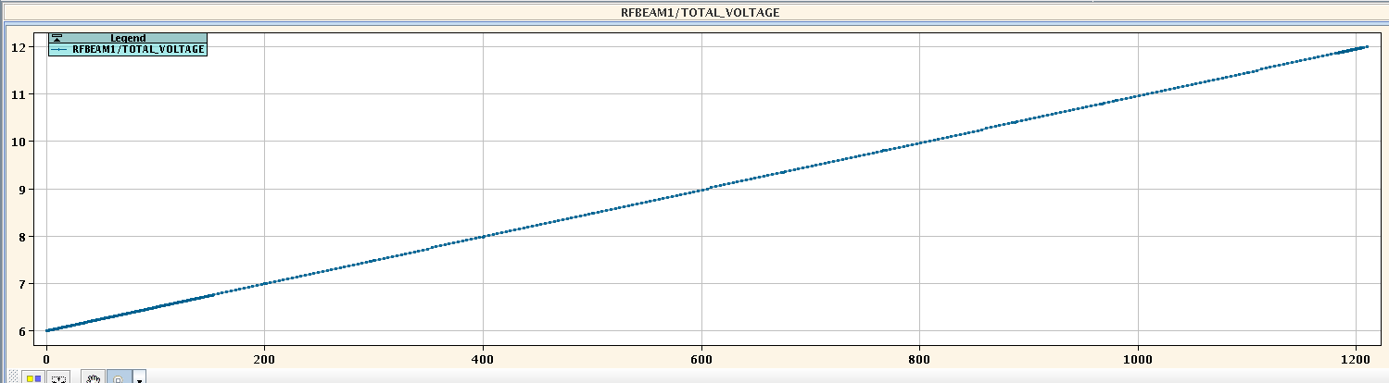
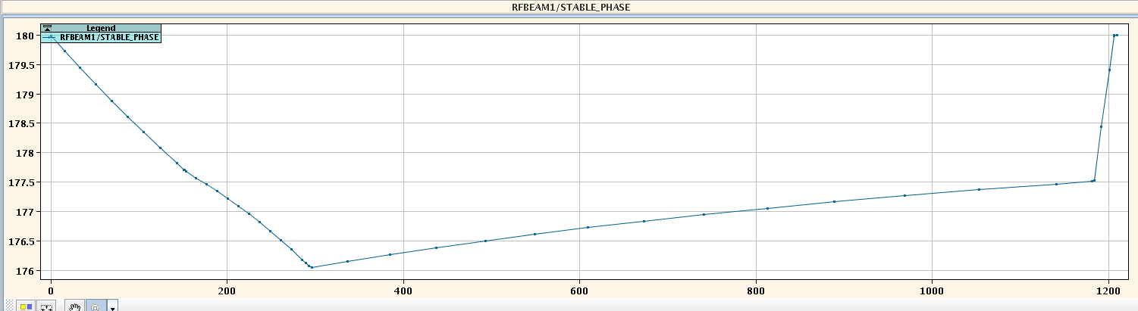

Synchronous phase
$$φ_{s}=arcsin\frac{{\left(ΔE\right)}_{turn}}{q{\hat{V}}_{RF}}$$
$$φ_{s}=arcsin\frac{2πρR\dot{B}}{{\hat{V}}_{RF}}$$
LHC momentum program
6500 GeV/c, flat top
Momentum, p [GeV/c]
450 GeV/c, flat bottom
12 MV
${\hat{V}}_{RF}$[MV]
LHC voltage program
6 MV
180°
180°, no acceleration
LHC stable phase
On average, in the LHC, synchronous particles gain around 0.5 MeV/turn during acceleration.
$φ_{s}$ [degrees]
176°
Ramp time [s]

Slide 34


How did we obtain the first equation of motion?
Just asking ourselves by how much the energy gain difference between the real and the ideal particle has changed after one turn
We considered the problem very adiabatic: the particle energy varies slowly in comparison with the synchrotron oscillations period. We also made a small simplification ignoring higher order terms
We also assumed that $Ω≈Ω_{s}$
$$\dot{w}=\frac{qV_{max}Ω_{s}}{2πW_{s}} (sin⁡(Δφ+φ_{s})−sinφ_{s})$$ | Eq. 25
FIRST EQUATION OF MOTION
Let’s now obtain the second equation of motion
We will ask ourselves: how much the difference between the real particle phase and the ideal particle phase ($Δφ=φ−φ_{s}$) has changed after one turn

Slide 35


To obtain the second equation of motion we need the concept of slip factor (Eq. 18) and that:
$$\frac{Δp}{p_{s}}=\frac{1}{{β_{s}}^{2}}\frac{ΔW}{W_{s}}$$ | Eq. 26 (*)
We start from the equations for the angular velocity:
$$δφ=Ω_{RF}δt \& δφ_{s}=Ω_{RF}δt_{s}$$ | Eq. 27
After one turn, the RF angular velocity in Eq. 27 corresponds to the revolution frequency, and $δφ$ = $δφ_{s}=2π$, i.e.
$$δφ=δφ_{s}=2π=Ω_{}δt=Ω_{s}δt_{s}$$ | Eq. 28
We ask ourselves the question by how much the difference between the real particle phase and the ideal particle phase ($Δφ=φ−φ_{s}$) has changed after one turn?, i.e. how much is $δ\left(Δφ\right)?$
$$δ(Δφ)=Ω_{RF}(δt−δt_{s})$$ | Eq. 29
(*) $W^{2}=p^{2}c^{2}+E_{0}^{2}⇒2WΔW=2pΔpc^{2}⇒we divide by W_{}^{2}⇒ \frac{ΔW}{W}=\frac{pΔpc^{2}}{W^{2}}=\frac{m_{0}γβc}{m_{0}^{2}γ^{2}c^{4}}Δpc^{2}=\frac{Δp}{p}β^{2}$

Slide 36

Where $δt−δt_{s}$ for one turn is $T−T_{s}$, i.e. the difference of the periods, and $Ω_{RF}=hΩ_{s}$, i.e. the acceleration frequency given by the RF system is a multiple h of the synchronous particle revolution frequency.
Now we ask ourselves a more general question: what is the rate of change of $δ(Δφ)$?, i.e.
$$\dot{Δφ=}\frac{δ(Δφ)}{δt}={hΩ}_{s}\left(1−\frac{δt_{s}}{δt}\right)$$ | Eq. 30
From Eq. 28 we can express $\frac{δt_{s}}{δt}$ as the ratio of angular velocities:
$$\dot{Δφ=}\frac{δ(Δφ)}{δt}={hΩ}_{s}\left(1−\frac{Ω}{Ω_{s}}\right)$$ | Eq. 31

Slide 37




$$\dot{Δφ=}\frac{δ(Δφ)}{δt}={hΩ}_{s}\left(1−\frac{Ω}{Ω_{s}}\right)$$ | Eq. 31
$$\dot{Δφ=}\frac{δ(Δφ)}{δt}={−hΩ}_{s}\frac{ΔΩ}{Ω_{s}}$$ | Eq. 32
Since the angular velocity and the energy of the particle are related, we can try to get an equation of motion with both variables present. Since the $2πf=Ω_{},$we can straight away use the equation of the slip factor, Eq. 18, that relates the relative change of revolution frequency with the relative momentum error: $\frac{∆f}{f_{}}=−η\frac{∆p}{p_{s}}$, with $η=α−\frac{1}{γ^{2}}$
As second step we replace the relative momentum error by Eq. 26 to get:
$$\frac{Δp}{p_{s}}=\frac{1}{{β_{s}}^{2}}\frac{ΔW}{W_{s}}$$ | Eq. 26
$$\frac{ΔΩ}{Ω_{s}}=−\left(α−\frac{1}{γ^{2}}\right)\frac{dp}{p}=−\left(α−\frac{1}{γ^{2}}\right)\frac{1}{β_{s}^{2}}\frac{ΔW}{W_{s}}=−Γ_{s}w$$ | Eq. 33
$$Γ_{s}=\frac{η}{β_{s}^{2}}$$
$$\dot{Δφ=}\frac{δ(Δφ)}{δt}={hΓ_{s}Ω}_{s}w$$ | Eq. 34
SECOND EQUATION OF MOTION
$Ω_{RF}=hΩ_{s}$ ➔angular RF frequency is a multiple of the revolution frequency, h: harmonic number

Slide 38
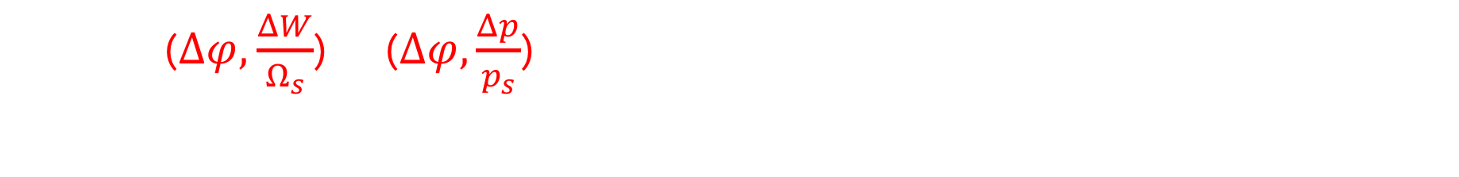
Note: in literature (e.g. S.Y. Lee) you’ll find the equation written like:
$$\dot{Δφ=}\frac{hΩ_{s}^{2}η}{β_{s}^{2}W_{s}}\left(\frac{ΔW}{Ω_{s}}\right) or\dot{ Δφ=}hΩ_{s}η\frac{Δp}{p_{s}}$$
Where ($Δφ,$ $\frac{ΔW}{Ω_{s}}$) or ($Δφ,\frac{Δp}{p_{s}}$) are pairs of conjugate phase-space coordinates. To change from one to another we use Eq. 26:
$$\frac{Δp}{p_{s}}=\frac{1}{β_{s}^{2}}\left(\frac{ΔW}{W_{s}}\right)\frac{Ω_{s}}{Ω_{s}}$$

Slide 39

$$\dot{Δφ=}\frac{δ(Δφ)}{δt}={hΓ_{s}Ω}_{s}w$$ | Eq. 34
SECOND EQUATION OF MOTION
$Ω_{RF}=hΩ_{s}$ ➔angular RF frequency is a multiple of the revolution frequency, h: harmonic number
Example:
If h =1, 1 RF period is equal to 1 particle period
LHC harmonic h = 35640, while the particle gives 1 turn the RF system has oscillated 35640 times
The harmonic number indicates the number of available “buckets”, i.e. the number of available potential wells where the particles are stable ==> see next course

Slide 40

SYNCHROTRON EQUATIONS OF MOTION
$$\dot{w}=\frac{qV_{max}Ω_{s}}{2πW_{s}} (sin⁡(Δφ+φ_{s})−sinφ_{s})$$ | Eq. 25
FIRST EQUATION OF MOTION
$$\dot{Δφ=}\frac{δ(Δφ)}{δt}={hΓ_{s}Ω}_{s}w$$ | Eq. 34
SECOND EQUATION OF MOTION
$$Γ_{s}=\frac{η}{β_{s}^{2}}, h=harmonic number$$
Differential equations system to describe the evolution as a function of time of the energy and phase of the real particle around the synchronous particle
Note: In order to obtain the first equation of motion, we have assumed that the beam energy can be change only by the applied RF field, and we have neglected any other energy variation due to interaction with the environment or the synchrotron radiation

Slide 41
PARTICULAR CASE ➔ SMALL DEVIATIONS

Slide 42

CASE OF SMALL DEVIATIONS
For this we need to take Eq. 25 and develop for the case $Δφ≪$
$\sin\left(Δφ+φ_{s}\right)=sinΔφcosφ_{s}+cosΔφsinφ_{s}≅Δφcosφ_{s}+sinφ_{s}$
Plugging the above relation into the first equation of motion we get Eq. 35
$$\dot{w}=\frac{qV_{max}Ω_{s}}{2πW_{s}} (sin⁡(Δφ+φ_{s})−sinφ_{s})$$
FIRST EQUATION OF MOTION
$$\dot{w}=\frac{qV_{max}Ω_{s}cosφ_{s}}{2πW_{s}} Δφ$$ | Eq. 35
FIRST EQUATION OF MOTION FOR SMALL PHASE AMPLITUDE OSCILLATIONS
Now we derivate the second equation of motion to get:
$$\dot{Δφ=}\frac{δ(Δφ)}{δt}={hΓ_{s}Ω}_{s}w$$
SECOND EQUATION OF MOTION
$$\ddot{Δφ}={hΓ_{s}Ω}_{s}\dot{w}$$
Replacing $\dot{w}$ by Eq. 35, and regrouping all the terms in this way:
$$Ω_{sy}^{2}=−\frac{q{hΓ_{s}V}_{max}cosφ_{s}}{2πW_{s}} Ω_{s}^{2}$$ | Eq. 36

Slide 43
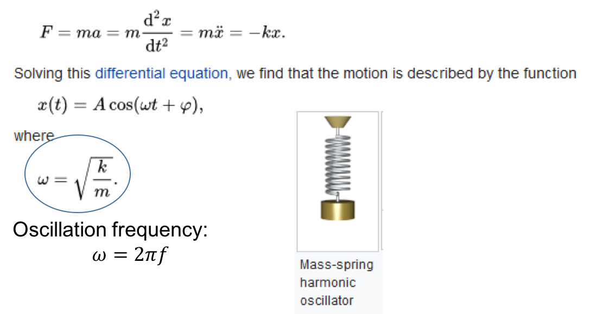
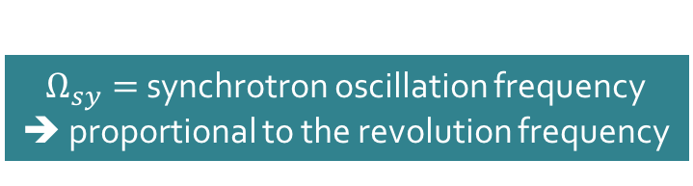

$$\ddot{Δφ}+Ω_{sy}^{2}Δφ=0$$ | Eq. 37
HARMONIC OSCILLATOR EQUATION TO DESCRIBE THE SYNCHROTRON OSCILLATIONS FOR SMALL AMPLITUDES
$Ω_{sy}=$synchrotron oscillation frequency
➔ proportional to the revolution frequency
$$Ω_{sy}^{2}=−\frac{q{hΓ_{s}V}_{max}cosφ_{s}}{2πW_{s}} Ω_{s}^{2}$$ | Eq. 36
An arbitrary potential can usually be approximated as a harmonic potential at the vicinity of a stable equilibrium point

Slide 44
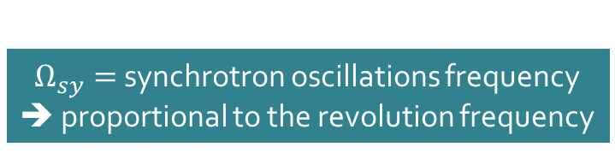

HARMONIC OSCILLATOR EQUATION TO DESCRIBE THE SYNCHROTRON OSCILLATIONS FOR SMALL AMPLITUDES
$$\ddot{Δφ}+Ω_{sy}^{2}Δφ=0$$ | Eq. 37
$Ω_{sy}=$synchrotron oscillations frequency
➔ proportional to the revolution frequency
$$Ω_{sy}^{}=\sqrt{−\frac{q{hΓ_{s}V}_{max}cosφ_{s}}{2πW_{s}}}Ω_{s}^{}$$
SYNCHROTRON TUNE ➔ number of synchrotron oscillations per turn
$$Q_{sy}=\frac{Ω_{sy}^{}}{Ω_{s}^{}}=\sqrt{−\frac{q{hΓ_{s}V}_{max}cosφ_{s}}{2πW_{s}}}$$ | Eq. 38

Slide 45


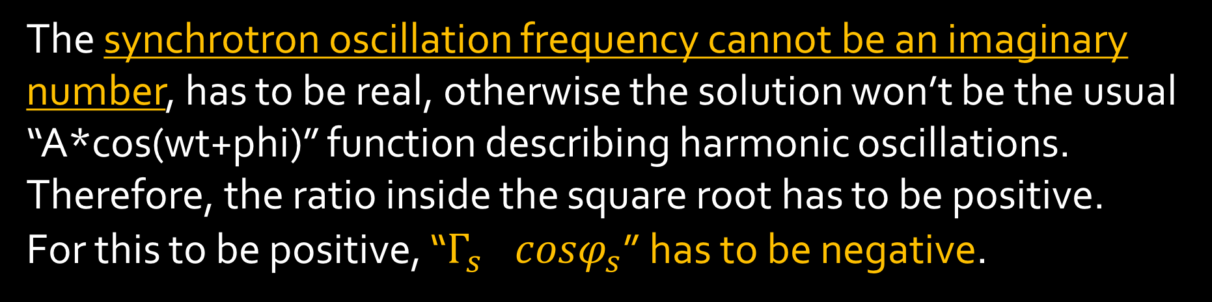
$$Q_{sy}=\frac{Ω_{sy}^{}}{Ω_{s}^{}}=\sqrt{−\frac{q{hΓ_{s}V}_{max}cosφ_{s}}{2πW_{s}}}$$ | Eq. 38
The synchrotron oscillation frequency cannot be an imaginary number, has to be real, otherwise the solution won’t be the usual “A*cos(wt+phi)” function describing harmonic oscillations. Therefore, the ratio inside the square root has to be positive.
For this to be positive, “${Γ_{s}}_{}cosφ_{s}$” has to be negative.
$$Γ_{s}=\frac{η}{β_{s}^{2}}$$

Slide 46
STABILITY CONDITON FOR SMALL AMPLITUDE OSCILLATIONS IN PHASE

Slide 47



$$Γ_{s}cosφ_{s}<0$$
Replacing $Γ_{s}$ by its value:
$$\left(α−\frac{1}{γ^{2}}\right)\frac{1}{β_{s}^{2}}cosφ_{s}<0$$
Since $β_{s}^{2}>0$, the condition simplifies to:
$$\left(α−\frac{1}{γ^{2}}\right)cosφ_{s}<0$$
In linear accelerators $α=0$ !! therefore, the stability condition reduces to
$$α=\frac{1}{l_{s}}\oint{\frac{D(s)}{ρ(s)}ds}$$ | Eq. 6
$$cosφ_{s}>0$$
The longitudinal stability in a linear accelerator requires that $φ_{s}$ is between 0 and π/2

Slide 48
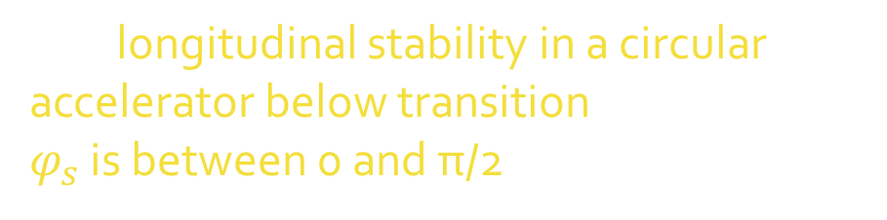

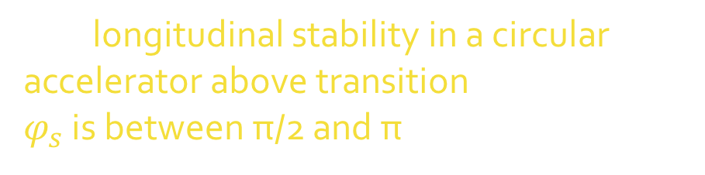
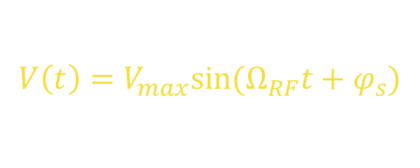

$$\left(\frac{1}{γ_{tr}^{2}}−\frac{1}{γ^{2}}\right)cosφ_{s}<0$$ | Eq. 42
$$γ_{tr}=\frac{1}{\sqrt{α}}$$ | Eq. 19
In circular accelerators the stability condition will depend on the energy of the particle.
At the beginning of the acceleration $γ<γ_{tr}$ ➔ $cosφ_{s}>0$
The longitudinal stability in a circular accelerator below transition requires that $φ_{s}$ is between 0 and π/2
At some point during the acceleration process $γ>γ_{tr}$ ➔ $cosφ_{s}<0$
The longitudinal stability in a circular accelerator above transition requires that $φ_{s}$ is between π/2 and π
$$V\left(t\right)=V_{max}sin⁡(Ω_{RF}t+φ_{s})$$

Slide 49
The principle of phase stability due to RF focusing assures that the ensemble of particles can be accelerated in synchrotrons even if they are not exactly at the synchronous phase and energy. Such particles just oscillate around the reference particle.
In the case where there is no acceleration applied to the synchronous particle, i.e.
$$V\left(φ_{s}\right)=V_{max}sinφ_{s}$$ $$V\left(φ_{s}\right)=0, sinφ_{s}=0$$
The phase stability gives for the synchronous particle:
$φ_{s}=0,$ below transition $$φ_{s}=π\text{,} \text{above} \text{transition}$$
Acceleration
V
No Acceleration
M₁
M₂
P₁
P₂
0
π/2
π
𝜑
N₁
N₂

