Slide 1
FUNDAMENTAL STATISTICS FOR DISCOVERY IN FUNDAMENTAL PHYSICS
UCL, Louvain-la-Neuve, June 14th 2018
Tommaso Dorigo
INFN-Padova

Slide 2
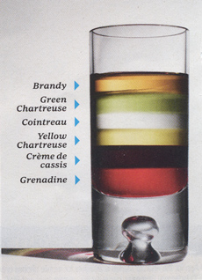
Contents
Confidence Intervals for Physicists
Coverage, and the lack thereof
Conditioning, relevant subsets, and ancillarity
The Five-Sigma Criterion: Still a Good Idea ?
From Rosenfeld to the LHC
The unknown unknowns and their misbehaviour
Counting wiggles, or How to get 2000 citations
Going Bayesian and the Related Thorns: The Jeffreys-Lindley Paradox

Slide 3
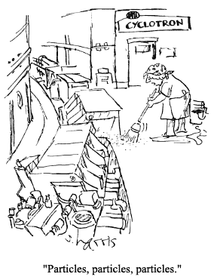
Particle Physics in Three Slides
The goal today is to discuss
statistical problems of relevance to particle physics
Also of interest for other branches of Physics
In order to do that, we need first to examine the general framework of these problems

Slide 4
What it Is That We Do in HEP
We have a theory – the standard model – which works wonders; yet we believe it is incomplete and to some extent unsatisfactory.
So we look for new physics processes: things that the standard model does not predict
New matter particles
New force carriers, new phenomena
We do that by creating energetic particle collisions, where we measure known processes in the attempt of finding a significant difference with model calculations
We thus make extensive use of
Hypothesis testing
Point and interval estimation

Slide 5
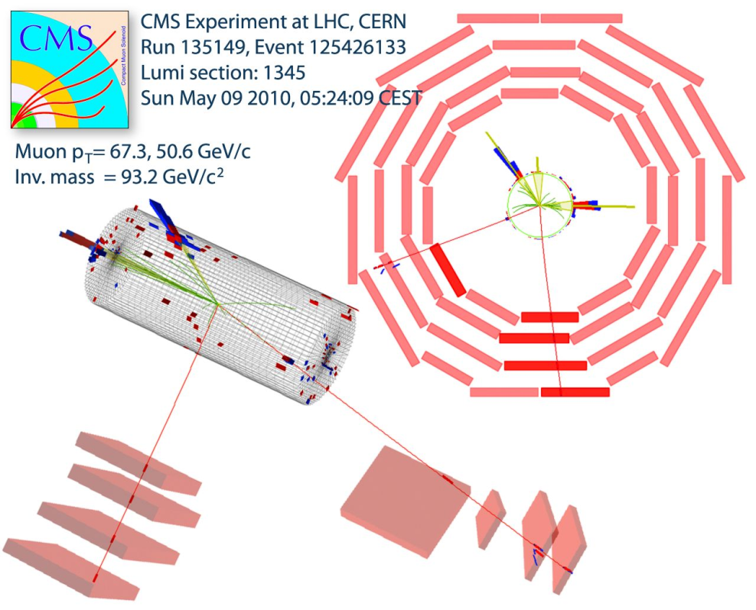
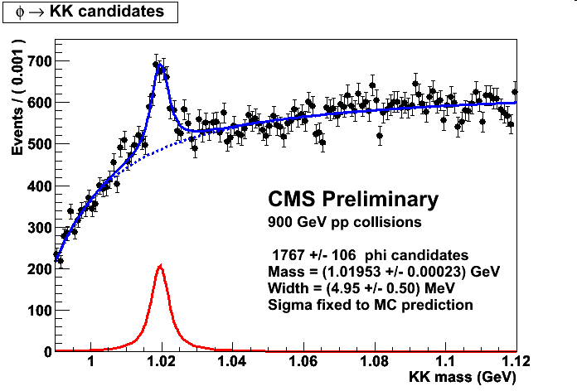
How we see a collision
A reconstruction of the electronic signals originated by a particle collision in the detector provides us a «view» of the created objects.
Using their characteristics we build high-level variables which we compare to theoretical models, for measurements and searches
In a way HEP physicists are bump-hunters,
much like spectroscopists one century ago

Slide 6
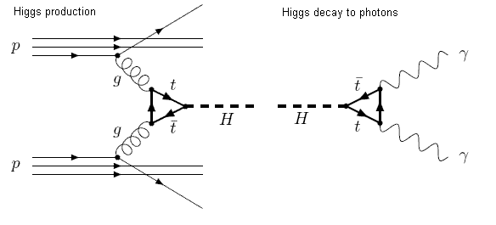
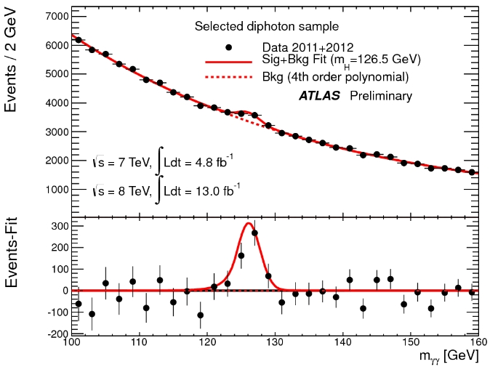
Typical setup: new particle searches
Production Decay
The typical search for a new particle involves a model which predicts the particle properties, from which we can derive a simulation of its production
Monte Carlo methods allow us to produce simulated datasets that teach us how the signal looks like
A data selection isolates a sample where we try to evidence the signal of the particle decay – typically a narrow bump over a smooth background in a reconstructed mass histogram
A test of hypotheses allows to derive p(data|H0)

Slide 7
Confidence Intervals for Physicists
At the heart of the activities of experimental physicists is what we call measurement
point estimation + interval estimation
Point estimation can be awfully complicated, but it is almost always non-controversial
Interval estimation is way more complex – and it is what we really care about
experimental design: minimize expected uncertainties on parameters of interest
BSM searches: "does it agree with the SM?"
define terra incognita: Hic Sunt Leones
The core question we should always be asking ourselves is "do my uncertainty bars cover at the stated confidence level ?"

Slide 8
What's Coverage ?
Suppose we use N data {x}, distributed as f(x; θ), to measure a parameter θ. An unbiased estimator based on {x} is used for this.
The value θ*+- σ*_{θ*} is finally reported. What does this mean ?
It means that in repeated estimates based on the same number N of observations of x, θ* would distribute according to a pdf G(θ*) centered around the true value θ with a true standard deviation σ_{θ*}, respectively estimated by θ* and σ*_{θ*}
In the large sample limit G() is a (multi-dimensional) Gaussian function
Unfortunately, in most interesting cases for physics G() is not Gaussian, the large sample limit does not hold, 1-sigma intervals do not cover 68.3% of the time the true parameter, and we have better be careful in constructing intervals !
Crucial is to have a hunch of the pdf f(x;θ)

Slide 9
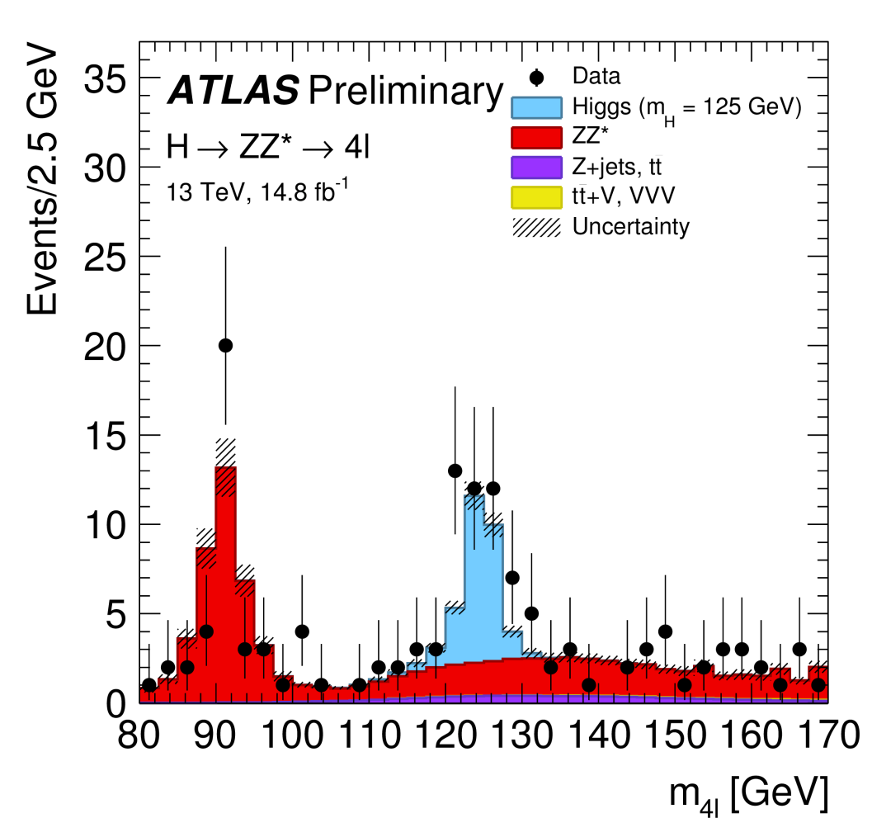
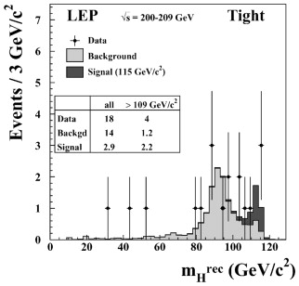
Coverage, or the Lack Thereof
Let us consider a typical HEP graph: event counts in a mass histogram, with sqrt(N) bars
What are those uncertainty bars supposed to mean? They report central intervals that "cover" at 68.3%.
Do they ?
Alas, usually they don't, as the Gaussian approximation for the Poisson distribution breaks down for small N
Is it relevant ?
If one claims x is in [a,b] with 68.3% confidence, but in fact the confidence level of [a,b] is, e.g., only 50%, that is a quite significant misrepresentation of the information content !
Of course, a solution exists: it was obtained in the fifites by Garwood, who used Neyman's construction for the Poisson distribution

Slide 10
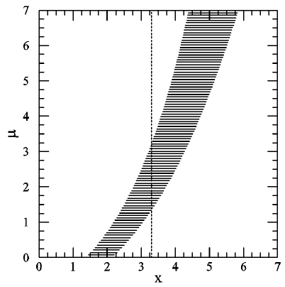
Neyman’s Confidence Interval Recipe
1 - Specify a model p(x|μ)
2 - Choose a Type-I error rate α (e.g. 31.7%, or 5%)
3 - For each μ, draw a horizontal acceptance interval [x₁,x₂] such that p (x∈[x₁,x₂] | μ) = 1 ‐ α.
There are infinitely many ways of doing this !
- for UL, integrate the pdf from x to infinity
- for LL, do the opposite
- or choose central intervals, or shortest intervals...
In general: an ordering principle is needed to well‐define.
4 - Upon performing an experiment, you measure x=x*. You can then draw a vertical line through it.
The vertical 1-α confidence interval [μ₁,μ₂] is the union of all values of μ whose corresponding acceptance intervals are intercepted by the vertical line.
p(x|μ)
μ₂
x₁
x₂
μ₁
Note: recipe is designed to cover. Thus, one should not, on average, win money by betting (at 1/α : 1 odds) that a result using Neyman's construction does not contain the true value (e.g. 5% → win $20 for every $1 bet)

Slide 11
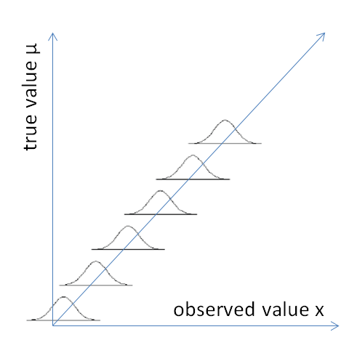
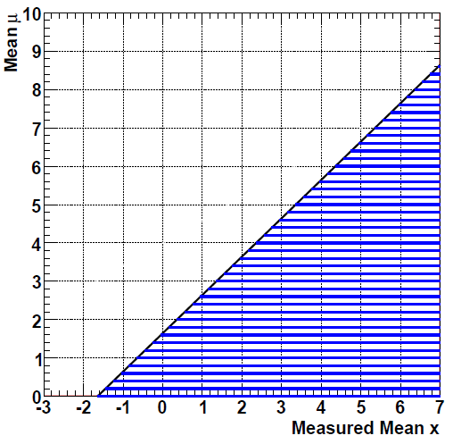
Where It Gets Murky
If the parameter you are measuring is bounded (e.g. a mass or a process rate, which are >0) Neyman's recipe needs a fix.
Take e.g. μ>0 measured by P(x|μ) = N(μ,1):
The classical method for α=0.05 produces upper limit μ<x+1.64σ
for x<-1.64 this results in the empty set!,
"Oh, my C.I. is empty"
"Fine, I'll bet it does not cover the true value"
Can it be fixed ? Yes !
Is there general agreement on how to deal with it ? No !

Slide 12
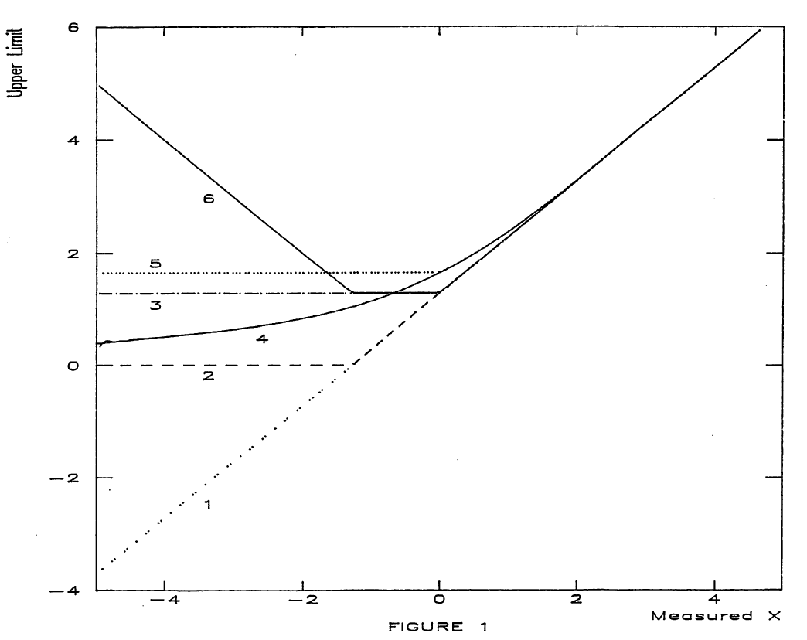
Bounded μ Problem: Proposed Solutions
The graph illustrates various choices for confidence belts one can construct for the bounded parameter problem
The most principled among classical constructions is the one provided by Feldman and Cousins[1] in 1998
Bayesians have their own solution too
(1) Neyman’s recipe for 90% upper limits: μ_{UL}=x+1.28.
(4) Bayesian solution: step-function prior
(6) Mc Farlane's "loss of confidence"

Slide 13
Food for Thought: Relevant Subsets
Neyman’s method, applied to Gaussian measurement with known σ of a parameter with unknown positive mean μ, yields upper limits at 95% CL in the form μ_{UL}=x+1.64σ . The procedure guarantees coverage, and yet...
Yet one can devise a betting strategy against it at 20:1 odds, using no more information than the observed x, and be guaranteed to win in the long run!
How ? Just choose a real constant k: bet that the interval does not cover when x<k, pass otherwise.
For k<-1.64 this wins EVERY bet! For larger k, advantage smaller but still >0.
Surely then, the procedure is not making the best inference on the data ?

Slide 14
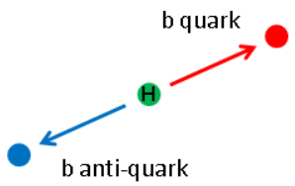
Conditioning and Ancillary Statistics
Τhe existence of winning bet strategies against Neyman- derived intervals forces us to look deeper in the general issue.
One finds that it is possible to identify ancillary statistics and use them to partition the space into relevant subsets.
“Ancillary statistic”: f(data) yielding information about the precision of the estimate of the parameter of interest, but no information about the parameter’s value.
Most typical case in HEP: branching fraction measurement. With N_{A}, N_{B} event counts in two channels one finds that
P(N_{A},N_{B}) = Poisson (N_{A}) x Poisson (N_{B}) =
= Poisson (N_{A}+N_{B}) x Binomial (N_{A}|N_{A}+N_{B})
By using the second expression, one may ignore the ancillary statistic N_{A}+N_{B}, since all the information on the BR is in the conditional binomial factor
→ by restricting the sample space, the problem is simplified and the resulting inference becomes more powerful
N_{B}
N_{A}

Slide 15
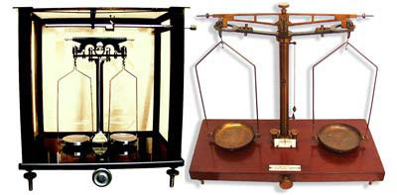
Cox Weighting Procedure
The A-HA moment comes when you consider the famous example by B. Cox[2]:
Flip a coin to decide whether to use a 10% scale (if you get tails) or a 1% scale (if you get heads) to measure an object's weight. Which error do you quote for your measurement, upon getting heads ?
Of course the knowledge of your device allows you to estimate that your precision is 1% -but a full Neyman construction (which is unconditional on the outcomes) would require you to include the coin flipping in the procedure!

Slide 16
Locating the Box
x₁ x₂
p(x|μ)
1
Another example:
Find μ using x₁, x₂ sampled from
p(x|μ) = Uniform [μ-1/2, μ+1/2]
Suppose e.g. that μ=1, and take the two datasets,
A: {0.99,1.01} ; B: {0.6,1.4}.
Neyman procedures considering the unconditional space yield the same confidence interval for data sets A and B; however, B restricts the set of possible μ to [0.9,1.1] while A only restricts it to [0.51,1.49] !
There exists in fact an ancillary statistics |x₁-x₂| which carries no information on μ, yet it can be used to divide the sample space in subsets where inference can be different.
See R. Cousins[3] for more discussion
μ-1/2 μ μ+1/2
x

Slide 17
Relevant Subsets: Take-Away Bit
Point made: The quality of Your inference depends on the breadth of the “whole space” you are considering. The more you can restrict it, the better (i.e. the more relevant) your inference becomes
Ancillary statistics are not easy to find, but they are quite useful
Conditioning should be routinely applied to our statistical procedures, as we really care to improve the precision of our measurements...
And then nobody will manage to win bets against your intervals!

Slide 18
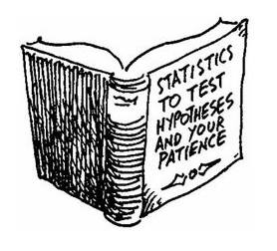
Hypothesis Testing in Three Slides

Slide 19
Statistical Significance: What It Is
Statistical significance reports the probability that an experiment obtains data at least as discrepant as those actually observed, under a given "null hypothesis“ H₀
In physics H₀ usually describes the currently accepted and established theory
Given data X and a test statistic T (a function of X), one may obtain a p-value as the probability of obtaining a value of T at least as extreme as the one observed, if H₀ is true.
p can then be converted into the corresponding number of "sigma," i.e. standard deviation units from a Gaussian mean. This is done by finding x such that the integral from x to infinity of a unit Gaussian equals p:
According to the above recipe, a 15.9% probability is a one-standard-deviation effect; a 0.135% probability is a three-standard-deviation effect; and a 0.0000285% probability corresponds to five standard deviations - "five sigma" in jargon.

Slide 20
Notes
The convention is to use a “one-tailed” Gaussian: we do not
care about fluctuations of x in the un-interesting direction
The conversion of p into σ is independent of experimental detail. Using Νσ rather than p is just a shortcut
In particular, using “sigma” units does in no way mean
we are operating some kind of Gaussian approximation
anywhere in the problem
Empirical PDF of p|H₀
BAD – don't even
think of converting
ill-defined p into Z !!
The whole construction rests on a proper definition of the p-value. Any shortcoming of the properties of p (e.g. a tiny non-flatness of its PDF under the null hypothesis) totally invalidates the meaning of the derived Nσ
GOOD
0 1 p

Slide 21
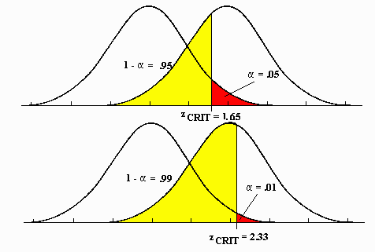
Type-I and Type-II Errors
In the context of hypothesis testing the type-I error rate α is the probability of rejecting the null hypothesis when it is true.
Strictly connected to α is the concept of “power” (1-β), where β is the type-2 error rate, defined as the probability of accepting the null when the alternative is instead true.
Suppose we test for a virus, and P is a positive result.
α = prob. of P if sample is not infected
β = prob. of !P if sample is infected
Once the test statistic is defined, by choosing α (e.g. to decide a criterion for a discovery claim, or to set a confidence interval) one is automatically also choosing β. There is no formal recipe to guide this choice.
H₀
H₁
T.S.
H₀
H₁
A stricter requirement for α (i.e. a smaller type-I error rate) implies a higher chance of accepting a false null (yellow region), i.e. smaller power.
T.S.

Slide 22
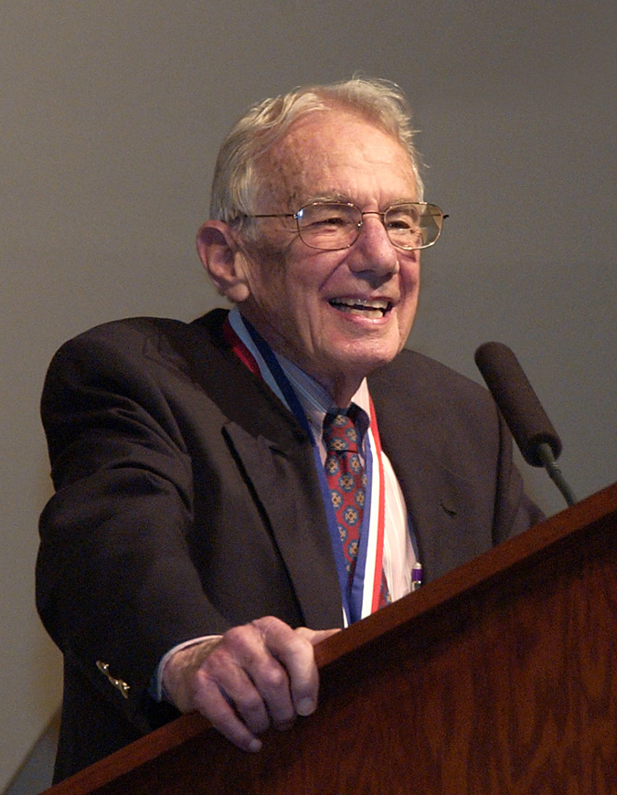
The Birth of the Five-Sigma Criterion
Arthur H. Rosenfeld (Univ. Berkeley)

Slide 23
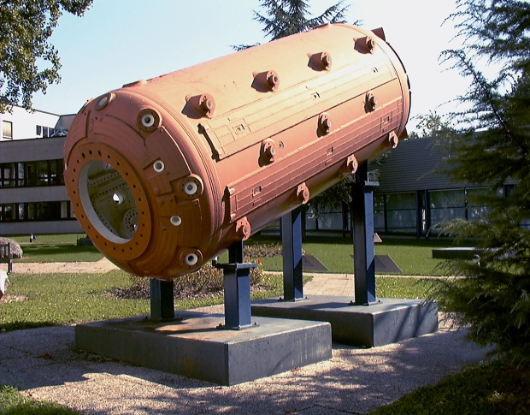
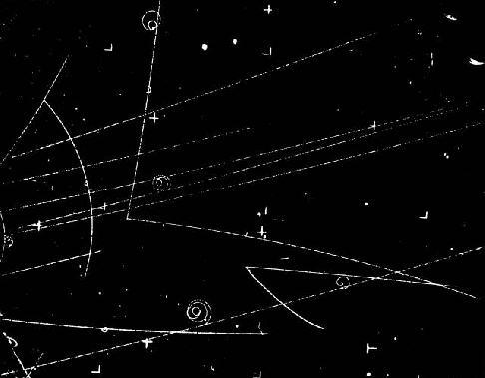
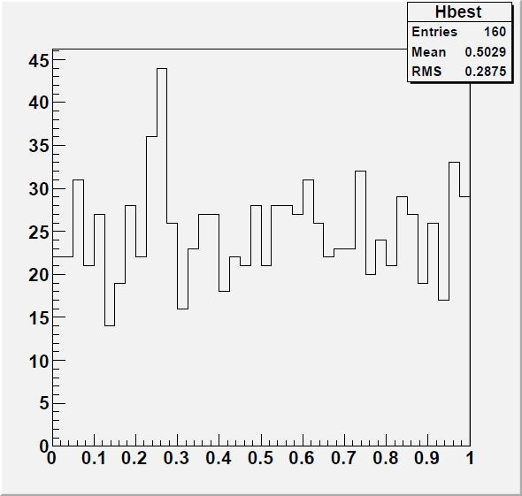
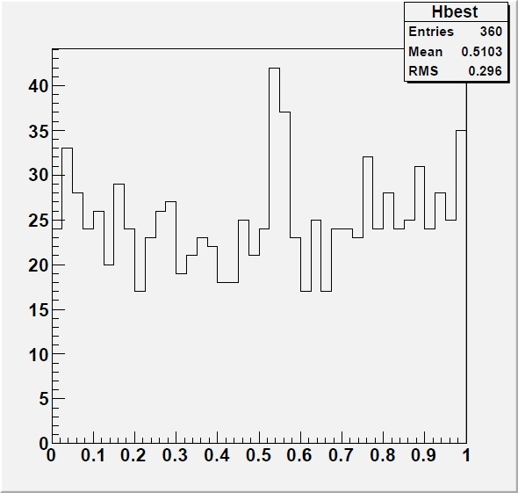
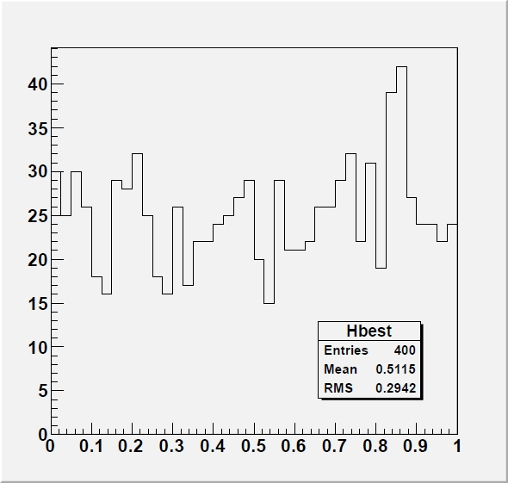
Far-Out Hadrons
In 1968 Rosenfeld wrote a paper titled "Are There Any Far-out Mesons or Baryons?“[4], where he demonstrated that the number of published claims of discovery of exotic particles agreed with the number of statistical fluctuations that one would expect in the analyzed datasets.
The issue: large trial factors coming into play due to the massive use of combinations of observed particles in deriving mass spectra containing potential resonances
“[...] This reasoning on multiplicities, extended to all combinations of all outgoing particles and to all countries, leads to an estimate of 35 million mass combinations calculated per year. How many histograms are plotted from these 35 million combinations? A glance through the journals shows that a typical mass histogram has about 2,500 entries, so the number we were looking for, h is then 15,000 histograms per year […]"

Slide 24
More Rosenfeld
“[...] Our typical 2,500 entry histogram seems to average 40 bins. This means that therein a physicist could observe 40 different fluctuations one bin wide, 39 two bins wide, 38 three bins wide...”
“[...] I conclude that each of our 150,000 annual histograms is capable of generating somewhere between 10 and 100 deceptive upward fluctuations”.
That was indeed a problem ! Rosenfeld concluded:
“[...] To the theorist or phenomenologist the moral is simple: wait for nearly 5σ effects. For the experimental group who has spent a year of their time and perhaps a million dollars, the problem is harder... go ahead and publish... but they should realize that any bump less than about 5σ calls for a repeat of the experiment.”
The proposal to raise to 5-sigma of the threshold above which a signal could be claimed was an earnest attempt at reducing the flow of claimed discoveries, which distracted theorists and caused confusion.

Slide 25
What 5σ May Do For You
Setting the bar at 5σ for a discovery claim undoubtedly removes the large majority of spurious signals due to fluctuations, especially when doing "repeated sampling"
Nowadays we call this “LEE”, for “look-elsewhere effect”.
The other reason at the roots of the establishment of a high threshold for significance has been the ubiquitous presence in our measurements of unknown, or ill-modeled, systematic uncertainties
To some extent, a 5σ threshold protects systematics-dominated results from being published as discoveries
Protection from trials factor and unknown or ill-modeled systematics
is the rationale behind the 5σ criterion
Still, the criterion has no basis in professional statistics literature, and is considered totally arbitrary by statisticians, no less than the 5% threshold often used in medicine, biology, social sciences, et cetera.
d

Slide 26
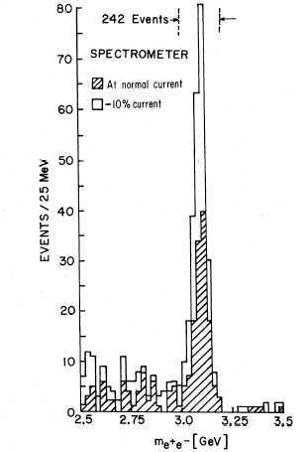
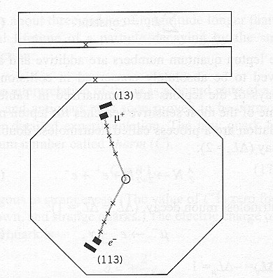
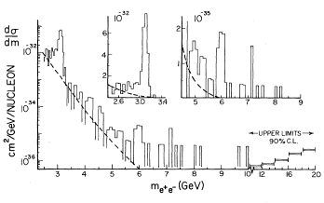
How 5σ Became a Standard in HEP: 1 - the Seventies
In the seventies the gradual consolidation of the SM shifted the focus from random bump hunting to more targeted searches
Let us check a few important searches to understand how the 5σ criterion gradually became a standard
The J/ψ discovery (1974): no question of significance – the bumps were too big to fiddle with stat tests
The τ discovery (1975-1977): no mention of significances for the excesses of (eμ) events; rather a very long debate on hadron backgrounds.
The Oops-Leon(1976): “Clusters of events as observed occurring anywhere from 5.5 to 10.0 GeV appeared less than 2% of the time⁸. Thus the statistical case for a narrow (<100 MeV) resonance is strong although we are aware of the need for a confirmation.”[5]
In footnote 8 they add: “An equivalent but cruder check is made by noting that the “continuum” background near 6 GeV and within the cluster width is 4 events. The probability of observing 12 events is again <=2%”
Note that P(μ=4;N>=12) = 0.00091, so this does include a x20 trials factor.

Slide 27
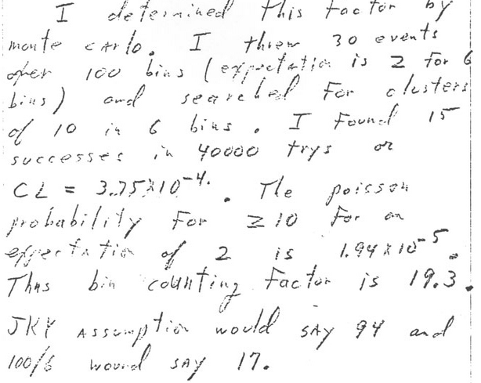
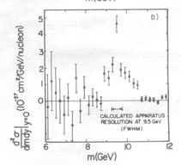
The Real Upsilon
Nov 19th 1976
The Upsilon discovery (1977): burned by the Oops-Leon, the E288 scientists waited more patiently for more data after seeing a promising 3σ peak at 9.5 GeV
They did many statistical tests to account for the trials factor
Even after obtaining a peak with very large significance (>>5σ) they continued to investigate systematical effects
Final announcement claims discovery but does not quote significance, noting however that the signal is “statistically significant”[6]
Nov 21st 1976
June 6th 1977

Slide 28
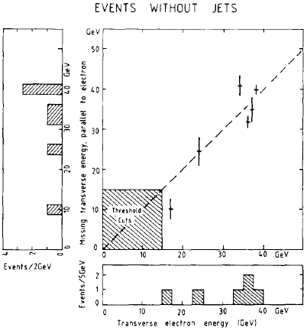
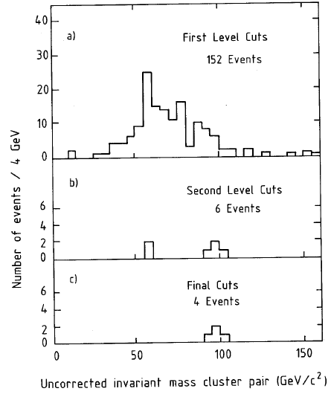
The W and Z Bosons
The 1983 W discovery was announced based on 6 electron events with missing energy and no jets.
No statistical analysis is discussed in the discovery paper[7], which however tidily rules out backgrounds as a source of the signal
There was no trials factor to account for: the signature was unique and predetermined; theory prediction for W mass (82+-2 GeV) was matched well by the measurement (81+-5 GeV).
The Z was discovered shortly thereafter, with an official CERN announcement based on 4 events
Also for the Z no trials factor was applicable
No mention of statistical checks in the paper[8], except notes that backgrounds were negligible

Slide 29
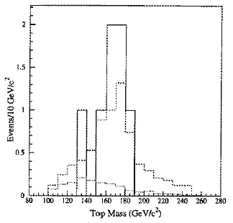
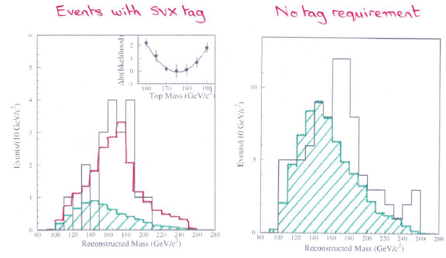
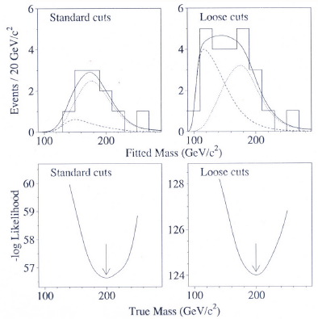
The Top Quark Discovery
In 1994 the CDF experiment had a serious counting excess (2.7σ) in b-tagged single-lepton and dilepton datasets, plus a mass peak at a value compatible with theory predictions
the mass peak, or corresponding kinematic evidence, was over 3σ by itself; M = 174 +- 10⁺¹³₋₁₂ GeV
The paper describing the analysis (120-pages long) spoke of “evidence” for top quark production[9]
One year later CDF and DZERO[10] both presented 5σ significances based on their counting experiments, obtained by analyzing 3x more data
The top quark was thus the first particle discovered by a willful application of the “5σ” criterion

Slide 30
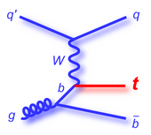
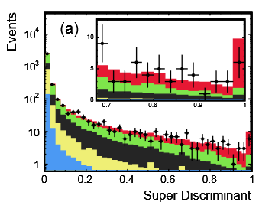
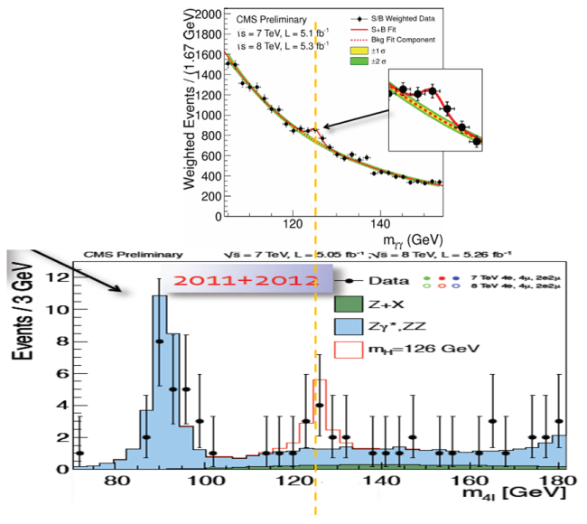
Following the Top Quark...
Since 1995, the requirement of a p-value below 3*10⁻⁷ slowly but steadily became a standard.
Striking examples of searches that diligently waited for a 5-sigma effect before claiming discovery:
1) Single top quark production: harder to detect than strong pair-production processes; it took 14 more years to be seen. CDF and DZERO claimed observation in 2009 [11], over clear 5-sigma effects
2) In 2012 the Higgs boson was claimed by ATLAS and CMS [12]. Note that the two experiments had mass-coincident >3σ evidence in their data 6 months earlier, but the 5σ recipe was followed diligently.
It is precisely the search for the Higgs what brought the five-sigma criterion to the attention of media

Slide 31
Going Deep Into the Implausible
If your trust that the LHC will find new physics is strong, you certainly approve to casting the net in the open sea even without a real idea of what fish you could be catching, or a gauge to assess critically the results
The attitude of taking any departure from
model predictions as a potential signal of
new physics can divert the attention from more
principled searches and studies – one example
is given in the next slide...
I believe we also need to explain to the
users of our physics results that
a "global p-value" is still not a p-value!
(I will get back to this issue later)
Let us give a look at one random example from recent practice...

Slide 32
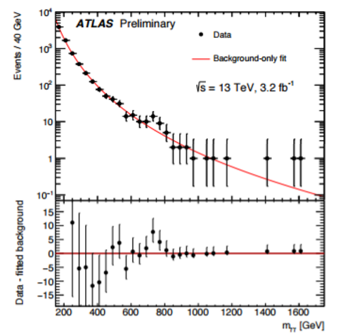
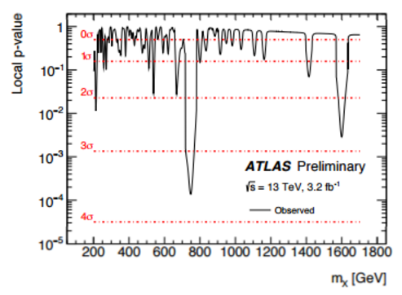
ATLAS, Circa 2015
In a end-of-the-year December 2015 talk ATLAS put their search for resonances decaying
to photon pairs as the last topic in a pot-pourri of selected results
A new resonance at 750 GeV ?

Slide 33
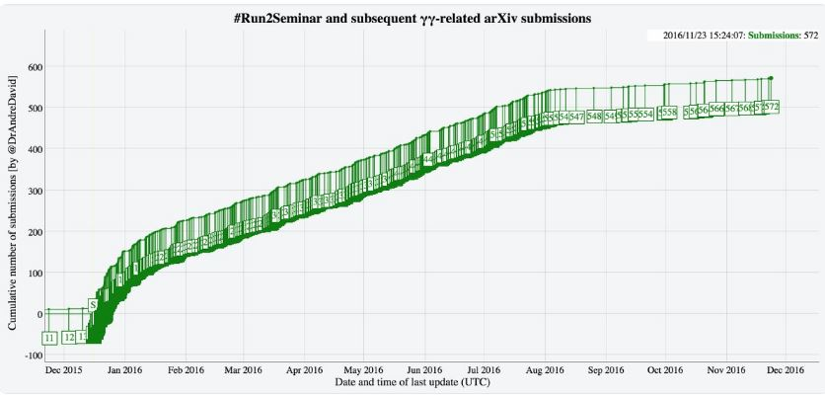
The Pheno Feeding-Frenzy
Since December 15th the Cornell arxiv got flooded with >500 new papers that tried to explain the observed diphoton peak
Some of the proposed explanations:
Two higgs doublets
Seesaw vectorlike fermions
Closed strings
Neutrino-catalyzed
Indirect signature of DM
Colorful resonances
Resonant sneutrino
SU(5) GUT
Inert scalar multiplet
Trinification
Dark left-right model
Vector leptoquarks
D3-brane
Deflected-anomaly SUSY breaking
Radion candidate
Squarkonium-Diquarkonium
R-parity violating SUSY
Gravitons in multi-warped scenario

Slide 34
A Look Into the Look-Elsewhere Effect
A compelling reason for enforcing a small test size as a prerequisite for discovery claims is the presence of large trials factors, a.k.a. LEE
The LEE was a concern 50 years ago, but nowadays we have enormously more CPU power. Still, the complexity of our analyses has also grown considerably
Take the Higgs discovery as an example: hundreds of nuisances, many final states
→ we still (occasionally) cannot compute the trials factor by brute force!
A further complication is that in reality the trials factor also depends on the significance of the local fluctuation, adding dimensionality to the problem.
A study by E. Gross and O. Vitells[13] demonstrated in 2010 how it is possible to estimate the trials factor in most experimental situations, without resorting to simulations

Slide 35
Trials Factors
In Statistics trials factors arise in a hypothesis test when a nuisance parameter is present only under the alternative hypothesis (a simple-vs-composite test).
Let us consider a particle search when the mass x is unknown.
The null hypothesis is that the data follow the background-only model b(x), and the alternative hypothesis is that they follow the model
b(x)+ μs(x|m_{H})
with μ a signal strength parameter and m_{H} the particle’s true mass (the nuisance!)
μ=0 corresponds to the null, μ>0 to the alternative.
One defines a test statistic summarizing all possible
mass values,
This could e.g. be the maximum of the likelihood ratio b/w models b(x) and b(x)+μs(x|m). The problem is assigning a p-value to the maximum of q(m_{H}) given the wide search range.
One can use an asymptotic “regularity” of the distribution of the above q₀ metric, to get a global p-value by using the technique of Gross and Vitells.

Slide 36
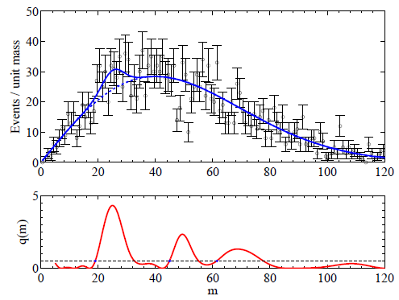
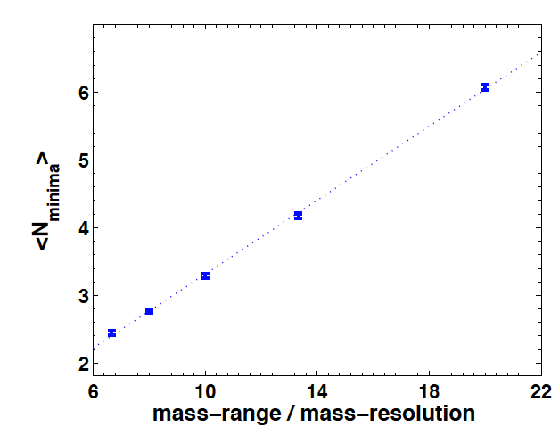
Local Minima and Upcrossings
One counts the number of “upcrossings” of the distribution of the test statistic, as a function of mass. Its wiggling tells how many independent places one has been searching in.
The number of times that the test statistic (below, the likelihood ratio between H₁ and H₀) crosses some reference line can be used to estimate the trials factor:
The number of upcrossings can be best estimated
using the data themselves at a low value of
significance, as it has been shown that the
dependence on Z is a simple
negative exponential:

Slide 37
Notes About the LEE Estimation
Even if we can usually compute the trials factor by brute force or estimate with asymptotic approximations, there is a degree of uncertainty in how to define it
If I look at a mass histogram and I do not know where I try to fit a bump, I may consider:
the location parameter and its freedom to be anywhere in the spectrum
the width of the peak: is that really fixed a priori ?
have I tried different selections before settling on the one I actually ended up with?
Have I been looking at several possible final states and mass distributions?
My colleagues in the experiment can be doing similar things with different datasets; should I count that in ?
→ There is ambiguity on the LEE depending who you are (grad student, experiment spokesperson, lab director...)
In fact, Rosenfeld considered the whole world’s database of bubble chamber images in deriving a trials factor
The bottomline is that while we can always compute a local significance, it may not always be clear what the true global significance is.

Slide 38
Systematic Uncertainties
Systematic uncertainties affect any physical measurement and it is sometimes quite hard to correctly assess their impact.
Often one sizes up the typical variation of an observable due to the imprecise knowledge of a nuisance parameter at the 1-sigma level; then one assumes that the probability density function of the nuisance be Gaussian.
→ if however the PDF has larger tails, it makes the odd large bias much more frequent than estimated
The potential harm of large non-Gaussian tails of systematic effects is one arguable reason for sticking to a 5σ significance level even when the LEE is not a concern. However, the safeguard that the criterion provides to mistaken systematics is not always sufficient.
One quick example: if a 5σ effect has uncertainty dominated by systematics, and the latter are underestimated by a factor of 2, the 5σ effect is actually a 2.5σ one (a p=0.006 effect): in p-value terms this means that the size of the effect is overestimated by a factor 20,000!

Slide 39
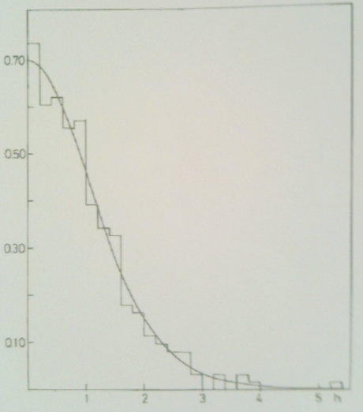
A Study of Residuals
The distribution of residuals
of 306 measurements in [14]
A study of the residuals of particle properties in the RPP in 1975 revealed that they were not Gaussian. Matts Roos et al. [14] considered residuals in kaon and hyperon mean life and mass measurements, and concluded that these are well described by a Student distribution S₁₀(h/1.11):
One should not extrapolate to 5-sigma the behaviour found by Roos and collaborators in the bulk of the distribution; yet it is evidence that the uncertainties evaluated in experimental HEP may have a significant non-Gaussian component
Black: a unit Gaussian;
red: the S₁₀(x/1.11) function
Left: 1-integral distributions of the two functions.
Right: ratio of the 1-integral values as a function of z
x1000!
significance
significance
significance

Slide 40
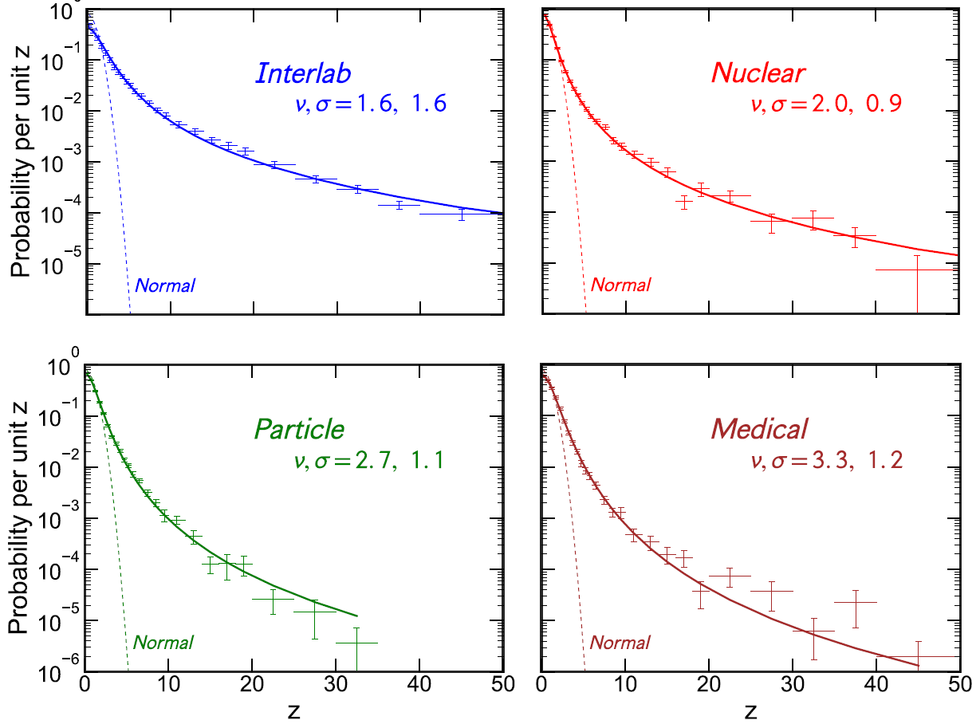
A Bigger, Meaner Study of Residuals
David Bailey (U. Toronto) recently published an article[15] where use of large datasets is made (all of RPP, Cochrane medical and health database, Table of Radionuclides)
41,000 measurements of 3200 quantities studied
The methodology is similar to that of Roos et al., but some shortcuts are made, and data input automation prevents more vetting (e.g. correlations not properly accounted for)
Results are quite striking - we seem to have ubiquitous Student-t distributions in our Z values, with large tails – almost Cauchy-like.

Slide 41
Going Bayesian: The Jeffreys-Lindley Paradox
So what happens if one tries to move to Bayesian territory ?
Consider a null hypothesis, H₀, on which we base a strong belief. In physics we do believe in our “point null” – a theory valid for a specific value θ₀ of a parameter θ (say the photon mass being 0); in other sciences a true “point null” hardly exists
Comparing a point null θ=θ₀ to an alternative which depends on continuous θ, we need to encode this in a prior belief. Bayesians use a “probability mass” at θ=θ₀ for H₀.
The Jeffreys-Lindley paradox[16] arises as frequentists and Bayesians draw opposite conclusions as data size becomes large, when comparing a point null to a composite alternative. This fact bears relevance to the issue of discovery, so let us give it a look.
We will find that the use of probability masses in priors for a simple-vs-composite test throws a monkey wrench in the Bayesian paradigm, as no matter how large and precise is the data, Bayesian inference strongly depends on the scale over which the prior is non-null – that is, on the prior belief of the experimenter.
p(θ)
θ₀
θ

Slide 42
The Paradox
Take X₁...X_{n} i.i.d. as X_{i}|θ ~ N(θ,σ²), and a prior belief on θ constituted by a mixture of a point mass p at θ₀ and (1-p) uniformly distributed in [θ₀-Δ/2, θ₀+Δ/2].
In classical hypothesis testing the “critical values” of the sample mean delimiting the rejection region of H₀: θ = θ₀ in favor of H₁: θ <> θ₀ at significance level α are
where z_{α/2} is the significance corresponding to test size α for a two-tailed normal distribution
The paradox is that the posterior probability that H₀ is true, conditional on seeing data in the critical region (i.e. ones which exclude H₀ in a classical α-sized test) approaches 1 (not α, NB!) as the sample size becomes arbitrarily large.
π(H₀)
X
π(H₁)
θ
θ₀-Δ/2
θ₀
θ₀+Δ/2
As evidenced by R. Cousins[17], the paradox arises
if there are three independent scales in the problem,
ε << σ/sqrt(n) << Δ, i.e. the width of the point mass,
the measurement uncertainty, and the scale Δ of the
prior for the alternative hypothesis
ε
σ/sqrt(n)
Common situation in HEP!!
Δ

Slide 43
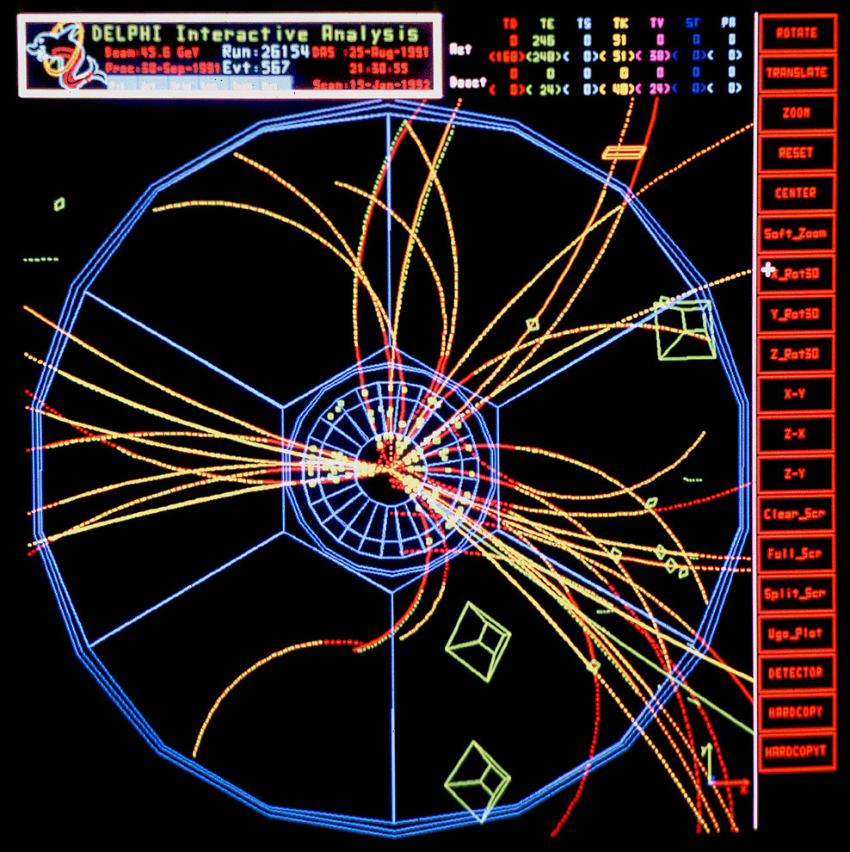
JLP Example: Charge Bias of a Tracker
Imagine you want to investigate whether your detector has a bias in reconstructing positive versus negative curvature, say at a lepton collider (e⁺e⁻). You take a unbiased set of collisions, and count positives and negatives in a set of n=1,000,000.
You get n⁺=498,800, n⁻=501,200. You want to test the hypothesis that the fraction of positive tracks, say, is R=0.5 with a size α=0.05.
Bayesians will need a prior π(R): a typical choice would be to assign equal probability to the chance that R=0.5 and to it being different (R<>0.5): a “point mass” of p=1/2 at R=0.5, and a uniform distribution of the remaining p=1/2 in [0,1]
We are in high-statistics regime and away from 0 or 1, so Gaussian approximation holds for the Binomial. The probability to observe a number of positive tracks n⁺ can then be written, with x=n⁺/n, as N(x,σ) with σ²=x(1-x)/n.
The posterior probability that R=0.5 is then
π(R)
R
0.5
from which a Bayesian concludes that there is no evidence against R=0.5, and actually the data strongly supports the null hypothesis (P>>α)

Slide 44
JLP Charge Bias: Frequentist Solution
Frequentists calculate how often a result “at least as extreme” as the one observed arises by chance, if the underlying distribution is N(R,σ) with R=1/2 and σ²=x(1-x)/n
One then has
(we multiplied by two since we would be just as surprised to observe an excess of positives as a deficit).
From this, frequentists conclude that the tracker is biased, since there is a less-than 5% probability, P’<α, that a result as the one observed could arise by chance!
A frequentist thus draws the opposite conclusion of a Bayesian from the same (large body of) data !

Slide 45
Notes on the JL Paradox
The paradox has been used by Bayesians to criticize the way inference is drawn by frequentists:
Jeffreys: “What the use of [the p-value] implies, therefore, is that a hypothesis that may be true may be rejected because it has not predicted observable results that have not occurred” [18]
Still, the Bayesian approach offers no effective substitute to the p-value
Bayes factors, which describe by how much prior odds are modified by the data, do not factor out the subjectivity of the prior when the JLP applies: even asymptotically, they retain a dependence on the scale of the prior of H₁.
In JLP debates, Bayesians have blamed the concept of a “point mass”, or suggested n-dependent priors. Their final line of defence is to argue that “the precise null” is never true.
However, we do believe our point nulls in HEP and astro-HEP!!
There is a large body of literature on the subject. The issue is an active research topic and is not resolved.
→ The trouble of picking α in classical hypothesis testing is not automatically solved by moving to Bayesian territory.

Slide 46
So What to Do With 5σ ?
To summarize:
the LEE can be estimated; experiments now routinely produce “global” and “local” p-values and Z-values
What is then the point of protecting from large LEE ?
Trial factor can be anything from 1 to enormous; a one-size-fits-all is hardly justified – it is illogical to penalize an experiment for the LEE of others
Impact of systematic uncertainties varies widely; sometimes one has control samples (e.g. particle searches), others one does not (e.g. OPERA's ν speed)
The cost of a wrong claim, as credibility loss or backfiring of media hype, can vary dramatically
Some claims are intrinsically less likely to be true
So why a fixed discovery threshold ?
Any claim is subject to criticism and independent verification, and the latter is always more rigorous when the claim is steeper and/or more important
It is good to just have a “reference value” for the level of significance of the data – a «tradition», a useful standard

Slide 47
Conclusions
Statistics is the universal language to express data-backed claims in Physics research, so as physicists we should pay attention to understand its nuances
Interval estimation requires attention – you can do (much) better or worse than your peer with the same data
Hypothesis testing requires a critical region. In HEP we fix the bar at 5 sigma. 50 years after the suggestion of a 5σ threshold for discovery, and 25 years after the start of its application, the criterion appears inadequate
It does not protect from steep claims that later peter out
It delays acceptance of uncontroversial finds
It is arbitrary and illogical
Bayesian hypothesis testing does not offer a robust replacement, due to hard-to-circumvent prior dependence of conclusions
For searches of unknown effects and fishing expeditions, the global p-value is the only real weapon – but in most cases the trials factor is hard to quantify
Probably 5σ are insufficient for unpredicted effects - large experiments look at thousands of distributions, multiple times → experiment-wide trials factor is extremely high

Slide 48
Thank you for your attention!

Slide 49
References
[1] G. Feldman and R. D. Cousins, "A Unified Approach to the Classical Statistical Analysis of Small Signals", Phys. Rev. D 57 (1998) 3873.
[2] D. Cox, "Some Problems Connected with Statistical Inference", Ann. Math. Stat. 29 (1958) no. 2, 357-372.
[3] R. D. Cousins, "Negatively Biased Relevant Subsets Induced by the Most-Powerful One-Sided Upper Confidence Limits for a Bounded Physical Parameter", arXiv:1109.2023 (2011).
[4] A. H. Rosenfeld, “Are there any far-out mesons and baryons?,” In: C. Baltay, A.H. Rosenfeld (eds.), "Meson Spectroscopy: A collection of articles", W.A. Benjamin, New York, 455-483.
[5] D. C. Hom et al., “Observation of High-Mass Dilepton Pairs in Hadron Collisions at 400 GeV”, Phys. Rev. Lett. 36, 21 (1976) 1236.
[6] S. W. Herb et al., “Observation of a Dimuon Resonance at 9.5-GeV in 400-GeV Proton-Nucleus Collisions”, Phys. Rev. Lett 39 (1977) 252.
[7] G. Arnison et al., “Experimental Observation of Isolated Large Transverse Energy Electrons with Associated Missing Energy at sqrt(s)=540 GeV", Phys. Lett. 122B, 1 (1983) 103.
[8] G. Arnison et al., “Experimental Observation of Lepton Pairs of Invariant Mass Around 95 GeV/c2 at the CERN SpS Collider”, Phys. Lett. 126B, 5 (1983) 398.
[9] F. Abe et al., “Evidence for Top Quark Production in p anti-p Collisions at s**(1/2) = 1.8 TeV”, Phys. Rev. D50 (1994) 2966.
[10] F. Abe et al., “Observation of Top Quark Production in p anti-p Collisions with the Collider Detector at Fermilab”, Phys. Rev. Lett. 74 (1995) 2626; S. Abachi et al., “Observation of the Top Quark”, Phys. Rev. Lett. 74 (1995) 2632.
[11] V.M. Abazov et al., “Observation of Single Top-Quark Production”, Phys. Rev. Lett. 103 (2009) 092001; T. Aaltonen et al., “Observation of Electroweak Single Top Quark Production”, Phys. Rev. Lett. 103 (2009) 092002.
[12] J. Incandela and F. Gianotti, “Latest update in the search for the Higgs boson”, public seminar at CERN. Video: http://cds.cern.ch/record/1459565; slides: http://indico.cern.ch/conferenceDisplay.py?confId=197461
[13] E. Gross and O. Vitells, “Trials factors for the Look-Elsewhere Effect in High-Energy Physics”, Eur. Phys. J. C70 (2010) 525-530.
[14] M. Roos, M. Hietanen, and M.Luoma, “A new procedure for averaging particle properties”, Phys.Fenn. 10 (1975) 21.
[15] D. Bailey, "Not Normal: the uncertainties of scientific measurements", ArXiv:1612.00778 (2016).
[16] D.V. Lindley, ”A statistical paradox”, Biometrika, 44 (1957) 187-192.
[17] R. D. Cousins, “The Jeffreys-Lindley Paradox and Discovery Criteria in High-Energy Physics”, arxiv:1310.3791v4 (2014).
[18] H. Jeffreys, “Theory of Probability”, 3rd edition Oxford University Press, Oxford, 385.

Slide 50
Backup Slides

Slide 51
The Standard Model
A misnomer – it is not a model but a full-blown theory which allows us to compute the result of subatomic processes with high precision
Three families of quarks, and three families of leptons, are the matter constituents
Strong interactions between quarks are mediated by 8 gluons, g
Electromagnetic interactions between charged particles are mediated by the photon, γ
The weak force is mediated by W and Z
Gravity is not included in the model

Slide 52
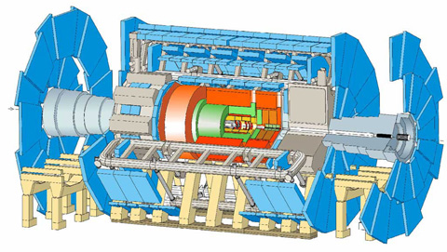
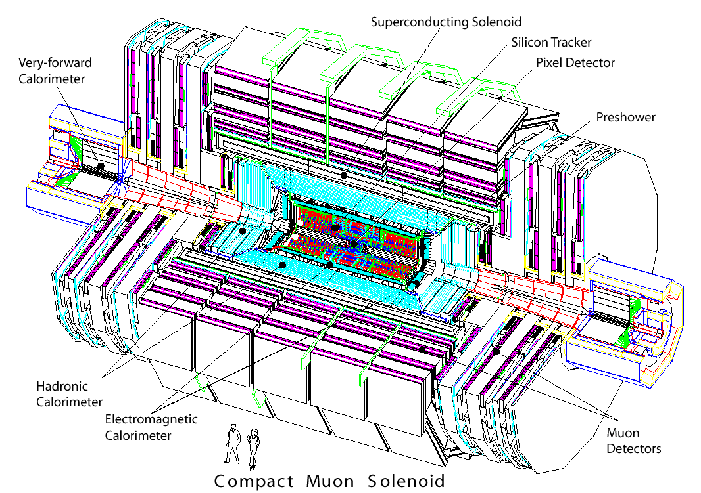
The LHC
LHC is the largest and most powerful particle accelerator, built to investigate matter at the shortest distances
It resides in a 27km long tunnel 100 meters underground near Geneva
Collisions between protons are created where the beams intersect: the caverns are equipped with huge
detectors. Two of these are multi-purpose «electronic eyes» that try to detect everything that comes out of the collision
ATLAS
CMS

Slide 53
How we detect particles
Charged particles are tracked in the inner section, through the ionization they leave on silicon;
a powerful magnet bends their trajectories, allowing a measurement of their momentum
Then calorimeters destroy both charged and neutral ones, measuring their energy
Muons are the only particles that can traverse the dense material and get tracked outside

Slide 54
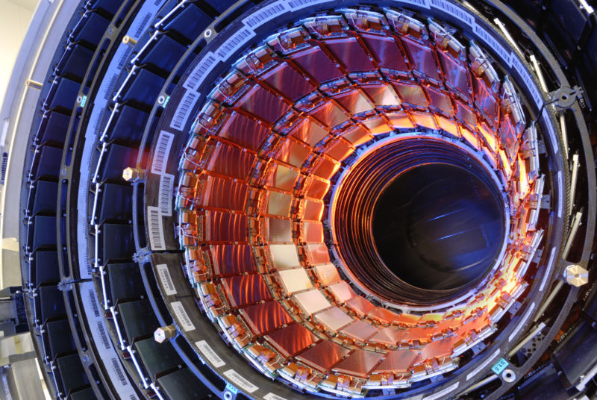
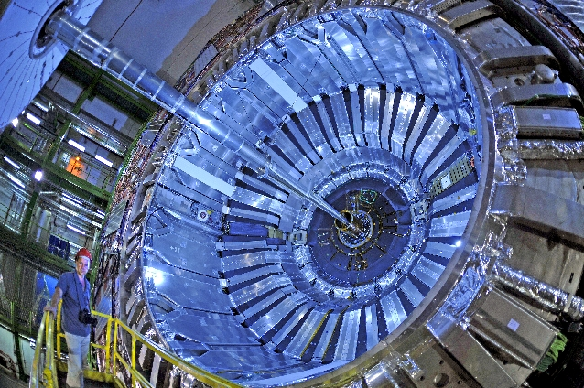
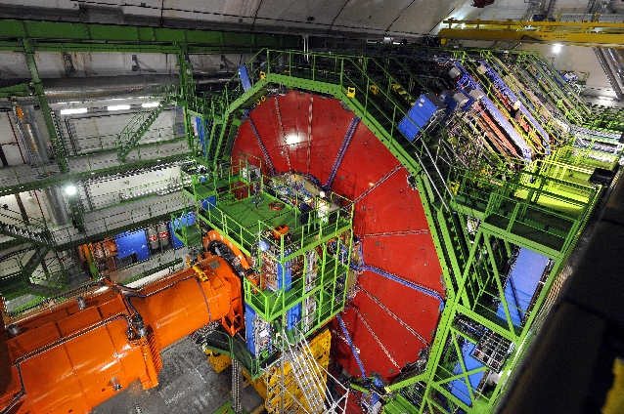
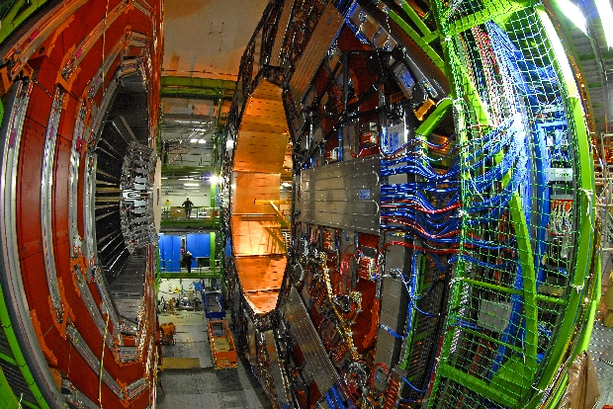
CMS
CMS (Compact Muon Solenoid) was built with the specific goal of finding the Higgs boson
Along with ATLAS, it is arguably the most complex machine ever built by mankind
Hundreds of millions collisions take place every second in its core, and each produces signals in hundreds of millions of electronic channels. These data are read out in real time and stored for offline analysis

Slide 55
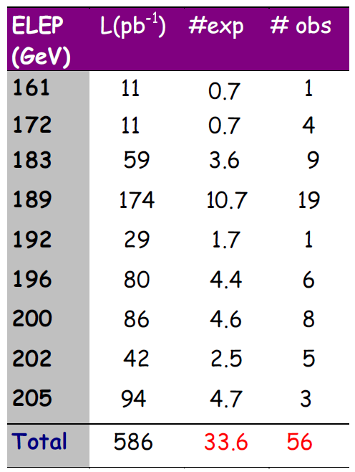
Sbottom Quarks in LEP II Data
ALEPH
In the summer of 2000 ALEPH researchers were informed of the CDF lepton excess and the sbottom quark interpretation. They looked for dijets with leptons and found a 3-sigma effect in their own data!
The signal was shown at a LEPC meeting, and then at a conference in Vietnam
DELPHI (see plot, right) first showed the thrust distribution for the signal was wrong, and that no excess was present in their data
Later the signal was understood as an artifact of a wrong MC simulation and miscalibrated electron fake rates, and disproven by the other LEP experiments and CLEO

Slide 56
The Case Of The Photon Pairs
In December 2015 ATLAS and CMS announced evidence for a 750 GeV particle decaying to photon pairs
Significance in the 4-sigma ballpark
ATLAS 3.6σ alone, CMS 2-sigmaish evidence
Conflicting evidence on width
Theorists jumped at it, proposing interesting and less interesting scenarios to fit it in
Experiments set out to search for it in other ways and with additional data

Slide 57
The pheno feeding frenzy
In the matter of 8 months the Cornell arxiv got flooded with over 550 new papers that tried to explain the diphoton excesses of ATLAS and CMS
Bets were offered and accepted on the nature of the new particle, with various odds
In the process, we learned that finding new physics will not teach us much per se – one needs
to then characterize it quite well to sort out what underlying theory can be responsible for it!
Some of the proposed explanations:
Two higgs doublets
Seesaw vectorlike fermions
Closed strings
Neutrino-catalyzed
Indirect signature of DM
Colorful resonances
Resonant sneutrino
SU(5) GUT
Inert scalar multiplet
Trinification
Dark left-right model
Vector leptoquarks
D3-brane
Deflected-anomaly SUSY breaking
Radion candidate
Squarkonium-Diquarkonium
R-parity violating SUSY
Gravitons in multi-warped scenario

Slide 58
750-GeV Bump Interpretation Summary
1 - It seems quicker to say what a 750 GeV bump cannot be:
Not Mickey Mouse, who
clearly has a non-Gaussian tail
Not the Lochness monster, which
has an evident 3-bump structure
2 – The signal clearly inspired the creativity of theorists: best title
in arXiv paper for a while -
"How the gamma-gamma Resonance Stole Christmas"

Slide 59
J.L. Paradox: Proof
In the first line the posterior probability is written in terms of Bayes’ theorem;
in the second line we insert the actual priors p and (1-p) and the likelihood values in terms
of the stated Normal density of the iid data X;
in the third line we rewrite two of the exponentials using the conditional value of the sample
mean in terms of the corresponding significance z, and remove the normalization factors
sqrt(n)/sqrt(2π)σ;
in the fourth line we maximize the expression by using the integral of the Normal.

Slide 60
THTQ: One Last Note on Very High Νσ
Recently heard claim from respected astrophysicist “The quantity has been measured to be non-zero at 40σ level”, referring to a measurement quoted as 0.110+-0.0027.
That is a silly statement! As N goes above 7 or so, we are rapidly losing contact with the reality of experimental situations
To claim e.g. a 5σ effect, one has to be reasonably sure to know the p-value PDF to the 10⁻⁷ level
Remember, Nσ is just as femtobarns or or attometers: a useful placeholder for small numbers
Hence before quoting high Nσ blindly, one shoud think at what they really mean
In the case of the astrophysicist, it is not even easy
to directly make the conversion, as ErfInverse() breaks
down above 7.5 or so. I resorted to a good approximation
by Karagiannidis and Lioumpas [25],
For N=40 my computer still refuses to give anything
above 0, but for N=38 it gives p=2.5*10⁻³¹⁶
so he was basically saying that the data had a probability
of less than a part in 10^316 of being observed if the
null hypothesis held.
That is beyond ridiculous ! We will never be able
to know the tails of our systematic uncertainties
to something similar.

Slide 61
Bubble chamber physics
A bubble chamber is a vessel filled with a gas in a phase of superheating. The passage of charged particles ionizes the gas and bubbles are formed along the path
By measuring the tracks in a magnetic
field, one determines their momentum.
The mass of a particle decaying into others
can be determined from the daughters’ momenta

Slide 62
Higgs Discovery: a case study

Slide 63
Nuts and Bolts of Higgs Combination
The recipe must be explained in steps. The first one is of course the one of writing down extensively the likelihood function!
One writes a global likelihood function, whose parameter of interest is the strength modifier μ. If s and b denote signal and background, and θ is a vector of systematic uncertainties, one can generically write for a single channel:
Note that θ has a “prior” coming from a hypothetical auxiliary measurement.
In the LHC combination of Higgs searches, nuisances are treated in a frequentist way
by taking for them the likelihood which would have produced as posterior, given a flat prior,
the PDF one believes the nuisance is distributed from.
In L one may combine many different search channels where a counting experiment is performed as the product of their Poisson factors:
or from a unbinned likelihood over k events, factors such as:

Slide 64
2) One then constructs a profile likelihood
test statistic q_{μ} as
Note that the denominator has L computed with the values of μ^ and θ^ that globally maximize it, while the numerator has θ=θ^_{μ} computed as the conditional maximum likelihood estimate, given μ.
A constraint is posed on the MLE μ^ to be confined in 0<=μ^<=μ: this avoids negative solutions for the cross section, and ensures that best-fit values above the signal hypothesis μ are not counted as evidence against it.
3) ML values θ_{μ}^ for H₁ and θ₀^ for H₀
are then computed, given the data
and μ=0 (bgr-only) and μ>0
4) Pseudo-data is then generated for the
two hypotheses, using the above ML
estimates of the nuisance parameters.
With the data, one constructs the pdf
of the test statistic given a signal of
strength μ (H₁) and μ=0 (H₀). This way
has good coverage properties.

Slide 65
5) With the pseudo-data one can then compute the integrals defining p-values for the two hypotheses. For the signal plus background hypothesis H₁ one has
and for the null, background-only H₀ one has
6) Finally one can compute the value called CL_{s} as
CL_{s} = p_{μ}/(1-p_{b})
CL_{s} is thus a “modified” p-value, in the sense that it describes how likely it is that the value of test statistic is observed under the alternative hypothesis by also accounting for how likely the null is: the drawing incorrect inferences based on extreme values of p_{μ} is “damped”, and cases when one has no real discriminating power, approaching the limit f(q|μ)=f(q|0), are prevented from allowing to exclude the alternate hypothesis.
7) We can then exclude H₁ when CL_{s} < α, the (defined in advance !) size of the test. In the case of Higgs searches, all mass hypotheses H₁(M) for which CL_{s}<0.05 are said to be excluded (one would rather call them “disfavoured”…)

Slide 66
Derivation of expected limits
One starts with the background-only hypothesis μ=0, and determines a distribution of possible outcomes of the experiment with toys, obtaining the CLs test statistic distribution for each investigated Higgs mass point
From CLs one obtains the PDF of upper limits μ^{UL} on μor each M_{h}. [E.g. on the right we assumed b=1 and s=0 for μ=0,
whereas μ=1 would produce <s>=1]
Then one computes the cumulative PDF of μ^{UL}
Finally, one can derive the median and the intervals for μ which correspond to 2.3%, 15.9%, 50%, 84.1%, 97.7% quantiles. These define the “expected-limit bands” and their center.

Slide 67
Significance in the Higgs search
To test for the significance of an excess of events, given a M_{h} hypothesis, one uses the bgr-only hypothesis and constructs a modified version of the q test statistic:
This time we are testing any μ>0 versus the H₀ hypothesis. One builds the distribution f(q₀|0,θ₀^{^obs}) by generating pseudo-data, and derives a p-value corresponding to a given observation as
One then converts p into Z using the relation
where p_{χ}² is the survival function for the 1-dof chi2.
Often it is impractical to generate large datasets given the complexity of the search (dozens of search channels and sub-channels, correlated among each other). One then relies on a very good asymptotic approximation:
The derived p-value and the corresponding Z value are “local”: they correspond to the specific hypothesis that has been tested (a specific M_{h}) as q₀ also depends on M_{h} (the search changes as M_{h} varies)
When dealing with many searches, one needs to get a global p-value and significance, i.e. evaluate a trials factor.
This can be done using the techniques discussed earlier.

Slide 68
The Likelihood Principle
In both Bayesian methods and likelihood-ratio based methods, only the probability (density) for obtaining the data at hand is used: it is contained in the likelihood function. Probabilities for obtaining other data (imaginary ones, or some other random sample) are not used
In contrast, in typical frequentist calculations (e.g., a p-value which is the probability of obtaining a value as extreme or more extreme than that observed), one uses probabilities of data not seen.
This difference is captured by the Likelihood Principle:
If two experiments yield likelihood functions which are proportional,
then Your inferences from the two experiments should be identical.
The likelihood Principle is built into Bayesian inference (except special cases).
It is instead violated (sometimes badly) by p-values and confidence intervals.
You cannot have both the likelihood principle fulfilled and guaranteed coverage.

Slide 69
Example of the Likelihood Principle
Imagine you expect background events sampled from a Poisson mean b, assumed known precisely.
For signal mean μ, the total number of events n is then sampled from Poisson mean μ+b. Thus,
P(n) = (μ+b)^{n}e^{-(μ+b)}/n!
Suppose that, upon performing the experiment, you see no events at all, n=0. You then write the likelihood as
L(μ) = (μ+b)⁰e^{-(μ+b)}/0! = exp(-μ) exp(-b)
Note that changing b from 0 to any b*>0, L(μ) only changes by the constant factor exp(-b*).
→ So for zero events observed, likelihood-based inference about signal mean μ is independent of expected b.
You immediately see the difference with the Frequentist inference: in the confidence interval constructions, the fact that n=0 is less likely for b>0 than for b=0 results in narrower confidence intervals for μ as b increases.
in violation of the likelihood principle
If two experiments have different backgrounds and equal acceptance for the process of interest, this becomes an upsetting situation for the more precise experiment, as for n=0 observed counts, their inference is weaker!

Slide 70
Abstract
The standard recipes followed by HEP and astro-HEP scientists to assess whether the data bear enough evidence to support a discovery claim for a new phenomenon, or to define how a confidence interval can be set on a measured parameter, are a quite important ingredient in today's research in fundamental physics. Understanding where those standards come from, and what is the rationale behind them, is a necessary step in order to publish correct scientific results, as well as to look beneath the surface of results published by others.
This talk will in particular focus on three topics: the "five-sigma" criterion, along with its history, its merits, and pitfalls; the classical derivation of confidence intervals and a few devils hidden in their detailed calculation; and the classic setup of simple-versus-composite hypothesis tests, where the Jeffreys-Lindley paradox remains an active topic for debate in the statisticians community.

