Slide 1


UCL – K110
Status Report
Standaert Laurent
UCL- Cyclotron Resource Centre
XXXIX ECPM

Slide 2
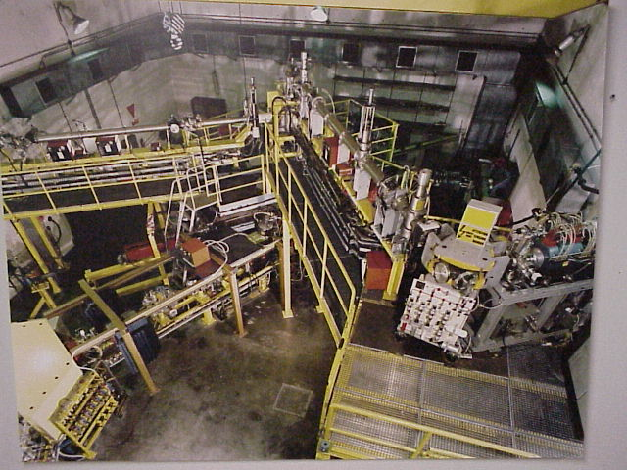
UCL-CRC cyclotron
First beam : 1974
K 110 :
  Radius = 93 cm
  B ≈ 1.6T
Frequency
  11-18 MHz
XXXIX ECPM

Slide 3
K110 uses
Electronic components tests : Light/heavy ions
Track etched membranes: heavy ions
Material tests : light ions/ neutrons
University research
XXXIX ECPM

Slide 4
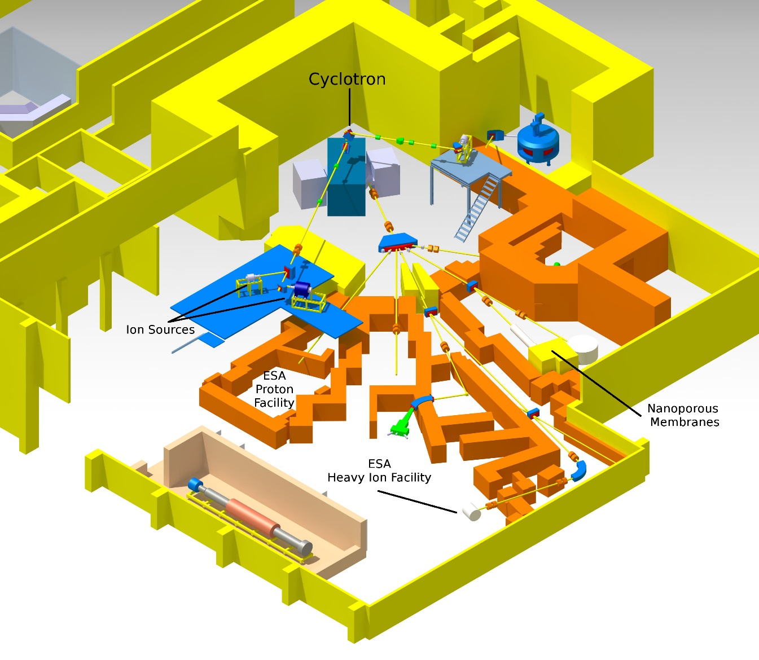
Experimental hall
XXXIX ECPM

Slide 5
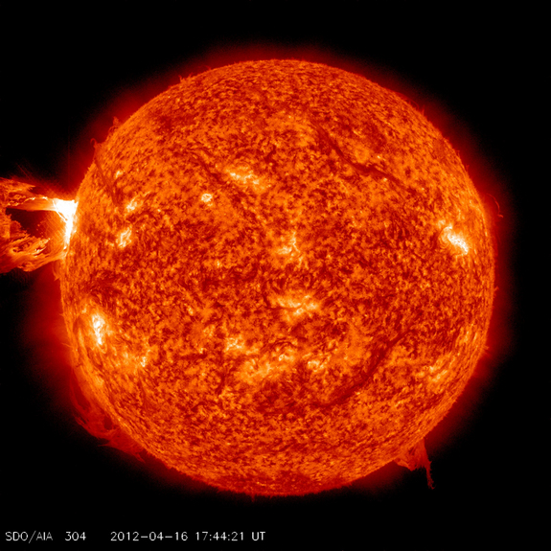
Space radiations
Sources
  Solar Wind
  Cosmic rays
Composition
  Protons
  Heavy ions
  Electromagnetic radiations
XXXIX ECPM

Slide 6
Beam requirements
Flux from few particles to 15000 ions/s.cm²
Homogeneity +/-10% on 25 mm
Range in Silicon larger than 60 µm
Different LET values available up to 60MeV/(mg/cm²) [Si]
Fast beam change : few minutes
XXXIX ECPM

Slide 7
CRC cockails
High range
High LET
M/Q=5
Ion | Energy [MeV] | Range Si [µm] | LET Si [MeV/(mg/cm²)]
¹⁵N³⁺ | 60 | 57,8 | 3,3
²⁰Ne⁴⁺ | 76 | 43,2 | 6,3
⁴⁰Ar⁸⁺ | 146 | 38,5 | 15,5
⁸⁴Kr¹⁷⁺ | 299 | 38,4 | 40,2
¹²⁴Xe²⁵⁺ | 417 | 36,4 | 69
M/Q=3,33
Ion | Energy [MeV] | Range Si [µm] | LET Si [MeV/(mg/cm²)]
¹³C⁴⁺ | 131 | 269,3 | 1,3
²²Ne⁷⁺ | 235 | 198,4 | 3,3
⁴⁰Ar¹²⁺ | 370 | 117,1 | 10,2
⁵⁸Ni¹⁷⁺ | 563 | 97,4 | 20,7
⁸³Kr²⁵⁺ | 750 | 91,8 | 32,6
¹²⁴Xe³⁵⁺ | 1000 | 73,1 | 62,5
XXXIX ECPM

Slide 8
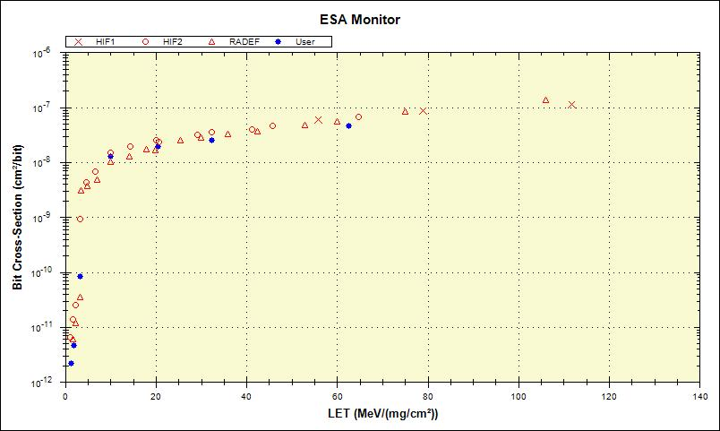
Component cross section
Xe
Ni
Kr
Ar
Ne
N
C
XXXIX ECPM

Slide 9
Development of a new ECRIS
Project funded by the Walloon region (Marshall plan : Skywin pole)
Objective : High charge state ion (Xe 35+ or 36+)
Increase the frequency : from 6 to 17,3 GHz
Room temperature coils
XXXIX ECPM

Slide 10
Development of a new ECRIS
Source | Scampi | Blue Whale
Frequency | 6 GHz | 17,3 GHz
B ECR | 0,215 T | 0,618 T
B inj | 1,2 T | 2,0 T
B ext | 0,65 T | 1,25 T
B rad | 0,65 T | 1,25 T
Power consumption | ~100kW | ~100kW
XXXIX ECPM

Slide 11
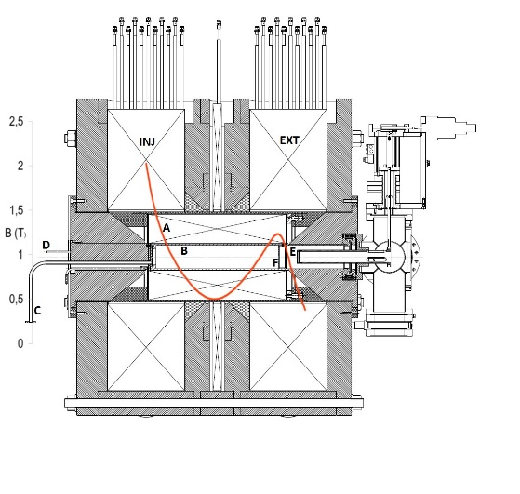
Development of a new ECRIS
Microwave Power : 2kW max
Plasma chamber
  diameter : 78 mm
  volume : 2,1 L
Coils current : 400 A
Available ions : C, N, Ne, Al, Ar, Ni, Kr, Xe
1m
XXXIX ECPM

Slide 12
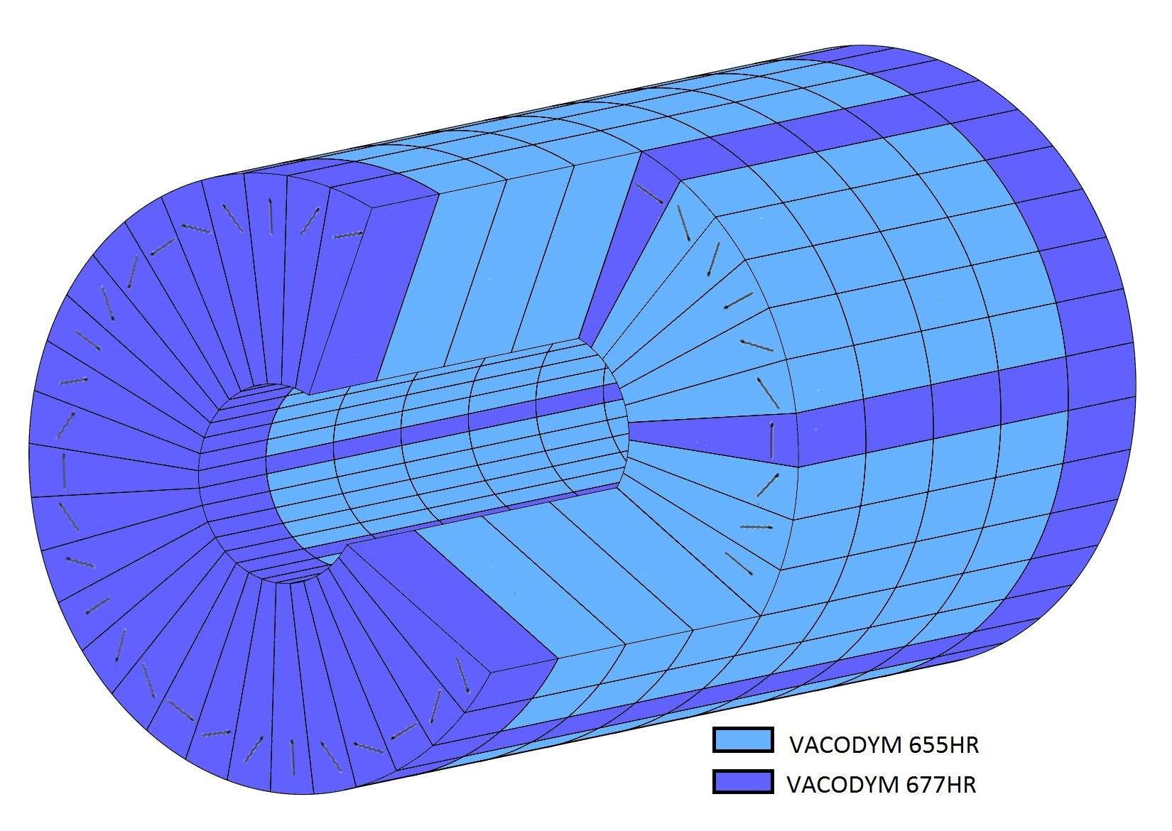
Hexapole configuration
Permanent magnet
9 rings
36 segments per ring
Higher coercivity for critical zones
XXXIX ECPM

Slide 13
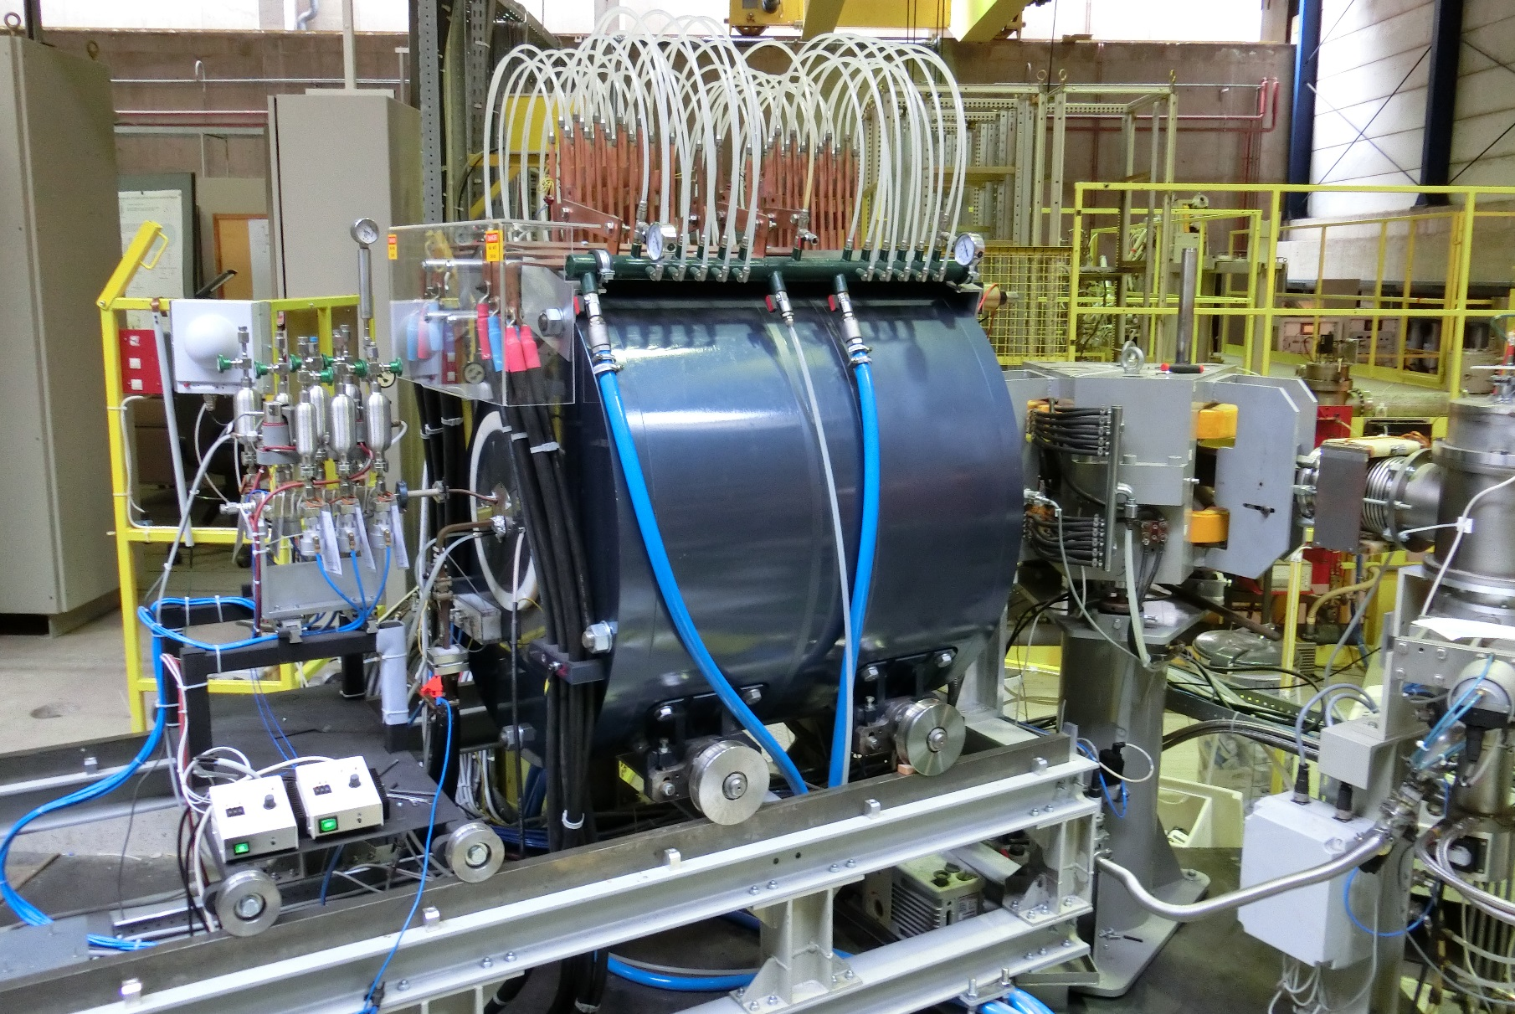
Development of a new ECRIS
XXXIX ECPM

Slide 14
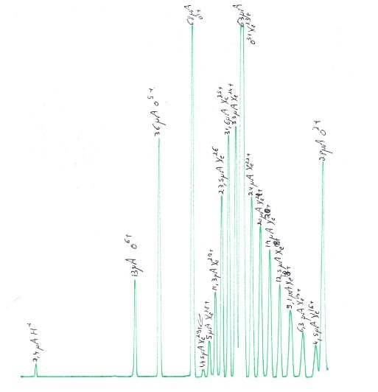
Xenon Spectrum
Gas : Xe and O₂
Microwave power : 500W
Extraction voltage: 10 kV
XXXIX ECPM

Slide 15
New cocktail
Ion | Energy on device | Range on device | LET on device
 | [MeV] | [µm] | [MeV/(mg/cm²)]
13C4+ | 131 | 269,3 | 1,3
14N4+ | 122 | 170,8 | 1,9
22Ne7+ | 238 | 202 | 3,3
40Ar12+ | 379 | 120,5 | 10,0
58Ni18+ | 582 | 100,5 | 20,4
84Kr25+ | 769 | 94,2 | 32,4
124Xe35+ | 995 | 73,1 | 62,5
XXXIX ECPM

Slide 16
Special features for ions cocktail
Beam change in few minutes with only one operator : use of calibrated leaks
Decrease the beam intensity (100 fAe for N⁴⁺) : Use of pepper pot grid
XXXIX ECPM

Slide 17
Heavy ions Irradiation Facility
90° bending magnet
Scanning magnet
Gold diffusion foil
Irradiation Vacuum chamber
beam monitoring detector
XXXIX ECPM

Slide 18
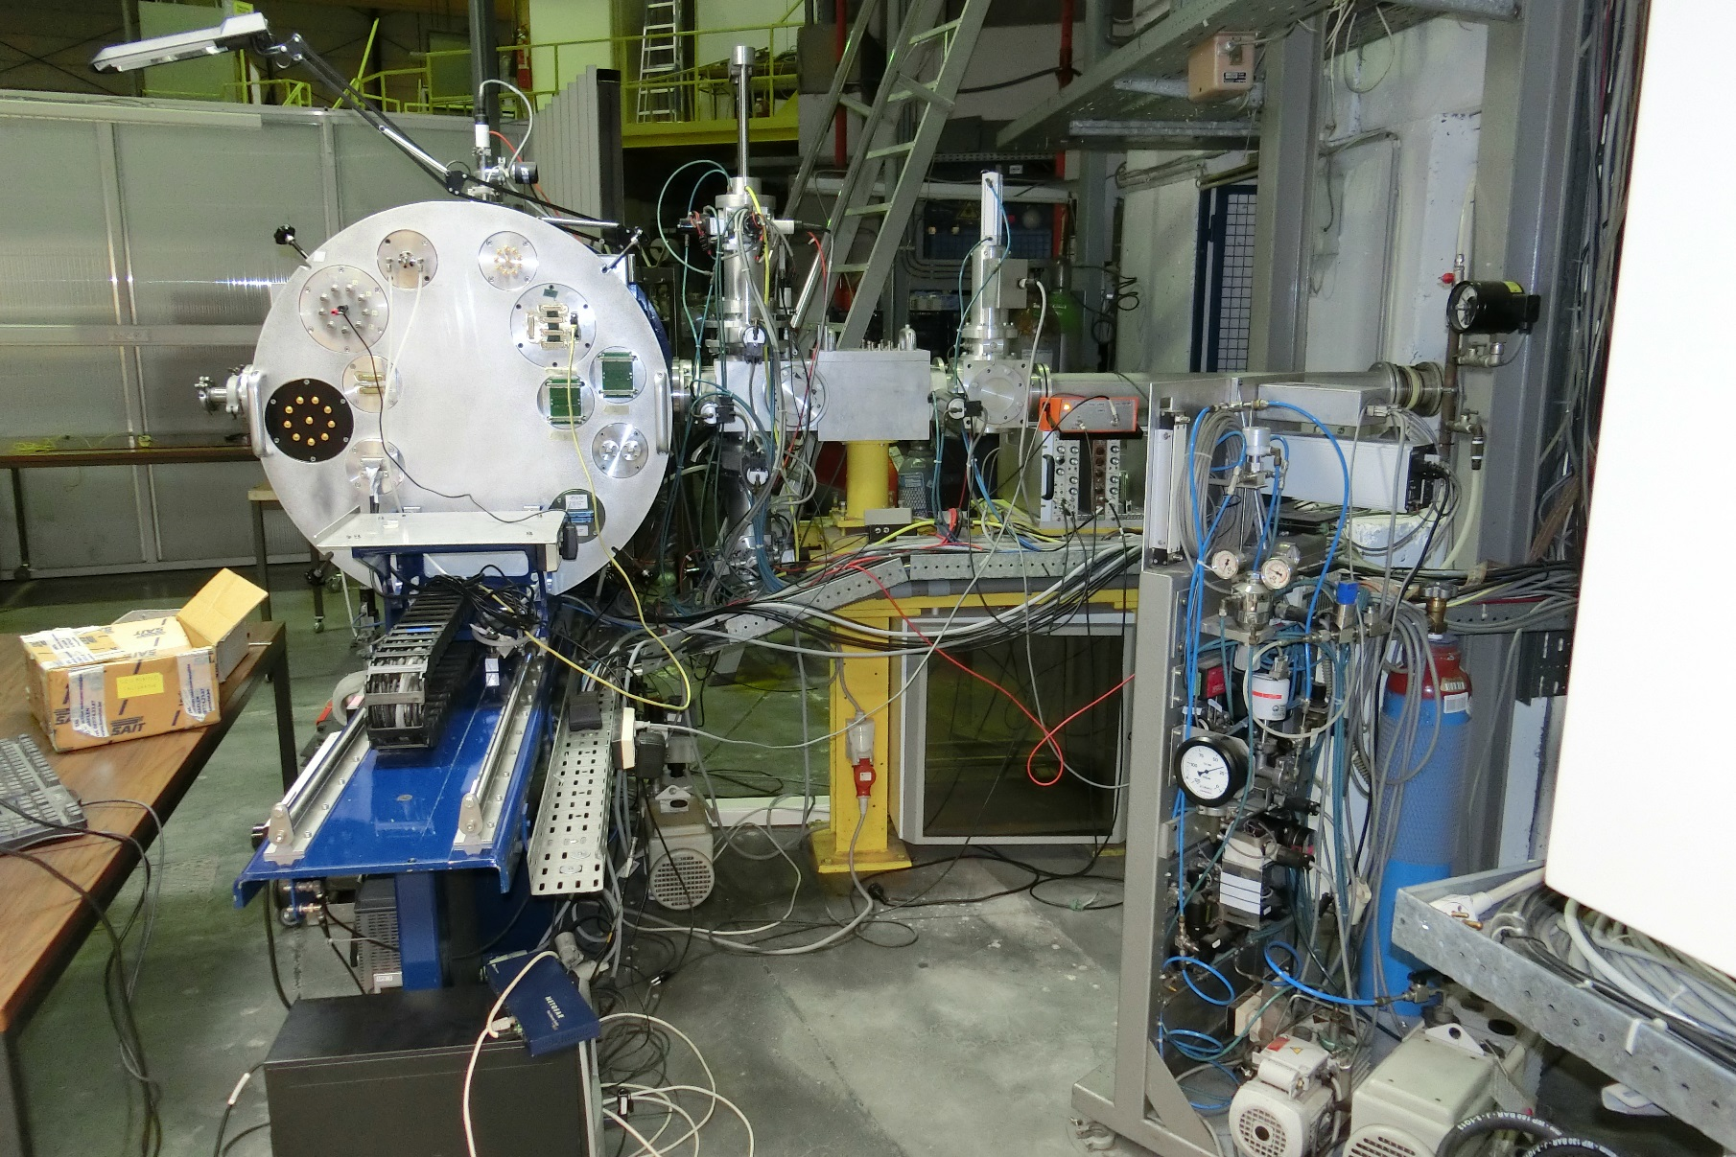
Heavy ions Irradiation Facility
Beam monitoring
Faraday cup
Irradiation chamber
XXXIX ECPM

Slide 19
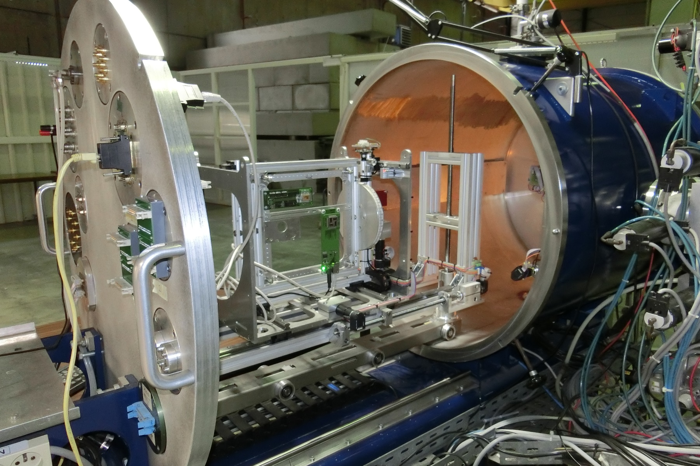
Heavy ions Irradiation Facility
XXXIX ECPM

Slide 20
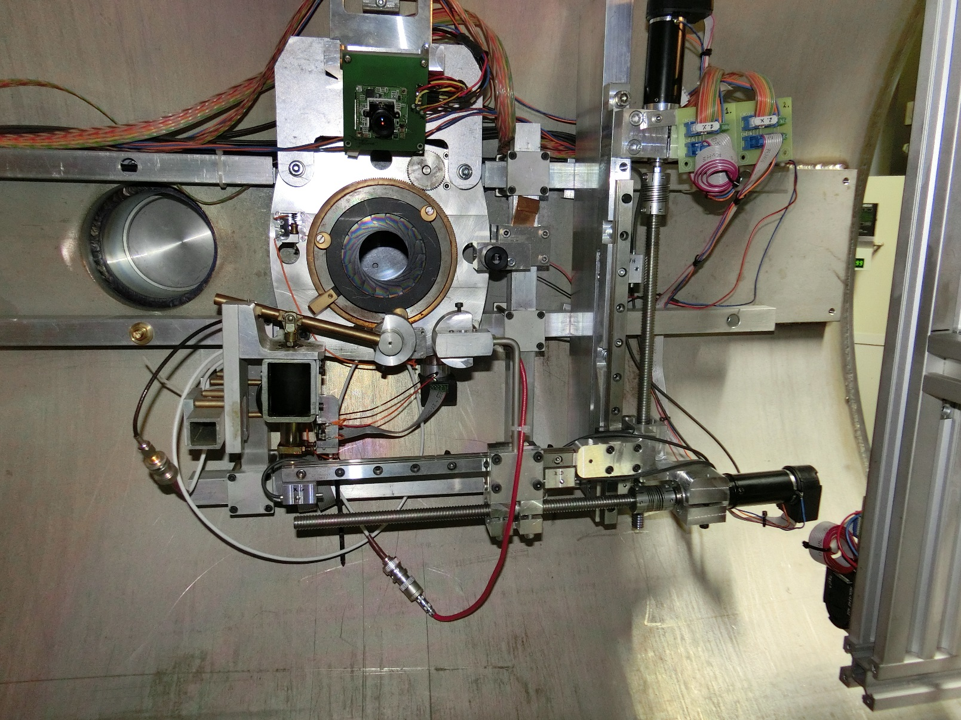
Heavy ions Irradiation Facility
Positioning camera
Scan Pips
Calibration Pips
XXXIX ECPM

Slide 21
Particles counting
Parallel Plate Avalanche Counter
  Transmission detector (Φ = 25 mm)
  In front of the vacuum chamber
  Surface normalization with a Pips before irradiation
  Count up to 15000 ions/s.cm²
XXXIX ECPM

Slide 22
Beam homogeneity
Diffusion with a thin gold foil (0,75 µm)
  Energy loss
  Not adjustable
  Beam transport limitation
XXXIX ECPM

Slide 23
Beam homogeneity
Scanning magnet
  Lissajoux figure
  Different frequencies for X and Y axes
Advantages
  Adjustable with the current
  No energy loss
XXXIX ECPM

Slide 24
Lissajoux figure
Two triangle waves :
X : 13 Hz
Y : 50 Hz
Current up to 50 A
Power supply from JEMA
XXXIX ECPM

Slide 25
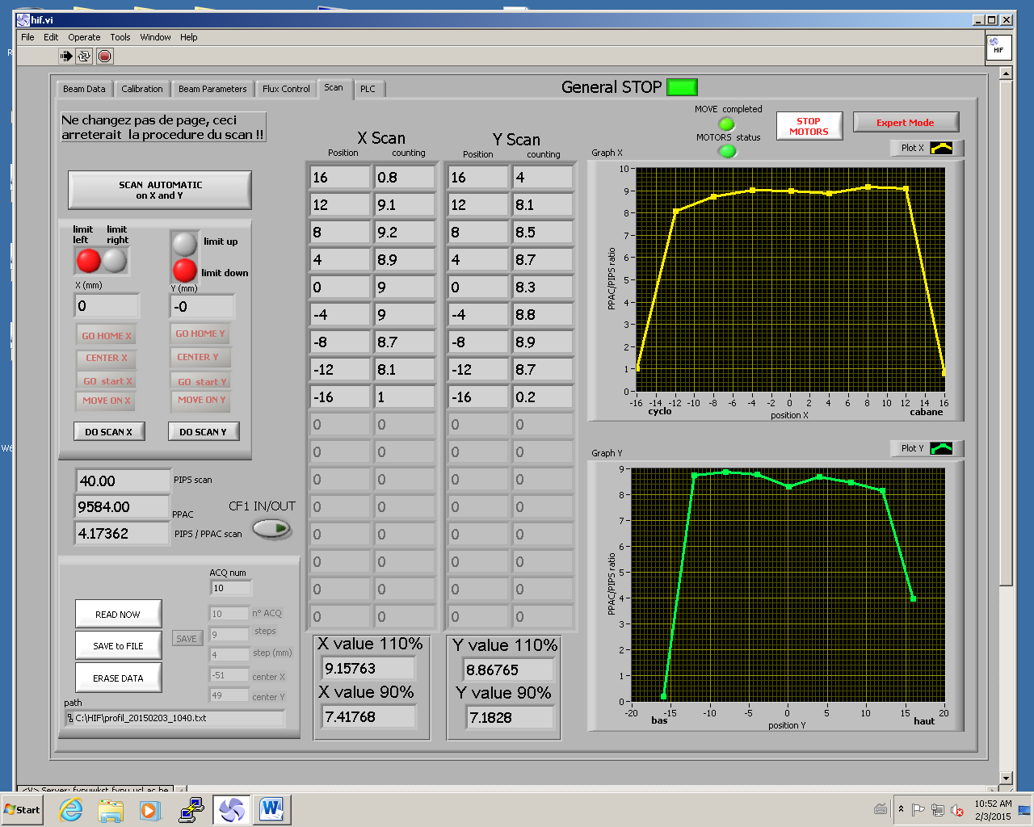
Beam homogeneity
XXXIX ECPM

Slide 26
SEU monitor
ESA reference component for quality control
Homogeneity and counting verification
Fast and visual test
XXXIX ECPM

Slide 27
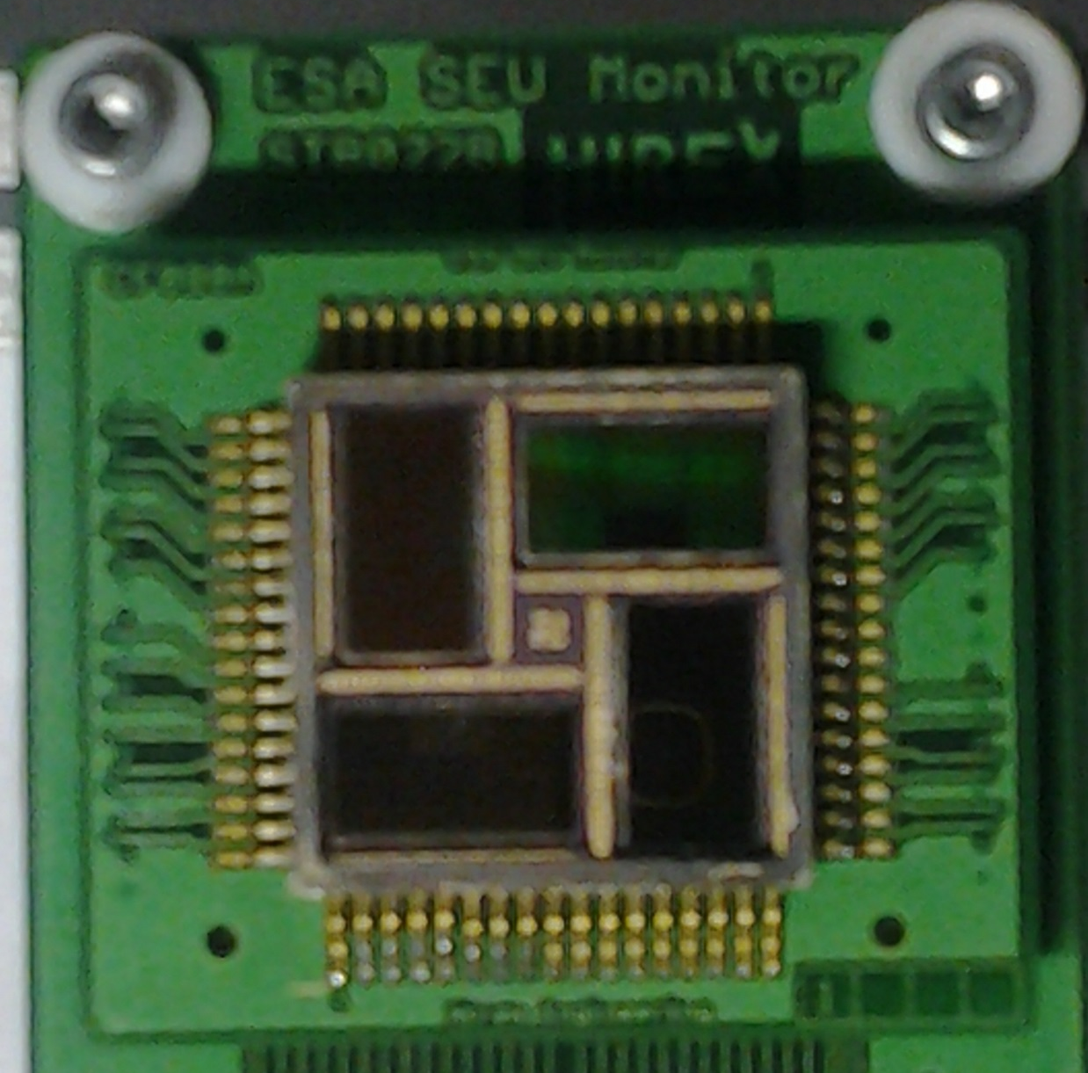
SEU monitor
20 X 20 mm
4 dies
128 memories by die
Procedure :
  Write
  Check
  Irradiate
  Read
  Number of error??
XXXIX ECPM

Slide 28
Seu monitor
XXXIX ECPM

Slide 29
Component cross section
Xe
Ni
Kr
Ar
Ne
N
C
XXXIX ECPM

Slide 30
Thank you for your attention
XXXIX ECPM

