Slide 1



Results from the LUX experiment and presentation of LUX-ZEPLIN
Timothy John Sumner
Imperial College London
on behalf of the LUX and LZ collaborations

Slide 2
Motivation
Detection
LUX Description
LUX Commissioning Performance
LUX WIMP Search
LUX Future Plans
LUX-ZEPLIN (LZ)

Slide 3
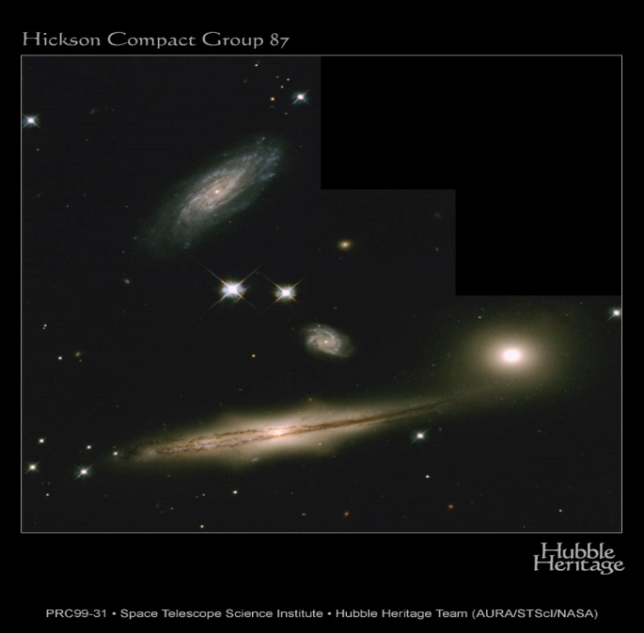
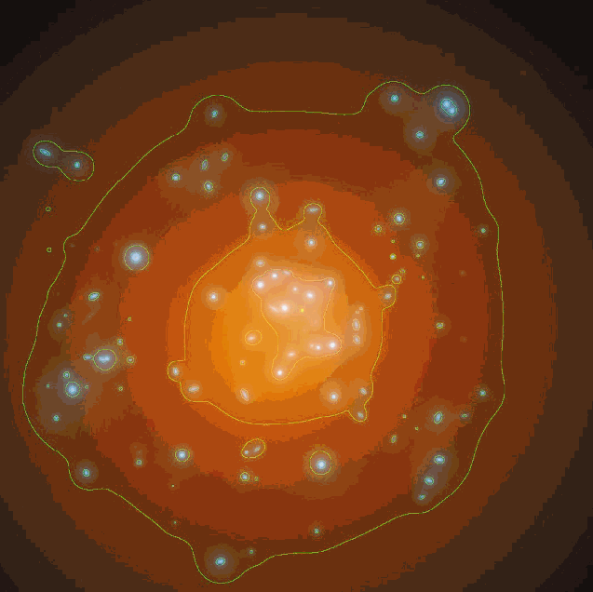
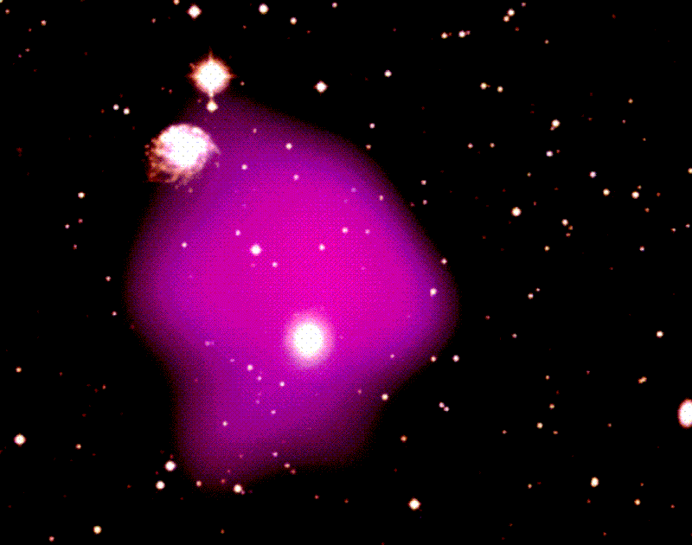
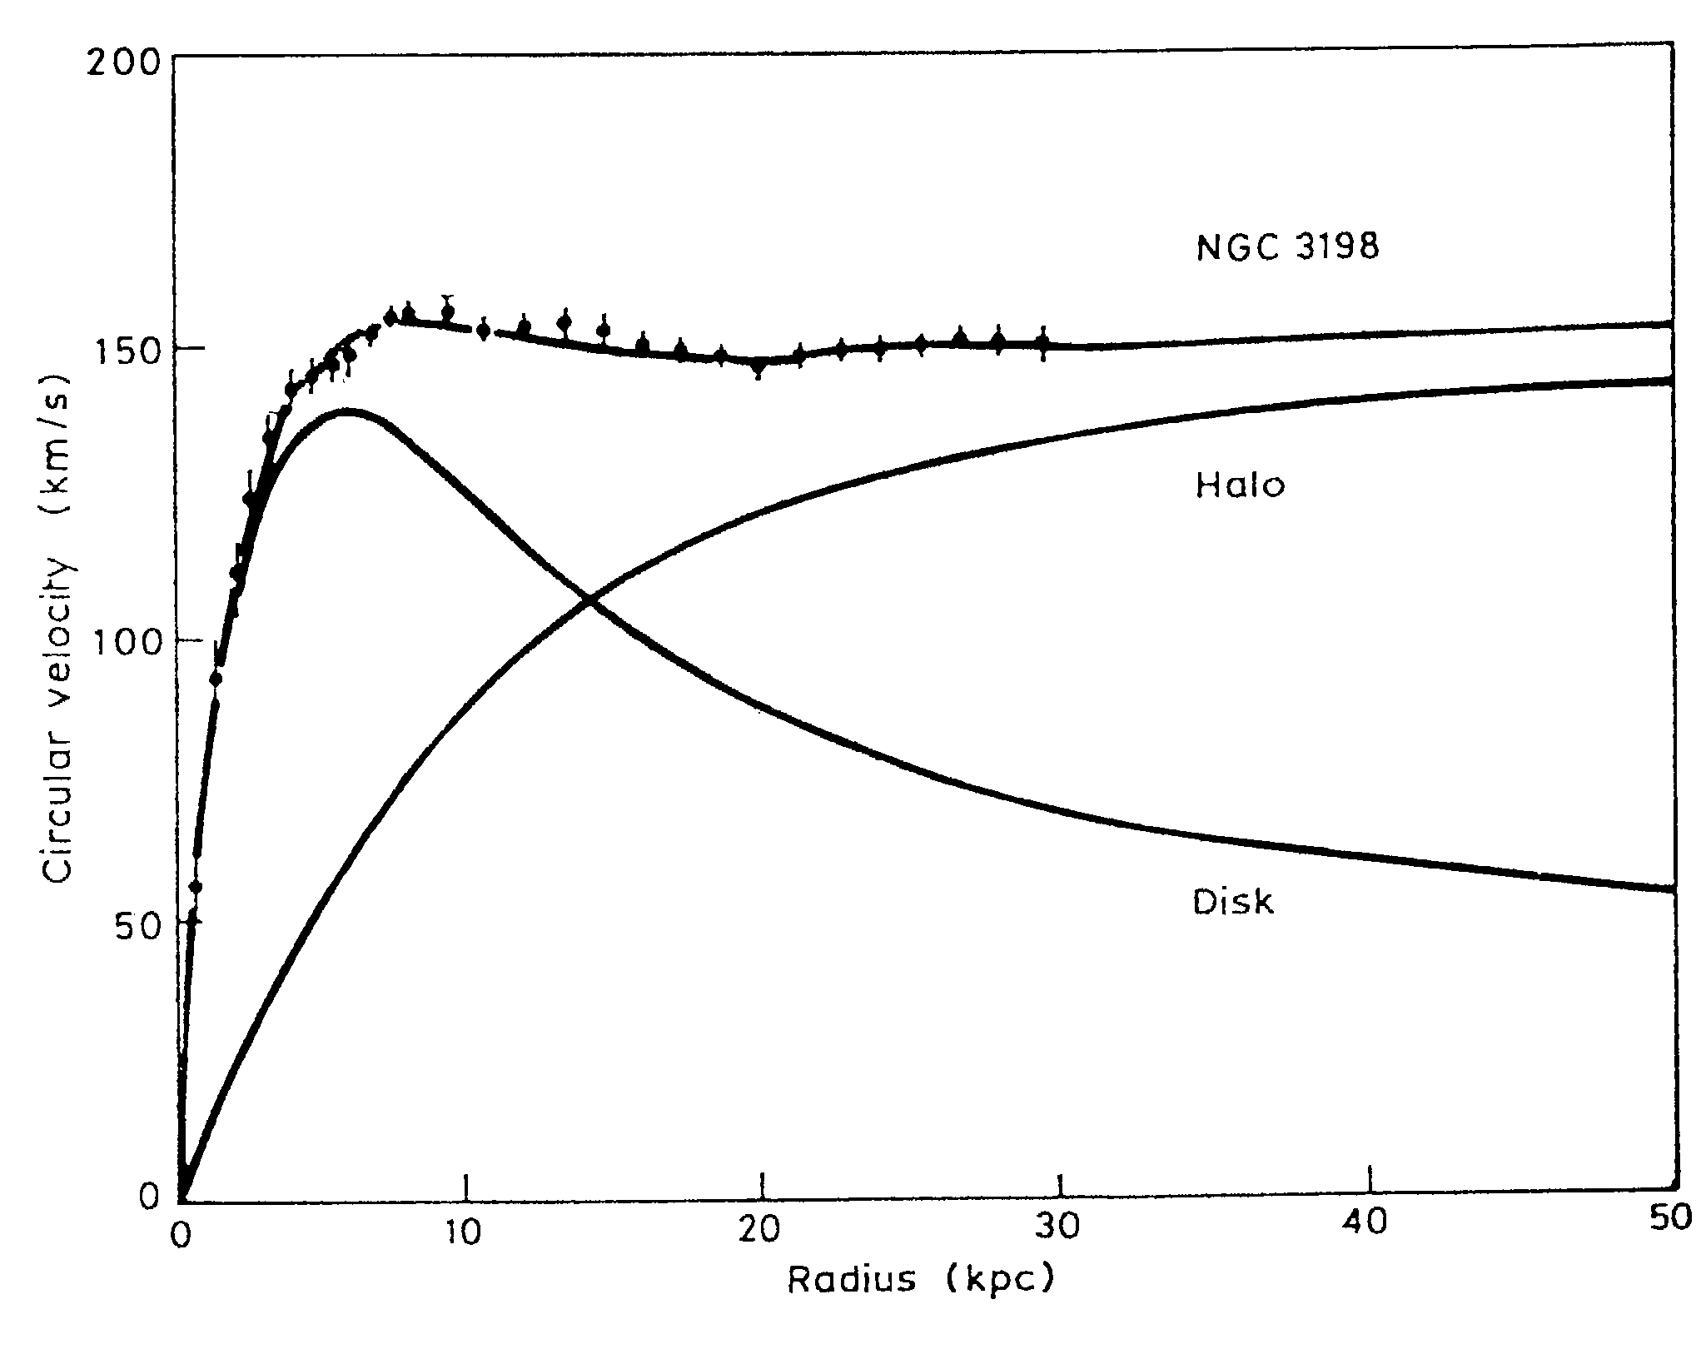
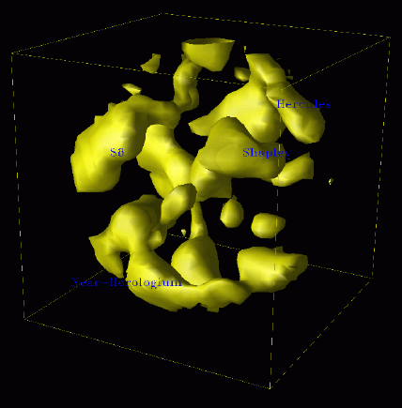
Evidence for Dark Matter a)Probing gravitational potentials

Slide 4
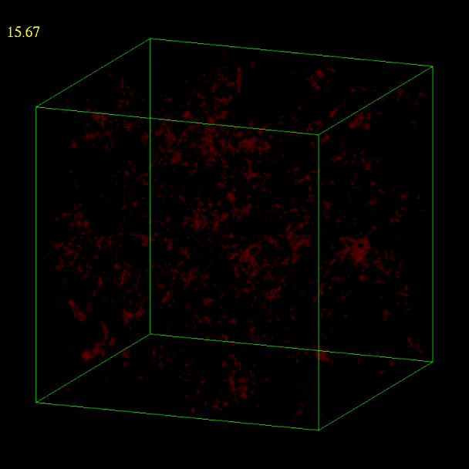
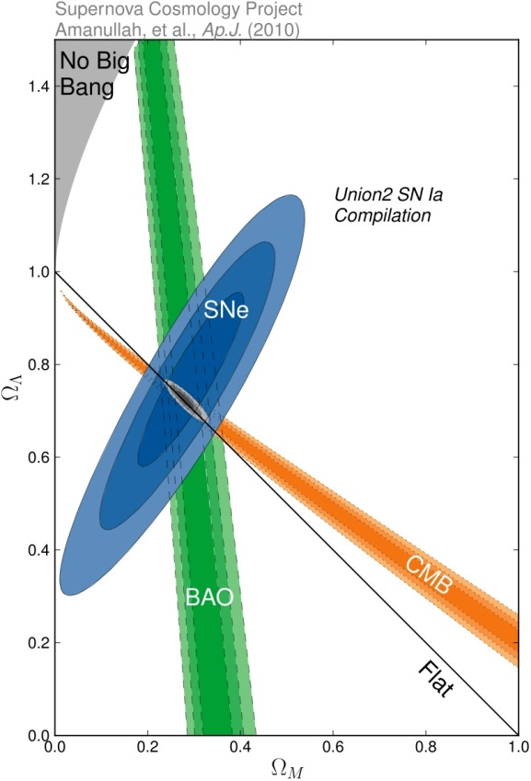
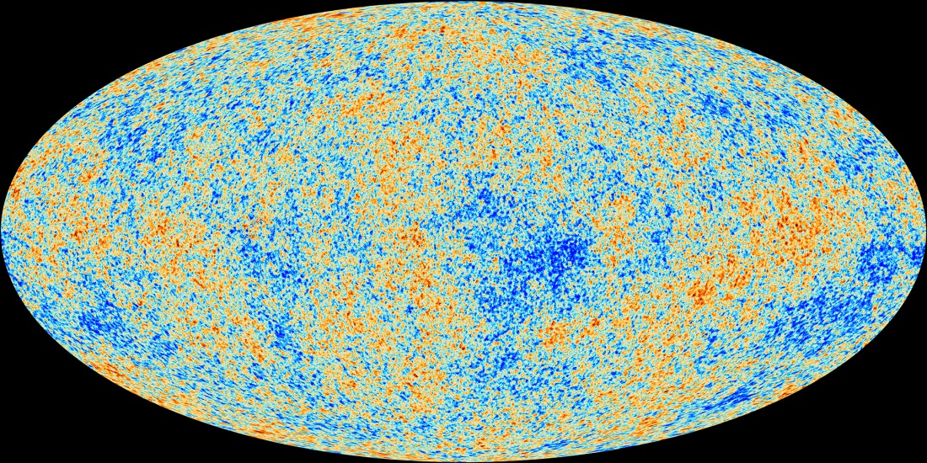
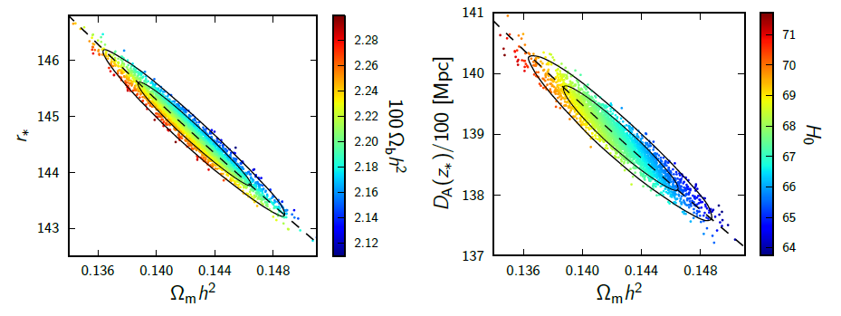
Evidence for Dark Matter b)Structure and evolution of the Universe

Slide 5
Scientific Motivation
Dark matter detection goals are driven by three questions
Cosmology – is the dark matter that makes up ~26% of the Universe in the form of massive particles?
Unification – are these the particles predicted by frameworks such as supersymmetry?
Galaxy formation and dynamics – how do these particles behave within galaxies?

Slide 6
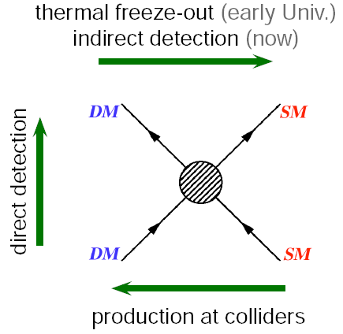
How to Detect WIMPs
After lunch
This talk
Next talks

Slide 7
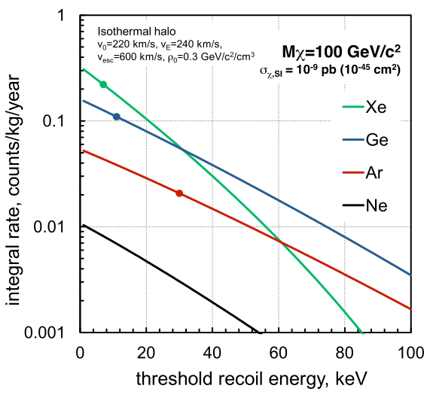
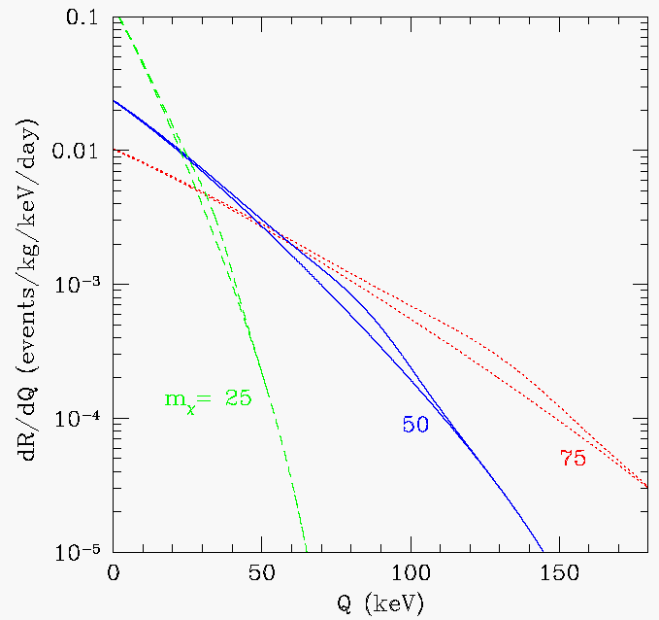
The Challenge
WIMP elastic nuclear recoils deposit < 50keV of energy at a rate < 1 event/day/tonne

Slide 8
WIMP DIRECT SEARCH TECHNOLOGY ZOO
Ionisation Detectors
Targets: Ge, Si, CS₂, CdTe
CoGeNT, DRIFT, DM-TPC
GENIUS, HDMS, IGEX, NEWAGE
Light & Ionisation Detectors
Targets: Xe, Ar
ArDM, Darkside, LUX, LZ,
WARP, XENON, ZEPLIN
cold (LN₂)
Heat & Ionisation Bolometers
Targets: Ge,Si
CDMS, EDELWEISS, EURECA
cryogenic (<50 mK)
ionisation
Q
Scintillators
Targets: NaI, Xe, Ar
ANAIS, CLEAN, DAMA,
DEAP, KIMS, LIBRA,
NAIAD, XMASS, ZEPLIN-I
L
scintillation
H
phonons
Bolometers
Targets: Ge, Si, Al₂O₃, TeO₂
CRESST-I, CUORE, CUORICINO
Bubbles & Droplets
CF₃Br, CF₃I, C₃F₈, C₄F₁₀
COUPP, PICASSO, SIMPLE
Light & Heat Bolometers
Targets: CaWO_{4,} BGO, Al₂O₃
CRESST, ROSEBUD
cryogenic (<50 mK)

Slide 9
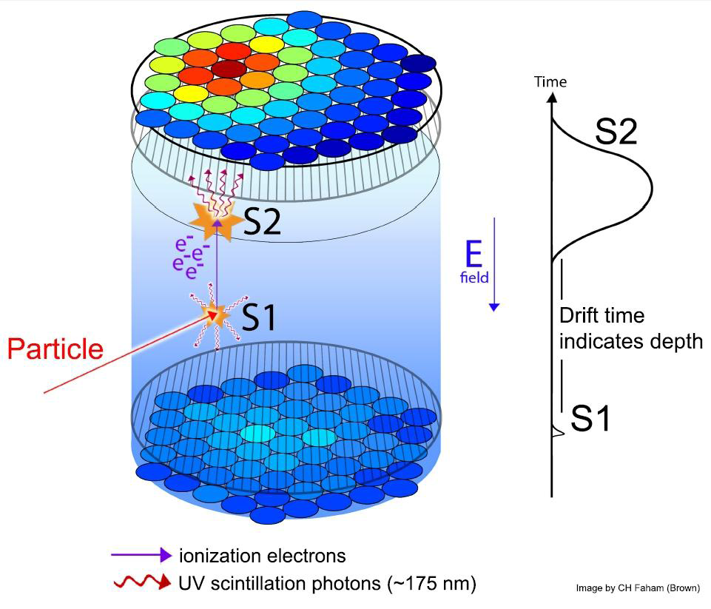
TWO-PHASE XENON DETECTORS
S1: LXe is an excellent scintillator
  Density: 3 g/cm³
  Light yield: ∼70 ph/keV (0 field)
  Scintillation light: 178 nm (VUV)
  Nuclear recoil threshold ∼5-10 keV
S2: Even better ionisation detector
  Sensitive to single ionisation electrons
  Nuclear recoil threshold ∼1 keV
And a great WIMP target too
  Scalar WIMP-nucleon scattering rate dR/dE∼A²
  Odd-neutron isotopes (¹²⁹Xe, ¹³¹Xe) enable spin-dependent sensitivity
  Excellent ionisation threshold: ‘light WIMP’ searches using S2 only
  No intrinsic backgrounds (⁸⁵Kr can be removed effectively)

Slide 10
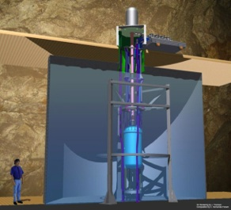
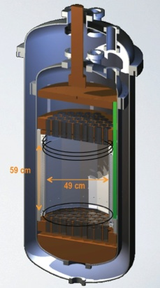
The Large Underground Xenon (LUX) Experiment
370 kg total xenon mass
250 kg active liquid xenon
118 kg fiducial mass

Slide 11
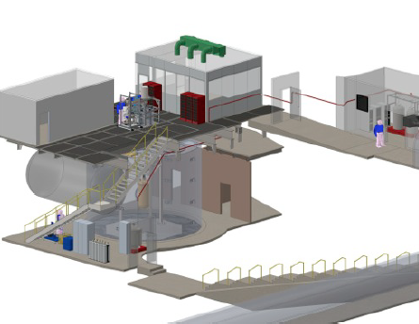
in the Davis Cavern

Slide 12
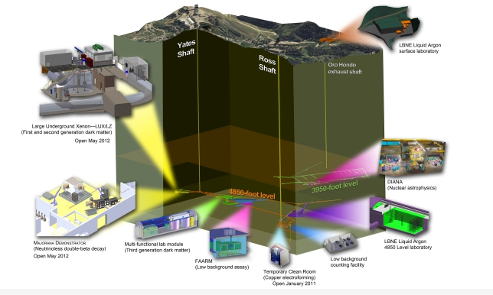
in the SURF at Homestake

Slide 13
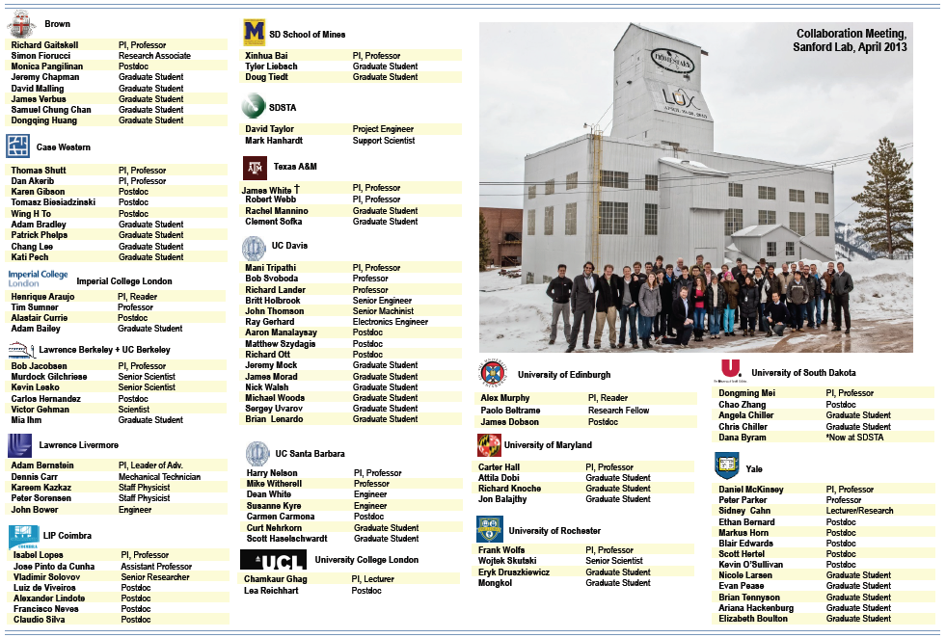
collaboration (at Homestake)

Slide 14
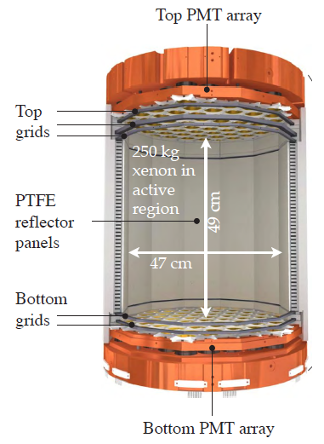
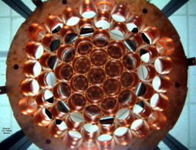
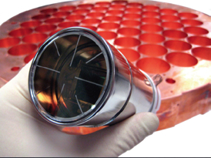
The Detector

Slide 15
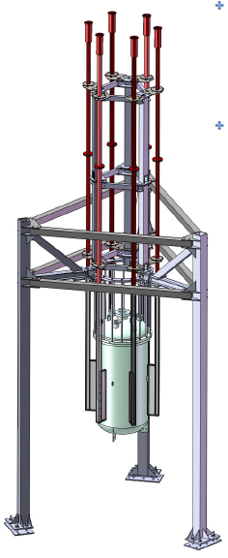
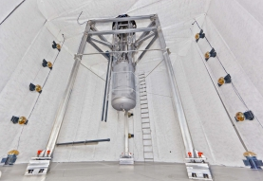
Detector Installation

Slide 16
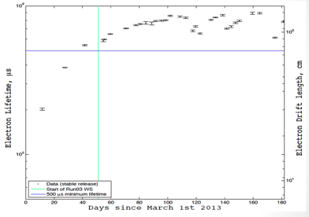
Detector Commissioning
Low-energy electron recoil background of 3e-3 e/keV/kg/day.
Kr/Xe ratio of 3.5 ppt.
Electron drift length >130 cm.
Light detection efficiency of 14%.
Electron recoil discrimination of 99.6%, with drift field of 181 V/cm.

Slide 17
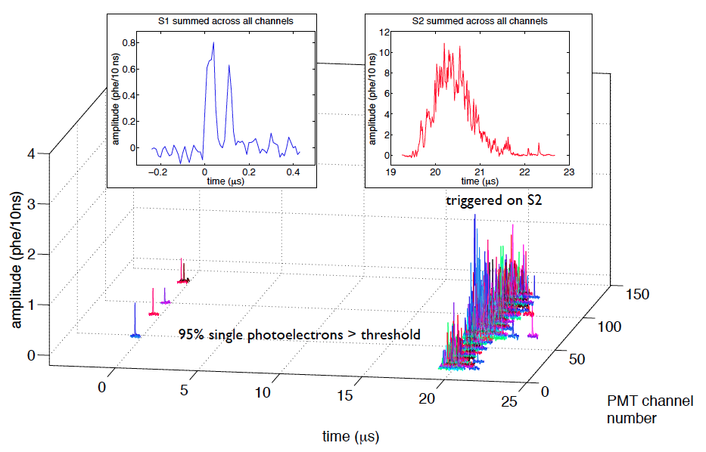
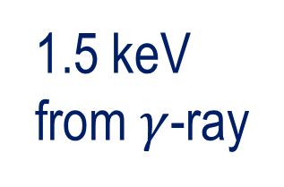
Detector Commissioning
1.5 keV from $γ$-ray

Slide 18
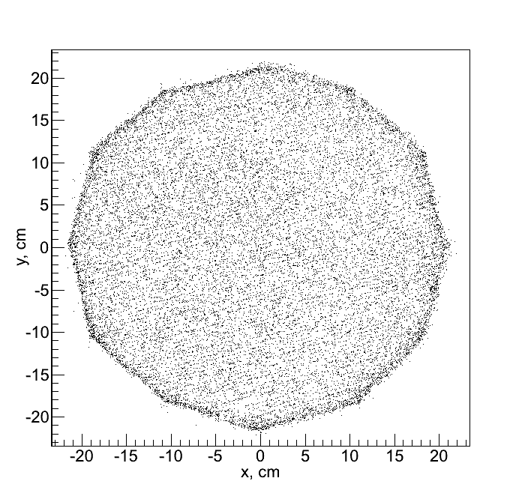
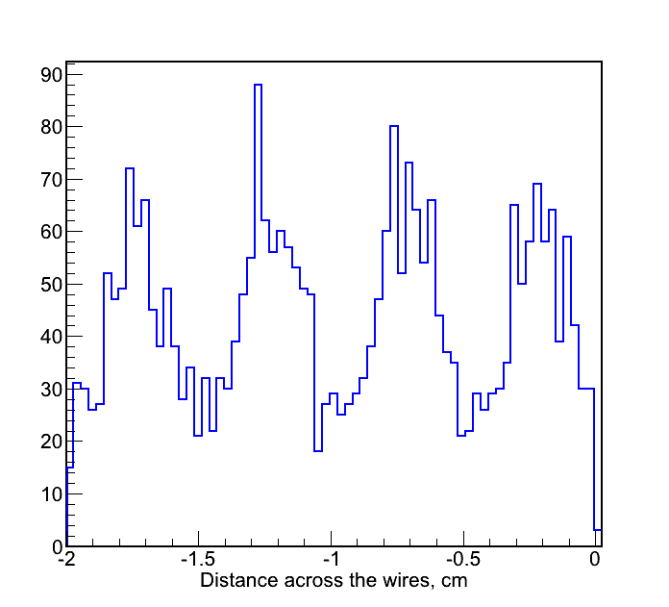
Detector Calibration
Position Reconstruction
Z from S1-S2 time delay (1.51 mm/microsecond)
X,Y from fitting the S2 hit pattern
X,Y reconstruction of events near
anode grid resolves grid wires with
5 mm pitch.

Slide 19
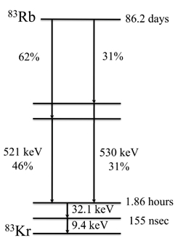
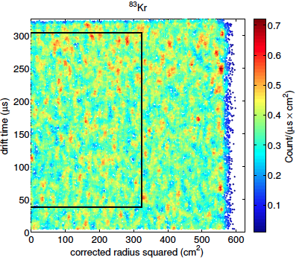
Detector Calibration
Light Collection
Dispersed Kr-83m calibration gives uniform
volume sampling of S1 and S2
Naturally decays away in few hours
Over 10⁶ events per calibration

Slide 20
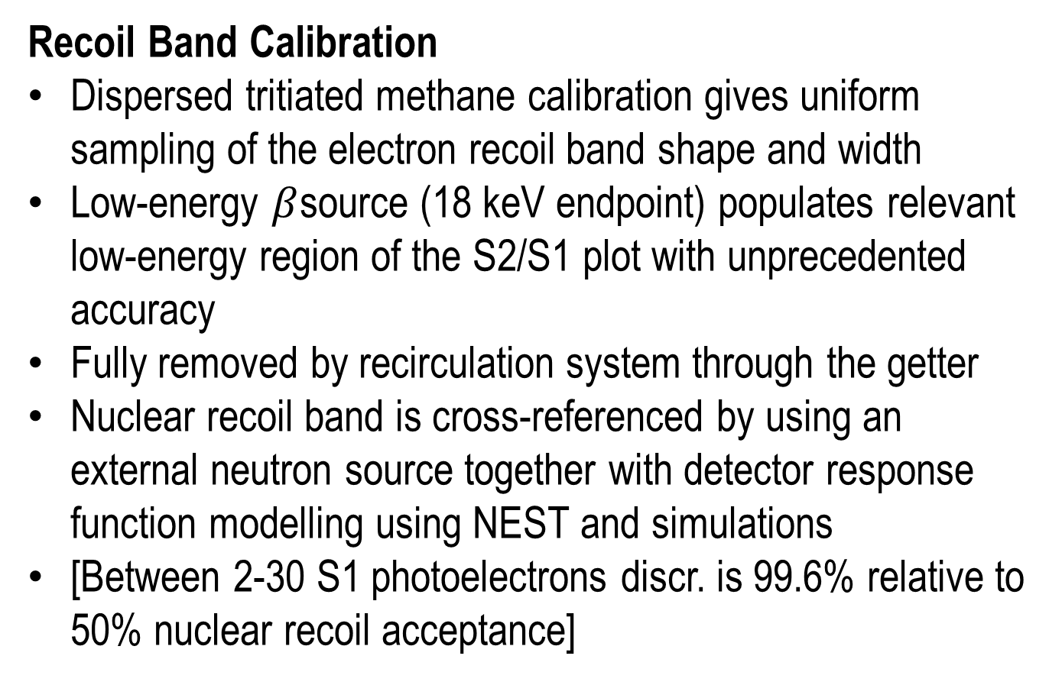
Detector Commissioning
Recoil Band Calibration
Dispersed tritiated methane calibration gives uniform sampling of the electron recoil band shape and width
Low-energy $β$source (18 keV endpoint) populates relevant low-energy region of the S2/S1 plot with unprecedented accuracy
Fully removed by recirculation system through the getter
Nuclear recoil band is cross-referenced by using an external neutron source together with detector response function modelling using NEST and simulations
[Between 2-30 S1 photoelectrons discr. is 99.6% relative to 50% nuclear recoil acceptance]

Slide 21
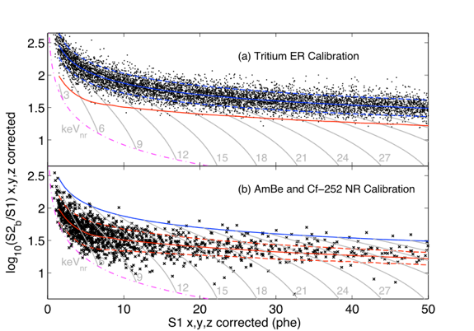
Detector Calibration

Slide 22
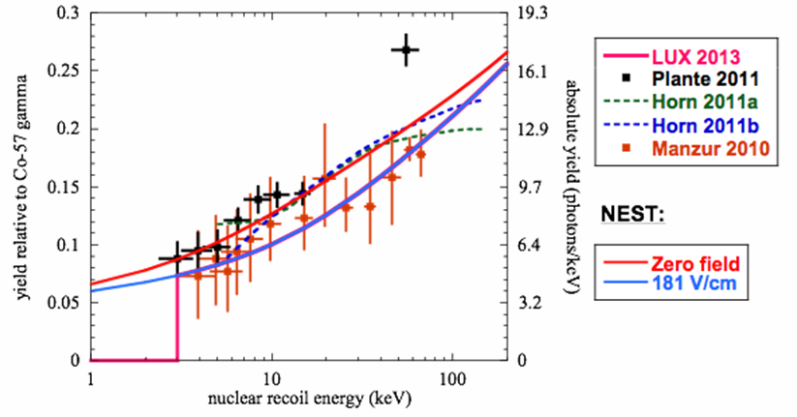
Detector Calibration
Nuclear Recoil Band Calibration Notes
NEST (Noble Element Simulation Technique) is based on extensive existing experimental data
Artificial cut-off in light and charge yields assumed <3 keVnr
Includes predicted electric field quenching

Slide 23
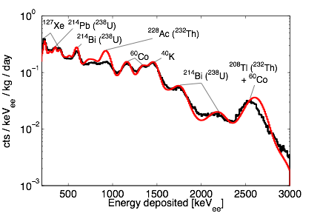
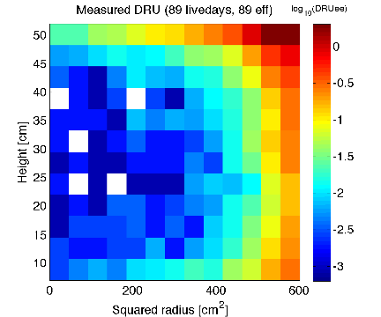
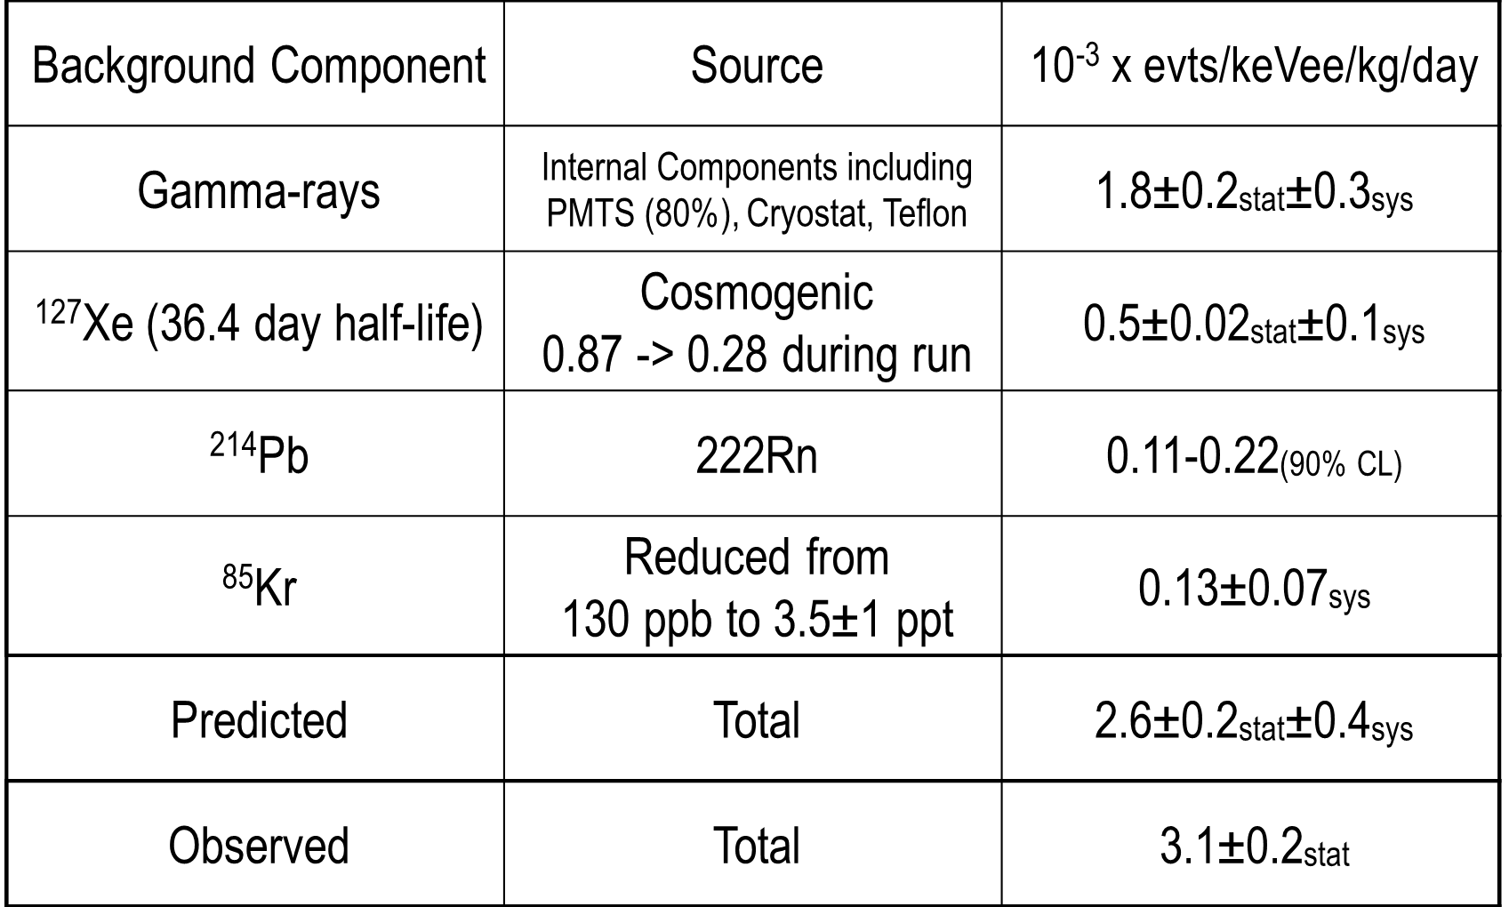
Detector Background
118 kg
3.1+/-0.2 mdru
(0.5 dru cosmogenic)
r<18 cm
z=7-47 cm

Slide 24
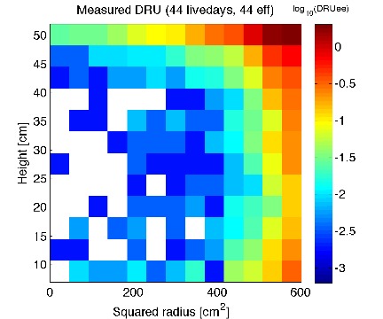
Detector Background

Slide 25
WIMP Search
April 21 - August 8, 2013 - 110 calendar days
  85.3 live days of WIMP Search
  118.3+/-6.5 kg fiducial mass
Calibrations
  Frequent ^{83m}Kr calibration of any S1 or S2 gain shifts
  AmBe&Cf calibrations + Sims to define NR band
  Injected Tritiated Methane for relevant ER band
Efficiency
  WIMP efficiency from calibration sets using multiple techniques

Slide 26
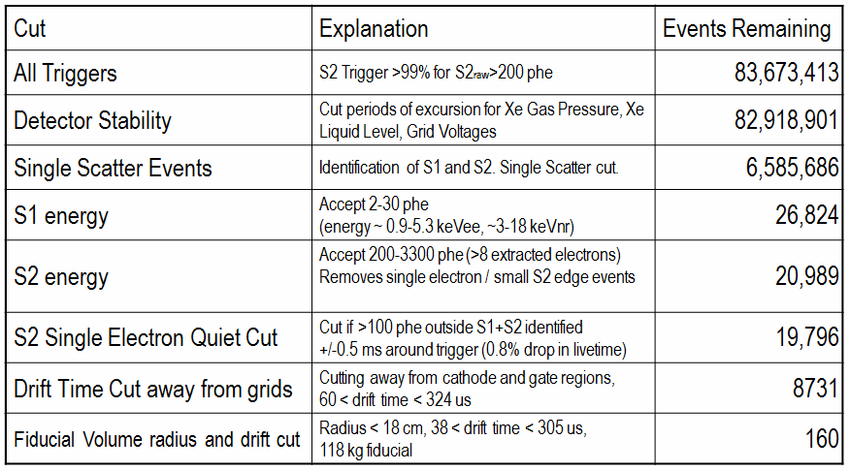
WIMP Search
Data Selection

Slide 27
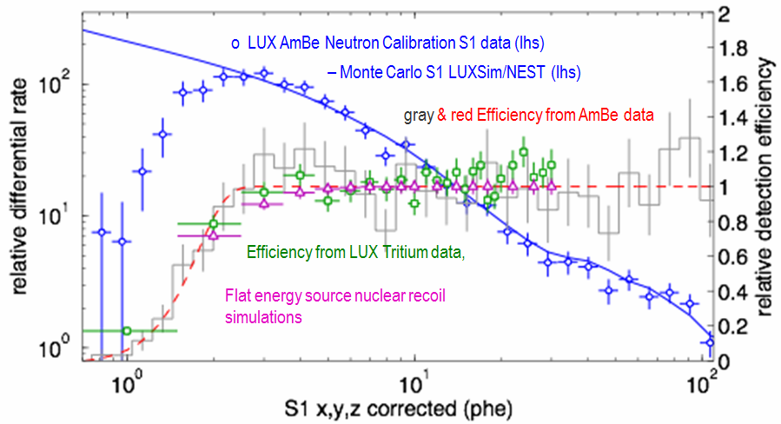
WIMP Search
Efficiency in S1 phe

Slide 28
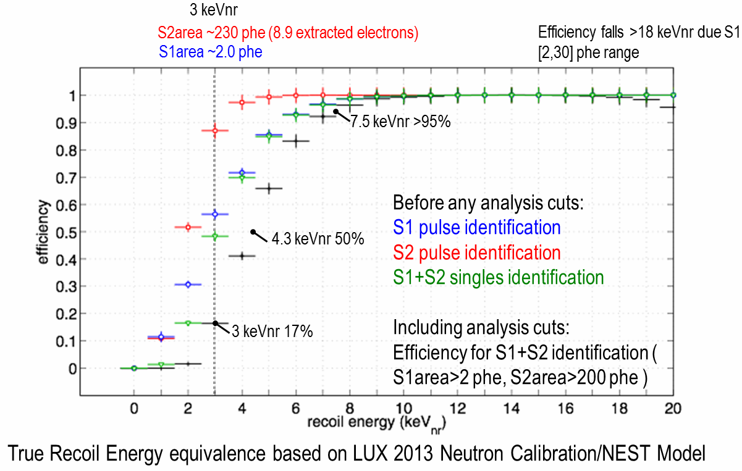
WIMP Search
Efficiency in keVnr

Slide 29
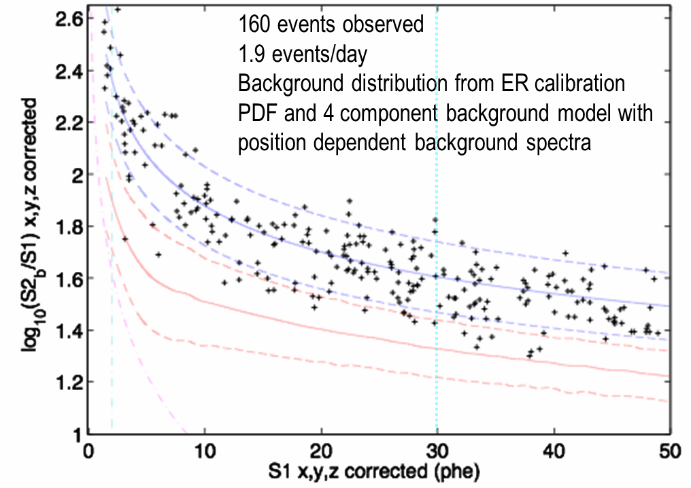
WIMP Search
S2/S1 plot

Slide 30
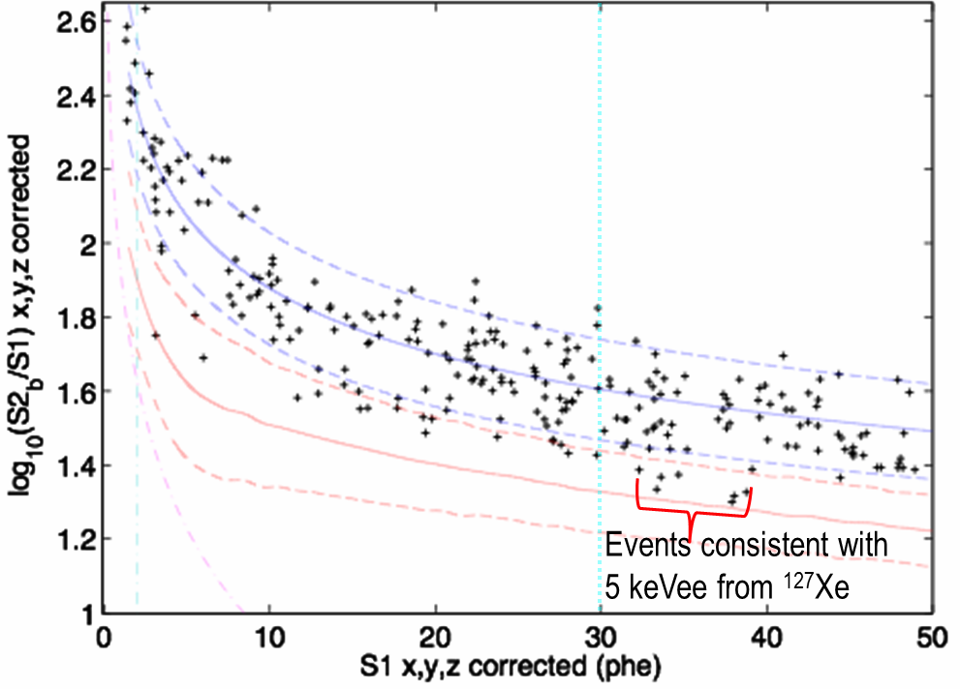
WIMP Search
S2/S1 plot

Slide 31
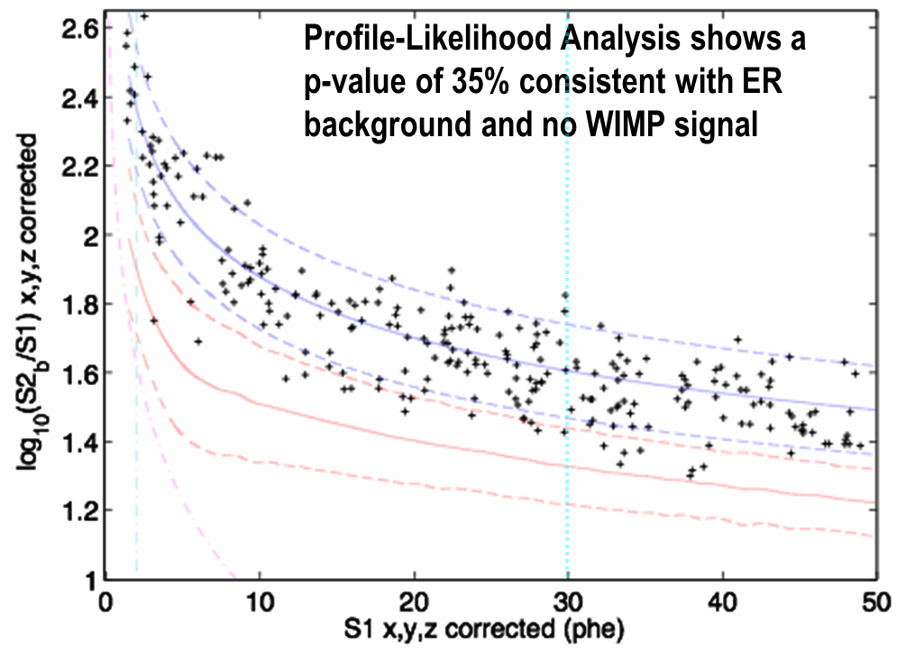
WIMP Search
S2/S1 plot

Slide 32
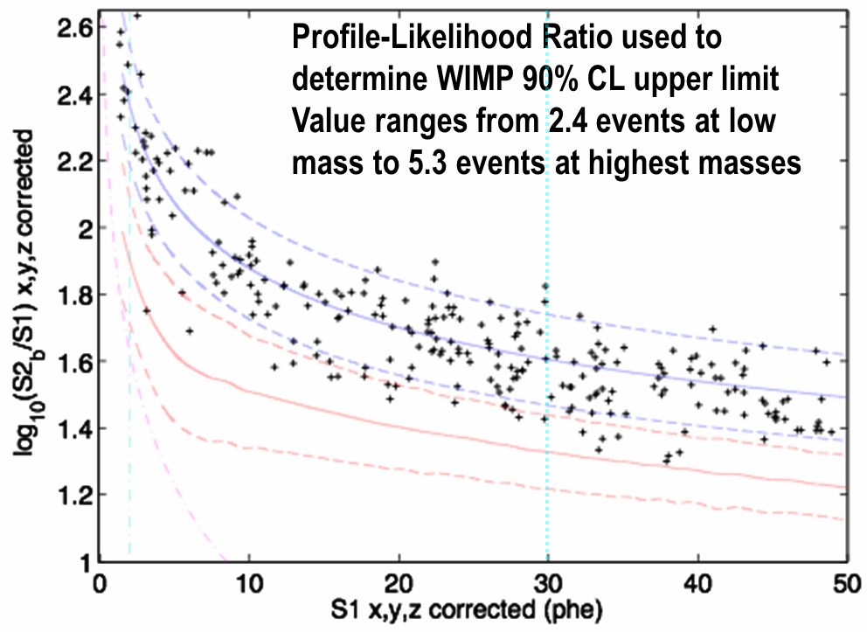
WIMP Search
S2/S1 plot

Slide 33
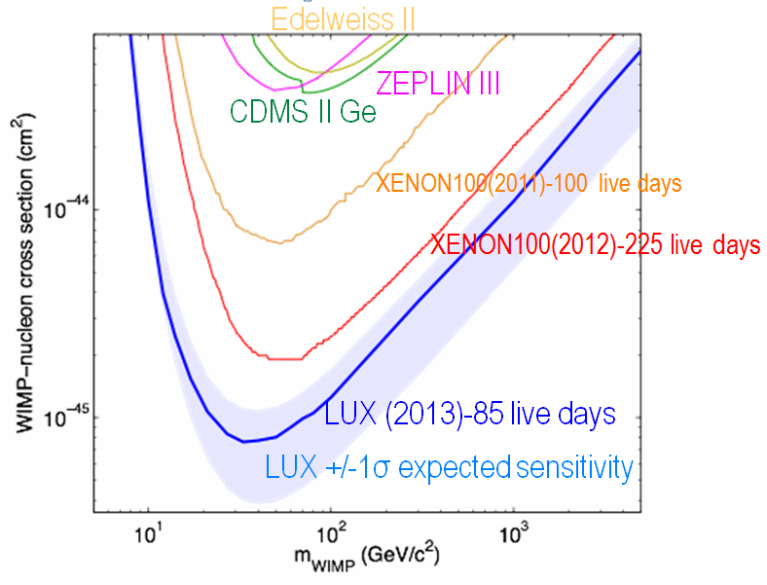
WIMP Search
Upper limit

Slide 34
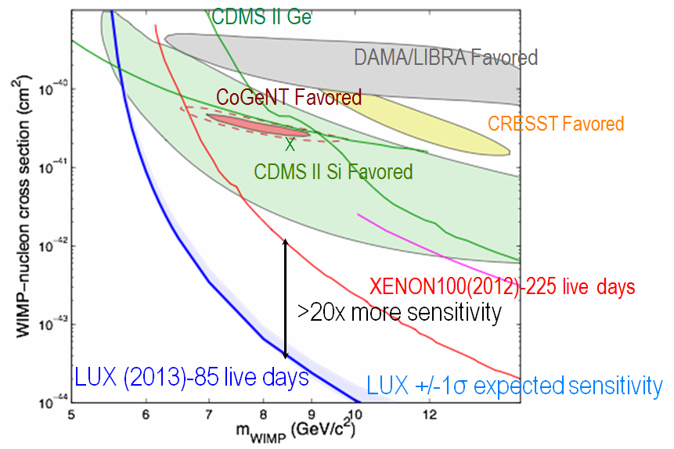
WIMP Search
Upper limit

Slide 35
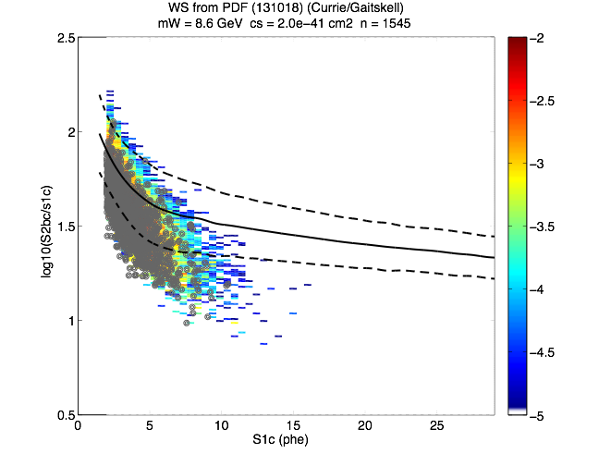
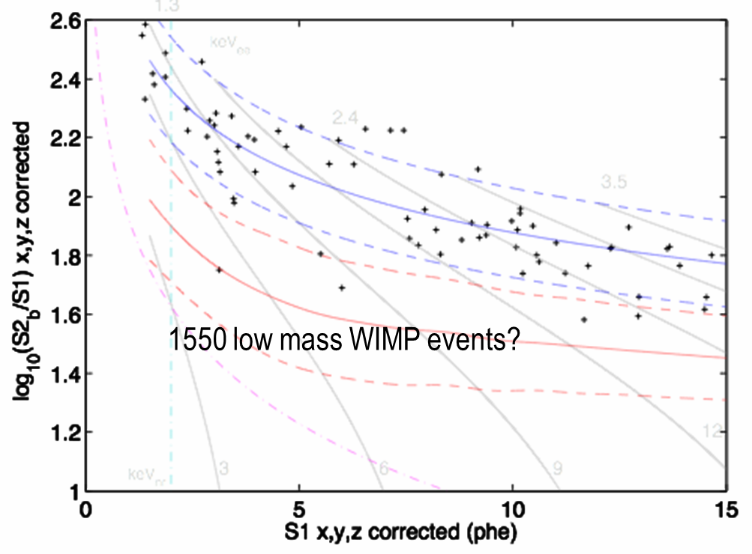
WIMP Search
Upper limit at low masses

Slide 36
Summary
LUX WIMP Search run of 86 live-days
  Backgrounds as expected, inner fiducial ER rate <2 events/day in region of interest
  Major advances in calibration techniques including ^{83m}Kr and Tritiated-CH4 injected directly into Xe target
  Very low energy threshold achieved 3 keVnr with no ambiguous/leakage events
  ER rejection shown to be 99.6+/-0.1% in range of interest
Intermediate and High Mass WIMPs
  Extended sensitivity by x3 at 35 GeV and x2 at 1000 GeV
Low Mass WIMP Favored Hypotheses ruled out
  LUX WIMP Sensitivity 20x better
  LUX does not observe 6-10 GeV WIMPs favoured by earlier experiments

Slide 37
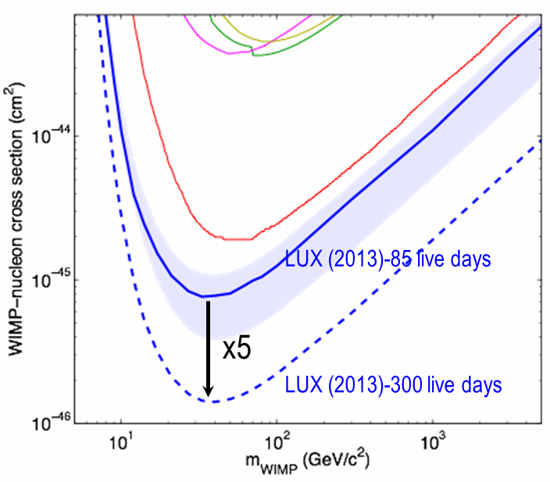
Next WIMP Search
New run of 300 days in 2014/15
x5 in sensitivity
Still discovery potential
WIMPs remain our favoured quarry

Slide 38

experiment
The LUX and ZEPLIN-III collaborations signed an MOU in 2008 to move forward on joint next generation experiments – LUX-ZEPLIN
Collaboration has grown substantially since then
USA – Brookhaven National Laboratory, Brown University, Case Western Reserve University, Lawrence Livermore National Laboratory, SLAC National Accelerator Laboratory, South Dakota School of Mines and Technology, South Dakota Science and Technology Authority, Texas A&M University, University Of Alabama, University of California, Berkeley/LBNL, University of California, Davis, University of California, Santa Barbara, University of Maryland, University of Rochester, University of South Dakota, University of Wisconsin, Physical Sciences Laboratory, Washington University, Yale University
‘European’ – Imperial College, London, LIP – University of Coimbra, Moscow Engineering Physics Institute, Oxford University, STFC Daresbury Laboratory, STFC Rutherford Appleton Laboratory, University College, London, University of Edinburgh, University of Sheffield

Slide 39
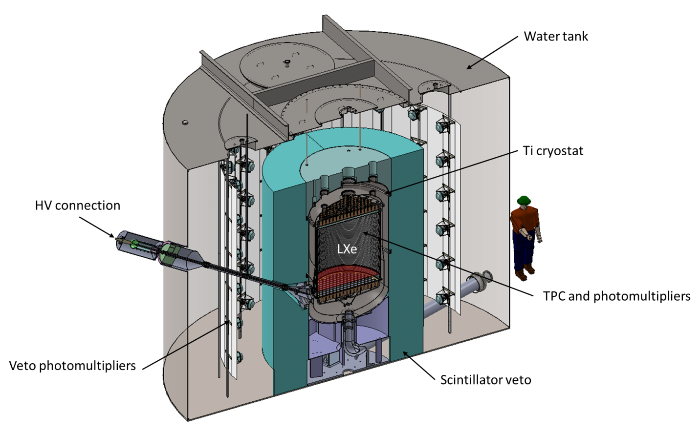
experiment concept
10 t total xenon mass
7 t active liquid xenon
6 t fiducial xenon mass
Active internal xenon veto
Active scintillator (Compton) veto

Slide 40
detector concept

Slide 41

sensitivity grasp

Slide 42

background suppression
Total NR backgrounds (in events/ton/year) from sources external to the central LXe in the TPC: (left) no vetoing by the external detector system, (centre) using Xe skin veto only, and (right) with Xe skin and liquid scintillator. Approximate fiducial contours are shown in black, and are 2.8, 4.1, and 5.6 tons. The grey contour in the right panel shows the 5.1 fiducial assumed conservatively for sensitivity estimates.

Slide 43
European responsibilities
UK, Portugal and Russia, are heavily involved in
The Xenon Vessel/Cryostat,
The Xenon Detector
Experiment Slow Controls and Monitoring
An Offline/Computing Data Centre
Low Background Materials Screening.
LZ would welcome interest from new groups bringing relevant technical expertise and resources. They should contact the Spokesperson to discuss possible areas of interest.

Slide 44
timeline
US proposal submitted November 2013
  evaluation underway, decision by Spring 2014
Ready to begin advanced design
UK proposal this summer 2014
Construction start during 2014
Install in SURF water tank in 2016
Begin operations in 2017

Slide 45

sensitivity
Current LUX result (upper limit)
Predicted LZ sensitivity for 1000-day exposure

Slide 46
summary
LZ consortium has a proven track record
  Has already delivered several major experiments, LUX, ZEPLINs I, II, III
  Significant contributions to others, CDMS, XENON10, CRESST, EDELWEISS, EURECA, NAIAD
LZ instrument
  Proven technology
  Major novel improvements from LUX
  Optimum combination of self-shielding and veto
LZ project
  Well defined management structure
  US National Laboratory lead
  Re-using existing underground infrastructure

