Slide 1
Report on WP8: Future Searches and Studies
IUAP/PAI Fundamental Interactions.be annual meeting UCL 19/12/2013

Slide 2
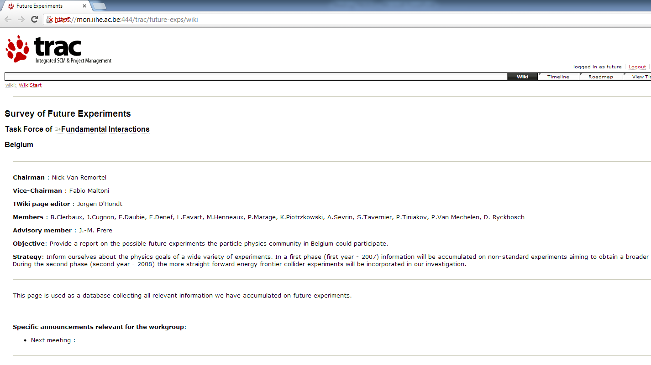
Website and links to previous meetings
+ Gilles De Lentdecker

Slide 3
Two meetings this year
June 27 2013, Antwerpen: Lepton Flavor Violation as probe for new physics
Theoretical introduction to lepton Flavor Violation
Thomas Hambye and Lorenzo Calibbi- ULB
The Mu2e experiment at FNAL
Doug Glenzinski, FNAL
The MEG experiment at PSI and its upgrade
Alessandro Baldini, INFN Pisa
September 2 2013, Gent: Search for sterile neutrinos with a Lithium 6 detector
Antonin Vacheret, Univ. Oxford

Slide 4
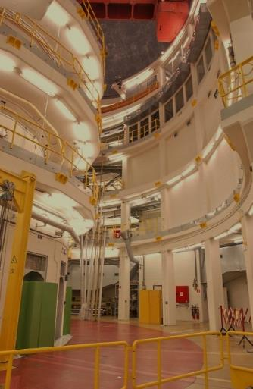
SoLi∂ Search for neutrino Oscillation with a Lithium-6 Detector
ν
ν
ν
ν
ν ?
ν
ν
ν

Slide 5
Gallium & Reactor ν anomalies
Ga anomaly: 14±6% effect
Reactor anomaly: 7 ± 2% effect
Could be due to:
Unknown biases
Wrong assumptions
New physics

Slide 6
Sterile neutrino hypothesis

Slide 7
ILL experiment
One of few benchmark reactors for initial flux calculations
Hint of oscillation pattern in 1981
Re-evaluated in 2011
Similar anomalies seen in LSND & MINIBOONE data
No oscillation hypothesis excluded
at 2σ level

Slide 8
3+1 ν hypothesis
J. Kopp et al. JHEP 1305 (2013) 050
Global fit of 3+1 hypothesis has large tension between
Appearance & dissapearance results and
Conflict between signal hints and null results
largely relieved by 3+2 or 1+3+1 hypotheses
Allowed regions from reactor and
Gallium data

Slide 9
Short baseline reactor search proposals

Slide 10
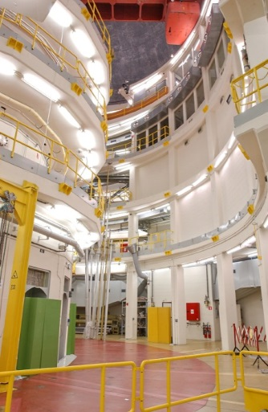
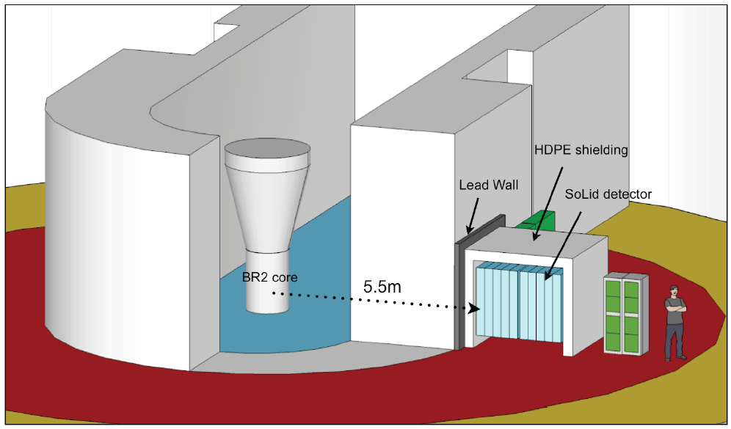
BR2 at SCK/CEN Mol
70MWatt neutrino flux: 10¹⁹ ν/s
Very compact core: ~ 25 cm (pointsource)
Experimental access: 5.5m-15m from core
Very low backgrounds (gamma+neutron)
Pure and well known fuel composition: precisely calculable reactor flux
Free of use for 140 d/year
ν
ν ?
ν
ν
ν

Slide 11
Detection principle

Slide 12
Technology& Design
Initiated by Univ. Oxford and Imperial College London

Slide 13
Sensitivity for 2yrs of datataking

Slide 14
Demonstrator in operation at BR2

Slide 15
Solid Collaboration plans
April 2015
April 2014
Total project cost: 1.6 M£
Oxford & Imperial: ~1M£ applied
UGent, UAntwerpen & VUB: 550 kEur

Slide 16
Lepton Flavor violation
From T. Hambye
From L. Calibbi
Many processes:

Slide 17
MEG
10⁸ μ⁺/s at 28 MeV
muon stopping rate of 3.10⁷ Hz
To be increased to 10⁸ Hz, with a 10% e⁺contamination
background
accidental
μ → e ν ν
μ → e γ ν ν
ee → γ γ
eZ → eZ γ
signal
μ → e γ
physical
μ → e γ ν ν
e⁺ μ⁺ γ
ν
e⁺ μ⁺ γ
ν
θeγ = 180°
Ee = Eγ = 52.8 MeV
Te = Tγ
ν
ν
e⁺ μ⁺
γ

Slide 18
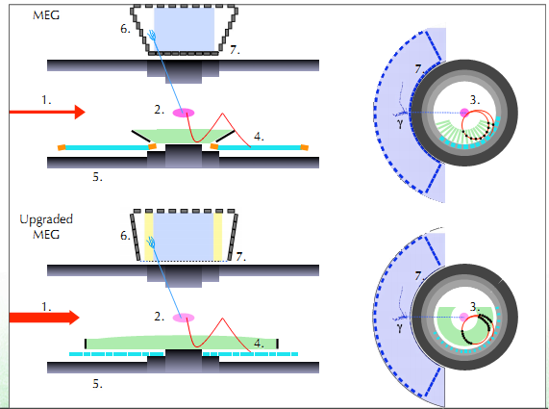
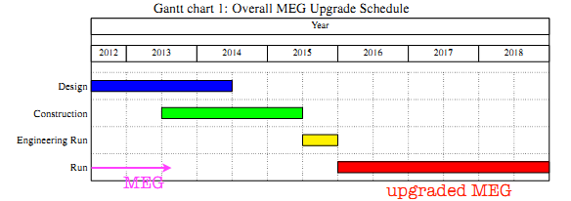
MEGII
Fixed elements
COBRA magnet: gradient field to provide constant bending radius independent of angle
Upgraded elements
Increase nr of stopped muons
Reduce target thickness
Replacing positron tracker (drift chamber)
Improve positron tracking and timing
Increasing timer granualrity
Extending γ-detection acceptance
Improving γ-position, energy and timing
Overhaul of DAQ system

Slide 19
Mu2e
From D. Glenzinski

Slide 20
Mu2e
8kW of 8 GeV proton beam

Slide 21
Mu2e pattern recognition
18 straw tracking stations, l~3m,
r~70cm
2 crystal calorimeters, r ~36-70 cm
3cm diam, 11 cm long, ~2600 pieces

Slide 22
Mu2e schedule

Slide 23
Backup

Slide 24
Lepton Flavor violation
Dipole operator
4 lepton operator
Λ = new physics scale

Slide 25
Lepton Flavor violation
From T. Hambye
Not possible to distinguish from conventional ν-oscillation or 0ν2β
Ratios can depend on only one crucial parameter: for example for TypeI see-saw
Note complementarity between capure vs free decay
experiments

Slide 26
Mu2e

Slide 27
Mu2e
From D. Glenzinski

