Slide 1
125 GeV Higgs from a not so Light Technicolor Scalar
Roshan FOADI
CP3 Higgs Workshop 2012

Slide 2
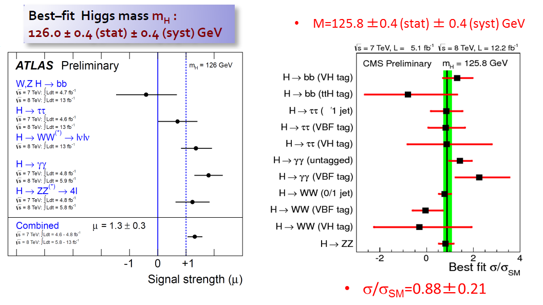
The 125 GeV Boson
It looks more and more like the SM Higgs

Slide 3
The 125 GeV Boson
Which theories can accommodate a 125 GeV Higgs?
Certainly all theories with weakly coupled dynamics at the 1 TeV scale:
SM
SUSY
Little Higgs / Composite Higgs
However it seems increasingly unlikely that that these theories can avoid large fine tuning in the Higgs mass. Unless the LHC finds something new...
What about strongly coupled dynamics at the 1 TeV scale?

Slide 4
Technicolor

Slide 5
Technicolor
Technicolor is a gauge theory which breaks the electroweak symmetry, and is strongly coupled at the 1 TeV scale. (Weinberg 79 – Susskind 79)
The fermions feeling the TC force are called techniquarks. The techniquark sector features a global chiral symmetry which is spontaneously broken by the TC force.
The techniquarks carry electroweak charge, so that EWSB is embededd in chiral symmetry breaking.
The techniquarks can either possess or not QCD color charge. If they do, the fermion condensate produced by the TC force should not break QCD!

Slide 6
Technicolor
The TC force produces a vacuum condensate which breaks the EW symmetry

Slide 7
Technicolor
This generate at least three massless composite Goldstone bosons, , which are eaten by the W and Z bosons to acquire mass.
The technipion decay constant plays the role of the vev v in the SM

Slide 8
Extended Technicolor
In TC the weak bosons get their mass because of the techniquarks weak gauging
Of course the TC force does not feature an interaction between the SM fermions and the techniquark condensate: thus if the SM is solely extended with the TC force, the SM fermions would be massless
In order for the SM fermions to interact with the techniquark condensate, and thus acquire mass, we need to introduce an additional gauge interaction, extended technicolor , with massive ETC gauge bosons (Dimopoulos-Susskind 79, Eichten-Lane 80)
Ordinary fermions and technifermions are in the same ETC multiplet

Slide 9
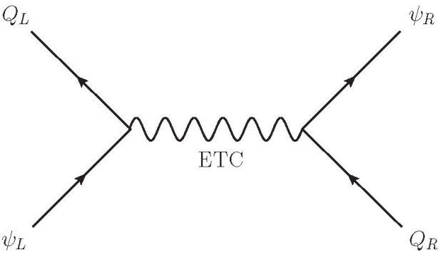
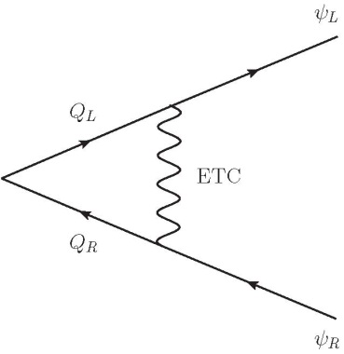
ETC and SM Fermion Masses
When techniquarks condense, a single ETC exchange leads to mass terms for SM fermions
Thus the mass of a SM fermion depends on the ETC coupling, the ETC mass, and the value of the techniquark condensate at the ETC scale

Slide 10
ETC at Low Energies
The terms give mass to the SM fermions

Slide 11
ETC at Low Energies
The terms contribute to the uneaten technipion mass. This implies that the corresponding generator is explicitly broken by the ETC interaction

Slide 12
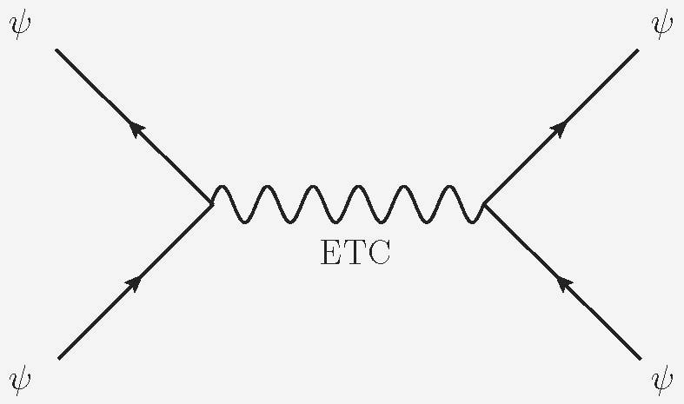
ETC at Low Energies
The contain flavor changing neutral currents, and are potentially dangerous

Slide 13
QCD is Technicolor!
An example of TC theory is QCD. The electroweak symmetry is broken by the QCD condensate
The resulting goldstone bosons are eaten by the W and Z boson to acquire mass

Slide 14
Scaling up from QCD
The W and Z mass from QCD is a very small contribution (of the order of a few tens of TeVs).
However QCD provides a powerful tool to estimate quantities in TC through a set of scaling rules.
Therefore, we can more or less make predictions for QCD-like TC theories.

Slide 15
QCD-like Technicolor

Slide 16
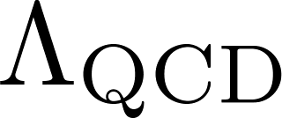
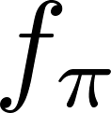
Scaling Rules
The scaling rules follow from taking QCD in the large- limit (‘t Hooft 77, 79, 83)
Let be the scale at which the perturbatively-defined QCD coupling runs to infinity. This scales like the constituent quark mass in hadrons,
Let be the pion decay constant. This means that if is the spontaneously broken current (that is, the current corresponding to the broken chiral symmetries), then

Slide 17
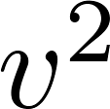
Scaling up from QCD
The scaling rules are
Each weak doublet contributes to :
This leads to the following rescaling from two-flavor QCD:

Slide 18
Scaling up from QCD
However in any TC theory we must have fixed at 246 GeV. This forces to scale with and
The rescaling of technihadron masses is the same as for , times possible powers of due to the nature of the bound state

Slide 19
QCD-like Techni-Higgs
The lightest scalar in QCD is the meson, with mass
In TC the lightest scalar singlet is interpreted as the Higgs!
The rescaling rule depends on the nature of the , whether it is a state or a multiquark state:

Slide 20
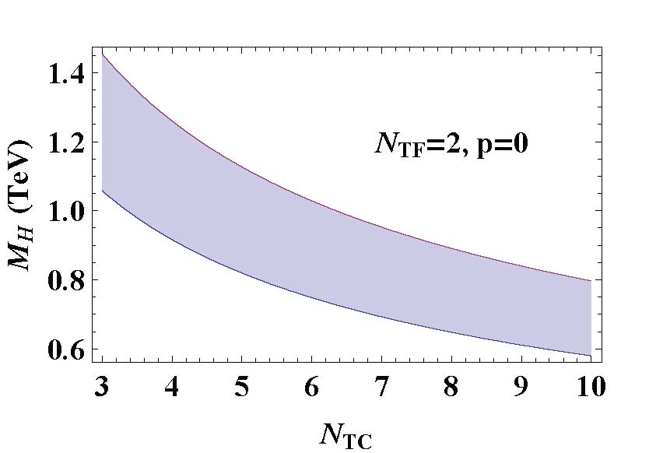
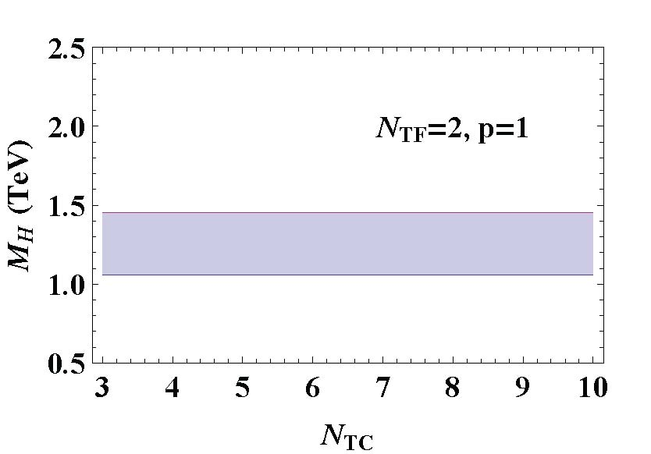
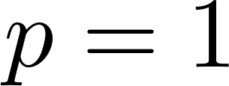
QCD-like Techni-Higgs
The lightest scalar in QCD is the meson, with mass
In TC the lightest scalar singlet is interpreted as the Higgs!
The rescaling rule depends on the nature of the , whether it is a diquark state or a multiquark state:
A p-wave diquark state is however expected to be in the 1.0-1.4 GeV range. The meson is more likely to be a four-quark state, with
Apparently no 125 GeV Higgs candidate in QCD-like TC

Slide 21
Other Problems of QCD-like TC
Large FCNC
Consider the flavor-changing interaction
This gives rise to mass splitting

Slide 22
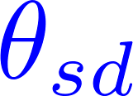
SM Fermion Masses vs FCNC
Experimentally we know that , whence
For of the order of the Cabibbo angle, we get
must be in the 10-50 TeV range in order to achieve the second-generation quark masses. Clearly, we have a conflict between SM fermion mass generation and FCNC!

Slide 23
Near-Conformal Technicolor

Slide 24
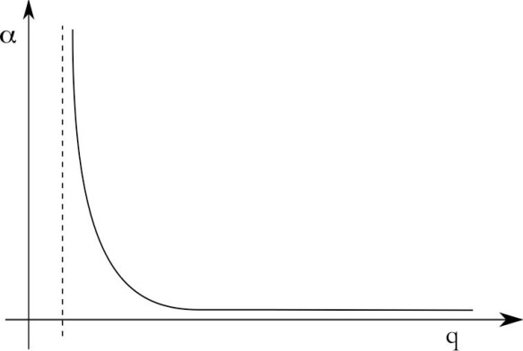
Enhancement of the TC Vacuum
Recall:
In QCD-like TC:

Slide 25
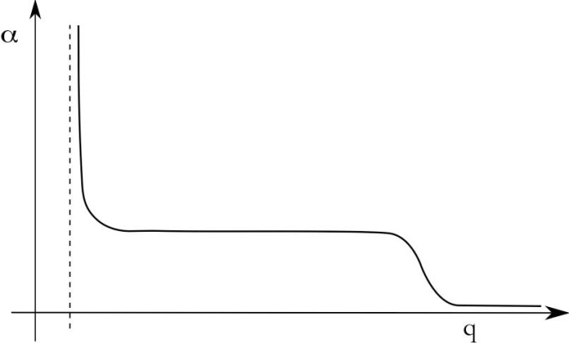
Enhancement of the TC Vacuum
Recall:
Suppose the dynamics is not QCD-like, and in the energy interval gauge dynamics is near conformal

Slide 26
Enhancement of the TC Vacuum
The SM fermion masses are now enhanced:
FCNC are not enhanced
For large enough this is a solution to the FCNC problem

Slide 27
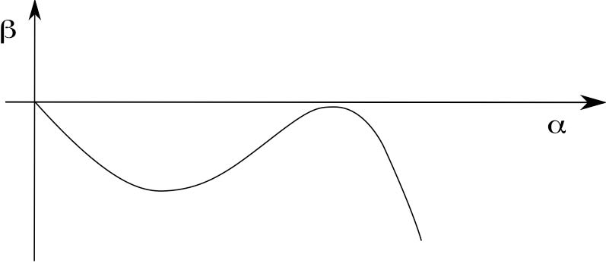
Infra-red Fixed Point
Is this real? Does a gauge theory with this kind of behavior exist? In the context of asymptotically-free gauge theories this can happen if the critical coupling for SSB, , is smaller than the coupling at the fixed point : then we have a nearby infra-red fixed point

Slide 28
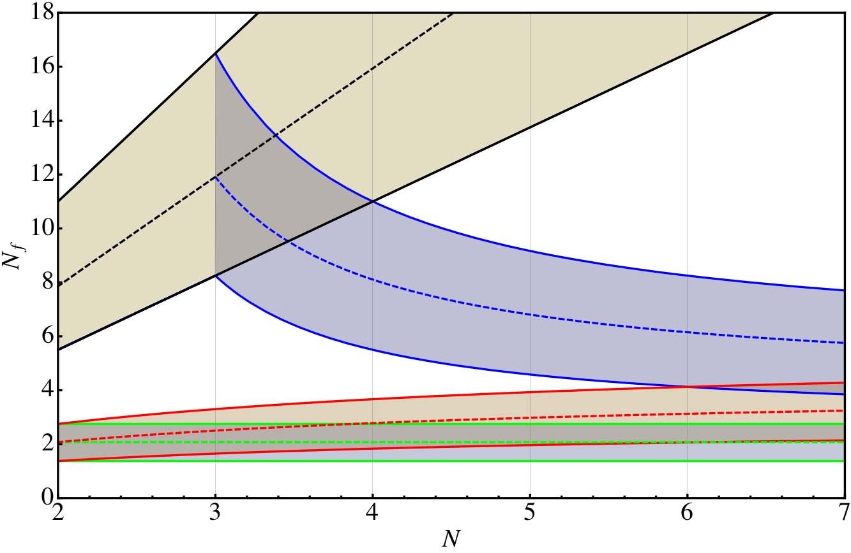
Conformal Window
all-order
SD,
Sannino-Tuominen 05
Dietrich-Sannino 06
Ryttov-Sannino 08
SU(N)

Slide 29
ETC Effects on the Conformal Window
What we have just seen were estimates of the conformal window for TC in isolation. However, there are “back-reactions” from ETC
This can be seen in a gauged NJL model, with four-fermion operators induced by the ETC sector
In the large- limit the four-fermion interaction is shown to favor chiral symmetry breaking (Bardeen-Leung-Love 86, Kondo-Mino-Yamawaki 88, Appelquist-Soldate-Takeuchi-Wijewardhana 88). If the four-fermion coupling is large enough, chiral symmetry breaking can occur even for subcritical TC gauge coupling, due to the four-fermion interaction

Slide 30
ETC Effects on the Conformal Window

Slide 31
Walking TC Candidates
It is important to have a small number of technicolors, because of the S parameter
one-family TC
(Fahri-Susskind 79)
minimal walking TC
(Sannino-Tuominen 05,
RF-Frandsen-Sannino-Ryttov 06)
next-to-minimal walking TC
(Sannino-Tuominen 05)

Slide 32
Higgs in Near-Conformal
Technicolor

Slide 33
Near-Conformal Technicolor Higgs
In QCD-like TC the Higgs is a lot heavier than 125 GeV What about in near-conformal TC?
Recall that in near-conformal TC we
have an approximate scale invariance,
which is spontaneously broken
Thus we expect the spectrum to
feature a light pseudo Nambu-
Goldstone boson, the dilaton (Gildener-Weinberg 76)
In TC this would be a techniquark bound state, a technidilaton
This could be a candidate for the observed 125 GeV boson

Slide 34
Near-Conformal-Higgs Mass
How do we estimate the mass of the near-conformal Higgs in TC?
Saturation of the trace anomaly (Dietrich-Sannino-Tuominen 05)
Partially conserved dilatonic current (Appelquist-Bai 10)
Bethe-Salpeter equation in ladder approximation (Harada-Kurachi-Yamawaki 03, Kurachi-Shrock 06, Doff-Natale 09)

Slide 35
Saturation of the Trace Anomaly
For a fixed number of technicolors, dynamics depend on the number of techniflavors
As we approach the conformal
window, the mass of the lightest
technihadrons approach zero
Different technihadrons have
different values of and
For the technidilaton we can infer the critical exponent by matching the scale anomaly in the effective theory and in the underlying gauge theory

Slide 36
Saturation of the Trace Anomaly
In the effective theory, assuming trace anomaly to be saturated by a single scalar field
In the underlying gauge theory:
Thus

Slide 37
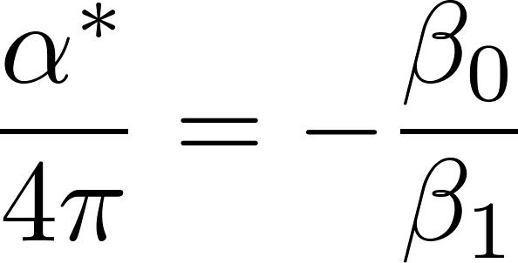
Saturation of the Trace Anomaly
Recall:
Assume , which implies, and

Slide 38
Saturation of the Trace Anomaly
Thus
Let be the scalar mass for a number of techniflavors sufficiently close to the critical value . Then
Scaling up from two-flavor QCD gives

Slide 39
Saturation of the Trace Anomaly
For three technicolors and eleven
techniflavors this gives
However seems too
below the conformal window for
this to be fully accurate

Slide 40
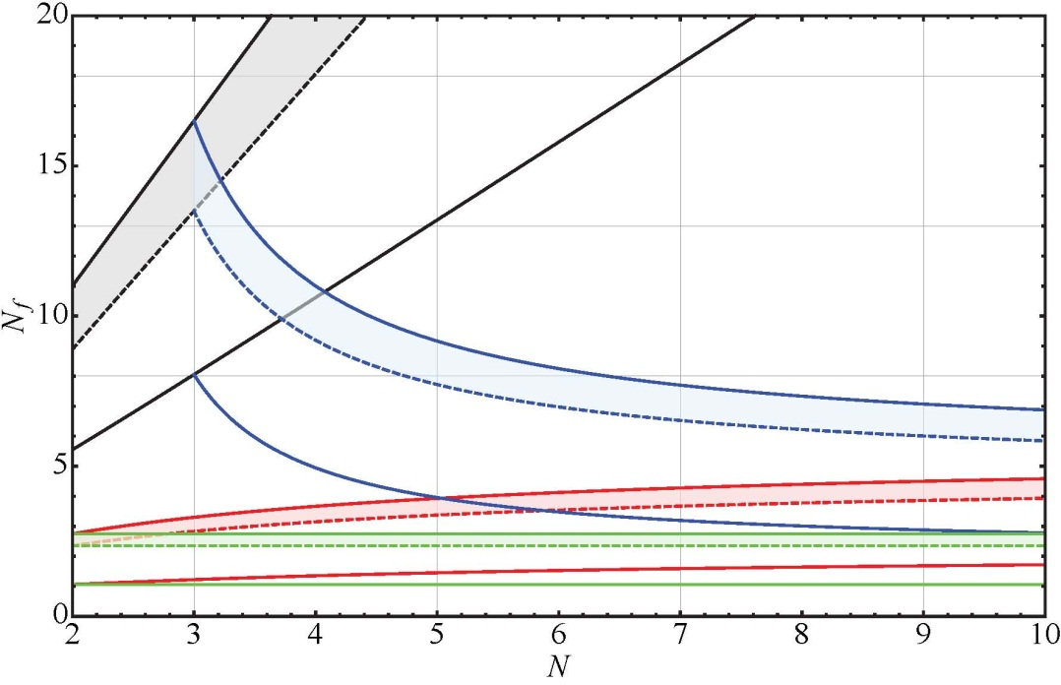
Saturation of the Trace Anomaly
We can use ETC to effectively
produce a non-integer value of

Slide 41
PCDC
Recall from PCAC

Slide 42
PCDC
Recall from PCAC

Slide 43
PCDC
A similar analysis holds for PCDC

Slide 44
PCDC
A similar analysis holds for PCDC
As before, assume , which implies, and

Slide 45
PCDC
Also, assume
Then
Numerical estimates are only possible by giving some mass scale input, so the result is the same as in scaling estimate

Slide 46
Bethe-Salpeter Equation
Solutions of the Bethe Salpeter equation can be found in the rainbow approximation
The full fermion propagator must be given as input, and in order to compute this, approximations and ansatz are employed
The results obtained by Harada, Kurachi, and Yamawaki are for scaled up QCD, with a large number of techniflavors, approaching the conformal window
Their results show that as the infra-red fixed point approaches the critical coupling, , whence, for SU(3) in the fundamental

Slide 47
Bethe-Salpeter Equation
The results obtained by Doff and Natale for SU(3) in the fundamental is

Slide 48
Radiative Corrections to the TC-Higgs Mass
A scaled-up sigma meson, in SU(3) TC with QCD-like dynamics, has mass
The estimates from near-conformal SU(3) TC are
Clearly a reduction, but still far from 125 GeV! We could attain that value by increasing either the number of technicolors or the number of techniflavors. But this is bad for the S parameter!

Slide 49
Radiative Corrections to the TC-Higgs Mass
However, we are missing an important contribution to the Higgs mass in TC: the radiative corrections from SM fields. (RF-Frandsen-Sannino 12)
The dominant correction is due to the top loop, and the subdominant from loops of EW gauge bosons
These corrections are quadratic in the cutoff. The latter is estimated to be

Slide 50
Radiative Corrections to the TC-Higgs Mass
However, we are missing an important contribution to the Higgs mass in TC: the radiative corrections from SM fields
The dominant correction is due to the top loop, and the subdominant from loops of EW gauge bosons

Slide 51
Radiative Corrections to the TC-Higgs Mass
A scaled-up sigma meson, in SU(3) TC with QCD-like dynamics, has dynamical mass
The estimates from near-conformal SU(3) TC are

Slide 52
Radiative Corrections to the TC-Higgs Mass
A scaled-up sigma meson, in SU(3) TC with QCD-like dynamics, has mass
The estimates from near-conformal SU(3) TC are
A 125 GeV Higgs boson is possible in near-conformal TC!

Slide 53
Higgs See-Saw in TC
Another possible mechanism to obtain a 125 GeV scalar singlet from intrinsically heavy scalars is the see-saw mechanism. (RF-Frandsen 12)

Slide 54
Higgs See-Saw in TC
Another possible mechanism to obtain a 125 GeV scalar singlet from intrinsically heavy scalars is the see-saw mechanism.

Slide 55
Higgs See-Saw in TC
TC theories with technifermions transforming under two different representations feature two different singlets and a mixing of order one!
Examples of two-scale TC theories are
ultra-minimal TC (Ryttov-Sannino 08)
Low-scale TC (Eichten-Lane 08)
In these theories the diagonal scalar singlet masses are of order of 1 TeV, but the lightest mass eigenstate is much smaller!
Radiative corrections and near-conformal dynamics (if applicable) further reduce the mass of the lightest scalar singlet.

Slide 56
Conclusions
When scaling up the meson from QCD, there is a new ingredient to be added in TC: the one-loop correction from the top quark!
Without the radiative corrections the Higgs in QCD-like TC would be heavier than 1 TeV.
The top loop gives a large and negative correction to the TC-Higgs mass.
Also the Higgs see-saw mechanism, in two-scale TC, naturally gives a light scalar singlet.
Near-conformal dynamics is an additional help to achieve the 125 GeV target.
The next years of running at the LHC are likely to give a definitive answer on TC.

