Slide 1



Matrix element method for differential cross section
CDF vs « LHC »
Arnaud Pin

Slide 2

Matrix element method for differential cross section
At Tevatron
Reference
Look for narrow resonance.
Cross section of production :
semi-leptonic decay channel
For each candidates event, hypothesis is applied. The observed kinematic is mapped to parton level using the « Matrrix element » for production and decay.

Slide 3

Matrix element method for differential cross section
M.E.M.
Give a weight to each experimental event based on the probability to be produced by a particular process (Here hypothesis).
Integration on the unknow variables.
MadGraph
MadGraph
Leading order computation
Using constraints event is reconstructed at parton level :
- several configuration -> integration on it
x : experimental event :
α : M_{top}.
dΦ : phase space element.
W(x,y) : transfer function.
Computation performs with MadWeight *

Slide 4

Matrix element method for differential cross section
For Differential cross section
Madweight have been adapted to estimate differential cross section.
    Showcase with in dileptonic decay channel. With MG/ME generation and Delphes reconstruction (√s = 14 TeV).
CDF M.E. tool provide the same analysis (subject of the paper).
    Data at √s = 1.96 TeV. Semileptonic decay channel.
CDF MadWeight
Top mass is fixed : 172.5 GeV 173.4 GeV
Z’ hypothesis Several template 1 M_{Z’} tested with several
Full analysis with Background effect
Prospect for a high purity selection of
binned TF : 10 GeV bins in Et and 5 bins in pseudo-rapidity
Un-binned TF
T.F.

Slide 5

Matrix element method for differential cross section
Differential Matrix element method
Resonances at hadrons colliders in decay chain with invisibles particles :
CDF formulation
MadWeight formulation
expression of the integration on parton distribution function.
Any quantity wich can be expressed as a function of the momenta of the top decay products can be estimated as a probability density function.
m0 = M(pk) : invariant mass of system for a given partonic configuration pk .
W : is the transfer function.
In both case we make a sum on the jets permutation

Slide 6
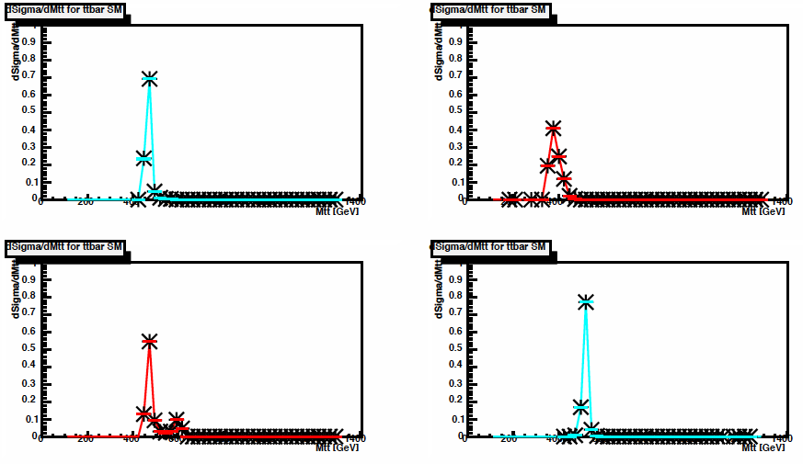
Matrix element method for differential cross section
P.D.F. for each event
With Madweight
For the system invariant mass.
Normalisation at 1 for each event.
Plot not available from CDF

Slide 7
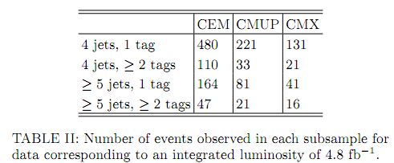

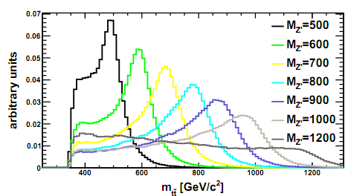
Matrix element method for differential cross section
At Tevatron (CDF) I
For each event : PDF of the reconstrucetd invariant mass.
each event is also normalized to 1 :
12 samples, according to different selection criteria.
CEM : electron reconstruction.
CMUP / CMX muons reconstruction.
Templates for several
values of Z’ pole mass :
Mass peak generally prominent.
Width = 1.2% of the pole mass
- Good separation with background shape.

Slide 8
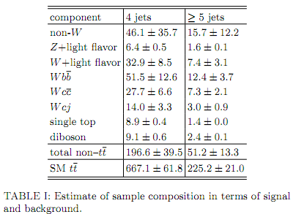





Matrix element method for differential cross section
At Tevatron (CDF) II
For each model (each background, signal)
Combination of event as (sum event-by-event pdfs) :
templates are normalized to unit area.
Background satisfying the selection are derived form cross section analysis
Probability for an event to be signal in sample i
With
Signal : Z’->
Background : SM and not process
L_{i} = Luminosity of the sample
A_{i} = acceptance (rec/selec efficiency)

Slide 9
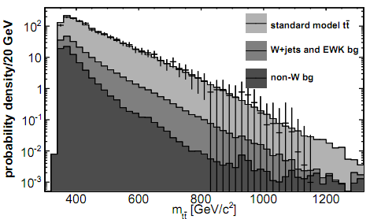
Matrix element method for differential cross section
At Tevatron
The reconstructed invariant mass observed in data :
No indication of resonant production.

Slide 10

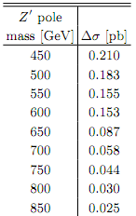
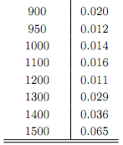
Matrix element method for differential cross section
At Tevatron
Likelihood definition is the product (over the event i ):
ν_{i} : nuisance parameters with ν_{i} expectation and σ_{j} uncertainty.
σ = Z’ cross-section (Z’ model).
They introduce nuisance with a gaussian distribution :
- to incorporate systematics effect to the likelihood.
- It’s systematics due to acceptance effect (leptons ; b-tag)
Systematics uncertainties :
ISR/FSR (generated by PYTHIA for M.C.)
JES contribute significantly
PDF negligible
Background model syst. uncertainties are estimated by evaluating sample test (modifying the experimental condition).

Slide 11

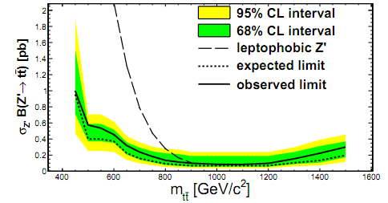
Matrix element method for differential cross section
At Tevatron
These errors are assuming to be gaussian. Likelihood definition become :
These quantity is used to compute a 95% C.L. upper limit FOR EACH Z’ pole mass.
(upper limit on the crosse section times branching ratio).
The limit correspond to the integral of the likelihood covering 95% of the area under the likelihood curve (starting from 0).

Slide 12
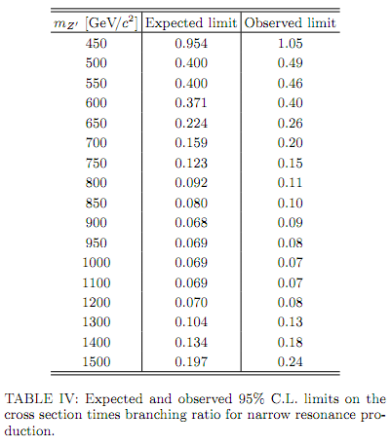
Matrix element method for differential cross section
Expected and observed limit

Slide 13
Matrix element method for differential cross section
D.M.E.M. using MadWeight
All plot are done with 5000 events.

Slide 14
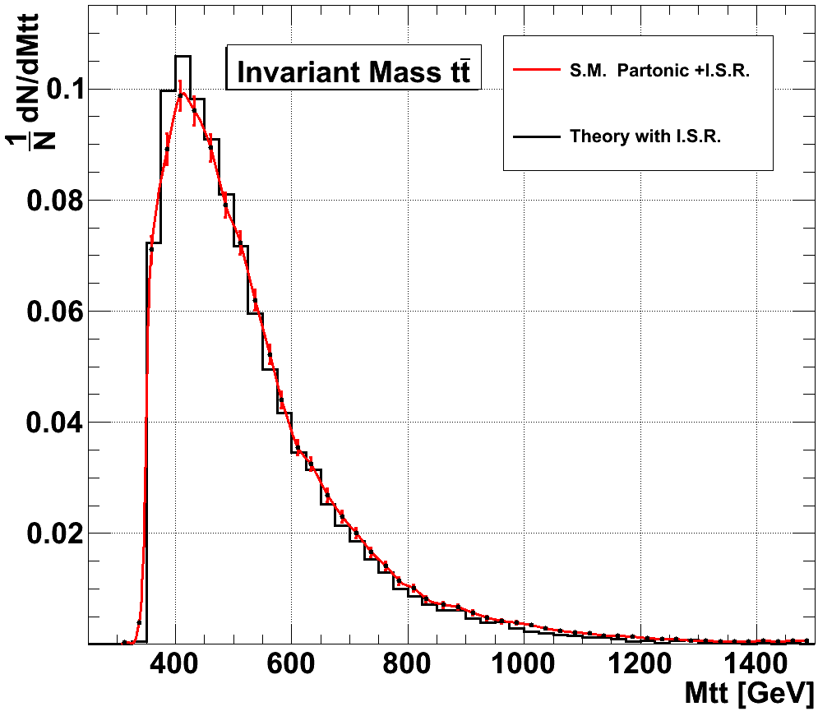



Matrix element method for differential cross section
LHC expectation : Partonic level
Comparison with theory at leading order for :
: sensitivity to .
: sensitivity to the spin of .
5000 events :
  2 isolated muons pt>20 GeV and |η|<2.4 .
  ONLY 2 jets pt>30 GeV and |η|<2.4 and b-tagged.
  MET > 30 GeV.
Perfect detector
transfer function :

Slide 15
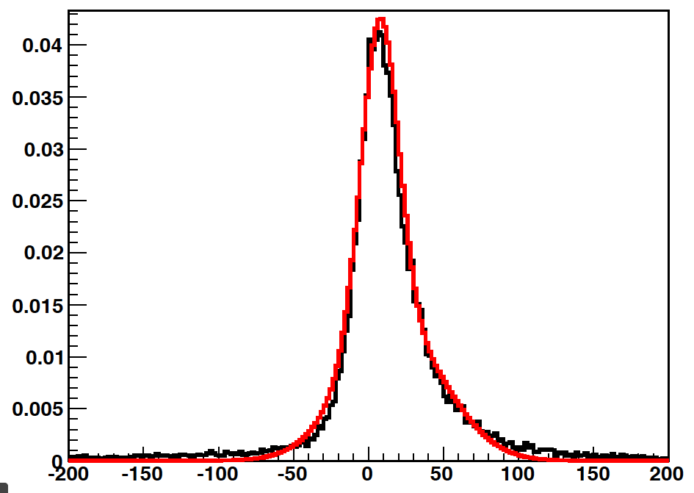
Matrix element method for differential cross section
LHC expectation : transfer function
Fast simulation with Delphes
Jets energy transfer function as a double gaussian.
M.C.
150.000 pairs of jets/partons
10 parameters :
T.F.

Slide 16
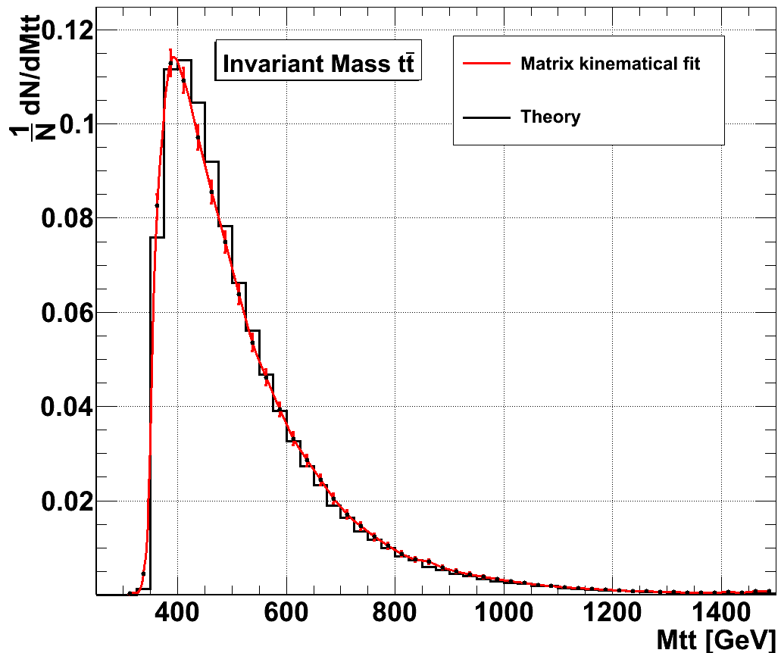
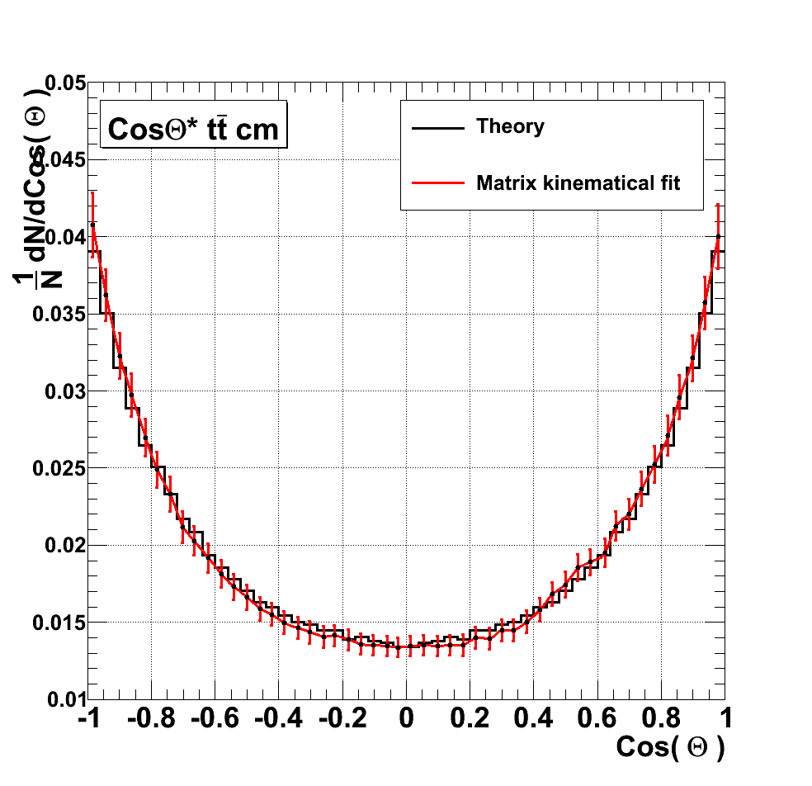
Matrix element method for differential cross section
LHC expectation : Delphes reconstruction
Good agreement with the theory.
No bias due to the transfer function
Reconstruction of other variables as

Slide 17
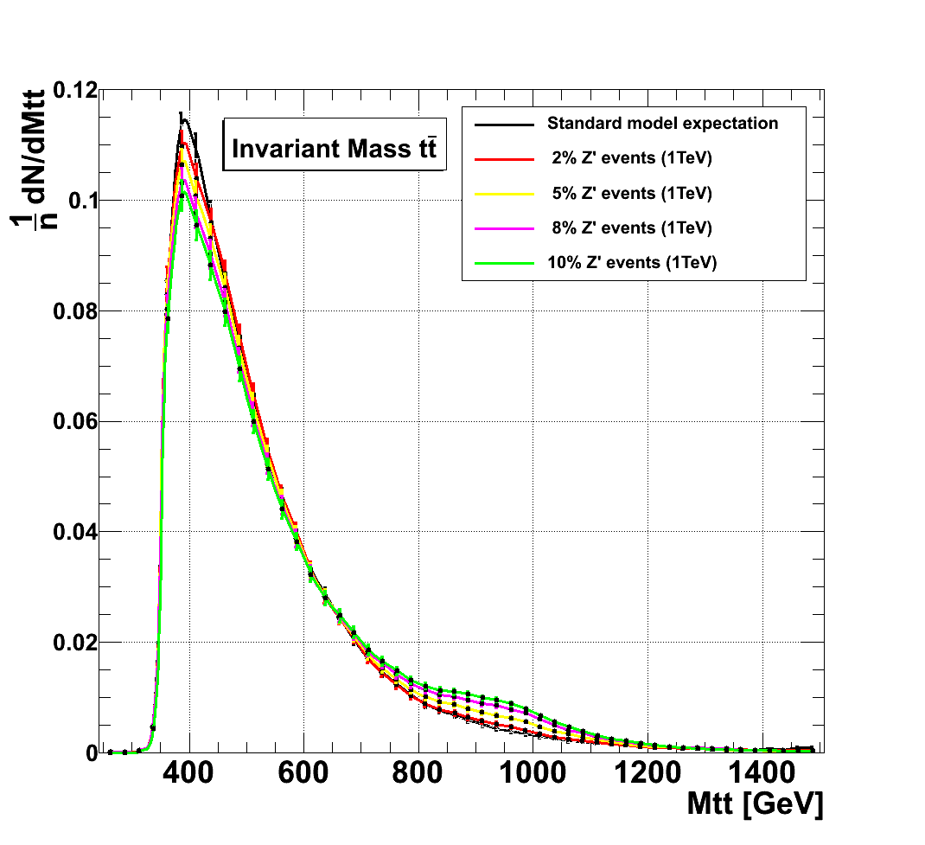
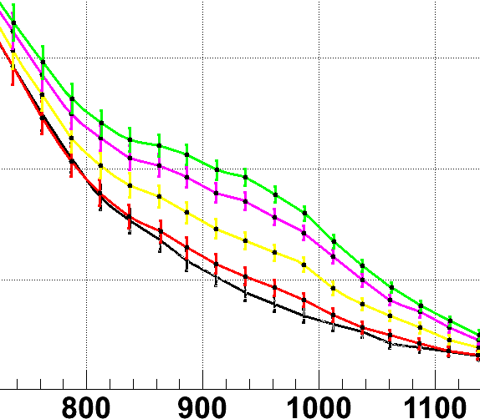

Matrix element method for differential cross section
LHC expectation : search of new physics
Deviation from the standard model introducing a resonance decaying in .
Spin 1 particule (Z’) ³ .
1 TeV
Various : 2%, 5%, 8%
10%
Compatibility with the S.M.
N_{Z’}/N_{tot} | NOT S.M. C.L.
2% | 72 %
3% | 95.6 %
5% | > 99.998%
8%
10%

Slide 18
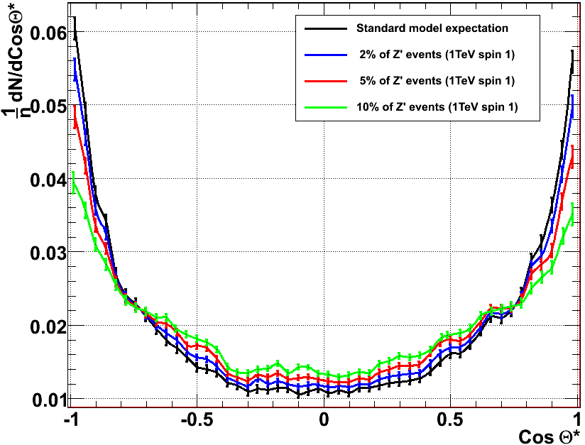
Matrix element method for differential cross section
LHC expectation : search of new physics
reconstructed for events with reconstructed above 700 GeV.
Agreement with spin 1 hypothesis.

Slide 19
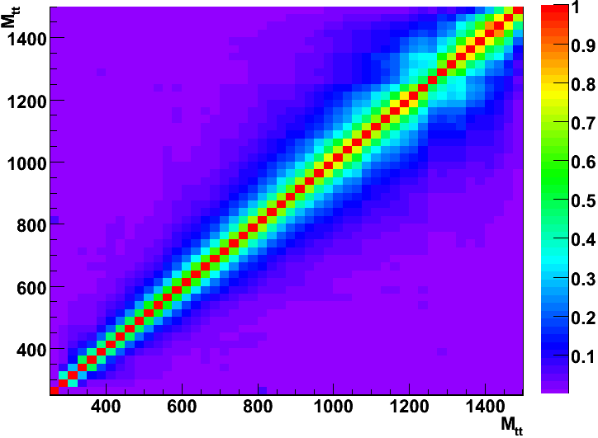







Matrix element method for differential cross section
LHC expectation : statistic
Each event contributes to a few bins. Errors on each bin ( k ) are correlated.
Correlation matrices have been computed :
  using 100.000 events.
  following : with
S.M. confidence level
is defined between the standard model expectation and the observed result.
Taking into account the correlation :

Slide 20
Matrix element method for differential cross section
LHC expectation

Slide 21
Matrix element method for differential cross section
LHC expectation

Slide 22
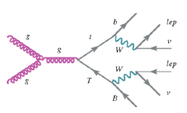
Matrix element method for differential cross section
Matrix Element method
Topology not fully reconstructed at detector level (ex: ttbar dileptonic)
Information has been lost :
Neutrinos are undetected.
b-quarks ave hadronized + showered -> jets
How to access to top quark information ?
Top mass or system invariant mass for example !
Matrix Element Method

Slide 23
Matrix element method for differential cross section
M.E.M.
Use theoritical information of the process :
- W and top mass.
- Energy-momentum conservation
Degree of freedom | Constraints
PDF : 2 dof | E-P conservation : 4
neutrino 1 : 3 dof | M_{W} : 2
neurtino 2 : 3 dof | M_{t} : 2
+ leptons and b-quark | + detector informations
TOTAL : 20 dof | TOTAL : 20 constraints
Give a weight to each experimental event based on the probability to be produced by a particular process (Here hypothesis).
Integration on the unknow variables.

Slide 24
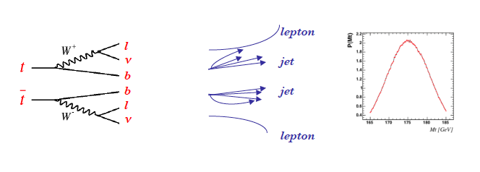
Matrix element method for differential cross section
M.E.M.
Give a weight to ttbar candidates.
Weight in function of M_{top}.
P(parton|M_{top})
|M|²
P(exp|parton)
W(exp,parton)
P(X|M_{top})
Transfer function : hadronization+showering + detector resolution effects
All jet combinations are considered.

Slide 25
Matrix element method for differential cross section
Why using it ?
We have not to use constraints on reconstructed kinematical variables to built estimator of the parameter(s) we are looking for.
Ilustration only No physics
What’s the best choice for X :
Pt
M_{jjb}
dσ/dX
M_{top}2
M_{top}1
X
Matrix Element method fit ALL distributions
with ALL correlations

Slide 26


Matrix element method for differential cross section
How to estimate a parameter
e.g. top quark mass :
For each event a weight is computed for
- several top mass hypothesis (correctly normalized)
For each hypothesis results of all events are combined.
Weight computed for different values of α (M_{top}).
Best estimation of parameters α is the one wich maximize L .
we minimize :

Slide 27
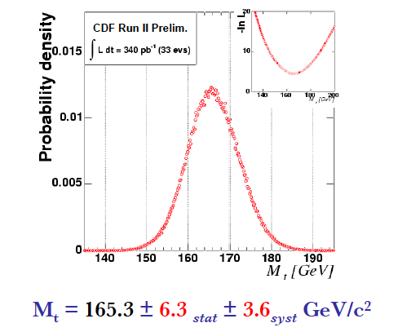
Matrix element method for differential cross section
At Tevatron
At CDF :

